Slide 1
Teams

Slide 2
What makes an effective team?
Effective teams are aware of and responsive to their internal and external environment
Clear objectives and goals
Openness and Confrontation
Support and trust
Co-operation and conflict
Sound procedures and practices
Appropriate leadership
Regular review
Individual development
Sound relationships with other teams

Slide 3
The process of making a team effective is called team building
The process of enabling the group of people to reach their goal

Slide 4
The importance of team development
‘To remain competitive organisations need to make optimum use of equipment and people if they are to thrive or even survive….
In a general sense people talk of teamwork when they want to emphasise the virtues of co-operation and the need to make use of the various strengths of employees.’
ACAS
Notes:
We need to build effective teams at work – this requires a spirit of unity and co-operation between team members.
Now we’re going to look at the roles, behaviours and performance of people working in groups or teams – they have to mesh, to gel, to come together – you need different sorts of people doing different things – doers, solvers, checkers, carers – all these roles need to be performed as you’re all about to find out yourselves.
So we need to look at what makes people and groups tick – one way of doing this is to examine ‘team roles’.

Slide 5
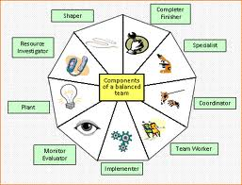
Belbin’s team-roles
A team-role is a pattern of behaviour, characteristic of the way in which one
team member interacts with another
whose performance serves to facilitate
the progress of the team as a whole.
“No one’s perfect, but a team can be”
“There’s no ‘i’ in team”
Notes:
Belbin is the guru on this subject - it’s about behavioural characteristics, what people like doing the most.
Get out your Mullins and go for it – do some reading – it’ll help you with this task.
Some of you chose who you want to work with for assignment 2 in your groups – how did you do that?
Well Belbin suggests that teams made up of people who are all similar tend to lack creativity and often fail
To be successful a team needs a variety of different roles done by different people, so don’t fear the ‘strangers’ in your group – welcome them because they could just be your secret weapon for success.
So how the group’s constructed can help to determine whether it ultimately succeeds or not.
Think about how the model can work in today’s de-layered recessionary workplace – is it valid?
Do people always fit neatly into set boxes or is real life not like that?
Are people necessarily prepared to acknowledge their weaknesses?
Let’s adopt a critical approach as we go through this task.

Slide 6
Belbin’s nine team-roles
Belbin identified 9 key roles that people tend to play in teams
Plant
Resource investigator
Co-ordinator
Shaper
Monitor-evaluator
Teamworker
Implementer
Completer
Specialist
Notes:
Belbin identified 9 key roles that people tend to play in teams. We’ll get on to the detail next.
So each of these represents ways of behaving or characteristics that help us tell one team member apart from another based on how they interact and deal with one another.
The way the theory works is that for each of these roles you have particular strengths but also what’s called ‘allowable weaknesses’ because people can’t be good at absolutely everything.
So certain people like doing certain things and not others – they might avoid or overlook certain things they don’t like/enjoy doing.
Some people like thinking up great plans or new ideas but can’t be bothered to work out the details about how to make them happen – somebody else can do that.
Not all teams need all of these at all times as we’ll see but the earlier comment that no-one’s perfect but a team can be is a thought worth holding as you approach this second assignment.
Let’s look at these more closelt

Slide 7
Belbin
Research showed that the most successful teams were made up of a diverse mix of behaviours.
Dr Meredith Belbin and his team discovered that there are nine clusters of behaviour - these were called ' Belbin Team Roles
https://www.belbin.com/about/belbin-team-roles/

Slide 8
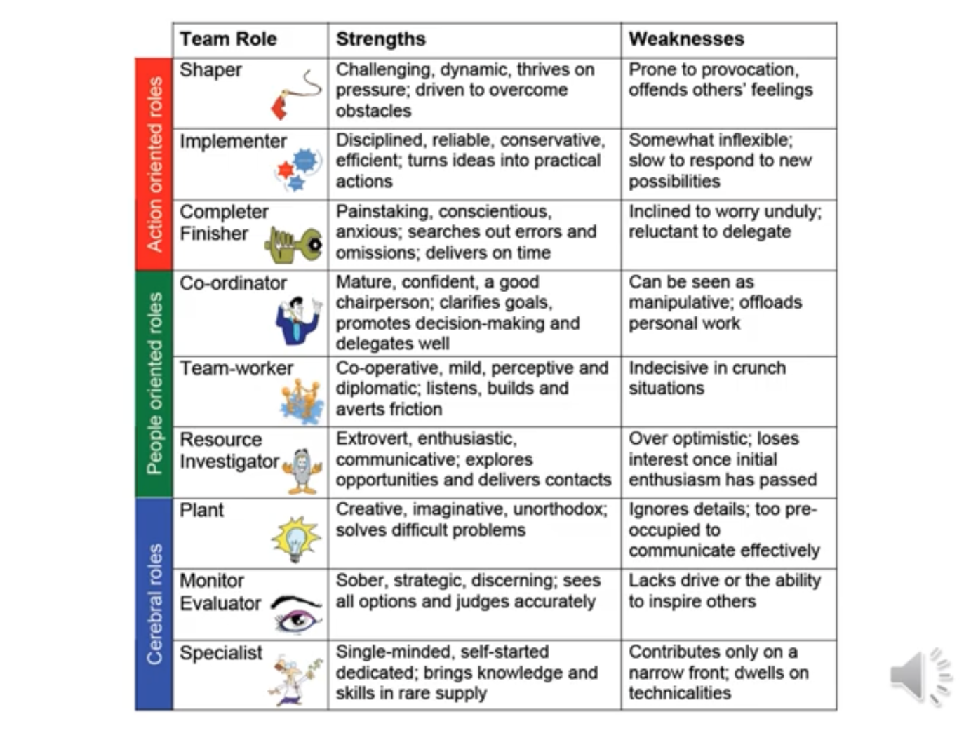

Slide 9
Belbin intro
https://eur01.safelinks.protection.outlook.com/?url=https%3A%2F%2Fyoutu.be%2Fo-t9YsbyXME&amp;data=02%7C01%7C%7Cc40ef9fff72c4a53325608d7bf5728b2%7C4e0f11f9046e45059cb8db2152311e21%7C0%7C0%7C637188253381845332&amp;sdata=gLh6%2BZFuv6PwcjZaeDXxFMYH%2FefMUVq28yhhlVdNCHc%3D&amp;reserved=0

Slide 10
1: The plant
Team-role contribution
Creative
Imaginative
Unorthodox
Solves difficult problems
Allowable weaknesses
Ignores details
Too preoccupied
to communicate effectively
Source: Belbin, R.M., Team Roles at Work, Belbin Associates (1993), p.23
Notes:
Any plants in the room today? Hands up if that sounds like you.

Slide 11
2: The resource investigator
Team-role contribution
Extrovert
Enthusiastic
Communicative
Explores opportunities
Develops contacts
Allowable weaknesses
Over-optimistic
Loses interest once enthusiasm has passed
Source: Belbin, R.M., Team Roles at Work, Belbin Associates (1993), p.23

Slide 12
3: The co-ordinator
Team-role contribution
Mature
Confident
A good chairperson
Clarifies goals
Promotes decision- making
Delegates well
Allowable weaknesses
Can be seen as manipulative
Delegates personal work
Source: Belbin, R.M., Team Roles at Work, Belbin Associates (1993), p.23

Slide 13
4: The shaper
Team-role contribution
Challenging
Dynamic
Thrives on pressure
Has the drive and courage to overcome obstacles
Allowable weaknesses
Can provoke others
Hurts others’ feelings
Source: Belbin, R.M., Team Roles at Work, Belbin Associates (1993), p.23

Slide 14

5: The monitor - evaluator
Team-role contribution
Sober, strategic and discerning
Sees all options
Judges accurately
Allowable weaknesses
Lacks drive and ability to inspire others
Overly critical
Source: Belbin, R.M., Team Roles at Work, Belbin Associates (1993), p.23

Slide 15

6: The teamworker
Team-role contribution
Co-operative
Mild
Perceptive and diplomatic
Listens
Builds
Averts friction
Calms the waters
Allowable weaknesses
Indecisive in crunch situations
Can be easily influenced
Source: Belbin, R.M., Team Roles at Work, Belbin Associates (1993), p.23

Slide 16
7: The implementer
Team-role contribution
Disciplined
Reliable
Conservative and efficient
Turns ideas into practical actions
Allowable weaknesses
Somewhat inflexible
Slow to respond to new possibilities
Source: Belbin, R.M., Team Roles at Work, Belbin Associates (1993), p.23

Slide 17

8: The completer
Team-role contribution
Painstaking
Conscientious
Anxious
Searches out errors and omissions
Delivers on time
Allowable weaknesses
Inclined to worry unduly
Reluctant to delegate
Can be a nit-picker
Source: Belbin, R.M., Team Roles at Work, Belbin Associates (1993), p.23

Slide 18
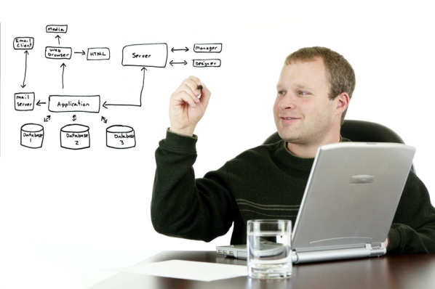
9: The specialist
Team-role contribution
Single-minded
Self-sharing
Dedicated
Provides knowledge and skills in rare supply
Allowable weaknesses
Contributes on only a narrow front
Dwells on technicalities
Overlooks the ‘big picture’
Source: Belbin, R.M., Team Roles at Work, Belbin Associates (1993), p.23

Slide 19
https://eur01.safelinks.protection.outlook.com/?url=https%3A%2F%2Fyoutu.be%2FjleXGZdIWr8&amp;data=02%7C01%7C%7C311975c6f64848d3dd2608d7bf57baef%7C4e0f11f9046e45059cb8db2152311e21%7C0%7C0%7C637188255828827073&amp;sdata=do2U0j2D4DfondqAQbo2CJzxxHx18WHyJtOuDYKvQqc%3D&amp;reserved=0

Slide 20
Create Belbin Team Map
https://eur01.safelinks.protection.outlook.com/?url=https%3A%2F%2Fyoutu.be%2F3wflOJ94EQE&amp;data=02%7C01%7C%7C8e83be7406804804b07f08d7bf57f200%7C4e0f11f9046e45059cb8db2152311e21%7C0%7C0%7C637188256763890043&amp;sdata=49WzmrU9GwdNUgJOXQlVuWK73ETZQ5Ub1MN%2BrVX%2BEXw%3D&amp;reserved=0

Slide 21
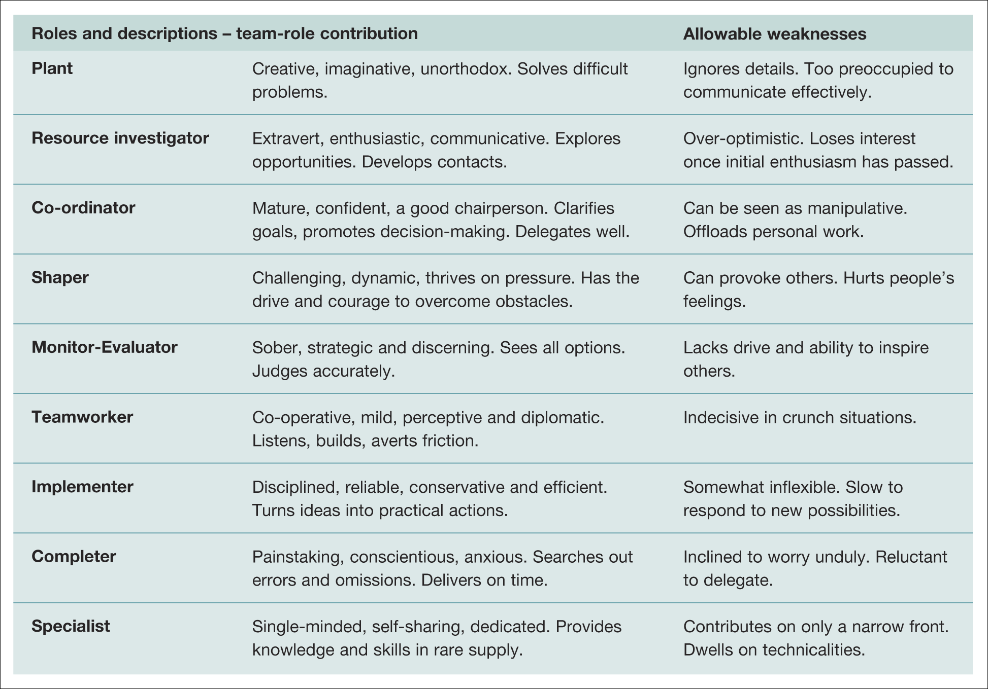
Table 9.1 Belbin’s evolved nine team roles
Source: Belbin, R. M. Team Roles at Work, Butterworth-Heinemann (a division of Reed Elsevier UK Ltd) and Belbin Associates (1993), p. 23. Reproduced with permission
Notes:
Here we have them listed in the first column with their respective ‘role contribution’ and ‘allowable weakness’
That is what they like to do the most, and what that means they sometimes tend to overlook or not do so well as a result of that behavioural tendency.
Eg Plant – creative, imaginative, unorthodox, solves difficult problems – sounds great but.... Can mean they ignore details and be too preoccupied to communicate effectively – so every style has its pluses and minuses.
So teams need these characters and features to be creative – but which are you? We’ll try to find out in the tutorials

Slide 22
Back-up and functional roles
Back-up Roles:
  Team members may be able to play more than one of Belbin’s Roles.
  These back-up roles can come into play if particular roles are missing from the team.
Functional Roles:
  These are the roles played by members in relation to specific technical needs.
  Functional roles are based on experience and knowledge, not on team-role characteristics.
Notes:
People are rarely good at all of these but can you begin to see that for a team to work you need people who can do all of them for the team to work effectively - it could sometimes mean that people perform a secondary back-up role to support the team
Remember these team roles aren’t the same thing as functional roles which tend to be based on people’s experience not on their personal characteristics or abilities.
No good having a team full of shapers – you’d never actually get the job finished as they’d be too busy thinking up new ideas all the time without following them through.
Teamwork has plugged the gap in organisations as they’ve de-layered – we rely on teamwork now more than every before just to get things done – that’s why I’m placing so much emphasis on it for assignment 2. you’ll need to do this one day soon.

Slide 23
Analysis of individual behaviour
‘Teamwork does not, of course, guarantee in itself good results. As in sport, there can be good teams and poor teams. And as in sport, it all depends on how the players play together.’
Belbin
Notes:
This is true – we’ve got to probe into how people behave and interact in a group setting – if you spend a fortune on players in a football team, they might be great individually but it doesn’t necessarily guarantee on the field success for them as a team – unless you’re Chelsea or Man City?
We need to get the right mix of people for the team to work effectively – not everyone who’s really good at what they do is necessarily a team player – sometimes good to have sceptics who like to change things.
Remember the team styles exercise you did on your induction where we had the 4 basic types of people – we had lots of ‘pragmatists’ and activists and very few reflectors and theorists – teams need a mixture of types. You’re just a really competitive lot.
We can monitor this behaviour by a technique called Sociometry

Slide 24
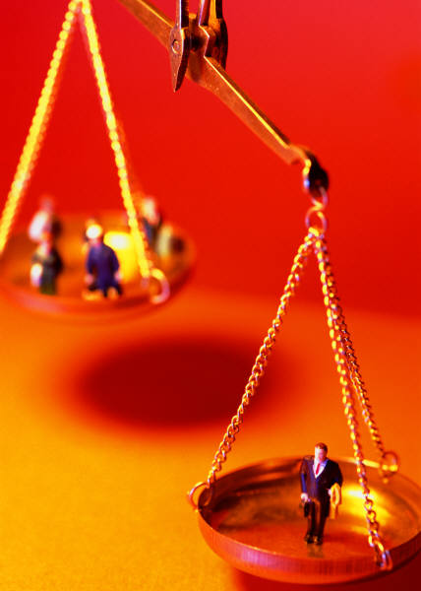
Group or individual decision?
When should you make a decision on your own and when in a group?
Misselhorn’s model:
The competence of the people to make
the decision
The context in which they are working
The commitment to the decision
Notes:
How to decide whether something needs a group or individual decision.
3 things to look at here
Are the people likely to be any good at it
Contenxt/culture of the organisation – personal relationships etc
How it would affect those involved - +/- for participants , rewards/punishments
Helps managers decide rationally how to go about deciding something

Slide 25

Brainstorming
Brainstorming or ‘thought showers’
involve the group adopting a
‘freewheeling attitude and generating as many ideas as possible, the more wild or apparently far-fetched the better’.
Osborn
Notes:
Q: Anyone done this before? Loads of ideas generated – all get put down, unfiltered – some are daft others usable but they all get logged, unfiltered
You suspend judgment and try to think creatively - quantity leads to quality in terms of ideas
Rules – no overt criticism of ideas at this stage , group of 6-10 ideal size , elaborate and build on ideas - need to record ideas
-freedom of expression

Slide 26
Procedures for brainstorming
Maximum freedom of expression and informality.
Initial emphasis is on the quantity of ideas, not their quality.
No individual ideas are criticised or rejected in the first stage.
Members are encouraged to elaborate or build on ideas expressed by others.
No evaluation of any particular idea until all ideas have been generated.

Slide 27
Activity - Brainstorming
Work in small groups
Follow the rules for brainstorming
You have 2 minutes to identify as many possible uses as possible for a:
Rubber Band

Slide 28

Self-managed work groups
Emerged from work redesign and job enrichment.
Key features:
  Specific goals are set but the group decides on the means of achieving them.
  Group members have freedom of choice and
  discretion over the planning and execution of work.
  Collectively members have the necessary expertise
  to succeed in the task.
  The level of external supervision is reduced.
  Feedback and evaluation are related to the performance of the group as a whole.
Notes:
Group members more autonomous – set their own rules to a point
Danger – could set its own values and norms which may be different to the organisation as a whole
Good for teamwork and potentially motivating – gives people autonomy and control – good for morale
Reduces dependency on management to do things
Teamwork is now more important than ever – all these things can affect team performance
-who is in the team and the characteristics of team members matter too – team selection is key.
This is really hard to get right when teams are introduced into organisations.

Slide 29
Building successful teams
Who builds/designs teams? Managers
  Clarification of objectives and resources
  Organisational processes and clarification of roles
  Empowerment, decision-making and channels of communication
  Patterns of interaction, task and maintenance functions
  Social processes and the informal organisation
  Management systems and leadership style
  Training and development
Notes:
Checklist for managers to build successful teams – we’ve covered them in this and previous lectures

Slide 30
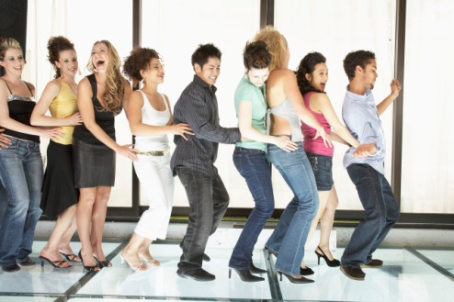
Skills for successful teamwork
Self management
Communication
Leadership
Responsibility
Supportiveness of diversity
Feedback and evaluation
Strategic planning
Shaping successful meetings
Resolving conflicts
And........
Enjoyment
Have fun!
Notes:
Cloke and Goldsmith – 10 special skills for teamwork – the things team members can develop to build successful self-managing teams
Team leadership role is crucial – trust, clear communication, full participation and self management
Can the team:
Overcome problems together
Show honesty, listen well
Develop skills
Members take personal responsibilty
Broaden their horizons by looking at different perspectives on issues
Learn and be self-critical
Identify new challenges and opportunities
Streamline the way they work – have shorter, more productive meetings
Problem solve and resolve conflict
And finally
Take pleasure from achievement of a team task?
Again all great in theory, but workable in practice? You’re going to find out. Fasten your safety belts – it could be a bumpy ride.......

Slide 31
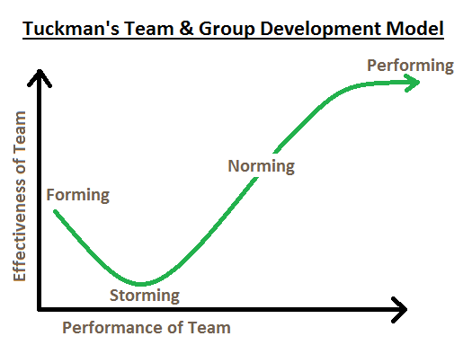
Stages in Team building B Tuckman & N. Jensen 1977
Bruce Tuckman presented a paper in 1965, ”Developmental Sequence in Small Groups."
outlining this model saying that four phases were necessary for a team to develop and grow
Forming
Storming
Norming
Performing
(Adjourning – added 1977)

Slide 32
Forming
Team building
Define team
Determine individual roles
Develop trust and communication
Develop norms
Task
Define problem and strategy
Identify information needed

Slide 33
How do we support each other
What do we do when we have problems
What are my responsibilities

Slide 34
Don’t get too absorbed in your own task
My efforts should add value to the team
My goal won’t be achieved if the team goal isn’t
Only use sufficient resources to complete your part of team task
Create cooperative friendly climate in team

Slide 35
Storming
Realisation that task is more difficult than imagined
Fluctuations in attitude about chances of success
Resistant to task
#poor collaboration

Slide 36
Do we have common goals and objectives
Do we agree on roles and responsibilities
Do task, communication and decision systems work
Do we have adequate interpersonal skills

Slide 37
Negotiating conflict
Separate problem issues from people issues
Be soft on people hard on problem
Look for underlying needs, goals of each party rather than specific solutions

Slide 38
Addressing the problem
State your views in clear non-judgmental language
Clarify the core issues
Listen carefully to each persons point of view
Check understanding by restating core issues

Slide 39
Norming
During this stage members Accept
Their team
Team rules and procedures
Their roles in the team
The individuality of fellow members
Team members realise that they are not going to crash and burn and start helping each other

Slide 40
Member behaviour during norming
Competitive relationships become more cooperative
There is a willingness to confront issues and solve problems
Teams develop the ability to express criticism constructively
There is a sense of team spirit

Slide 41
Performing
Team members have gained insight into personal and team processes
A better understanding of individuals strengths and weaknesses
Gained the ability to prevent or work through group conflict and resolve differences
Developed a close attachment to the team

Slide 42
Adjourning
Tuckman added a 5th stage 10 years later in 1977
The process of unforming the group, letting go of the group structure and moving on
Completeing the task and breaking up the team

Slide 43
5R’s
Results
relationship
rules
roles
responsibilities

Slide 44
5 R’s pdf
https://usaidlearninglab.org/sites/default/files/resource/files/5rs_techncial_note_ver_2_1_final.pdf

Slide 45
Management roles
Mintzberg’s Management Roles Theory

Slide 46
The roles
Mintzberg (1990) suggested that there are ten roles or behaviours that can be used to catagorise the different functions of managers:
Figurehead 6. Spokesperson
Leader 7. Entrepreneur
Liaison 8. Disturbance Handler
Monitor 9. Resource Allocator
Disseminator 10. Negotiator

Slide 47
Mintzberg’s management roles
Managers fulfil many different roles every day
  They lead teams
  Resolve conflict
  Negotiate new contracts (internal and external)
  Attend board meetings

Slide 48
The 10 roles are then divided up into three categories, as follows:
Category | Roles
Interpersonal | Figurehead Leader Liaison
Informational | Monitor Disseminator Spokesperson
Decisional | Entrepreneur Disturbance Handler Resource Allocator Negotiator

Slide 49
Interpersonal Category
The roles in this category involve providing information and ideas.
Figurehead – As a manager, you have social, ceremonial and legal responsibilities. You're expected to be a source of inspiration. People look up to you as a person with authority, and as a figurehead.
Leader – This is where you provide leadership for your team, your department or perhaps your entire organization; and it's where you manage the performance and responsibilities of everyone in the group.
Liaison – Managers must communicate with internal and external contacts. You need to be able to network effectively on behalf of your organization.

Slide 50
Informational Category
The roles in this category involve processing information.
Monitor – In this role, you regularly seek out information related to your organization and industry, looking for relevant changes in the environment. You also monitor your team, in terms of both their productivity, and their well-being.
Disseminator – This is where you communicate potentially useful information to your colleagues and your team.
Spokesperson – Managers represent and speak for their organization. In this role you're responsible for transmitting information about your organization and its goals to the people outside it.

Slide 51
Decisional Category
The roles in this category involve using information.
Entrepreneur – As a manager, you create and control change within the organization. This means solving problems, generating new ideas, and implementing them.
Disturbance Handler – When an organization or team hits an unexpected roadblock, it's the manager who must take charge. You also need to help mediate disputes within it.
Resource Allocator – You'll also need to determine where organizational resources are best applied. This involves allocating funding, as well as assigning staff and other organizational resources.
Negotiator – You may be needed to take part in, and direct, important negotiations within your team, department, or organization.

