Slide 1
BMSN7001
SUPPLEMENTS USE IN SPORT

Slide 2
MOST COMMONLY USED SUPPLEMENTS
CREATINE
CAFFEINE
BICARB
PROTEIN SUPPLEMENTS INC WHEY PROTEIN, AMINO ACIDS / CARB SUPLEMENTS
VITAMIN/MINERALS
PLUS 100S OF OTHERS!!

Slide 3
SENR
Statement on the use of Supplements in Sport
http://www.senr.org.uk/wp-content/uploads/SENr-Supplement-Position-Statement-v-June-2017.pdf
This includes a disclaimer form for practitioners.

Slide 4
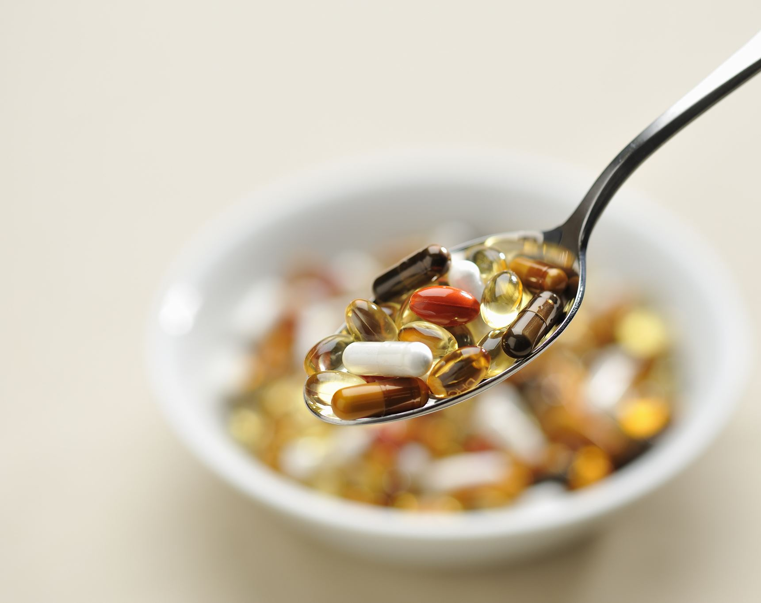
Your Thoughts on selling supplements
Class discussion?

Slide 5
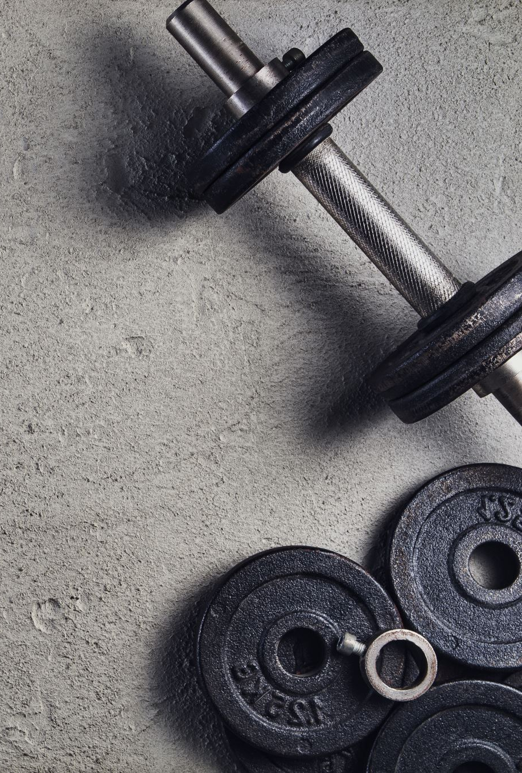
Sports foods
These include all of the supplements that contain CHO or protein
Huge range of both types – they appear to be ordinary foods that have extra protein or CHO
Athletes likely to be tested still need to consider these foods in the same way as other supplements – there is a possibility of contamination!
Whey protein may be an issue – added to some desserts and ice cream.

Slide 6
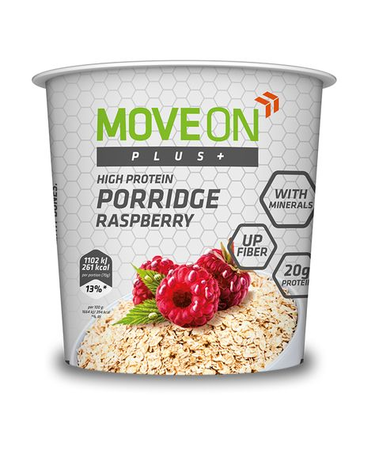
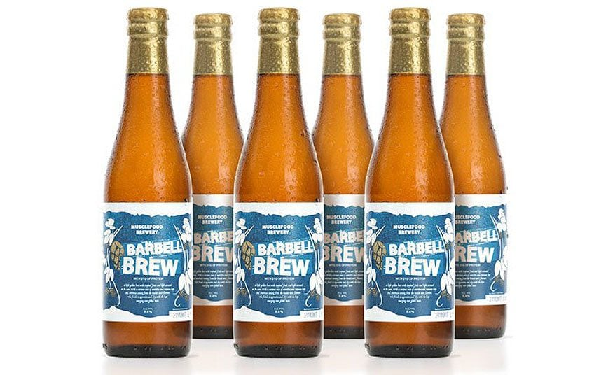
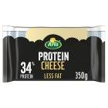
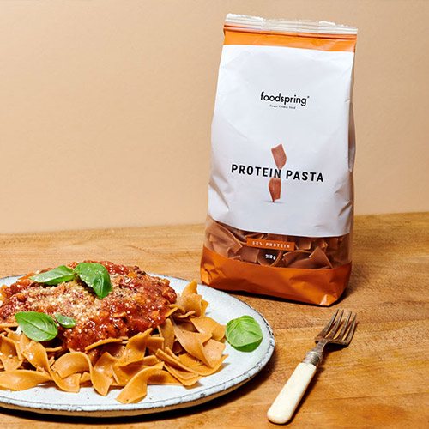
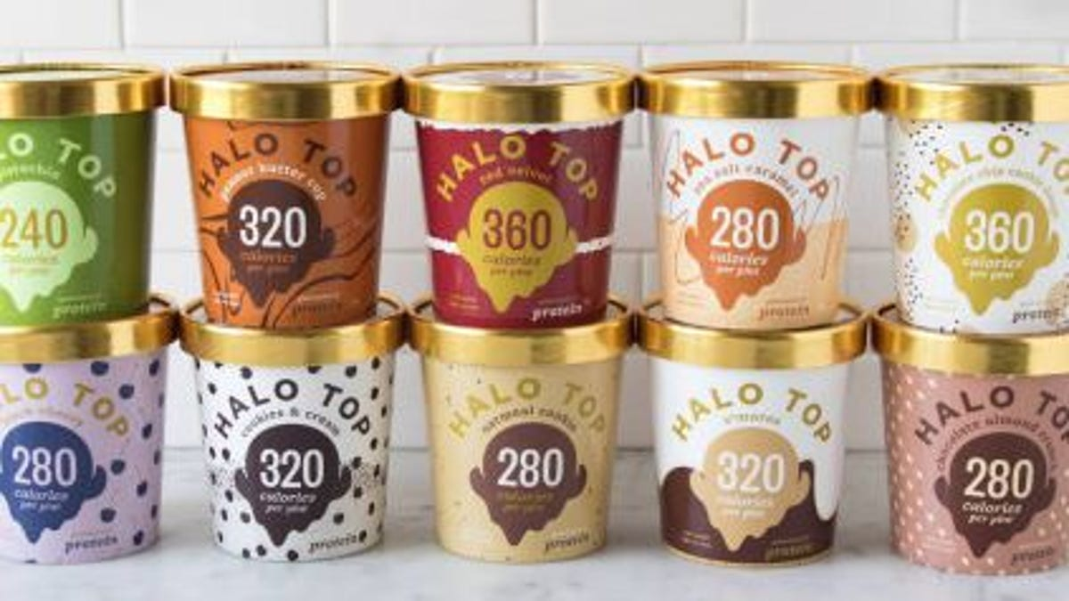
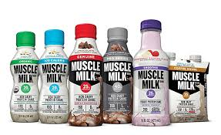
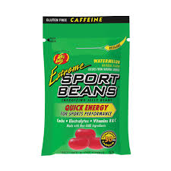
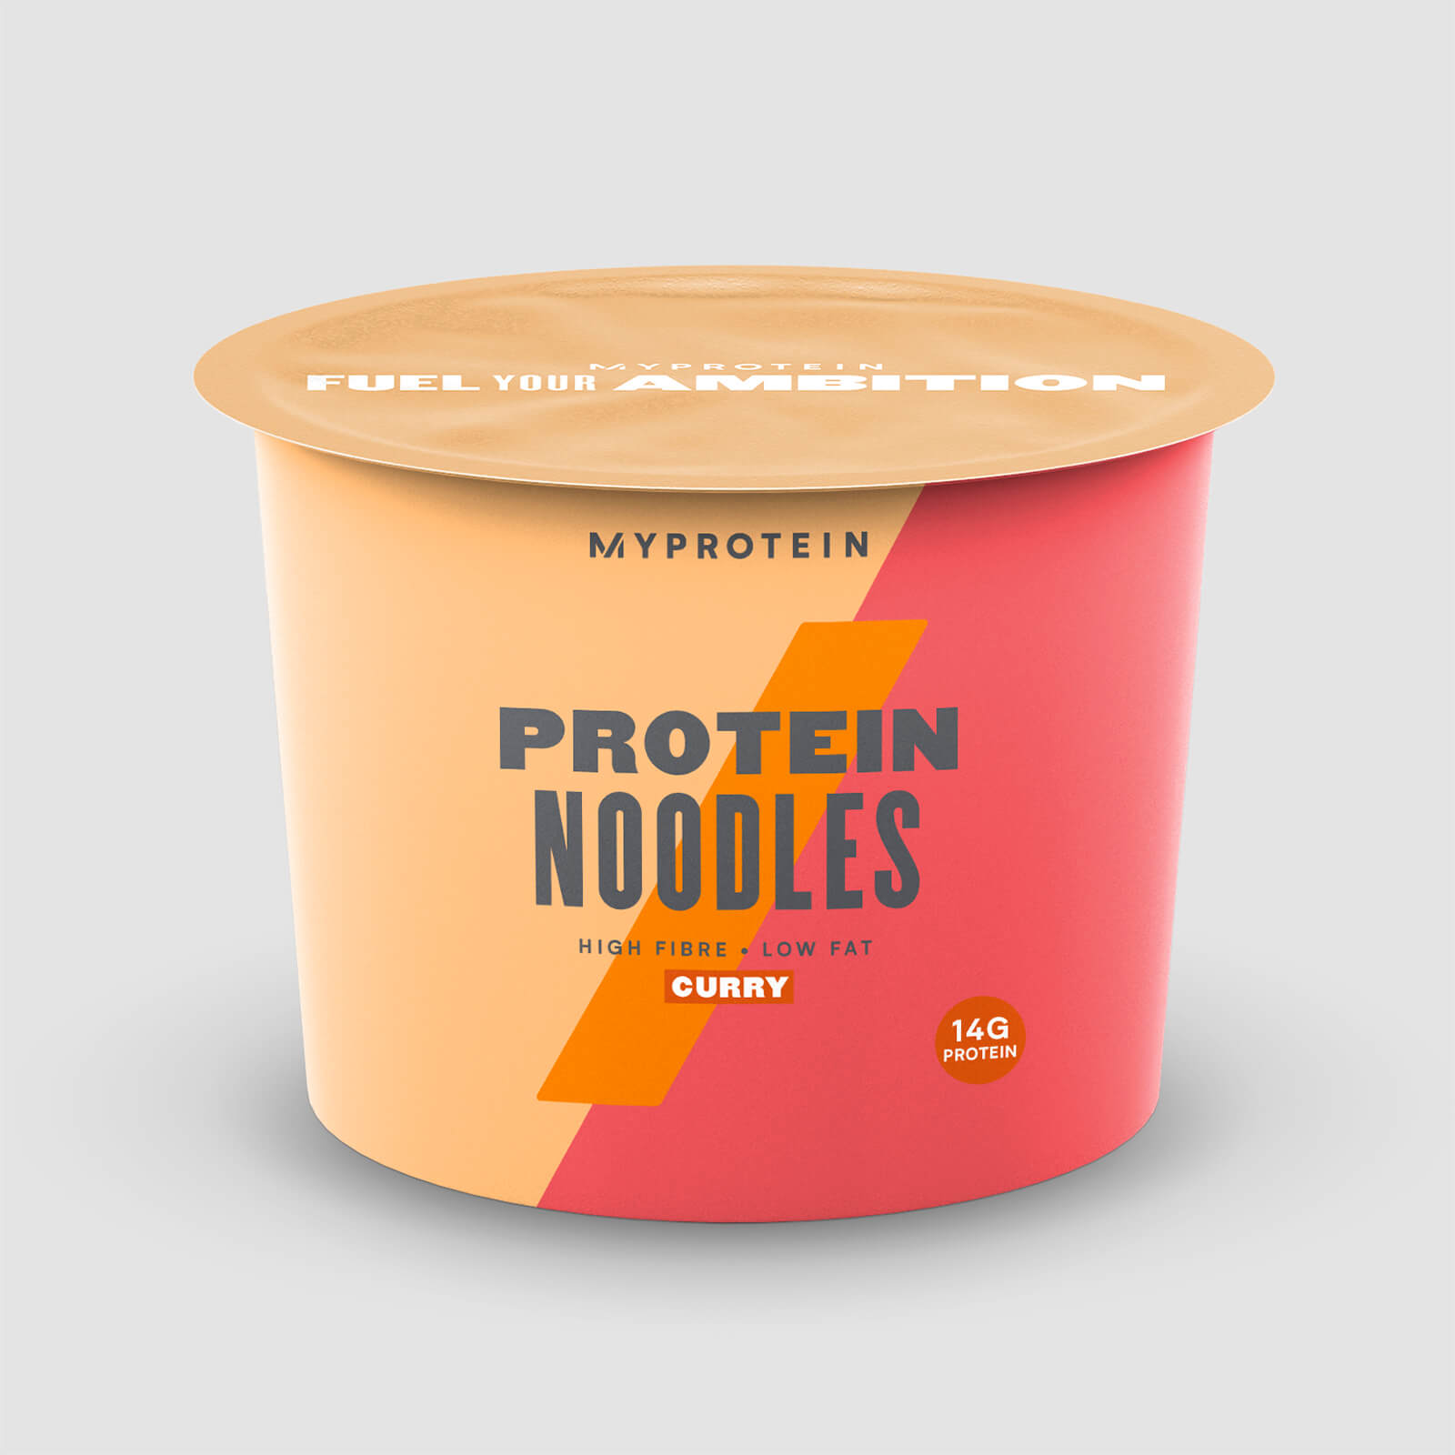
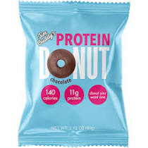

Slide 7
CREATINE
Naturally occurring protein that is made from 3 amino acids – arginine , glycine and methionine
Involved in energy production
Found in meat and fish – veggies produce it
You need 2kg of steak to provide the same as a supplement!
It does work in some sports – sprints, football, rugby
But probably only in 50% of athletes
Improves performance and recovery by enhancing ATP turnover
Need to take it properly – 20g loading dose for 5 days then dec to 2g /day. It has been suggested in the loading phase the 20g is divided into 4 doses
It is not banned – commonly used since the 90s – 80% of athletes at the Atlanta Olympics were reported to be taking it.

Slide 8
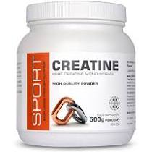
CREATINE
It has been shown to inc weight by around 2-5 kg – women and weight category sports rarely use it! May increase extra cellular fluid.
May increase dehydration!
Side effects – cramps, stomach pains, anecdotal risk of injury – think you are stronger than you are!!
Suggested you take it in cycles – 6 weeks then a rest of 4 weeks

Slide 9
Caffeine
Most widely used psychoactive drug in the world
Found in around 63 plants – therefore in a variety of food and drink
It is readily absorbed and degraded in the liver – with a half life of 2-10 hours
Foods high in caffeine include coffee, tea, cola, chocolate and a variety of pain relief medication

Slide 10
CAFFEINE
It was removed from the banned list in 2004.
Caffeine is a stimulant – it acts on the central nervous system increasing adenosine – increase alertness
Previously would test positive with a urine level of 12ug or more
Previously you would have to restrict caffeine intake to under 350mg day
Athletes are taking caffeine – usually by tablet form, chewing gum or caffeine rich drinks such as red bull.

Slide 11
CAFFEINE
Studies have shown it is performance enhancing – inc fat mobilisation and stimulate the central nervous system
Dose 1-2 mg /kg 60 mins before an event
Side effects - inc dehydration, poor sleep, inc heart rate, GI problems etc.
Is being commonly used.

Slide 12
SODIUM BICARBONATE
Not banned and being commonly used in athletics
Claims to mop up the effect of lactic acid build up by lowering the ph.
The dose is 0.3g / kg – taken in divided doses 1-3 hours before an event
Capsules may lessen the side effects but you may have to take a lot 0.5-1g/capsule.

Slide 13
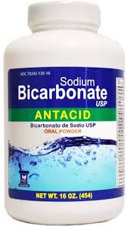
BICARBONATE
Side effects – vomiting, cramps, diarrhoea. Need to take plenty of water with it.
Not good practice to try it out at a competition!

Slide 14
L - Carnitine
L – carnitine is synthesised from the amino acids lysine and methionine
Required for fatty acid transport and metabolism
Found in red meat and dairy products
Suggestions that it can increase fatty acid turn over, sparing glycogen and improve performance.
Suggestions it may improve VO2 Max
There has also been a suggestion that it may help with weight loss
May be a possibility but there is no evidence to back it up

Slide 15
Alanine and Carnosine
Alanine – amino acid precursor
Carnosine – di peptide – occurs in muscle
It is thought to be a ph buffer in muscle
May improve high intensity performance – increases buffering
? Evidence for this

Slide 16
Branched Chain Amino Acids
3 essential amino acids – leucine, iso-leucine and valine
There has been a suggestion that they increase post exercise protein synthesise
Would you get enough from food anyway?
Also very little evidence for this

Slide 17
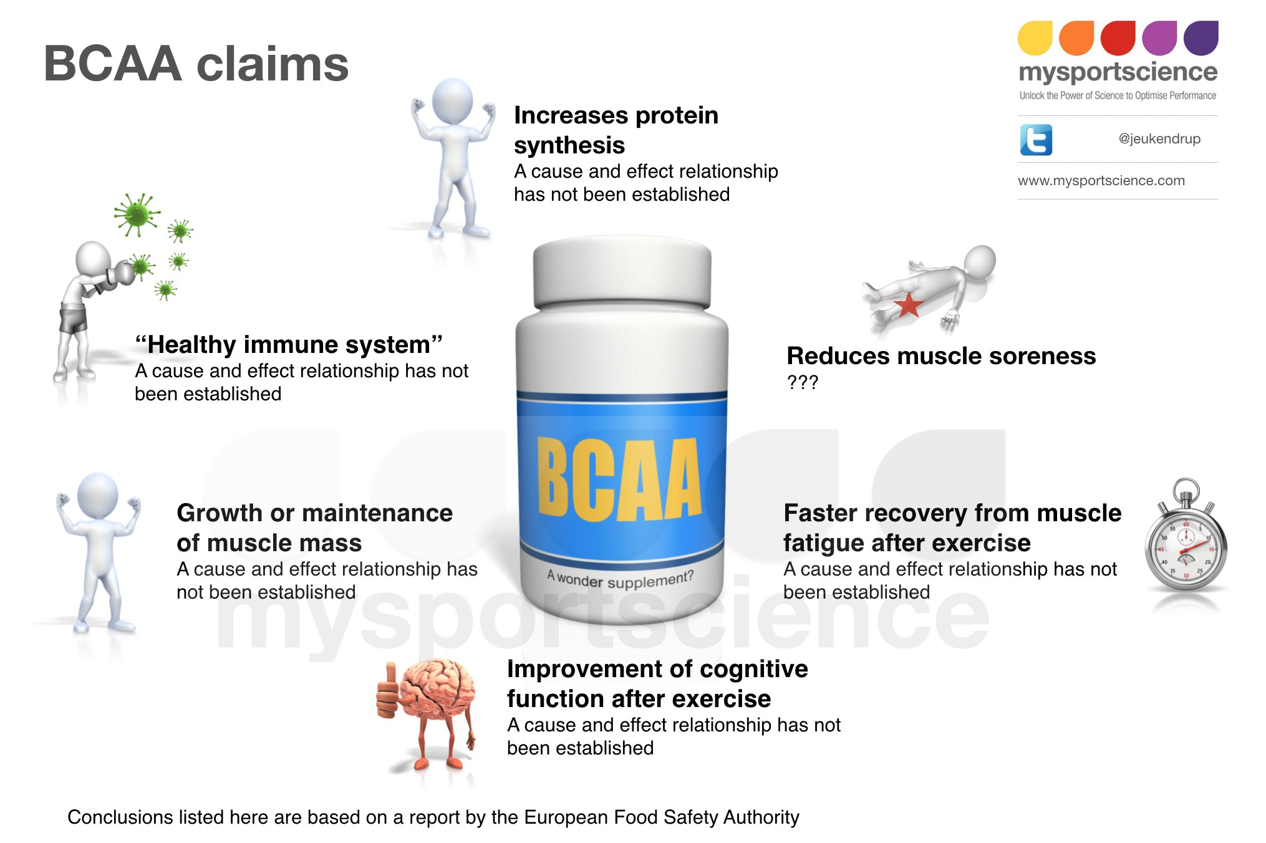
BCCA

Slide 18
HMB
Hydroxy methyl butyrate – known as HMB
It is a metabolite of the essential amino acid Leucine playing a role protein re synthesis
It has been suggested it prevents breakdown of muscle
The evidence has mainly come from the study of rats!

Slide 19
Colostrum
Bovine colostrum is milk produced in the first weeks of life
Higher in protein – immunoglobulin's
Research has shown an improvement in sports performance – evidence of an improvement in buffering capacity – this may be more effective in endurance type training
There is no evidence it supports the immune system

Slide 20
Glutamine
A non essential amino acid.
It is used as fuel by some of the immune system cells.
It is decreased in exercise therefore the rationale is that supplementing may offer a boost to the immune system
The evidence is very scarce but it is widely taken

Slide 21
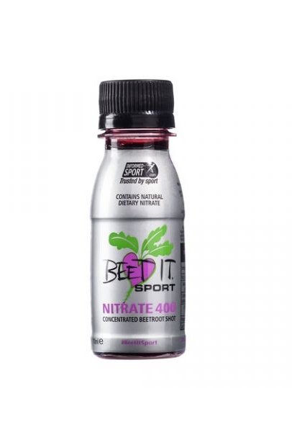
Nitrates
Beetroot juice is really high in Nitrates
They are absorbed into the blood stream, converted into nitrous oxide and causes vasodilation of blood vessels
Reduces resting blood pressure, improves oxygen cost of exercise – exercise for longer
Dose – 1-2 x 70ml shots pre exercise

Slide 22
Green Tea
Made from the leaves of the plant Camellia Sinesis
Rich in polyphenols and caffeine
Potential role in increasing fat metabolism
Some studies have shown an antioxidant effect
Evidence re weight loss is not very conclusive
Some evidence that more than 8 cups a day may be toxic and cause liver damage

Slide 23
PROTEIN
Some sports have a fixation about protein and believe you have to drastically increase protein to increase muscle.
Intakes of over 200g are common!
Use of expensive protein, amino acids mixes – take a trawl of the internet and you will find 100s
My protein shake is nicer!! And cheaper and not contaminated

Slide 24
VITAMINS AND MINERALS
Widely used.
Are not banned .
Athletes may have a slightly raised requirement
Main problem is that a lot of supplements have them added – potential risk of overdose
Uk Anti Doping has reported a lot is appearing in urine samples.

Slide 25
New Supplements
What is current?
Collagen seems to be the one I keep hearing about
Collagen is a fibrous protein found in connective tissues such as tendons, ligaments, Cartlidge, bones and teeth
Also needed for wound healing and scar formation

Slide 26
Collagen
It keep the joints elastic and skin plump
Body production decreases with age – wrinkles
It is added to many cosmetics but the structure is too big to be absorbed via the skin!

Slide 27
Collagen in sport
Often taken prior to training – said to prevent damage to ligaments and repair injuries
Taken as a shot in some cases prior to training along with Vitamin C as this is required in its synthesis – proline and lysine are key amino acids
Is there any evidence it works?
Do we just digest it !
Look at the article on Moodle

Slide 28
Are there any of interest to you?
Class discussion

Slide 29
CONCLUSION
Athletes need to take extreme care
There is some evidence for a placebo effect!
Be alert to drinks etc. being spiked!
Sort their diet out first - by a SPORTS NUTRITIONIST
Look at the SENr Statement on Food First

