Slide 1




Nails & Lush: Your Sanctuary of Colour and Care
Module Name: Enterprise and Entrepreneurship
Module Code: LCLM4006
Assignment Title: Task 2: Individual presentation
Lecturer: Ejike Udeogu
Student: Nadia Qamar (2312083)

Slide 2
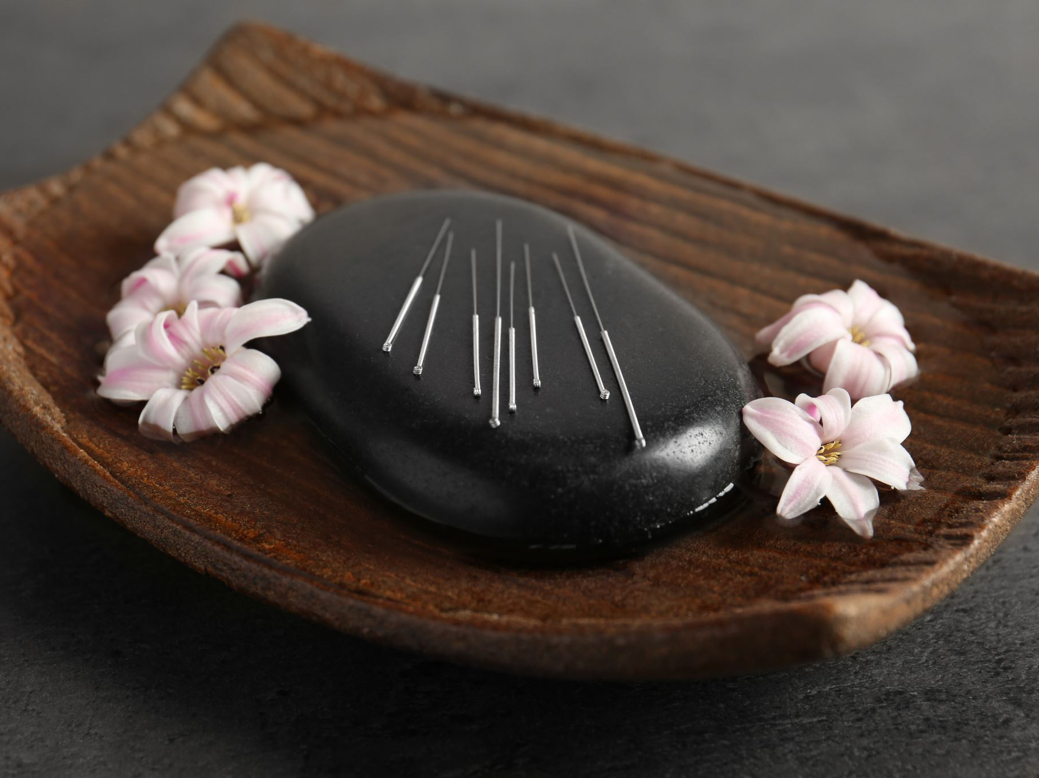
Overview of the Business Idea
Nails & Lush is a wellness-focused nail bar combining beauty and relaxation.
It offers manicures and pedicures enhanced with aromatherapy, meditation, and herbal teas.
Operating on an appointment-only model, it ensures exclusivity and hygiene.
The business targets the growing UK clean beauty market worth £30.4 billion in 2024, focusing on ethical, non-toxic treatments that appeal to health –conscious and eco aware customers.

Slide 3
Legal Format and Management Structure
Formed as a Private Limited Company (Ltd), giving it a separate legal identity.
The company can own assets, sign contracts, and incur liabilities in its own name.
Shareholders have limited liability, protecting their personal assets.
The Ltd structure enhances credibility with lenders and investors.
Chosen over sole proprietorship or partnership, which expose owners to unlimited liability.
Management Structure:
Founder-led, with one or two directors managing operations, finance, and strategic decisions.
Supported by a team of nail technicians delivering services.
A receptionist manages client bookings and communication.
Clear hierarchy ensures accountability, professionalism, and efficient coordination.

Slide 4

Marketing Strategies Product And service
Target: the marketing plan for Nails & Lush aims to appeal to its core target market of Wellness-Working Women aged 25–45, who are digitally active, time-constrained, and self-care conscious. The strategy will be formulated using the 4Ps of marketing.
Product: Three service tiers—Aura Ritual, Express Refresh, and Take-Home Lush.
Price: Mid-to-premium range for ethical, quality services.
Place: Central urban area with high professional foot traffic.
Promotion: Instagram, TikTok, influencer marketing, SEO website, email campaigns, and local partnerships with gyms and yoga studios.

Slide 5
Environmental Analysis (PESTEL)
Political: Compliance with UK salon hygiene and safety regulations.
Economic: Growing beauty sector with resilience despite inflation.
Social: Rise of wellness culture and conscious consumers seeking cruelty-free, non-toxic services.
Technological: Use of online booking, digital marketing, and influencer partnerships.
Environmental: Sustainable practices with eco-friendly, cruelty-free products.
Legal: Adherence to employment, consumer, and hygiene laws ensuring brand trust.

Slide 6
SWOT Analysis
Strengths:
- Unique wellness-oriented concept integrating beauty and mindfulness.
- Use of non-toxic, cruelty-free products.
- Strong digital presence for seamless booking.
Weaknesses:
- High initial setup and marketing costs.
- New brand with limited customer base.
- Reliance on urban clientele.
Opportunities:
- Rising demand for clean beauty and self-care.
- Potential for brand expansion and partnerships with wellness studios.
- Growth of the UK wellness economy.
Threats:
- Economic uncertainty affecting discretionary spending.
- Intense competition from established salons.
- Evolving consumer trends requiring constant innovation.

Slide 7

Funding and Financial Projections
Total Funding Required: £65,000
• £30,000 – Premises, deposit, and zen-style refurbishment
• £15,000 – Professional equipment and hygiene tools
• £5,000 – Ethical product stock (Zoya, CND)
• £5,000 – Marketing (social media & influencer launch)
• £10,000 – Working capital (staff, utilities, contingencies)
Funding Sources: Personal savings, UK Start-Up Loans (£25k per director), small business loan, or angel investment.
Projected Revenue: ~£28,600/month based on 520 clients at £55 per service.

Slide 8
Conclusion
Nails & Lush offers a premium, wellness-centred experience blending aesthetics and mindfulness. By embracing sustainability, technology, and customer-centric marketing, it positions itself as a trusted, ethical urban sanctuary. The growing UK wellness market provides significant expansion opportunities for this business model.

