Slide 1
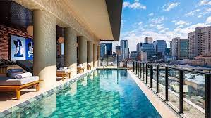
HOTEL INDIGO
HOTEL INDIGO

Slide 2
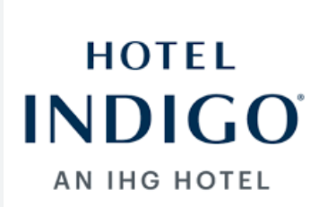
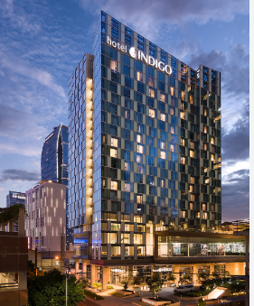
HOTEL CHAIN
INTRODUCTION
The presentation aimed to highlight the significance of guest service and hospitality in the hotel sector.
The presentation intends to deliver an insightful evaluation of Hotel Indigo, which is a captivating and unique hotel brand.
This presentation will examine a number of features of Hotel Indigo, such as its clientele, guest services, and extraordinary capacity to fulfil and beyond guests' expectations.
Notes:
The main goal of this presentation is to focus on the critical role that hospitality and guest services play in the hotel industry. The presentation will concentrate on a thorough analysis of the Hotel Indigo, which is well-known for its unique character. Thus, the presentation will evaluate a variety of aspects of Hotel Indigo, such as clients, guest services, and its astonishing capacity to continuously outperform guest expectations.

Slide 3
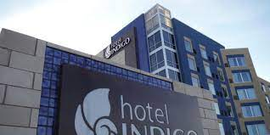
Overview of Hotel Indigo
HOTEL CHAIN
Hotel Indigo is a global network of privately run small boutique hotels.
IHG owns Hotel Indigo.
It is renowned for its modified services, lively atmosphere, and distinctive style.
The surrounding areas' culture, community, and many factors are promoted at every Hotel Indigo hotel.
The Hotel is the perfect spot for celebration, creativity, and collaboration.
The Hotel Indigo curates experiences and spaces that highlight the beauty in their neighbourhood (IHG, 2023a).
Hotel Indigo has 143 locations worldwide (Statista, 2023).
Notes:
The location of Hotel Indigo draws inspiration from the district in which it is located and uses that inspiration to indicate the local history, unique qualities, and culture. The InterContinental Hotels Group (IHG) is the owner of the boutique hotel brand known as Hotel Indigo. It is well-known for its tailored services, unique aesthetics, and vibrant ambience.

Slide 4
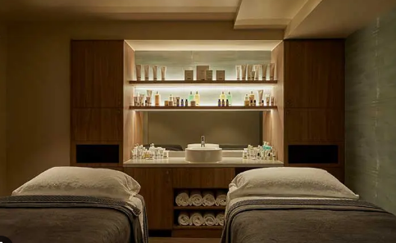
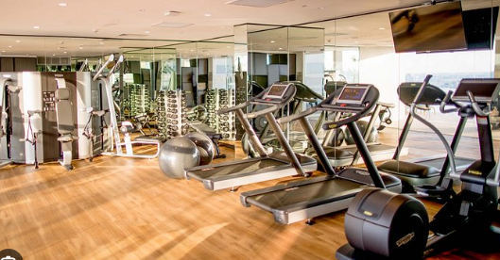
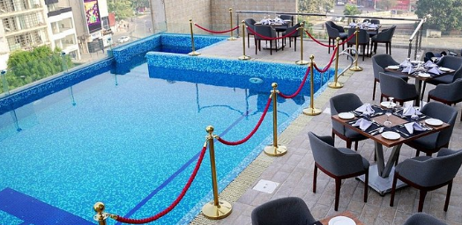
HOTEL CHAIN
Guest Services and Facilities
From regular rooms to suites, hotels deliver a range of accommodation options that meet varied guest preferences, providing comfort and suitability during their stay.
Access to various culinary experiences, from informal eating to gourmet dining, is made possible by the room service and on-site restaurants that are frequently found in hotels.
The whole experience of guests is enhanced by the services offered by hotels, which include spas, fitness centres, business centres, and swimming pools (IHG, 2023c).
Regular maintenance procedures and room cleaning keep the space welcoming and tidy (Hotel Indigo, 2023a).
Notes:
The capacity of Hotel Indigo to adjust to local markets and customise its buildings to suit the distinctive qualities of the immediate neighbourhood is one of its strengths. It enables Hotel Indigo to distinguish itself from rivals and stand out in the industry.

Slide 5

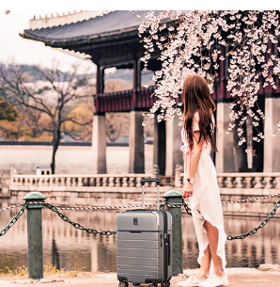
Customer Base
HOTEL CHAIN
The Hotel segments its consumer to cater for their expectations and needs
Sophisticated leisure travellers are looking for innovative and thrilling experiences.
Business travellers seeking a pleasant environment with a unique vibe.
Millennials and Gen Z are the target markets of Hotel Indigo (Widhiasih et al., 2023).
Customers are attracted to Hotel Indigo because of their boutique-style design.
This reflects the local heritage, culture, and art, developing a sense of authenticity.
Notes:
Hotel Indigo deliberately divides its clients to meet a range of expectations and demands. It attracts many customers, such as business travellers who value a comfortable setting with affluent leisure travellers and distinctive ambience looking for exciting and novel experiences. Notably, Hotel Indigo has had success reaching the millennial and Gen Z generations.

Slide 6
Role and Function of Guest Services
The role of guest service is to assure a positive guest experience
Guest service address requests and needs of clients (Lemon and Verhoef, 2016)
The main function includes, reservation, check-in/out, local insights, and problem resolution
Hotel indigo excel in providing customized guest services and elevating the stay of customers

Slide 7
HOTEL CHAIN
Nature of Brand
The Hotel mixes regionally inspired décor with unique embellishments made by local artists to promote a sense of wonder and curiosity among guests.
The distinctive narrative and design of Hotel Indigo serve as inspiration.
At Hotel Indigo, a long history, unique architectural design, vibrant personality, and the local cuisine culture are all unified (IHG, 2023b)
The Hotel is also a perfect setting for whatever customers can dream up (IHG, 2022b).
Notes:
The unique appeal of Hotel Indigo is found in the way that it combines locally made art and décor that is impacted by the local area. Arriving there inspires a sense of discovery and admiration due to the perfect integration of its rich history, dynamic personality, and distinctive architectural style.

Slide 8

HOTEL CHAIN
Importance of Hospitality
Hospitality is essential to ensure the comfort of clients, which promotes great evaluations and repeat business.
The promotion of tourism, which boosts the local economy, is a critical function of the hospitality sector (Chen, 2019).
Therefore, Hotel Indigo attract discerning travelers looking for an immersive experience
The Hotel stands out by delivering modified and local-inspired hospitality that makes them different from rivals (IHG Plc, 2023)
Local collaborations, which assist the marketing and development of the neighbourhood, are part of the dedication of Hotel Indigo to hospitality.
Notes:
Success for Hotel Indigo rests on its reputation for hospitality. By assuring they are comfortable, it encourages customer adherence and good feedback. The dedication of this distinctive brand to individualised, locally-inspired hospitality sets it apart, enhancing its reputation, attracting discriminating tourists, and contributing to community development through local partnerships, eventually assisting economic development.

Slide 9
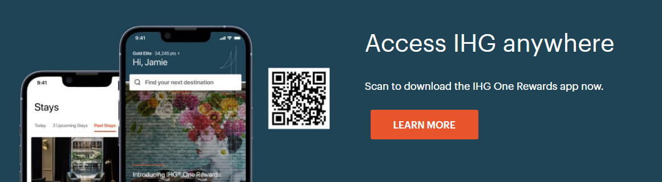

How Hotel meet guest expectations
HOTEL CHAIN
Hotel Indigo meet the guest' expectation by focusing on several aspects
The Hotel provide some essential benefits by using loyalty cards, such as no blackout dates, Free Wi-Fi, late check-out, and earning points for a reward night (Hotel Indigo, 2023b)
To reflect culture and history, the Hotel deliver exclusive localisation
They spend money educating employees to forecast and satisfy the expectations of visitors
They provide highly tailored services, satisfying requests and guaranteeing a custom experience.
Notes:
By focusing on these areas, Hotel Indigo seeks to consistently go above and beyond the expectations of guests. However, personalised service, dedication to authentic experiences, distinctive design, and attention to detail are just a few of the ways Hotel Indigo seeks to create extraordinary stays that leave guests satisfied and eager to return.

Slide 10
Conclusion
HOTEL CHAIN
The presentation made clear the significance of guest services and hospitality to the hotel industry.
The presentation addressed the attractive and unique Hotel Indigo brand, renowned for its personalised services and energetic atmosphere.
It looked at the varied clients of Hotel Indigo, its amazing capacity to consistently exceed guests' expectations and excellent guest services.
Hotel Indigo is well-positioned for long-term success and neighbourhood development due to its dedication to great service.
It is noted that Hotel Indigo is still devoted to providing outstanding stays that encourage loyalty by concentrating on meeting and exceeding guest expectations.

Slide 11
References
HOTEL CHAIN
Chan, E.S. and Hsu, C.H., 2016. Environmental management research in hospitality. International Journal of Contemporary Hospitality Management, 28(5), pp.886-923.
Chen, L. F. (2019). Green certification, e-commerce, and low-carbon economy for international tourist hotels. Environmental science and pollution research, 26, 17965-17973.
Hotel Indigo, 2023a. IHG Clean Promise - Stay with Confidence. Available at https://www.hotelindigodubai.com/ihg-way-of-clean/. [Accessed on 3rd October 2023]
Hotel Indigo, 2023b. Join IHG® One Rewards. Available at https://www.hotelindigo.com/rewardsclub/us/en/enrollment/join. [Accessed on 3rd October 2023]
IHG Plc, 2023. IHG Hotels & Resorts opens new Hotel Indigo in the heart of Guadalajara. Available at https://www.ihgplc.com/en/news-and-media/news-releases/2023/ihg-hotels-and-resorts-opens-new-hotel-indigo-in-the-heart-of-guadalajara. [Accessed on 3rd October 2023]
IHG, 2023. OUR STORY. Available at https://www.ihg.com/hotelindigo/content/us/en/about-us. [Accessed on 3rd October 2023]
IHG, 2023c. Hotel Indigo. Available at https://careers.ihg.com/en/our-brands/hotel-indigo/. [Accessed on 3rd October 2023]
IHG. 2022b. WELCOME TO OUR NEIGHBORHOOD. Available at https://www.ihg.com/hotelindigo/hotels/us/en/reservation. [Accessed on 3rd October 2023]
Lemon, K.N. and Verhoef, P.C., 2016. Understanding customer experience throughout the customer journey. Journal of marketing, 80(6), pp.69-96.
Statista, 2023. Number of Hotel Indigo hotels worldwide from 2008 to 2022. Available at https://www.statista.com/statistics/223370/number-of-hotel-indigo-hotels/. [Accessed on 3rd October 2023]
Widhiasih, N.P.A., Sadjuni, N.L.G.S., Harmini, A.A.N., Rejeki, I.N.M. and Waelan, W., 2023. Pengaruh social media marketing terhadap purchase intention pada wisatawan domestik di hotel indigo bali seminyak beach. Journal of Commerce, Management, and Tourism Studies, 2(1), pp.42-57.

