Slide 1

Name: Sophie Albangbe
Student ID: 1916094
Module: Independent Project
Title of dissertation: The impact of anxiety on older adults in care homes in the UK

Slide 2
CHAPTER 1: Introduction
Introduction and Rationale
This study introduced the impact of anxiety on older adults in care homes in the UK.
Older adults face problems such as sleeping trouble, brain and nervous system changes, and more other issues.
The increasing problems create anxiety and it causes heart diseases, high blood pressure and more.
Therefore, the study has identified the problems and solutions to reduce anxiety among older adult people in the UK

Slide 3
Contd....
Aim
The aim of this study is to analyse the impact of anxiety on older adults living in a care home in the UK.
Objective
Examine the reason behind anxiety among older adults in the UK
Analyse the main elements that cause anxiety in the care homes
Evaluate the impact of anxiety that compromises the well-being of elderly care homes
Provide recommendations for the improvement of health and well-being among older adults

Slide 4
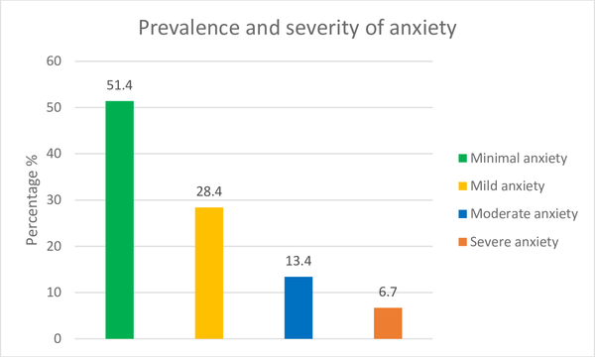
CHAPTER 2: BACKGROUND
Historical information
Anxiety is a common problem faced by most people.
More than 26% of old men and 28% of old women face anxiety in the UK (org.uk, 2022).
Stress from emotional, physical abused or death of loved one generate anxiety.
Anxiety creates problems such as high blood pressure, heart disease, and more among older people.

Slide 5
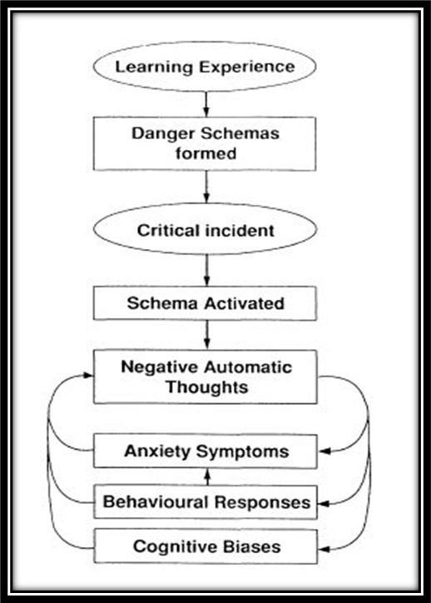
Contd...
Theoretical background
The cognitive theory of anxiety helps to imagine the worst-case scenario due to anxiety among the older people
The feeling of fear, threat and the perceived believed
It effectively describes the reasons of anxiety (Theelen et al. 2022)
The learning behaviour theory has described that anxiety changes the behaviour of older people in the UK
Learning behaviour theory helps to improve behavioural disorders due to anxiety

Slide 6
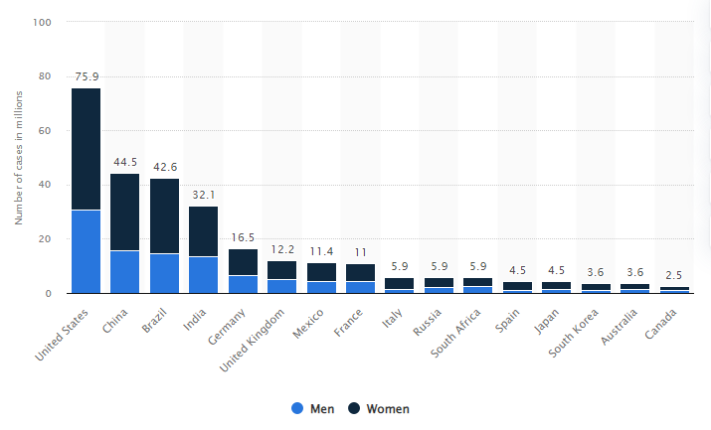
Contd...
International context
The “Mental Health Act 1983” helps to identify older adult suffering from anxiety and allowed treatment (Giebel et al. 2021, p.1283).
The Act help to Identify the risk factors of anxiety among older adult and to reduce the symptoms by providing a proper treatment
The care homes help to provide physical care, as well as some particular therapy to reduce anxiety among older people

Slide 7
Contd...
National / Local context
The care homes in the UK need to reduce the loneliness and isolation of older people.
Mental Health Act 1983” was implemented to ensure older people have a place to live and feel secure in the care home (gov.uk,2022).
Reducing the anxiety levels in older adults it facilitates them to lead happy and reduces diseases among them.
Eradicate anxiety among older adults, provide them with a peaceful environment to survive effectively without any trauma or implications in the care home. (Wand et al. 2020, p.2025).

Slide 8
CHAPTER 3: METHODS
Data collection/search strategy
The method used in collecting data is effective and important factor of systematic literature review
The primary qualitative data collection method has been used to collect the data.
The relevant data has been gathered by analysing the articles related to the research topic (O'Neill et al. 2020, p.12).
It has helped to collect relevant information about the impact of anxiety among older people in the UK.
The study help to collect different overviews and incidents on the issues of anxiety on older adult and to gain potential understanding and the improvement of health and well-being among older adults

Slide 9
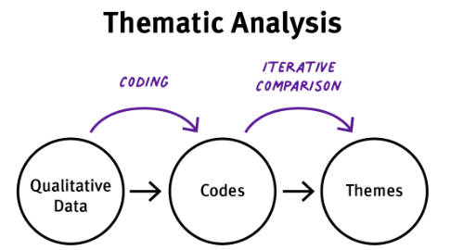
Contd...
Data analysis
The thematic data analysis has been used to analyse the gathered data.
Thematic analyse makes themes and identifies the quality result after analysing the data and identifying code (Clark Bryan et al. 2020).
Ethical Consideration
The study has maintained proper ethics during data collection. (gov.uk, 2022).
This study did not contain any personal information about any author or other people
This study has maintained bias-free results.

Slide 10

CHAPTER 4: RESULTS and Findings
Due to loneliness and stress, most older people got anxiety.
Anxiety impacts negatively on older people in the UK.
Mental Health Act 1983 helps to identify older adults affected with anxiety and the treatment for them (gov.uk, 2022).

Slide 11
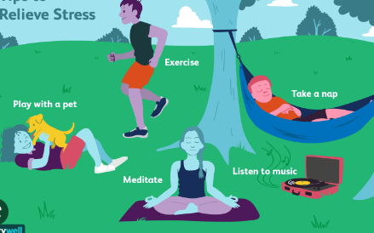
Contd...
Reducing loneliness and isolated among older people can help to mitigate anxiety.
Effective training can provide physical stability that reduces anxiety among older people (Monahan et al. 2021).
Practising mindfulness, yoga and meditation can help to reduce anxiety.

Slide 12
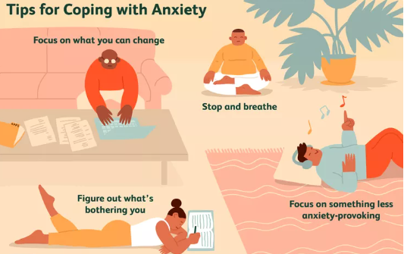
CHAPTER 5: RECOMMENDATION
Improving health practices such as physical and mental activities improves the well-being of older people in the UK.
Promoting mental health within society to reduce anxiety among older people (Arango et al. 2018, p. 10).
Providing effective training for health care professionals help to reducer the anxiety issues among older people in the UK.

Slide 13
CHAPTER 5: CONCLUSION
The overall study concludes that anxiety can effect negatively on older people.
The implementation of “The Mental Health Act 1983”. Help to recognised anxiety and how to managed it
Moreover, by practising a healthy lifestyle, reduce anxiety among older people.
Health care professionals need to be aware of anxiety among the older adults and how it can be improved in the care home

Slide 14
REFERENCES
Arango, C., Díaz-Caneja, C.M., McGorry, P.D., Rapoport, J., Sommer, I.E., Vorstman, J.A., McDaid, D., Marín, O., Serrano-Drozdowskyj, E., Freedman, R. and Carpenter, W., 2018. Preventive strategies for mental health. The Lancet Psychiatry, 5(7), pp.591-604.
Bauer, M., Fetherstonhaugh, D., Haesler, E., Beattie, E., Hill, K.D. and Poulos, C.J., 2018. The impact of nurse and care staff education on the functional ability and quality of life of people living with dementia in aged care: A systematic review. Nurse education today, 67, pp.27-45.
Brooke, J. and Clark, M., 2020. Older people’s early experience of household isolation and social distancing during COVID‐19. Journal of clinical nursing, 29(21-22), pp.4387-4402.
Brooke, J. and Jackson, D., 2020. Older people and COVID-19 isolation, risk and ageism. Journal of clinical nursing.
Giebel, C., Lord, K., Cooper, C., Shenton, J., Cannon, J., Pulford, D., Shaw, L., Gaughan, A., Tetlow, H., Butchard, S. and Limbert, S., 2021. A UK survey of COVID‐19 related social support closures and their effects on older people, people with dementia, and carers. International journal of geriatric psychiatry, 36(3), pp.393-402.
Gov.uk, 2022, Data protection, available at:https://www.gov.uk/data-protection#:~Protection implementation [accessed on: 22/11/2022]

Slide 15
Contd...
Mentalhealth.org.uk, 2022. “Older people: statistics” , Mentalhealth.org.uk , Available at: https://www.mentalhealth.org.uk/explore-mental-health/mental-health-statistics/older-people-statistics, [Accessed on 02.01.2023]
Monahan, C., Macdonald, J., Lytle, A., Apriceno, M. and Levy, S.R., 2020. COVID-19 and ageism: How positive and negative responses impact older adults and society. American Psychologist, 75(7), p.887.
O'Neill, M., Ryan, A., Slater, P.F., Ferry, F.R. and Bunting, B., 2020 Mental health, quality of life and medication use among care home residents and community-dwelling older people International Journal of Research in Nursing, 10(1), pp.10-23.
Theelen, H., van den Beemt, A. and Brok, P.D., 2022. Enhancing authentic learning experiences in teacher education through 360-degree videos and theoretical lectures: reducing preservice teachers' anxiety European journal of teacher education, 45(2), pp.230-249.
Wand, A.P.F., Zhong, B.L., Chiu, H.F.K., Draper, B. and De Leo, D., 2020. COVID-19: the implications for suicide in older adults. International psychogeriatrics, 32(10), pp.1225-1230.
Welzel, F.D., Stein, J., Röhr, S., Fuchs, A., Pentzek, M., Mösch, E., Bickel, H., Weyerer, S., Werle, J., Wiese, B. and Oey, A., 2019. Prevalence of anxiety symptoms and their association with loss experience in a large cohort sample of the oldest-old. Results of the AGECODE/AGEQUALIDE study. Frontiers in Psychiatry, 10, p.285

