Slide 1

Autistic Spectrum Disorder
(ASD)
Redefining Autism: A Critical Analysis of ICD-11, Neurodiversity, and Future Digital Care Models in the UK
Tutors Details: Neale Haddon
Internal Verifier: Dr Eleni Koutsogeorgou-Andreou
Student name: Kamila Zikavska
Student number: 233 25 69
Psychological Classifications and Provisions
BMHP6029

Slide 2
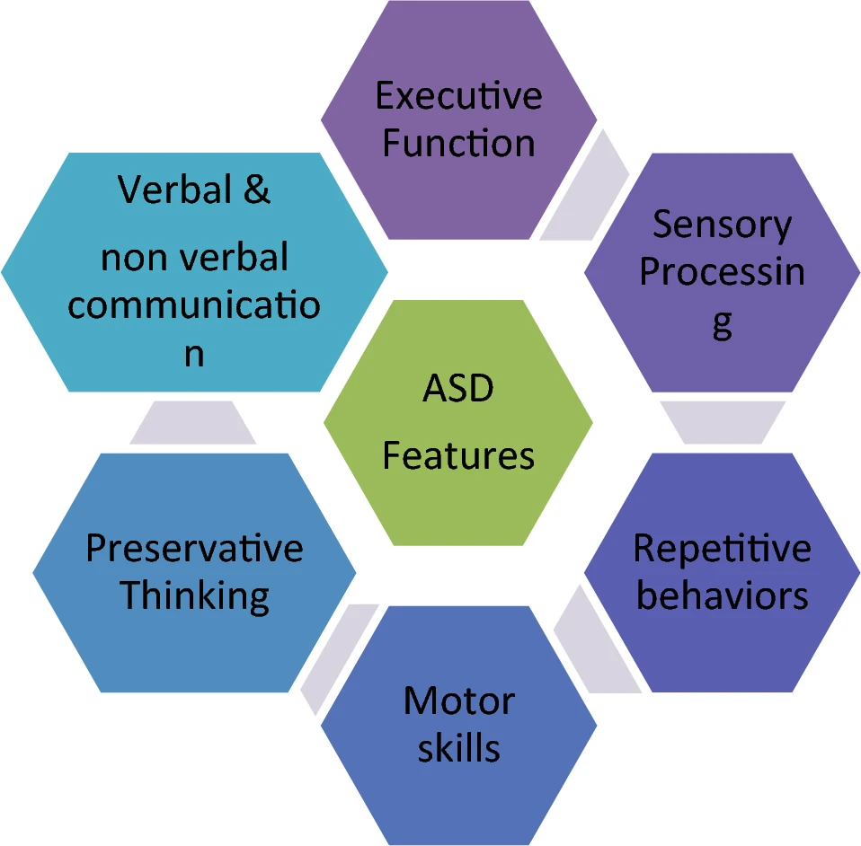
1. Introduction & ICD-11 Framework
Definition:
According to WHO (2024), Autism Spectrum Disorder (ASD) is a neurodevelopmental condition characterized by persistent deficits in initiating and sustaining reciprocal social interaction and communication.
Behavioural Patterns:
It involves restricted, repetitive, and inflexible patterns of behaviour, interests, or activities that are clearly atypical or excessive for the individual's age and sociocultural context (WHO, 2024).
Dimensional Approach:
ICD-11 (6A02) categorizes ASD as a spectrum, utilizing dimensional specifiers to evaluate functional impairment in intellectual and language development rather than using obsolete subtype labels (WHO, 2024).
Lifespan Presentation:
Unlike older versions, ICD-11 acknowledges that symptoms present across the lifespan, though they may only become fully manifest when social demands exceed the individual's limited capacity (WHO, 2024).
Neurodiversity:
This modern shift aligns with the Neurodiversity Movement, which views autism as a natural neurobiological variation rather than a disease (Kapp, 2020).
2. Critical Analysis: Psychological Models &
Social Context
Beyond Deficit Models:
While the "Reading the Mind in the Eyes" test is established tool for assessing theory of mind, research by Baron-Cohen et al. (2015, p.11) indicates it should not be used as a standalone diagnostic tool, as it captures only one aspect of the autism phenotype and its performance is influenced by factors such as verbal IQ and linguistic abilities.
The Double Empathy Problem:
Communication breakdown is not a one-sided "autistic deficit," but a mutual misunderstanding between two different neurotypes (Milton, 2022). This shifts the focus from individual pathology to the social environment.
Gender Bias & Masking:
To ensure your text is academically rigorous and fully supported by the provided sources, I have refined the wording to clearly distinguish between the mechanism of camouflaging (Wood-Downie et al., 2020) and the severe mental health outcomes identified in suicide prevention research (Cassidy et al., 2022, p.7).
Concept Creep & Clinical Practice:
The expansion of diagnostic boundaries in ICD-11 (Stein et al., 2020) improves support access but risks "concept creep"—the pathologization of normal human variation if not applied with caution (Haslam, 2016).
Moving Toward Affirming Care:
Best practices must evolve from traditional, potentially ineffective behavioral interventions toward "Neurodiversity-Affirming Therapy," which prioritizes sensory needs and individual identity over social compliance (Therapist Neurodiversity Collective, 2026).
Aspects observed while diagnosing ASD (Farooq, 2022).

Slide 3
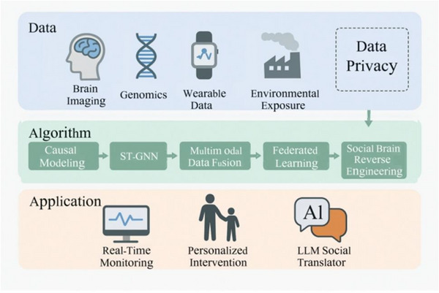
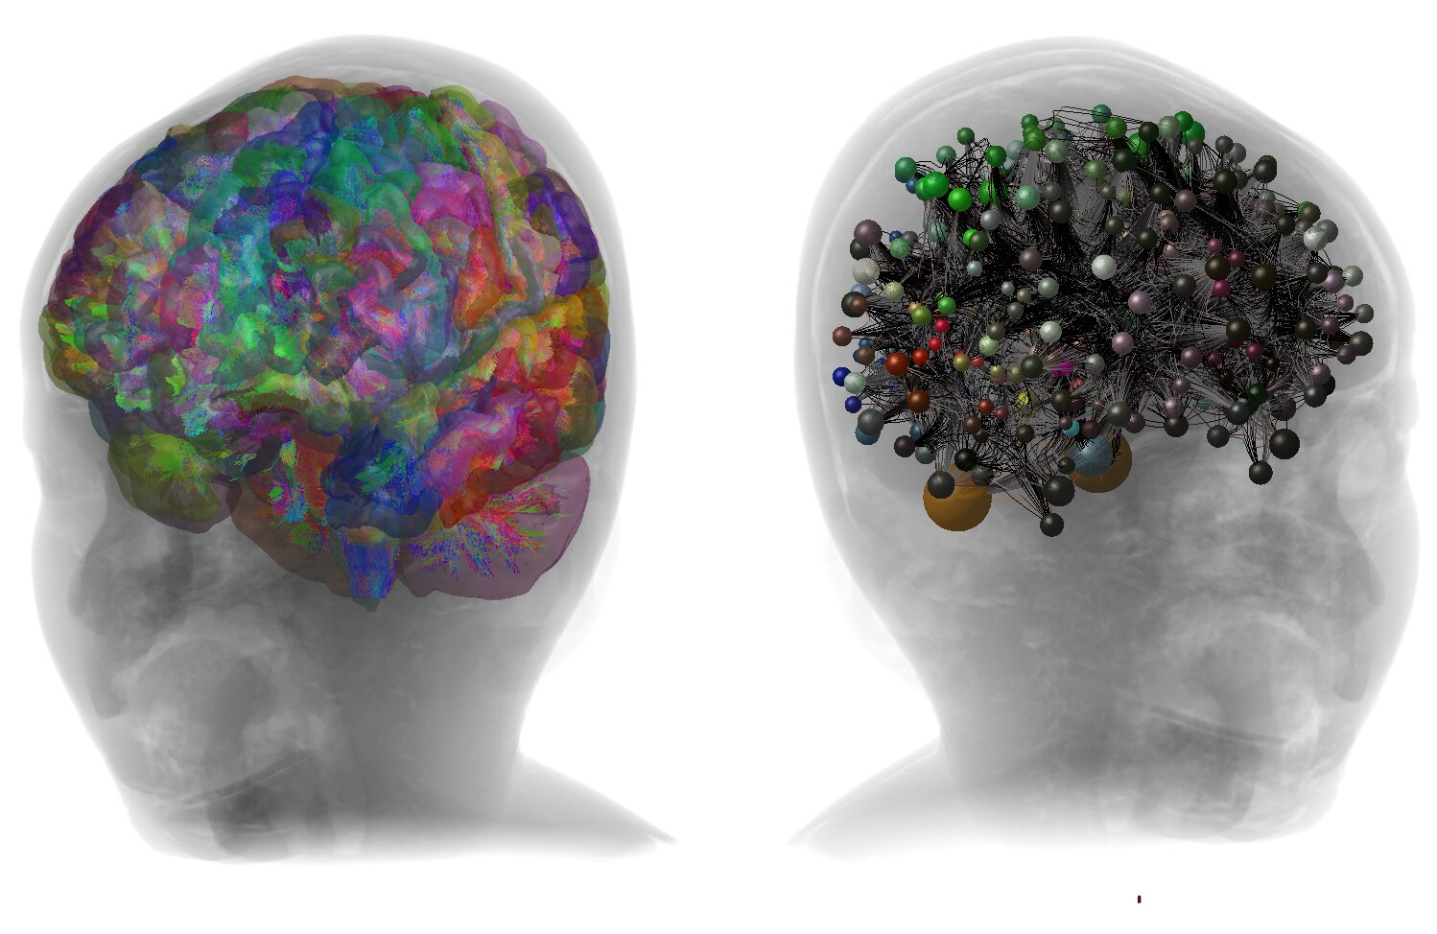
3. Innovation:
Future Digital Care Models
Innovation: AI-Driven Research Paradigms
(Zhang et al. 2026)
Multimodal Data Foundation:
Integrates diverse inputs—Brain Imaging, Genomics, Wearable Data, and Environmental Exposure—to capture complex ASD heterogeneity.
Algorithmic Pathway:
Employs advanced Causal Modelling, ST-GNNs, and Data Fusion to move beyond simple correlation toward identifying causal biological mechanisms.
Privacy & Collaboration:
Uses Federated Learning to enable cross-institutional research while maintaining strict data privacy.
Precision Applications:
Translates complex algorithms into actionable clinical tools: Real-Time Monitoring, Personalized Interventions, and LLM-based Social Translators.
Digital Twin: Anatomically Accurate Modeling
(Mondal, 2026)
Unified Modelling:
The FEDE system creates a personalized "digital twin" (virtual replica) by integrating MRI structural maps with real-time EEG data.
System Integration:
Unlike fragmented traditional tools, FEDE unifies brain structure and dynamic signalling into one workflow.
Hidden Signatures:
Advanced modelling of myelination and tissue properties reveals neural irregularities—like a 3x higher excitation-to-inhibition (EI) ratio—invisible to standard diagnostics.
4. Conclusion &
Recommendations for Practice
Paradigm Shift:
Move beyond deficit-based models toward Neurodiversity-Affirming Care, prioritizing sensory needs and individual identity over social compliance (Kapp, 2020; Therapist Neurodiversity Collective, 2026).
Systemic Inclusion:
Address the "Double Empathy Problem" by fostering mutual understanding between neurotypes, rather than pathologizing autistic communication styles (Milton, 2022).
Evidence-Based Innovation:
Integrate AI-driven tools (e.g., Digital Twins, LLMs) to personalize care pathways, ensuring interventions are data-informed, ethical, and human-centered (Mondal, 2026; Zhang et al., 2026).
Clinical Equity:
Proactively address gender bias and diagnostic delay in females by accounting for camouflaging behaviors in both assessment and support provision (Wood-Downie et al., 2020).
Future Policy:
Promote integrated care pathways that acknowledge the complexity of neurodevelopmental conditions while strictly protecting patient privacy and data sovereignty (NHS Digital, 2024; Zhang et al., 2026).
Legislative Alignment:
Future practice must strictly adhere to the Equality Act 2010 to eliminate discrimination and meet the statutory requirements of the Care Act 2014 regarding personalissed, preventative support pathways.

Slide 4
Reference List:
Baron-Cohen, S., Wheelwright, S., Hill, J., Raste, Y. and Plumb, I. ,(2015), The "Reading the Mind in the Eyes" Test', PLOS ONE, 10(8). Available at: https://www.pure.ed.ac.uk/ws/portalfiles/portal/21511884/The_Reading_the_Mind_in_the_Eyes_test.pdf, (Accessed: 14 June 2026), p.11
Care Act 2014, c. 23. London: The Stationery Office. Available at: https://www.legislation.gov.uk/ukpga/2014/23/contents (Accessed: 19 June 2026)
Cassidy, S., Gould, L., Townsend, E., Pelton, M., Robertson, A. E. and Rodgers, J. (2022) 'Autism and autistic traits in those who died by suicide in England', The Lancet Psychiatry. Available at: https://docs.autismresearchcentre.com/papers/2022_Cassidy_Autism-and-autistic-traits-in-those-who-died-by-suicide-in-england.pdf, (Accessed: 16 June 2026), p.7
Equality Act 2010, c. 15. London: The Stationery Office. Available at: https://www.legislation.gov.uk/ukpga/2010/15/contents (Accessed: 19 June 2026)
Farooq, M. S., Tehseen, R., Sabir, M. and Atal, Z. (2023) 'Detection of autism spectrum disorder (ASD) in children and adults using machine learning', Scientific Reports, 13(1), article number 9605. Available at: https://doi.org/10.1038/s41598-023-35910-1 , (Accessed: 16 June 2026)
Haslam, N. (2016) 'Concept Creep: Psychology's Expanding Concepts of Harm and Pathology', Psychological Inquiry, 27(1), pp. 1-17. Available at: https://www.tandfonline.com/doi/full/10.1080/1047840X.2016.1082418, (Accessed: 22 June 2026).
Kapp, S. K., (2020), Autistic Community and the Neurodiversity Movement: Stories from the Frontline. Cham: Palgrave Macmillan. Available at: https://researchportal.port.ac.uk/en/publications/autistic-community-and-the-neurodiversity-movement-stories-from-t/, (Accessed: 11 June 2026)
Milton, D. , Gurbuz E., Lopez B., (2022), The Double Empathy Problem, Autism, 2022 Nov;26(8):1901-1903. doi: 10.1177/13623613221129123., Epub 2022 Oct 20. Sage Journal, Available at: https://doi.org/10.1177/13623613221129123 , (Accessed: 10 June 2026)
Mondal, S. ,(2026), Anatomically accurate digital twin of 2-year-old's brain uncovers neural signatures linked to autism, Medical Xpress. Available at: https://medicalxpress.com/news/2026-06-anatomically-accurate-digital-twin-year.html, (Accessed: 25 June 2026)
NHS Digital, (2024) ,Neurodevelopmental data hub., Available at: https://digital.nhs.uk/data-and-information/data-tools-and-services/data-services/neurodevelopmental-data-hub, (Accessed: 2 July 2026).
Ott, D. L., Russo, E. and Moeller, M. (2022) 'Neurodiversity, Equity, and Inclusion in MNCs', AIB Insights, 22(3). Available at: https://doi.org/10.46697/001c.34627 , (Accessed: 29 June 2026)
Stein, D. J., Szatmari, P., Gaebel, W., Berk, M., Vieta, E., Maj, M., de Vries, Y. A., Roest, A. M., de Jonge, P., Maercker, A., Brewin, C. R., Pike, K. M., Grilo, C. M., Fineberg, N. A., Briken, P., Cohen-Kettenis, P. T. and Reed, G. M. ,(2020), Mental, behavioural and neurodevelopmental disorders in the ICD-11: an international perspective on key changes and controversies', World Psychiatry, 19(2), pp. 1-13. Available at: https://pmc.ncbi.nlm.nih.gov/articles/PMC6983973/, (Accessed: 21 June 2026)
Therapist Neurodiversity Collective, (2026), Neurodiversity-Affirming Therapy: Positions, Therapy Goals, and Best Practices. Available at: https://therapistndc.org/, (Accessed: 17 June 2026)
Wood-Downie, H., Wong, B., Kovshoff, H., Mandy, W., Hull, L. and Hadwin, J. A. ,(2020), Sex/Gender Differences in Camouflaging in Children and Adolescents with Autism, Journal of Autism and Developmental Disorders, 51, pp. 1-13. Available at: https://pubmed.ncbi.nlm.nih.gov/32691191/, (Accessed: 15 June 2026), p.1
World Health Organization, (WHO), (2024), ICD-11 for Mortality and Morbidity Statistics: 6A02 Autism spectrum disorder., Available at: https://icd.who.int/browse/2024-01/mms/en#437815624, (Accessed: 8 June 2026)
Zhang, T., Cao, Z., Li, W. and Lv, Z., (2026), Six artificial intelligence innovation strategies applied to autism spectrum disorder research: A narrative review, PMC, 13109870., 2026 Jan 27;10(2):182–198., Available at: https://doi.org/10.1002/ped4.70038, (Accessed: 24 June 2026)

