Slide 1


Training and Development needs for a HR officer
Alexandra Mintoiu(2111131)
Lecturer:Nishi Ramsurrun

Slide 2

Introduction
This presentation will do the following:
Company overview
Knowledge, skills and behaviors HR officer should have.
Personal SWOT analysis as a HR officer.
Finally, importance of training and development as a HR officer.

Slide 3

Company overview
Aviva isa British insurance provider
It headquarters in London, England
It was founded in 1696.
Number of employees: 22,000
It serves around 18 million users

Slide 4
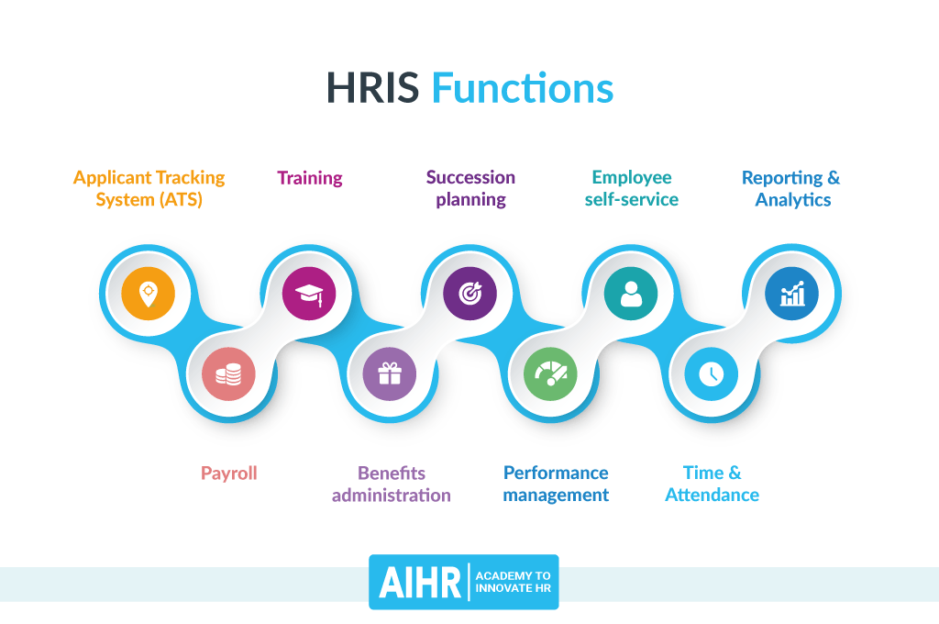
Knowledge a HR officer should have
Recruitment & selection
Learning & development
Succession planning

Slide 5
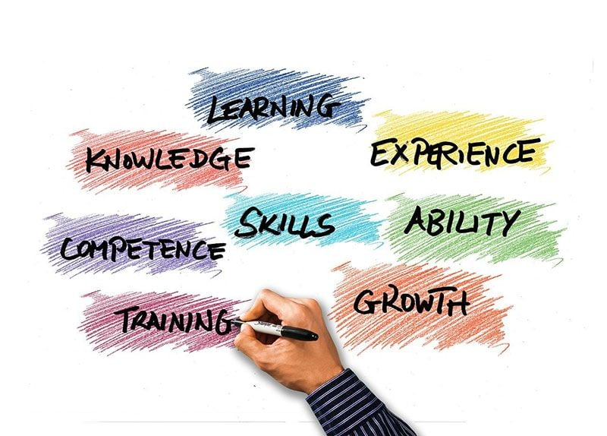
Skills should have for a HR officer
Communication skills
Administrative expert
Proactivity

Slide 6

Behaviors should have for a HR officer
Transparency and trustworthiness
Purpose oriented
Technology savvy

Slide 7
SWOT analysis of a HR officer
Strengths | Weaknesses
The ability to make good decisions and frankness and honesty as well. The ability to listen others. As a HR an officer I have good communication skills that will help communicate effectively. | Though being a good listener, biggest weakness is public speaking . Another weakness is being very critical of my own work and seldom turn in anything I am not happy with. I becomes anxious when knowing won't be able to reach a deadline.
Opportunities | Threats
Will apply new technologies to improve recruitment efforts. Utilizing skills in different ways. Leadership stability. | An HR officer is frequently threatened by things like litigious employees and tougher employment rules. Also, HR teams might need to combat preconceived notions about the HR role.

Slide 8
Skills Audit
Name
Job role: Human Resource Officer
 | Very good | Good | Adequate | Little or no experience
Information Technology
Use Microsoft Office Word
Use Excel spreadsheet
Use a Database
Use specialist HR software
Use the internet
Use e-mail
Use PowerPoint

Slide 9
Skills Audit
 | Very good | Good | Adequate | Little or no experience
Communication Skills
Drafting contracts of employment
Taking notes of disciplinary hearings
Write reports
Produce material to support presentations
Delivering a training session
Resolving disputes/complaints
Interviewing
Advising on HR issues

Slide 10
Skills Audit
 | Very good | Good | Adequate | Little or no experience
Problem solving skills
Make good use of verbal reasoning skills, able to handle complex data and make selective use of information
X
Consider the ideas of others to help solve problems

Slide 11
Supervisory Management
How much experience have you had in your role? | < 1 month 0 month | 1-3 months | > 3 months
How many people have you managed at any one time? | None | 1-5 | Above 5
I declare that the information given in this form is true
Signed | ALEXANDRA MINTOIU
Date | 22.03.2022

Slide 12

Importance of training and development as a HR officer
Retains Employees
Develops Future Leaders
Empowers Employees

Slide 13
Conclusion
Location of Aviva plc's London, England, headquarters; the company provides insurance to around 18 million Britons.
Aviva's HR manager will be able to choose the best candidate more easily if the company has a solid recruitment and selection procedure in place. If a company has done adequate succession planning, they will have a larger pool of candidates from which to choose.
As a HR officer the author has several strengths as opportunities. He has also some weaknesses and threats as well. His strengths and opportunities will help him to overcome this threats and weaknesses.
Consistently cited as a requirement for human resources roles is strong verbal and written communication skills. Proactivity is sometimes seen as more of a character fault than a skill, yet this is a common misconception.
Human Resources employees at Aviva are required to handle the problem with professionalism and a firm but fair hand. HR managers also need to be aware of the ways in which technology might affect human resources.

Slide 14
Refference list
Kulkarni, P.P., 2013. A literature review on training &amp; development and quality of work life. Researchers World, 4(2), p.136.
Bhatta, K., Ohe, Y. and Ciani, A., 2020. Which human resources are important for turning agritourism potential into reality? SWOT analysis in rural Nepal. Agriculture, 10(6), p.197.
Paillé, P., Chen, Y., Boiral, O. and Jin, J., 2014. The impact of human resource management on environmental performance: An employee-level study. Journal of Business ethics, 121, pp.451-466.
Ulrich, D., Younger, J., Brockbank, W. and Ulrich, M.D., 2013. The state of the HR profession. Human Resource Management, 52(3), pp.457-471.
Paramasivan, C., 2015. AN OVERVIEW OF MICRO INSURANCE INDUSTRIES IN INDIA. Editorial Board, 4(6), p.115.

Slide 15

Leadership is not being in charge.Leadership is about taking care of those in your charge.

