Slide 1
Anti-social behaviour and crime: can history inform the future?
What aspects of community policing offer the potential
to reduce anti-social behaviour and crime?
Milly Golledge and Maja Szeczesniak

Slide 2
Contents to be discussed and explored:
Present day: problem solving approaches
Present day: evidence of success and impact
Present day and the future: challenges and limitations – barriers
In the future: directions – innovative strategies
In the future: directions – policy recommendations
Conclusion

Slide 3
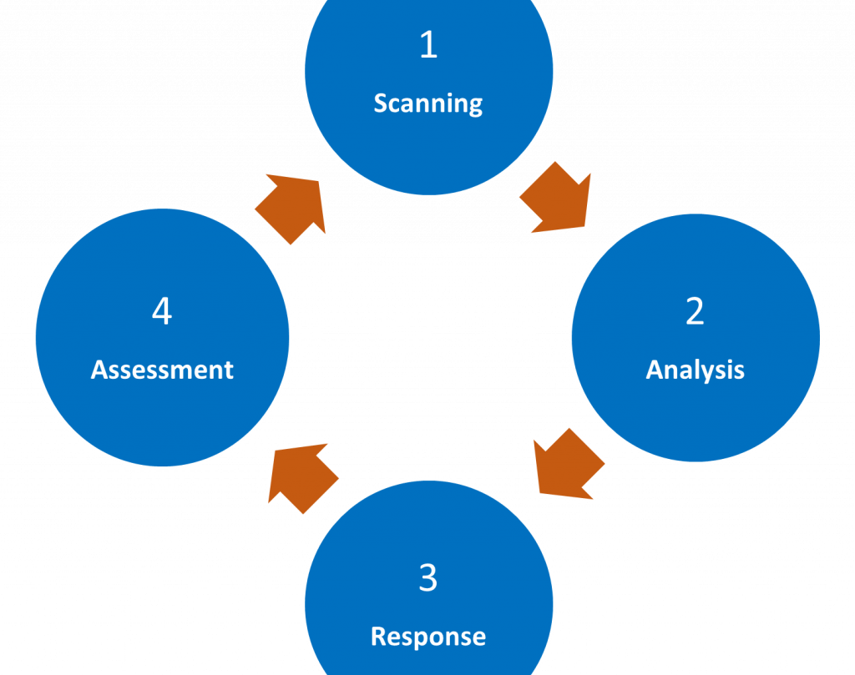
Present day: Problem-solving approaches
OSARA model
Implementations in Cardiff
(College of Policing, 2022)
(South Wales Police, 2024 (A))

Slide 4
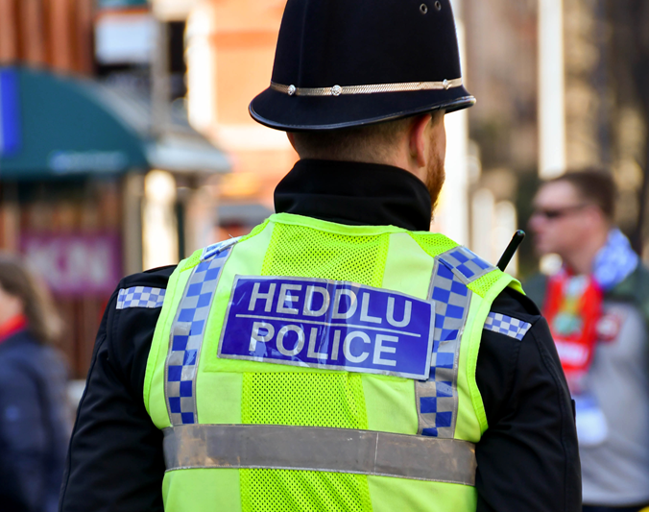
Present day and the future: Challenges and limitations - Barriers
The need for evidence-based policing.
Front line officers vs. Staff who aren't frontline.
Multi-agency safeguarding hubs.
Brixton Riots.
(Pepper et al, 2024)
(College of Policing, 2024)
(Innes and Weston, 2010)
(Peplow, 2024)
(BBC, 2021)
(Dunne and Finalay, 2016)

Slide 5
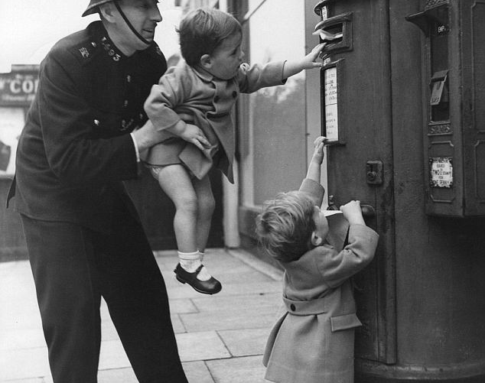
In the future – Directions – Policy
Recommendations
Suggest ways to improve community policy practices using community engagement and involvement.
The use of modern technology.
(Barnes and Eagle, 2007)
(South Wales Police, 2024 (B))

Slide 6
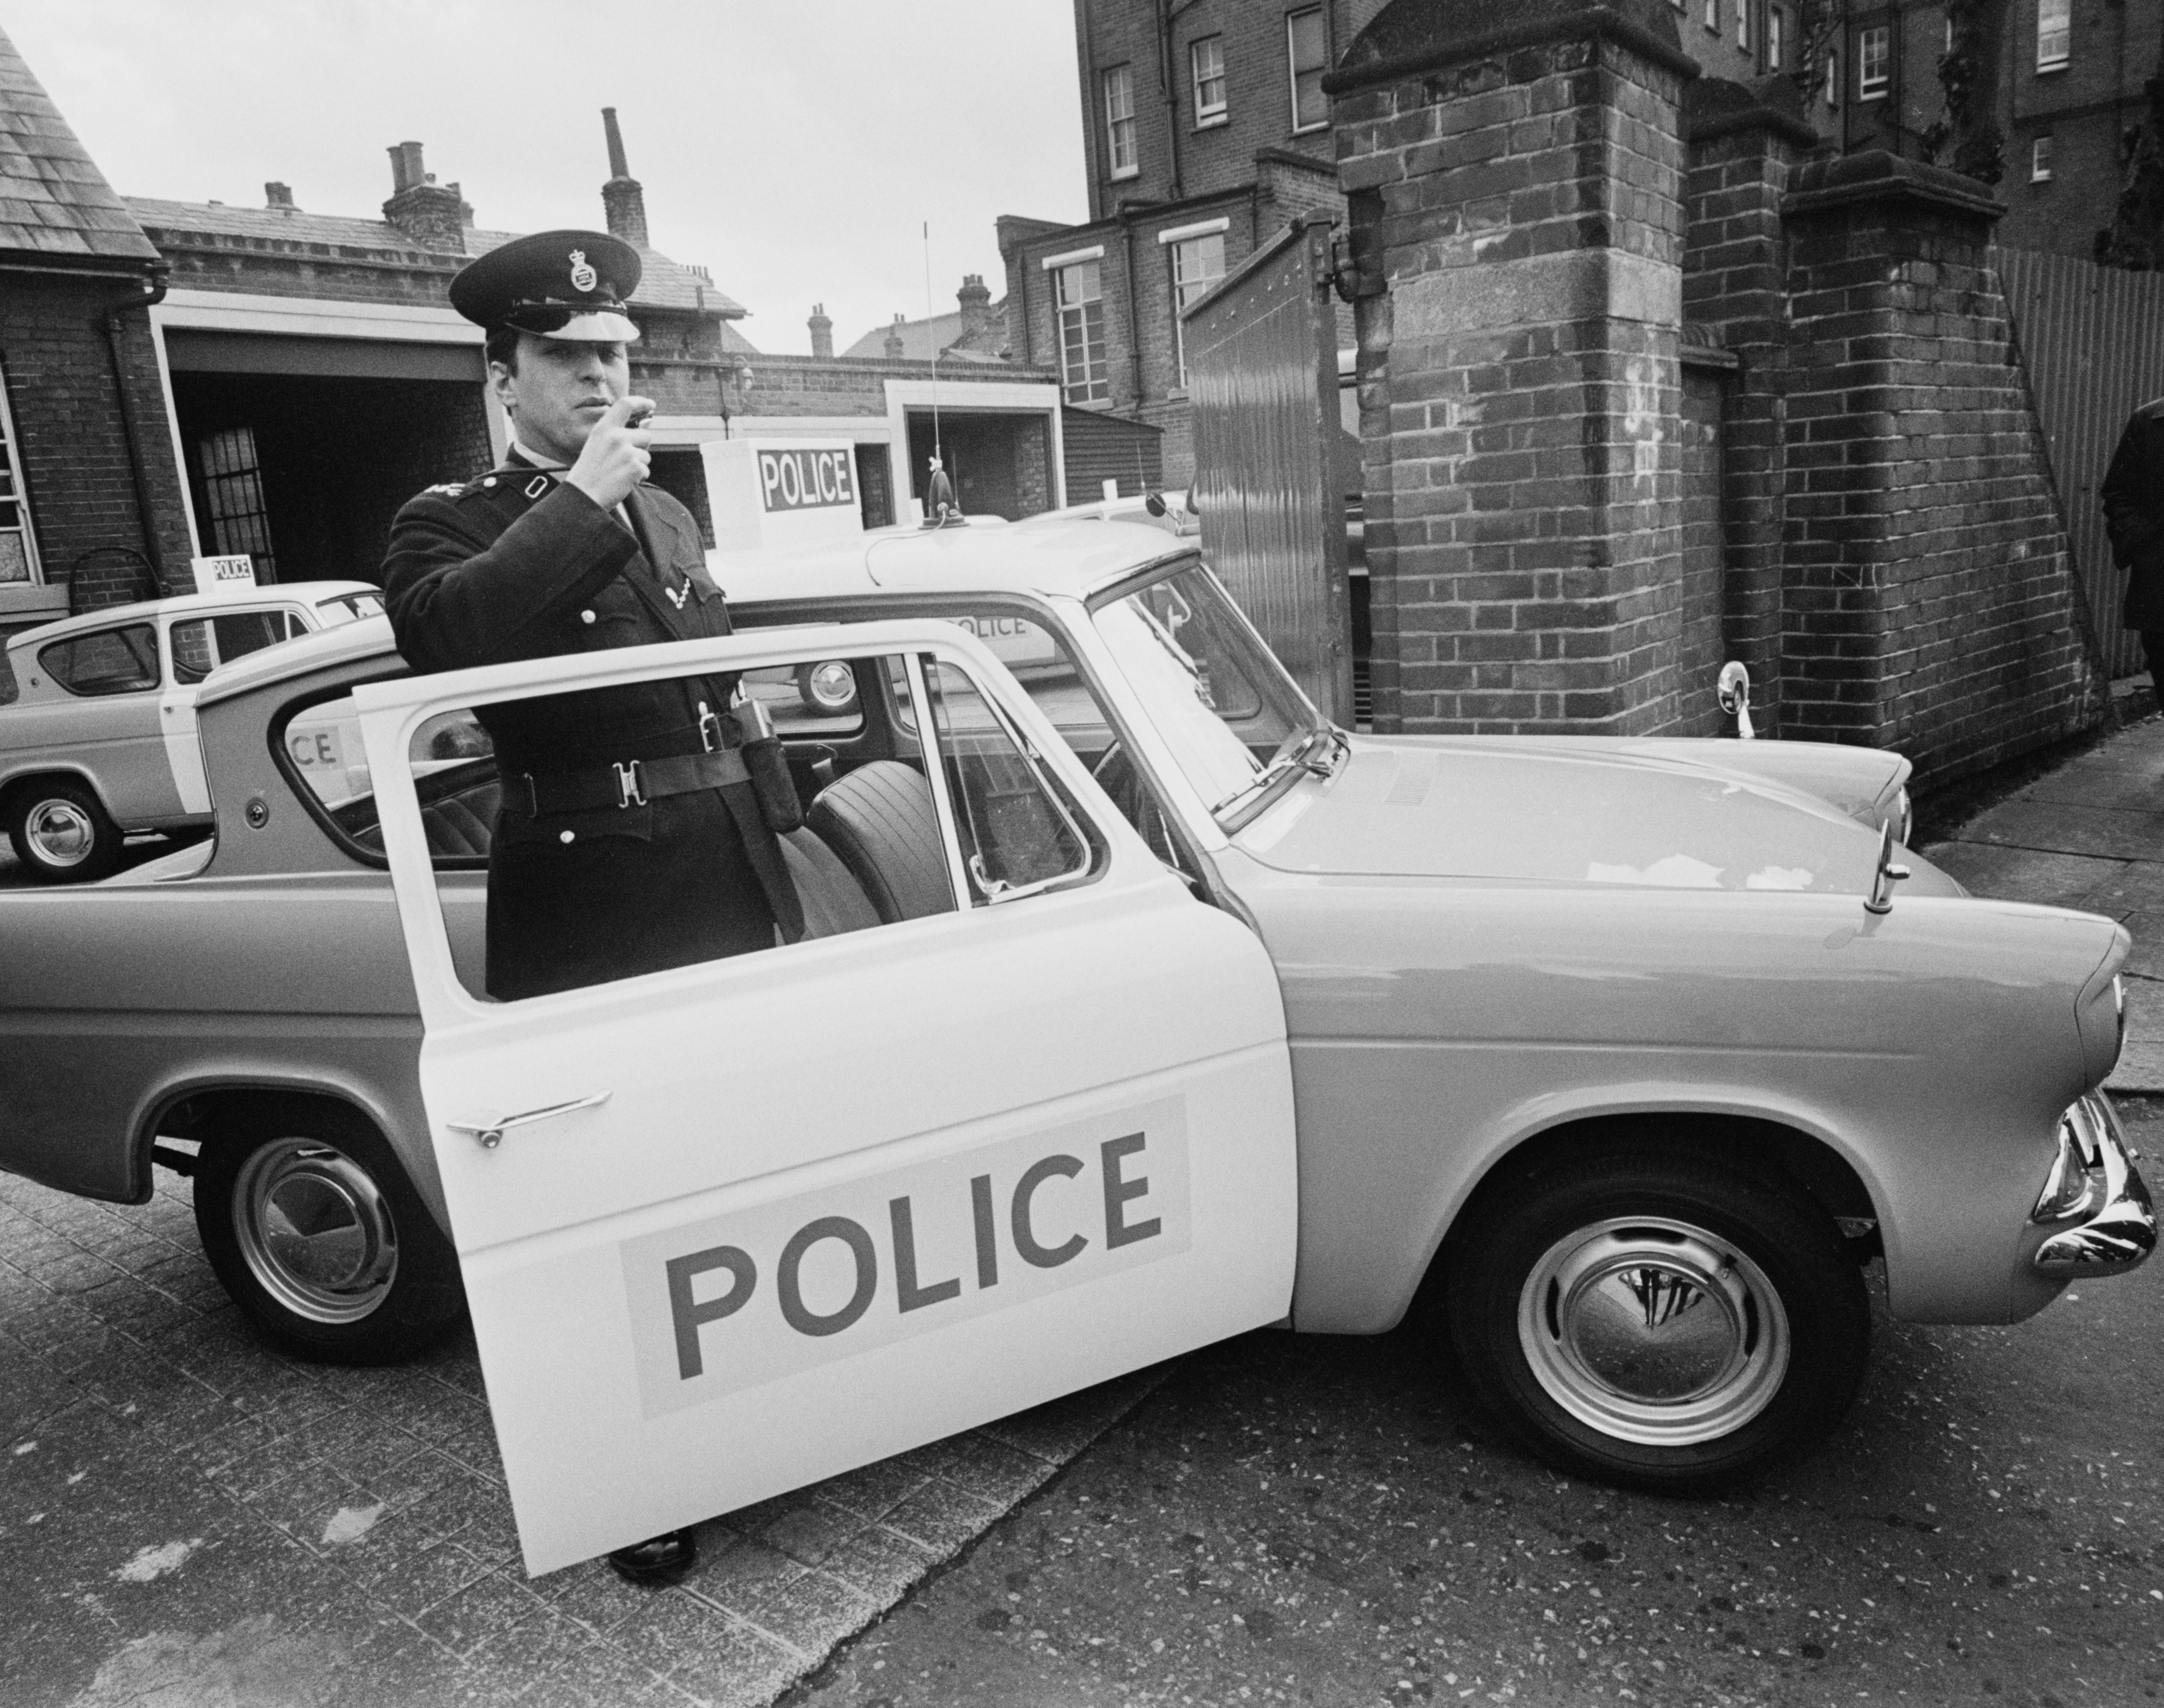
Conclusion
Vital to learn from the history of policing, especially where police forces went 'wrong.'
Advocate for community policing initiatives in local areas.

Slide 7
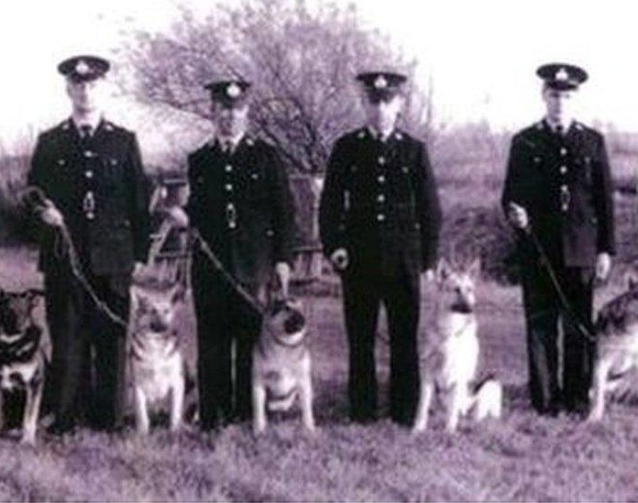
Any questions?
Thank you for listening!

Slide 8
Reference list:
Barnes, 1. and Eagle, T., 2007. " The role of community engagement in neighbourhood policing." Policing: A Journal of policy and Practice, 1(2), pp.161-172. Available at: https://academic.oup.com/policing/article-abstract/1/2/161/1566318 Access date: 3/11/24.
BBC (2021). Brixton riots 1981: What happened 40 years ago in London? Available at: https://www.bbc.co.uk/newsround/50035769#:~:text=For%20three%20days%2C%20rioters%20%2D%20mostly,known%20as%20the%20Brixton%20riots. Access date: 2/11/24.
College of Policing (2022). Problem-solving policing. [online] College of Policing. Available at: https://www.college.police.uk/guidance/problem-solving-policing. Access date: 29/10/24.
College of Policing (2024). Evidence based policing. [online] College of Policing. Available at: https://www.college.police.uk/research/evidence-based-policing-EBP#:~:text=Evidence%2Dbased%20policing%20(EBP),with%20academics&20and%20other%20partners Access date: 1/11/24.
Dunne, J. F., & Finalay., 2016. G625 multi-agency safeguarding hub-a new way of working. Available at: https://adc.bmj.com/content/101/Suppl_1/A369.2.abstract Access date: 1/11/24.
Innes, M. and Weston, N., 2010. Re-thinking the policing of anti-social behaviour. HMIC, 1, p.e57. Available at: https://assests-hmicfrs.justiceinspectorates.gov.uk/uploads/re-thinking-the-policing-of-anti-social-behaviour-20100923.pdf Access date: 2/11/24.
Peplow, S. (2024). "A deadly weapon aimed at our hearts': the scope and composition of Lord Scarman's 1981 public inquiry", Critical Military Studies, 10(3), pp.321-337. doi:10.1080/23337486.2024.2345550. Access date: 2/11/24.
Pepper, I., Rogers, C. And Turner, J., 2024. The adoptions of evidence-based policing: the pivotal role of first-line police leaders across England and Wales. International Journal of Emergency Services, 13(1), pp.111-122. Available at: https://www.emerald.com/insight/content/doi/10.1108/ijes-05-2023-0020/full/html Access date: 31/10/24.
South Wales Police (2024 (A))., Extra police powers to prevent crime and anti-social behaviour in Butetown. Available at: https://www.heddlu-de-cymru.police.uk/news/south-wales/news/2024/october/section-35-notice-issued-butetown--grangetown-cardiff/ Access date: 31/10/24.
South Wales Police (2024 (B))., Facial recognition technology. Available at: https://www.south-wales.police.uk/police-forces/south-wales-police/areas/about-us/about-us/facial-recognition-technology/ Access date: 4/11/24.

