Slide 1
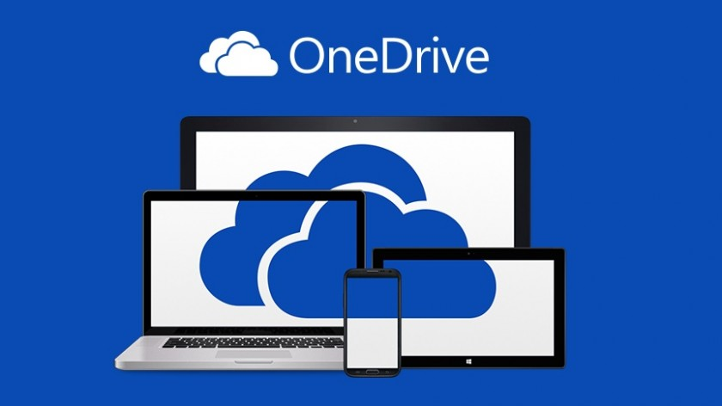
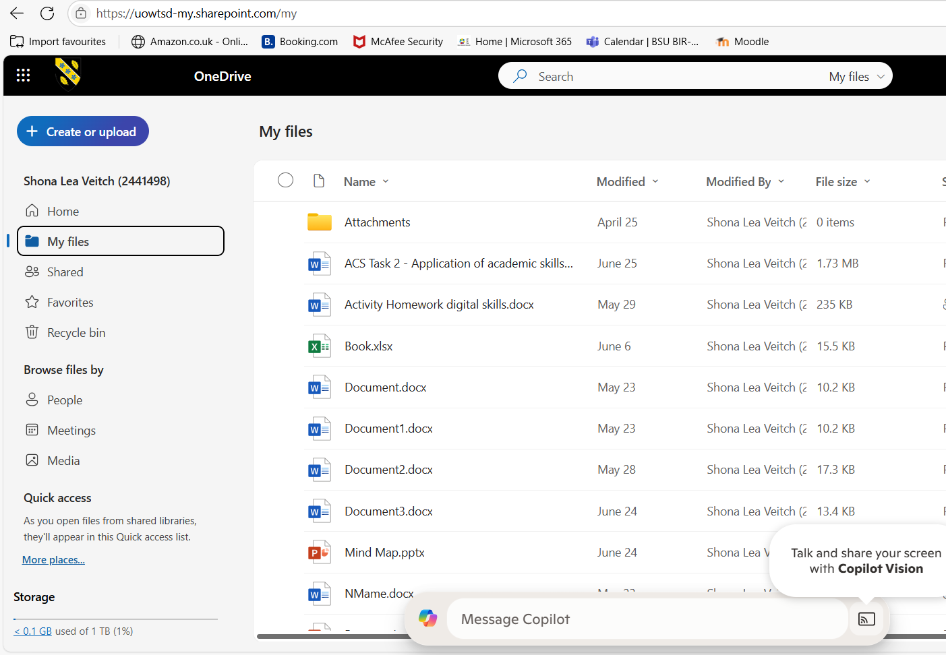
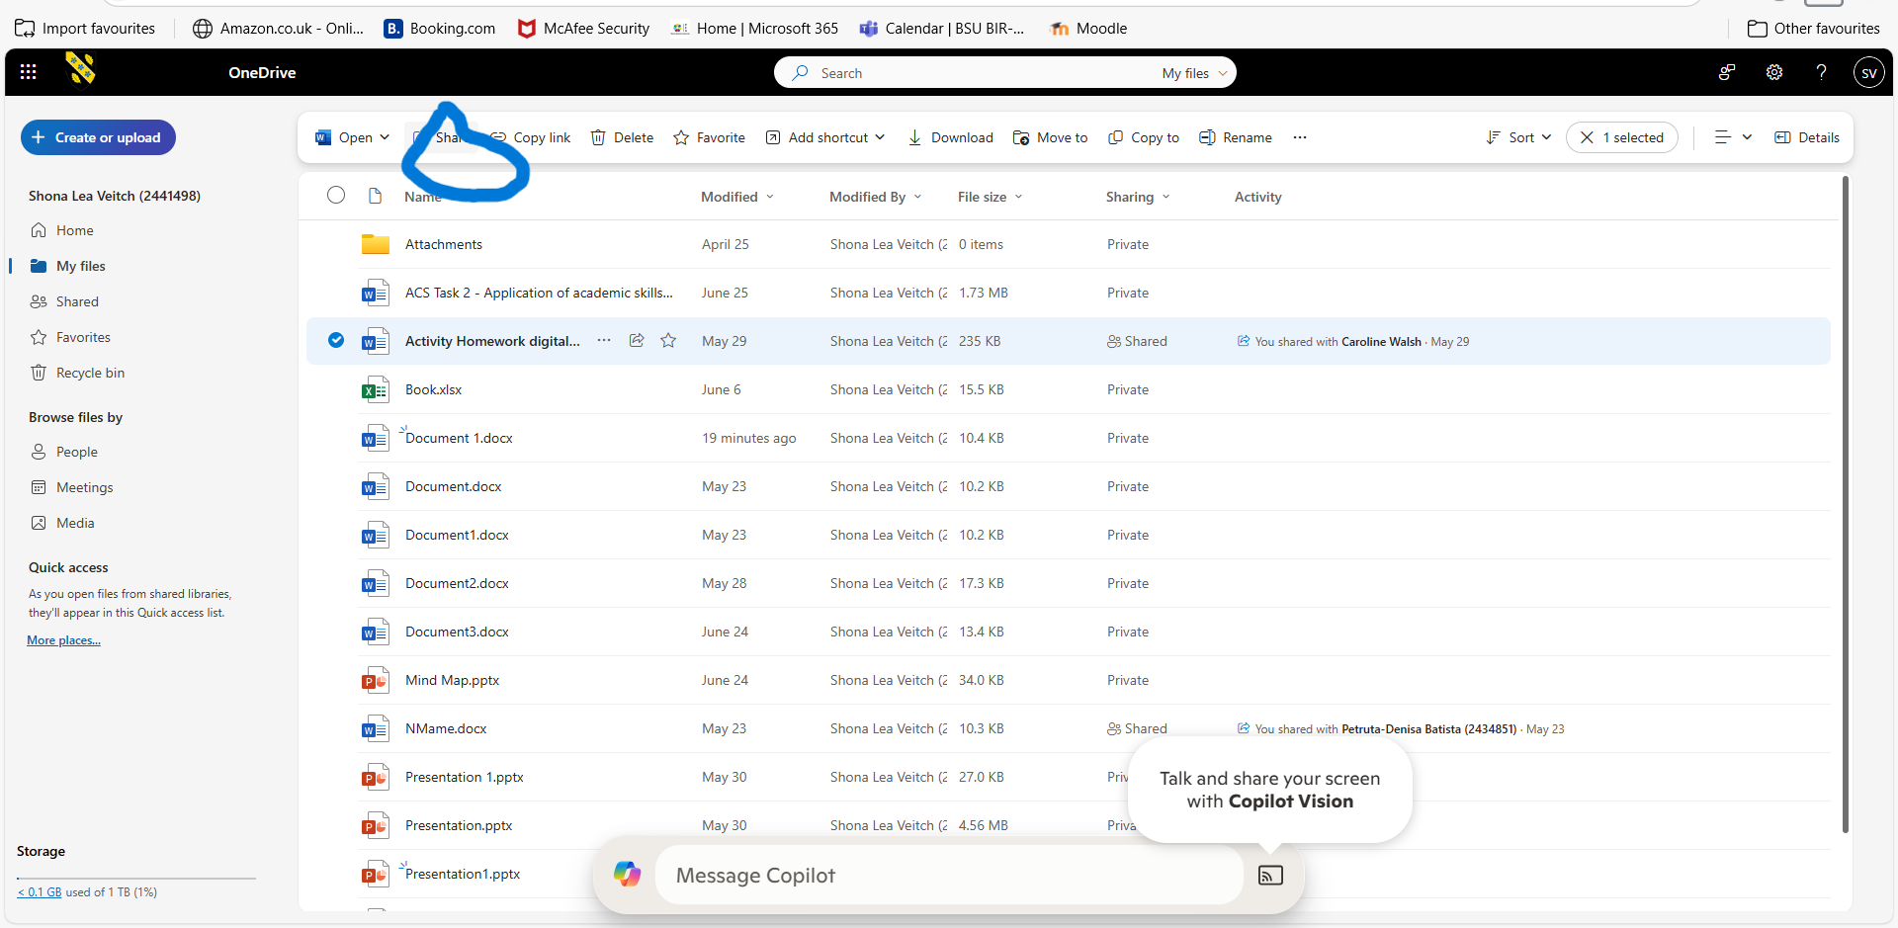
How To Share A File Via The One Drive
Step 1
Sign in to one drive.
Sign in with your microsoft account or you can access via your browser onedrive.com
Step 2
Locate the file that you wish to share.
You can do this by using your search bar or browsing your files. You can share documents and photos also.
Step 3
Select the file and highlight it.
Step 4.
Right click on the file or click the share icon. You can share using email, link copy or outllo
Step 5
Set your permissions settings to your personal preference then click send.
There are several advantages to sharing files using OneDrive, Microsoft's clouds storage service, particularly for teams, individuals and businesses. This includes the ability to access the files anywhere once stored in the cloud. It also offers easy file sharing as you can send via link anywhere and lastly it collaborate with real time. However, you must always consider disadvantages as within any technology there is always risk of privacy and security risks and also the dependency on internet connection.
Shona Veitch 2441498

