Slide 1

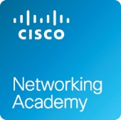


Advanced Networking
(ACCA5024)
Network Security

Slide 2
From our previous class… (recap)
Networks! (Communication with the functioning of various devices)
  Network Components
  Types of Networks
  Trends and Security
    Connections, Convergence
    Reliability (Fault Tolerance, Scalability, Security and QoS)
    BYOD, Cloud, Online Collaboration, Communications
    Security Devices and Techs. (Firewalls, VPN, acl’s)
Nitheesh Murugan Kaliyamurthy | n.Kaliyamurthy@uwtsd.ac.uk

Slide 3
From our previous class… (recap)
Standards and Protocols
  OSI Reference Model and TCP/IP Protocol Model
Ethernet Networks
  Physical Addressing (MAC Addresses)
  ARP
Nitheesh Murugan Kaliyamurthy | n.Kaliyamurthy@uwtsd.ac.uk

Slide 4
From our previous class… (recap)
Logical Addressing
  IP Addresses
  IPv4, Subnet Mask and Default Gateways
  Subnetting: FLSM and VLSM
  IPv6, Migrating from IPv4 to IPv6
  Neighbour Discovery
  Auto Configuration
Nitheesh Murugan Kaliyamurthy | n.Kaliyamurthy@uwtsd.ac.uk

Slide 5
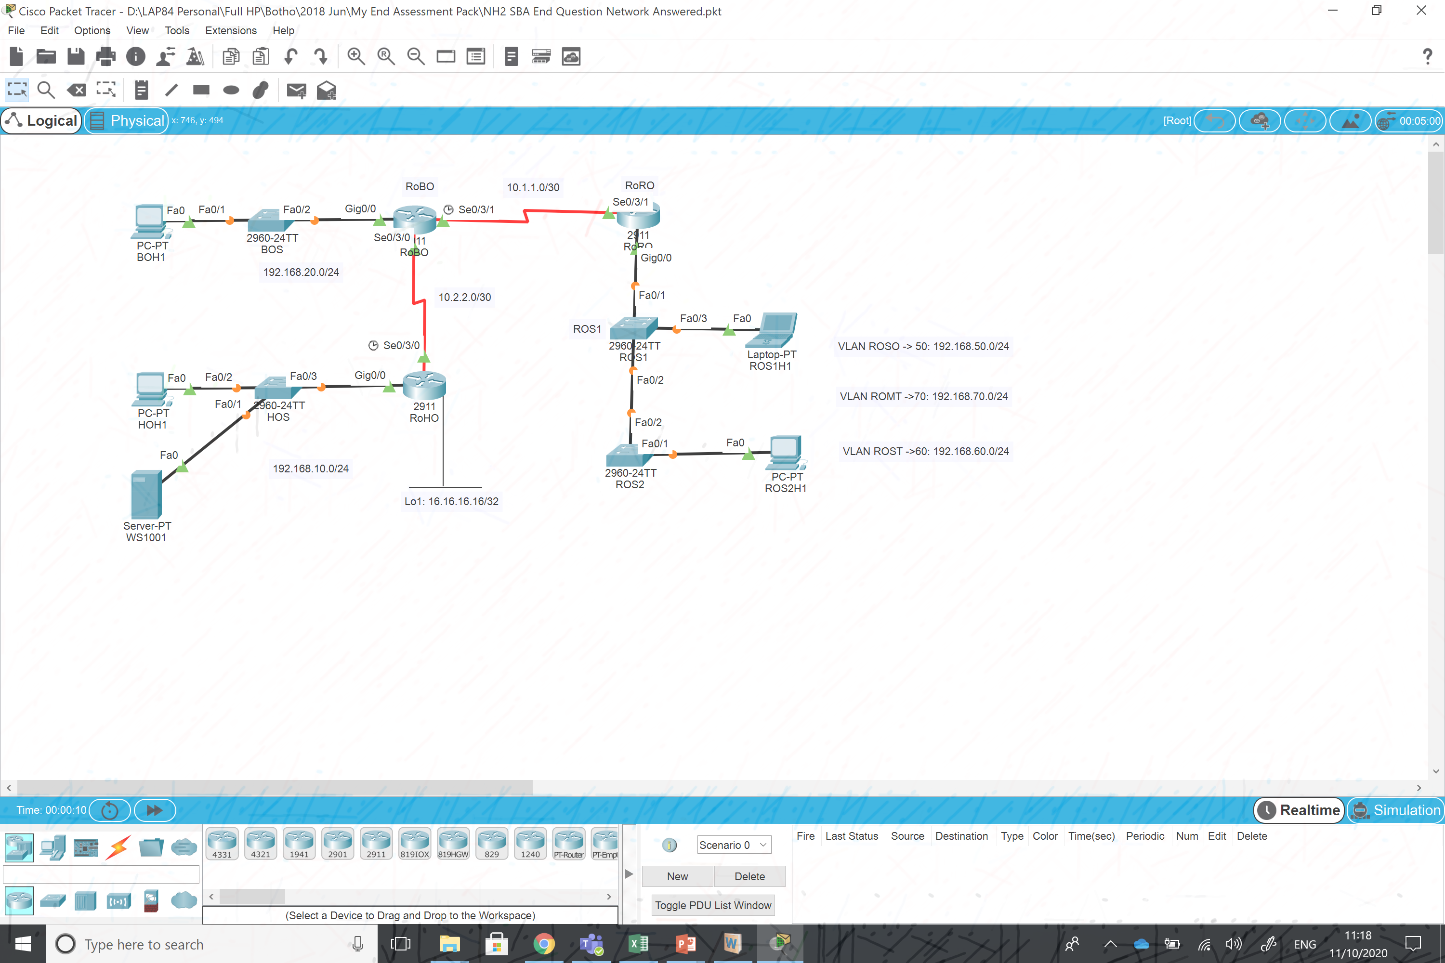
From our previous tutorials… and Independent Learning (recap)
Using Packet Tracer – Build simple networks, Configure end devices and test the connection.
Use Wireshark (Packet Sniffing Tool) to capture the packets and analyse them.
Analysed ARP and ICMP (Ethernet Frames).
Configuring IPv4, IPv6 Networks, Troubleshooting them
Nitheesh Murugan Kaliyamurthy | n.Kaliyamurthy@uwtsd.ac.uk

Slide 6
Objectives and Discussions
Vulnerabilities
Security Threats
Network Attacks
Network Attack Mitigation
Device Security
Nitheesh Murugan Kaliyamurthy | n.Kaliyamurthy@uwtsd.ac.uk

Slide 7
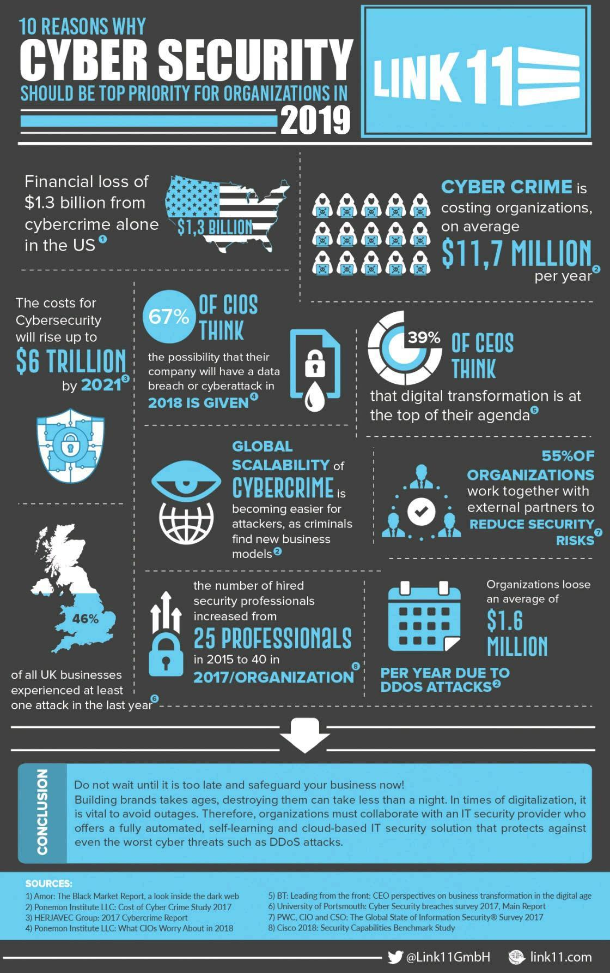
Why always Security???
Lets grab a statistical bite
Nitheesh Murugan Kaliyamurthy | n.Kaliyamurthy@uwtsd.ac.uk

Slide 8
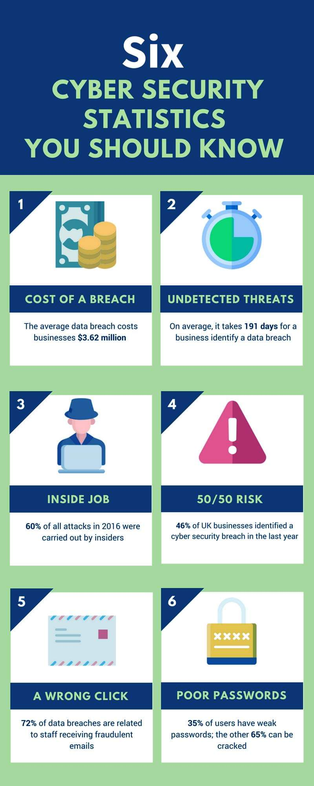
Lets grab a statistical bite
Nitheesh Murugan Kaliyamurthy | n.Kaliyamurthy@uwtsd.ac.uk

Slide 9
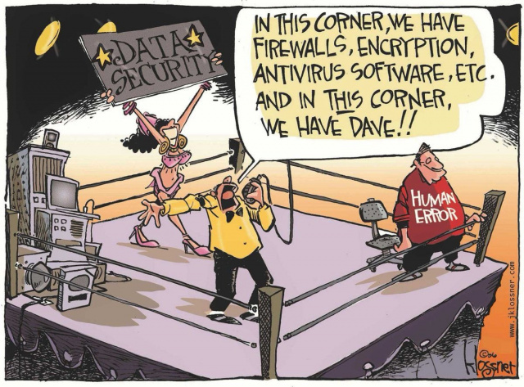
Attacks!!!
INTENTIONALLY CAUSING NEGATIVE IMPACTS
Attacks
→ loss of time and money due to damage,
→ theft of important information/assets.
How attacks happen?
Intruders can gain access to a network
→ through software vulnerabilities,
→ hardware attacks,
→ Guessing someone's username and
password.
Nitheesh Murugan Kaliyamurthy | n.Kaliyamurthy@uwtsd.ac.uk

Slide 10
Threats Actors at the 1st Place!!!
Intruders who gain access by modifying software or exploiting software vulnerabilities are called threat actors.
After the threat actor gains access to the network, it may lead to…
  Information Theft
  Data Loss and manipulation
  Identity Theft
  Disruption of Service
Nitheesh Murugan Kaliyamurthy | n.Kaliyamurthy@uwtsd.ac.uk

Slide 11
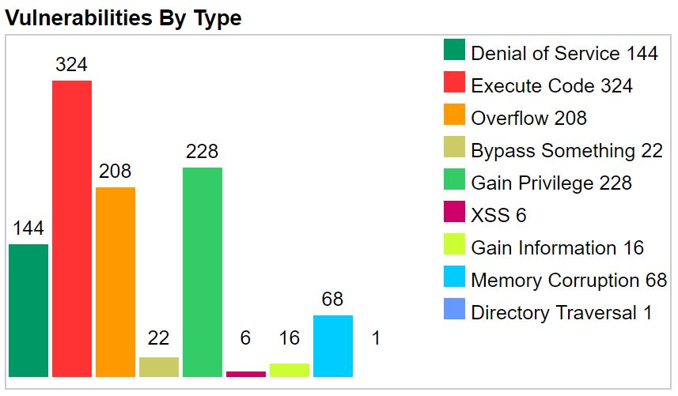
Vulnerabilities
  Vulnerability is the degree of weakness in a network or a device.
  Sometimes, vulnerability is inherent in routers, switches, desktops, servers, and even security devices
  Typically, the network devices under attack are the endpoints, such as servers and desktop computers.
Nitheesh Murugan Kaliyamurthy | n.Kaliyamurthy@uwtsd.ac.uk

Slide 12
Vulnerabilities
Technological Vulnerabilities
  TCP/IP Protocol weaknesses,
  Operating System Weaknesses,
  Network Equipment weaknesses.
  Configuration Vulnerabilities
    unsecured user accounts,
    system accounts with easily guessed passwords,
    misconfigured internet services,
    unsecure default settings,
    misconfigured network equipment.
Nitheesh Murugan Kaliyamurthy | n.Kaliyamurthy@uwtsd.ac.uk

Slide 13
Security Threats and Vulnerabilities
  Security Policy Vulnerabilities
    lack of a written security policy,
    politics,
    lack of authentication continuity,
    logical access controls not applied,
    software and hardware installation
    changes not following policy, and a nonexistent disaster recovery plan.
  These sources of vulnerabilities can leave a network or device
  open to various attacks, including malicious code attacks and network attacks
Nitheesh Murugan Kaliyamurthy | n.Kaliyamurthy@uwtsd.ac.uk

Slide 14
Threats
Apart from those threats….
If network resources can be physically compromised, a threat actor can deny the use of network resources. The four classes of physical threats are as follows:
  Hardware threats - This includes physical damage to servers, routers, switches, cabling plant, and workstations.
  Environmental threats - This includes temperature extremes (too hot or too cold) or humidity extremes (too wet or too dry).
  Electrical threats - This includes voltage spikes, insufficient supply voltage (brownouts), unconditioned power (noise), and total power loss.
  Maintenance threats - This includes poor handling of key electrical components (electrostatic discharge), lack of critical spare parts, poor cabling, and poor labeling.
  A good plan for physical security must be created and implemented to address these issues.
Nitheesh Murugan Kaliyamurthy | n.Kaliyamurthy@uwtsd.ac.uk

Slide 15
Chats!!!
    Have you ever seen or experienced a lapse in security (the actual threat) which could lead to any attacks?
    Lets share our experience!!!
    Here is mine….. Password Scan (OneNote)
Nitheesh Murugan Kaliyamurthy | n.Kaliyamurthy@uwtsd.ac.uk

Slide 16

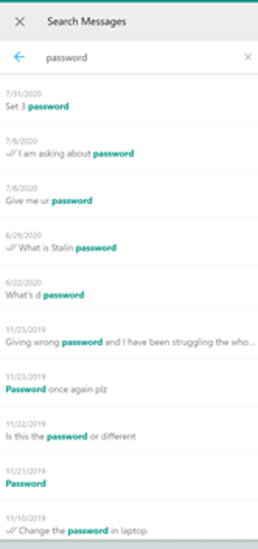
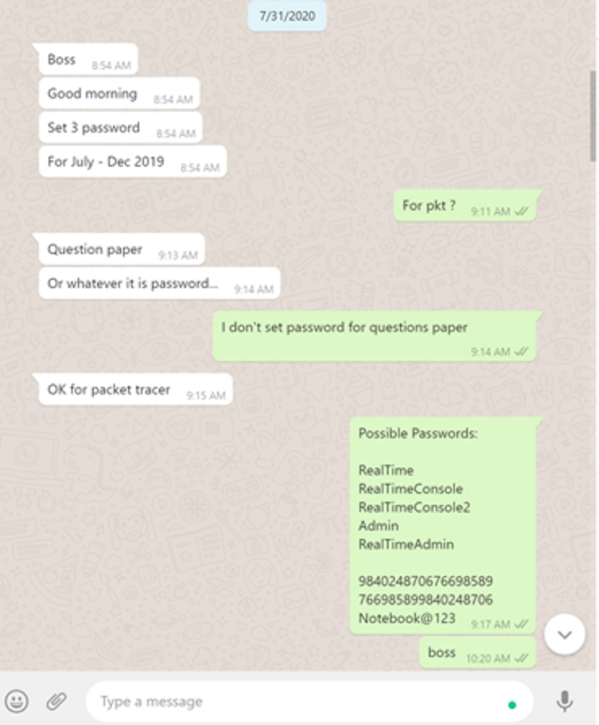
Chats!!!
Nitheesh Murugan Kaliyamurthy | n.Kaliyamurthy@uwtsd.ac.uk

Slide 17
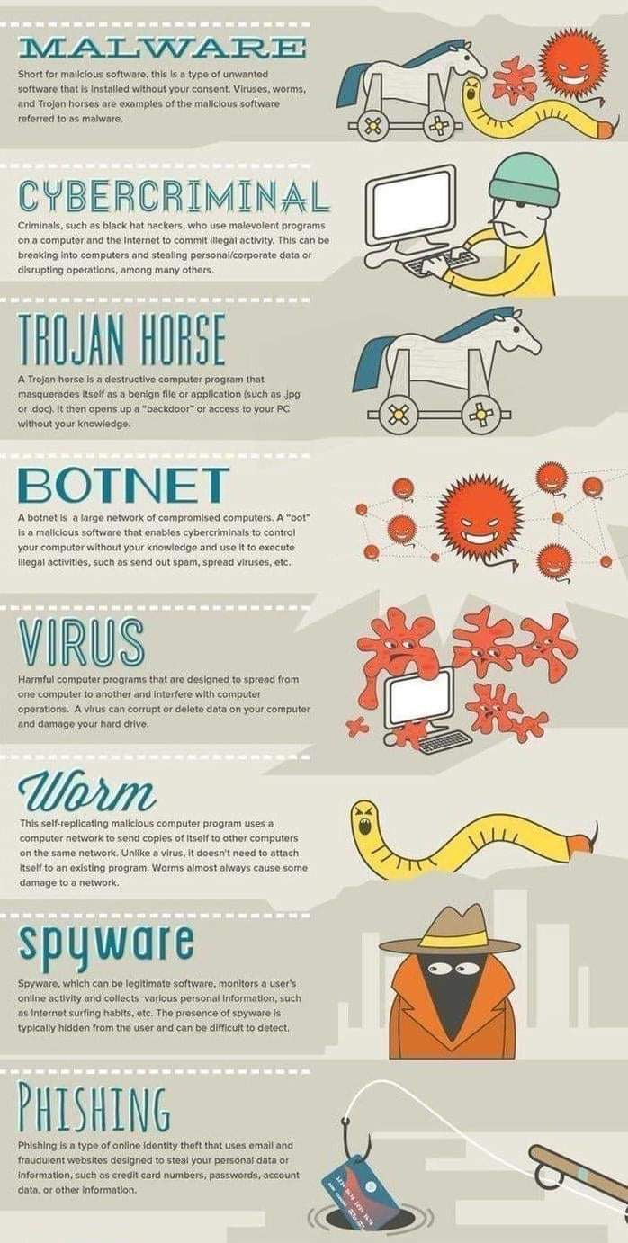
Attacks

Slide 18
Attacks
Malware is short for malicious software. It is code or software specifically designed to damage, disrupt, steal, or inflict “bad” or illegitimate action on data, hosts, or networks.
  Viruses - A computer virus is a type of malware that propagates by inserting a copy of itself into, and becoming part of, another program. It spreads from one computer to another, leaving infections as it travels.
  Worms - Computer worms are similar to viruses in that they replicate functional copies of themselves and can cause the same type of damage. In contrast to viruses, which require the spreading of an infected host file, worms are standalone software and do not require a host program or human help to propagate.
  Trojan Horses - It is a harmful piece of software that looks legitimate. Unlike viruses and worms, Trojan horses do not reproduce by infecting other files. They self-replicate. Trojan horses must spread through user interaction such as opening an email attachment or downloading and running a file from the internet.
Nitheesh Murugan Kaliyamurthy | n.Kaliyamurthy@uwtsd.ac.uk

Slide 19
Attacks
In addition to malicious code attacks, it is also possible for networks to fall prey to various network attacks. Network attacks can be classified into three major categories:
  Reconnaissance attacks
  Access attacks
  Denial of service
Nitheesh Murugan Kaliyamurthy | n.Kaliyamurthy@uwtsd.ac.uk

Slide 20
Attacks
  Reconnaissance attacks
    The discovery and mapping of systems, services, or vulnerabilities. Usually, external threat actors use internet tools, such as the nslookup and whois utilities, to easily determine the IP address space assigned to a given corporation or entity. After the IP address space is determined, a threat actor can then ping the publicly available IP addresses to identify the addresses that are active.
Nitheesh Murugan Kaliyamurthy | n.Kaliyamurthy@uwtsd.ac.uk

Slide 21
Attacks
  Access attacks
    The unauthorized manipulation of data, system access, or user privileges.
    Access attacks exploit known vulnerabilities in authentication services, FTP services, and web services to gain entry to web accounts, confidential databases, and other sensitive information.
    Access attacks could be of any form…
      Password attacks - Implemented using brute force, trojan horse, and packet sniffers
      Trust exploitation - A threat actor uses unauthorized privileges to gain access to a system, possibly compromising the target.
      Port redirection: - A threat actor uses a compromised system as a base for attacks against other targets. For example, a threat actor using SSH (port 22) to connect to a compromised host A. Host A is trusted by host B and, therefore, the threat actor can use Telnet (port 23) to access it.
      Man-in-the middle - The threat actor is positioned in between two legitimate entities in order to read or modify the data that passes between the two parties.
Nitheesh Murugan Kaliyamurthy | n.Kaliyamurthy@uwtsd.ac.uk

Slide 22
Attacks
  Denial of service -
    The disabling or corruption of networks, systems, or services.
    Denial of service (DoS) attacks are the most publicized form of attack and among the most difficult to eliminate. However, because of their ease of implementation and potentially significant damage, DoS attacks deserve special attention from security administrators.
    DoS attacks take many forms. Ultimately, they prevent authorized people from using a service by consuming system resources.
    To help prevent DoS attacks it is important to stay up to date with the latest security updates for operating systems and applications.
    DoS attacks are a major risk because they interrupt communication and cause significant loss of time and money.
    These attacks are relatively simple to conduct, even by an unskilled threat actor.
    A DDoS is similar to a DoS attack, but it originates from multiple, coordinated sources.
      For example, a threat actor builds a network of infected hosts, known as zombies. A network of zombies is called a botnet. The threat actor uses a command and control (CnC) program to instruct the botnet of zombies to carry out a DDoS attack.
Nitheesh Murugan Kaliyamurthy | n.Kaliyamurthy@uwtsd.ac.uk

Slide 23

3 – 1 – 3
    Can you all write maximum
    3 words
    to describe
    1 method
    / step to prevent or protect yourself against reconnaissance attacks?
    3 Minutes
    time for you….. Here we go…
Nitheesh Murugan Kaliyamurthy | n.Kaliyamurthy@uwtsd.ac.uk

Slide 24
Mitigations
  Defend yourself…
    The Defense-in-Depth Approach
      To mitigate network attacks,
      secure devices including routers, switches, servers, and hosts.
      Most organizations employ a defense-in-depth approach (also known as a layered approach) to security.
      This requires a combination of networking devices and services working in tandem.
Nitheesh Murugan Kaliyamurthy | n.Kaliyamurthy@uwtsd.ac.uk

Slide 25
Mitigations
  Defend yourself…
    The Defense-in-Depth Approach
      Several security devices and services are implemented to protect an organization’s users and assets against TCP/IP threats:
  VPN
  ASA Firewall
  IPS
  ESA/WSA
  AAA Server
Nitheesh Murugan Kaliyamurthy | n.Kaliyamurthy@uwtsd.ac.uk

Slide 26
Mitigations
  Defend yourself…
    But, what is the first step?
    To install VPN OR ASA FIREWALLS?
    Exactly, NO!!! Then what?
Nitheesh Murugan Kaliyamurthy | n.Kaliyamurthy@uwtsd.ac.uk

Slide 27
Mitigations
  Defend yourself…
    Backing up device configurations and data is one of the most effective ways of protecting against data loss.
    Backups should be performed on a regular basis as identified in the security policy.
    Data backups are usually stored offsite to protect the backup media if anything happens to the main facility.
Consideration | Description
Frequency | Perform backups on a regular basis as identified in the security policy. Full backups can be time-consuming, therefore perform monthly or weekly backups with frequent partial backups of changed files.
Storage | Always validate backups to ensure the integrity of the data and validate the file restoration procedures.
Security | Backups should be transported to an approved offsite storage location on a daily, weekly, or monthly rotation, as required by the security policy.
Validation | Backups should be protected using strong passwords. The password is required to restore the data.
Nitheesh Murugan Kaliyamurthy | n.Kaliyamurthy@uwtsd.ac.uk

Slide 28
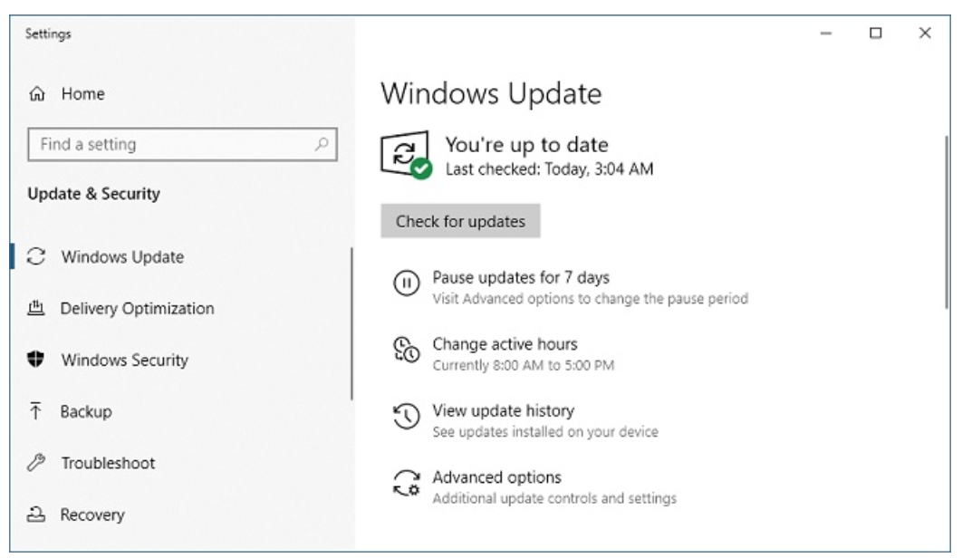
Mitigations
  Defend yourself…
Nitheesh Murugan Kaliyamurthy | n.Kaliyamurthy@uwtsd.ac.uk

Slide 29
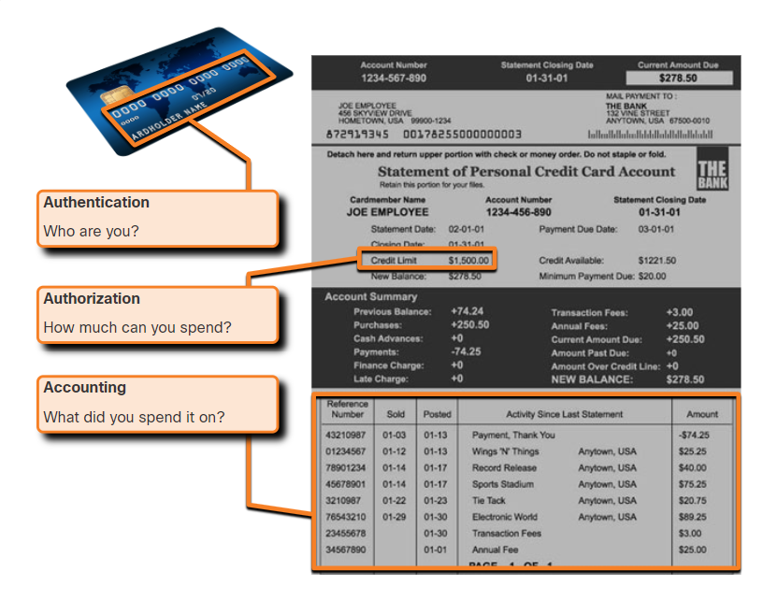
Mitigations
  Defend yourself…
Nitheesh Murugan Kaliyamurthy | n.Kaliyamurthy@uwtsd.ac.uk

Slide 30
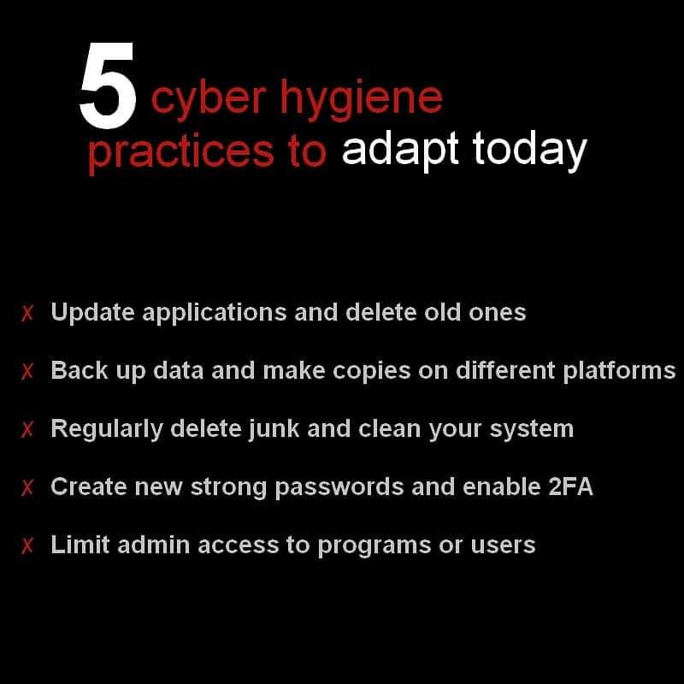
Mitigations
  Defend yourself…
Nitheesh Murugan Kaliyamurthy | n.Kaliyamurthy@uwtsd.ac.uk

Slide 31
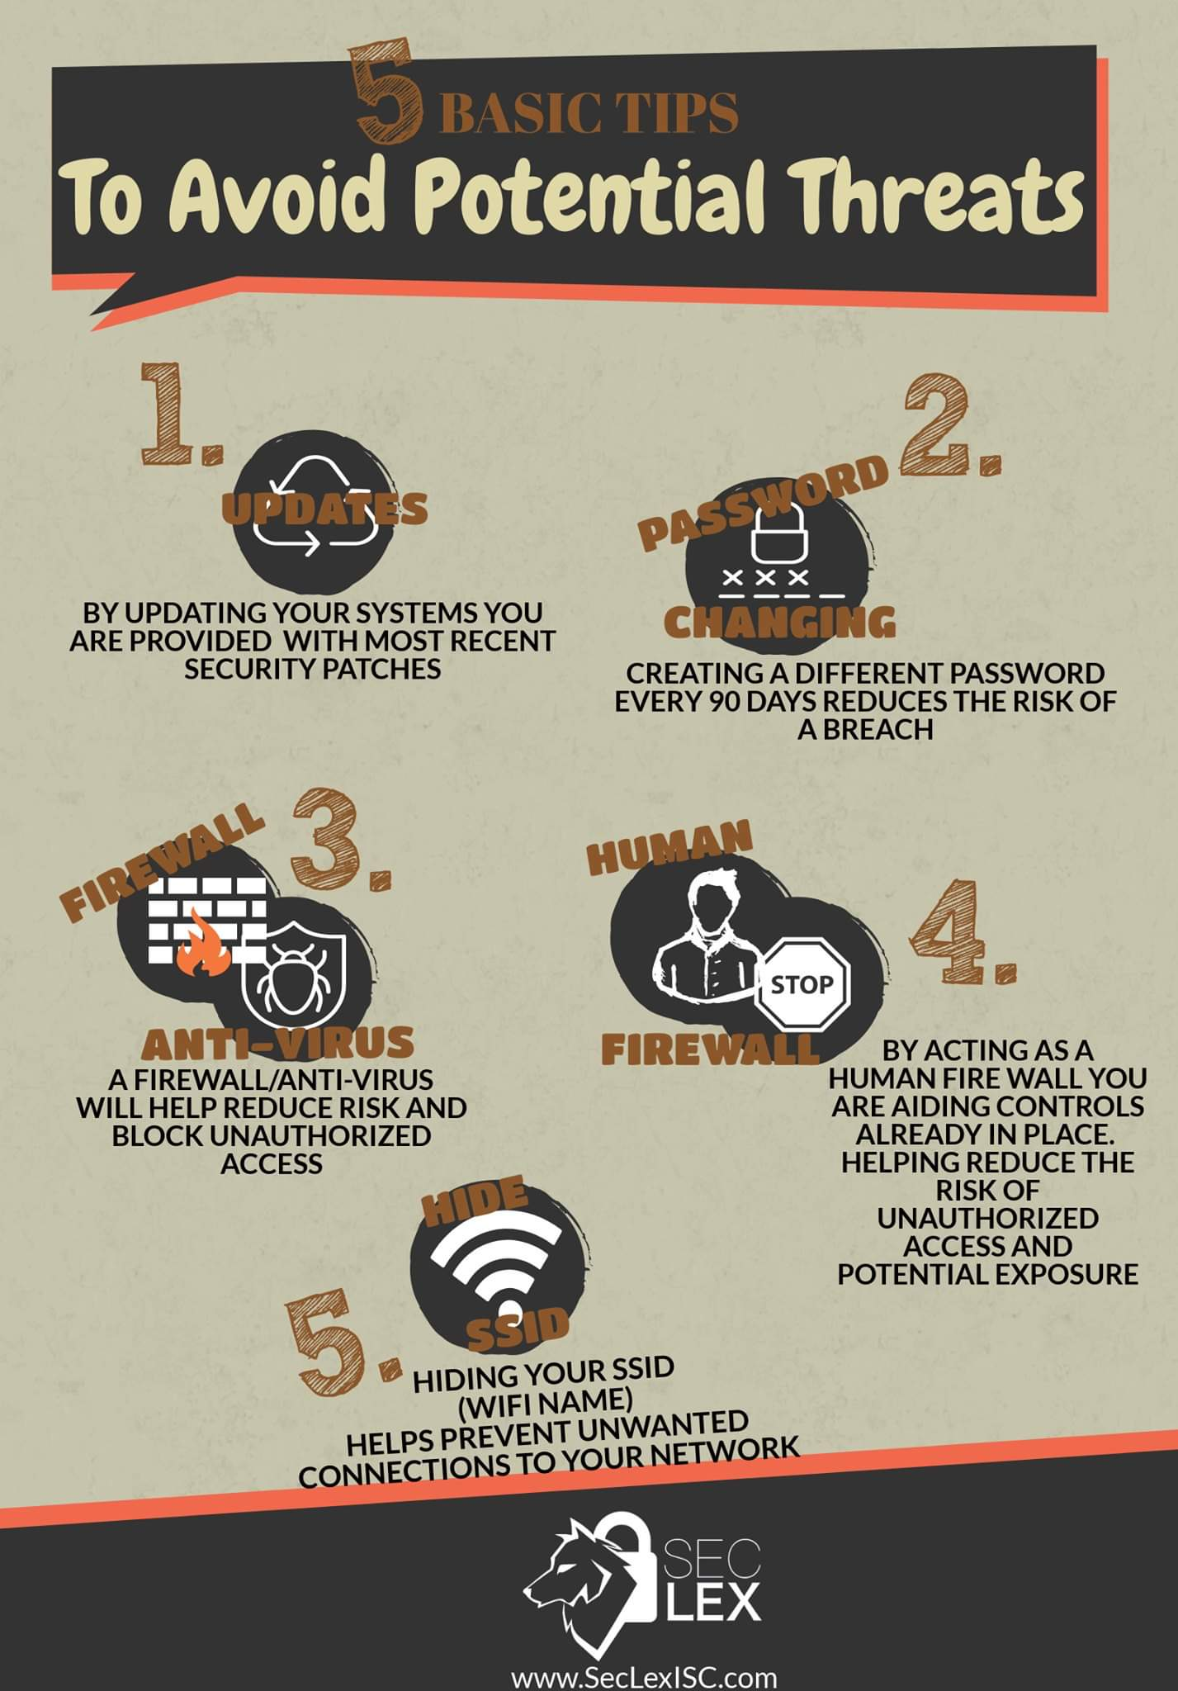
Mitigations

Slide 32
Mitigations
  Defend yourself…
  Default usernames and passwords should be changed immediately.
  Access to system resources should be restricted to only the individuals that are authorized to use those resources.
  Any unnecessary services and applications should be turned off and uninstalled when possible.
  Often, devices shipped from the manufacturer have been sitting in a warehouse for a period of time and do not have the most up-to-date patches installed. It is important to update any software and install any security patches prior to implementation.
Nitheesh Murugan Kaliyamurthy | n.Kaliyamurthy@uwtsd.ac.uk

Slide 33
Mitigations
  Defend yourself…
Strong passwords
Use a password length of at least eight characters, preferably 10 or more characters and make it complex.
  Avoid passwords based on repetition, common dictionary words, letter or number sequences, usernames, relative or pet names, biographical information, such as birthdates, ID numbers, ancestor names, or other easily identifiable pieces of information.
  Deliberately misspell a password. For example, Smith = Smyth = 5mYth or Security = 5ecur1ty.
  Change passwords often. If a password is unknowingly compromised, the window of opportunity for the threat actor to use the password is limited.
  Do not write passwords down and leave them in obvious places such as on the desk or monitor.
On Cisco routers, leading spaces are ignored for passwords, but spaces after the first character are not. Use passphrase. A passphrase is often easier to remember than a simple password. It is also longer and harder to guess.
Nitheesh Murugan Kaliyamurthy | n.Kaliyamurthy@uwtsd.ac.uk

Slide 34
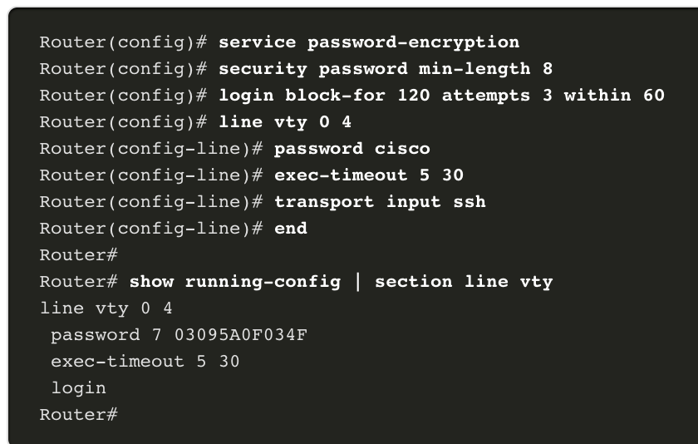
Mitigations
  Defend yourself…
In our Cisco Devices…
Nitheesh Murugan Kaliyamurthy | n.Kaliyamurthy@uwtsd.ac.uk

Slide 35
Mitigations
  Defend yourself…
In our Cisco Devices…Enable SSH
Configure a unique device hostname. A device must have a unique hostname other than the default.
Configure the IP domain name. Configure the IP domain name of the network by using the global configuration mode command ip-domain name.
Generate a key to encrypt SSH traffic. SSH encrypts traffic between source and destination. However, to do so, a unique authentication key must be generated by using the global configuration command crypto key generate rsa general-keys modulus bits. The modulus bits determines the size of the key and can be configured from 360 bits to 2048 bits. The larger the bit value, the more secure the key. However, larger bit values also take longer to encrypt and decrypt information. The minimum recommended modulus length is 1024 bits.
Verify or create a local database entry. Create a local database username entry using the username global configuration command.
Nitheesh Murugan Kaliyamurthy | n.Kaliyamurthy@uwtsd.ac.uk

Slide 36
Mitigations
  Defend yourself…
In our Cisco Devices…Enable SSH
5. Authenticate against the local database. Use the login local line configuration command to authenticate the vty line against the local database.
6. Enable vty inbound SSH sessions. By default, no input session is allowed on vty lines. You can specify multiple input protocols including Telnet and SSH using the transport input [ssh | telnet] command.
Refer to my video on SSH/ Telnet Demonstration in Moodle, to configure SSH
Nitheesh Murugan Kaliyamurthy | n.Kaliyamurthy@uwtsd.ac.uk

Slide 37
Mitigations
  Defend yourself…
In our Cisco Devices… Close doors!!!
The type of services that are on by default will vary depending on the IOS version.
  For example, IOS-XE typically will have only HTTPS and DHCP ports open. You can verify this with the show ip ports all command.
IOS versions prior to IOS-XE use the show control-plane host open-ports command.
Nitheesh Murugan Kaliyamurthy | n.Kaliyamurthy@uwtsd.ac.uk

Slide 38
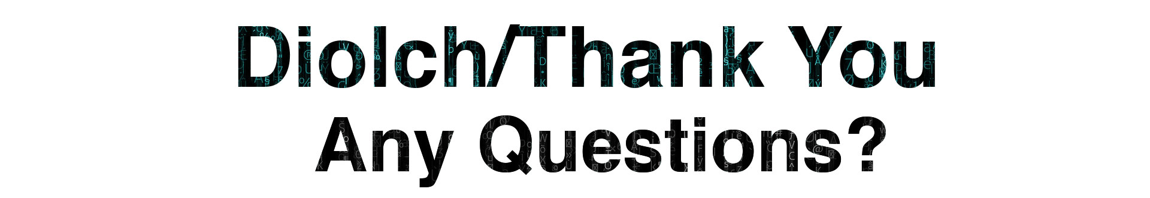
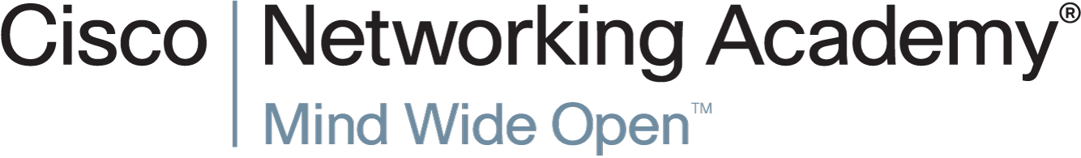
Contents/ References/ Images used in this Presentation:
Contents & Selective Images : Cisco Networking Academy Course – Network Essentials | Selective images from Bing Internet Search | Peter Packet Animation on Subnets _{https://youtu.be/VcVz6Lwxe2c}

Slide 39
Reminders/ Action Plans:
All your homeworks – Independent Learning – Will be useful to complete your Assessments (Component 1 & 2).
Introduction to Networks v7 course

