Slide 1
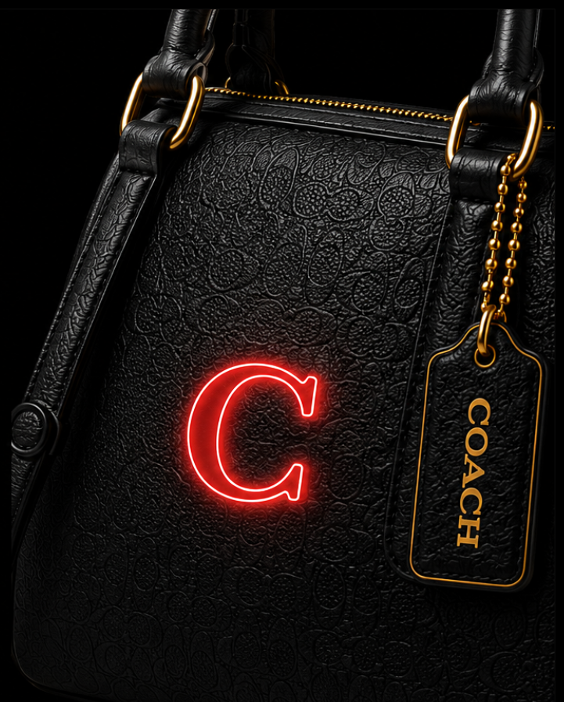
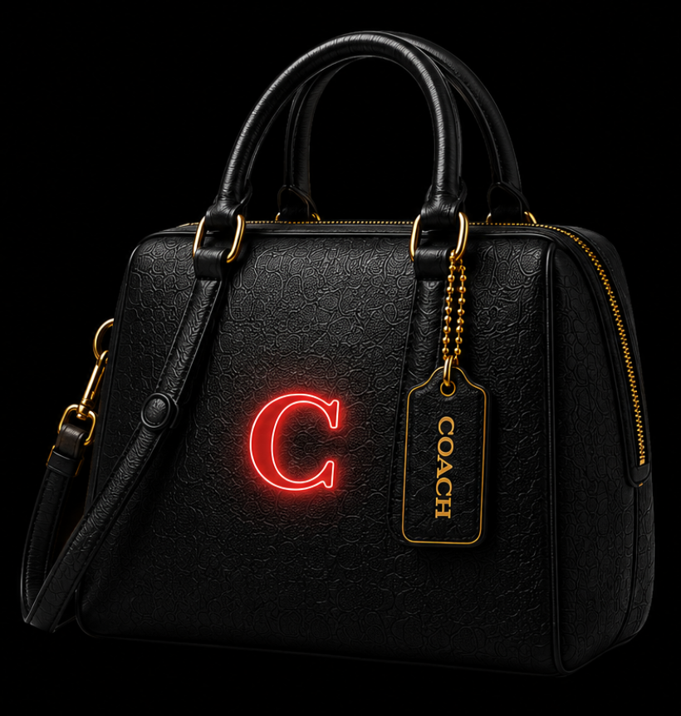
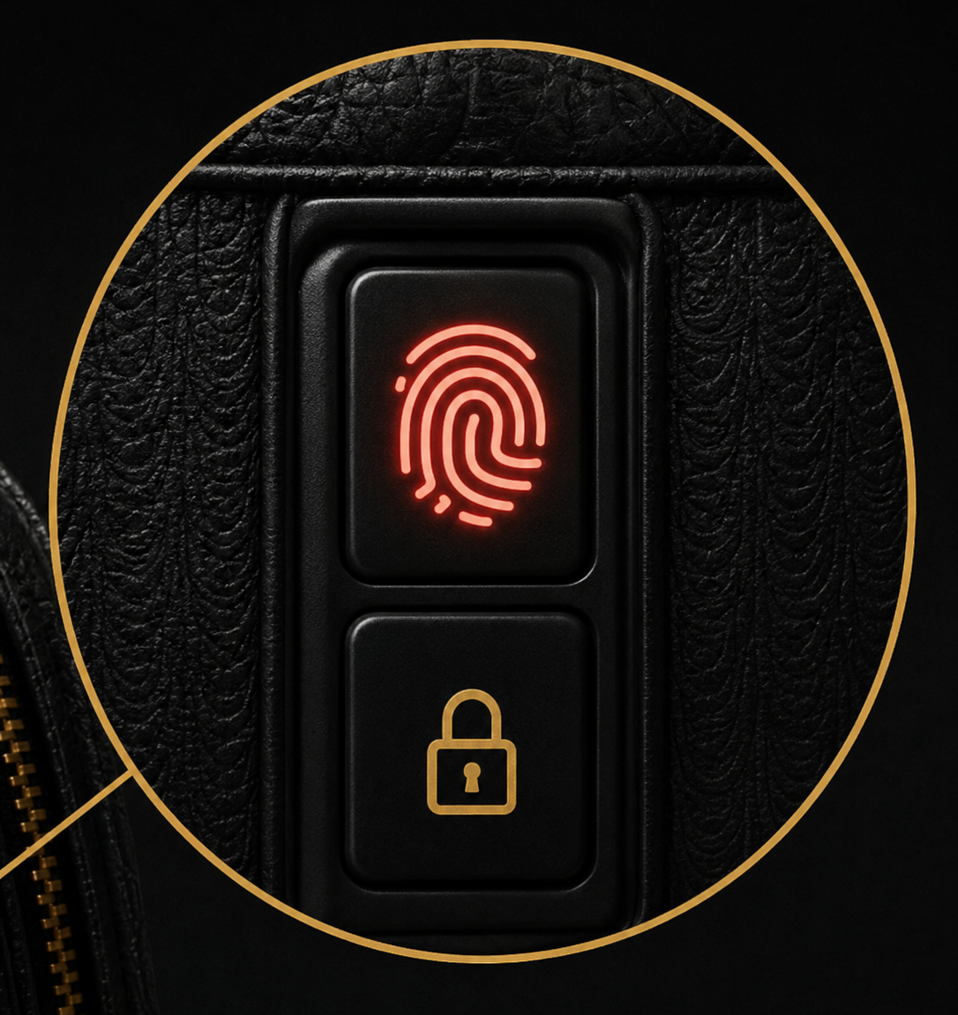
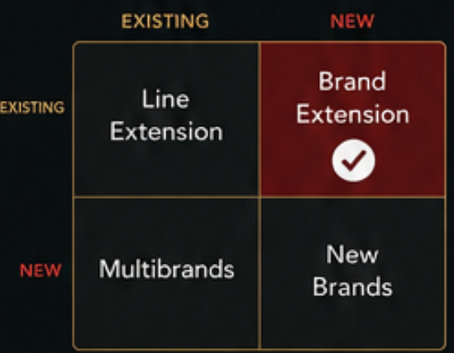
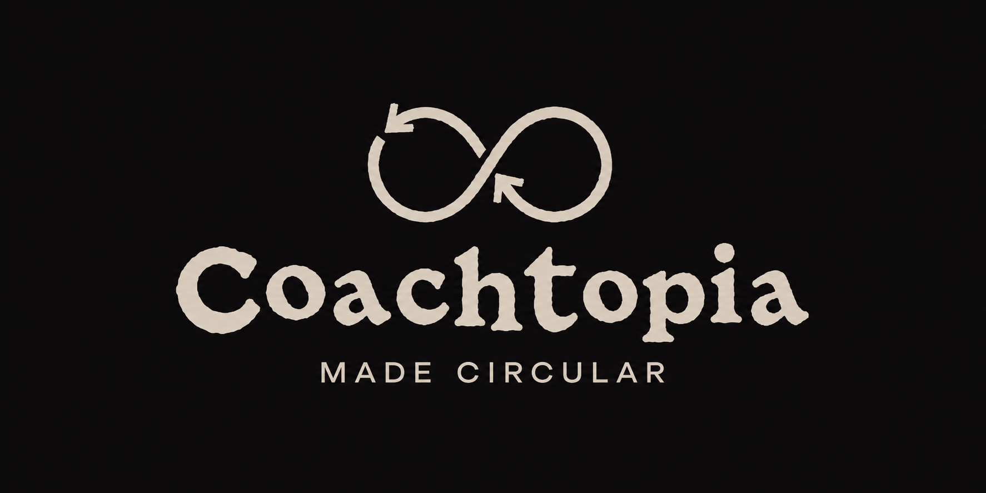





Name: Andre Pinto - 2242421
COACH SecureAI™
THE AI-POWERED LUXURY HANDBAG
ABOUT COACH
BRAND EXTENSION
Coach is a global luxury fashion brand recognised for its premium leather craftsmanship and timeless designs.
Through its Coachtopia initiative, Coach is committed to reducing waste by using recycled materials, encouraging repair, and promoting circular fashion.
Coach SecureAI™ extends these values by combining luxury with intelligent technology to create a safer and more sustainable handbag.
( Coach, 2025)
Coach SecureAI™ expands Coach into the smart luxury accessories market while maintaining its premium brand identity.
It combines AI technology, personal safety and sustainability to meet changing consumer needs and market trends
FINGERPRINT UNLOCK
Biometric security allows only the owner's fingerprint to unlock the bag.
AI Safety Alert
Uses AI, GPS and publicly available crime data
The Coach logo glows red and the bag vibrates discreetly to alert the user.
Fingerprint Unlock
Biometric fingerprint scanner.
Only the registered owner can unlock the handbag.
GPS & Bluetooth Tracking
Locate the handbag instantly using the Coach SecureAI™ mobile app.
Emergency SOS
Hidden SOS button.
Shares live location with trusted contacts during an emergency.
Wireless & Solar Charging
Built-in wireless charging pocket.
Flexible solar panel helps recharge the battery while travelling.
SUSTAINABILITY
BENEFITS
MARKET APPEAL
♻ Recycled Materials
Recycled leather and lining.
🔋 Replaceable Battery
Reduces electronic waste.
🔧 Repairable Design
Extends product lifespan.
📦 Eco-Friendly Packaging
Recyclable and biodegradable.
🌍 Lower Carbon Impact
Solar charging reduces energy use.
For Customers
Enhanced personal safety
Protection for valuable belongings
Premium luxury design
Smart everyday convenience
Sustainable materials
AI & Smart Technology
Consumers increasingly expect intelligent products that improve everyday life.
Sustainable Luxury
Demand continues to rise for environmentally responsible premium products.
Growing Safety Concerns
Consumers are looking for discreet technology that enhances personal security.
Smart Fashion
Fashion and wearable technology are becoming increasingly integrated.
For Coach
Expands into the growing smart fashion market
Attracts younger, technology-focused consumers
Creates a competitive advantage
Reinforces innovation and sustainability
Conclusion
Coach SecureAI combines AI, luxury and sustainability to meet evolving consumer needs. This innovative brand extension supports responsible design, enhances customer value and strengthens Coach's position in the smart luxury market.
References
Coach. (2025) Coachtopia: Our Impacts. Available at: https://uk.coach.com/shop/coachtopia/about/impacts (Accessed on (24/07/2026).
McKinsey & Company (2024) The State of Fashion 2025. Available at: https://www.mckinsey.com/industries/retail/our-insights/the-state-of-fashion (Accessed: 27/07/2026).

