Slide 1
Hospitality & Guest Services LEVEL 4
BMIH4003
Student ID: 2241870
Student : LIDIA MADALINA DUMITRU
Module : BMIH4003
Lecturer : Daniel Payne

Slide 2
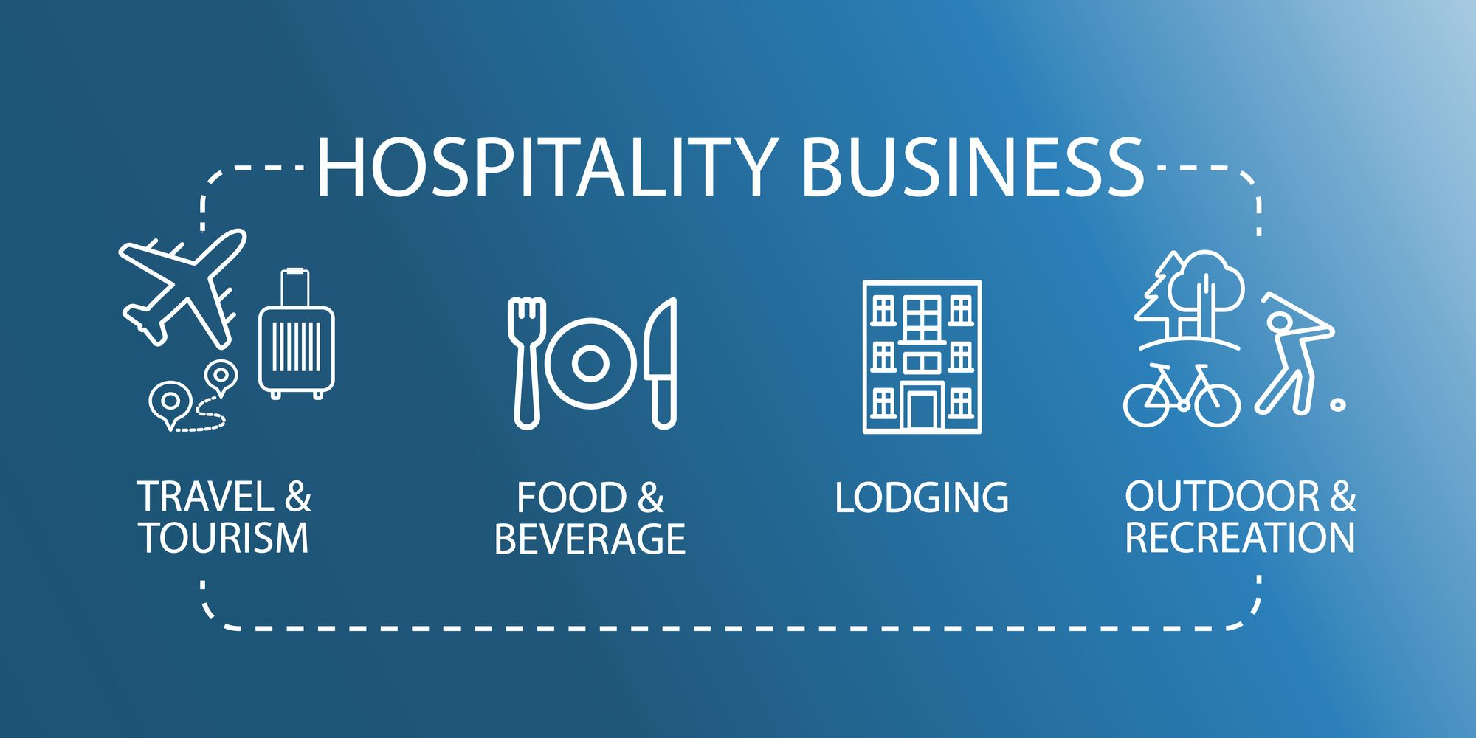
INTRODUCTION
Hospitality industry is delineated as the broad category of the field within the service industry that involves wide range of services (Al- Adwan 2020).
It is highly essential that hospitality services must be comprised with quality services so, larger number of the customers can be attracted.
The presentation will be based on analysing the role and importance of the quality services in hospitality industry in context of JW Marriot.

Slide 3

INTRODUCING THE HOTEL
The selected hotel for demonstrating current study context is- JW Marriot; this brand was established in 1984.
Marriot International Inc. is an American multinational company that mainly operates, franchise and license the lodging involving residential, timeshare properties and hotels.
Marriot is global organisation with having more than 800 properties that established in 139 countries and territories (JW Marriot, 2023).
The organisation is famous for its quality services across the world which lead to attract larger segment of the customers from all over world.

Slide 4

Identifying the main customers of hotel and explaining why they appeal to this group
Identification of the customer needs to be done in specific manner that help in gaining the position in the market.
Marriot has emphasised effectual focus in this area and organisation has developed focus on approaching customers from significant area. The targeted customers the JW Marriot are-
Luxury travellers
Business travellers
People who are fond of travelling
Customers who prefer quality services
Notes:
The JW Marriot has is created by Marriot International as a luxury brand and therefore, it focuses on such customers that are seeking quiet and opulent atmosphere during accommodation (JW Marriot, 2023). The organisation has successfully building the different targeting market strategies within industry by specifying the targeting requirement of its customers. Thereupon, the customers of the company are individualistic self-defined travellers and sophisticated who have desire to spend extra on their accommodation as well as people that are travelling on a business trip.
Emphasising on the motivation of travelling which involves- luxurious and comfortable table, personalised services, convenient business trips, quality relaxation and leisure, loyalty rewards appreciation (Olimovich, and Khudoynazarovich, 2020) Thus, those consumers have been approached by the organisation that need quality luxury services, JW Marriot is a brand that has its image in the market. Rich class people are the major targeted customer of the organisation that results in earning of higher profitability. The prices of the organisation are high and therefore, people with low income cannot prefer the charges (Buhalis and Cheng, 2020). JW Marriott charges on the basis of the services provided by them and therefore, their occupancy rates are high and accordingly business attracts the customers (Gretzel, 2022).

Slide 5
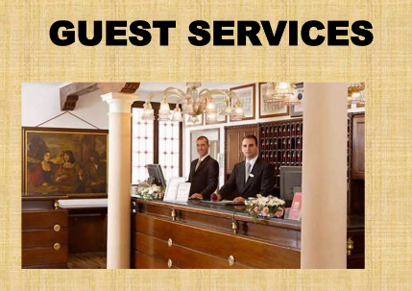
Scope of guests services and families-
The contextual information has depicted that scope of guest service is higher as this lead to create support for the business (Ngoma and Ntale, 2019).
When hospitality services are comprised with full-filling the needs of employees then this lead to create satisfaction level in the employees and therefore, specific focus should be implemented in this area.
JW Marriot analyse the marketing needs of the customers and on the basis of that services have been provided to consumers and this result in enhancing their satisfaction level (Irfan and Sami, 2021).
Hence, this can be said that scope of guest service is higher.

Slide 6
Outlining the nature scope and role of the guest services and families
Nature of guest services and families-
The nature of guest services involves direct interaction between the employees and guest.
This is concerned with greeting, assisting, handling complaints and ensuring that guest needs have been met in proper manner (Haghkhah 2020).
The customer utilities should be increased to higher extent in accordance with the nature of guest services.
JW Marriot has assured significant focus in this area and the organisation provides effectual services to the customers so they can get the higher level of satisfaction.
In this manner customers have been attracted towards the hotel.

Slide 7
Role of guests services and families-
The role of guest service associates with creating effective experience for the customers so they can get higher level of the satisfaction.
The role is comprised with taking such actions that lead to create support for the business and JW Marriot is focusing on this area that enable organisation to enhance the satisfaction level of the customers (Jhaiyanuntanan and Nomnian, 2020).

Slide 8
CONCLUSION
Conclusively this could be said that, is hospitality businesses it is important to provide effective services to the guest so they can be retained for a longer period.
Effectual service helps in enhancing the satisfaction level of consumers and that has been considered as highly essential in the business.

Slide 9

Discussing the importance of hospitality along with the ways in which hotel meet and exceed the guest expectoration
Hospitality is highly important as this helps in making people feel valued and enhance their satisfaction level.
It helps in setting apart from the competition and helps in retaining the customers and therefore, this can be said that hospitality supports in making people feel valued and with the help of this their needs can be taken in consideration that are considered as essential for the business (Park and Kim, 2019).
JW Marriot is meeting the expectation of guest within providing them high class services and enhancing their satisfaction level.
This results in attracting them towards the organisation.
Notes:
Furthermore, customer trends have been analysed by the business and on the basis of that further actions are being taken that are considered as essential in order to gain the attention of the customers (Peng and Lee, 2019)
Thus, there is no doubt in stating that JW Marriot is enhancing the satisfaction level of guest within focusing on the preferences of the guest and therefore, company is able to approach larger segment for the business. Hence, it could be said that, it is important to create specific focus on this area so, preferences of the consumers can be analysed and on the basis of that hospitality services can be designed which lead to attract large number of the consumers (Reidhead, 2020).

Slide 10
REFERENCES
Al-Adwan K., 2020. Building customer loyalty in online shopping: the role of online trust, online satisfaction and electronic word of mouth. International Journal of Electronic Marketing and Retailing. 11(3). pp.278-306.
Buhalis, D. and Cheng, E.S.Y., 2020. Exploring the use of chatbots in hotels: technology providers’ perspective. In Information and Communication Technologies in Tourism 2020: Proceedings of the International Conference in Surrey, United Kingdom, January 08–10, 2020 (pp. 231-242). Springer International Publishing.
Gretzel, U., 2022. Online Reputation Management. In Encyclopedia of Tourism Management and Marketing (pp. 384-387). Edward Elgar Publishing.
Haghkhah C., 2020. EFFECTS OF CUSTOMER VALUE AND SERVICE QUALITY ON CUSTOMER LOYALTY: MEDIATION ROLE OF TRUST AND COMMITMENT IN BUSINESS-TO-BUSINESS CONTEXT. Management Research & Practice. 12(1).
Irfan, A. and Sami, A., 2021. Creating Public Value Through Reputation Management. JISR management and social sciences & economics. 19(2), pp.136-153.
Jhaiyanuntana, A. and Nomnian, S., 2020. Intercultural communication challenges and strategies for the Thai undergraduate hotel interns. PASAA: Journal of Language Teaching and Learning. 59. pp.204-235.
Notes:
Ngoma, M. and Ntale, P.D., 2019. Word of mouth communication: A mediator of relationship marketing and customer loyalty. Cogent Business & Management.
Olimovich, D.I. and Khudoynazarovich, S.A., 2020. The cost-effectiveness of improving the quality of hotel services. Academy. (4 (55)). pp.40-42.
Park, E. and Kim, K.J., 2019. What drives “customer loyalty”? The role of corporate social responsibility. Sustainable Development. 27(3). pp.304-311.
Peng, X. and Lee, S., 2019. Self-discipline or self-interest? The antecedents of hotel employees' pro-environmental behaviours. Journal of Sustainable Tourism. 27(9). pp.1457-1476.
Reidhead, C., 2020. Impact of organizational culture on employee satisfaction: A case of Hilton hotel, United Kingdom. Journal of Economics and Business. 3(1).
Online
JW Marriot, 2023. [Online] Available through < https://jw-marriott.marriott.com/ >

