Slide 1



Hospitality and Guest Services

Slide 2
Simona Claudia Ursu
Stefan Cheles
Estera Codreanu Raluca Andreea Lefter
Lecture: Dale Clarke

Slide 3


Table of Content
Introduction
An appraisal of a Guest service experiences
Conclusion
Findings
References

Slide 4

Introduction
Guest services is also considered as the customers services. In hospitality industry, guest services plays crucial role within enterprises. As the appreciation as well as impression of consumers aids hotels to have higher ratings, effective business and others.
Notes:
This services is not only performed at the time when guest utilises it but also considered before and after the consumers usages hotel products or services. For this presentation, the chosen company is Marriott International, which is an American multinational hospitality firm. Its headquarters is in Maryland, Bethesda, U.S. The purpose of this presentation is to so appraisal of guest services experiences for understanding its requirements as well as the cutting edge guest services strategies and its application.

Slide 5
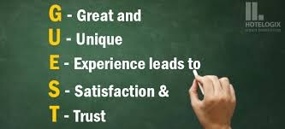
An appraisal of a Guest service experiences
Guest services is all about meeting as well as exceeding the desires of clients. The expectation can be different for various kinds of enterprises but the principle is almost similar. In hospitality sectors, guest services is known as the consumer services.

Slide 6
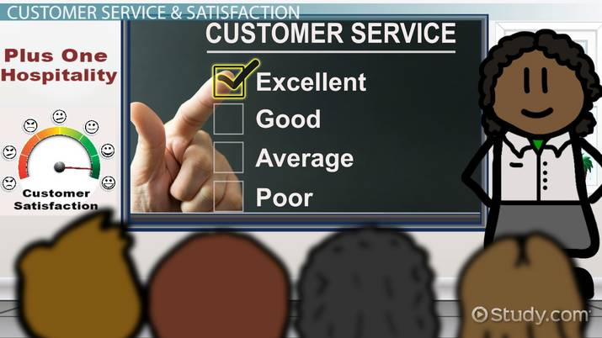
An appraisal of a Guest service experiences
The aim this particular services is to make clients more satisfied. The guest services involves receiving feedbacks from visitors, solve their complaints, take care of consumers and others. Moreover, guest services is considered as the key success within hospitality sectors UK.
Notes:
Within hotel such as Marriott International guest services plays essential role as they facilitate excellent services to clients.Better guest services is considered as services which treats consumers with a friendly attitude as well as tries to solve its issues or queries in effective and efficient manners.
Guest service experience is considered as the art of managing consumers as well as accomplishing its needs as well as requirements when they contact guest services. This can be utilised to explain customers about firm products or services they are offerings. Within UK, the services quality is leading concern for various hospitality company. Now a days hotels such as Marriott Internation are more focused towards the customers expectation as well as its requirements through consistently developing the quality of services facilitated to its guest. With effective and quality guest services, hospitality firm develops great efforts for maintaining, improving as well as distinguishing its services quality by adoption of efficacious business strategies, as well as operative policies and process. The Marriott international is a leading as well as famous hotel in all over the world that operates in various countries such as UK, U.S.A, France and other. It provides several different kinds of services such as dining, spa services, hosts venue for weddings, meetings, events and many more. Also, it manages as well as franchises a broad portfolio of hotel and provide facilities related to lodging. Moreover, it facilitates high value services to their customers. As the aim of respective hotel is to become a growing hotel offering the effective services within hospitality sectors. It facilitates customers a comfortable as well as secure atmosphere with high quality services.

Slide 7

An appraisal of a Guest service experiences
For understanding about the customers needs and wants the respective firm have to considered few things which are discussed below:
Regularly collect consumer feedback
Understanding consumer wishes
Actively serve consumers
Serve fairly with each guest
Prioritizing the care of consumer emotions
Notes:
Regularly collect consumer feedback: The feedbacks as well as reviews are considered as the strong bases for hospitality sectors to innovate as well as develop the quality of their services. Thus, Marriott International are very much concentrated upon the guest services after they leave hotel. Moreover, asking them to for comments regarding their services when they about to leave, the respective hotel are continuously observe the consumers reviews about its hotels at booking sites, travel forums and others. With the help of this they can able to understand about what actually guest wants from us.
Understanding consumer wishes: When communicating as well as introducing services to guest, the hospitality firm like Marriott International have bases on its expectations to introduce appropriate services. Many customers want to select services which suit its budget. So, it is essential for to suggest that services which is beneficial and under the budget of clients. In most of the service providing company, for receiving more commission from various guest into hotel are often provides expensive services which make consumers feel bothered as well as awkward.
Actively serve consumers: Making guest satisfied as well as more satisfaction is related with performing effective things which clients demand. It is not very much important to provide services to clients passively but that must be actively introduce the services which customers will required and search as well. For performing this, staff of the Marriott international has to facilitate quick as well as should have capability to capture effective guest psychology. So, training of employees within respective organisation can be performed in professional and systematized way.
Serve fairly with each guest: Various types of guest come to the hotel such as VIP, regular, long stay, foreign, national and others. However, in hotel it does not matter to the employees of hotel what type of guest are there, they should have similar as well as equal attitude. Also, the attitude of the services are to be thoughtful, enthusiastic and meticulous ever for fastidious guest. So, in well known and big hotel such as Marriott effective services is essential for all kinds of services also provides similar quality services as they can not bale to spend more time in hotel but guest reviews as well as recommendation can aids respective hotel to gain more number of customers. It is one of most effective way to treat with each guest in equal manner which helps to create sense of belongingness towards the owner and create loyalty in positive manner. They by best serve food and beverages to their consumers can give one of most pleasant experience that impact in their mind in positive manner.
Prioritizing the care of consumer emotions: When guest feel dissatisfaction, frustrated regarding the products or services facilitated in hotels such as Marriott International then its employees are dealing with the situations have to be apologize urgently, enthusiastic as well as taking fast measures. Even though, they do not have any fault then also staff have to be clever for pleasing guest. Moreover, they should not have to do arguments with customers as well as does not show bad attitude to its consumers.
Guest services are more appreciated when competition within hospitality sectors is becoming more strong In addition to this, all the above mentioned aspects help Marriott International to understand their customers wants and demands by facilitating fair service to all guest, provide the active service and others.

Slide 8


An appraisal of a Guest service experiences
  Cutting edge is defined as the techniques which is utilised to explain the newer, advanced services. Moreover, this is often usages to explain disruptive technology for providing the customer satisfaction.
Addressing complaints
Artificial intelligence for greater guest experiences
Chat-bots strategy
Happier environment
Notes:
Also, it provides as edge to improve the guest services within hospitality industry. So, some cutting edge guest services are applied by Marriott International which are discussed below:
Addressing complaints: Within whole firm there are some services provided to guest that allows them to make complaints or recommend improvement. In case someone have bad experiences then there should be an simple as well as clear means to show how they feel. For example: Marriott international are facilitating various service to their customers such as spa, quality foods and others. In guest are not satisfied with its services they may place complaints regrading this or give effective suggestion. So, respective hotel has to address that complaint effectively and efficiently as soon as possible. By applying this strategies, they can able to resolve the issues of their guest and provides satisfied services.
Artificial intelligence for greater guest experiences: Hospitality sector is abuzz with artificial intelligence ability for understanding consumers utilising their data analytical platform which aids hotels employees to develop effective frame for guest. So, Marriott International can utilise Amazon's AI based services this is the cloud based services that is usages through developers can applied for delivering voice enabled experiences. As voice have become important for guest who want an effortless as well as intuitive manner for interacting with day to day technology. Therefore with the assistance of Amazon's Alexa respective hotel can keep connected with its customers, this become simple for guest to make request to employees by utilising only its voice as a essential command. This strategies is applied in Guest of Marriott International for controlling room lighting, temperature,hailing cabs, ordering room services and other hotel related services.
Chat-bots strategy: Chat bots are considered as the key to mobile first approach to guest services. By virtual interaction such as mobile app can bypass employees of hotel as well as be a service representative as a human. So, the Marriott International can utilise this strategies as a special mobile device to guest which help their customers to perform various task such as order meal or drinks, recommend special dishes, scheduling dinner or lunch, managing reservation and many more. Also, help in answering critical queries related to services or food they are serving. All these makes respective hotels staff easier as well as provide satisfaction and enhances loyalty to their guest.
Happier environment: The physical perception imparted through the hospitality firm is essential in attaining consumer satisfaction. For this the hotel do not have to spend more money in developing an amicable atmosphere. Over the top interior design can be sensed as whether off placing as well as cold, inviting and genial or anywhere in between. The difference occurs into emotive quality of their staff, the essential ingredients into developing a special experiences for their consumers is clean, comfortable as well as effective atmosphere that they feel at home. So, the Marriott International can applied this strategies by facilitating friendly as well as happier environment to its guest so that they can bale to maximise their customer satisfaction and loyalty effectively and efficiently.
All these strategies helps Marriott International to provide fastest, advanced and effective services to its guest for maximising customer satisfaction, enhanced loyalty.

Slide 9
Conclusion
As per the above presentation it has been concluded that guest services is considered as the key aspects in hospitality industry. As this services treats consumers with a friendly attitude as well as tries to solve its issues or queries in effective and efficient manners. This main aim of this customer services is to make them satisfied in effective and efficient manner. Moreover, some cutting edge strategies are used for enhancing their customer satisfaction.
Notes:
In addition to this, the guest service experiences is inextricably related to the brand image. They can able control its brand identity. Through knowing the customer experiences they can radically develop it within their organisation. Providing effective and quality services to guest effects positively as this help them to make their customers happy and satisfied effectively as well as efficiently

Slide 10
Findings
From the appraisal of guest services, it have been identified that customer requires equal services from hotel staff and the services has to be provided active and effective manner. Moreover, it has been identified that by taking feedbacks as well as reviews they can able to accomplish the guest wants. Also, resolve the problems as well as issues related to service that they are providing.
Notes:
In addition to this, it is also identified that the respective firm adopt some cutting guest services strategies such as Artificial intelligence, address feedbacks and others for providing effective and advanced quality of services to its guests as well as resolving its problems. Also, these strategies are helpful in enhancing customer satisfaction and loyalty in effective and efficient manner.

Slide 11
References
Ionel, M., 2016. Hospitality industry. Ovidius University Annals: Economic Sciences Series. 1(1). pp.187-191.
Lashley, C., 2015. Hospitality experience: An introduction to hospitality management.
Manhas, P. S. and Tukamushaba, E. K., 2015. Understanding service experience and its impact on brand image in hospitality sector. International Journal of Hospitality Management. 45. pp.77-87.

Slide 12
Thank you

