Slide 1
BMSK4001
Academic + Employability Skills
Time Management

Slide 2
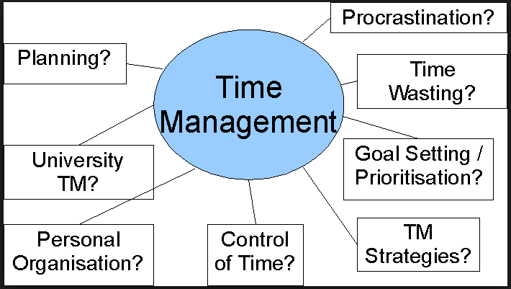

Slide 3
Assessing your work
How you manage your work behaviour
How you manage your work planning
How you manage your tendency to procrastinate
How you manage your work stress

Slide 4
What would a perfect week look like for you?
Here are some ideas:
A week where you got all your key tasks done (not everything, but your key tasks).
A week where you got time to see you loved ones.
A week where you did some exercise and other activities to keep you healthy.
A week where you spent time doing some of the things you love to do.

Slide 5
Exercise
Identify 5 main activities/demands on your time that cause you problems in a typical day.
Ask yourself whether the demand was
  planned (pro-active) – Why?
  or unplanned (re-active) – Why?
Identify and prioritise the areas that you would like to improve.

Slide 6
Making Time
Main Areas to consider:
Planning and Prioritising
Dealing with People
Ways of Working

Slide 7
Making Time
Planning and Prioritising
Get priorities clear - and keep them in mind
Plan the day - and stick to the plan
Set realistic deadlines
Look ahead to possible problems

Slide 8
Making Time
Dealing with People
Deal decisively with interruptions
Know how to say ‘no’
Act assertively
Limit phone and online time
See others as a source of support

Slide 9
Making Time
Ways of Working
Do the difficult things first
Cut the clutter
Complete one task before going on to the next
Concentrate on a limited number of tasks
Build in thinking time
Be conscious of time

Slide 10
Prioritisation
Urgent – requires immediate attention. Tasks are usually visible and insist on action.
Important – has to do with results and contributes to your role. Tasks require initiative and pro-activity.

Slide 11
Urgent & Non-urgent work
THE DIFFERENCE BETWEEN IMPORTANT AND URGENT |  | Important Those tasks that will lead to the accomplishment of an important objective. The situation will worsen if they are not completed successfully. Urgent Those tasks that have to be done in a very short time-scale. Which usually means NOW!
Important | Urgent
To do with meeting company objectives | Tasks which have a specific deadline for completion

Slide 12
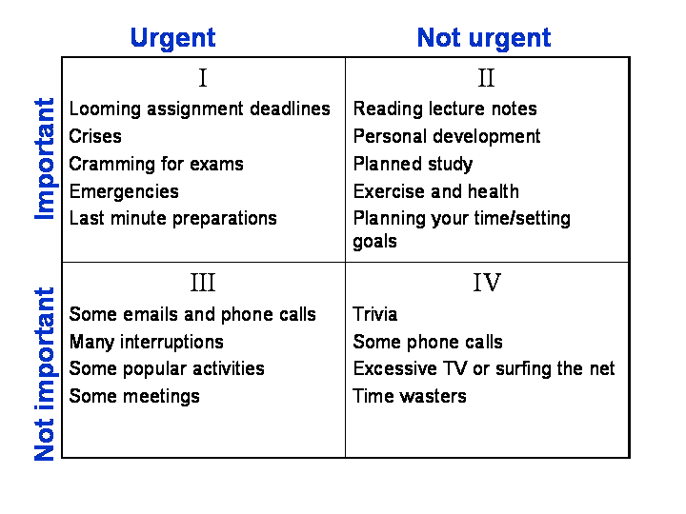
Time Management for students

Slide 13
Procrastination
Why do we Procrastinate?
Not Important
Confused
Overwhelmed
Perfectionism
Distractions

Slide 14
Planning Your Time
Identify your ‘Project’, and confirm its importance
Define your Outcome
Break the Project down into bite size Activities
Determine the order they have to be completed
Determine ‘Best Time’, based on the activity type
Schedule the Activity
Methodically work your way through your Schedule
Monitor Progress, adjust as appropriate

Slide 15
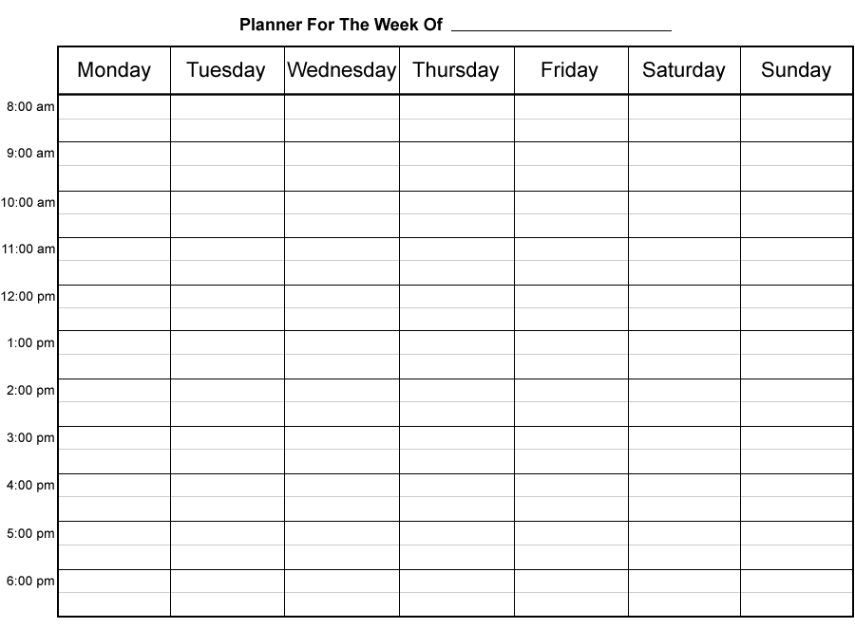

Slide 16
Work Planning
Work planning must meet 4 criteria:
Planning needs to be flexible
Planning must be directed at achievable objectives and communicated to others around you
Planning must concentrate on the effective use of resources and time
Planning must be reviewed constantly and adapted as needed

Slide 17
Work Planning
Positive attitudes to planning:
Commit yourself to planning and implementing your plans
Use a planning system which is simple and practical - it needs to be flexible
Organise yourself for planning - Planning needs time for organising and review

Slide 18
Work Planning
Positive attitudes to planning:
Communicate your plans and what you intend to achieve
Link long-term planning with short-term planning
Accept change and benefit from it - always see the benefits and plan to achieve these benefits

