Slide 1
The Respiratory System
Every cell in your body requires oxygen and your lungs are highly adapted to extract this gas from the atmosphere!
This extraction occurs from 300 million tiny air sacs called alveoli which give your lungs a sponge like texture.

Slide 2
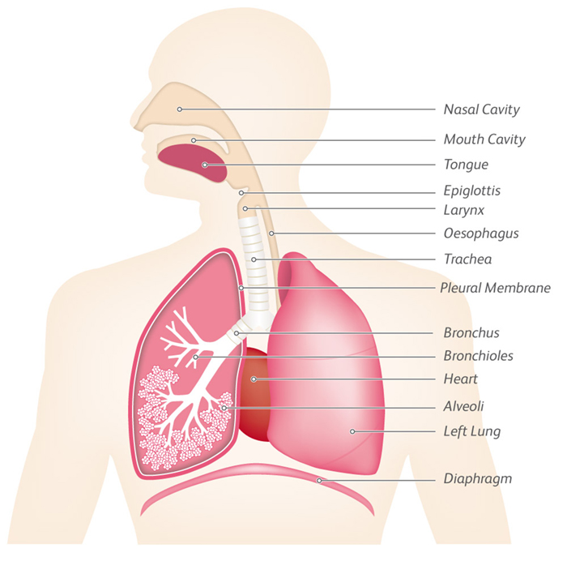
The Respiratory System

Slide 3
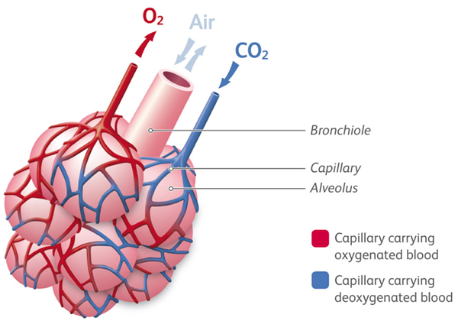
The Respiratory System

Slide 4
The Respiratory System
The primary survey is a way to identify life threatening conditions.
A condition is life threatening if it interferes with oxygen reaching the vital organs.
If the body has a lack of oxygen we call it Hypoxia.

Slide 5
Hypoxia - Airway
Not enough oxygen in the surrounding air, such as:
Suffocation
Drowning
Blockage, swelling or narrowing of the Airway, caused by:
The tongue
Vomit
Choking
Burns
Strangulation
Hanging
Anaphylaxis

Slide 6
Hypoxia - Breathing
Inability of the lungs to function properly, caused by:
Crushing the chest
Collapsed lung
Chest Injury
Poisoning
Asthma
Disease or illness
Failure of the respiratory centre in the brain (or nerves connecting to the lungs) caused by:
Stroke
Head Injury
Drug overdose
Poisoning
Spinal injury
Electric shock

Slide 7
Hypoxia - Circulation
Loss of blood, a fall in blood pressure, failure to circulate the blood, or inability of the blood to carry oxygen. Caused by:
Heart attack (Myocardial Infarction)
Cardiac arrest
Severe bleeding
Poisoning
Anaphylaxis

Slide 8
Choking
Signs and Symptoms:
Partially blocked airway:
Casualty agitated, looking for help but able to breathe
Completely blocked airway:
  Casualty struggling to or can’t breathe
  Cyanosis (blueness)
  Can’t speak
  Clutching at throat

Slide 9
Choking Treatment – Partial Blockage
Encourage to cough and try and keep the casualty calm.

Slide 10
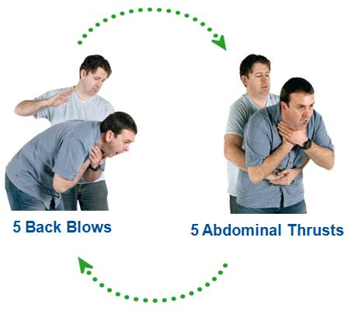
Choking Adult

Slide 11
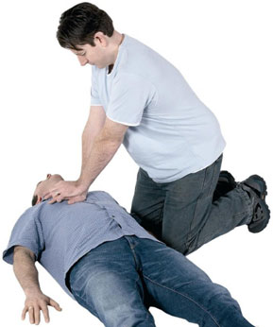
Choking Unconscious Casualty

Slide 12
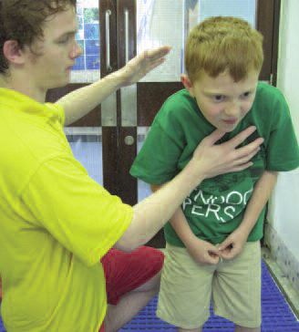
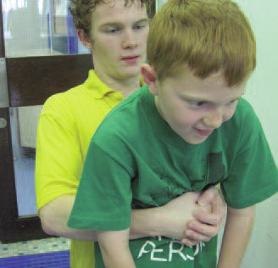
Choking Child Treatment
Encourage to cough
Up to 5 Back Blows
Up to 5 Abdominal Thrusts
Alternate 5 Back Blows & 5 Abdominal Thrusts

Slide 13
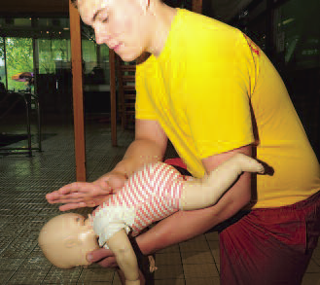
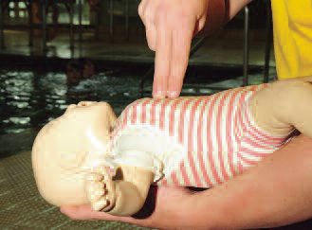
Choking Infant Treatment
Up to 5 Back Blows
Up to 5 Chest Thrusts
Alternate 5 Back Blows & 5 Chest Thrusts

Slide 14
Asthma
Caused by an allergic reaction in the lungs to any of the following; dust, traffic fumes, pollen, exercise, types of food, certain medications, emotions such as fear.
Muscles surrounding the bronchioles go into spasm and constrict, making it difficult to breathe
Signs and symptoms:
  Difficulty breathing
  Wheezing sounds
  Difficulty speaking
  Pale, clammy skin
  Using the next and upper-chest muscles to breathe
  May become unconscious and stop breathing

Slide 15
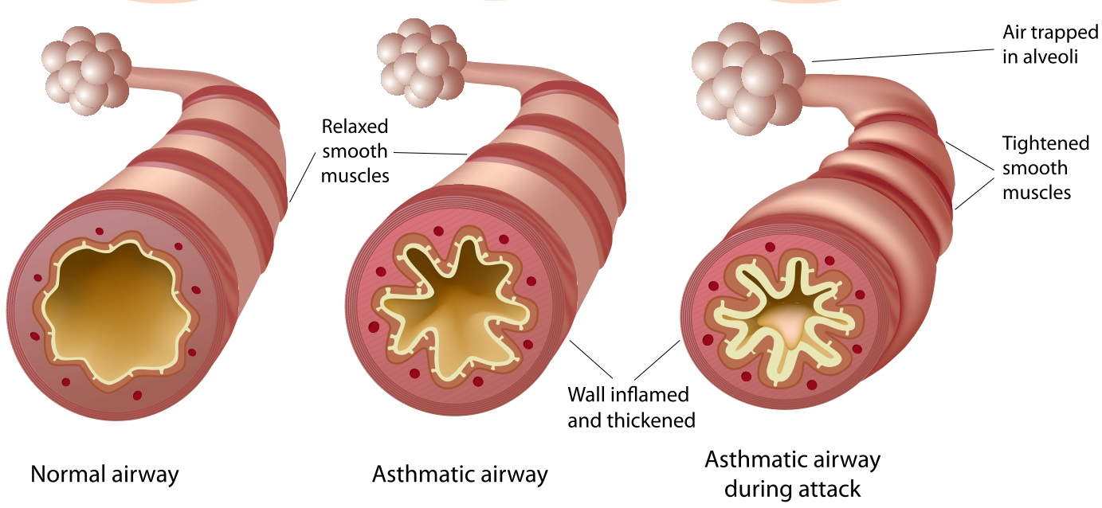

Slide 16
Asthma - Treatment
Help the casualty to sit down.
Stay calm and reassure the casualty.
Encourage the casualty to use their reliever inhaler.
If the attack is prolonged, severe or appears to be worsening call 999/112 for emergency help.
Be aware that cold winter air can make an attack worse.
Be prepared to resuscitate if the casualty goes unconscious and stops breathing.

Slide 17
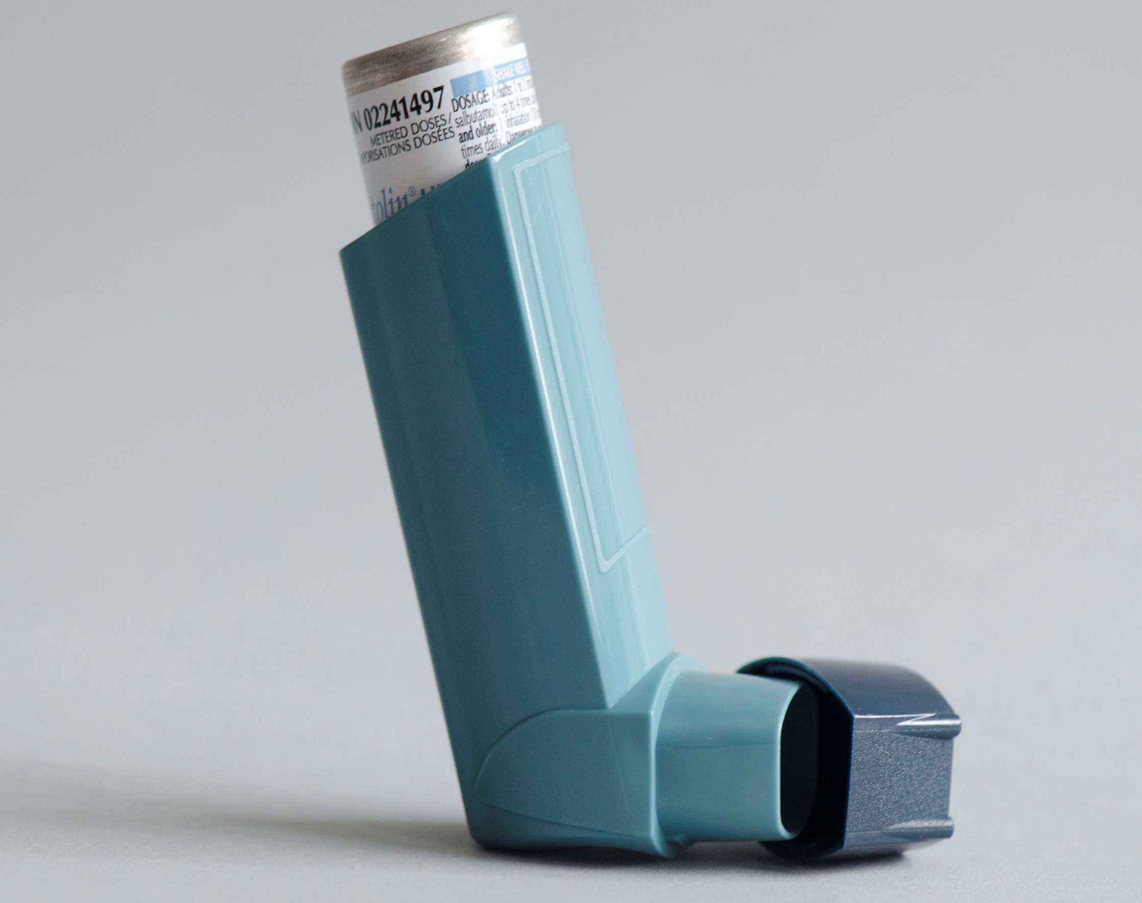

Slide 18
Hyperventilation
  Hyperventilation is ‘excessive breathing.’
  There is only a trace of CO2 in the air we breathe in, but 4% CO2 in the air we breathe out.
  A person hyperventilates when the CO2 levels become reduced in the blood.
  The condition of hyperventilation can often be mistaken for asthma.

Slide 19
Hyperventilation Signs and Symptoms
Unnaturally deep, fast breathing.
Attention seeking behaviour.
Dizziness.
Feeling of a tight chest.
Cramps in hands and feet.
Pins and needles in arms and hands.
The casualty will think they can’t breathe.

Slide 20
Hyperventilation - Treatment
Be firm and calm, but reassuring.
Explain to them that they are hyperventilating.
Sit in front of them and ‘coach’ their breathing.
You can offer them sips of water which helps to reduce the number of breaths they take.

Slide 21
Flail Chest
Flail chest is a condition where the ribs surrounding the chest have become fractured in several places creating a ‘floating’ section of chest wall.
As the casualty breathes, the chest wall moves out, but the flail segment move inwards. So during inspiration and expiration the flail area gets sucked in and out.
These are called ‘paradoxical’ chest movements.

Slide 22
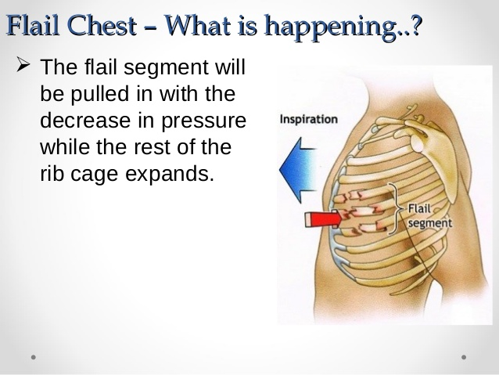

Slide 23
Flail Chest Signs and Symptoms
Severe difficulty breathing.
Shallow, painful breathing.
Signs and symptoms of a fracture.
‘Paradoxical chest movements’.

Slide 24
Flail Chest - Treatment
999/112
Put the casualty into the position they most feel comfortable – this is often sat up, inclined towards the injury.
Place large amounts of padding over the flail area.
Place the arm on the injured side in an elevated sling.

Slide 25
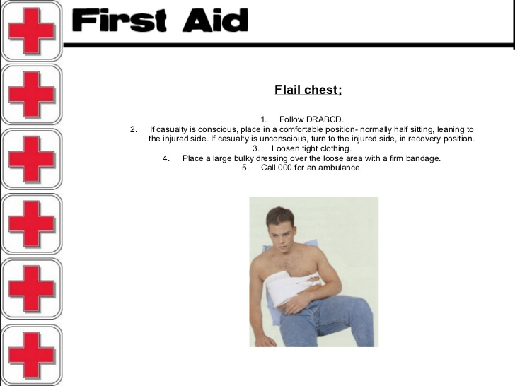

Slide 26
Drowning
A person who drowns does not usually inhale large amounts of water into the lungs.
There are three types of drowning which need to be considered:
Dry Drowning
Wet Drowning
Secondary Drowning

Slide 27
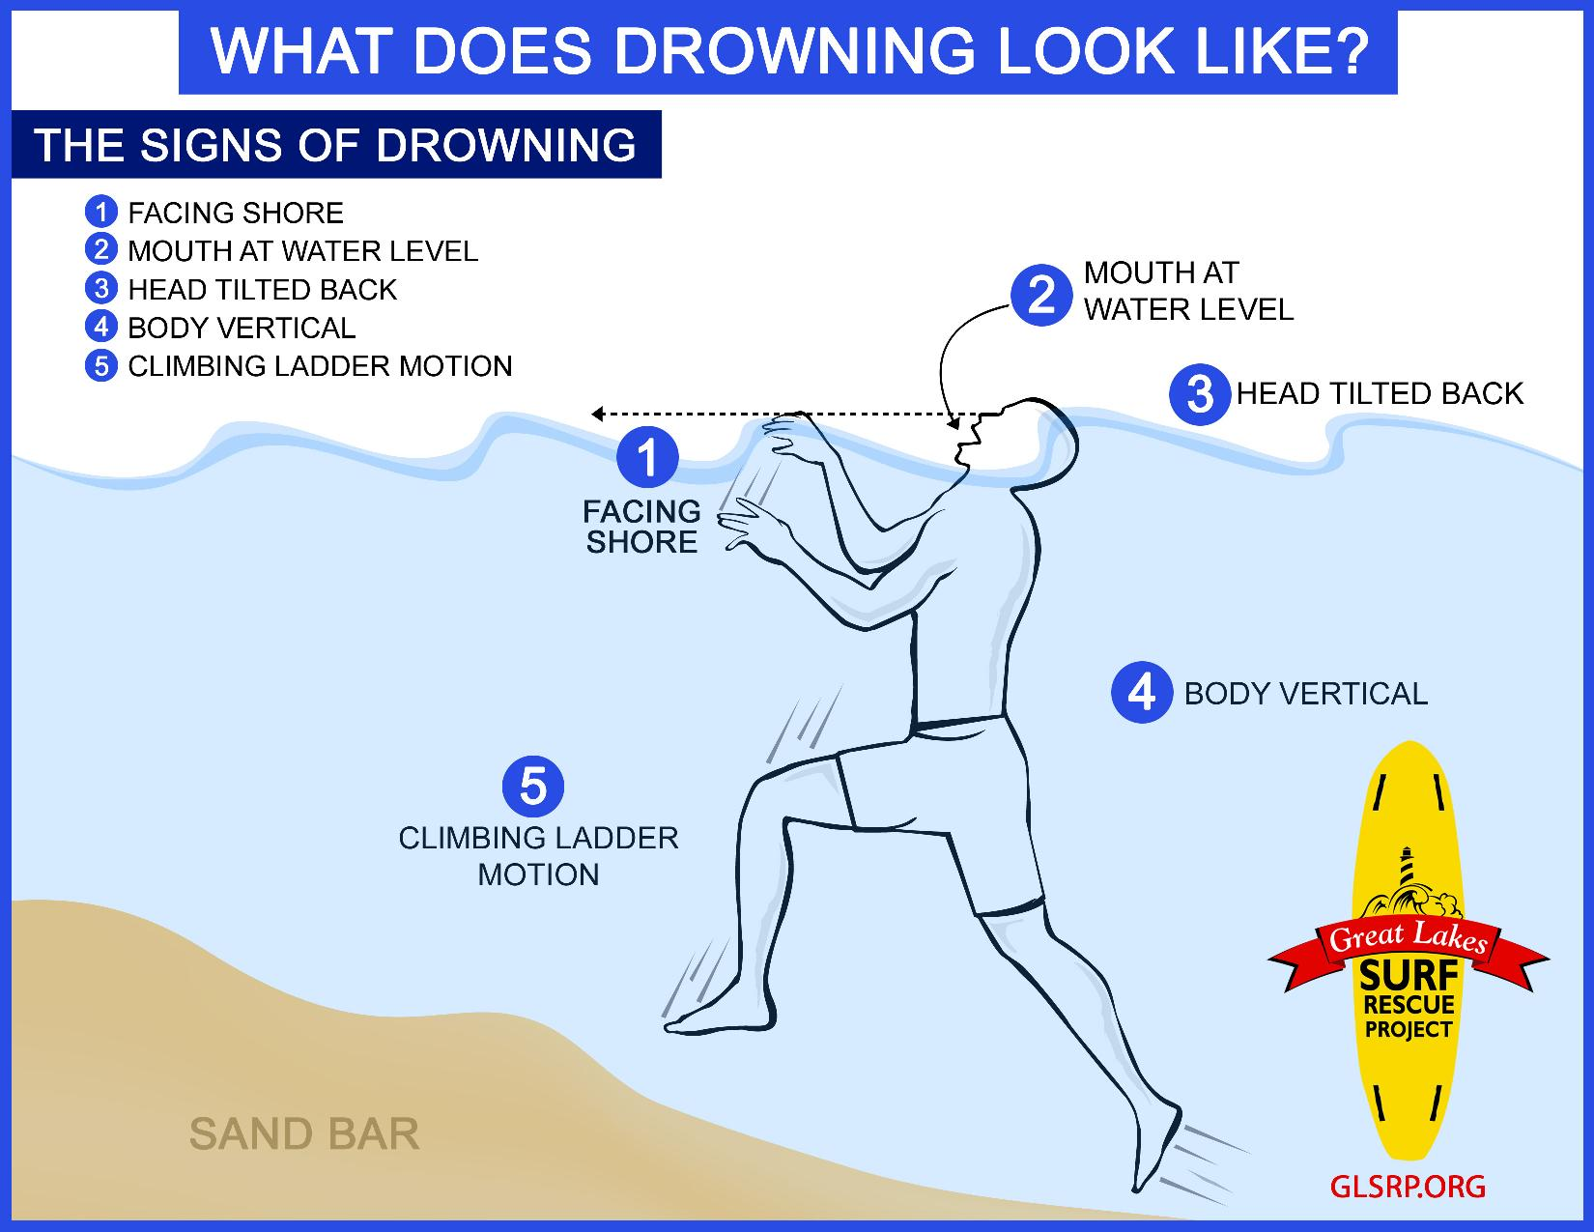

Slide 28
Dry Drowning
In 10% of drowning cases water never reaches the lungs.
A muscle spasm near the epiglottis and larynx blocks the airway and stops water entering the lungs. It does however cut off the air supply.
The casualty will usually swallow large amounts of water which will enter the stomach and may be vomited as they are rescued or resuscitated.

Slide 29
Wet Drowning
90% of drowning cases are described as wet drowning but even these casualties don’t inhale large amounts of water into the lungs.
The body only needs a relatively small amount of water entering the lungs to interfere with the oxygen exchange in the alveoli.

Slide 30
Secondary Drowning
If a small amount of water enters the lungs, irritation is caused and fluid is drawn from the blood into the alveoli.
This reaction could be delayed for up to 72 hours after the ‘near drowning.’
It is for this reason that any casualty who recovers from a ‘near drowning’ should be taken to hospital immediately.

