Slide 1
Week 2
Professional Career Development (BMSW4012)

Slide 2
What did you learn last week?

Slide 3
10 Minute Reflection

Slide 4
Learning outcomes
By the end of this session, students will be able to:
Explain the difference between fixed and growth mindsets and their relevance to learning, resilience, and professional development.
Identify personal mindset tendencies and reflect on how these influence responses to challenge, feedback, and change.
Apply the Honey and Mumford learning styles framework to evaluate their own learning preferences and study behaviours.
Use the Johari Window to explore self-awareness, feedback, and areas for personal and professional development.
Construct a personal SWOT analysis to identify strengths, weaknesses, opportunities, and threats in relation to academic study and future employability.
Begin to reflect on how self-awareness tools can support ongoing professional development and inform Assignment Part 1.

Slide 5
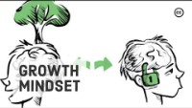

Slide 6
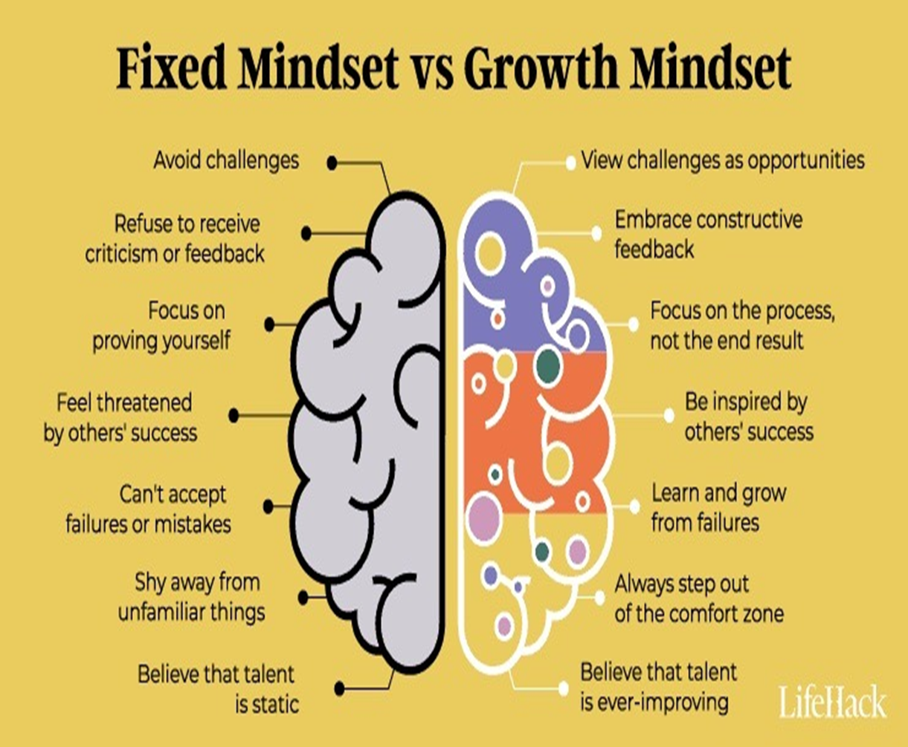
Types of mindset
Mindsets are beliefs about yourself and your most basic qualities.
The most common types of mindset are fixed mindset and growth mindset.
Let us find out what type of mindset you are with a quick activity.

Slide 7
How can we develop a growth mindset?
Actively seek out challenges and view them as opportunities for growth and learning
See failures as opportunities for improvement
Prioritise progress over immediate results
Practice positive self-talk
Actively seek out constructive feedback
Seek out challenges for their own sake
Regularly reflect on your successes and failures
Seek out mentors, colleagues, and friends who embody a growth mindset

Slide 8
Developing resilience
Resilience is:
“The process of adapting well in the face of adversity, trauma, tragedy, threats or significant sources of stress - such as family and relationship problems, serious health problems or workplace and financial stressors. It means ‘bouncing back’ from difficult experiences.”
In these turbulent times, people who are resilient are more able to cope with today’s constantly changing world. They are more likely to be able to:
● anticipate and prepare for risks
● limit damage
● absorb hard knocks
● regroup and bounce back
● spot trends and turn them into opportunities
● accept responsibility
● develop solutions
● learn, grow and develop

Slide 9
Common myths about resilience
Myth: Resilience is a trait - you are either born resilient or you are not.
Truth: Resilience is a skill that can be learned and developed over time.
Myth: Resilient people are immune to stress and negativity.
Truth: Everyone experiences stress and negativity from time to time. However, resilient people choose to respond to challenges positively, to find meaning and purpose in their lives.
Myth: Resilient people are tough and independent; they don’t need help from others.
Truth: Resilient people are resourceful - family and friends are among their most important resources.
Myth: Adversity makes people stronger.
Truth: It is not adversity that makes people stronger - it is the process of struggling, learning and persevering that makes people strong.

Slide 10
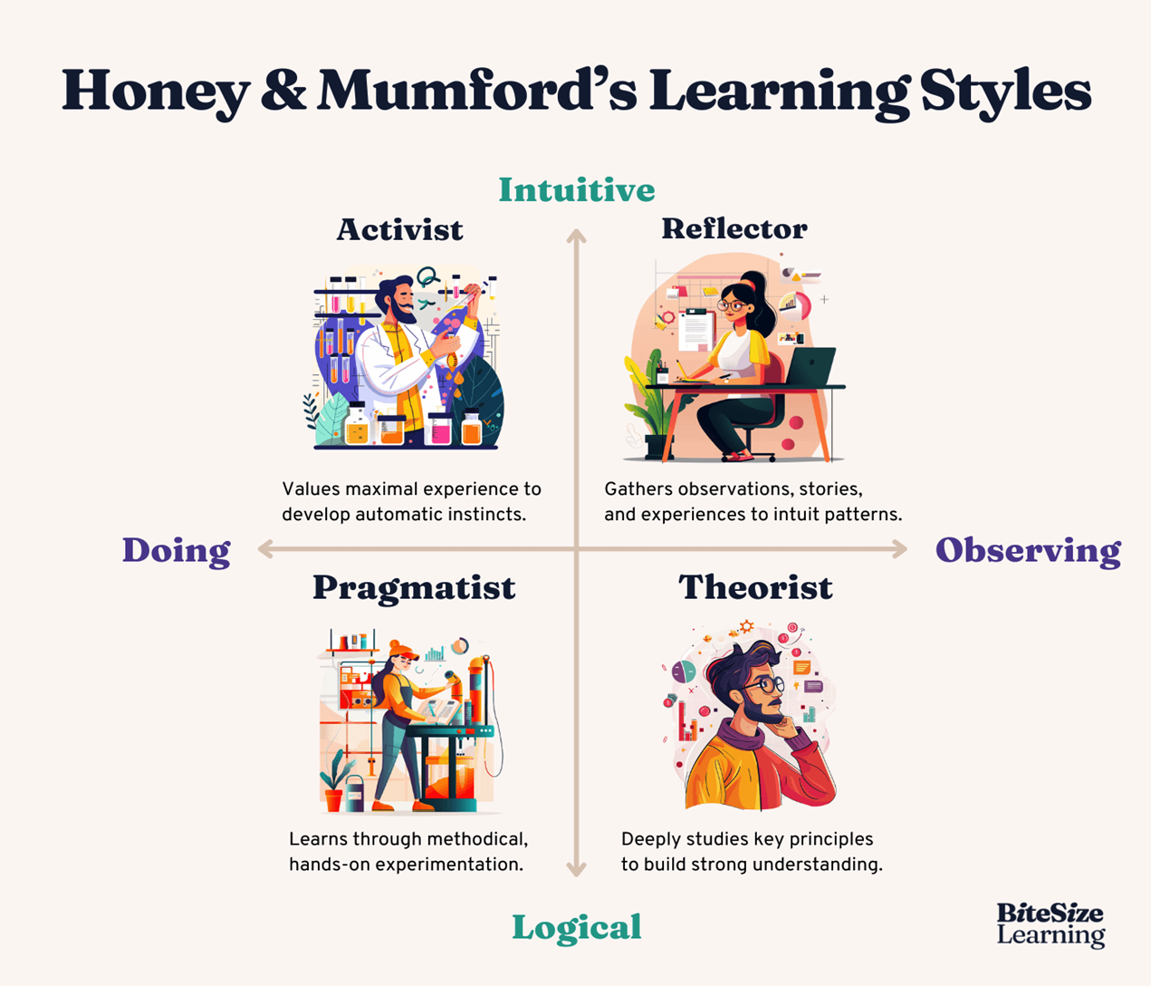
Honey & Mumford learning styles

Slide 11
Activists
Activists involve themselves fully and without bias in new experiences. They enjoy the here and now and are happy to be dominated by immediate experiences. They are open-minded, not sceptical, and this tends to make them enthusiastic about anything new. Their philosophy is: "I'll try anything once". They tend to act first and consider the consequences afterwards. Their days are filled with activity. They tackle problems by brainstorming. As soon as the excitement from one activity has died down they are busy looking for the next. They tend to thrive on the challenge of new experiences but are bored with implementation and longer-term consolidation. They are gregarious people constantly involving themselves with others but in doing so; they seek to centre all activities on themselves.

Slide 12
Reflectors
Reflectors like to stand back to ponder experiences and observe them from many different perspectives. They collect data, both first hand and from others, and prefer to think about it thoroughly before coming to any conclusion. The thorough collection and analysis of data about experiences and events is what counts so they tend to postpone reaching definitive conclusions for as long as possible. Their philosophy is to be cautious. They are thoughtful people who like to consider all possible angles and implications before making a move. They prefer to take a back seat in meetings and discussions. They enjoy observing other people in action. They listen to others and get the drift of the discussion before making their own points. They tend to adopt a low profile and have a slightly distant, tolerant unruffled air about them. When they act it is part of a wide picture which includes the past as well as the present and others' observations as well as their own.

Slide 13
Theorists
Theorists adapt and integrate observations into complex but logically sound theories. They think problems through in a vertical, step-by-step logical way. They assimilate disparate facts into coherent theories. They tend to be perfectionists who won't rest easy until things are tidy and fit into a rational scheme. They like to analyse and synthesise. They are keen on basic assumptions, principles, theories models and systems thinking. Their philosophy prizes rationality and logic. "If it's logical it's good". Questions they frequently ask are: "Does it make sense?" "How does this fit with that?" "What are the basic assumptions?" They tend to be detached, analytical and dedicated to rational objectivity rather than anything subjective or ambiguous. Their approach to problems is consistently logical. This is their "mental set" and they rigidly reject anything that doesn't fit with it. They prefer to maximise certainty and feel uncomfortable with subjective judgments, lateral thinking and anything flippant.

Slide 14
Pragmatists
Pragmatists are keen on trying out ideas, theories and techniques to see if they work in practice. They positively search out new ideas and take the first opportunity to experiment with applications. They are the sorts of people who return from management courses brimming with new ideas that they want to try out in practice. They like to get on with things and act quickly and confidently on ideas that attract them. They tend to be impatient with ruminating and open-ended discussions. They are essentially practical, down to earth pile who like making practical decisions and solving problems. They respond to problems and opportunities "as a challenge". Their philosophy is: "There is always a better way" and "if it works it's good".

Slide 15
Honey & Mumford personality test
Do you think you’re a
Activist?
Reflector?
Theorist?
Pragmatist?

Slide 16
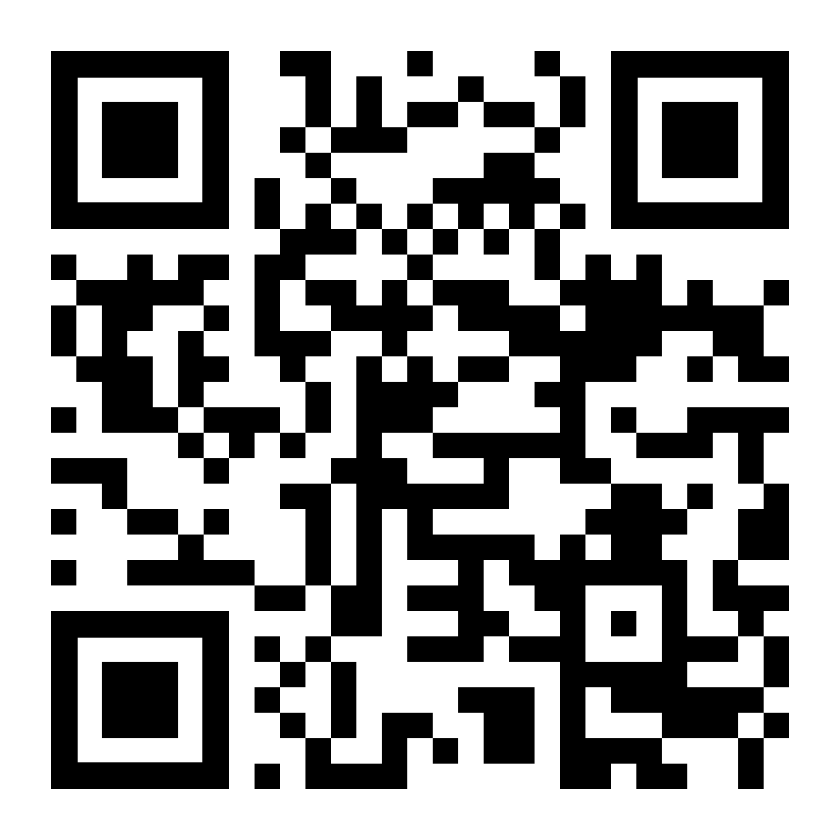
Let’s Find Out!

Slide 17
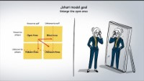

Slide 18
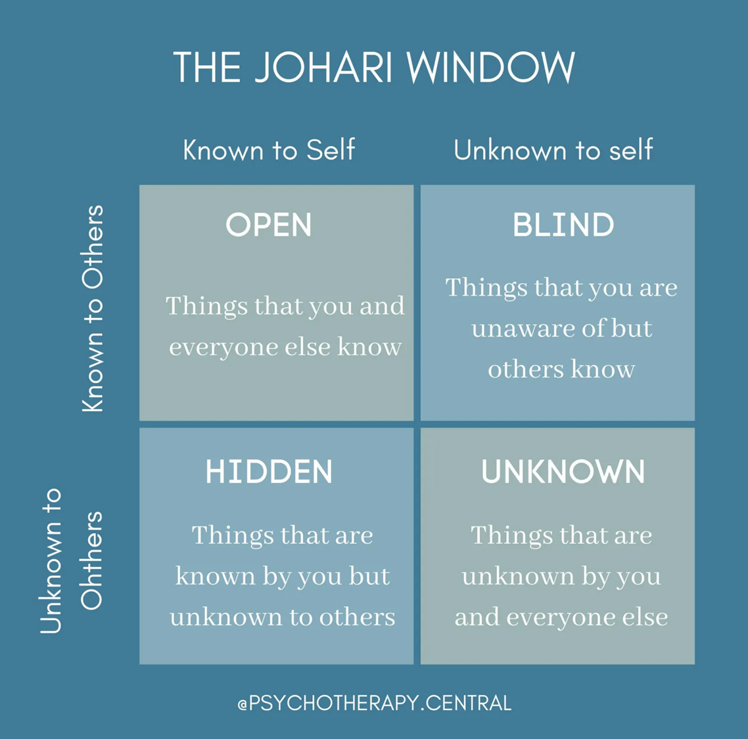
Open area: Anything you know about yourself and are willing to share with others.
Blind area: Anything you do not know about yourself, but that others have become aware of.
Hidden area: Anything you know about yourself and are not willing to share with others.
Unknown area: Any aspect unknown to you or anyone else

Slide 19
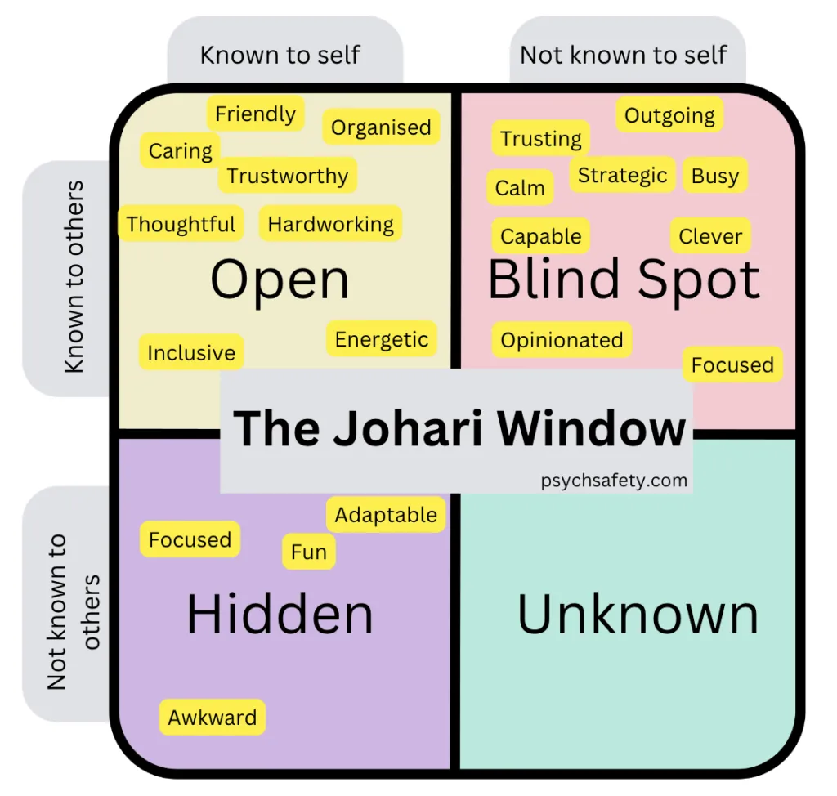
Example

Slide 20
Have a think about:
One strength others might see in you that you underestimate
One area you might benefit from feedback on
If you’re struggling, ask a colleague

Slide 21
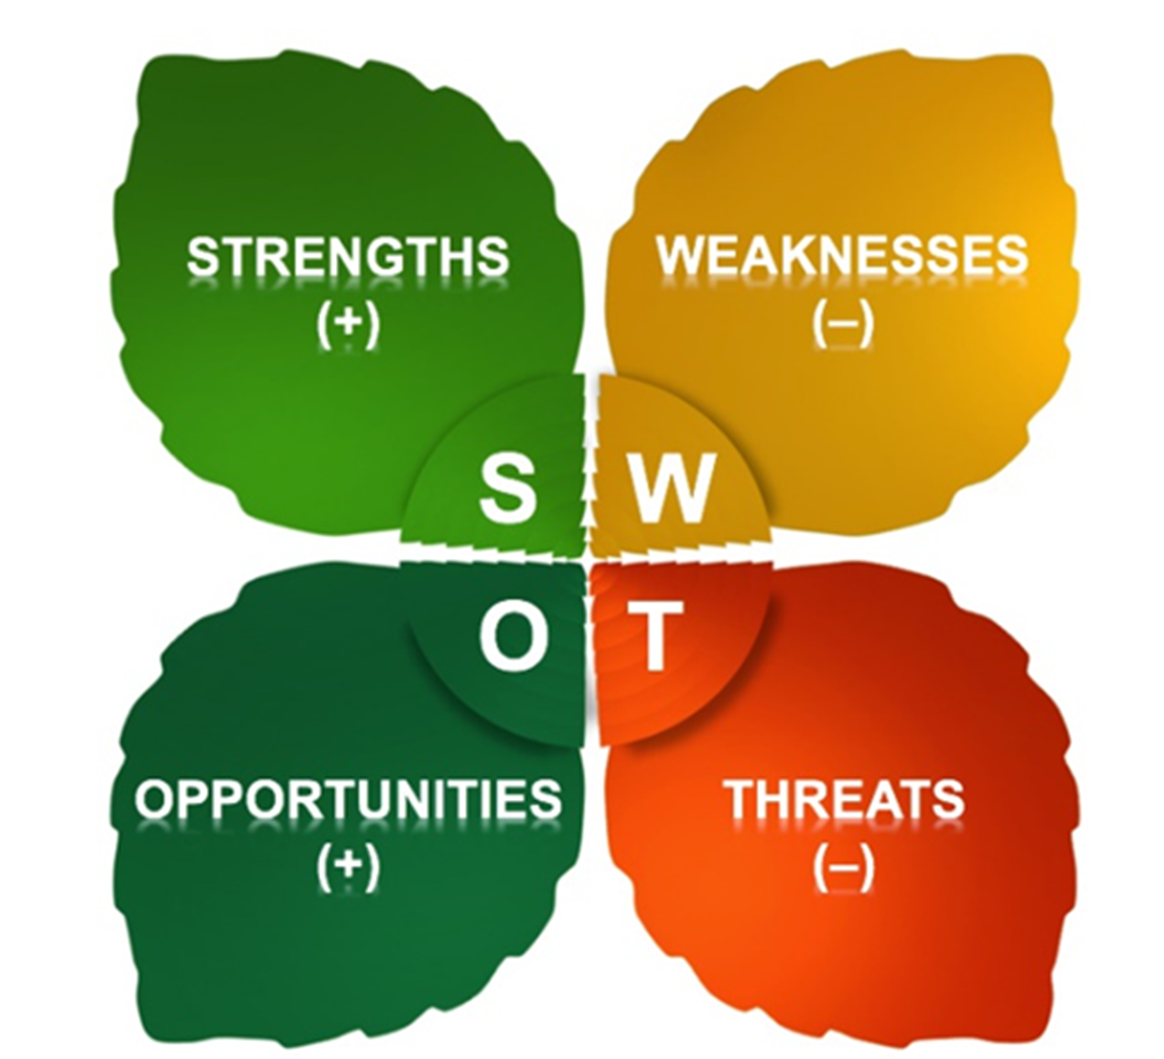
Personal SWOT analysis
A SWOT analysis is a useful, quick tool for taking stock of your personal situation.
It stands for STRENGTHS, WEAKNESSES, OPPORTUNITIES AND THREATS
Consider this from your own perspective, and from the point of view of the people around you. And don't be modest or shy – be as objective as you can.

Slide 22
Strengths
What advantages do you have that others don't have ?
What do you do better than anyone else?
What personal resources can you access?
What do other people (and your boss, in particular) see as your strengths?
Which of your achievements are you most proud of?
What values do you believe in that others fail to exhibit?
Do you have connections with influential people?

Slide 23
Weaknesses
What tasks do you usually avoid?
What do you and the people around you see as your weaknesses?
Are you completely confident in your education and skills training? If not, where are you weakest?
What are your negative work habits?
Do you have personality traits that hold you back in your field?
Are you restricted by any personal circumstances?

Slide 24
Opportunities
Is your industry/sector growing?
Do you have a network of strategic contacts to help you, or offer good advice?
What trends do you see and how can you take advantage of them?
What new technology can help you?
Are any of your competitors failing to do something important?
Is there a need in your company, industry or sector that no one is filling?
Do your customers, internal or external, complain about something in your company? If so, could you create an opportunity by offering a solution?

Slide 25
Threats
What obstacles do you currently face at work?
Are any of your colleagues competing with you for projects or roles?
Is your job (or the demand for the things you do) changing?
Does changing technology threaten your position?
Could any of your weaknesses lead to threats?

Slide 26
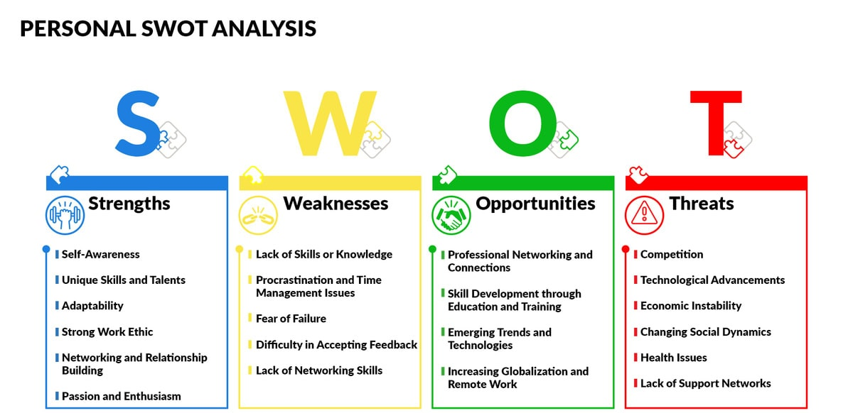

Slide 27
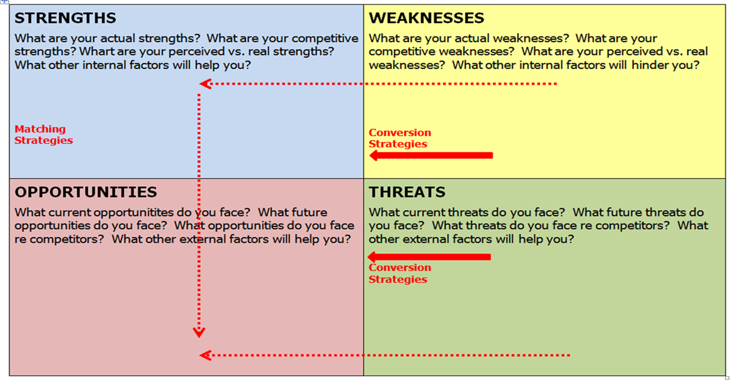

Slide 28
Reflect
Which tool today helped you understand yourself the most?
Which tool felt least useful - and why?

Slide 29
Learning outcomes
By the end of this session, students will be able to:
Explain the difference between fixed and growth mindsets and their relevance to learning, resilience, and professional development.
Identify personal mindset tendencies and reflect on how these influence responses to challenge, feedback, and change.
Apply the Honey and Mumford learning styles framework to evaluate their own learning preferences and study behaviours.
Use the Johari Window to explore self-awareness, feedback, and areas for personal and professional development.
Construct a personal SWOT analysis to identify strengths, weaknesses, opportunities, and threats in relation to academic study and future employability.
Begin to reflect on how self-awareness tools can support ongoing professional development and inform Assignment Part 1.

