Slide 1
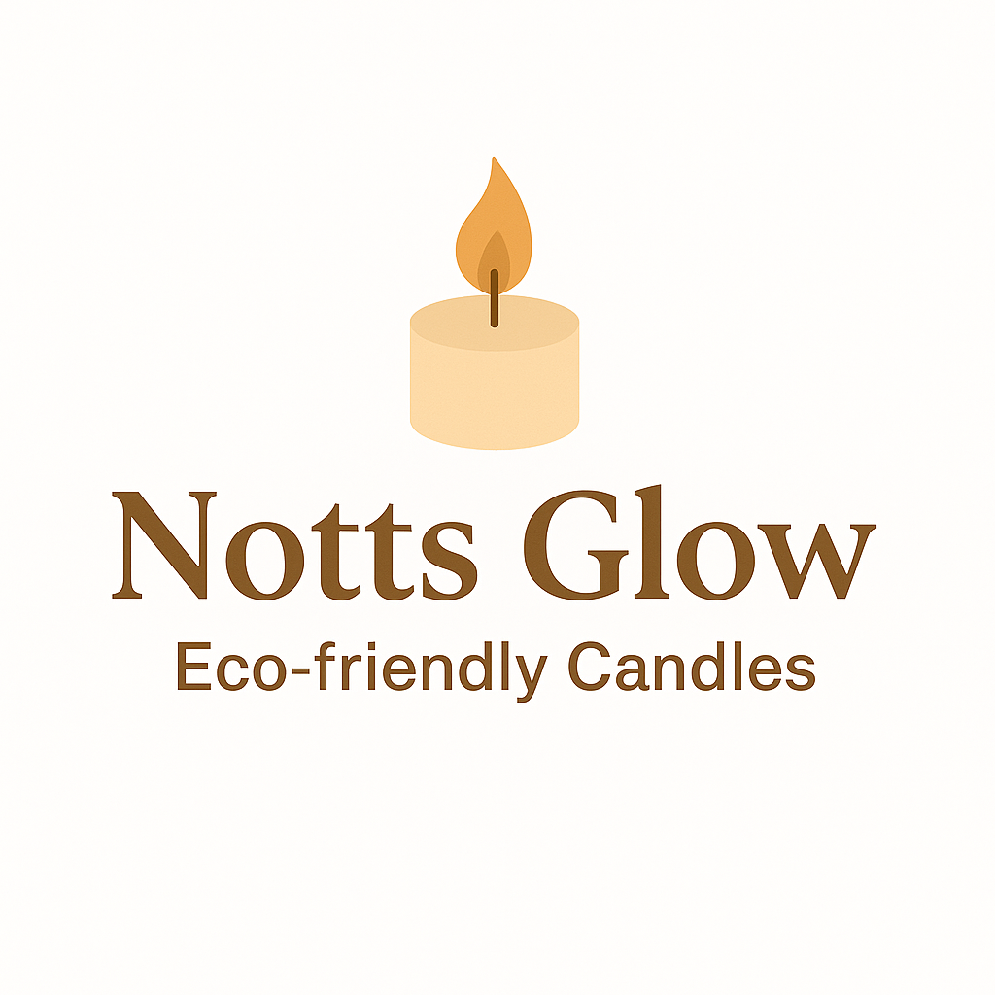
Notts Glow
Artisan Candle Business Plan
Program of study: Bachelor of Arts Business Management
Module name: Entrepreneurship
Module Code: LCBB5013
Lecturer’s name: Masud Ibrahim
Student number: 2324363

Slide 2
Business Overview
Business Idea, Product/services, Objectives and USP
Business Environment and Competitor Analysis
Market Segmentation, 4Ps, and Marketing Strategies
Management and Financial Planning
Conclusion
References

Slide 3

Products and Services
Candles will be:
Soy and beeswax, essential oil scents: lavender, citrus, sandalwood;
hand-poured,
for events and personal use,
with custom messages for gifts and events.
Image source: Krukau, Y. (2021)
Notes:
Future additions: wax melts, aromatherapy kits, candle-making workshops.

Slide 4
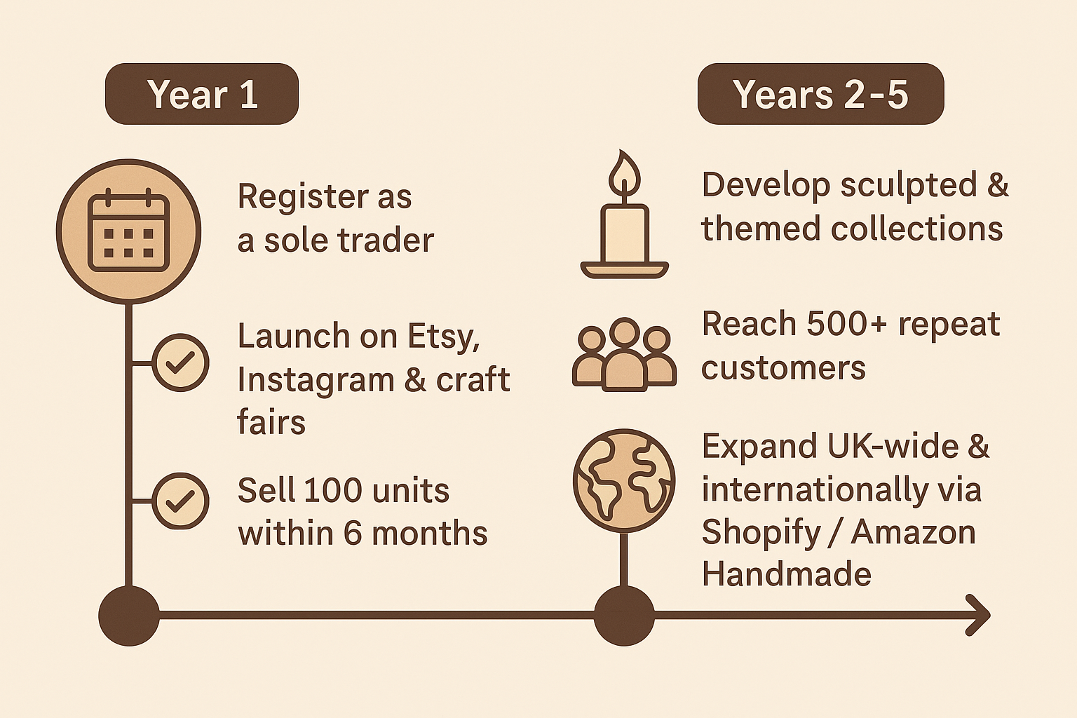



Business Objectives
CLP
(Source: Author, 2025)
Notes:
Develop 5-6 candle designs, introduce personalised candles, and build partnerships with local florists, spas, and gift shops. Scale production: invest in studio space & better equipment. Hire 1–2 employees. Establish Notts Glow as a regional premium candle brand.

Slide 5
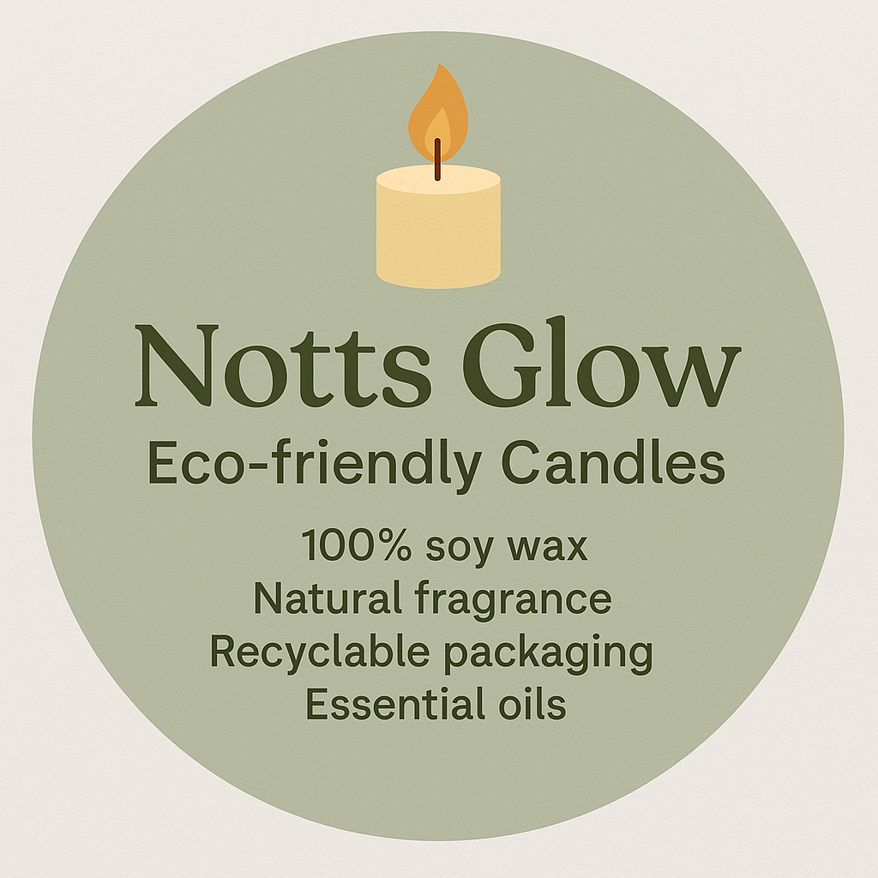
Unique Selling Point (USP)
🌿 Partnering with local beekeepers and herb growers to source natural materials.
💛Committing to social impact by donating a portion of profits to local charities.
🎁Offering seasonal editions and customisable gifts to drive engagement and repeat purchases.
🔁Introducing eco-friendly refills and subscription options to boost loyalty.
♻️Using Recyclable packaging to minimise environmental impact.
Author’s own design (2025)
Notes:
A successful business can reach and retain customers, turning the USP into tangible results.

Slide 6

Industry and Market Overview
The UK candle market is valued at £1.9 billion (Mintel, 2023), driven by rising demand for handmade, eco-friendly, and premium candles.
Key Trends:
🍃 Sustainability (soy and beeswax candles with recyclable packaging).
🌸 Wellness: growing interest in aromatherapy and essential oils.
💚 Local and artisanal: consumers value authenticity, supporting small-batch and handmade products (Euromonitor, 2022).
Target Market: Eco-conscious millennials and Gen Z products that reflect their lifestyle and values.
Mintel (2023) UK Candle Market Report
Notes:
Our focus should not be on expanding the business or the brand, but rather on creating unique and special products/collections.

Slide 7

Market Positioning Map: Notts Glow Compared to Competitors
High
The UK candle market is highly competitive, with global and local brands.
Major players (Yankee Candle, Jo Malone) hold strong retail presence but lack eco-focus.
Supermarket brands compete on price, while local Etsy sellers compete on creativity and uniqueness.
Notts Glow fills a market gap — offering eco-friendly, customisable candles at affordable prices.
Etsy
Sellers
Notts
Glow
Yankee
Candle
Eco-friendly/Sustainability
Tesco/Aldi
Jo
Malone
Low
Price
High
Author (2025), based on Mintel (2023) and Euromonitor (2022)

Slide 8
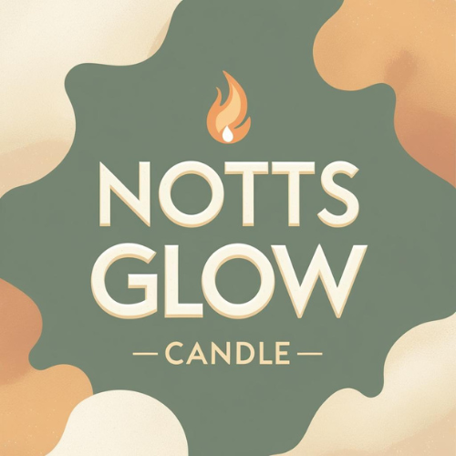
Target Market and Segmentation
Segmentation Type | Description | Targeted Attributes
👨‍👩‍👧‍👦 Demographic | Women aged 25-45, middle-income, working professionals. | Buy for comfort, relaxation, or as a gift.
🌱 Psychographic | Eco-conscious, creative, value authenticity. | Prefer sustainable, mindful products.
🎁 Behavioural | Gift-givers, home décor users, corporate clients. | Seek personalised and seasonal designs.
🌍 Geographic | Local-based and the nearby areas, online expansion. | Value identity and “Handmade in Mansfield” branding.
Author’s own design (2025)

Slide 9
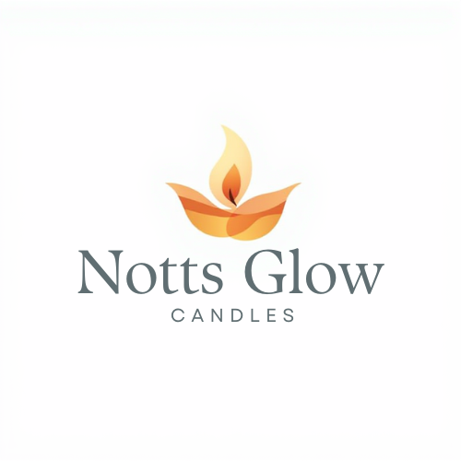
The 4Ps of Marketing – Notts Glow
🕯️Product: handmade, sustainable, personalised. | 🏪Place: Local craft fairs and gift shops, Online via Etsy, Shopify.
💰 Price: £8–£30 (custom). Value-based pricing, with discounts on bundles and seasonal offers. | 📢 Promotion: Instagram and TikTok storytelling, Facebook ads and community groups, seasonal campaigns, and customer loyalty offers.
Author’s own design (2025)
Author’s analysis based on Kotler and Keller (2016)

Slide 10
Online Marketing Strategy
📱 Social Media Storytelling
🤝 Influencer Collaborations
📸 User-Generated Content Campaigns
📧 Email Marketing & Loyalty Program
🔍 SEO & Blog Content
📊 Online Ads & Retargeting
🛒 Etsy & Shopify Optimisation
Author’s analysis based on Chaffey and Ellis-Chadwick (2019)
🎯Utilising these online marketing strategies is cost-effective, builds brand awareness and engagement, provides measurable results and reinforces Notts Glow’s unique selling point.
Author’s own design (2025)
Notes:
Engage customers on Instagram and Ticktock with behind relevant content.
Send newsletters and offer discounts for repeat purchases.
Optimise Etsy and Shopify listings with relevant keywords/hashtags.
Run targeted ads on social media platforms.

Slide 11

Legal and Management Structure
☑️ Legal Structure:
Business Form: Sole Trader.
Reason: Low-cost, simple setup, creative freedom.
Comply with UK tax laws (HMRC registration).
Insurance: public and product liability.
Health and Safety Compliance for Candle Production.
⚖️
☑️ Management Structure:
Owner/Founder: Laura – managing production, marketing, and finance.
Plan – hire 1-2 employees for production and packaging (assistant, retail support if scaling online sales).
Source: Author’s analysis (2025)
Source: Author’s analysis (2025) based on Mintel (2023) and Kotler & Keller (2016)
(Source: Depositphotos, 2023)

Slide 12
Financial Planning and Funding
Funding Sources (that ensure low start-up risk and maintain business independence):
💰Personal Savings,
🏢Government Start Up Loan
🌱Crowdfunding,
🤝Microloans
Author’s own design (2025)
Author’s own analysis (2025) based on Mintel (2023) and Gov.uk (2025)
Notes:
Ensures financial sustainability during the launch phase. Diversified funding reduces risk and supports growth.

Slide 13

Conclusion
Notts Glow offers meaningful, handcrafted candles that merge sustainability, creativity and local pride.
With its eco ethos and online reach, it can evolve from a local startup into a recognised UK brand.
Author’s own design (2025)

Slide 14
Reference List:
Author, 2025. Entrepreneurship Portfolio: Notts Glow Business Plan. Unpublished student work. University of Wales Trinity Saint David.
Author, 2025. Market Positioning Map – Notts Glow vs Competitors. Created by the author using data from Mintel (2023) and Euromonitor (2022).
Author, 2025. Notts Glow logo. [Digital graphic]. Created by the author using Canva, November 2025.
Chaffey, D. and Ellis-Chadwick, F., 2019. Digital Marketing: Strategy, Implementation and Practice. 7th ed. Harlow: Pearson Education.
Depositphotos, 2023. Set of different aroma candles in brown glass jars. [Online image]. Available at: https://st5.depositphotos.com/10811838/63318/i/450/depositphotos_633180770-stock-photo-set-different-aroma-candles-brown.jpg [Accessed 1 November 2025].

Slide 15
Euromonitor International, 2022. UK Home Fragrance and Candle Market Report. [Online] Available at: https://www.euromonitor.com [Accessed 9 November 2025].
Gov.uk, 2025. Start Up Loans: government-backed funding for new businesses. [Online] Available at: https://www.gov.uk/start-up-loans [Accessed 9 November 2025].
Kotler, P. and Keller, K.L., 2016. Marketing Management. 15th ed. Harlow: Pearson Education Limited.
Krukau, Y., 2021. Woman in white long-sleeve shirt holding white ceramic plate. [Online image]. Available at: https://www.pexels.com/photo/woman-in-white-long-sleeve-shirt-holding-white-ceramic-plate-7234618/ [Accessed 3 November 2025].
Mintel, 2023. Candle Market Report: UK Home Fragrance Industry Overview 2023. London: Mintel Group Ltd.
Mintel, 2023. UK Candle Market Report 2023. London: Mintel Group Ltd.

