Slide 1
Reminder: MS-Teams Qs via chat
Open MS-Teams
Select: Chat (Left side menu)
Search: James Williams
Type a Message:
If you are struggling with an activity, you can message me via chat or request a 1-2-1 voice chat whenever needed.
You can also ask each other and help and support each other.

Slide 2
Log-in to MS-Teams
Log-in to Teams to:
  Ask Questions
  Request & receive feedback
  Collaborate with others
  Share good resources
  * Reminder: Bring Headphones with mic for additional 1-2-1 support

Slide 3
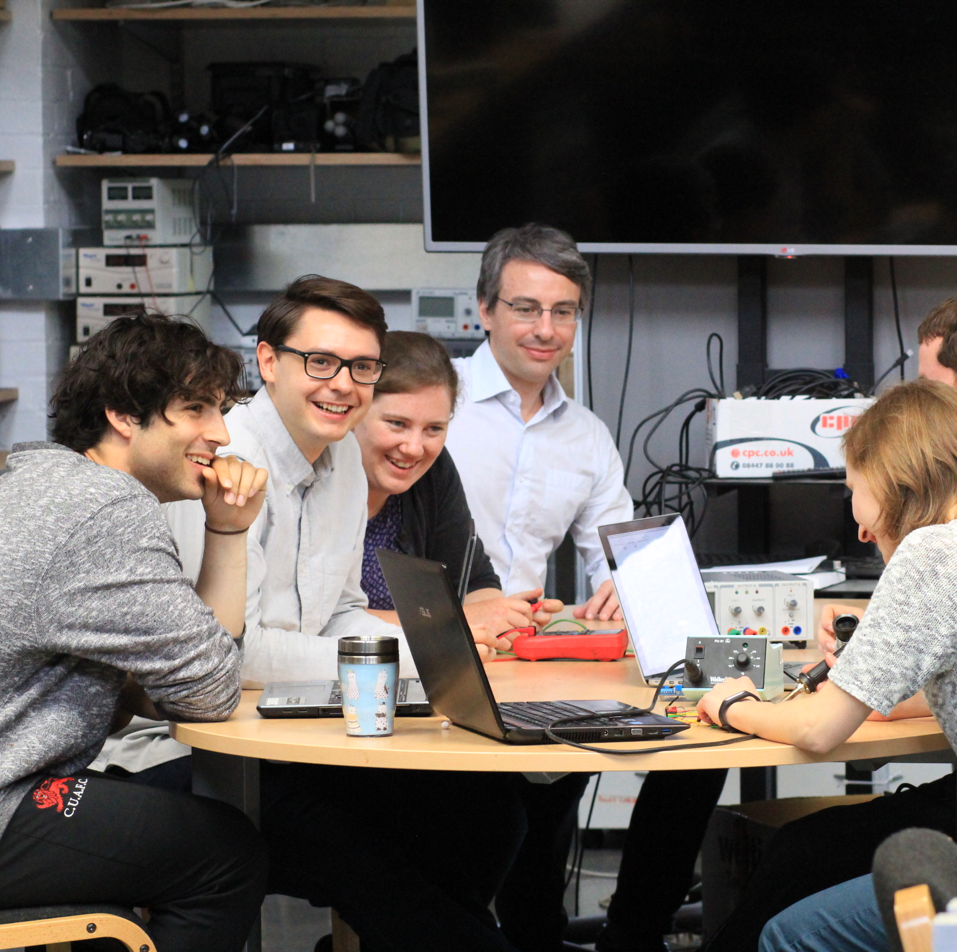
L4: Learning in the Digital Era
Assignment 1:
L4 GAC5: Mini Team-working Challenge
This Photo by Unknown Author is licensed under CC BY

Slide 4

Introduction & Overview
Over the last 2 weeks while completing Tasks 2 & 3 we have looked at ‘Effective Team working’ & ‘Virtual Collaboration’ concepts & theories.
Now it’s time to put that learning into practice.
As part of GAC5 ‘Professional practice’ there are marks available for completing a contextualised ‘Team-working’ Activity.
Each LDE module includes an Activity that is contextualised/tailored for the specific School where it’s run.
For Computing: students are asked to complete a min team-working project in small groups of 2/3. Next page…

Slide 5

Let’s put your Team-working skills to test
Be Positive
Be Respectful
Collaborate: Work together and
GO FOR IT

Slide 6
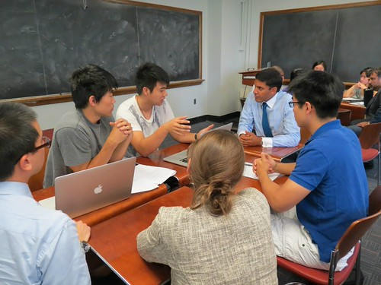
AI can be used freely for this activity 👍
Vibe code it with many iterations / enhancements 👍
This Photo by Unknown Author is licensed under CC BY-NC

Slide 7
Marks are awarded for:
Working as a Team
Doing the best you can
Engage with the Activity
Be positive and work with the limited time and resources available to complete the task.
This Photo by Unknown Author is licensed under CC BY-NC

Slide 8
DO YOU & YOUR TEAM HAVE WHAT IT TAKES?
TO COMPLETE TODAY’S TEAM CHALLENGE?
CAN YOU DO IT?
CAN YOU OVERCOME CHALLENGES AND SUCCEED?

Slide 9
Activity: Computing Team-working Challenge
In small Teams of 2/3 create a prototype program/app/game using languages/tools of your choice that includes key syntax areas (such as variables, arrays, loops, if statements, functions)
  The prototype could be a Web / Mobile / Game / Network / Data / Media / other prototype application.
Document: Team Name, Team Members, several screenshots with brief description to show the prototype and your contribution.
Time & Scope: Approx. 2 hours and 1 page of A4. Complete after Lecture-tutorial if needed.
Place in the Appendix of your Word Submission document and as an e-Portfolio Appendix page.
Work together and support each other to complete the task.
Example workflow:
Ideate: Brainstorm ideas and choose 1 idea (must have a purpose)
Design: Create a short simple Feature/requirement list
Organisation: Assign roles or work together as one
Create: Develop your prototype using tools of your choice. AI can be used freely for this activity.
Publish: Publish your prototype online using a Free Hosting provider / GitHub Pages, Netlify, Cloud storage or other facility.
Document: Use several screenshots with brief description to document the prototype and your contribution. + An online ‘Share’ link.
* Ensure each person has a task/role and contribute to the completion of the task *

Slide 10
Update:
Choose a Team leader
Team leader / 1 Team rep to update Tutor on:
  Team members
  Team leader
This Photo by Unknown Author is licensed under CC BY

Slide 11
Activity: Computing Team-working Challenge
In small Teams of 2/3 create a prototype program/app/game using languages/tools of your choice that includes key syntax areas (such as variables, arrays, loops, if statements, functions)
  The prototype could be a Web / Mobile / Game / Network / Data / Media / other prototype application.
Document: Team Name, Team Members, several screenshots with brief description to show the prototype and your contribution.
Time & Scope: Approx. 2 hours and 1 page of A4. Complete after Lecture-tutorial if needed.
Place in the Appendix of your Word Submission document and as an e-Portfolio Appendix page.
Work together and support each other to complete the task.
Example workflow:
Ideate: Brainstorm ideas and choose 1 idea (must have a purpose)
Design: Create a short simple Feature/requirement list
Organisation: Assign roles or work together as one
Create: Develop your prototype using tools of your choice. AI can be used freely for this activity.
Publish: Publish your prototype online using a Free Hosting provider / GitHub Pages, Netlify, Cloud storage or other facility.
Document: Use several screenshots with brief description to document the prototype and your contribution. + An online ‘Share’ link.
* Ensure each person has a task/role and contribute to the completion of the task *

Slide 12
Update:
Team leader / 1 representative to update Tutor on:
  Prototype idea
This Photo by Unknown Author is licensed under CC BY

Slide 13
Activity: Computing Team-working Challenge
In small Teams of 2/3 create a prototype program/app/game using languages/tools of your choice that includes key syntax areas (such as variables, arrays, loops, if statements, functions)
  The prototype could be a Web / Mobile / Game / Network / Data / Media / other prototype application.
Document: Team Name, Team Members, several screenshots with brief description to show the prototype and your contribution.
Time & Scope: Approx. 2 hours and 1 page of A4. Complete after Lecture-tutorial if needed.
Place in the Appendix of your Word Submission document and as an e-Portfolio Appendix page.
Work together and support each other to complete the task.
Example workflow:
Ideate: Brainstorm ideas and choose 1 idea (must have a purpose)
Design: Create a short simple Feature/requirement list
Organisation: Assign roles or work together as one
Create: Develop your prototype using tools of your choice. AI can be used freely for this activity.
Publish: Publish your prototype online using a Free Hosting provider / GitHub Pages, Netlify, Cloud storage or other facility.
Document: Use several screenshots with brief description to document the prototype and your contribution. + An online ‘Share’ link.
* Ensure each person has a task/role and contribute to the completion of the task *

Slide 14
Update:
Team leader to update Tutor on:
Prototype progress
This Photo by Unknown Author is licensed under CC BY

Slide 15
Break time:
Start back: 12:15pm

Slide 16
Activity: Computing Team-working Challenge
In small Teams of 2/3 create a prototype program/app/game using languages/tools of your choice that includes key syntax areas (such as variables, arrays, loops, if statements, functions)
  The prototype could be a Web / Mobile / Game / Network / Data / Media / other prototype application.
Document: Team Name, Team Members, several screenshots with brief description to show the prototype and your contribution.
Time & Scope: Approx. 2 hours and 1 page of A4. Complete after Lecture-tutorial if needed.
Place in the Appendix of your Word Submission document and as an e-Portfolio Appendix page.
Work together and support each other to complete the task.
Example workflow:
Ideate: Brainstorm ideas and choose 1 idea (must have a purpose)
Design: Create a short simple Feature/requirement list
Organisation: Assign roles or work together as one
Create: Develop your prototype using tools of your choice. AI can be used freely for this activity.
Publish: Publish your prototype online using a Free Hosting provider / GitHub Pages, Netlify, Cloud storage or other facility.
Document: Use several screenshots with brief description to document the prototype and your contribution. + An online ‘Share’ link.
* Ensure each person has a task/role and contribute to the completion of the task *

Slide 17
Reminder:
To finish today’s Activity
Feel free to spend another 30mins outside the Lecture-tutorial
Work together using Virtual collaboration tools such as Zoom/Discord/MS-Teams/Google Workspace etc..
To finish off today’s activity.
This Photo by Unknown Author is licensed under CC BY

Slide 18
Update:
Team leader to update Tutor:
Share prototype link when finished
  Either now or if you need to spend another 3.g. 30mins to finish it off that’s fine.
  Send the link to your tutor when ready.

Slide 19
Check-in
Qs?

Slide 20
Register
Register reminder.
Thanks to D.

Slide 21
The Key to Success
THE KEY TO SUCCESS FOR THIS MODULE IS TO MAKE WEEKLY PROGRESS.
Don’t leave it until the end.

Slide 22
The End.

