Slide 1
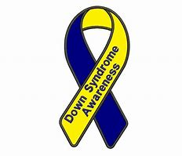
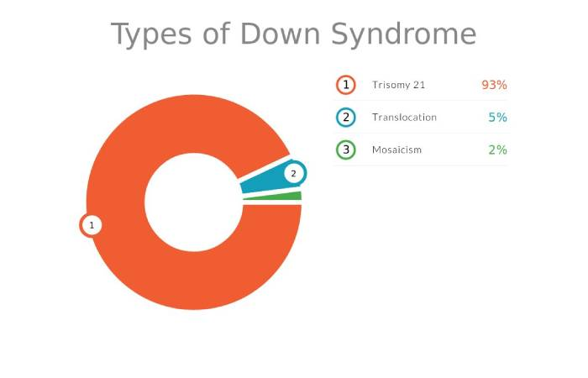

Downs Syndrome
Etsy, no date
Barriers
Children with Downs Syndrome often find it difficult to move around due to low muscle tone. This is called hypotonia. This can have an impact on children's physical development. Hypotonia can and often does improve with age. However, most children will develop gross motor skills such as crawling and walking later than other children (Fergus, 2022).
Children with Downs Syndrome usually develop at a slower rate when compared to other children. Although DSE (no date) state that children with Downs Syndrome have good social skills. Although some children have delays in their speech and language skills. Children with Downs Syndrome need a lot of support with their development.
Around half of children born with downs syndrome have heart defects and as a result most will need heart surgery soon after birth. Most children will also have some vision and hearing impairments that will have an impact on their development. Children with Downs Syndrome are not expected to live as long because of some of the complications after birth( Downs Syndrome, no date).
Children with Downs Syndrome will usually face some sort of discrimination in their lifetime. This could be at school or in society in general. It is important that everyone has a good understanding that children with downs syndrome can do many things. (Callison, 2023)
Children with downs syndrome should have a support system in school. Some children may have delayed fine and gross motor skills. This could mean that children with Downs Syndrome may struggle in some lessons using scissors and doing lots of writing.
To help support the child it is important that the teacher is aware of the child's individual learning plan, and it is the teacher's responsibility to be aware of the child's target (Scotens, 2008).
Screening during pregnancy
Every pregnant women will be offered screening tests during their pregnancy. It is completely optional and not every women will choose to take part. The screening tests will be offered between 10-14 weeks of pregnancy.
The tests combines an ultrasound with blood tests. The fluid at the back of the babies' neck is measured, and blood tests usually taken at the 12 weeks scan combined with the woman's age is then used to work out the chances of the child having Downs Syndrome and other syndromes. (NHS, 2021).
Support for parents
When a child is diagnosed with Downs Syndrome. It can be a worrying time for parents. It is important that parents and carers get the help they need. They are many support groups available for parents to get help and advice when needed. There are charities such as Downs Syndrome Association that will do all they can to provide support for families when needed. (NHS, 2019).
Introduction
Downs Syndrome is a genetic disorder that effects one in 700 children (Fergus, 2022).
Children with Downs Syndrome are born with an extra chromosome. This is usually down to chance and has nothing to do with something that happened during pregnancy (NHS, 2019).
Every child with downs syndrome will have different abilities. Some children will grow up and live a very independent live and some children will rely on others for support (Downs Syndrome Association, 2021)
Identifying Downs Syndrome
Downs Syndrome can sometimes be identified during pregnancy. If not then, it is usually identified soon after birth.This is because the distinctive features of Downs Syndrome. These include a flattened face, a short neck, small ears, smaller hands and feet, and shorter in height as children and adults. (CDC, 2022).
Types of Downs Syndrome
Every person has 23 pairs of chromosomes. Children born with Downs Syndrome have an extra set all 23 pairs of chromosomes but also an extra set of chromone 21. Sometimes Downs Syndrome can be called Chromosome 21 Syndrome. (Heid, 2022)
Strategies
Although there is no treatment for Downs Syndrome. There are a few things that would help children. As children with downs syndrome struggle with their speech and language. Children seeing a speech and language therapist can help improve their communication skills (Cheung, no date).
(Scoten, 2014) states that children who are delayed in their speech and language should sit at the front of the class and use simple language. This could make children feel excluded and may make it harder for children to build relationships with other children in the classroom.
Some children with hearing and vision impairments need the extra support in the classroom. Teachers should make use of the teaching assistants in the classroom to help support children. Children with downs syndrome should be intitled to a 1-1 teaching assistant. This will help support the child to learn in a busy classroom alongside other children (Scoten, 2014). Children having the same 1-1 support worker will allow the child to build a healthy strong relationship with their support worker. This will have a positive impact on the child's development as they will be learning to the best of their ability with the correct support.
Barriers
Sign language is often used as a way of children with downs syndrome communicating. However, sign language is not taught in all schools as some schools say the curriculum is full and there is no time for teachers to teach sign language. This can make it very difficult for children with delayed speech and language to communicate in schools.
Conclusion
To conclude, downs syndrome is a genetic disorder and children with downs syndrome have many difficulties as a result. Although there is no cure for downs syndrome, children with downs syndrome can still live their life to the best of their abilities.. Children can still live an independent life depending on their abilities. There is lots of support available for families including support groups from families that have been through the same diagnosis of downs syndrome.
Redbubble, no date
1809210 959 words ECEY6006
Etsy, no date
(Fatima, 2020)

Slide 2
Reference list
Buckey, S (2007) 'Teaching Numeracy' Number and Mathematics, 12 (1), pp.11-14. URL:updates-2031.pdf (down-syndrome.org) (Accessed: 12th January 2023.)
Centres for Disease Control and Prevention CDC (2022) Facts about Downs Syndrome. Available at:Facts about Down Syndrome | CDC (Accessed: 5th January 2023).
Callison, K (2023) Inclusive Employment: Removing Barriers for People with Downs Syndrome. Available at: Inclusive Employment: Removing Barriers for People With Down syndrome (linkedin.com) (Accessed: 5th January 2023).
Cheung, N (no date) Downs Syndrome. Available at: Down syndrome - Home (weebly.com) (Accessed: 5th January 2023).
Downs Syndrome Assocation (2021) About Downs Syndrome. Available at: About Down's Syndrome - Downs Syndrome Association (downs-syndrome.org.uk) (Accessed: 19th December 2022).
Downs Syndrome Association (2020) Screening Diagnosis and Support. Available at: 25.08.2020-Screening-diagnosis-support-final-1.pdf (downs-syndrome.org.uk) (Accessed: 11th January 2023).
Downs Syndrome International (no date) Recommendations for Education. Available at:Recommendations for education | Down Syndrome International (ds-int.org) (Accessed: 11th January 2023).
Downs Syndrome International (no date) Education Guidelines. Available at: Education Guidelines | Down Syndrome International (ds-int.org) (Accessed: 11th January 2023).
Downs Syndrome Toolkit (no date) Communication Strategy. Available at: Sign Language - Down Syndrome (weebly.com) (Accessed: 9th January 2023).

Slide 3
Downs Syndrome (no date) Barriers. Available at: Barriers - Down syndrome (weebly.com) (Accessed: 5th January 2023).
DSE (no date) Development and Learning. Available at: Development and learning for people with Down syndrome (down-syndrome.org) (Accessed: 5th January 2023).
Disability Nottinghamshire, no date) Social model vs medical model of disability. Available at: Social Model vs Medical Model of disability - disabilitynottinghamshire.org.uk. (Accessed: 12th January 2023).
Etsy (no date) Downs Syndrome Awareness. Available at: Down Syndrome Awareness Ribbon Applique Machine Embroidery - Etsy UK (Accessed: 5th January 2023).
Fatima, S (2020) Down Syndrome. Available at: Down Syndrome – Definition, Facts, Statistics, Types and More (gethealthandbeauty.com) (Accessed: 5th January 2023).
Fergus, K (2022) Symptoms of Downs Syndrome. Available at: Down Syndrome: Signs, Symptoms, and Characteristics (verywellhealth.com). (Accessed: 9th January 2023).
Finch, M (2022) How to support a child with hearing impairment in school. Available at: How to support a child with a hearing impairment in school - Engage Education (engage-education.com) (Accessed: 12th January 2023).
Fraser, S (no date) 10 facts you may not know about downs syndrome. Available at:10 Facts You May Not Know About Down Syndrome | CanadaHelps - Donate to any charity in Canada (Accessed: 15th January 2023).
Heid, M (2022) Types of Downs Syndrome. Available at: Types of Down Syndrome| Everyday Health. (Accessed: 5th January 2023).
Mayo Clinic (no date) Downs Syndrome. Available at: Down syndrome - Symptoms and causes - Mayo Clinic (Accessed: 11th January 2023).

Slide 4
NHS (2019) What is Downs Syndrome? Available at: Down's syndrome - NHS (www.nhs.uk) Accessed: 19th December 2022).
NHS (2019) Support for families and carers. Available at: Support for families and carers - NHS (www.nhs.uk) (Accessed: 5th January 2023).
NHS (2021) Screening for Downs Syndrome, Edwards Syndrome and Patau’s Syndrome. Available at: Screening for Down's syndrome, Edwards' syndrome and Patau's syndrome - NHS (www.nhs.uk) (Accessed: 5th January 2023).
National Deaf Children’s Society (no date) Early Years Education. Available at: Professional resources for early years | Supporting deaf children (ndcs.org.uk) (Accessed: 12th January 2023).
Redbubble (no date) Downs Syndrome Awareness Butterfly. Available at: "Down Syndrome Awareness Butterfly" by gdiciero | Redbubble (Accessed: 9th January 2023).
Rudy, L J (2022) 'How 1-1 aides support autistic students'. Available at: How 1:1 Aides Support Autistic Students (verywellhealth.com) (Accessed: 12th January 2023).
Scotens (2014) Downs Syndrome. Available at: Down’s Syndrome - Classroom strategies - SCoTENs Teacher Education Ireland (Accessed: 9th January 2023).
Speech Buddies (2012) Speech Difficulties in Downs Syndrome. Available at: Speech Difficulties in Down Syndrome (speechbuddy.com) (Accessed: 9th January 2023).
Watson, S (2019) 10 strategies to support hearing-impaired students in the classroom. Available at: Supporting Hearing-Impaired Students in Classrooms (thoughtco.com). (Accessed: 15th January 2023).

