Slide 1
Introduction to Lego Mindstorms

Slide 3
Lesson Objectives
Overview of key elements of Lego Mind-storms and Key components
Excerpts and images from LegoEducation.com User-guide.

Slide 4
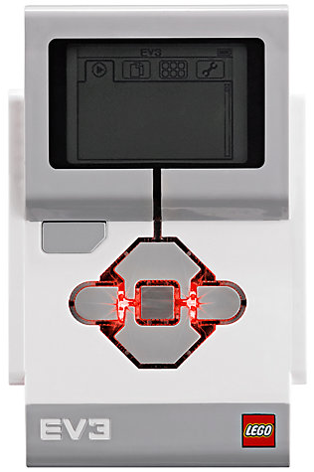
The “Brick” Buttons
1 = Back Undo
Stop Program
Turn robot off
2 = Center Button
Select options
Run Program
Turn robot on
3 = L, R, Up, Down
Navigate menus
1
3
3
2
3
3

Slide 5
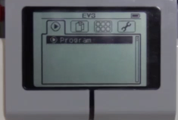
The “Brick” Screen
Tabs on Screen
Run Recent
Find programs you ran recently
2. File Navigation
Find all programs by project
3. Brick Apps
Port views
4. Settings
Bluetooth, Wifi, Volume
1
2
3
4

Slide 6
The Brick Status Light
It can be green, orange, or red and can pulse.
Brick Status Light codes are the following:
    Red = Start-up, Updating, Shutdown
    Red pulsing = Busy
    Orange = Alert, Ready
    Orange pulsing = Alert, Running
    Green = Ready
    Green pulsing = Running Program

Slide 7
The Brick Status Light
You can also program the Brick Status Light to show different colours and to pulse when different conditions are met
Learn more about using the Brick Status Light Block in the EV3 Software Help.

Slide 8
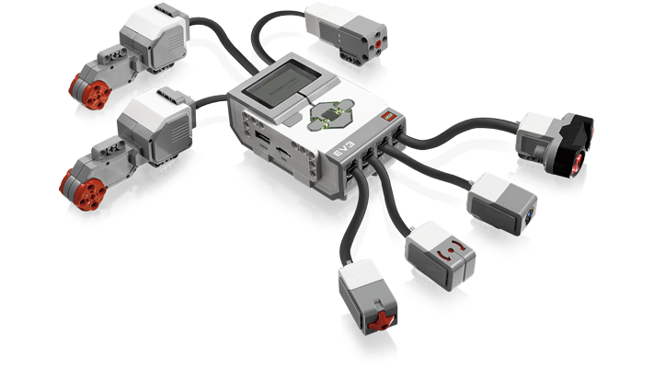
Ports, Sensors, motors
Ports A, B, C, D = Motors
Default setup assumes Right Motor in C, Left Motor in B
Ports 1, 2, 3, 4 = Sensors

Slide 9
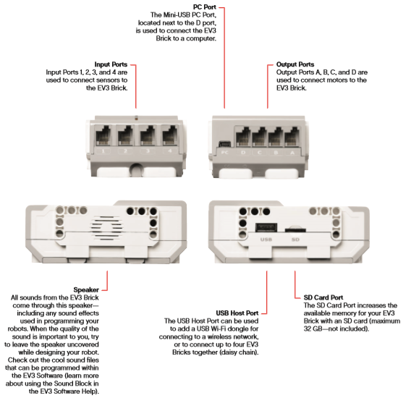
EV3 Ports

Slide 10
Motors: Large Motor
The Large Motor is a powerful ‘smart’ motor. It has a built-in Rotation Sensor with 1-degree resolution for precise control.
The Large Motor is optimised to be the driving base on your robots.
By using the Move Steering or Move Tank Programming Block, the Large Motors will coordinate the action simultaneously

Slide 11
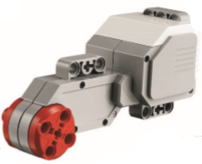
Motors: Large Motor

Slide 12
Motors: Medium Motor
The Medium Motor also includes a built-in Rotation Sensor (with 1-degree resolution), but it is smaller and lighter than the Large Motor.
That means it is able to respond more quickly than the Large Motor.
The Medium Motor can be programmed to turn on or off, control its power level, or to run for a specified amount of time or rotations.

Slide 13
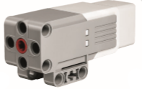
Motors: Medium Motor

Slide 14
Sensors: Colour sensor
The digital Colour Sensor can detect the colour or intensity of any light that passes through its lens. This sensor can be used in three different modes: Colour Mode, Reflected Light Intensity Mode, and Ambient Light Intensity Mode.

Slide 15
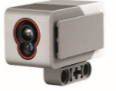
Motors: Medium Motor

Slide 16
Colour sensor: Colour Mode
In Colour Mode, the Colour Sensor recognises seven colours –
black, blue, green, yellow, red, white, and brown – plus No Colour.
This ability to differentiate between colours means your robot might be programmed to sort coloured balls or blocks, speak the names of colours as they are detected, or stop action when it sees red.

Slide 17
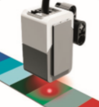
Colour sensor: Colour Mode

Slide 18
Colour sensor: Reflect Mode
In Reflected Light Intensity Mode
The Colour Sensor measures the intensity of light reflected back from a red light – emitting lamp. The sensor uses a scale of 0 (very dark) to 100 (very light).
This means your robot might be programmed to move around on a white surface until a black line is detected, or to interpret a colour-coded identification card.

Slide 19
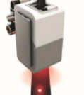
Colour sensor: Reflect Mode

Slide 20
Sensors: gyro sensor
The Gyro Sensor is a digital sensor that detects rotational motion on a single axis. If you rotate the Gyro Sensor in the direction of the arrows on the case of the sensor, the sensor can detect the rate of rotation in degrees per second.
You can then use the rotation rate to detect, for example, when a part of your when your robot is falling over.

Slide 21
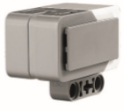
Sensors: gyro sensor

Slide 22
Sensors: Touch sensor
Touch Sensor The Touch Sensor is an analogue sensor that can detect when the sensor’s red button has been pressed and when it is released.
That means the Touch Sensor can be programmed to action using three conditions – pressed, released, or bumped (both pressed and released).

Slide 23
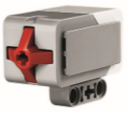
Sensors: touch sensor

Slide 24
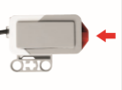
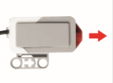

Sensors: touch sensor modes

Slide 25
Sensors: Ultrasonic sensor
The Ultrasonic Sensor is a digital sensor that can measure the distance to an object in front of it.
It does this by sending out high-frequency sound waves and measuring how long it takes the sound to reflect back to the sensor.
The sound frequency is too high for you to hear.

Slide 26
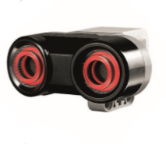
Sensors: Ultrasonic sensor

Slide 27
Sensors: Ultrasonic sensor
Distance to an object can be measured in either inches or centimetres.
This allows you to program your robot to stop a certain distance from a wall.

Slide 28
Sensors: Ultrasonic sensor
A steady light around the sensor eyes tells you that the sensor is in Measure Mode. A blinking light tells you that it is in Presence Mode.
In Presence Mode, this sensor can detect another Ultrasonic Sensor operating nearby. When listening for presence, the sensor detects sound signals but does not send them.

Slide 29
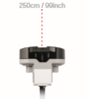
Sensors: Ultrasonic sensor

Slide 30
Sensors: Ultrasonic sensor
Since the Ultrasonic Sensor depends on reflection of the sound waves it may be ineffective at detecting surfaces that are textured or objects that are rounded.
It is also possible for an object to be too small for the Ultrasonic Sensor to detect it.

Slide 31
Programming
Without a program, a robot is just a statue. It may be a cool statue, but it’s still a statue.
When you program a robot you give it abilities – to move, to follow lines, to avoid objects, to make mathematical calculations, and much more.
The EV3 Software has an intuitive, graphics-based format that users can quickly learn and successfully use.
.

Slide 32
Programming
A programing interface is available for-
    PC
    MAC
    ANDROID
  There are some significant differences between the software solutions

Slide 33
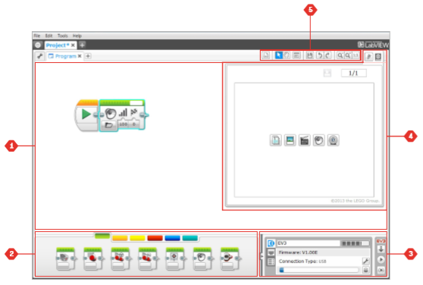
Desktop application

Slide 34
Desktop application
The EV3 Programming environment consists of the following main areas: Programming
1. Canvas – Lay out your program here.
2. Programming Palettes – Find the building blocks for your program here.

Slide 35
Desktop application
3.Hardware Page – Establish and manage your communication with the EV3 Brick here and see what motors and sensors are connected where.
This is also where you download programs to the EV3 Brick.

Slide 36
Desktop application
4. Programming Toolbar – Find basic tools for working with your program here.
Learn more about these tools in the EV3 Software Help.

Slide 37
Desktop application
5. Programming Toolbar – Find basic tools for working with your program here.
Learn more about these tools in the EV3 Software Help.

Slide 38
Desktop application

Slide 39
Desktop application: Blocks and Palettes
All the programming blocks that are used for controlling your robot are located in Programming Palettes
The Programming blocks are divided into categories according to type and nature, making it easy to find the block you need.

Slide 40
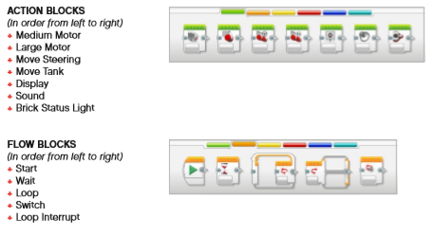
Desktop application

Slide 41
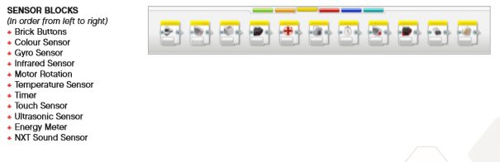
Desktop application

Slide 42
Desktop application

Slide 43
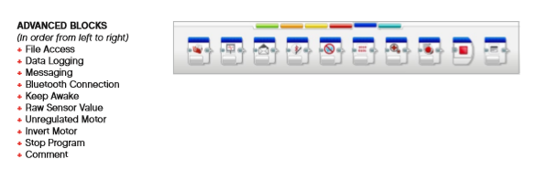
Desktop application

Slide 44
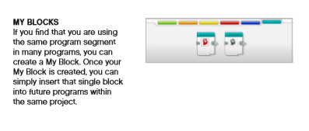
Desktop application

Slide 45
Desktop application: Data Logging
To log data is to collect information for analysis.
The EV3 Software cannot only record data, it can help you to organise and analyse it.

Slide 46
Desktop application: The Hardware Page
provides a range of information about your EV3 Brick.
Even when collapsed, the Hardware Page Controller will be visible, allowing you to download your program or experiment

Slide 47
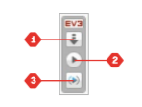
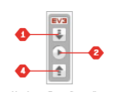
Desktop application: The Hardware Page
The different Hardware Page Controller buttons have the following functionality:

Slide 48
Desktop application: The Hardware Page
1.Download – Downloads the Program or Experiment to the EV3 Brick
2. Download and Run – Downloads the Program or Experiment to the EV3 Brick and runs it immediately

Slide 49
Desktop application: The Hardware Page
3.Download and Run Selected – Downloads only the highlighted blocks to the EV3 Brick and runs them immediately
4. Upload – Uploads your collected datasets from the EV3 Brick to your Experiment

Slide 50
Desktop application: The Hardware Page
The Brick Information tab displays important information about the EV3 Brick that is currently connected
It also gives you access to the Memory Browser and Wireless Setup tools.

Slide 51
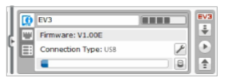
Desktop application: The Hardware Page
BRICK INFORMATION

Slide 52
Desktop application: The Hardware Page
The Port View tab displays information about the sensors and motors connected to the EV3 Brick.
If your Brick is not connected, you can still set up the Port View tab manually.
Select a port, to select appropriate sensor or motor from the list.

Slide 53
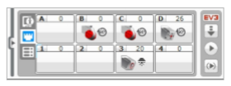
Desktop application: The Hardware Page
PORT VIEW

Slide 54
Desktop application: The Hardware Page
The Available Bricks tab shows the Bricks that are currently available for connection.
You are able to choose which EV3 Brick you want to connect to and the type of communication.
Also, you can disconnect an existing EV3 Brick connection.

Slide 55
Desktop application: Content Editor
The Content Editor offers a convenient way for users to document the purpose, process, and analysis of their projects.
You can include text, images, videos, sound effects, and even building instructions.
It is also a convenient, paperless way for educators to monitor and evaluate student projects

Slide 56
The LEGO® MINDSTORMS® Education EV3
Programming App is a great way to learn about programming with the EV3 Brick using Chromebooks or tablets.
With the same look and feel as the EV3 Software
Fewer features than desktop version

Slide 57
APP: lobby
The Lobby is where you start each time you open the Programming App.
The Lobby makes it easy to create programs, open saved programs that you previously created, view tutorials, and access other resources that will help you familiarise yourself with the Programming App.

Slide 58
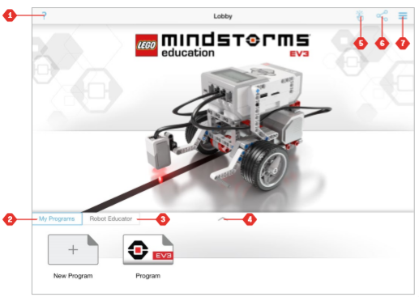
APP: Lobby

Slide 59
APP: Lobby
1. Help – View an overlay showing the key components of the Lobby.
2. My Programs Tab – Create a new program or load previously created programs. Note: Tap the program name to modify it

Slide 60
APP: Lobby
3. Robot Educator Tab – Access six helpful tutorials that guide you through the basics of the EV3, from building simple modules to performing complex tasks using the robot’s various sensors. 4. Expand – Increases the size of the lower pane to view more programs/tutorials at once.

Slide 61
APP: Lobby
5. Select (available from My Programs Tab) – Select programs for deletion or duplication.
6. Share your programs via compatible apps installed on your device, such as email.

Slide 62
APP: Lobby
Note: Select ‘Desktop’ if you want to export your program in a format that is compatible with the EV3 Software on your computer. Chromebooks support an import feature.

Slide 63
App: Programming
Like the EV3 Software, the Programming App features an intuitive graphical interface that users of almost any age can quickly learn.
The Programming Environment consists of the following main areas:

Slide 64
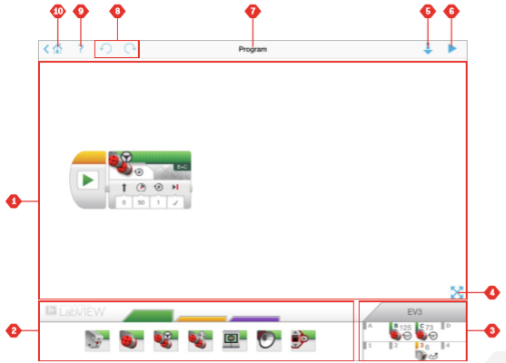
App: programming

Slide 65
APP: Programming Interface
1. Programming Canvas – Create your program here using the various programming blocks.
2. Programming Palettes – Find the building blocks for your program here.

Slide 66
APP: Programming Interface
3. Port View – View the sensors and motors connected to your EV3 Brick. Tap to open the Hardware Page and view more detailed information
The EV3 Brick name is also shown above the Port View

Slide 67
APP: Programming Interface
4. Resize and Centre – Resize the Programming Canvas to show all objects that you have placed on it.
5. Download – Download the active program to your EV3 Brick. Note: This will not be displayed if no EV3 Brick is connected.

Slide 68
APP: Programming Interface
6. Run – Download the active program to the EV3 Brick and run it. Note: The time taken to download a program will depend on the number of images and sounds it includes.
7. Program Name – Identifies the currently open program

Slide 69
APP: Programming Interface
8. Undo/Redo – Undo or redo the previously executed command.
9. Help – View an overlay showing the key components of the Programming Environment.
10. Lobby – Return to the Lobby.

Slide 70
App: programming

Slide 71
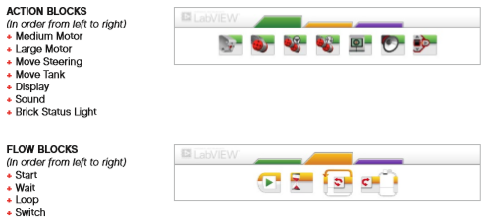
App: programming blocks

Slide 72
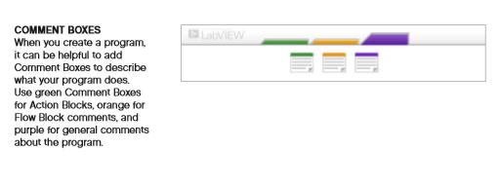
App: programming blocks

