Slide 1
BA in Leadership and Management Skills for the Workplace
Workplace culture and its impact on organisational efficiency
(BMSW 5105)
What is an organisation? Part - II

Slide 2

Previously…..
Got to know each other
Set class rules
Discuss student queries
Overview the module
Define organisations
Explore the organizational environment

Slide 3
In this session…..
We will;
Explore Porter’s 5 forces
Analyse the relationship between the Porter’s 5 forces and the culture of an organisation

Slide 4
Background information
Developed by Michael E. Porter in his book “Competitive Strategy: Techniques for Analyzing Industries and Competitors“ in 1980.
Highly regarded as an important tool in analyzing the industry structure
The model identifies the forces that shape an industry

Slide 5
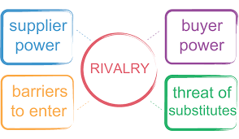
What is Porter’s 5 forces?

Slide 6
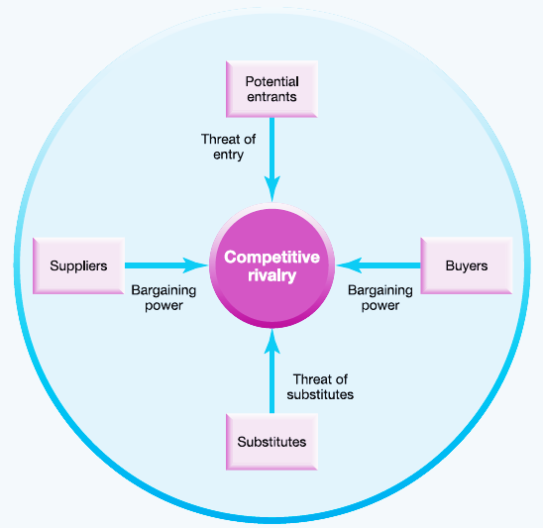

Slide 7
The 5 forces
Bargaining power of Customers
Bargaining power of Suppliers
Rivalry among existing competitors
Threat from substitutes
Threat from new entrants

Slide 8

Entry Barriers/New Entrants
Economies of scale
Proprietary product differences
Brand identity
Switching costs
Capital requirements
Access to distribution
Absolute cost advantages
Proprietary learning curve
Access to necessary inputs
Proprietary low-cost product design
Government policy

Slide 9

Determinants of Supplier Power
Differentiation of inputs
Switching costs of suppliers and firms in the industry
Presence of substitute inputs
Supplier concentration
Importance of volume to supplier
Impact of inputs on cost or differentiation

Slide 10

Determinants of Buyer Power
Buyer volume
Buyer switching costs relative to firm switching costs
Buyer information
Ability to backward integrate
Substitute products
Product differences
Brand identity
Impact on quality / performance
Buyers profits

Slide 11

Rivalry Determinants
Industry growth
Fixed (or storage) costs/value added
Intermittent over capacity
Product differences
Brand identity
Switching costs
Diversity of competitors
Corporate stakes
Exit barriers

Slide 12

Determinants of Substitution Threats
Relative price performance of substitutes
Switching costs
Buyer propensity to substitute

Slide 13
The 5 forces
Lets hear from Professor Porter himself…
https://www.youtube.com/watch?v=mYF2_FBCvXw

Slide 14
Group activity 1
Complete the activity as per the instructions of your Lecturer.
Notes:
Instructions to Lecturers:
Divide the class in to maximum of 5 groups
Hand each group a pack of cards
Instruct the groups to sort the cards according to the 5 forces. Note that some cards may have more than one which means it could be part of more than one source
Once the activity is finished display the suggested answers
Explain any cards that the students may not be familiar.

Slide 15
Read the report on Moodle on Costa coffee

Slide 16
Classroom debate
Propose:
Porter’s 5 forces does not impact the culture of an organisation
Oppose:
Porter’s 5 forces does impact the culture of an organisation
Notes:
Instructions:
Divide the class in to 2 groups one will be the proposers and the other opposes
Provide 15 minutes for preparation.
Each member of the group will have 1 minute to express their views/findings. (All members have to take part in the debate)
No formal scoring is required, but scores will help to add an element of competitiveness and more engagement.

Slide 17


Summary
Can you explain;
What are the 5 forces?
What are the factors that will influence the 5 forces?
Does the 5 forces affect the culture of an organisation?

Slide 18

Next session
The organisational Structures

