Slide 1

Entrepreneurship
Level 7 Assessment (MBA)
Module Code: LCMB7004

Slide 2
NAME : PATEL NISHWA JATINBHAI
STUDENT ID : 2244538
LECTURER NAME : MASUD IBRAHIM

Slide 3
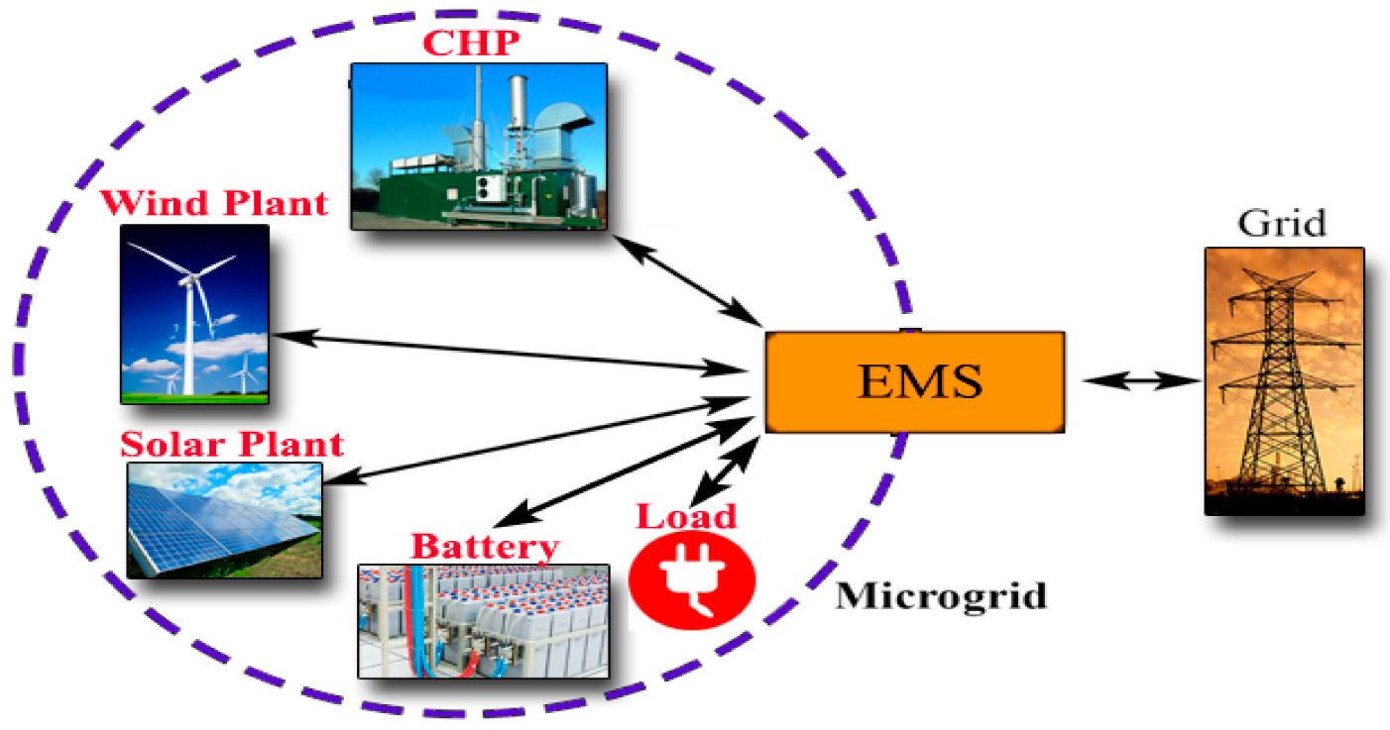
Introduction
Entrepreneurship idea for a renewable business energy (Pagliaro and Meneguzzo, 2020).
Business model on the climate resilient micro grids by being energy efficient
Delivering innovative solutions for enhancing against catastrophic weather
Suggestions for improving the business idea with the identification of investors
Models, theories and concepts for the renewable business idea
(Sources: Ramli, Bouchekara and Alghamdi, 2019).
Notes:
The overall presentation will focus and analyse on the application of a renewable energy business idea to a group of investors. The aim of the presentation will define some important models, concepts and theories for delivering innovations for improving resilience against the catastrophic events of weather hit by the destruction of climate and the related changes. The overall presentation will focus on the budget investment by assuring that the network of energy efficient micro grids will manufacture from both the business for commercial buildings and fighting against the events of catastrophic weather. This will further require lesser investment by typically connecting to the distribution grid of local utility. The group of investors for the business idea can be identified as the Enel Green Power who will be known to purchase the bonds or equities of installing micro grids and climate resilient Lastly, the presentation will discuss the uses of the renewable business with the major energy micro grids such as mini-hydro, solar cell, wind energy, and system of energy storage.

Slide 4
Business Idea of Renewable Energy on Climate-Resilient Energy Efficiency
Idea of converting sunlight into electricity as a radiation and climate resilient-energy energy (Cai et al., 2019)
Strategy of thinking forward for renewable energy sources with innovative solutions
Improving resilience against the catastrophic weather in the atmosphere being hit by destructive impact of climate
Marketing strategies offering subscription focused payment to make energy clean and affordable
Key Partners | Developers of renewable energy projects, installation of micro-grids, manufacturers of components, government agencies and so on
Key Activities | Installing and setting up the renewable energy micro-grids for maintaining electricity during emergencies.
Key Resources | These are known as the eco-friendly materials known as steel, glass, patent codes of software, algorithms and so on
Value Proposition | Maintaining partnerships with regional authorities and personnel of emergency
Customer Relationships | Enthusiasts of technology, seminar, webinars and workshops on community participation and so on.
Channels | Connection to the local utility of the grid distribution, social media and online advertisements and so on.
Customer Segments | Residents of vulnerable climate areas of California, regions prone to disasters involved with hotels, centres of data and so on.
Cost Structure | Investing for enhancing technology, costs of procurement and installation, support of customers and marketing administration.
Revenue Streams | Sale of excess energy, selling electricity to the grid at a fixed price and lease income from financing given to the customers
Notes:
The major business idea is mainly focused on the energy efficient energy micro-grids known to be resilient of climate. It is also referred to as a thinking strategy taken forward for the renewable sources of energy. This business idea will further speed up the recovery by keeping up the powered event of disaster. The gross profit that can be expected from the installation of solar panels with distribution and sales within the commercial buildings are known as approximately 15-20%. The installation of energy efficient micro-grids will help to eliminate the reduction of power expenses as a major source of additional revenue. The major objective of the business idea aims to improve the cost effective growth, quality of power and the potential for reducing the costs of energy for the business idea.

Slide 5
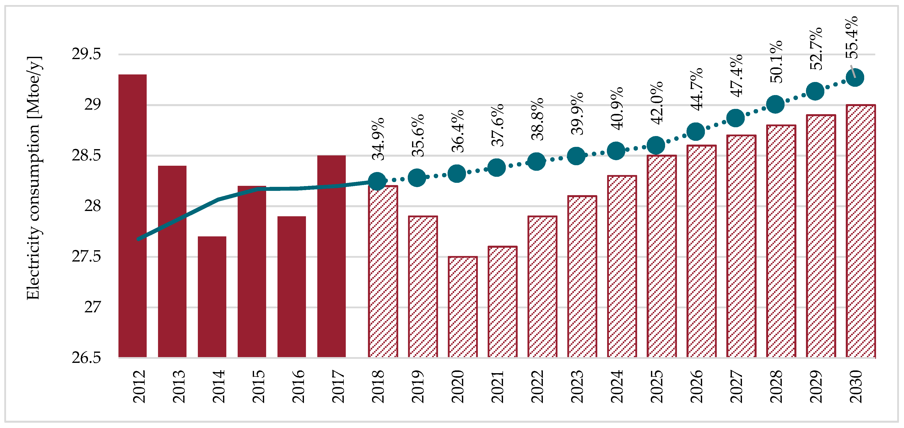
ESAS Model for the Renewable Energy Business
Target of reaching total zero emissions of carbon by 2070 for enough labour
Optimisation of energy yields in the renewable energy sector and meteorological satelllites (Pickl, 2019).
Penetration levels of renewable energy by measuring offshore wind on use of land
(Sources: Mancini and Nastasi, 2020).
Notes:
The ESAS model is used for measuring the offshore wind by using topography of surface and roughness for supplementing the regional wind. The model is also used for the renewable business idea for optimising the yields of energy by guiding wind, solar and levels of wave for the instruments focusing on space for assuring the construction of plants and operating for optimum capacity. This can also provide the maps of global sunshine like the digital elevation with the focus on landscape for selecting site. The European Commission has aimed the renewable energy and Commission of European consisting approximately 22% of the supply of continent’s energy by the end of decade from the baseline of almost 14% in 1997. The investors will be successfully replacing the fossil fuels with the sources of clean energy preventing the environment. The ESAS Model plays a significant role for speeding up the process of environmental assessment important for the plants for planning the construction and sustainable energy for reducing the pollution and minimising the rate of diseases for installing the energy efficient micro-grids. Thus, the overall analysis of the concerned research topic has also turned to be useful for introducing a business plan to prove a healthy process in during the making of decisions.

Slide 6
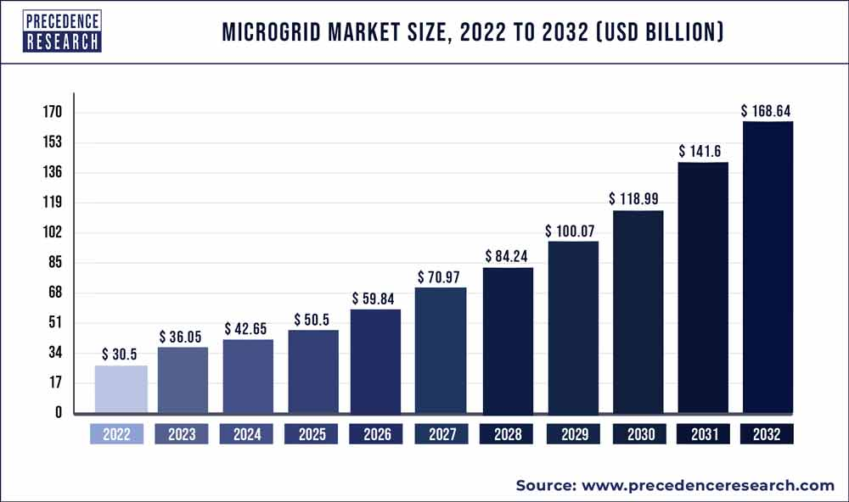
Major Areas (Legal Entity) of the Renewable Business Plan
Reconciliation of sustainable power, upgraded versatility, security and autonomy of energy (McKuin et al., 2021)
Free of utility expenses and reduction of expenses as an import of duty in the energy sector
Clean solar energy with creating no emission of trapping heat and greenhouse gases
Providing backup during outrages of power to function during emergencies for the business
(Sources: Insel, Sadikoglu and Melikoglu, 2022).
Notes:
The major part of renewable business plan can be defined as a reduction of dependency on grid and assure for the uninterrupted supply of power in the commercial buildings. This is also known as the integration of renewable sources of energy with the ability to operate and handling the benefits of connecting grids. The micro-grids can improve the resilience of grid and help to address the disturbances of grid with the ability of operating the operations of grid sources for faster recovery and responses of systems. The legal entity is known for the restriction of responsibilities with an adaptable administration for the structure of management and settling for the corporate and individual levels. This factor is also known as the shaping the LLC of California with the constant and sensible contrast with the other structures of business permitting to zero and more on the centre of the organisation and exercises of business. Lastly, the importance can be defined as a reduction of emissions of greenhouse gases in the commercial buildings such as offices. The sources of energy can be defined as turbines of wind, panels of solar, gen-sets of diesel, banks of battery and modules of CHP.

Slide 7
SWOT Analysis of the Business Idea
Strengths | Keeping the levelised average costs of energy and annual below of power shutoffs for public safety Reduction of greenhouse emissions of gases and conservation of energy to manage demand and supply of power
Weaknesses | Increasing complexity and expenses of operations for the dependency of power system (Torra and Gilmour, 2019). Creating safety and issues of protection in the renewable energy sector
Opportunities | Providing backup of power for shelters of disasters including facilities during outages of related weather Operators of micro-grids can optimise production and consumption of energy
Threats | Energy mostly stored in batteries focusing on the demand of power and community Variation in the fault level with location and condition of micro-grid operations.
Notes:
The SWOT analysis can be used for the improvement of energy efficient and resilient micro-grids of energy mostly results as a lower upfront expenses and immediate savings in the commercial buildings. The SWOT analysis will also result as a minimum maintenance of responsibilities by having limited flexibility. This model is known to be a zero investment where the consumers pays only for the generation of electricity. The importance and benefits can also be identified as gaining an important amount of electrical power by saving and causing less pollution included for the use of power. Mainly, this is produced by the energy efficient micro-grids to control and advance the control systems of energy, storing and applying the smart grids for optimising production of energy, working for consumption and production and so on. This also further operates for the reduction of costs related to energy and improvement of can be defined as a decrease of world’s pollution for the highly choice of sustainability for helping to create a greener source of energy reduced to the systems and processes of solar power instead of the conventional electricity.

Slide 8
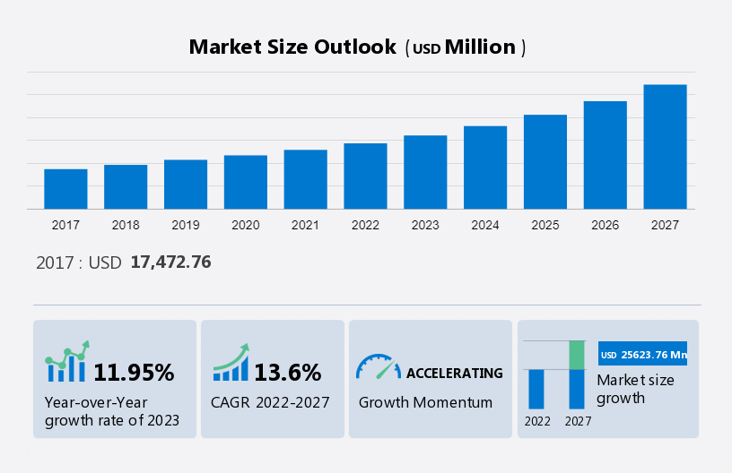
Proposed Location and Gaps of the Renewable Business
Proposed location is the California for the micro-grids of renewable energy (Cuñado, Díez and Román, 2020).
Explicit activities across the locales of seaside and blaze inclined areas of Southern California
Wild fires, hurricanes and increase of storms
Excess tempests with outrageous occasions of climate such as typhoons and out-of-control fires and so on
(Sources: Bankel and Mignon, 2022).
Notes:
The major gaps and proposed location for the idea of renewable energy is known as the increase impact of environmental changes with the extreme climate conditions such as typhoons and out of control tempests. The proposed location is majorly known as the Southern California leaving networks without power for longer periods and compromising lives. The issues can be addressed for compromising lives of people and subverting solidness of monetary situations in the market of United States for Sustainable power of environment and sustainability for becoming obvious. The gaps and proposed locations also includes the US market is known for the ever growth and impact of changes in the international market including the rise of environmental damage such as broadening periods and energy framework resulting as leaving the networks without power and subverting the solidness of monetary aspects. The issues can also be addressed in the entire southern California by offering the strong wellspring of energy during the duration of requiring the most and lessening the discharges of ozone harms. This will further result as an elevation of changes to practical energy lined up with the development of interests in clean power.

Slide 9
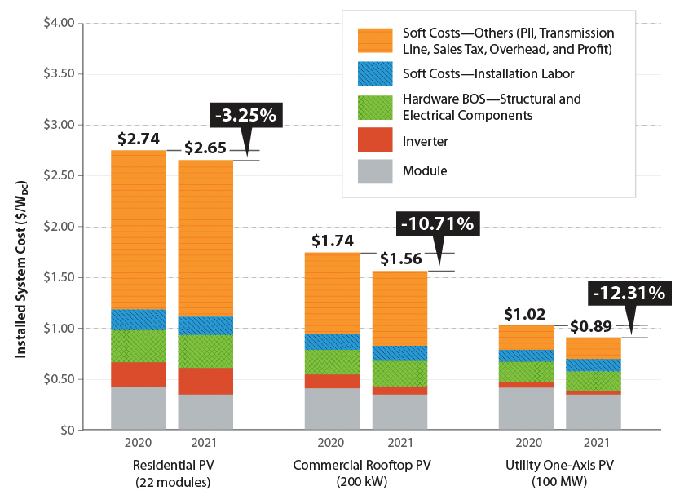
Investors will get Benefitted from the Business Idea
Saving the rates of utility with longer duration and sustainability (Schulte et al., 2022)
Enhancing the security of energy on non-renewable sources of energy
Reduction of carbon footprint and enhancement of image related to the business
Supporting the savings of households and independence of energy in a safer planet
Security and dependency of energy grid to power homes with solar energy.
(Sources: Van Kooten, 2021).
Notes:
The ways by which the investors will get benefitted from the business idea of installing solar panels including sales and distribution can be identified as the solar panels will result as a lower amount of emission of carbon in comparison with the other sources of energy by investing in the solar farm of stocks. The most important way of solar panels or energy can be identified as it will help the investors to save money by consuming a lot of power by getting the power required from solar panels. Here, a photo voltaic array will enable the controlling the energy getting from the grid of power not producing pollutants of air and carbon dioxide. The return of investment also results among 10-20% where most of the solar farms pays off systems within a span of five-ten years having almost 30 years of free electricity with the general estimations.

Slide 10
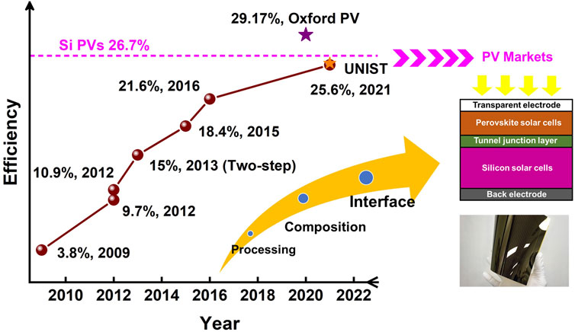
STP Analysis of the Target Market and Strategies
Segmentation | Incorporating networks located in the environment weaker regions in Southern California for instance, the districts of waterfront for the helpless of typhoons and inclined with blaze zones (Song et al., 2022)
Targeting | This targets the modification of micro-grid frameworks for the organisations, basic foundations and neighbourhoods and so on.
Positioning | Positions the supplier of environment tough with sustainable power of micro-grids and stressing by accompanying the wellspring of energy and incited catastrophe
(Sources: Zhang, Li and Chen, 2022).
Notes:
The STP analysis for the renewable business idea can be defined as the segmentation, targeting and positioning factors such as implementing the networks located in weaker environmental regions, local organisations and basic offices of framework. The socioeconomics for the business idea can be defined as the requirement of focusing sources of energy with the exercises of business during the catastrophes and limited monetary aspects. The organisations will help to offer and assemble cycles while underscoring the importance of business coherence and alleviation of hazards identified for the business such as the natural disasters. The organisation factors mostly includes the legislature of joint efforts for neighbourhood and innovation of suppliers confided in the local area of strength endeavours. The arrangements are regarded as accommodating arrangements added to the decrease of fossil fuels by the products

Slide 11
Budget Plan for the Renewable Energy Business Plan
Solar Energy Systems | 2020 | 2021 | 2022 | 2023
Completed Installations | 700 | 1200 | 1200 | 1200
Progress in construction | 1,050,000 | 1,050,000 | 1,050,000 | 1,050,000
Systems of solar energy on lease | 1,860,000 | 4,990,000 | 8,110,000 | 11,240,000
Total assets including cash | $2,900,000 | $5,790,000 | $8,500,000 | $11,020,000
Total Equity and Liabilities | $4,140,000 | $13,730,000 | $23,990,000 | $25,240,000
Notes:
The budget plan for the renewable energy business plan can be identified as it can cost among Rs45,000 to almost Rs70,000 for every 1KW solar system and capacity with the procedure. The project has costed almost a national average of Rs1,89,000 to Rs2,15,000 for the 3kW system of solar panel. Thus, the size and costs of solar panels can be identified as between 6kW, 8kW and 10kW to be approximately $17,100, $22,800 and $28,500 known to be the estimated and average production of annual energy by connecting the solar inverter to the units of consumers. Thus, the promotion strategies and marketing for installing renewable energy micro-grids can be identified as expanding the access, leading the ways and becoming an advocate to partner with the utilities followed by the most effective solar advertising known as pay-per-click due to the effectiveness of costs, results and reach.

Slide 12
4Ps of the Business Idea in Industries
Product | Micro-grid frameworks for the objective frameworks Incorporating sunlight focused, wind power and savvy innovation (Song et al., 2022)
Price | Private arrangements for viewing versatility and requests of energy Monetary incorporations for offering choices of funding and low interest credits
Place | Workers of projects and inclined districts in California extended with geographic availability with regions across the US
Promotion | Distribution of sites, articles and micro-grids, industry meetings and so on Marketing of the objective through the web and cooperation of displays for fabricating objectives.
Notes:
The different uses of the renewable business idea of using renewable energy micro-grids including distribution and sales are known as enhancement of recovering oil, desalination of water, processing of food and so on. The other major uses are known as a reduction of grid dependence by assuring an uninterrupted supply of power by providing backup of power. This is also known as the renewable businesses will operate without an interruption of supplying power. It also results as a lower bill of electricity and higher values of homes with important installation and expenses of maintenance with the magnitude of gains. The industrial and domestic uses of solar panels installation can be defined as generating electricity for installing an array of solar panels from the station of solar power. Desalination of water and improvement of recovering oil (Lan, 2023). It is considered to be the best for industrial use. Reduction on dependency on grid and uninterrupted supply of power in industries. Also, this works for the improvement of security against the increases of power expenses with a life span of almost 25-30 years. Lastly, it helps to process of minerals and food including chemical production in the sector.

Slide 13
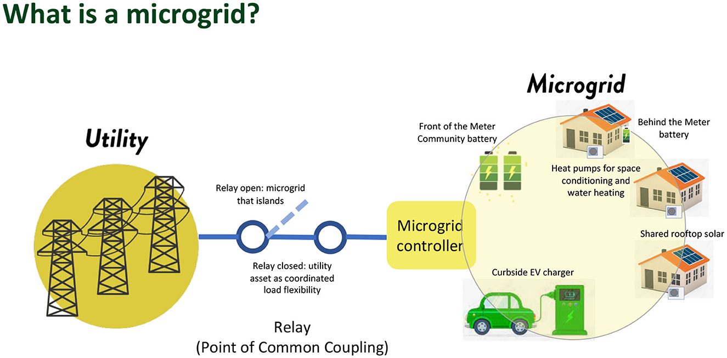
Recommendations
Selling and knowing solar products by researching the market
Eliminating the shade of solar panels to operate best in direct sunlight
Growing up a network of solar panel distributors including sales (Puranen, Kosonen and Ahola, 2021).
Important to coordinate strategies of handling on-ground sales and schedules
Availing for a storage system of backup energy by solar installer
(Sources: Hindarto, Indrajit and Dazki, 2021).
Notes:
The important ways to enhance the renewable energy business idea o can be identified as always availing for a backup energy in the storage system for enhancing the use of renewable energy and offering up a source of backup power including distribution and sales. It is also important to work on coordinating strategies for handling on-ground schedules and sales for the solar panel installation as it helps to make replacing or repairing the solar panels in a simple way. The suggested strategies will also help the business idea to have an access to the system on ground resulting as a reduction of time required for solar technicians. It is also important to research on the solar energy as it creates no emission of carbon or other trapping of heat for the greenhouse gases by ignoring environmental damage related with drilling or mining for fossil fuels for the business idea.

Slide 14
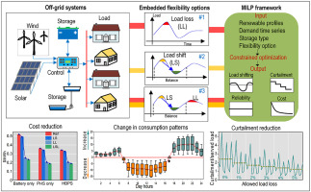
Conclusion
Entrepreneurial opportunities of renewable idea of business in the global market
Major investors financing for the renewable business idea in the market
Selling of solar products and distribution and marketing of products
Saving money are known as manufacturing plants
(Sources: Van Opstal and Smeets, 2023).
Notes:
The important facts that can be concluded from the entire presentation has been summarised as an overall focus on observing major concepts, theories and definitions of renewable business energy idea to the group of investors. It has been summarised from the overall presentation that there has been selling of solar distribution and marketing of products by consuming lots of power. There has been a detailed analysis on the investors for the renewable business idea known as the partners of energy capital by making the components and equipment required to create power for the renewable energy market. It has been decided that the selling and manufacturing of solar products has been recognised as solar gadgets, home lighting and so on for the solid idea of business plan and strategies of marketing. The budget investments for the installation of solar panel business has been defined as up to a mark of approximately 10-15% in distributorship.

Slide 15
References List
Aggarwal, R.K., (2023). Installation and Performance Evaluation of On-grid 640 kWp Capacity Rooftop Solar Power Plant at the University Campus–a case study. https://www.researchsquare.com/article/rs-3274240/latest.pdf
Bankel, A. and Mignon, I., (2022). Solar business models from a firm perspective–an empirical study of the Swedish market. Energy Policy, 166, p.113013. https://www.sciencedirect.com/science/article/pii/S0301421522002385
Cai, X., Xie, M., Zhang, H., Xu, Z. and Cheng, F., (2019). Business models of distributed solar photovoltaic power of China: The business model canvas perspective. Sustainability, 11(16), p.4322. https://www.mdpi.com/2071-1050/11/16/4322/pdf
Cuñado, J.H., Díez, J.C. and Román, J.A.E., (2020). Engie: business model transformation. UNIE Business Research, 9(2), pp.152-167. https://www.researchgate.net/profile/Jorge-Hernando-Cunado/publication/347699011_Engie_Business_Model_Transformation/links/5fe33cf092851c13feb1f8ab/Engie-Business-Model-Transformation.pdf
Hindarto, D., Indrajit, R.E. and Dazki, E., (2021). Sustainability of Implementing Enterprise Architecture in the Solar Power Generation Manufacturing Industry. Sinkron: jurnal dan penelitian teknik informatika, 6(1), pp.13-24. http://jurnal.polgan.ac.id/index.php/sinkron/article/download/11115/610
Insel, M.A., Sadikoglu, H. and Melikoglu, M., (2022). Assessment and determination of 2030 onshore wind and solar PV energy targets of Türkiye considering several investment and cost scenarios. Results in Engineering, 16, p.100733. https://www.sciencedirect.com/science/article/pii/S2590123022004030
Kasaeian, A., Bellos, E., Shamaeizadeh, A. and Tzivanidis, C., (2020). Solar-driven polygeneration systems: Recent progress and outlook. Applied Energy, 264, p.114764. https://www.researchgate.net/profile/Evangelos-Bellos-2/publication/339773498_Solar-driven_polygeneration_systems_Recent_progress_and_outlook/links/5e66650e4585153fb3cea020/Solar-driven-polygeneration-systems-Recent-progress-and-outlook.pdf
Lan, T.T.N., (2023). Market development strategy of renewable energy industry in Vietnam. International journal of business and globalisation. https://www.researchgate.net/profile/Nguyen-Tien-32/publication/368987885_Market_development_strategy_of_renewable_energy_industry_in_Vietnam/links/64030d9bb1704f343f9f2c28/Market-development-strategy-of-renewable-energy-industry-in-Vietnam.pdf
Mancini, F. and Nastasi, B., (2020). Solar energy data analytics: PV deployment and land use. Energies, 13(2), p.417. https://www.mdpi.com/1996-1073/13/2/417/pdf
McKuin, B., Zumkehr, A., Ta, J., Bales, R., Viers, J.H., Pathak, T. and Campbell, J.E., (2021). Energy and water co-benefits from covering canals with solar panels. Nature Sustainability, 4(7), pp.609-617. https://escholarship.org/content/qt8cj5j07p/qt8cj5j07p.pdf
Pagliaro, M. and Meneguzzo, F., (2020). Distributed generation from renewable energy sources: ending energy poverty across the world. Energy Technology, 8(7), p.2000126. https://www.preprints.org/manuscript/202002.0054/download/final_file
Pickl, M.J., (2019). The renewable energy strategies of oil majors–From oil to energy?. Energy Strategy Reviews, 26, p.100370. https://www.sciencedirect.com/science/article/pii/S2211467X19300574
Puranen, P., Kosonen, A. and Ahola, J., (2021). Techno-economic viability of energy storage concepts combined with a residential solar photovoltaic system: A case study from Finland. Applied energy, 298, p.117199. https://www.sciencedirect.com/science/article/pii/S0306261921006231
Ramli, M.A., Bouchekara, H.R.E.H. and Alghamdi, A.S., (2019). Efficient energy management in a microgrid with intermittent renewable energy and storage sources. Sustainability, 11(14), p.3839. https://www.mdpi.com/2071-1050/11/14/3839/pdf
Schulte, E., Scheller, F., Sloot, D. and Bruckner, T., (2022). A meta-analysis of residential PV adoption: The important role of perceived benefits, intentions and antecedents in solar energy acceptance. Energy Research & Social Science, 84, p.102339. https://arxiv.org/pdf/2112.12464
Sharma, A., Pandey, S. and Kolhe, M., (2019). Global review of policies & guidelines for recycling of solar PV modules. Int. J. Smart Grid Clean Energy, 8(5), pp.597-610. https://www.researchgate.net/profile/Arvind-Sharma-48/publication/342714127_Global_review_of_policies_guidelines_for_recycling_of_solar_PV_modules/links/5fc16d86a6fdcc6cc6766489/Global-review-of-policies-guidelines-for-recycling-of-solar-PV-modules.pdf
Song, Z., Li, C., Chen, L. and Yan, Y., (2022). Perovskite solar cells go bifacial—mutual benefits for efficiency and durability. Advanced Materials, 34(4), p.2106805. https://www.osti.gov/pages/servlets/purl/1898048
Torra, M. and Gilmour, J., (2019). Sustainable Decentralised Renewable Energy through the RESCO Model in Indonesia. HIVOS SEA. https://www.academia.edu/download/61575760/Report_Sustainable-Decentralised-Renewable-Energy-through-the-RESCO-Model-in-Indonesia_final20191221-128625-10qfjw3.pdf
Van Kooten, G.C., (2021). Energy Economics and the Potential for Net Zero. REPA Resource Economics & Policy Analysis Research Group, Department of Economics, University of Victoria. http://web.uvic.ca/~repa/publications/REPA%20working%20papers/WorkingPaper2021-02.pdf
Van Opstal, W. and Smeets, A., (2023). Circular economy strategies as enablers for solar PV adoption in organizational market segments. Sustainable Production and Consumption, 35, pp.40-54. https://www.sciencedirect.com/science/article/pii/S2352550922002871
Zhang, P., Li, M. and Chen, W.C., (2022). A perspective on perovskite solar cells: emergence, progress, and commercialization. Frontiers in Chemistry, 10, p.802890. https://www.frontiersin.org/articles/10.3389/fchem.2022.802890/full

Slide 16


