Slide 1
BMSK6002
Developing Innovation and Creativity for Business Advantage
Virtual Conference Session Four

Slide 2
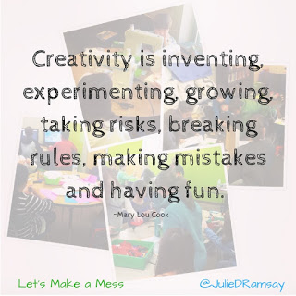
Agenda
Creativity & its role in innovation
Individuals as innovators
Creativity and risk taking

Slide 3
Creativity & its Role in Innovation
Perhaps there is a clue to this in Mary Lou Cook’s quote on the previous slide – “Creativity is inventing, experimenting, growing, taking risks, breaking rules, making mistakes, and having fun”
So, if ‘innovation is successful exploitation of new ideas’, then creativity can be seen as the provider of those ‘new ideas’...the fuel for the innovation engine.
Perhaps, also, innovation provides the structural rigour and process discipline to exploit the best ideas? Turning quantity into quality?

Slide 4
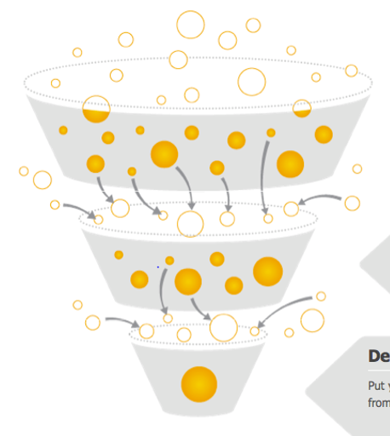
Creativity & its Role in Innovation
Quantity of ideas
Quantity of ideas
…feeds
the
Innovation
process
Quality of ideas….

Slide 5
Creativity & its Role in Innovation
Creativity also plays a significant part in helping to refine those ideas that are to be implemented, by providing the energy and insights to modify, refine, adapt, synthesise, flex, in order to ensure that value is derived from the innovation process.
In other words, creativity doesn’t stop with the idea generation, it is utilised throughout the innovation process.

Slide 6

Important! The Ideas That Are Rejected…
Why might they be rejected?
      Cost
      Practicality/ies
      Ethical/Moral/Legal
      Values/Beliefs
      Technology
      Resources
      Logistics, etc.
What to do with them?
      Knowledge Assets – manage them, review them, rework, refine, store, protect?
      Idea Bank
      Review your assets regularly

Slide 7

Feedback to Originators
Why bother doing this? Why feedback to the originators of ideas?
And…
What should you say?
Discussion

Slide 8

Feedback to Originators
Why?
To minimise negative emotions – resentment, anger, envy, disappointment,
Reasons for not adopting them – clear rationale…it’s a learning opportunity…not irrational dismissal!
Idea has not gone away...it’s in the bank.
Recognition….of effort, engagement, intent, positives
Encouragement to revisit, review, refine, resubmit
Encouragement to keep the ideas coming!

Slide 9
Creativity & Innovation
Innovation = Creativity x Risk Taking
If we think of innovation as the act of introducing something new, then the something new has its origins in creativity.
‘Foster and Kaplan (2001) say, “The underlying element in all innovation is creativity. Only by understanding creativity can one grapple with what is needed for sustained performance”.’
(Byrd, J. & Lockwood Brown, Paul, 2003. p.12)
Notes:
So, once again, we see how the concepts of creativity and innovation are inextricably linked.

Slide 10
Risk Taking and Innovation
The 2nd component of innovation is risk taking (not recklessness)
‘Taking risks is the only way that creative ideas become a reality.’ Q. Why is this true?
‘Risk taking is a deliberately willed activity that creates and accelerates change’ (another key concept)
‘Risk taking means that a person is willing to push his or her ideas forward at some potential risk to his or her own security, career, reputation, or self-esteem’
                (Byrd, J. & Lockwood Brown, Paul, 2003. p.17)

Slide 11
Risk taking – summed up
‘Risk taking is the ability to drive new ideas forward in the face of adversity’
(Byrd, J. & Lockwood Brown, Paul, 2003. p.17)
This adversity need not be dramatic or life-threatening, it can be as simple as snide comments from others, jealousy, dismissiveness, or other emotional responses, but it could be more elevated

Slide 12
Risk taking – an important caveat
‘…taking risks just to take risks is pointless. You must be able to see a positive payoff in taking the risks. People who take risks just for the sake of taking risks are addicted to the thrill, not to the appropriateness of the risk given the situation and the potential loss and gains.’
              (Byrd, J. & Lockwood Brown, Paul, 2003. p.17)

Slide 13


Question:
Is innovation solely the domain of ‘Project Teams’ and ‘Executive Teams’?
Discussion

Slide 14

Innovation and the Individual
“Innovation will come from everywhere and everyone, and when we are successful, every job at Whirlpool will change”.
This is a quote from Dave Whitwam, CEO of Whirlpool Corporation in Tennant Snyder, N. & Duarte, D.L. (2008) Unleashing innovation: How Whirlpool transformed an industry. San Francisco, CA; Jossey-Bass
Discuss: What are the implications of this statement?

Slide 15
Innovation and the Individual
Innovation can be seen in lots of places, and on lots of scales, every day – large and small innovation.
Innovation does not have to be dramatic or large scale in nature
It can be at the level of an individual, team, dept., division, site, or multi-national……….preferably ALL of these
‘Innovation keeps companies alive through continuous renewal and growth. Without innovative ideas, a company stagnates and may even cease as a going concern. Thus, innovation becomes a must, rather than an option.’
        Byrd, J. & Lockwood Brown, P. (2003) The innovation equation. San Francisco, CA; Jossey-Bass/Pfeiffer

Slide 16

Some thoughts on Creativity & Innovation
Inner Obstacles:
The most significant obstacles are internal
Doubts about what’s possible, fear of failure, hopelessness, and other blocking thought processes are often linked to the creative process
These thought processes are powerful enough to prevent us from creating the results we want
Empowerment and leadership:
Leadership means keeping our focus on what we want, even when we don’t ‘know how’…….and what we are doing is not working!
Empowerment means continuing to act on our vision in the face of system resistance and our own doubts and fears
The Process of creating:
We never know whether what we want to do is possible
We don’t ‘know how’ until we are finished!
Having a vision means seeing the result clearly enough to know whether we have created it. It does not mean seeing the final solution, structure, processes, procedures, etc.
Experimenting is central to the creative process – so we need a tolerance for failure
Breakthroughs often come through intuitive insight – perhaps more often than through hard work

Slide 17
“Imagination is more important than knowledge.”
– Albert Einstein
“After years of telling corporate citizens to ‘trust the system,’ many companies must relearn instead to trust their people – and encourage their people to use neglected creative capacities in order to tap the most potent economic stimulus of all: idea power.”
– Rosabeth Moss Kanter
“If you can dream it, you can do it.”
– Walt Disney
"The horse is here to stay, but the automobile is only a fad"
President of the Michigan Savings bank
(When advising Henry Fords lawyer not to invest in the Ford motor company)

Slide 18

Summary
Take 5 minutes to reflect upon the session – what have you learnt?
Which areas will you want to research further?
What can help you with your assignment?
What can help you in your career?

Slide 19

Tea/Coffee Break
15 mins

Slide 20
Book References
Byrd, J. & Lockwood Brown, P. (2003) The innovation equation. San Francisco, CA; Jossey-Bass/Pfeiffer
Dawson, P. and Andriopoulos, C. (2014). Managing change, creativity and innovation. Thousand Oaks: SAGE Publications.
Tennant Snyder, N. & Duarte, D.L. (2008) Unleashing innovation: How Whirlpool transformed an industry. San Francisco, CA; Jossey-Bass

