Slide 1
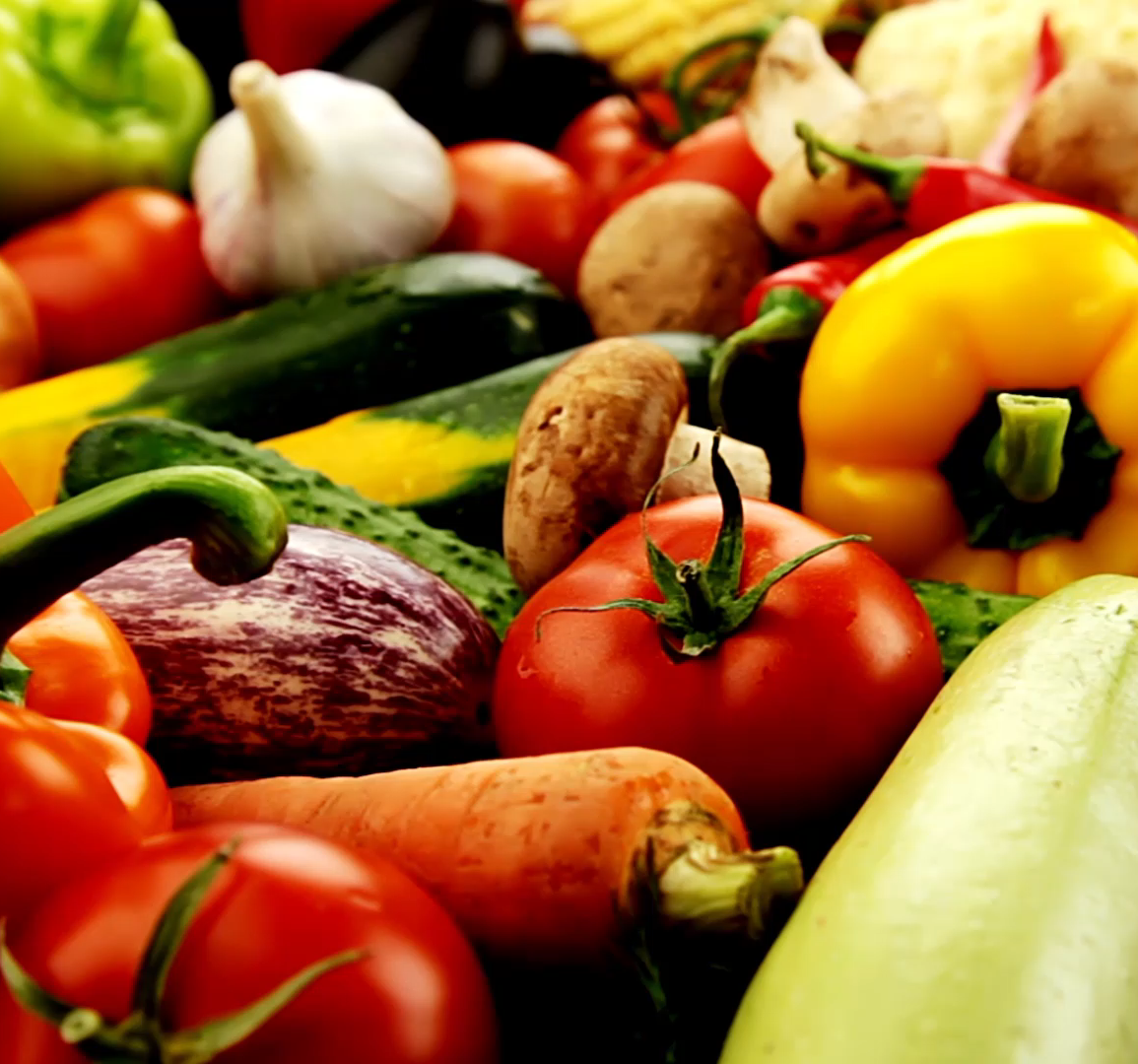
Food Preparation and Hygiene

Slide 2
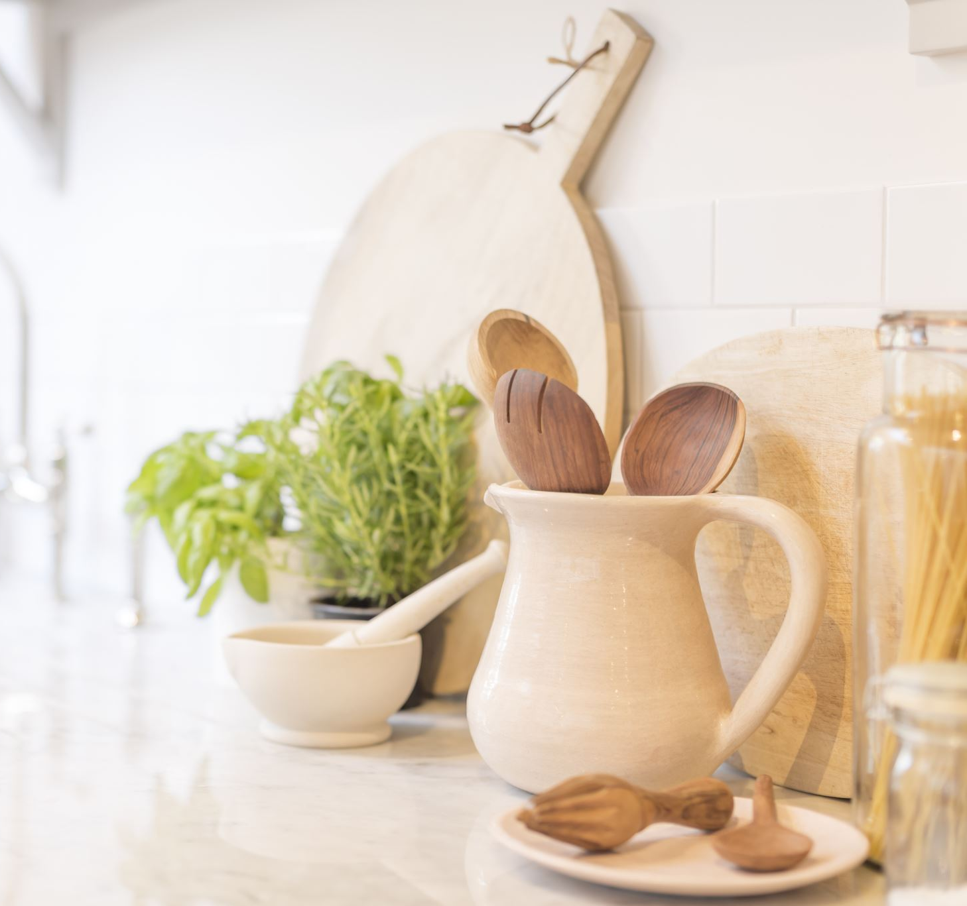
Food Preparation
We all need to eat but some lack the basic cooking skills
If you don’t then you really need to learn
What are your thoughts?

Slide 3
Food Preparation
Many of you clients may not be able to cook and this may hinder their attempts to improve diet.
It is often worth speaking to local Dietitians/Nutritionists and libraries to find out where local cooking clubs are.
An important point – if you are offering any cooking or food demonstrations you will need to obtain a food hygiene certificate

Slide 4
Food Hygiene
An important concern as we still have episodes of food poisoning – particularly from raw meat.

Slide 5
One of the most important things you can do is to make sure that your hands are clean at all times – although it sounds simple enough, many of us are guilty of forgetting at some point.
Cleaning your hands doesn’t mean just passing your hands under the tap – give them a proper scrub with soap. In particular, remember to wash your hands:
after using the toilet
before you handle any food
after you handle raw meat

Slide 6
Basic Guide to Cleaning
If possible, remove any rings, watches and bracelets before you handle food. This is because bacteria can hide under these and transfer to your food.
Before you start to prepare any food, make sure that the area you’re working in and the utensils you’re using are clean. Clean worktops thoroughly and wash utensils with washing-up liquid and hot water, or use a dishwasher if you have one. Make sure you clean up any spilt food straight away.
Change all tea towels, dishcloths and other cleaning materials regularly as these can harbour bacteria, especially if they are damp.

Slide 7
Food Hygiene
Use separate chopping boards for different food
Always check labels for guidance on where to store food.
Make sure you keep your fridge between 0 and 5°C and your freezer at less than -18°C – this will prevent bacteria from multiplying. You can use a thermometer to regularly check these temperatures, or your fridge or freezer may have a thermometer built in.
Store fresh and frozen food in the fridge or freezer as soon as possible after you buy it. This is especially important in hot weather.
Keep raw meat and seafood separate from other foods.
Store raw meat in an airtight container at the bottom of the fridge to prevent juices or blood dripping onto other food.

Slide 8
Food Hygiene
Defrost frozen foods in the fridge. Place them on a plate or in a container as they defrost, so they don't drip onto or contaminate other foods.
1
Don't store opened tins of food in the fridge – transfer the contents to a suitable airtight container instead.
2
If you’re keeping cooked leftovers, allow them to cool to room temperature before you store them in the fridge. Make sure you use up any leftovers within two days.
3
Throw away any food that has passed its use-by date.
4

Slide 9
Food Hygiene
Don’t wash raw meat especially chicken as you may spray the bacteria over the kitchen
01
Keep raw meat and seafood separate from other foods.
02
Store raw meat in an airtight container at the bottom of the fridge to prevent juices or blood dripping onto other food.
03
Defrost frozen foods in the fridge. Place them on a plate or in a container as they defrost, so they don't drip onto or contaminate other foods.
04

Slide 10
https://www.youtube.com/watch?v=eqoPPN63ZpY
This short video highlight what to do in the kitchen

Slide 11
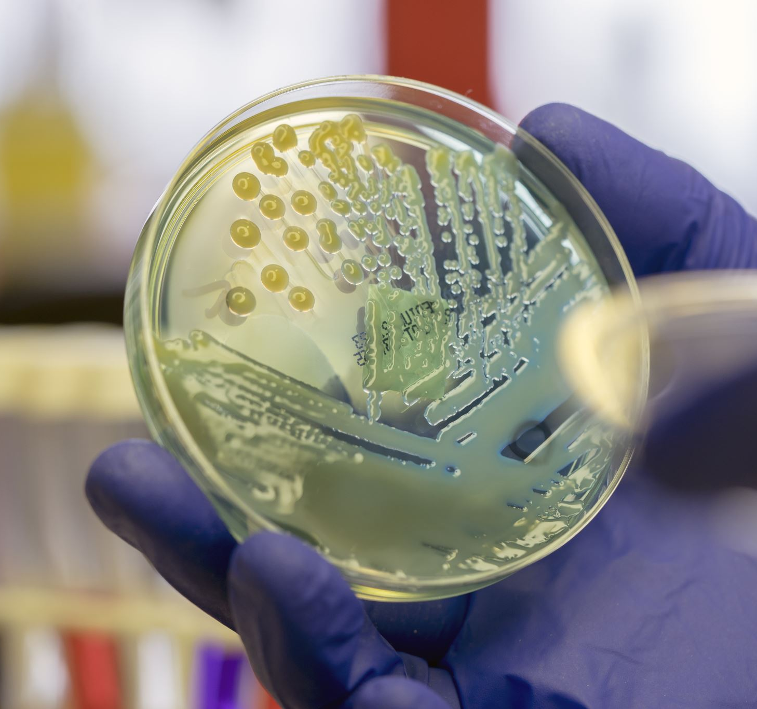
Food Hygiene Certificate
You must have an up to date certificate for the SENr
Look at the link on Moodle for an online course

Slide 12
Cooking Workshops
Task
Lets discuss this?

Slide 13
Cooking workshops
Who is it for ?
Where?
Risk assessment?
What will you cook?
Providing food – transport, cross contamination
Demonstration
Athletes cooking

Slide 14
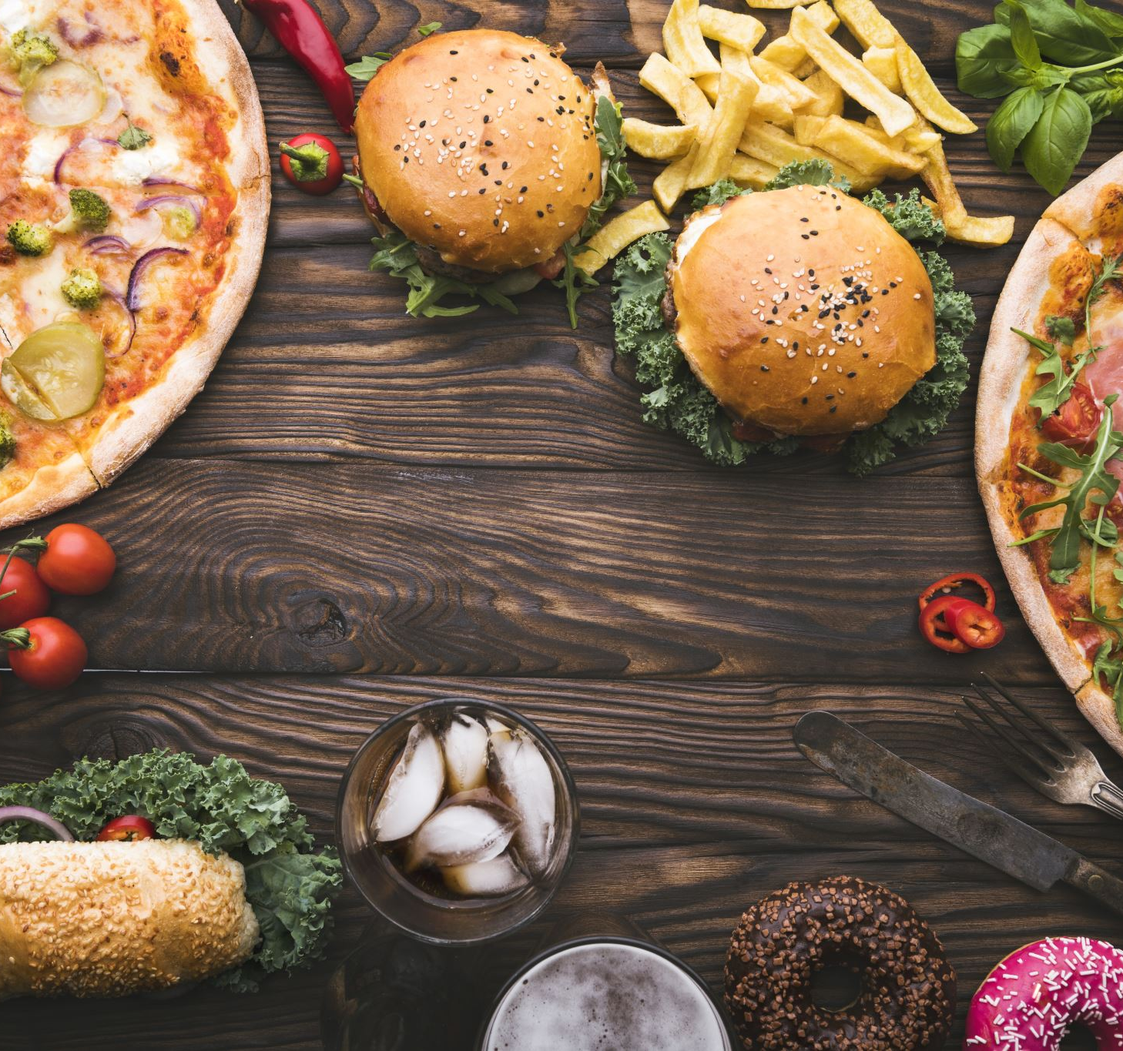
Planning for Athlete Groups
Nutritionists are often required to plan and supervise menus for groups at camps and hotels
You will need to liaise with the catering manager – look at menus
Buffet or set meals
Does it meet requirements – what type of food
Variety of food
Does it cater for allergies or food preferences

Slide 15
Planning
Cost – there may be an allocated amount
Timing of meals – at major sports events probably not a factor
Seasonal variation
Do you provide nutrition information for each meal – this happens in a food hall like the Olympics
Food safety

Slide 16
Athlete's self catering
You may travel with them – who is going to do the cooking?
Shopping?
You can use this as education?

Slide 17
Catering Staff
They may never have worked with athletes
You may need to do some training with them

Slide 18
Recipes
You now need to build a recipe file
Analyse each recipe so that you use the nutrition information to inform athletes or caterers

Slide 19
Resources
Think about what you need to work with an athlete
What would you give them ?
Class debate

