Slide 1

Assessment for Learning
‘Learning to learn’
Google image (2018)
Welsh Government (2013, p.6).

Slide 2
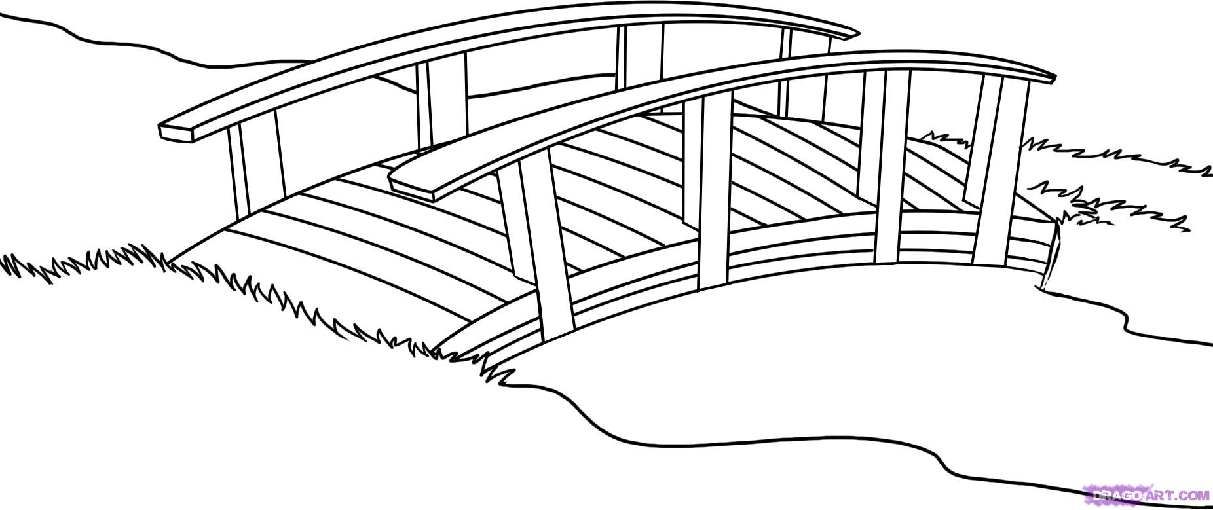

2. This is where we are going.
3. This is how we will get there
AfL- ZPD - Vygotsky
Scaffolding - Bruner
1. Here we are!
Black et al (2004) Google images (2018) Pound (2005) Pritchard (2014, p.26-28)

Slide 3
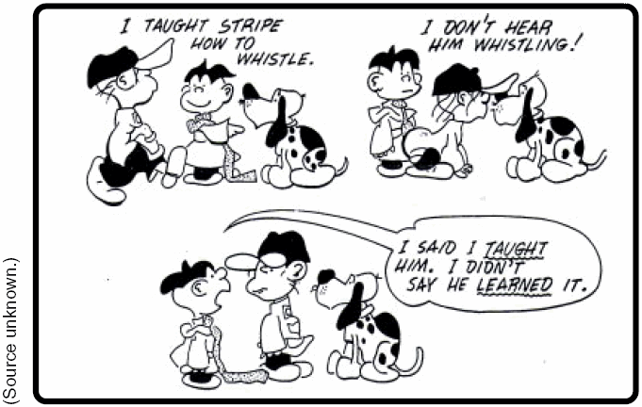
Google images (2018) The Classroom Experiment (2012, 1, 2) Wiliam (2011) Wiliam (2017)

Slide 4
5 Key strategies to formative assessment
Teachers need to;
Discuss learning objectives-relevance and direction of a given task
Take time to discover what pupils already know
Provide feedback so learning can move forward
Encourage Peer learning
Give pupil’s control over learning
Black et al (2004) Davie (2017) Google image (2018) Pritchard (2014) Wiliam (2011, p.2) Wiliam (2017)

Slide 5
Formative Assessment During Informs future learning (AfL)
Summative Assessment After Sums up learning (AoL)
Summative Assessment
Feedback
Improve learning
Black et al (2004) Welsh Assembly Government (2010) Welsh Government (2013) Wiliam (2011)

Slide 6
National Literacy and Numeracy Framework (LNF) (ages 5-14)
Literacy
Reading
Writing
Oracy
Numeracy
Number
Measuring
Data skills
Numerical reasoning
Welsh Government (2013, p. 8 )
AfL – pupils learn best when they can fully comprehend:
The aim of a task/ activity
Where they are in relation to aim
How the aim can be achieved
Claxton and Lucas (2015) Welsh Government (2011) Welsh Government (2014)

Slide 7

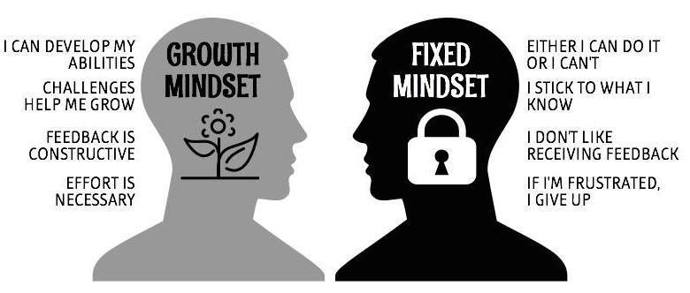


Reasons pupils disengage
Don’t understand
Afraid to ask
Afraid to try
Intrinsic motivation
Ability is not fixed
Extrinsic motivation
Black et al (2004) Claxton and Lucas (2015) Dweck (2012) Gardner (2006) Google images (2018) The Classroom Experiment (2012, 1, 2) Wiliam (2011) Wiliam (2017)

Slide 8
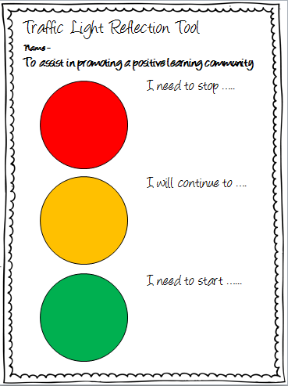
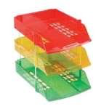
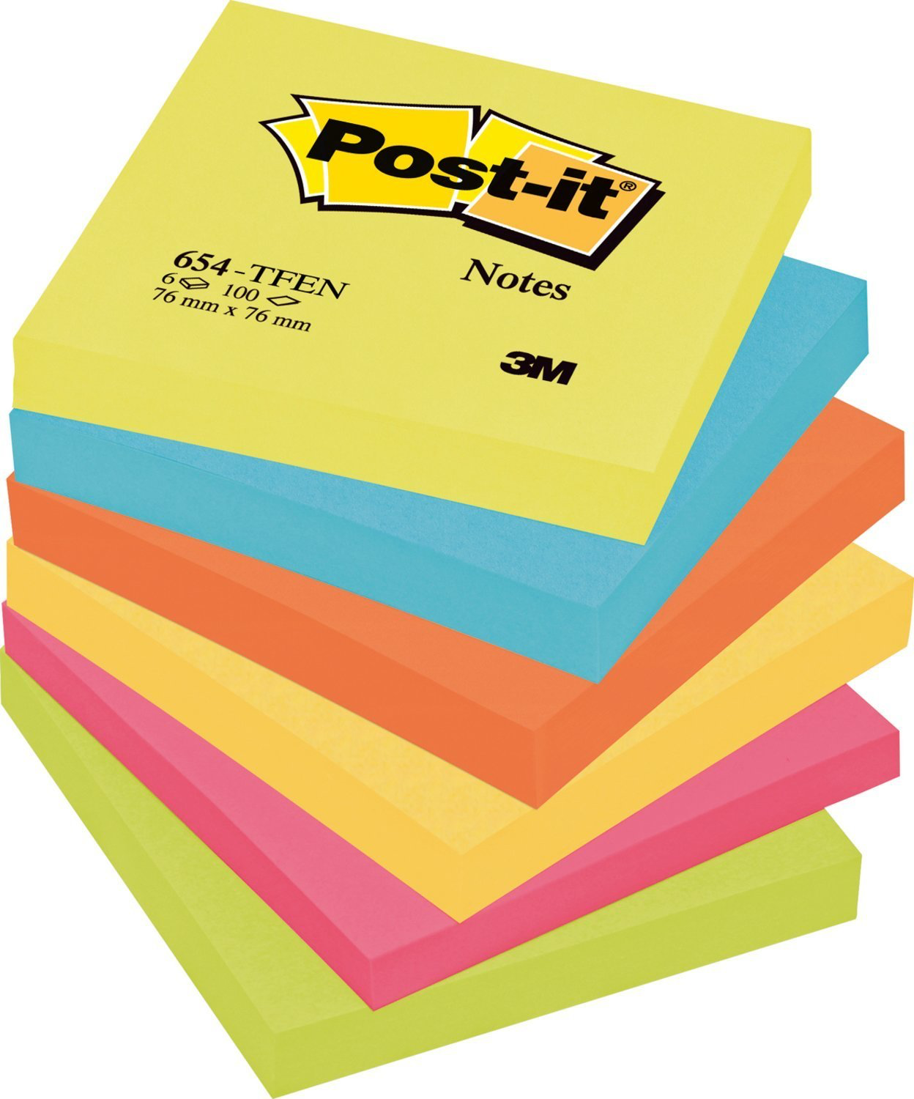

AfL strategies
2.
Learning Wall/ self assessment/
feedback
Stop midway
Throughout on going topic work
Traffic lights/ understanding/
self/peer assess
Learning Objective
Returning to previous topic
Stop midway
End of session
Homework
3. Lollipop sticks/effective questioning/
discussion/ group work/ feedback
Bing image (2018) Black et al (2004) Google images (2018) The classroom experiment (2012, 1, 2)Welsh Assembly Government (2010) Wiliam (2011)

Slide 9
Advantages of strategies
Traffic lights/ learning wall/ questioning
Whole school approach/ consistency/progression
Supports/ compliments LNF
Clear understanding of LO/ success criteria/ moves learning forward
Pupils can self assess/ peer assess/ reflect/ feedback/ improve learning
Pupils develop growth mindset/ resilience/ metacognition
Pupils empowered/ motivated to learn/ engaged
Can be adapted to different year groups
Transferable independent/ collaborative tasks
Inclusive of ability ALN/ MAT

Slide 10
Further advantages…
Informs Planning/ shapes teaching
Teachers know pupils level/ scaffold
Can identify pupils who do not understand, quickly
Feedback to pupils/ parents evenings/ teachers/ school/ governors
Consider pedagogy/ learning styles
Cost effective/ durable
Develop reflective practise throughout the school
Network with other schools/ share best practise
Links to school development plan
Black et al (2004) Gardner (2006) Classroom Experiment (2012, 1, 2) Welsh Government (2013)
Drawbacks for teachers
Time
Fear of change

Slide 11
Conclusion
To conclude this presentation I would like you all to seriously consider the whole school AfL strategies I have recommended for our pupils, I believe they would truly enhance learning and teaching. Teaching and learning is not always, easy I think we would all agree with that. Not every child will enjoy school, but we know that, but where this is the case we don’t want the reason behind it to be a lack of understanding. To progress, pupils first need to understand what is being asked of them. Something that is easily remedied with AfL. We need to implement transferable, inclusive, cost effective, simple yet important whole school strategies, as already outlined that support teachers and help motivate, empower, and engage all pupils. Lets not let our pupils become another statistic.

Slide 12
Thank you for listening
Any questions?

Slide 13
Reference List
Bing images. Lollipop sticks. (2018) https://www.bing.com/images/search?view=detailV2&ccid=K0eM4PKr&id=228A2BFEA51F3B8CC724136F1D54E11305506B7D&thid=OIP.k0eM4PKUu_SgXszndRWggHaHZ&mediaurl=http%3a%2f%2f4.bp.blogspot.com%2f-r5vjokw0Zw8%2fVIBAoze0_iI%2fAAAAAAAAAJw%2fxMZ_X-A66tw%2fs1600%2f77629178.jpg&exph=599&expw=600&q=lollipop+sticks+with+names&simid=608026887106134924&selectedIndex=5&ajaxhist=0
(Accessed: 13 February 2018).
Black, P., Harrison, C., Lee, C., Marshall, B. and Wiliam, D. (2004) ‘Working Inside the Black Box’,86 (1), (1, September), pp.8-21. [Online]. Available at:http://journals.sagepub.com.ezproxy.uwtsd.ac.uk/doi/abs/10.1177/0031721704086001053#articleCitationDownloadContainer (Accessed: 11 February 2018).
Claxton, G and Lucas, B. (2015) Educating Ruby. Wales: Crown House Publishing.
Davie, E. (2017) How To Be An Outstanding Primary Teaching Assistant. Great Britain: BLOOMSBURY EDUCATION.
Dweck, S, C. (2012) Mindset. London: Robinson.
Dylan Wiliam: Embedding Formative Assessment SSAT/EEF celebration event keynote
(2017) https://www.youtube.com/watch?v=zwGaG1b_T2w (Accessed: 7 February 2018).
Gardner, J. (ed) (2006) Assessment and Learning. London: SAGE Publications Ltd.
Google image. (2018) Assessment for learning in the classroom. https://www.google.co.uk/url?sa=i&rct=j&q=&esrc=s&source=images&cd=&ved=2ahUKEwjkvZjqiabZAVIKsAKHaZTC20QjRx6BAgAeAY&url=https%3A%2F%2Fedtech4beginners.com%2F2016%2F06%2F19%2Fassessment-for-learning-helpsheet%2F&psig=AOvVaw00Bjfc09Uiechlv9DpFAy0&ust=1518720750174118 (Accessed: 11 February 2018).
Google image (2018) Assessment more than just a grade.https://www.google.co.uk/url?sa=i&rct=j&q=&esrc=s&source=images&cd=&cad=rja&uact=8&ved=2ahUKEwjO9YiM_YvZAhUIK8AKHSqfDXEQjRx6BAgAEAY&url=https%3A%2F%2Fmoniquebowes.wordpress.com%2F2014%2F09%2F21%2F454%2F&psig=AOvVaw21wo_Bneq-TsoCDfThcy8m&ust=1517823719076533 (Accessed: 11 February 2018).

Slide 14
Google image. (2018) Drawn bridge. https://www.google.co.uk/url?sa=i&rct=j&q=&esrc=s&source=images&cd=&cad=rja&uact=8&ved=2ahUKEwiy7tLD6pHZAhUKBcAKHV4mBhUQiRx6BAgAEAY&url=http%3A%2F%2Fmoziru.com%Fexplore%2FDrawn%2520bridge%2F&psig=AOvVaw0UbYEkGIRo-X2KAZTrxZU5&ust=1518025153652433 (Accessed: 11 February 2018).
Google image. (2018) Growth Mindset.https://www.google.co.uk/url?sa=i&rct=j&q=&esrc=s&source=images&cd=&cad=rja&uact=8&ved=2ahUKEwiws8TSrKPZAhXDCMAKHTEPA-sQjRx6BAgAEAY&url=http%3A%2F%2Fwww.cambridgeschool.org%2Fblog%2Fgrowth&psig=AOvVaw06my-f7r1MNjZ-PYo8fROI&ust=1518626996133009 (Accessed: 13 February 2018).
Google image. (2018) Is Your Child Struggling At School. https://www.google.co.uk/url?sa=i&rct=j&q=&esrc=s&source=images&cd=&cad=rja&uact=8&ved=2ahUKEwjA0cbRq6PZAhXmA8AKHfoyBdUQjRx6BAgAEAY&url=http%3A%2F%2Fmysheenvillage.com%2Fjust-kids-magazine%2Fis-your-child-struggling-at-school%2F&psig=AOvVaw0YLRx-G-qnjJrDEnu_ejgy&ust=1518626743231207 (Accessed: 13 February 2018).
Google image. (2018) Letter trays. https://www.google.co.uk/url?sa=i&rct=j&q=&esrc=s&source=images&cd=&cad=rja&uact=8&ved=2ahUKEwiOz5Tj8ZHZAhWEL8AKHbQOCYoQjRx6BAgAEAY&url=https%3A%2F%2Fwww.amazon.co.uk%2FSet-Letter-Trays-Yellow-Green%2Fdp%2FB008MWGWBY&psig=AOvVaw2qYVXwN_4Jrr3FfRq8R4Bd&ust=1518027090238471
(Accessed: 13 February 2018).
Google image. (2018) Motivation Techniques. https://www.google.co.uk/url?sa=i&rct=j&q=&esrc=s&source=images&cd=&cad=rja&uact=8&ved=2ahUKEwiajLbxraPZAhWBN8AKHZZBBe8QjRx6BAgAEAY&url=https%3A%2F%2Fwww.fundesem.es%2Fbt%2Fpublicacion-motivation-techniques-for-personel-management&psig=AOvVaw0OPsp7iwK4BRjn_17aUQLk&ust=1518627121208942 (Accessed: 13 February 2018).
Google image.(2018) Post-It Notes. https://www.google.co.uk/url?sa=i&rct=j&q=&esrc=s&source=images&cd=&cad=rja&uact=8&ved=2ahUKEwiVusOCwabZAhXnJ8AKHax-CowQjRx6BAgAEAY&url=https%3A%2F%2Fwww.amazon.co.uk%2FPost-Notes-76-Energetic-Colours%2Fdp%2FB006jCQJJY&psig=AOvVaw0RXvfPI_g0gAQe7dlgEltE&ust=1518735565039973 (Accessed: 13 February 2018).

Slide 15
Google image. (2018) Stick kids clip art. https://www.google.co.uk/url?sa=i&rct=j&q=&esrc=s&source=images&cd=&cad=rja&uact=8&ved=2ahUKEwOXf65HZAhXBAMAKHaEqDfIQjRx6BAgAEAY&url=http%3A%2F%2Flaoblogger.com%2Fstick-kids-clip-art.html&psig=AOvVaw1-SrdedULM8G460iPz8jWE&ust=1518025436192154 (Accessed: 11 February 2018).
Google image. (2018) Traffic lights. https://www.google.co.uk/url?sa=i&rct=j&q=&esrc=s&source=images&cd=&cad=rja&uact=8&ved=2ahUKEwignPrLt6bZAhXIIMAKHV0JBEMQjRx6BAgAEAY&url=http%3A%2F%2Fteachingcommons.yorku.ca%2Fstoplight-assessment%2F&psig=AOvVaw0UVmP7bstCuH4uenEeGWku&ust=1518732955365001 (Accessed: 13 February 2018).
Google image. (2018) Yes You Can. https://www.google.co.uk/url?sa=i&rct=j&q=&esrc=s&source=images&cd=&cad=rja&uact=8&ved=2ahUKEwj2jbmeyabZAhULC8AKHUUBD0AQjRx6BAgAEAY&url=https%3A%2F%2Fwww.fotolia.com%2Ftag%2F%2522yes%2520you%2520can%2522&psig=AOvVaw0wyyFxB47ICStnAOCJ7W8c&ust=1518737710312208 (Accessed: 13 February 2018).
Pound, L. (2005) How children learn. Leamington Spa: Step Forward Publishing Limited.
Pritchard, A. (2014) Ways of Learning. 3rd edn. Oxon: Routledge.
The Classroom Experiment (Ep.1). (2012) https://www.youtube.com/watch?v=J25d9aC1GZA (Accessed: 7 February 2018).
The Classroom Experiment (Ep. 2) (2012) https://www.youtube.com/watch?v=1iD6Zadhg4M (Accessed: 7 February 2018).
Welsh Government. (2013) Assessment for learning and the National Literacy and Numeracy Framework. http://learning.gov.wales/docs/learningwales/publications/131104-assessment-for-learning-and-the-nlnf-en.pdf (Accessed: 12 February 2018).
Welsh Government.(2014) Assessment, recording and reporting using the National Literacy and Numeracy Framework. http://learning.gov.wales/docs/learningwales/publications/140710-assessment-recording-reporting-using-the-lnf-en.pdf (Accessed: 13 February 2018).

Slide 16
Welsh Assembly Government. (2010) How to develop thinking and assessment for learning in the classroom.http://learning.gov.wales/docs/learningwales/publications/130429how-to-develop-thinking-en.pdf (Accessed: 11 February 2018).
Welsh Government. (2013) National Literacy and Numeracy Framework. http://learning.gov.wales/docs/learningwales/publications/130415-lnf-guidance-en.pdf
(Accessed: 13 Feb 2018).
Welsh Government. (2011) National Survey of Adult Skills in Wales 2010. http://gov.wales/docs/caecd/research/111208NatSurAdultSkillsWales2010en.pdf
(Accessed: 13 February 2018).
Welsh Government. (2014) National Literacy and Numeracy Framework. http://learning.gov.wales/resources/browse-all/nlnf/framework?lang=en (Accessed: 13 February 2018).
Wiliam, D. (2011) Embedded Formative Assessment. Bloomington: Solution Tree Press.

