Slide 1

The Benefits and Challenges of Collaborative Learning in Professional and Global Contexts

Slide 2
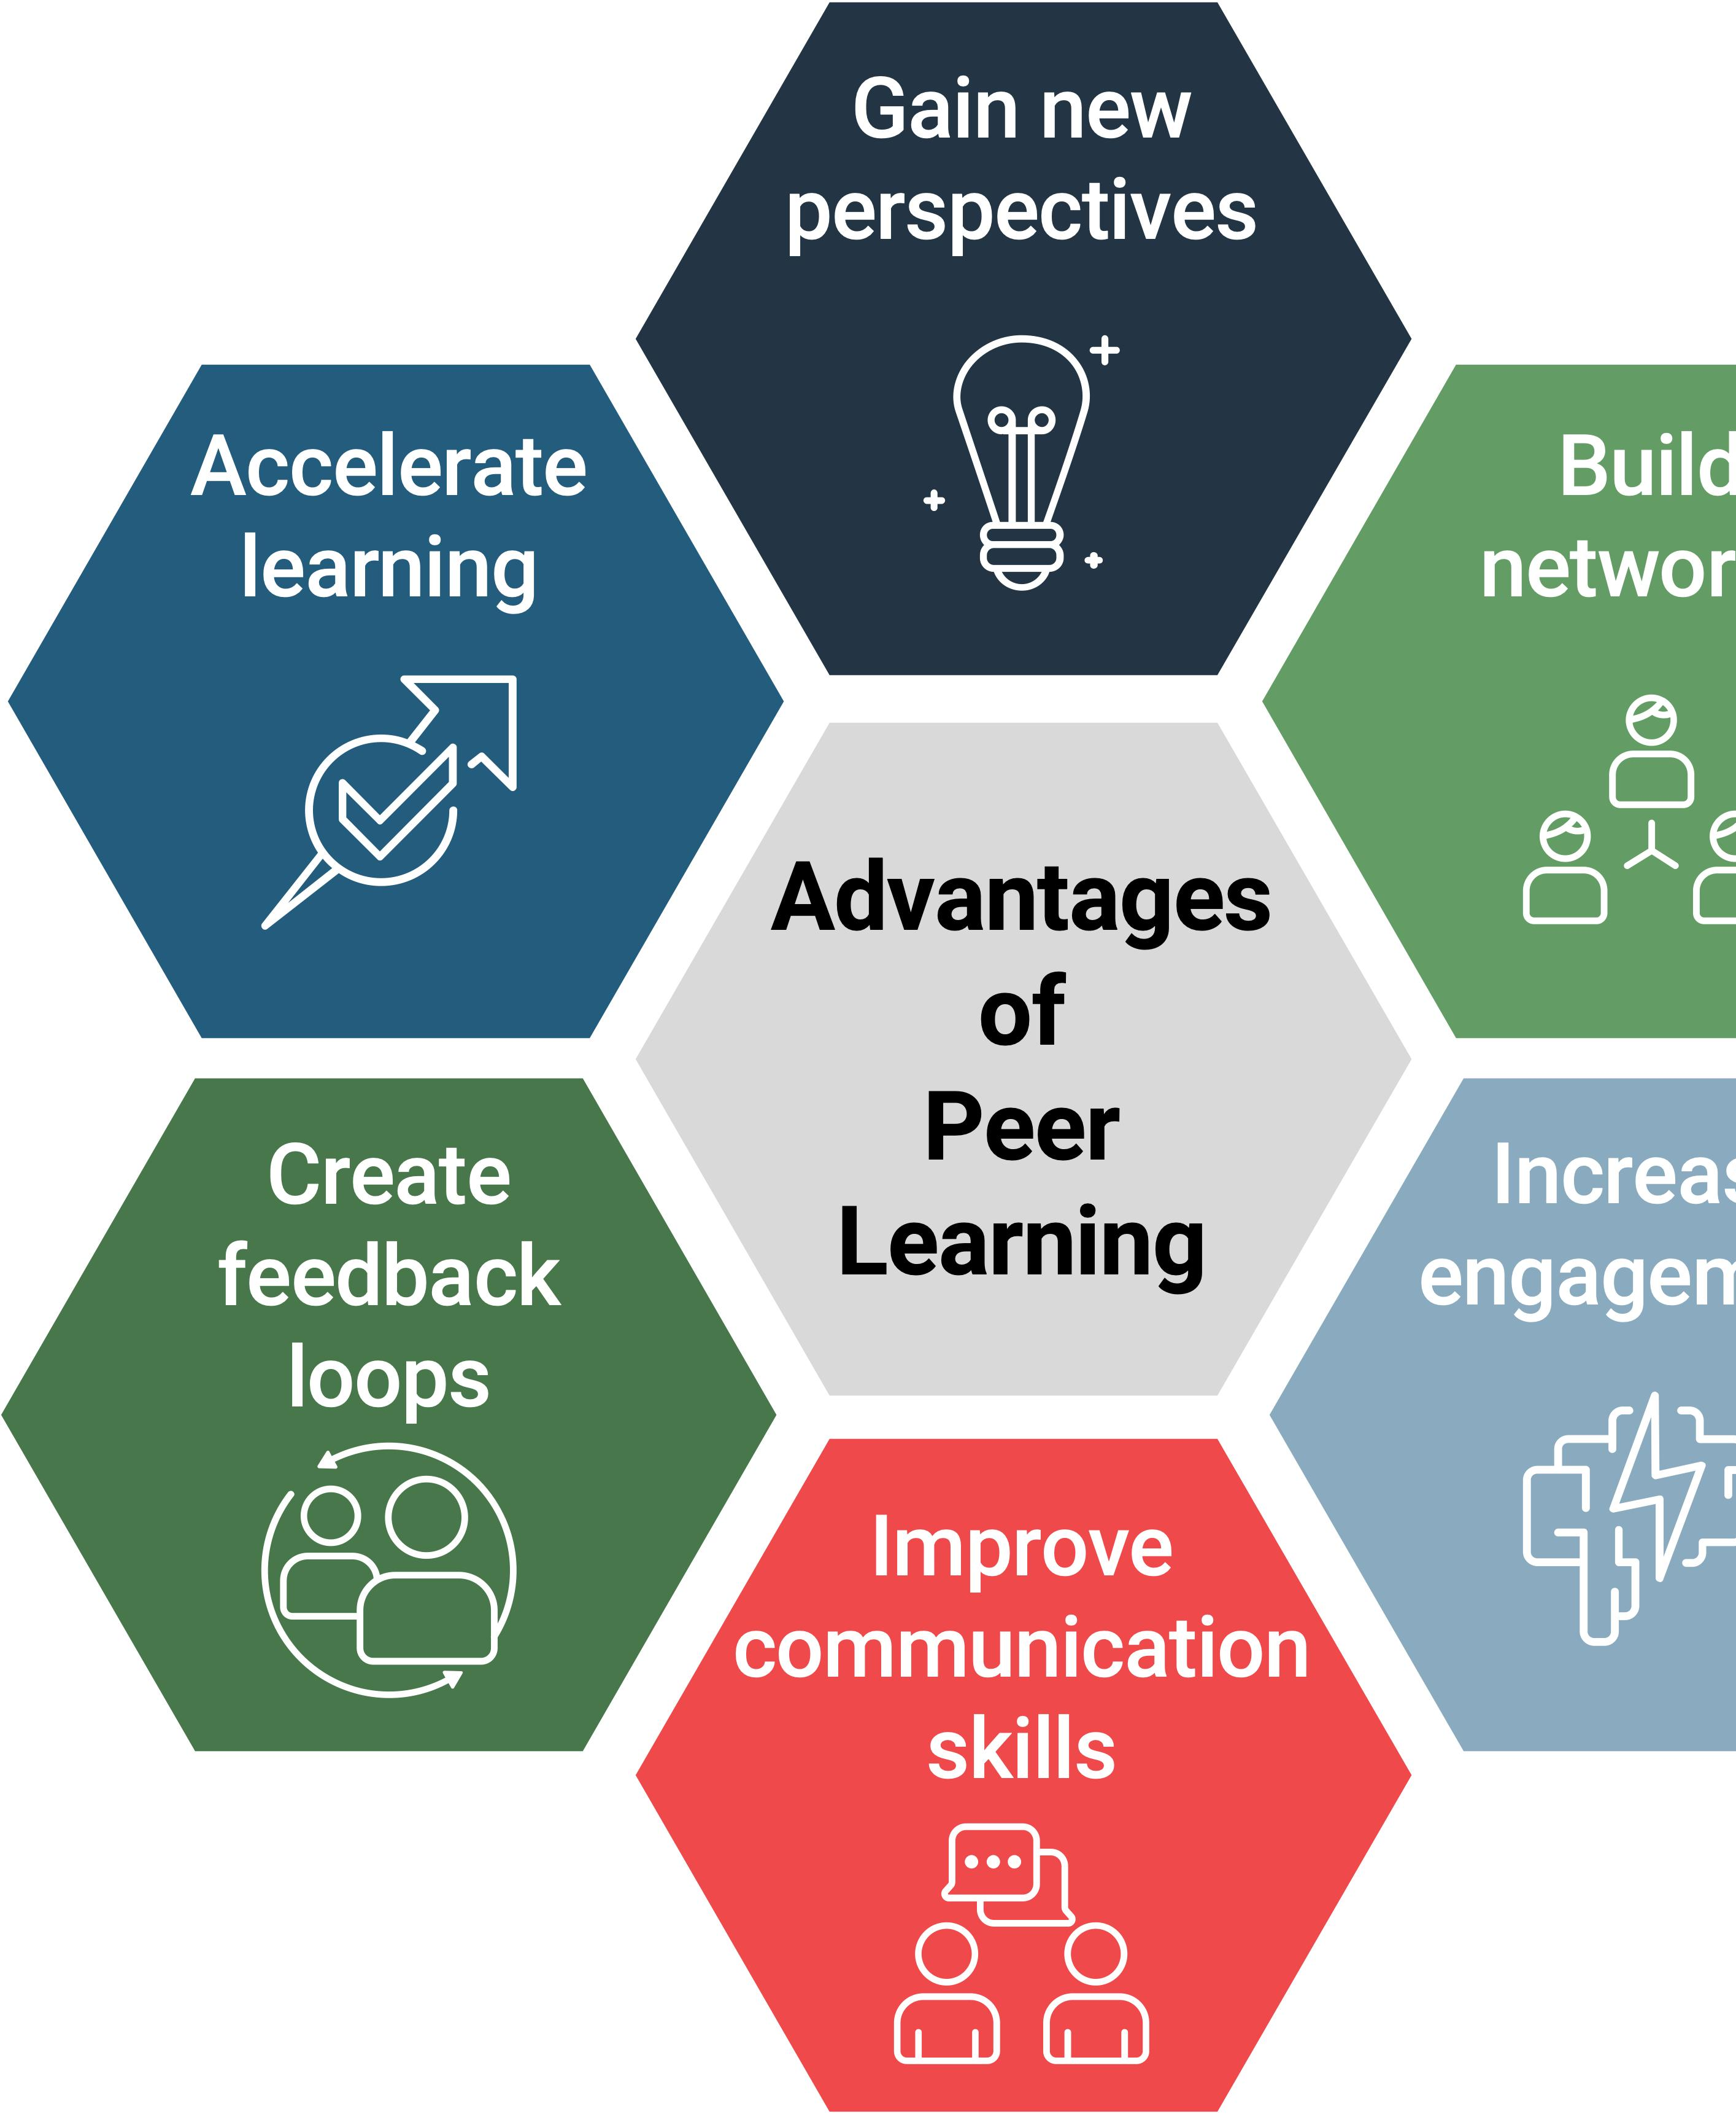
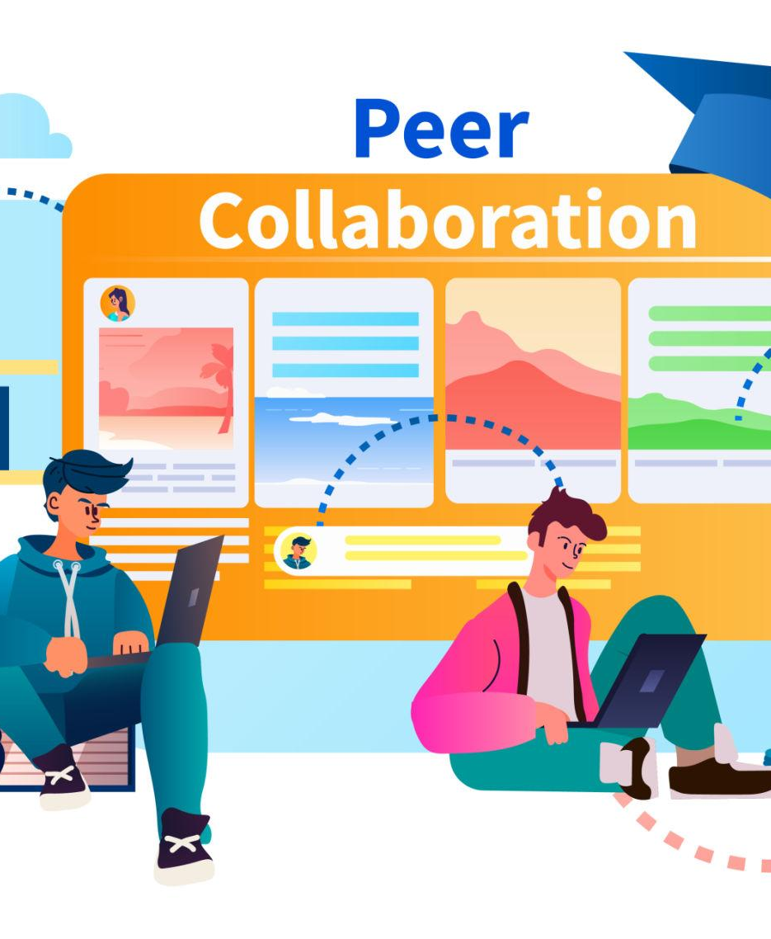

Introduction
The presentation explores collaborative learning.
It evaluates both the benefits and limitations of the approach.
Emphasis is placed on its support for professional practice.
The context includes its operation within the global business.
Current academic research underpins the discussion.
The goal is to highlight the strengths and challenges of collaborative learning.

Slide 3
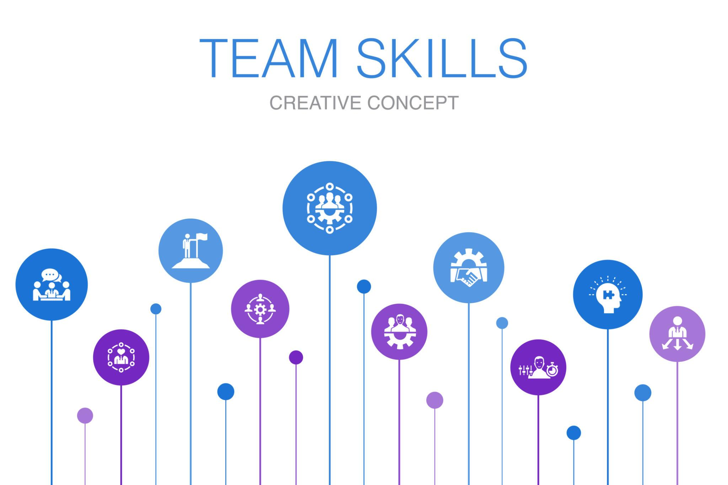
Understanding Collaborative Learning
Collaborative learning is a method where individuals collaborate to build knowledge through interaction, discussion, and problem-solving.
This approach is founded on social constructivist theory, emphasising the importance of collective learning experiences.
It has developed from earlier models of cooperative learning, according to Yang (2023).
Unlike isolated learning, collaborative learning encourages active engagement among learners to enhance understanding.
The methodology highlights the social aspects of learning, underscoring interaction and collective meaning-making.

Slide 4
Academic and Professional Benefits
Collaborative learning enhances academic performance.
It strengthens critical thinking and communication skills.
Teamwork skills developed through collaborative learning are essential in professional environments.
Research by Qureshi et al. (2023) shows that engagement significantly improves learning outcomes.
Mercier et al. (2023) highlight the benefits of collaborative approaches in engineering education for fostering analytical thinking and problem-solving skills.
The skills gained through collaborative learning are transferable to professional practice.

Slide 5
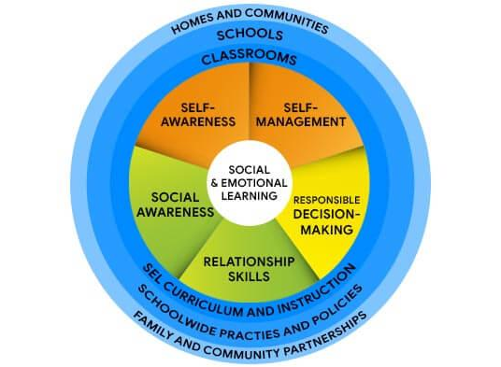
Social and Emotional Dimensions
Effective collaborative learning hinges on social and emotional interaction.
Key emotions include trust, motivation, and the ability to manage feelings in group contexts (Huang & Lajoie, 2023).
Emotions such as engagement greatly influence group performance and learning outcomes.
A supportive environment enhances collaboration efficacy, while negative emotions can hinder benefits.
Emotional awareness is essential for successful group dynamics.

Slide 6


Technology and Global Contexts
Technology has broadened collaborative learning from physical classrooms to global platforms.
Social media facilitates international collaboration, providing access to varied perspectives (Al-Rahmi et al., 2022).
Virtual reality promotes immersive learning experiences that enhance engagement (Fitrianto & Saif, 2024).
Lipponen (2023) warns that digital collaboration should be carefully structured to mitigate risks like cyberbullying and distraction, emphasising the necessity of effective management.

Slide 7
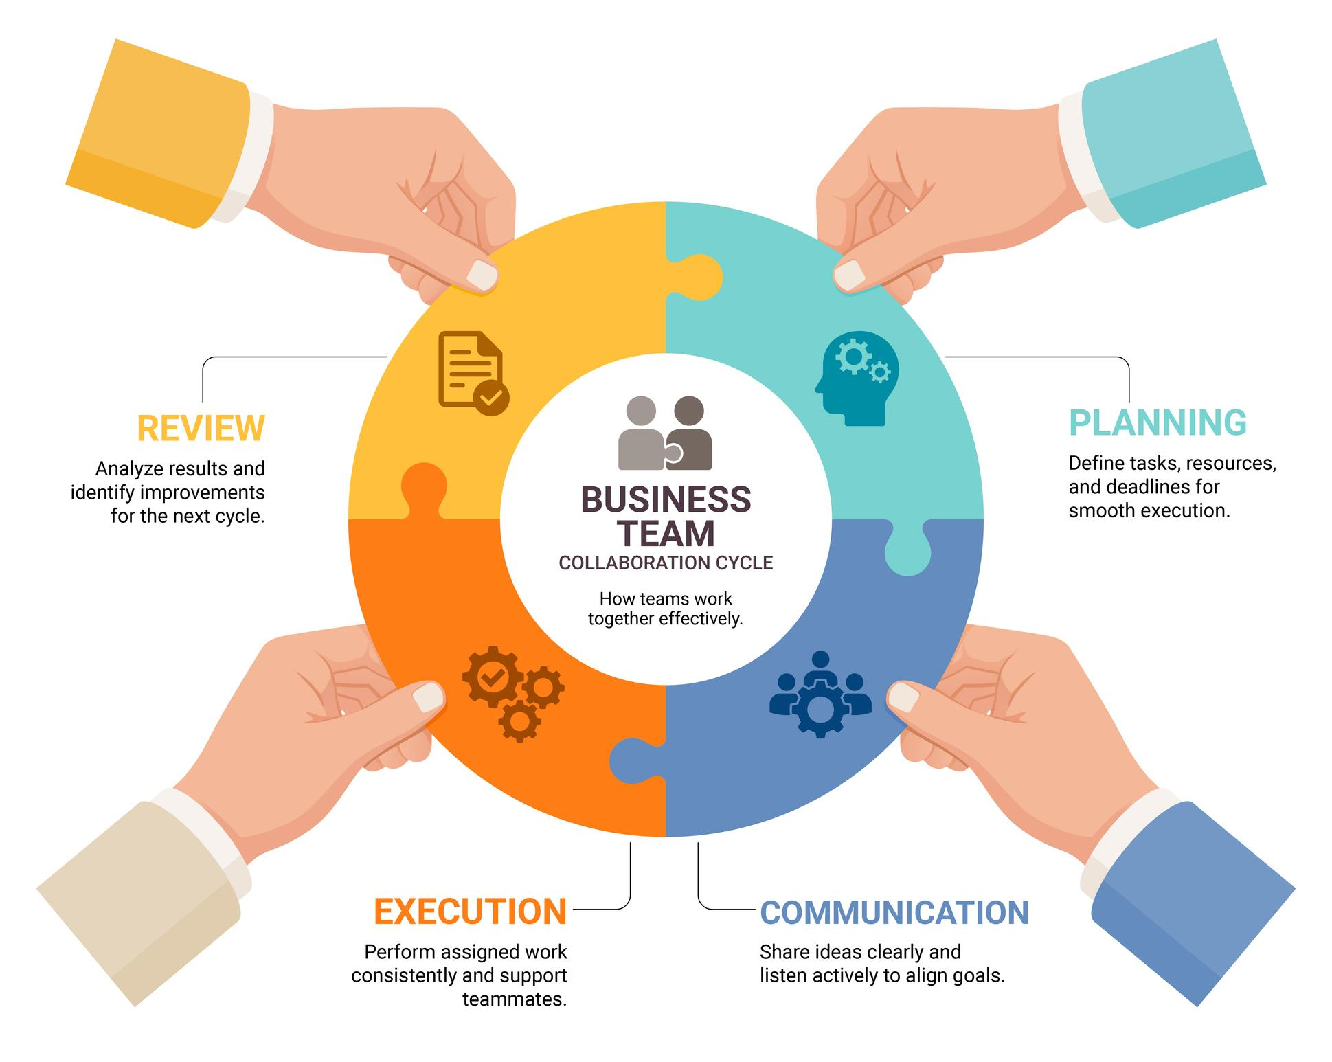
Challenges and Limitations
Collaborative learning faces limitations such as unequal participation, group conflict, cultural differences, and coordination challenges.
Issues like free-riding can negatively impact group effectiveness.
Conflicts and miscommunication may occur due to differing expectations and working styles.
Cultural differences can affect communication and collaboration in global settings.
Coordinating tasks across various time zones and platforms can pose practical difficulties, especially in digital environments.

Slide 8

Conclusion
Collaborative learning enhances skills for professional practice.
It establishes a strong link to global teamwork and innovation.
Successful collaborative learning requires structure, support, and technology management.
There is a need to balance benefits with challenges.
Proper implementation, clear structure, and addressing group dynamics and technological risks are crucial for effectiveness.

Slide 9
References
Al-Rahmi, W. M., Yahaya, N., Alturki, U., Alrobai, A., Aldraiweesh, A. A., Omar Alsayed, A., & Kamin, Y. B. (2022). Social media–based collaborative learning: The effect on learning success with the moderating role of cyberstalking and cyberbullying. Interactive Learning Environments, 30(8), 1434–1447.
Fitrianto, I., & Saif, A. (2024). The role of virtual reality in enhancing experiential learning: A comparative study of traditional and immersive learning environments. International Journal of Post Axial: Futuristic Teaching and Learning, 97–110.
Huang, X., & Lajoie, S. P. (2023). Social emotional interaction in collaborative learning: Why it matters and how we can measure it? Social Sciences & Humanities Open, 7(1), 100447.
Lipponen, L. (2023). Exploring foundations for computer-supported collaborative learning. In Computer support for collaborative learning (pp. 72–81). Routledge.
Mercier, E., Goldstein, M. H., Baligar, P., & Rajarathinam, R. J. (2023). Collaborative learning in engineering education. In International handbook of engineering education research (pp. 402–432). Routledge.
Qureshi, M. A., Khaskheli, A., Qureshi, J. A., Raza, S. A., & Yousufi, S. Q. (2023). Factors affecting students’ learning performance through collaborative learning and engagement. Interactive Learning Environments, 31(4), 2371–2391.
Yang, X. (2023). A historical review of collaborative learning and cooperative learning. TechTrends, 67(4), 718–728.

