Slide 1


Leadership Models
BMBM6012: Leading and Developing People

Slide 2

Objectives of today’s session:
Further develop your knowledge and understanding of a variety of Leadership Models, including;
Transformational Leadership
Authentic Leadership
Servant Leadership
Adaptive Leadership
2. Critically analyse Situational V’s Transformational Leadership

Slide 3

Is Donald Trump an Authentic Leader?

Slide 4
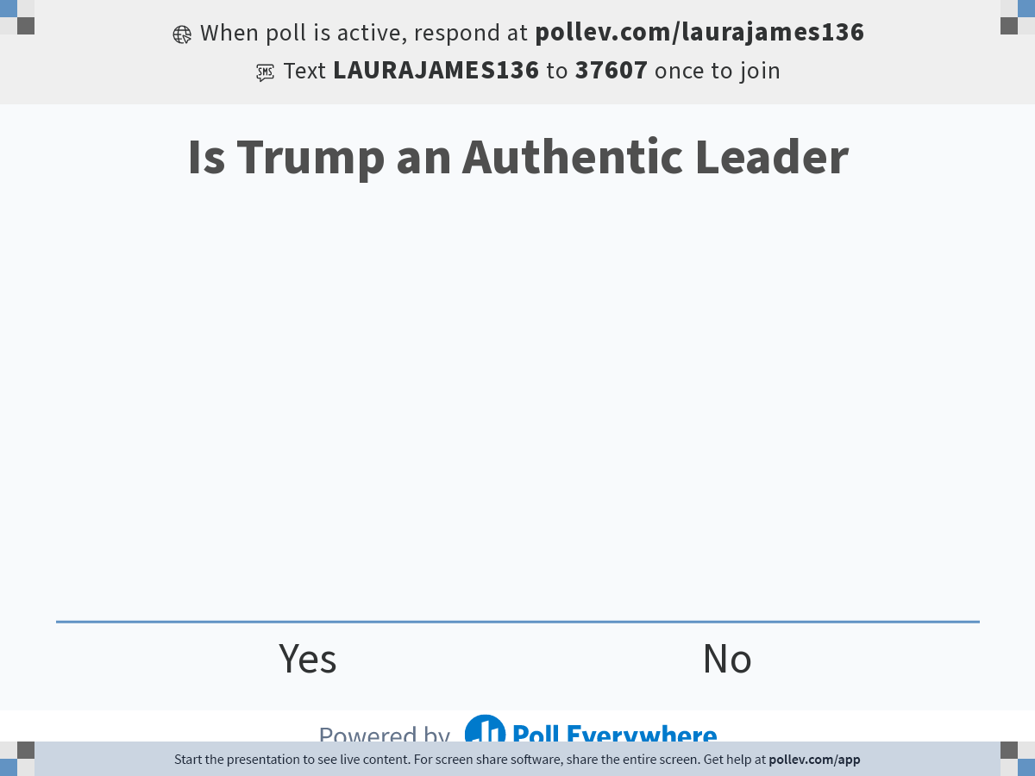
Notes:
Poll Title: Do not modify the notes in this section to avoid tampering with the Poll Everywhere activity.
More info at polleverywhere.com/support
Is Trump an Authentic Leader
https://www.polleverywhere.com/multiple_choice_polls/Mc53AyKbHEKYa2PC6183s?state=opened&flow=Default&onscreen=persist

Slide 5
Beddoes-Jones: 3 Pillars of an Authentic Leader?
Self Awareness
Relationships
Strengths
Weaknesses
Empathy
Influence
Impact
Appreciates the impact of moods, behaviours, thoughts and language on followers
Ethics
Integrity
Honour
Courage
Honesty
Transparency
Fairness
Has the courage to speak up for what they believe in
Self Regulation
Discipline
Energy
Flexibility
Emotional control
Patience
Resilience
Actively and deliberately is in control of their thoughts and emotions

Slide 6

AN ALALYSIS OF THE LEADERSHIP STYLE OF DONALD J TRUMP
STRENGTHS
Calculated risk taker - Discipline
“Sometimes your best investments are the ones you don't make.”
Ambition/BIG Goals - Courage
“You have to think anyway, so why not think big?”
Passionate - Energy
“If you're interested in 'balancing' work and pleasure, stop trying to balance them. Instead, make your work more pleasurable.”
Charismatic - influence
“I AM YOUR VOICE. I have joined the political arena so that the powerful can no longer beat up on people that cannot defend themselves. Nobody knows the system better than me, which is why I alone can fix it.”

Slide 7

AN ALALYSIS OF THE LEADERSHIP STYLE OF DONALD J TRUMP
WEAKNESSES
Aggressive – Emotional Control
“When somebody challenges you, fight back. Be brutal, be tough.”
Narcissistic - Empathy
http://www.huffingtonpost.com/zac-thompson/is-donald-trump-a-narciss_b_14153726.html
Listening - Relationships
The inability to listen to another person’s point of view can signal underlying anger or a fear of being ignored.
Empathy
Trump shows no empathy in discussions on ways to create a path to citizenship for immigrants. Similarly, The Donald’s rhetoric about the shortcomings of women as contributors to business or politics has been labelled a "war on women."
Exaggeration - Honesty
“I play to people's fantasies. People may not always think big themselves, but they can still get very excited by those who do. That's why a little hyperbole never hurts.”

Slide 8
Based on the 3 Pillars is Trump an Authentic Leader?
Self Awareness
Relationships
Strengths
Weaknesses
Empathy
Influence
Impact
Appreciates the impact of moods, behaviours, thoughts and language on followers
Ethics
Integrity
Honour
Courage
Honesty
Transparency
Fairness
Has the courage to speak up for what they believe in
Self Regulation
Discipline
Energy
Flexibility
Emotional control
Patience
Resilience
Actively and deliberately is in control of their thoughts and emotions

Slide 9
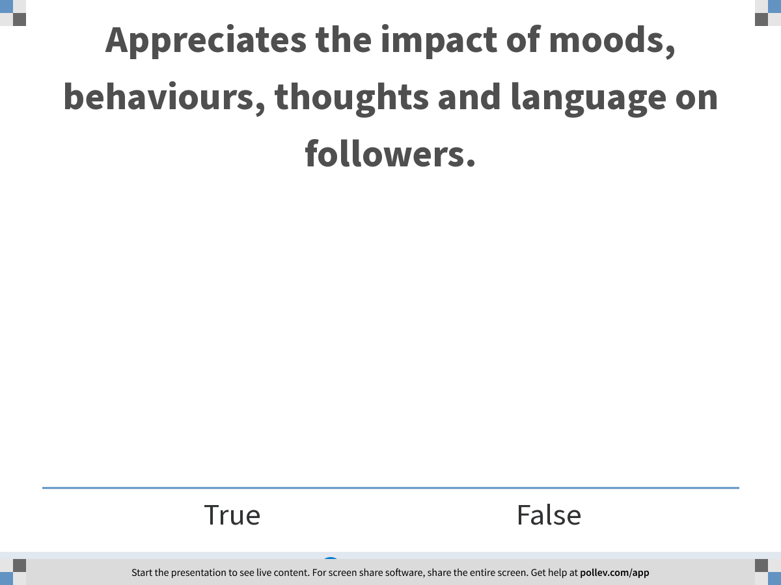
Notes:
Poll Title: Appreciates the impact of moods, behaviours, thoughts and language on followers.
https://www.polleverywhere.com/multiple_choice_polls/CT94ecAztXsGxVyQJCzu6

Slide 10
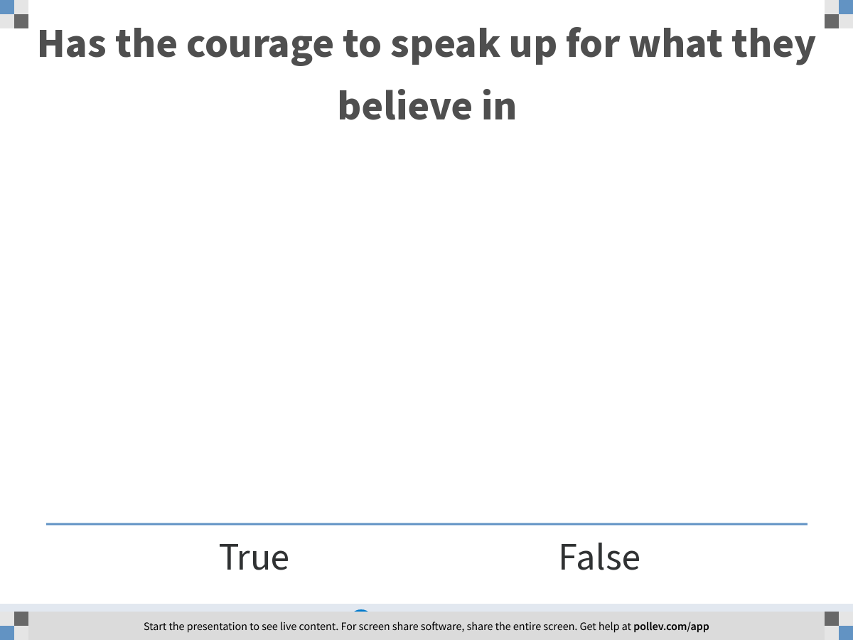
Notes:
Poll Title: Has the courage to speak up for what they believe in
https://www.polleverywhere.com/multiple_choice_polls/f8yorbQhZN7Jwf7h0LSBY

Slide 11
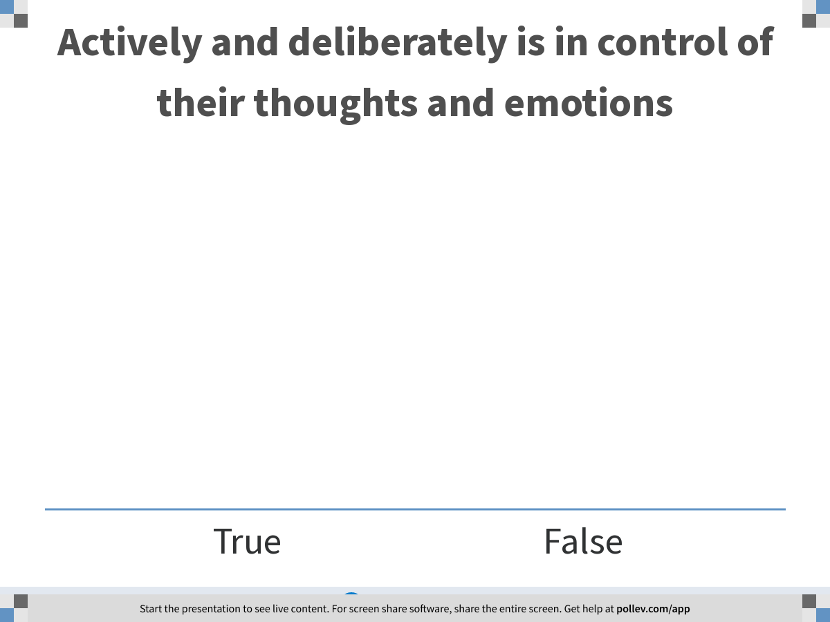
Notes:
Poll Title: Actively and deliberately is in control of their thoughts and emotions
https://www.polleverywhere.com/multiple_choice_polls/dTNQmFpFHB7HKPzmz9vZA

Slide 12
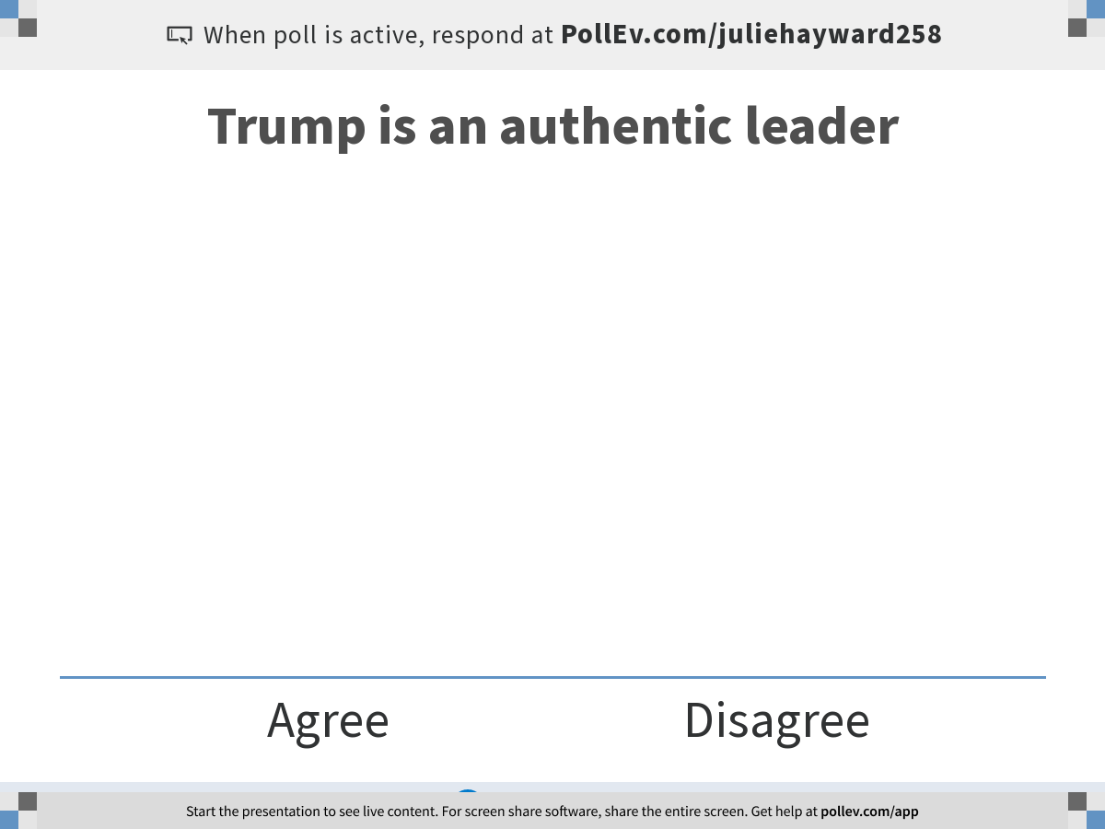
Notes:
Poll Title: Trump is an authentic leader
https://www.polleverywhere.com/multiple_choice_polls/msac0Meub9e4bU0Y7XSrU?flow=Default&onscreen=persist

Slide 13

Transformational Leadership

Slide 14

What is Transformational Leadership?
The transformational leadership approach encourages, inspires, and motivates employees to innovate and create the change necessary to shape the future success of the company. This is accomplished by setting an example at the executive level through authenticity, a strong sense of corporate culture, employee ownership, and independence in the workplace. Transformational leaders are change agents in the business, who can identify innovative and shifting trends in technology, and then help the organization embrace that change.
Transformational leaders inspire and motivate their workforce without micromanaging — they trust trained employees to take authority over decisions in their assigned jobs. It’s a management style that’s designed to give employees more room to be creative, look to the future, and find new solutions to old problems. Employees on the leadership track will also be prepared to become transformational leaders themselves through mentorship and training. (White, 2022)
Notes:
Transformational leadership theory
The concept of transformational leadership started with James V. Downton in 1973 and was expanded by James Burns in 1978. In 1985, researcher Bernard M. Bass further expanded the concept to include ways for measuring the success of transformational leadership. This model encourages leaders to demonstrate authentic, strong leadership with the idea that employees will be inspired to follow suit.
While Bass’ transformational leadership theory dates to the ’70s, it’s still an effective leadership model practiced today — this style of authentic leadership never changes, just the environments it’s used in. It’s applicable across every industry, but it’s especially vital to the fast-paced tech industry where innovation and agility can make or break a company.

Slide 15

Transformational Leadership Model
Four main elements define the transformational leadership model which were developed by Bass n 1985 to help define what transformational leadership looks like and how to be successful as this type of leader.

Slide 16
Transformational Leadership
Idealised Influence
Intellectual Stimulation
Inspirational Motivation
Individual Consideration

Slide 17

Idealized influence
The most important thing you can do as a transformational leader is to lead by example. Employees will look to you as a role model for behavior in all areas of the workplace. If you lead with authenticity, employees will pick up on that behavior and feel inspired to maintain that high standard for performance. It’s not about manipulating employees into working hard, it’s about leading by example and positively influencing others through a commitment to trust, transparency, and respect.
Notes:
Idealized influence

Slide 18

Intellectual stimulation
To help create change, transformation leaders challenge long-standing beliefs in the company and push the status quo by encouraging innovation, creativity, critical thinking, and problem-solving. Transformative leaders help employees feel comfortable exploring new ideas and opportunities that can inject innovation into the organization. They want to establish an environment that welcomes growth and gets everyone excited about digital transformation and other important initiatives in the organization

Slide 19

Inspirational motivation
As a transformational leader, you will need to encourage your team to feel attached and committed to the vision of the organization. You want to ensure employees feel as committed to these goals as you do as a leader by giving employees a strong sense purpose, rather than attempting to motivate them through fear.

Slide 20
Individual consideration
Employees need to feel a sense of independence and ownership in the overall business goals. As a transformational leader, it’s important to understand every employee is a unique person within the company and will have specific needs, mentorship styles, and their own contributions to the company. These leaders will tailor their coaching and mentorship styles to the employee and help them reach goals both inside and outside of the organization.

Slide 21

Characteristics of Transformational Leadership
Encouraging the motivation and positive development of followers
Exemplifying moral standards within the organization and encouraging the same of others
Fostering an ethical work environment with clear values, priorities, and standards
Building company culture by encouraging employees to move from an attitude of self-interest to a mindset where they are working for the common good
Holding an emphasis on authenticity, cooperation, and open communication
Providing coaching and mentoring but allowing employees to make decisions and take ownership of tasks

Slide 22
Activity: What are the advantages and disadvantages of Transformational Leadership?

Slide 23
Authentic Leadership

Slide 24

Bill George has defined 5 dimensions that help shape Authentic Leadership. These are Purpose, Values, Heart, Relationships, Self-Discipline.

Slide 25
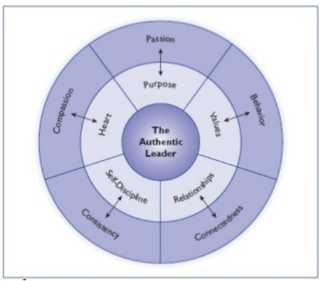
Authentic Leadership- Bill George
(Northouse, 2016 – See Chapter 9)

Slide 26
Purpose
The first step to being an Authentic Leader is to know yourself, to have an awareness of yourself, your strengths, and weaknesses. Only in this way can you learn more about your personal needs and thus your purpose.

Slide 27

Values:
Every decision that you as an Authentic Leader make and every behavior that you display are predetermined by your values. Therefore, you are authentic when your own values are transparent.

Slide 28

Heart:
As an Authentic Leader, it is important to be empathetic with yourself and with your team members. In doing so, you should find the right balance between the needs of yourself, your team members, and those of the organization. To achieve this, you must have a clear understanding of the kind of relationship you have with yourself, and everyone else.

Slide 29

Self-Discipline:
Always practice what you preach. Authentic Leadership can be learned. But the learning path itself can be a painful self-exploration. In order to stay on the path, you’ll need a lot of self-discipline.

Slide 30

Characteristics of an Authentic Leader:
Sense of purpose
Self-Discipline
Compassion and Heart
Self-Awareness
People-centred connections
Focus on Improvement
Transparency
Shared Success
Open to other viewpoints

Slide 31
Activity: What are the advantages and disadvantages of Authentic Leadership?

Slide 32
Servant Leadership

Slide 33

What is servant leadership?
Servant leadership is a management philosophy that highlights the improvement of employees working for your company. The attention given to employee development aids in your company’s growth and contributes to the society your employees live in. The combination of enhancing your company’s culture and caring for your employees demonstrates how your company motivates them to elevate their performance.

Slide 34
Servant leadership
Servant Leadership isn’t a complete leadership theory. This is one aspect of leadership that really makes a difference.
Its not in contrast with the other leadership models that we have looked at- in fact, it can often be used in conjunction with them.
Servant Leadership is a Paradox of both service and influence.
It centres around the idea that the leader will serve other people at the same time as influencing other people.
Most of the scholarship and research that has been done around Servant Leadership has been prescriptive. It aims to understand; What are the characteristics of good leaders that really care about the people they lead?
This researched developed during the 21st Century to include more of a focus on what happens when leaders put followers first.

Slide 35
Greenleaf Definition (Northouse, 2016)
Greenleaf Definition:
“ Servant leadership begins with the natural feeling that one wants to serve, to serve first. Then conscious choice brings one to aspire to leadership.”
The best test then is…Do those served grow as persons; do they, while being served, become healthier, wiser, freer, more likely themselves to become servant?

Slide 36
Spear’s (2002) version of Greenleaf’s Servant- 10 Characteristics of a Servant Leader:
Listening
Empathy
Healing- looking at where people are suffering and doing what they can to ease that suffering
Awareness
Gentle Persuasion- to help people to what is best for them
Conceptualization- need to be able to have the big picture of what's going on in the organisation AND in peoples lives
Foresight- foresight of what might happen and what would be beneficial
Stewardship- we have different resources available to us and we need to use all of those resources in the best way to benefit other people
Commitment to the Growth of people
Building community- Bringing people closer together in healthy relationships to work better together
(Northouse, 2016 – See Chapter 10)

Slide 37
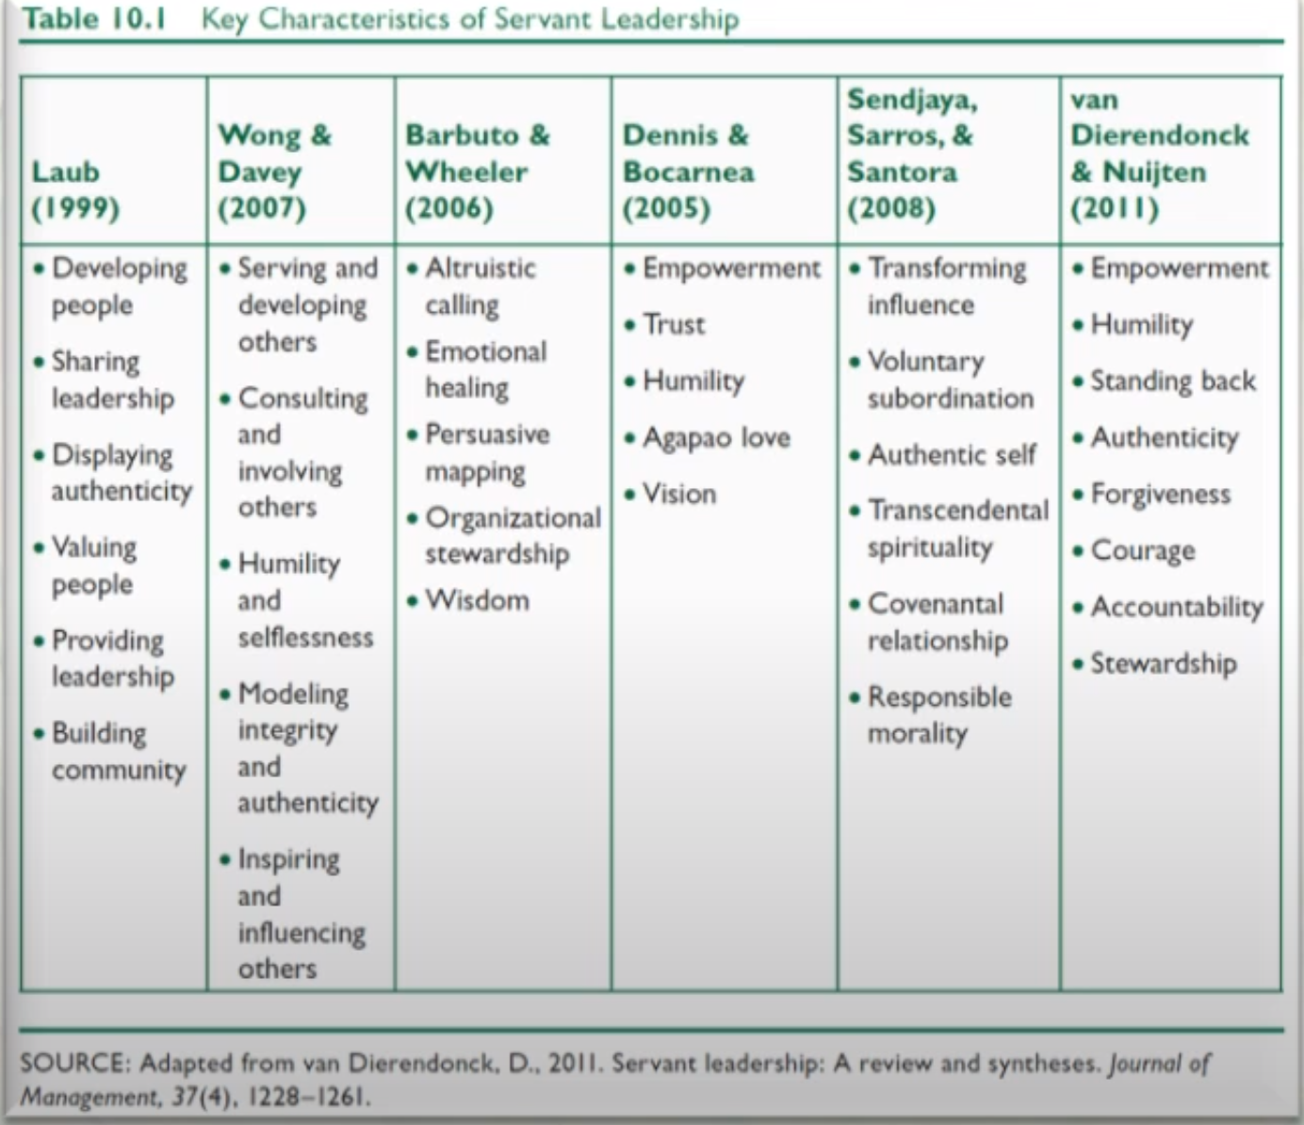
Other versions of Servant Leadsership
Notes:
The idea is similar
Further Reading: Chapter 10 Northouse

Slide 38
Activity: What are the advantages and disadvantages of Servant Leadership?

Slide 39
Adaptive Leadership

Slide 40
Adaptive Leadership
What is Adaptive Leadership?
Focusses on the adaptations workers need to make in response to changing environments
Stresses the activities of the leader that optimise the work of the followers in the contexts in which they find themselves.
The leader helps the workers best do the work in changing environments
Definition could be:
“The Practice of mobilising people to tackle tough challenges and thrive.”

Slide 41


Adaptive leaders help others do the work by;
Mobilising them- setting them in motion
Motivating them- giving them the energy for doing it
Organizing them- giving them the structure for doing it
Orienting them- sending them in the right direction
Focusing their attention of what’s important- so that that stay focused on the job

Slide 42
When is Adaptive Leadership Relevant?
What type of situational challenges are workers facing?
Technical problem: Problems that are clearly defined with known solutions that cab be implemented through existing organizational procedures
No need for adaptive leadership
2. Adaptive challenges: Problems that are not clearly defined or easy to identify, and which do not have a clear solution. They require innovation and learning.
The challenges facing the organisation are not clearly defined, nor are there any solutions. These challenges require adaptive leadership.

Slide 43
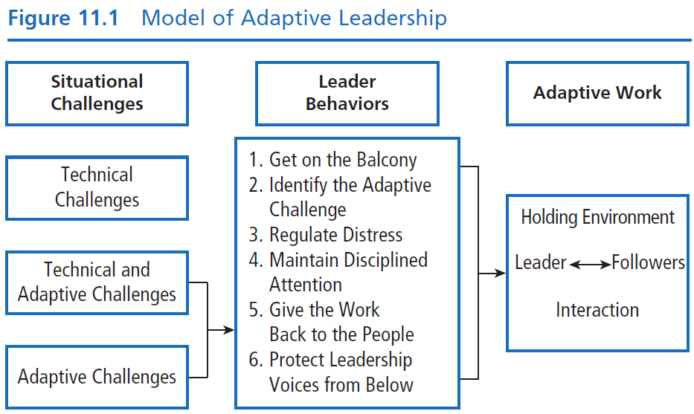


Adaptive Leadership
(Northouse, 2016 – See Chapter 11)
Notes:
This gives an overview of how adaptive leadership works.

Slide 44

Leader Behaviours
Get on the balcony: getting a big picture of everything that’s happening- the organisations, the challenges people are facing, the culture etc
Identify Adaptive Challenges: Distinguish between technical and adaptive challenges.
4 types of adaptive challenges
A gap between values and behaviour
Competing commitments/goals (quality vs. cost)
Elephants in the room (problems people don’t want to address)
People avoiding work

Slide 45
3. Regulate Distress: Help other people recognise the need for change but not be overwhelmed by it.
The leader must…
Create a holding environment (safe atmosphere to discuss everything)
Provide direction, protection, orientation, conflict management, productive norms
Regulate his or her own personal distress and the distress of the workers, keeping it in the productive range
4. Maintain Disciplined Attention: Encouraging people to focus on the tough work they need to do.
5. Give the work back to the people: Avoid Mico-managing and give people freedom to solve the problems
6. Protect Leadership voices from Below: Consider the ideas of people who may blame you, be at the fringe, marginalised, or even deviant in the group or organisation
Notes:
When these 6 characteristics are me then adaptive work happens.

Slide 46
Activity: What are the advantages and disadvantages of Adaptive Leadership?

Slide 47

Take a Break

Slide 48

Situational Leadership

Slide 49
Summary (Hersy & Blanchard, 1969)
Leaders should match their style to the competence and commitment of subordinates
It focusses on choosing a leadership style appropriate for the situation
Used extensively in organisational leadership training and development

Slide 50

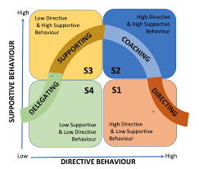

Slide 51
Class Debate!
Transformational Leadership V’s Situational Leadership

Slide 52
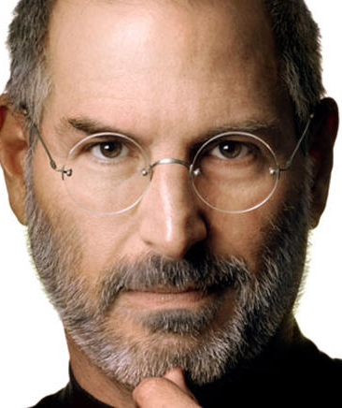
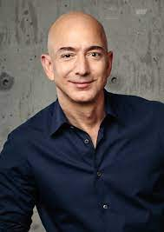
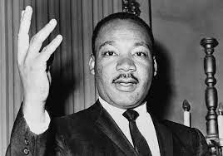
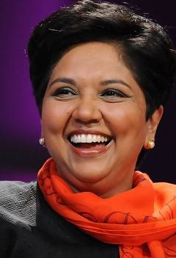
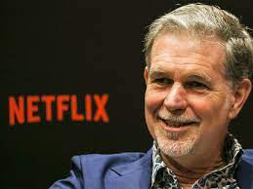
Notes:
Steve Jobs and Tim Cook, Apple: HBR points to Apple as an example of “dual transformation”: Jobs innovated on original Microsoft products while also building a software ecosystem. Cook has extended on Jobs’ vision, maintaining a focus on innovation, software, and brand loyalty.
Jeff Bezos, Amazon: Harvard Business Review attribute’s Bezos’ “insider, outsider” status as part of what makes him a great transformational leader. As someone who jumped from the finance world, he brought a fresh perspective to e-commerce through years of experience in a different industry.
Reed Hastings, Netflix: Hastings tied for first alongside Bezos, and for similar reasons. Hailing from the software industry, he wasn’t rooted in pre-established process and procedure in the television industry
Indra Nooyi, PespisCo: Authentic and Transformational
Martin Luther King: Authentic

