Slide 1
Decision Trees

Slide 2
Decision Trees
Can perform both classification and regression tasks.
Can fit complex datasets (be careful about overfitting!)
A decision tree classifier will look at a training set and then build a classifier to predict a new response to previously unknown data.
A decision tree looks at each attribute and splits the training data into subsets recursively to produce a decision tree.

Slide 3
By Example
Predict if Lara wins or loses (again)
We used Naïve Bayes in previous lectures to help decide whether or not she will beat an opponent in a fight. Now we will use a decision tree to answer the same question.
Recall the probability tables we produced last time* gave us an estimate of the probability of winning or losing. We’ll start with that table and illustrate how a decision tree works.

Slide 4
Lara’s previous results
Fight | Character Type | Opponent’s Fitness | Opponent’s Skill | Opponent’s Strength | Win?
1 | orc | high | high | weak | no
2 | orc | high | high | strong | no
3 | orc | medium | high | weak | yes
4 | orc | low | high | weak | yes
5 | human | low | normal | weak | yes
6 | human | low | normal | strong | no
7 | orc | medium | normal | strong | yes
8 | ogre | high | high | weak | no
9 | ogre | high | normal | weak | yes
10 | human | low | normal | weak | yes
11 | ogre | high | normal | strong | yes
12 | human | medium | high | strong | yes
13 | orc | medium | normal | weak | yes
14 | human | low | high | strong | no

Slide 5
Fitness
9 Yes/5 No
Medium
4 Yes/0 No
Pure Subset
High
2 Yes/3 No
Split further
Low
3 Yes/2 No
Split further
Fight | Character | Fitness | Skill | Strength | Win?
3 | orc | medium | high | weak | yes
7 | orc | medium | normal | strong | yes
12 | human | medium | high | strong | yes
13 | orc | medium | normal | weak | yes
Fight | Character | Fitness | Skill | Strength | Win?
1 | orc | high | high | weak | no
2 | orc | high | high | strong | no
8 | ogre | high | high | weak | no
9 | ogre | high | normal | weak | yes
11 | ogre | high | normal | strong | yes
Fight | Character | Fitness | Skill | Strength | Win?
4 | orc | low | high | weak | yes
5 | human | low | normal | weak | yes
6 | human | low | normal | strong | no
10 | human | low | normal | weak | yes
14 | human | low | high | strong | no

Slide 6
Fitness
9 Yes/5 No
Medium
4 Yes/0 No
Pure Subset
High
2 Yes/3 No
Split further
Low
3 Yes/2 No
Split further
Fight | Character | Fitness | Skill | Strength | Win?
3 | orc | medium | high | weak | yes
7 | orc | medium | normal | strong | yes
12 | human | medium | high | strong | yes
13 | orc | medium | normal | weak | yes
Skill
2 Yes/ 3 No
Fight | Character | Fitness | Skill | Strength | Win?
4 | orc | low | high | weak | yes
5 | human | low | normal | weak | yes
6 | human | low | normal | strong | no
10 | human | low | normal | weak | yes
14 | human | low | high | strong | no
High
0 Yes/ 3 No
Pure Subset
Normal
2 Yes/ 0 No
Pure Subset
Fight | Char-acter | Skill | Stren- gth | Win?
1 | orc | high | weak | no
2 | orc | high | strong | no
8 | ogre | high | weak | no
Fight | Char-acter | Skill | Stren- gth | Win?
9 | ogre | normal | weak | yes
11 | ogre | normal | strong | yes

Slide 7
Fitness
9 Yes/5 No
Medium
4 Yes/0 No
Pure Subset
High
2 Yes/3 No
Split further
Low
3 Yes/2 No
Split further
Fight | Character | Fitness | Skill | Strength | Win?
3 | orc | medium | high | weak | yes
7 | orc | medium | normal | strong | yes
12 | human | medium | high | strong | yes
13 | orc | medium | normal | weak | yes
Skill
2 Yes/ 3 No
Strength
3 Yes/ 2 No
High
0 Yes/ 3 No
Pure Subset
Normal
2 Yes/ 0 No
Pure Subset
Weak
3 Yes/ 0 No
Pure Subset
Strong
0 Yes/ 2 No
Pure Subset
Fight | Char-acter | Skill | Stren- gth | Win?
1 | orc | high | weak | no
2 | orc | high | strong | no
8 | ogre | high | weak | no
Fight | Char-acter | Skill | Stren- gth | Win?
9 | ogre | normal | weak | yes
11 | ogre | normal | strong | yes
Fight | Char-acter | Skill | Stren-gth | Win?
4 | orc | high | weak | yes
5 | human | normal | weak | yes
10 | human | normal | weak | yes
Fight | Char-acter | Skill | Stren-gth | Win?
6 | human | normal | strong | no
14 | human | high | strong | no

Slide 8
Using Decision Tree
Lara is fighting an Orc of low fitness, high strength and high skill.
Starting at the top of the tree, take the low fitness branch, then the high strength branch.
We are at a terminal node so we predict a WIN.
Notice that some attributes are irrelevant – we don't care about them.
If we obtained more fight data then perhaps things might change. We'd have to re-train the decision tree. Which begs the question, how do we train a decision tree in the first place?

Slide 9
Creating a Decision Tree
Several algorithms exist. A common algorithm is called CART (Classification And Regression Tree). It is a greedy algorithm that splits the training set into two subsets using a single feature, k and a threshold value kt. It searches for the pair (k,kt) that produces the purest subset and repeats this recursively for each subtree.
What is meant by "purest" here.

Slide 10
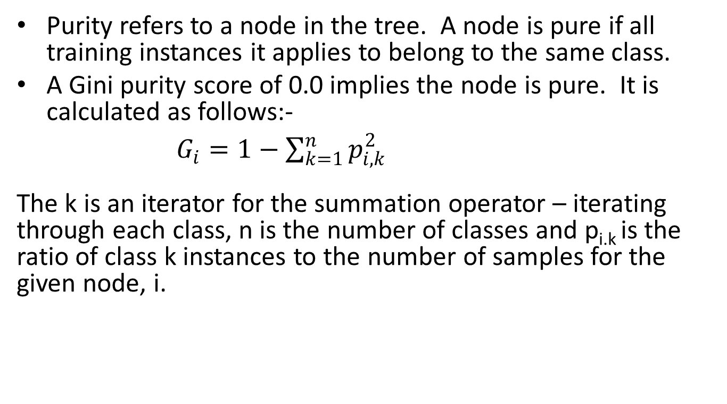
Purity and the Gini score.
Purity refers to a node in the tree. A node is pure if all training instances it applies to belong to the same class.
A Gini purity score of 0.0 implies the node is pure. It is calculated as follows:-
$G_{i}=1−\sum_{k=1}^{n}{p_{i,k}^{2}}$
The k is an iterator for the summation operator – iterating through each class, n is the number of classes and p_{i.k} is the ratio of class k instances to the number of samples for the given node, i.

Slide 11
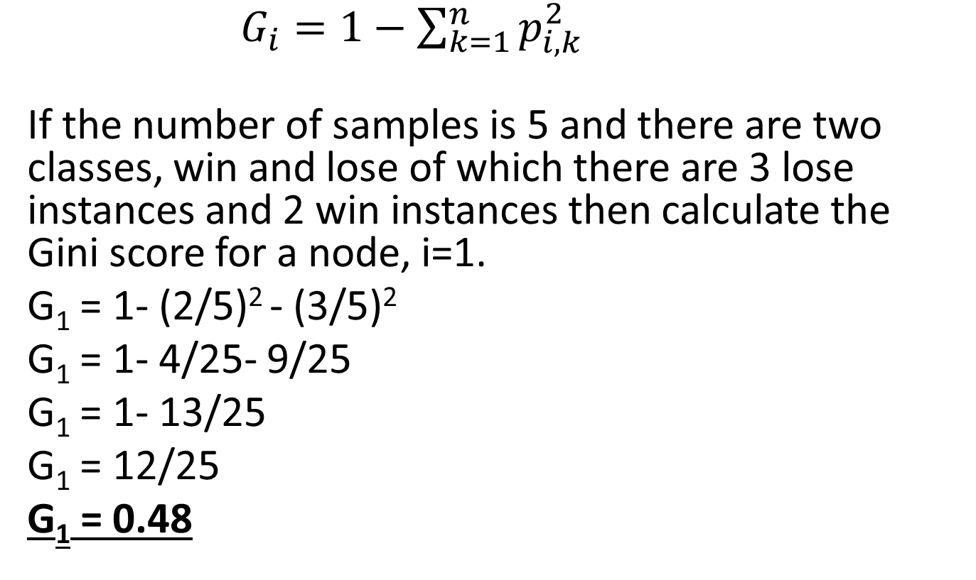
Gini Example Calculation
$G_{i}=1−\sum_{k=1}^{n}{p_{i,k}^{2}}$
If the number of samples is 5 and there are two classes, win and lose of which there are 3 lose instances and 2 win instances then calculate the Gini score for a node, i=1.
G₁ = 1- (2/5)² - (3/5)²
G₁ = 1- 4/25- 9/25
G₁ = 1- 13/25
G₁ = 12/25
G₁ = 0.48

Slide 12
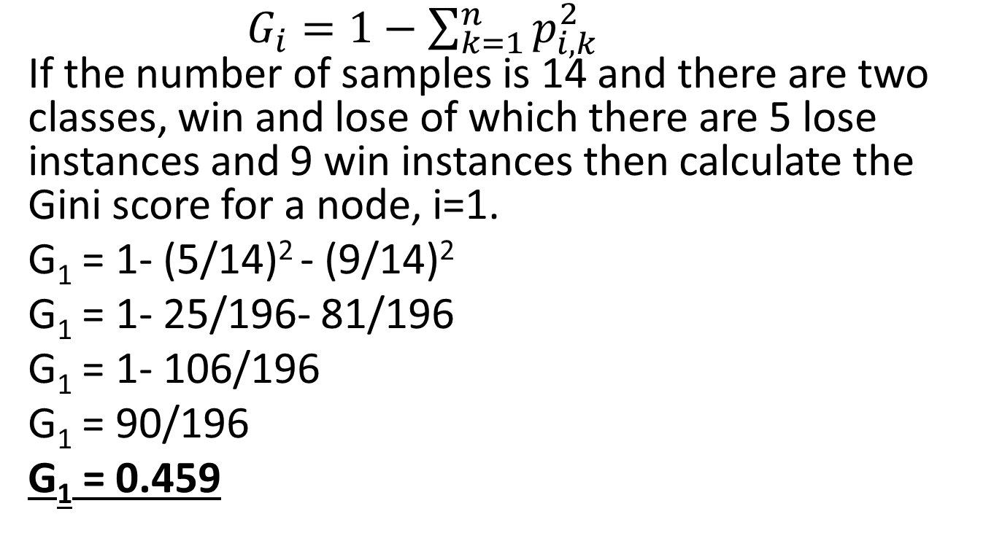
Another Gini Example Calculation
$G_{i}=1−\sum_{k=1}^{n}{p_{i,k}^{2}}$
If the number of samples is 14 and there are two classes, win and lose of which there are 5 lose instances and 9 win instances then calculate the Gini score for a node, i=1.
G₁ = 1- (5/14)² - (9/14)²
G₁ = 1- 25/196- 81/196
G₁ = 1- 106/196
G₁ = 90/196
G₁ = 0.459

Slide 13
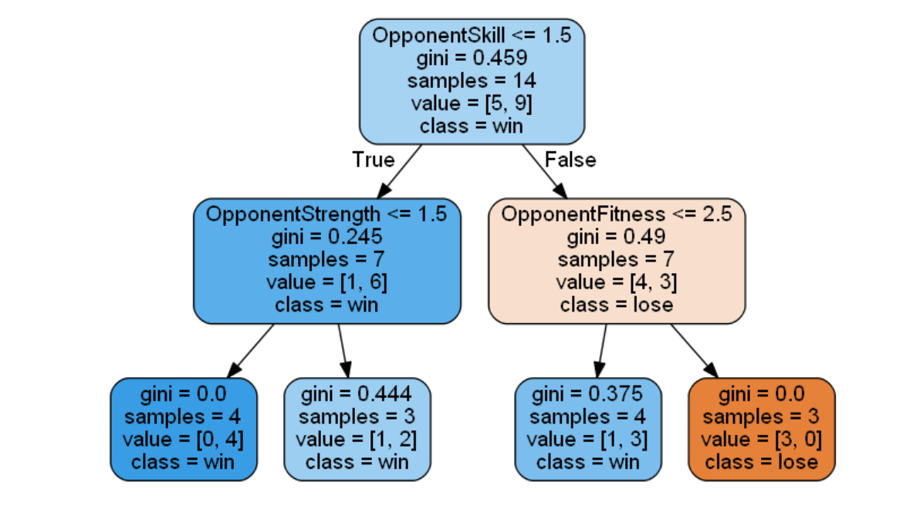
Example CART algorithm Decision Tree generated by Sci-Kit Learn

Slide 14
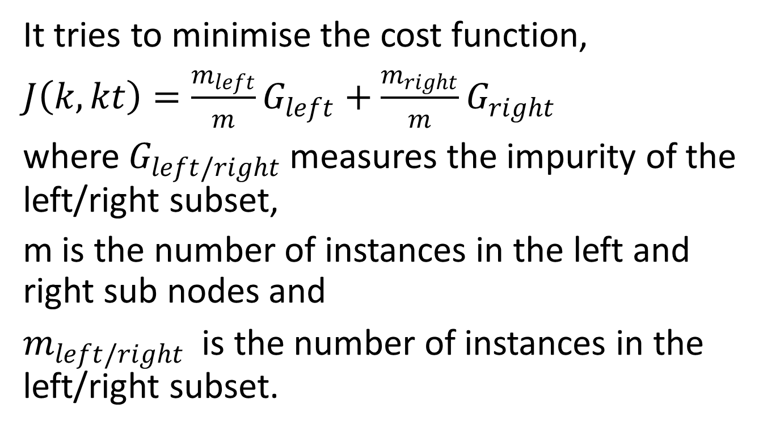
How does the CART algorithm determine the pair (k,kt)?
It tries to minimise the cost function,
$J\left(k,kt\right)=\frac{m_{left}}{m}G_{left}+\frac{m_{right}}{m}G_{right}$
where $G_{left/right}$ measures the impurity of the left/right subset,
m is the number of instances in the left and right sub nodes and
$m_{left/right}$ is the number of instances in the left/right subset.

