Slide 1
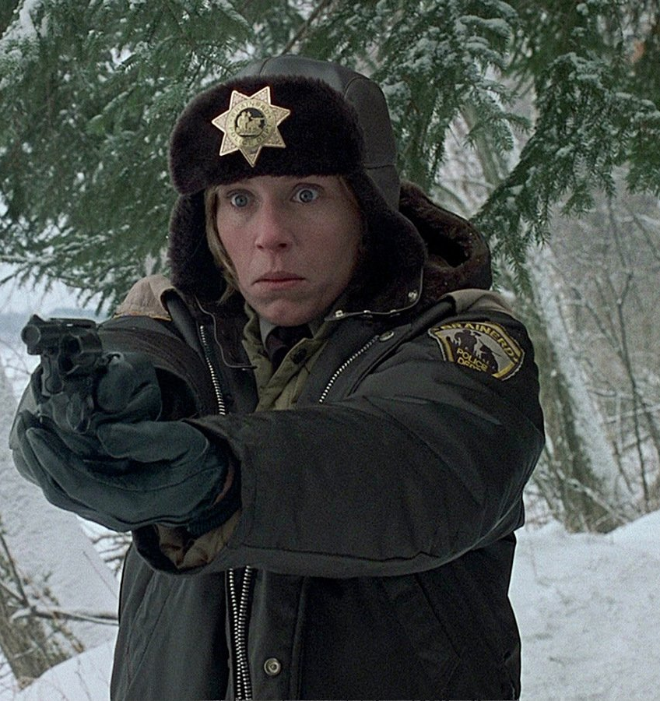
Genre Case Study
Fargo (Coens, 1996)
Fargo television series

Slide 2
The Coens, Neo-Noir, and Intertextuality
The neo-noir text references classical noir, often by ‘writing back’ and critiquing the original genre cycle (meta-textuality)
By simply interpreting the text in light of classical genre conventions, we may misread elements of the narrative.
By identifying and interpreting the intertextual references, we can enrich our viewing experience.
The Coen Brothers reference their own films. This expands the ‘story world’ so that it becomes effectively a ‘story universe’. Identifying and interpreting references to the Coens’ oeuvre further enriches the viewing experience
By incorporating what we know about the story worlds of the Coens into what we understand of noir and neo-noir we are better able to interpret texts such as Blood Simple and The Man Who Wasn’t There

Slide 3
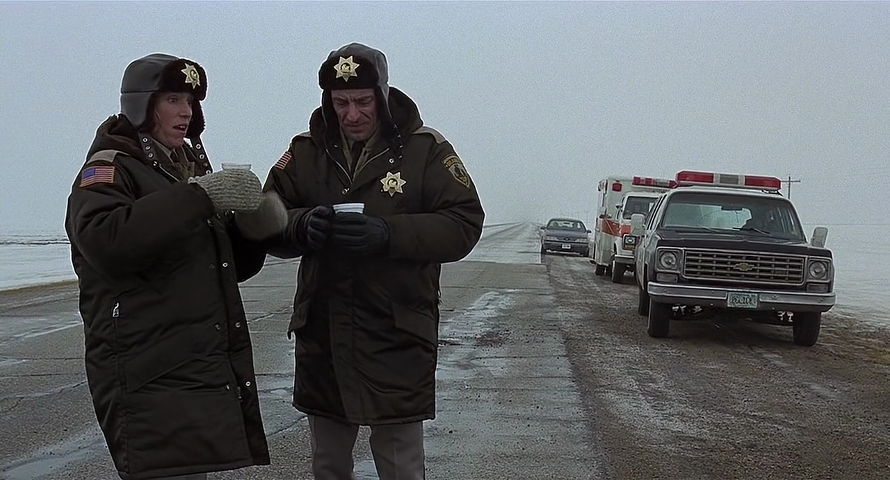

1 – Coen Brothers early work: 1980s, 1990s
2 – Later work and Fargo television series

Slide 4
Fargo
Coens, 1996
Coen Brothers 1980s-90s
Playfully subversive
Rejection of:
Male power
Critique of:
Family
Capitalism
Masculinity
Deconstructing gender:
Strong female characters
Weak male characters
Traditional wife/working woman

Slide 5
Fargo: ‘The emotional instability of men’
‘Fargo is a self-consciously odd, off-centre film … and its idiosyncrasy is in large part a displacement of familiar categories, not least of which is that the detective has the attributes of both the traditional wife and the new working woman.
‘Occupying a place of unquestioned authority [Marge] must … remain composed when faced with the results of horrifying violence. She uses logic and common sense to contain the emotional instability of men.’
R. Barton Palmer, Joel and Ethan Coen, p.81

Slide 6
Marge vs. Men: structuring oppositions
Rational Irrational
Knowledgeable Clueless
Good judgement Poor judgement
Calm Hysterical/Violent
Practical Inept
Compassionate Uncaring
Empathetic Sociopathic
Steadfast Feckless
Good Evil
Authoritative Lacking authority
In control Out of control

Slide 7
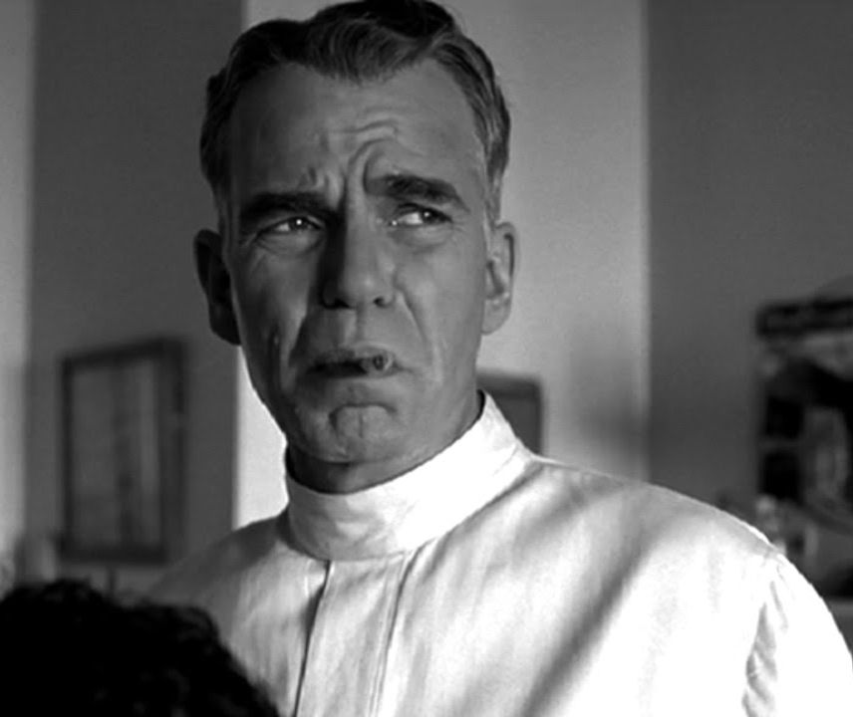
The Coens and Masculinity
  ineptitude
  impotence
  duplicity
  fragility
  instability
  hysteria
  violence

Slide 8

Fargo television series
Hawley, 2014-
Intertextuality
Rejection of:
Male power
Critique of:
Family
Capitalism
Masculinity
Deconstructing gender:
Strong female characters
Weak male characters
Traditional wife/working woman
New Media
Video on Demand (VOD)
‘story universe’

