Slide 1

CertHE Business Skills for the Workplace
EcoBrew Refill Bar
A Sustainable Coffee Refill Kiosk in Birmingham City Centre
Student name: Abel Stoica
Student ID: 2331827

Slide 2
Introduction
To present the EcoBrew Refill Bar business idea developed in Component 1.
To demonstrate alignment with LO1 by evaluating the feasibility and viability of the proposed start-up.
To meet LO2 by showing a structured, evidence-based business plan informed by entrepreneurial theory.
To justify the business concept through academic research showing that feasibility analysis improves new venture survival and performance (Burns, 2023).
To highlight the sustainability-driven value proposition, supported by studies showing that sustainable business models enhance long-term competitiveness (Bocken et al., 2014).
To demonstrate that rising consumer demand for ethical and eco-friendly products strengthens market opportunity (Kotler et al., 2022).

Slide 3
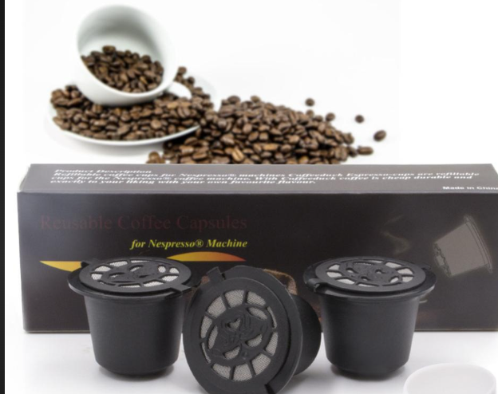
Overview of the Business Idea
Business Concept
EcoBrew Refill Bar is a zero-waste coffee kiosk offering premium coffee, teas, and refillable beans.
Designed to reduce single-use waste by encouraging reusable cups and refill systems.
Aligned with sustainable entrepreneurship principles, which emphasise reducing environmental impact while creating economic value (Cohen & Winn, 2007).
Market Opportunity
The UK remains a high-consumption coffee market, with demand resilient even during economic fluctuations (British Coffee Association, n.d.).
Consumer expectations increasingly favour ethical and environmentally responsible products (White, Habib & Hardisty, 2019).
Birmingham city centre provides strong footfall, supported by commuters, students, and event attendees—ideal for kiosk-based retail.
Unique Selling Proposition (USP)
Combines convenience, sustainability, and affordability in one service model.
Zero-waste focus differentiates EcoBrew from traditional coffee outlets, aligning with circular economy principles (Geissdoerfer et al., 2017).
Digital ordering and QR-based loyalty system enhance customer experience and operational efficiency.

Slide 4
Why Birmingham?
High Footfall: Birmingham city centre has strong pedestrian traffic supporting kiosk sales (Central BID Birmingham, 2025).
Young, Eco-Aware Consumers: Students and professionals increasingly favour sustainable brands (White et al., 2019).
Start-Up Friendly City: Birmingham is recognised as one of the UK’s fastest-growing entrepreneurial hubs (Centre for Entrepreneurs, 2023).
Pop-Up Opportunities: Regular events and markets support mobile kiosks and brand exposure (Warnaby et al., 2020).

Slide 5

Legal Format
Start as a Sole Trader:
Simple, low-cost setup and full control during early testing (Burns, 2023).
Later Convert to a Limited Company (Ltd):
Provides limited liability, higher credibility, and better access to external finance (Mazzarol, 2014).
Why This Approach Works:
Many successful small ventures begin as sole traders, then incorporate once stable cash flow is achieved (OECD, 2022).

Slide 6

Management Structure
Lean Team Structure:
Efficient small-team model reduces costs and improves operational flexibility (Barringer & Ireland, 2020).
1
Owner/Manager:
Oversees daily operations, supply chain, and financial decisions.
2
Two Part-Time Baristas:
Handle customer service, drink preparation, and maintaining service quality.
3
Freelance Accountant:
Supports compliance, bookkeeping, and financial reporting common practice in early-stage start-ups (Burns, 2023).
4
Why Lean Works:
Small teams improve adaptability and responsiveness in early venture growth (Cardon & Stevens, 2004).
5

Slide 7
PESTEL Analysis
Factor | Key Point | Relevance to EcoBrew
Political | UK start-up support schemes encourage entrepreneurship (Centre for Entrepreneurs, 2023). | Access to Start-Up Loans and local SME programmes.
Economic | Coffee demand remains stable even during inflation (ONS, 2025). | Strong and resilient customer base.
Social | Consumers increasingly prefer ethical, sustainable products (White et al., 2019). | High demand for zero-waste coffee options.
Technological | Widespread smartphone adoption drives mobile ordering (Ofcom, 2024). | Supports digital loyalty and QR-based ordering.
Environmental | UK’s Net Zero goals promote low-waste business models (Department for Energy Security & Net Zero, 2024). | Aligns with EcoBrew’s sustainability mission.
Legal | Must comply with UK food safety and allergen laws (Food Standards Agency, 2023). | Ensures safe operations and regulatory compliance.

Slide 8
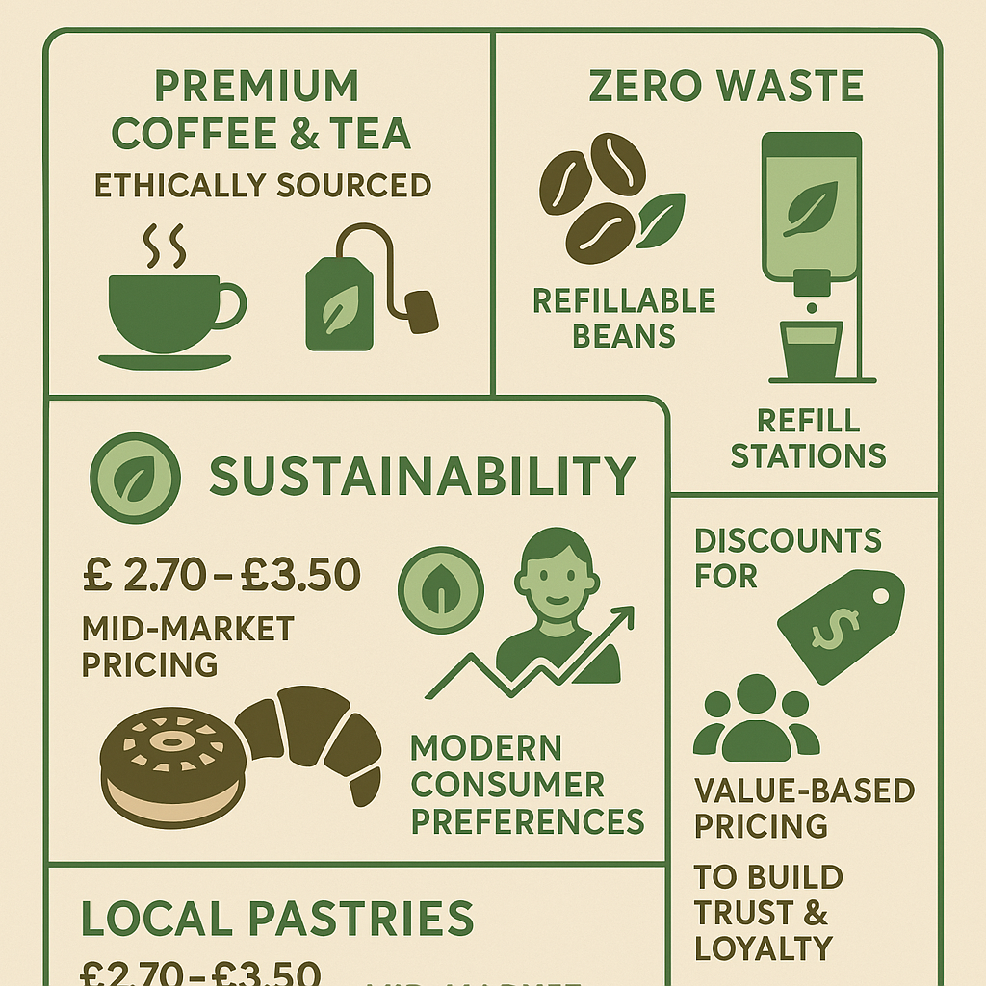
Marketing Strategy: Product & Price
Product Strategy
Premium coffee, tea, and refillable beans sourced ethically.
Zero-waste concept using reusable cups and refill stations.
Sustainable products are strongly preferred by modern consumers (White et al., 2019).
Local pastries strengthen community connection and freshness perception.
Price Strategy
Mid-market pricing (£2.70–£3.50) to balance quality and affordability.
Discounts for reusable-cup users to encourage sustainable behaviour.
Value-based pricing builds trust and supports customer loyalty (Kotler et al., 2022).

Slide 9
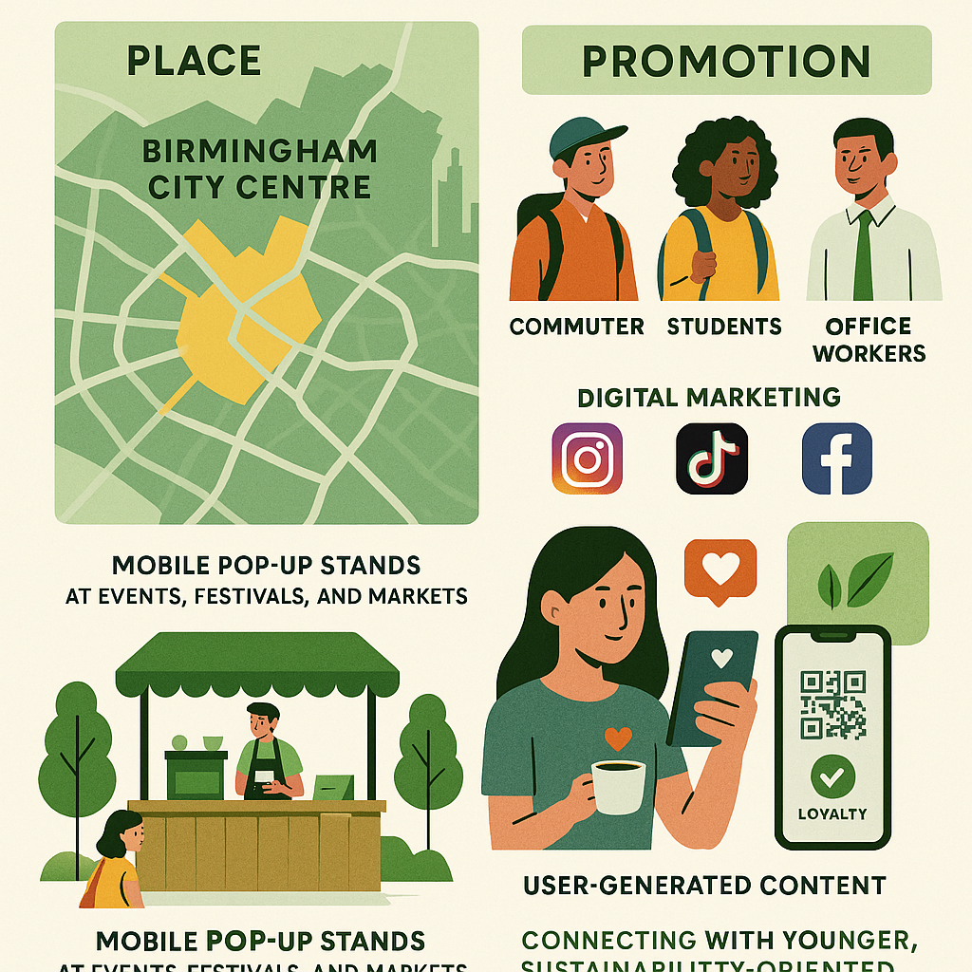
Marketing Strategy: Place & Promotion
Place Strategy
Located in Birmingham city centre for maximum footfall.
Targets commuters, students, and office workers—segments proven to drive daily coffee demand (Teller, Wood & Floh, 2016).
Mobile pop-up stands allow expansion at events, festivals, and markets.
Promotion Strategy
Strong digital marketing using Instagram, TikTok, and Facebook.
User-generated content increases brand authenticity and engagement (Ashley & Tuten, 2015).
QR-code loyalty programme rewards repeat customers and increases retention.
Social media essential for reaching younger, sustainability-oriented audiences (Ofcom, 2024).

Slide 10
Funding Requirements
Cost Category | Amount (£) | Purpose
Kiosk & Equipment | 6,000 | Coffee machines, kiosk build, energy-efficient tools
Inventory | 1,800 | Coffee beans, teas, pastries, packaging
Rent, Licences & Insurance | 3,200 | Legal setup, permits, basic insurance
Marketing & Branding | 500 | Launch marketing + social media promotion
Working Capital | 3,000 | First two months’ operating expenses
Funding Source
British Business Bank Start-Up Loan: Up to £25,000 for new SMEs at fixed 6% interest commonly used by early-stage entrepreneurs (British Business Bank, 2025).
Personal Savings Contribution: £2,000 to demonstrate commitment and reduce loan dependency.
Why This Structure Works
External financing combined with founder investment improves start-up stability and lender confidence (Robb & Robinson, 2014).

Slide 11
First-Month Cash Flow
Category | Amount (£)
Income | 10,160
Expenses
Equipment & Kiosk Setup | 5,500
Rent, Utilities & Insurance | 1,900
Stock & Supplies | 2,100
Marketing & Promotion | 180
Wages (Part-time Staff) | 1,000
Miscellaneous/Contingency | 300
Total Expenses | 10,980
Net Cash Flow | –820
Interpretation
Early-stage start-ups often operate at a small loss during the first months due to initial investments (Barringer & Ireland, 2020).
Cash deficit covered through working capital reserve included in funding plan.

Slide 12

Risk Assessment & Mitigation
Energy Cost Increases
UK businesses have faced sharp rises in energy prices (ONS, 2025).
Mitigation: Use energy-efficient coffee machines; operate during peak footfall hours.
High Market Competition
Coffee shops are a saturated market, requiring differentiation (Sirieix et al., 2013).
Mitigation: Zero-waste concept + ethical sourcing + personalised customer service.
Variable Footfall
Daily coffee sales fluctuate due to seasonality and events (Teller et al., 2016).
Mitigation: Mobile pop-ups at events; diversify locations.
Financial Liquidity Risk
Early-stage ventures often struggle with cash flow stability (Robb & Robinson, 2014).
Mitigation: Weekly cash flow monitoring; contingency funds included in budget.

Slide 13
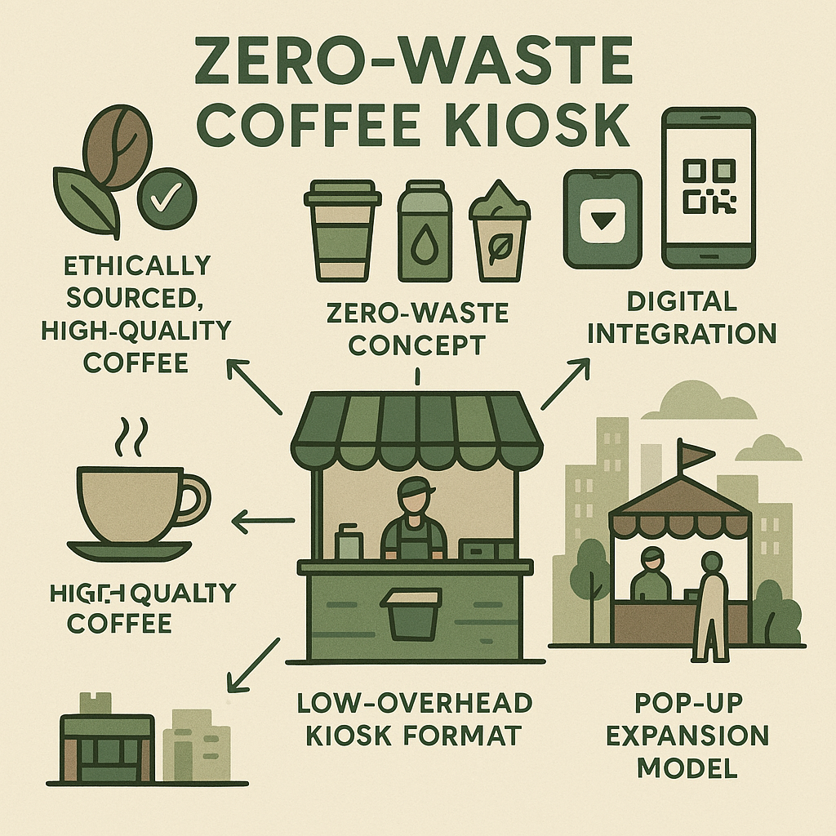
Competitive Advantage
Zero-Waste Business Model
  Strongly aligns with consumer demand for sustainable and ethical products (White et al., 2019).
Ethically Sourced, High-Quality Coffee
  Ethical sourcing enhances brand trust and loyalty (Davies & Gutsche, 2016).
Digital Integration
  Mobile ordering and QR loyalty systems improve convenience and customer retention (Pantano & Gandini, 2017).
Low Overhead Kiosk Format
  Small-format retail is cost-efficient and adaptable, supporting growth and scalability (Sorescu et al., 2011).
Pop-Up Expansion Model
  Temporary retail formats increase visibility and reduce financial risk (Warnaby et al., 2020).

Slide 14

Conclusion
EcoBrew Refill Bar presents a feasible and sustainable start-up aligned with UK market trends.
The business leverages rising demand for ethical, low-waste consumption (White et al., 2019).
A lean management model and kiosk format ensure cost efficiency and scalability (Barringer & Ireland, 2020).
Strong market fit supported by Birmingham’s high footfall and eco-aware consumer base.
Strategic use of digital tools improves customer engagement and retention (Pantano & Gandini, 2017).
Overall, EcoBrew is well-positioned to grow as a competitive, responsible, and future-ready micro-enterprise.

Slide 15
Reference List
Ashley, C. & Tuten, T. (2015) ‘Creative strategies in social media marketing’, Journal of Business Research, 68(1), pp. 175–183.
Barringer, B.R. & Ireland, R.D. (2020) Entrepreneurship: Successfully Launching New Ventures. 6th edn. Pearson.
Bocken, N.M.P., Short, S.W., Rana, P. & Evans, S. (2014) ‘A literature and practice review to develop sustainable business model archetypes’, Journal of Cleaner Production, 65, pp. 42–56.
Burns, P. (2023) New Venture Creation: A Framework for Entrepreneurial Start-ups. 3rd edn. London: Palgrave Macmillan.
Cardon, M.S. & Stevens, C.E. (2004) ‘Managing human resources in small organizations’, Human Resource Management Review, 14(3), pp. 295–323.
Cohen, B. & Winn, M.I. (2007) ‘Market imperfections, opportunity and sustainable entrepreneurship’, Journal of Business Venturing, 22(1), pp. 29–49.
Davies, I.A. & Gutsche, S. (2016) ‘Ethical consumer decision-making’, Journal of Business Ethics, 134(2), pp. 243–262.
Geissdoerfer, M., Savaget, P., Bocken, N.M.P. & Hultink, E.J. (2017) ‘The Circular Economy: A new sustainability paradigm?’, Journal of Cleaner Production, 143, pp. 757–768.
Kotler, P., Keller, K.L., Goodman, M. & Hansen, T. (2022) Marketing Management. 5th European edn. Pearson.
Pantano, E. & Gandini, A. (2017) ‘Exploring sociality mediated by innovative technologies in retail settings’, Computers in Human Behavior, 77, pp. 367–373.
Robb, A.M. & Robinson, D.T. (2014) ‘The capital structure decisions of new firms’, The Review of Financial Studies, 27(1), pp. 153–179.
Sirieix, L., Kledal, P.R. & Sulitang, T. (2013) ‘Organic food consumers’ trade-offs’, Food Quality and Preference, 28(1), pp. 1–7.
Sorescu, A. et al. (2011) ‘Innovations in retail business models’, Journal of Retailing, 87, pp. S3–S16.
Teller, C., Wood, S. & Floh, A. (2016) ‘Adaptive resilience in retail agglomerations’, Journal of Retailing and Consumer Services, 28, pp. 185–193.
Warnaby, G., Dennis, C. & Walsh, S. (2020) ‘Pop-up retailing’, Journal of Retailing and Consumer Services, 52, 101923.
White, K., Habib, R. & Hardisty, D.J. (2019) ‘How to SHIFT consumer behaviours to be more sustainable’, Journal of Marketing, 83(3), pp. 22–49.

Slide 16

This Photo by Unknown Author is licensed under CC BY-SA

