Slide 1
Social Media AND MENTAL hEALTH.
Does social media effect mental health?

Slide 2
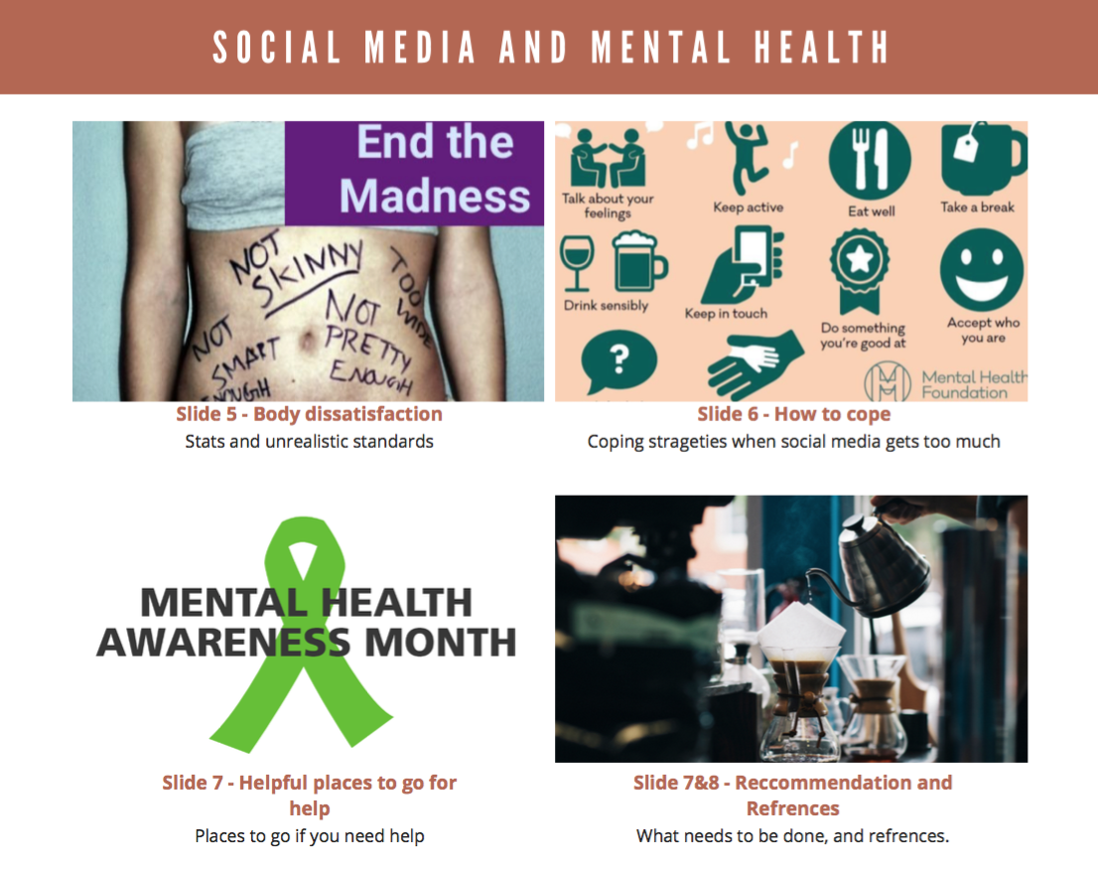
STORY BOARD

Slide 3
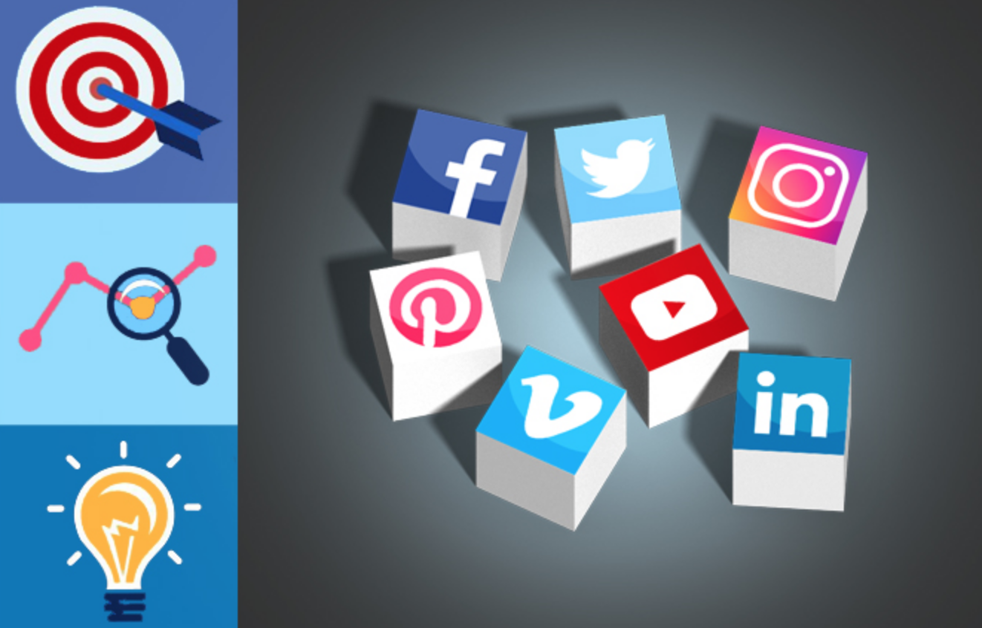
AIMS AND OBJCTIVES
To raise awareness about mental health and social media
Understand the standards made up by society in order to fit in
What price you pay by having a blue tick or being insta famous.
Self help
Raise awareness about social media and mental health
(Sean,2019)
Notes:
https://www.youtube.com/watch?v=idyXOMAZOUg

Slide 4
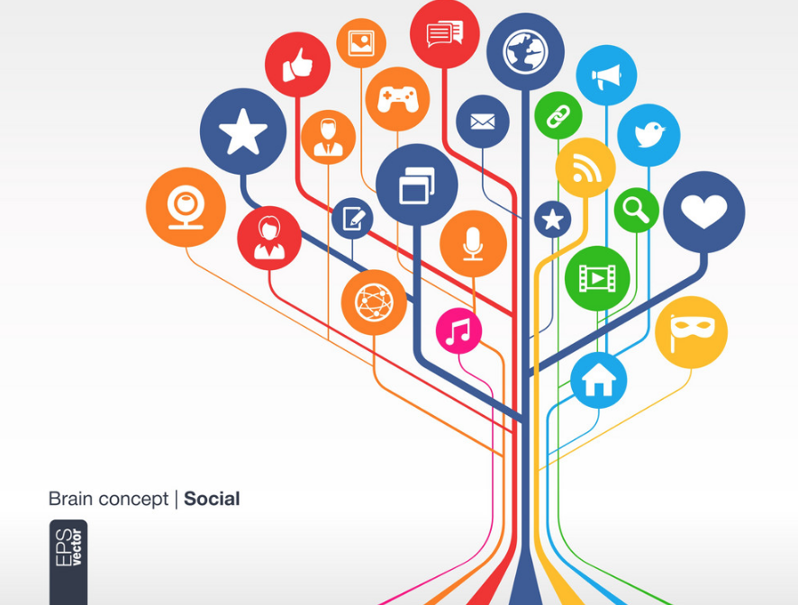
Background information
Social media was invented in order to make it easier for people to communicate over distances, share images and memories.
First social media site Six Degrees 1997 to 2001.
Myspace and LinkedIn in the early 2000s
Photobucket (2003) and Flickr (2004) allowing photo and image sharing
Youtube in 2005
Facebook and Twitter go worldwide by 2006
Tumblr, Spotify, Pinterest, and Foursquare fill certain social media niche desires
Notes:
According to Internetlivestats, this is the live action as of 11:51AM today:
2.6 million blog posts have been written
2.8 trillion searches have been conducted on Google
35.9 million photos have been uploaded to Instagram
58.4 million posts have been published to Tumblr
2.1 billion people actively use Facebook
595.8 million people actively use Google+
333.4 million people actively use Twitter
230.5 million people actively use Pinterest
3.1 billion videos have been watched on Youtube today!
The number of computers sold is 350,000 today
and, 2 million smart phones have been sold today!

Slide 5
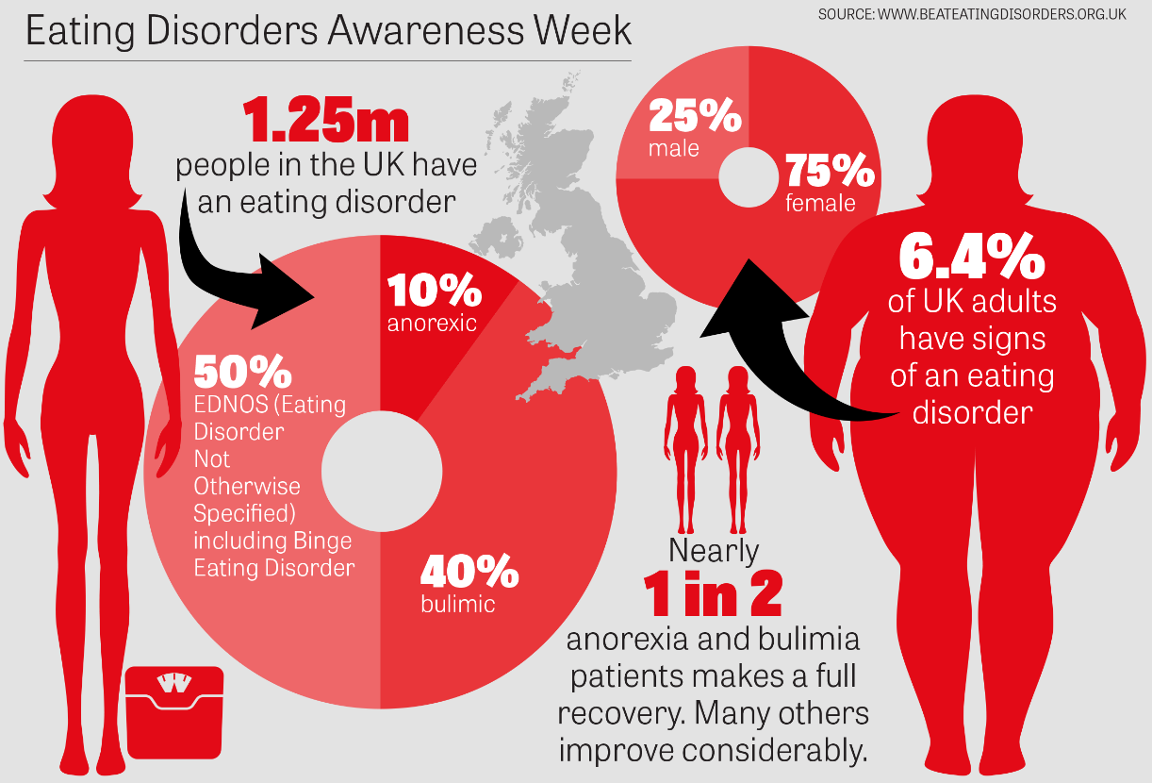
KEY ISSUES
Body dismorphia/ Anxiety/ depression Online trolling
Over exposure
Catfishing
Addiction
Cyberbullying
(Hopkins, 2019)
Notes:
So-called ‘social media addiction’ is thought to affect around 5% of adolescents and has been described as potentially more addictive than both alcohol and cigarette consumption (Jenner, 2015; Hofmann, Vohs, Baumeister, 2012).
According to the National Eating disorder “as many as 65% of people with eating disorders say bullying contributed to their condition.” According to the National Institute of mental health, “about 3 percent of U.S. adolescents are affected by an eating disorder, but most do not receive treatment for their specific eating condition.”
User participation at sites such as Blogger.com, MySpace.com, and Wikipedia.org increased by 525%, 318%, and 275% respectively. However, the networking capabilities of the Internet can cause social isolation and functional impairment of daily activities. In the workplace, Internet addictive behaviour symptoms include a decline in work performance and a withdrawal from co-workers, leading to reduced job satisfaction and decreased efficiency. Broadly speaking, addiction is defined as a “compulsive, uncontrollable dependence on a substance, habit, or practice. (

Slide 6
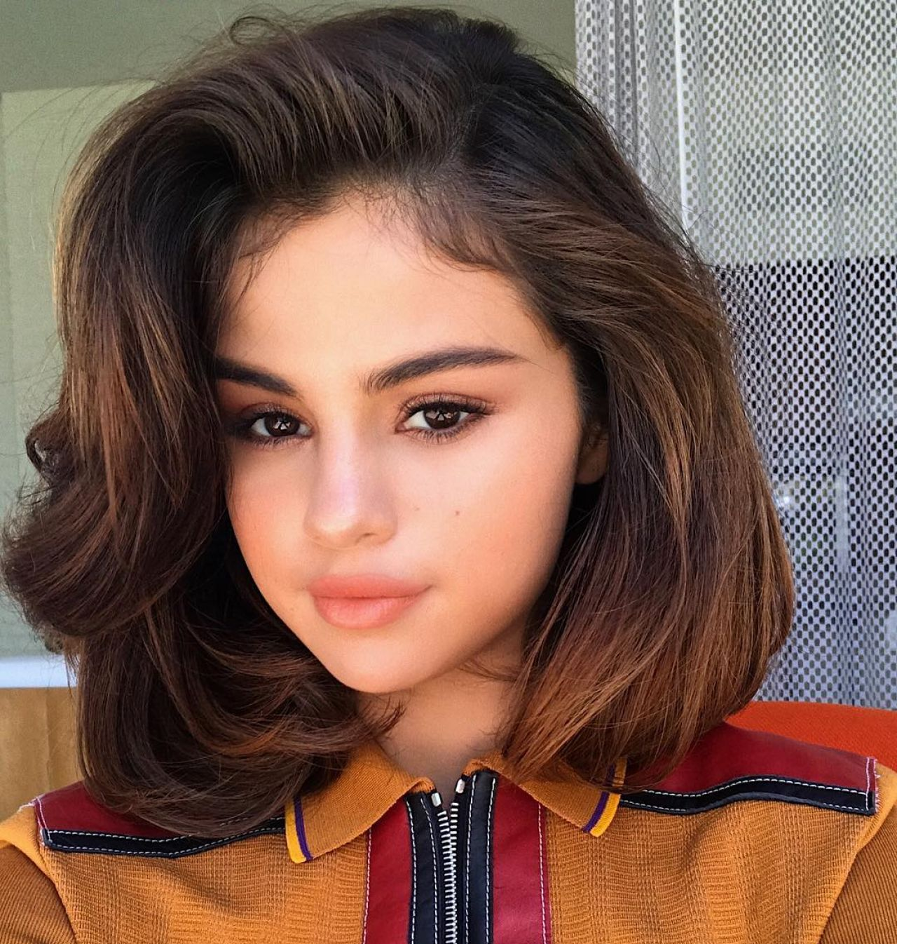
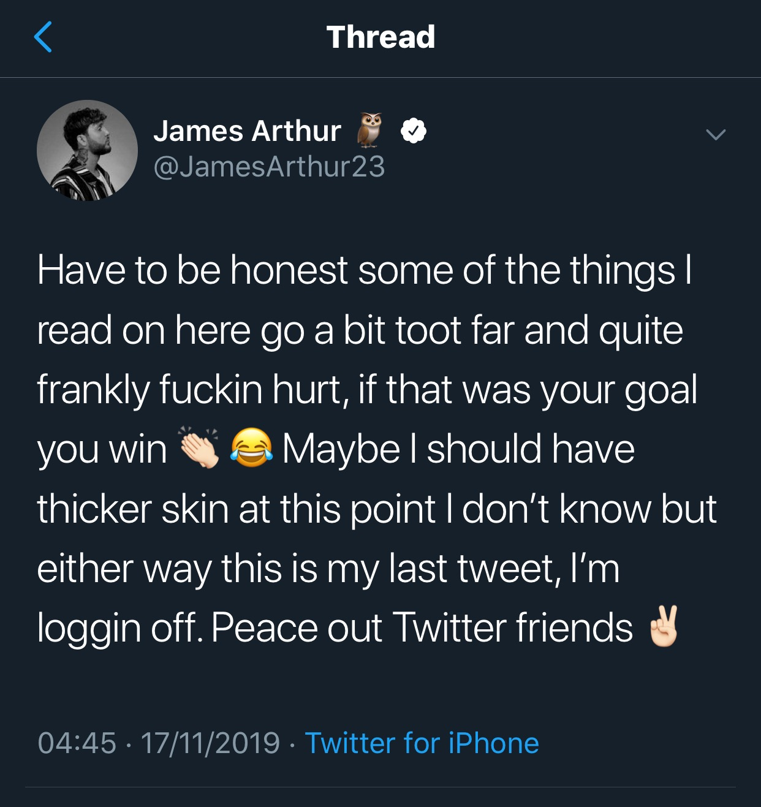
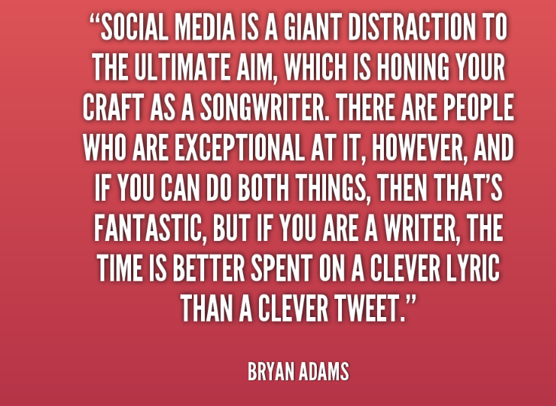
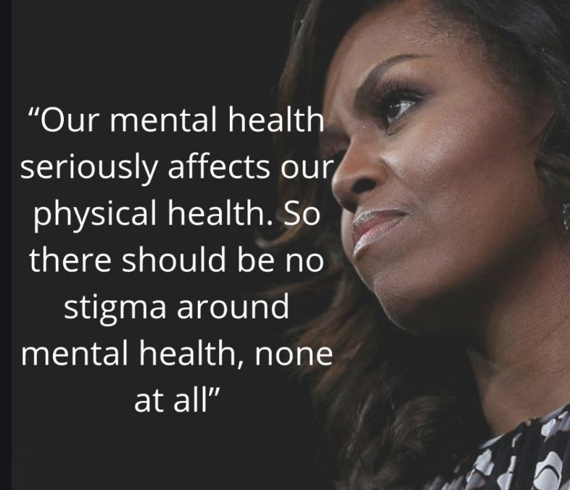
Celebrities that have opened up about mental health and the affect from social media.
“As soon as I became the most followed person on Instagram, I sort of freaked out.” The platform “had become so consuming to me. It’s what I woke up to and went to sleep to. I was an addict, and it felt like
I was seeing things I didn’t want
to see, like it was putting things
in my head that I didn’t want to
care about. I always end up
feeling like shit when I look at
Instagram.”
(Gomez, 2017)
Notes:
https://www.youtube.com/watch?v=YIG5mqXpVl4

Slide 7
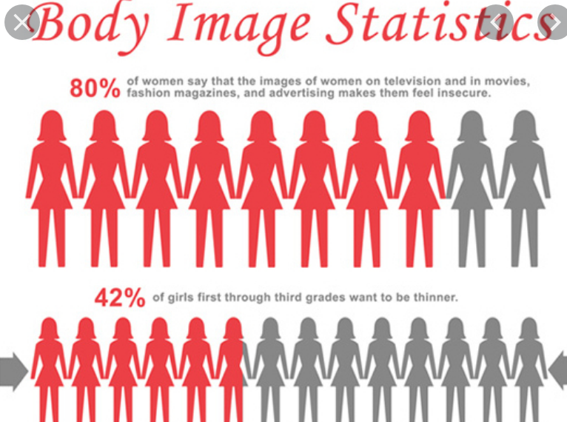
Body dissatisfaction and social media
1. South Africa: 64%
2. Russia: 45%
3. Turkey: 42%
4. India: 40%
5. China: 37%
6. Mexico: 36%
7. Germany: 34%
8. Brazil: 27%
9. US: 24%
10. Canada: 22%
11. Australia: 20%
12. UK: 20%
13. Japan: 8%
Notes:
Thee company The Dove Global Beauty and Confidence Report questioned 10,500 women aged between 10 and 60 and from 13 countries around the world.
They were asked about their self esteem. Only 20% of women revealed that they had high self esteem.
77 per cent of Australians blaming “unrealistic standards” set by media
https://www.youtube.com/watch?v=Czg_9C7gw0o

Slide 8
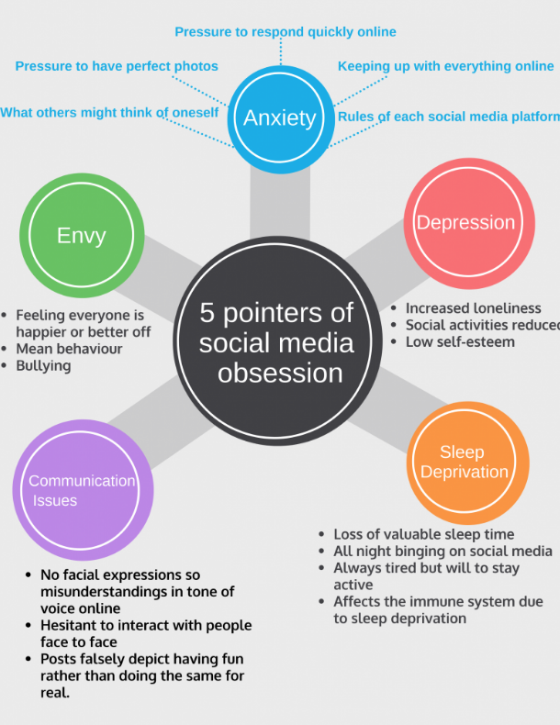
How to cope when social media gets you down.
Unplug
Unfollow
Unwind
Create boundaries
Time limit
Notes:
With a wide range of social media platforms used among all age groups including Instagram, Facebook, Snapchat, and Twitter, it can be increasingly difficult to escape the pressures and influences of social media. (huffpost, 2017)
Social media has made its way to every classroom, every household and every workplace.

Slide 9
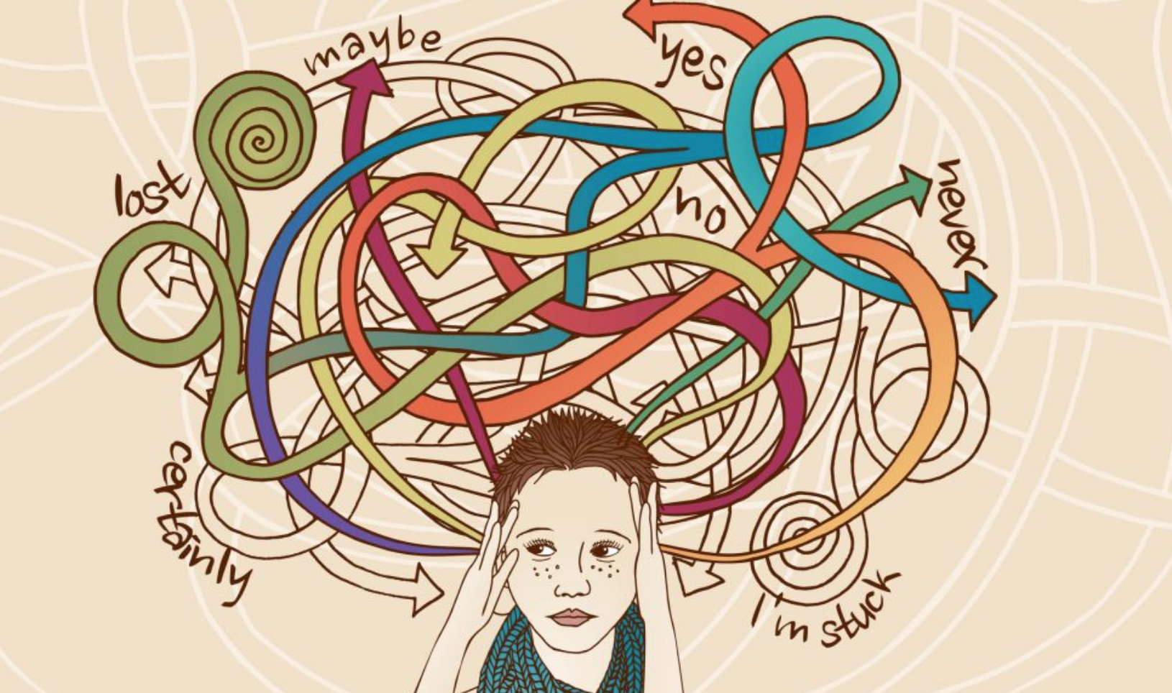
Helpful places if you are suffering.
Mind
NHS
Time to change
Samaritans
Healthy Place
Better Help
Spark support

Slide 10
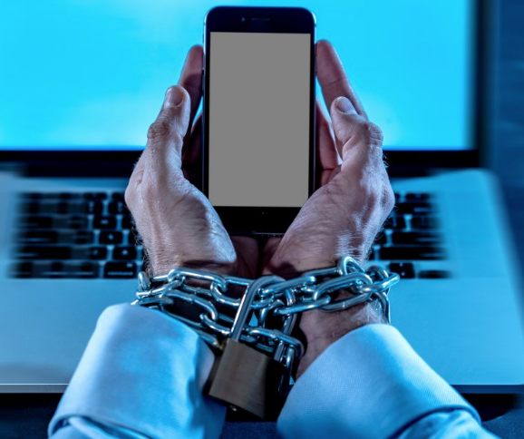
Strategic Recommendation
Creating awareness
Helping stop ridiculous society standards
Talking about the issues
Targeting the correct audiences
Overcome social media addiction

Slide 11
References
Sean. 2019. How to Set and Reach Social Media Goals for Your Business. [Online]. [12 November 2019]. Available from: https://www.lyfemarketing.com/blog/social-media-goals/
Tiffany , D.O.M.E.N.O. 2019. When Was Social Media Invented? Facts, Statistics & Key Takeaways. [Online]. [15 November 2019]. Available from: https://howtoentrepreneur.org/when-was-social-media-invented
Internetlivestats. 2019. Internet stats lives. [Online]. [14 November 2019]. Available from: https://www.internetlivestats.com/
Tiffany , D.O.M.E.N.O. 2019. Category: The History of the Internet Series. [Online]. [14 November 2019]. Available from: https://howtoentrepreneur.org/category/marketing/internet-marketing/the-history-of-the-internet-series
Sookeun byun, phd,1 celestino ruffini, bsc,2 juline e mills, phd,3 alecia c douglas, phd,4 mamadou niang, msc,5 svetlana stepchenkova, msc,2 seul ki lee, bsc,2 jihad loutfi, bsc,2 jung-kook lee, phd,6 mikhail atallah, phd,7 and marina blanton, phd8 (2009). Rapid Communication Internet Addiction: Metasynthesis of 1996–2006 . (2 ed.). Connecticut: CYBERPSYCHOLOGY & BEHAVIOR.
Madeline, L.U.C.K.E.L. 2017. Kanye West Is the Latest Celebrity to Take a Break From Social Media. [Online]. [15 November 2019]. Available from: https://www.vogue.com/article/celebrity-social-media-breaks-selena-gomez
Vanessa , B.R.O.W.N. 2016. Women’s body confidence becomes a ‘critical issue’ worldwide. [Online]. [16 November 2019]. Available from: https://www.news.com.au/lifestyle/beauty/face-body/womens-body-confidence-becomes-a-critical-issue-worldwide-dove-global-study-indicates/news-story/5bf063c6a19c838cee9464a248af6bff
Lachlan, B.R.O.W.N. 2019. How to stop overthinking: 10 effective tips. [Online]. [16 November 2019]. Available from: https://hackspirit.com/overthinking-one-biggest-causes-unhappiness-heres-stop/
Tim, H.O.P.K.I.N.S.O.N. 2019. How stereotypes are stopping people getting help for eating disorders. [Online]. [16 November 2019]. Available from: https://www.portsmouth.co.uk/read-this/how-stereotypes-are-stopping-people-getting-help-for-eating-disorders/
Ashley, M.O.R.G.A.N. 2016. The Effects Of The Media's Portrayal Of Celebrities In Society. [Online]. [16 November 2019]. Available from: https://www.theodysseyonline.com/the-effects-of-medias-portrayal-of-celebrities-in-society
Body image statistcs . 2019. Body Image Statistics. [Online]. [16 November 2019]. Available from: https://www.statisticbrain.com/body-image-statistics/
Jelena, K.E.C.M.A.N.O.V.I.C. 2019. 6 ways to protect your mental health from social media's dangers. [Online]. [16 November 2019]. Available from: https://medicalxpress.com/news/2019-05-ways-mental-health-social-media.html
Greta, G.L.E.I.S.S.N.E.R. 2017. Social Media and its Effect on Eating Disorders. [Online]. [16 November 2019]. Available from: https://www.huffpost.com/entry/social-media-and-its-effect-on-eating-disorders_b_591343bce4b0e3bb894d5caa?guccounter=1&guce_referrer=aHR0cHM6Ly93d3cuYmluZy5jb20v&guce_referrer_sig=AQAAAN3_VFJ76NBfm32TV5ZNrA8BF87vCGQNvVlC46pTp0DKwZwnLx14uyJYcLJqhVU0ArycIlXLXG4Zp82b-jWWtS_9FLsYLa6lkyl06g3HIS9-byucbla2A5O6IVJe-35qLzxlwALPxEBbyIpdagzVZme0KqSoZIP4MBVjEr5n1L0H
Hofmann, W., Vohs, K. D., Baumeister, R. F., 2012. What people desire, feel conflicted about, and try to resist in everyday life. Psychological Science, 23(6), 582-588
Horvath, J. C., Horton, A. J., Lodge, J. M., Hattie, J. A., 2017. The impact of binge watching on memory and perceived comprehension. First Monday, 22(9).

