Slide 1
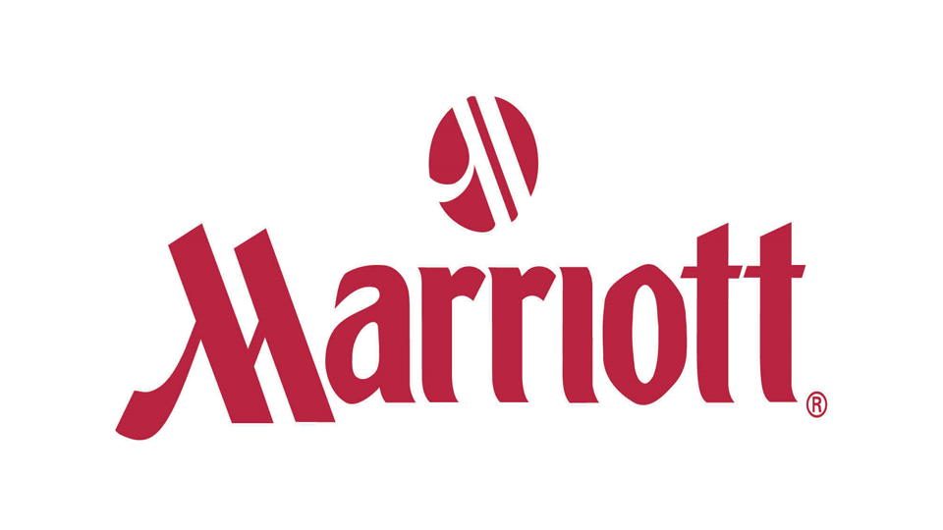
Food and Beverage operations at Forest of Arden Marriott
Student Name: Ionela Mioara Butoi
Student Number: 1816307
Lecturer: Dr Jahanzeeb Qurashi
Module Name: Food and Beverage Operations
Module Code: M4X01918

Slide 2

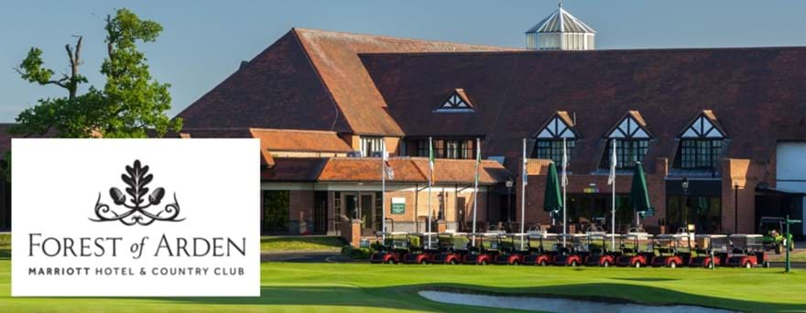
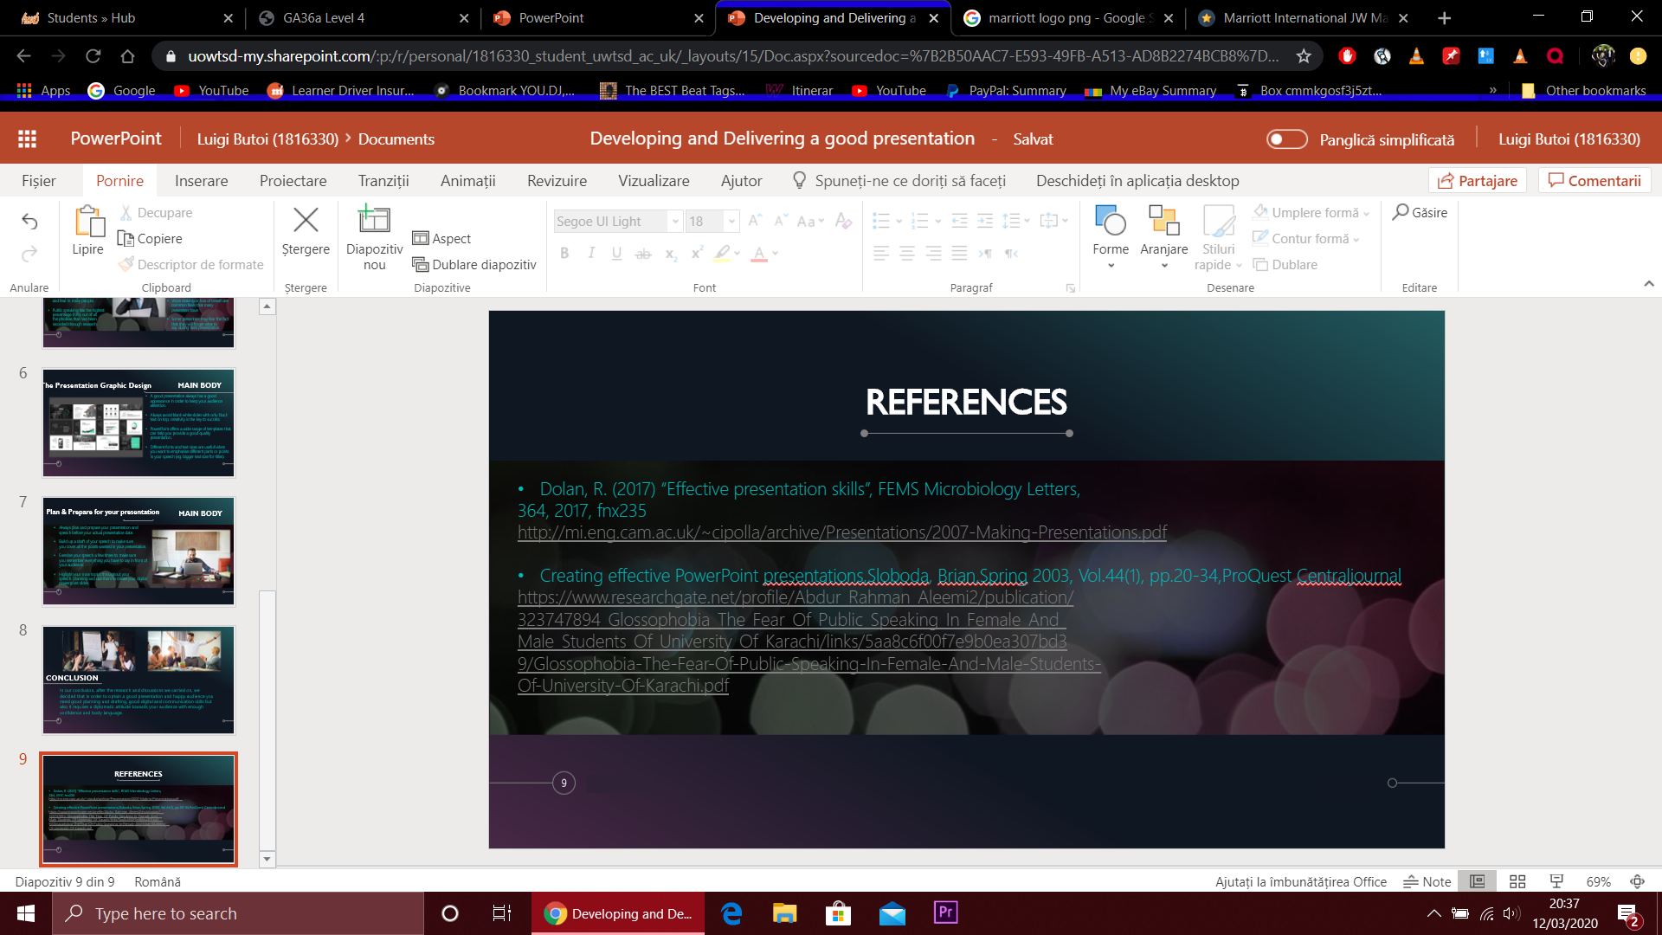
Content Page
INTRODUCTION……………………………….3
MAIN BODY………………………………..….4-9
CONCLUSION…………………………….…...10
REFERENCES…………………………………….11

Slide 3

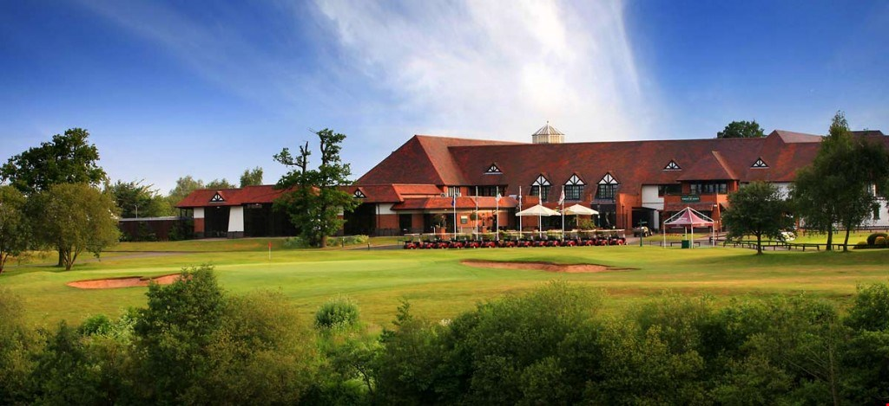
INTRODUCTION
In today's presentation I will be talking about Food and Beverage operations at Forest of Arden Marriott, the hotel and country club we have recently visited in a field trip. Food and Beverage is one of the main departments in such industry and during this presentation I will discuss the importance of it and how the company is using their resources to meet the hospitality goals.

Slide 4
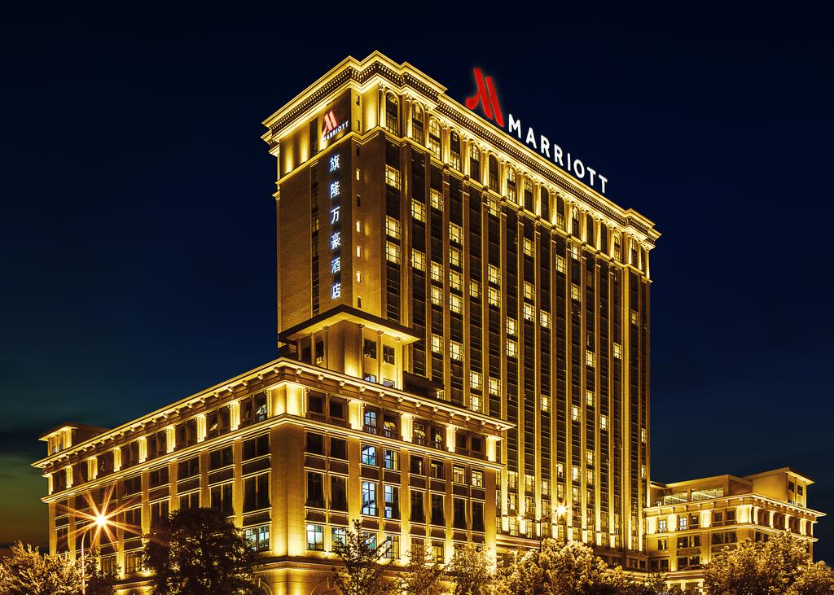
Marriot is one of the biggest hotel chain company that is currently owning over 7000 properties on a worldwide scale. The whole brand has first started in 1927 as a root beer stand founded by J. Willard Marriott and his wife, following years ahead growing their business bigger than they ever expected. They first opened their first hotel in 1957 which was situated in Arlington, Virginia, this being their first step into the hotel industry. Around 2015-2016 Marriott has acquired most of the hotel chains in U.S. which has allowed the business to expand with 1800 more international properties (S. Lock, 2019).
History of Marriott

Slide 5
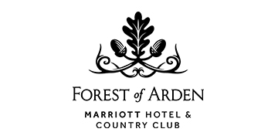

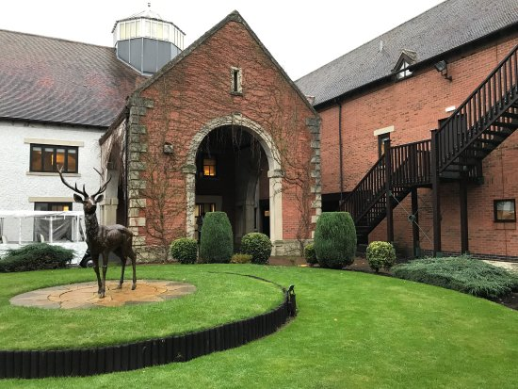
History of Forest of Arden Marriott
Forest of Arden is one of Marriott's best located hotels in UK, providing their Guests with a pleasant, natural and clean environment during their accommodation. The estate is a natural reserve, full of deer and old oak trees, with a natural golf field established in 1975 before the hotel was in place. The Forest of Arden Hotel & Country club first opened for business in 1989 and it was rebranded the "Marriott Forest of Arden" in 1996 and the whole hotel was upgraded to Marriott's standards.

Slide 6
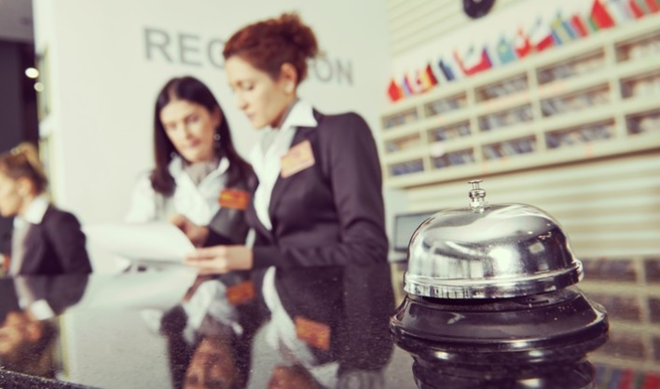
Types of Operations at Forest of Arden Marriott
Some of the main operations at Forest of Arden Marriott are:
Human Resources
Housekeeping
Security
Sales and Finance
Spa and Leisure
Food and Beverage
Front office
Facilities
Next, I will expand in more details how Forest of Arden Marriott is using their resources for Food and Beverage in order to meet the company's hospitality goals.

Slide 7
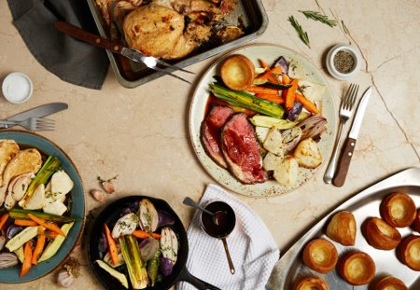
Food and Beverage Operations at Forest of Arden Marriott
They have a weddings venue where they offer different packs and meals for wedding guests making the preparation and booking for a wedding much easier. "You can observe profits from weddings when it comes to food and beverage departments and the management cannot disregard this type of operations" (H. Adler, 2004). They also provide the golf club with food and beverage which is an advantage by gaining more customers that enjoy golf and at the same time enjoy a fresh meal.

Slide 8
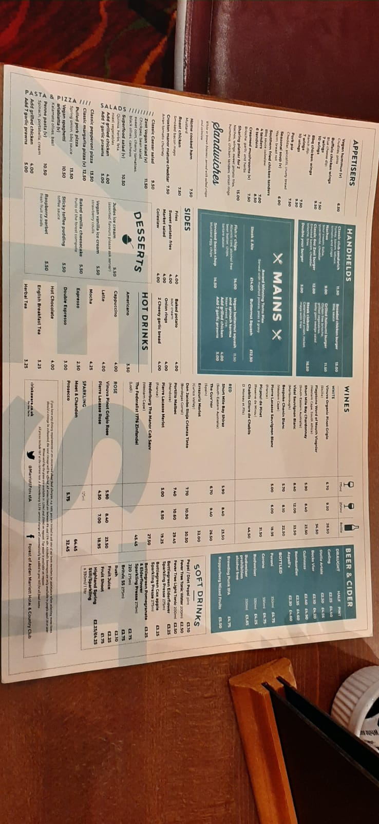
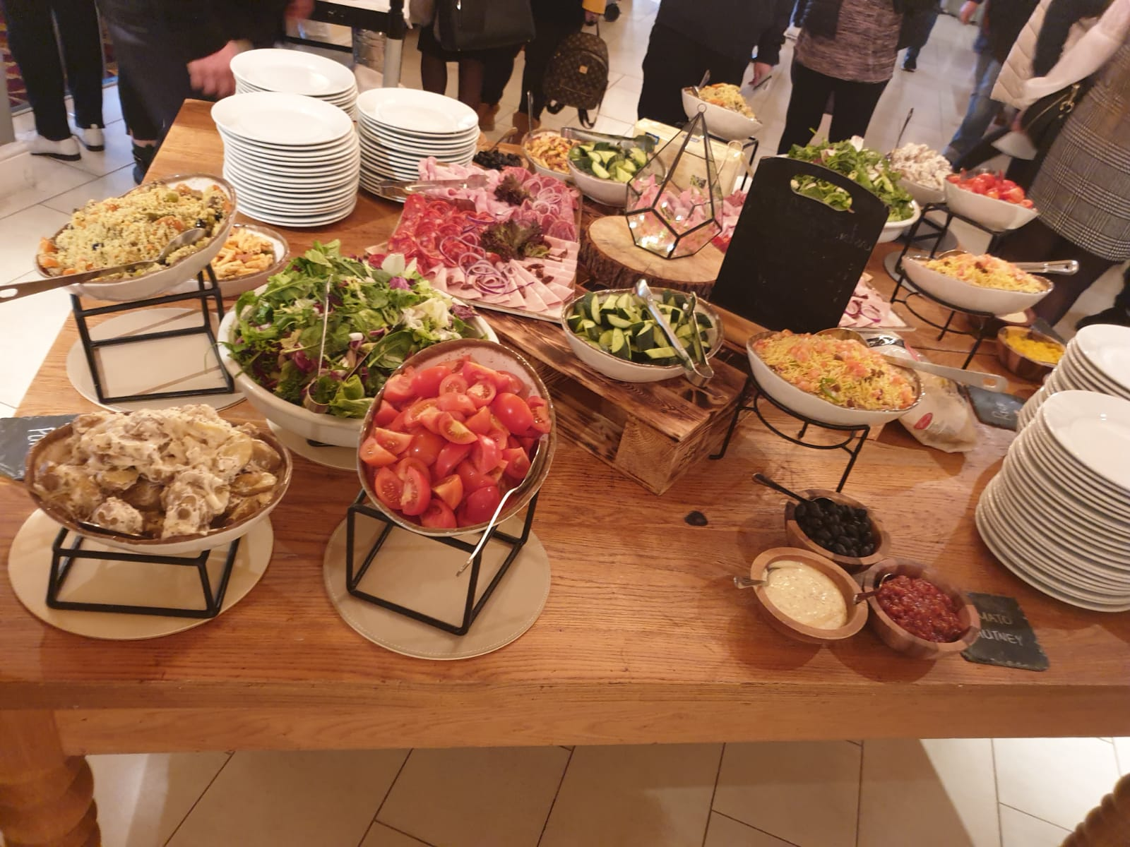
Types of Menus and Products at Forest of Arden Marriott
Marriott has a wide range of meals and food freshly supplied from local sources and keeping a relatively low and decent price. Two on-site restaurants are available for customers and guests. Fresh meat on grill but also snacks and sandwiches are available on site. They provide traditional meals but also international food in order to meet guest's expectation from all over the world.
Grill / Fresh Meals / Natural Juice and drinks / Fruits and Vegetables /
Snacks and Sweets / Desserts / Hot Drinks / Appetisers / Handhelds /

Slide 9
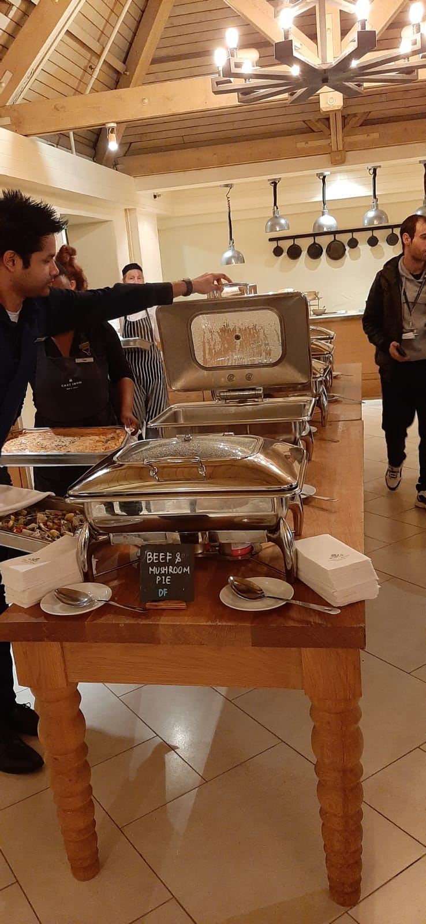
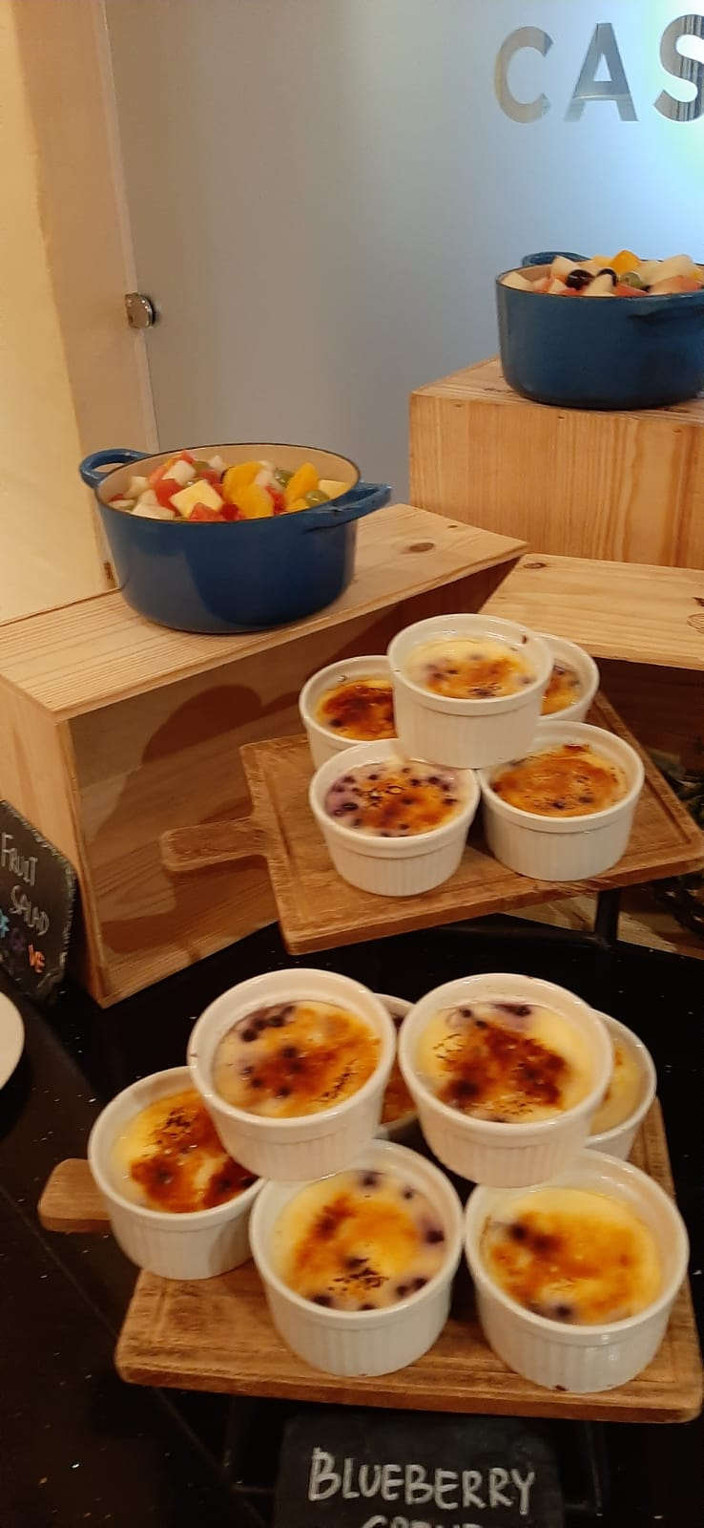
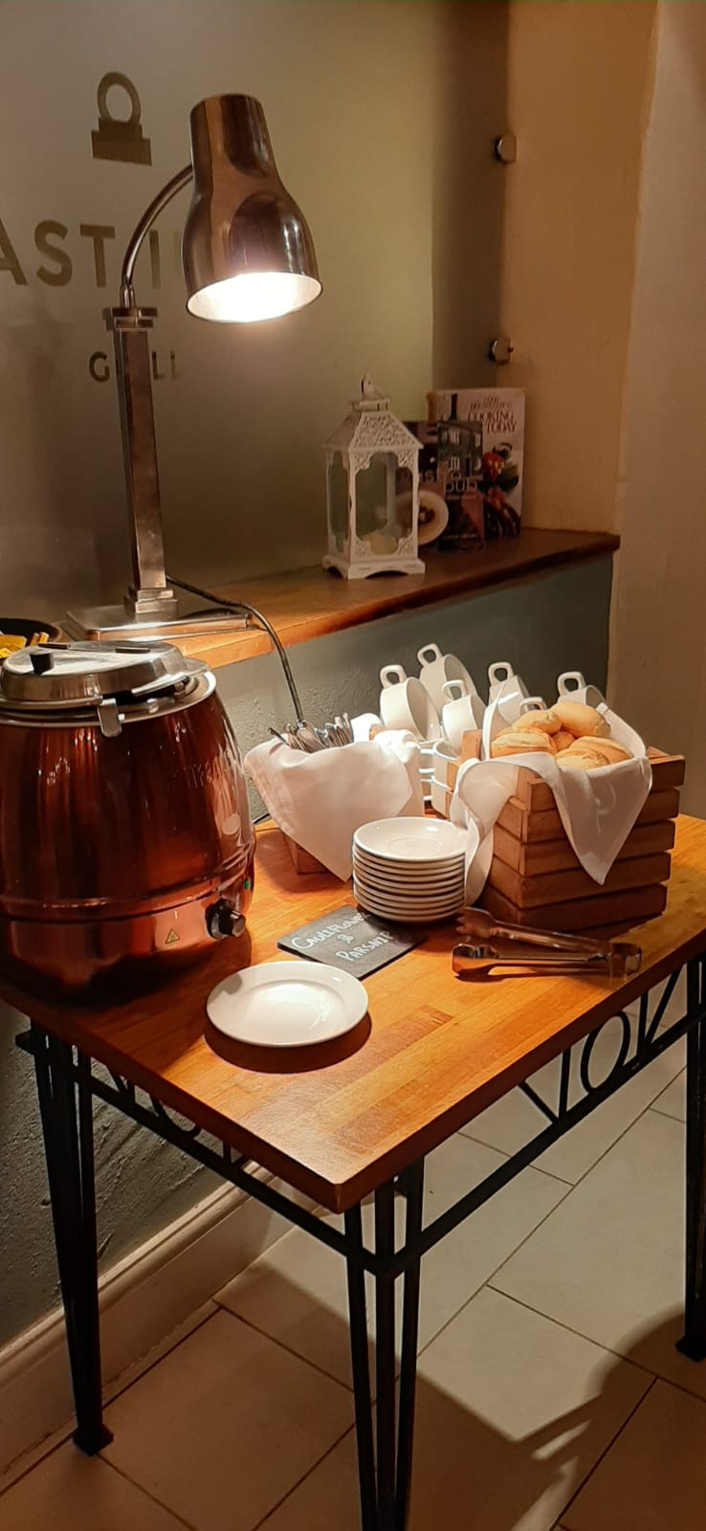
Types of Kitchens at Forest of Arden Marriott
The forest of Arden Marriott has a wide variety of serving methods, they have open self-serving buffets where the food is brought by catering companies but also some of the food is prepared on-site. They have modern kitchens with plenty of equipment in order to prepare a wide range of food products. "Spa hotel customers have expectations of receiving freshly-prepared, healthy, organic foods rather than artificial, pre-prepared foods" (Bastic and Gojcic, 2012; Mueller and Kaufmann, 2001; Saar, 2010).

Slide 10
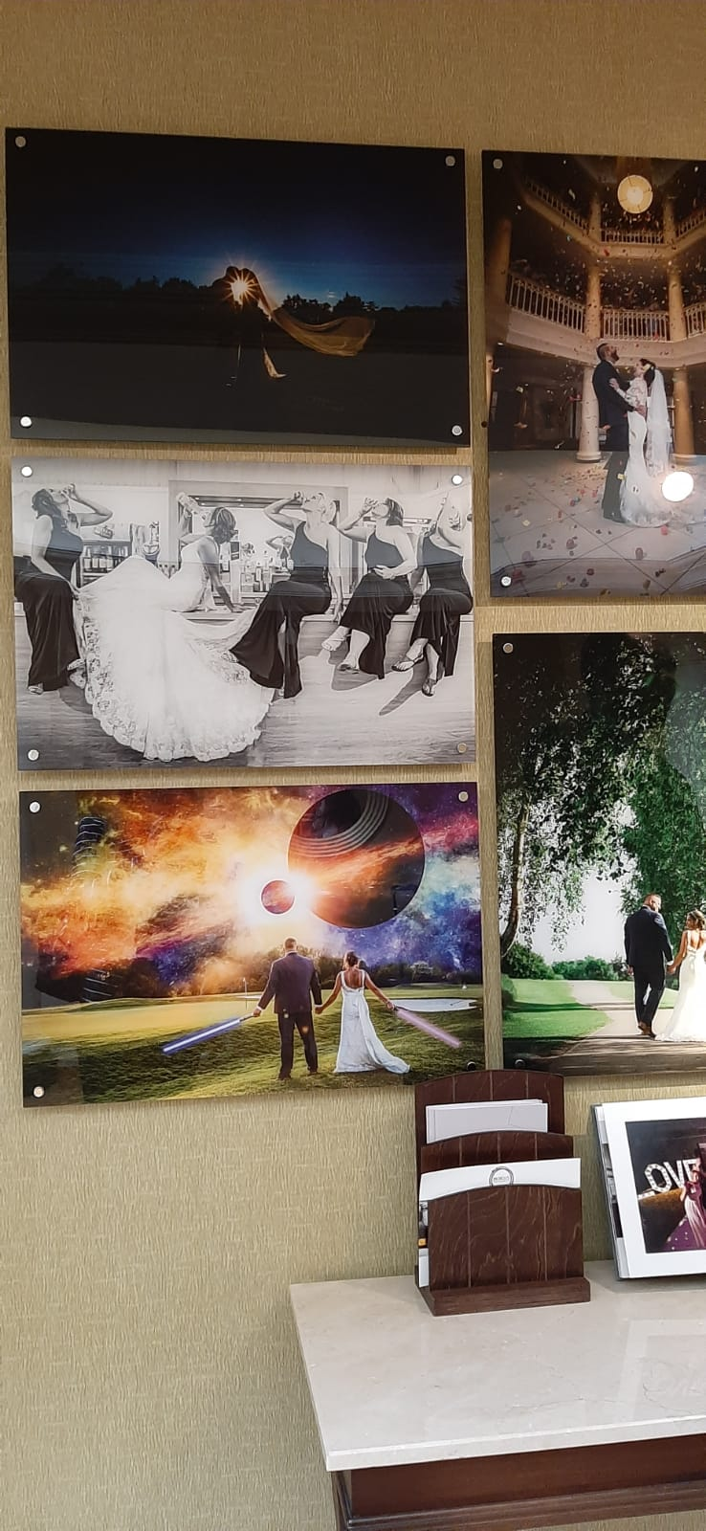
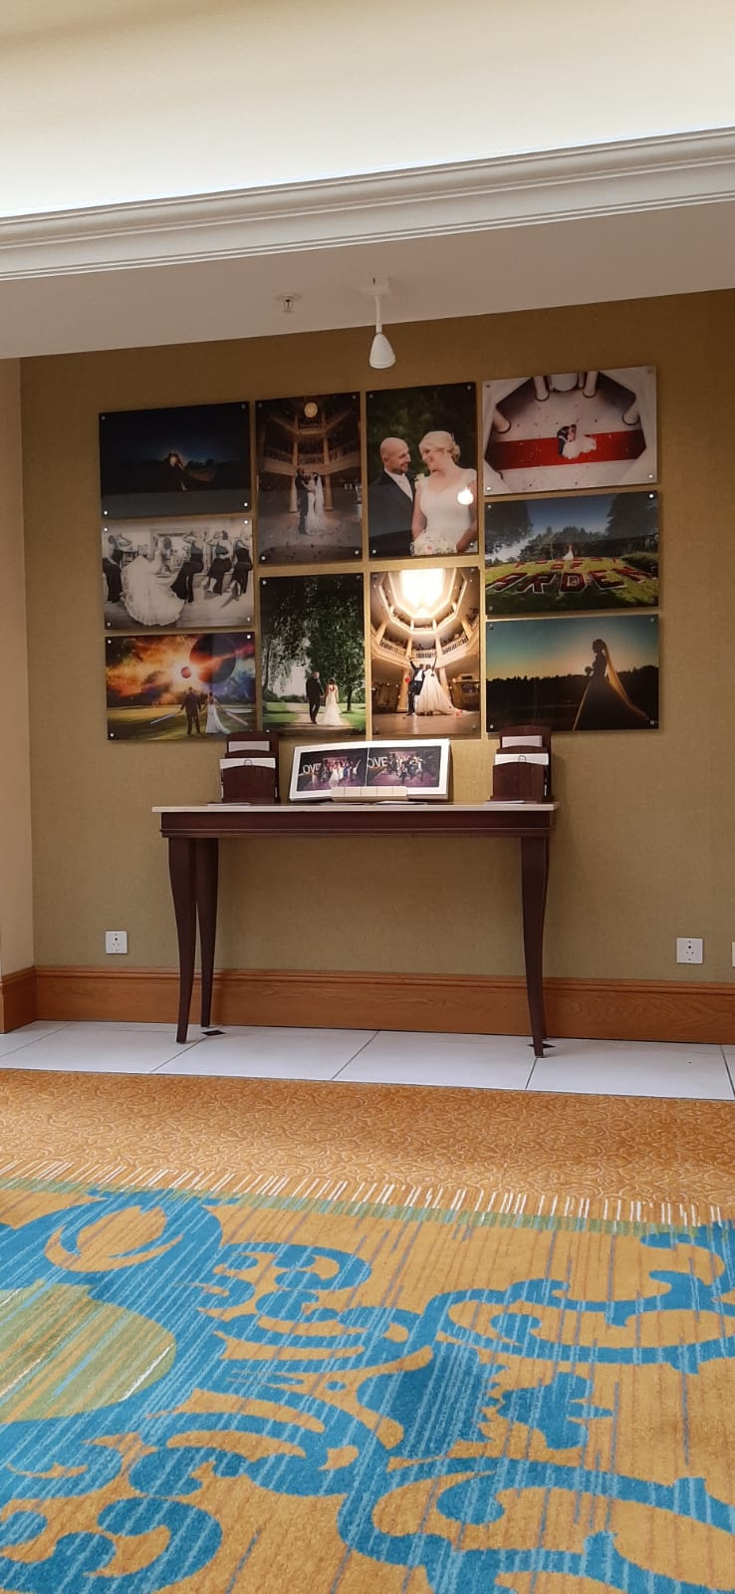
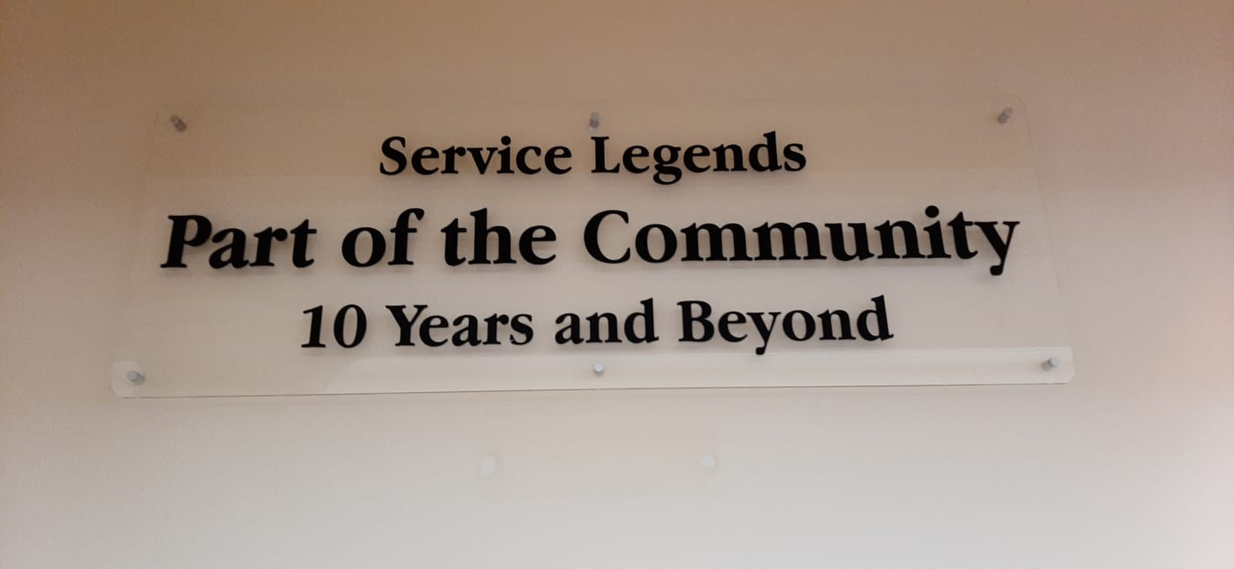
Marketing at Forest of Arden Marriott
The Food and Beverage operation at Forest of Arden Marriott is one of the main marketing operation for the hotel because it gives the management the opportunity to expand the business and not only limit to rooms accommodations. "Whether food and beverage is provided by the hotel management or it is leased out to another operator, this operation is crucial to the hotel's image, and therefore remains closely linked to success (Hallam, G. and Baum, T., 1996).

Slide 11

Health and Safety (Hygiene) at Forest of Arden Marriott
Health and Safety is treated very seriously at Forest of Arden Marriott, the management team making sure all the time that the equipment is up to date and used correctly, also new staff members are trained before starting the job to make sure they know how to use the equipment is a safe and hygienic way. "Occupational health and safety law in the UK has since the 1970s encouraged self-regulation. An important element of self-regulation is the principle that employers should be able to manage safety in their own businesses" (Dawson, Willman, Bamford and Clinton, 1998).

Slide 12
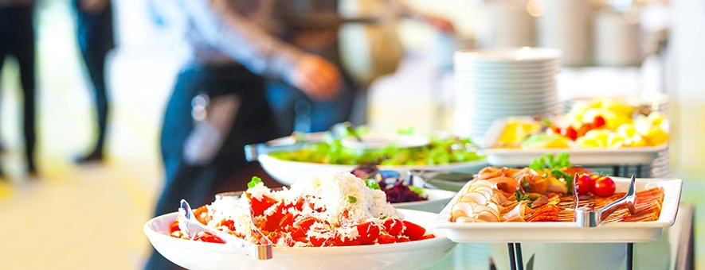
CONCLUSION
In my conclusion, Food and Beverage is a successful operation among any hotel which provides the company with a financial boost but also keeps the hotel's image nice and positively appreciated.
"Previous studies indicate that the outsourcing of hotel restaurants can offer financial benefits for both parties, the hotel and the guests" ( Hemmington, N. and King, C., 2000).

Slide 13
REFERENCES
Giritlioglu, I., Jones, E. and Avcikurt, C., 2014. Measuring food and beverage service quality in spa hotels. International Journal of Contemporary Hospitality Management.
http://dspace.balikesir.edu.tr/xmlui/bitstream/handle/20.500.12462/8558/ibrahim-giritlio%C4%9Flu.pdf?sequence=1&isAllowed=y
Howard Adler & Tzu Chu Chienm (2004) The Wedding Business, Journal of Foodservice Business Research, 7:1, 117-125, DOI: 10.1300/J369v07n01_08
https://www.tandfonline.com/doi/abs/10.1300/J369v07n01_08
Hallam, G. and Baum, T., 1996. Contracting out food and beverage operations in hotels: a comparative study of practice in North America and the United Kingdom. International Journal of Hospitality Management, 15(1), pp.41-50.
https://www.sciencedirect.com/science/article/pii/0278431995000550
Hemmington, N. and King, C., 2000. Key dimensions of outsourcing hotel food and beverage services. International Journal of Contemporary Hospitality Management.
https://www.researchgate.net/profile/Nigel_Hemmington/publication/261099812_Key_dimensions/links/004635333935607f94000000/Key-dimensions.pdf
Maguire, K. and Howard, M., 2001. A study of the social and physical environment in catering kitchens and the role of the chef in promoting positive health and safety behaviour. International Journal of Environmental Health Research, 11(3), pp.203-217.
http://irep.ntu.ac.uk/id/eprint/7700/1/184604_2327%20Maguire%20postprint.pdf
Statista, Travel, Tourism and Hospitality, Accommodations, Published by S. Lock, Mar. 20, 2019.
https://www.statista.com/topics/1872/marriott-international/

