Slide 1
Introduction
Lecture 1: Application Development (AppDevWeb)
Dr Kemi Ademoye

Slide 2
Today’s Lecture
Overview of Module
HTML and CSS Recap
Introduction to Responsive Web Design

Slide 3


Module Aim
The aim of this module is to provide you with a systematic understanding of the concepts underlying the implementation of interactive web, games, desktop or mobile experiences.
The module will focus on web applications and will cover two main areas:
  Client-side Responsive Web Development
  Server-side Web Development with Microsoft ASP.NET

Slide 4
Module Assessment
100% Coursework
  Coursework 1
    Hand out: October 2019
    Hand in: December 2019
  Coursework 2
    Hand out: February 2020
    Hand in: April/May 2020

Slide 5
Reading Materials
Books
  The reading list is available on Moodle under the reading materials section.
Online Resources
  A list of online resources is also available on Moodle in the sidebar.

Slide 6
Application Development

Slide 7
HTML and CSS Recap
Log on to Moodle for the
Test ☺

Slide 8
The Web Design Layout Problem
Web Designers¹
  desire the control available in the print medium
  view the flexibility of the web medium a limitation.
Initially, the problem was:
  Screen sizes got larger
  Too many browsers behaving differently
Now:
  Screen sizes are both smaller and larger!
  And the browsers still behave differently!
Notes:
¹A Dao of Web Design. Available: http://alistapart.com/article/dao [accessed: 08-Oct-2018]

Slide 9

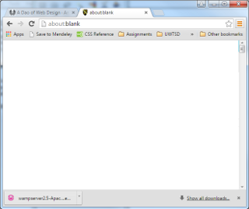
Screen Size or Viewport Problem?
The Viewport is actually what you need to design for, not the screen size!
Viewport: actual display area of the content within the browser, excluding toolbars, tabs, etc.
Screen size: physical display area of a device.
Screen size
Viewport size

Slide 10
What is Responsive Web Design?
Responsive Web Design (RWD) is the presentation of web content in the most relevant format for the viewport and device accessing it.
Ben Frain¹
It uses HTML and CSS to achieve this!
Responsive Web Design =
  Flexible Grid Layout + Flexible Images and Media + CSS Media Queries
Ethan Marcotte
Notes:
¹Responsive Web Design with HTML5 and CSS3, 2nd Edition, Packt (2015), By Ben Frain
Responsive Web Design by Ethan Marcotte: http://alistapart.com/article/responsive-web-design [accessed: 08-Oct-2018]

Slide 11
Responsive Web Design Rule 1
Mobile First!
  Design content for mobile devices first.

Slide 12
RWD and the Viewport Meta Tag
Modern Browsers tend to auto-resize the page (shrink/scale) content to fit the viewport.
  The scaled down display on small devices is often quite small and may be difficult to read.
HTML5 introduced the <meta> viewport tag to enable web developers take over the viewport:

Slide 13
The Viewport Meta Tag
The viewport <meta> tag is added to the <head> section of a page:
  <meta name="viewport" content="width=device-width, initial-scale=1.0" />
  width=device-width sets the width of the page to follow the screen width of the device.
  initial-scale=1.0 sets the initial zoom level when page first loads i.e. zoom to full size.
Notes:
The shrink-to-fit attribute is added to support Safari browsers. In 2015, iOS 9 was released and with it Apple changed how Safari handled the initial viewport zoom on page load.
See more:
https://www.google.com/search?q=html+viewport+shrink-to-fit
https://www.scottohara.me/blog/2018/12/11/shrink-to-fit.html

Slide 14
The Viewport Meta Tag
iOS 9, however, changed how Safari works and to support the browser the following was added:
  <meta name="viewport" content="width=device-width, initial-scale=1.0, shrink-to-fit=no" />
  shrink-to-fit=no stops Safari from resizing page to fit the largest fixed width element found on the page and then shrinking all other content based on this width.
There are, however, suggestions that this is no longer needed as use of iOS 9 is now very low.
Notes:
See more:
https://www.google.com/search?q=html+viewport+shrink-to-fit
https://www.scottohara.me/blog/2018/12/11/shrink-to-fit.html
For more information on why shrink-to-fit was introduced, see:
https://bitsofco.de/ios-safari-and-shrink-to-fit/ [accessed: 08-Oct-2018]
https://developer.mozilla.org/en-US/docs/Mozilla/Mobile/Viewport_meta_tag
https://www.quirksmode.org/mobile/viewports2.html
http://kihlstrom.com/2015/shrink-to-fit-no-fixes-zoom-problem-in-ios-9/

Slide 15
Page Layouts Grids Recap
Website content is usually displayed in a grid.
Grid systems are popular in web design and other visual design fields.
A grid system arranges content horizontally (rows) and vertically (columns) in a grid.
Question: Why do we use grids?

Slide 16
Grid Systems In Web Design:
The Design
Row 1
HEADER SECTION
Spans the 12 columns of the grid
Row 2
SIDEBAR SECTION
Spans 3 columns of the grid
MAIN CONTENT SECTION
Spans 9 columns of the grid
Row 3
FOOTER SECTION
Spans the 12 columns of the grid
Notes:
Grids are used to achieve an important web design principle: alignment.
Alignment is about organising information to create order.
Each element on the page visually connects to other elements on the page.
The grid lines, even when invisible, connect elements and make divisions on the page, creating order.
Alignment is the “A” of C.R.A.P. Design (https://www.google.com/search?q=crap+design), the four basic principles of good design.

Slide 17
Grid Systems in Web Design:
The CSS
CSS classes for the elements of the grid, usually:
.container: representing the grid
.row: representing a row
For a 12-column version, you will need 12 column classes representing when the content spans:
  1 column e.g. .col-1
  2 columns e.g. .col-2
  …
  12 columns e.g. .col-12

Slide 18
Grid Systems in Web Design:
The HTML - Two solutions for previous slide design
<header>
<div class="container">
<div class="row">
<div class="col-12">
<!-- Header Content -->
</div>
</div>
</div>
</header>
<main>
<div class="container">
<div class="row">
<section class="col-9">
<!-- Col 1, Main Content -->
</section>
<aside class="col-3">
<!-- Col 2, Side Bar Content -->
</aside>
</div>
</div>
</main>
<footer>
<div class="container">
<div class="row">
<div class="col-12">
<!-- Footer Content -->
</div>
</div>
</div>
</footer>
<div class="container">
<header class="row">
<div class="col-12">
<!-- Header Content -->
</div>
</header>
<main class="row">
<section class="col-9">
<!-- Col 1, Main Content -->
</section>
<aside class="col-3">
<!-- Col 2, Side Bar Content -->
</aside>
</main>
<footer class="row">
<div class="col-12">
<!-- Footer Content -->
</div>
</footer>
</div>
Can you think of what the difference between these two structures is?
Notes:
The first design:
has three separate grids, each with one row for the content
Provides the most flexible solution For example, it is easier to have different background colours for the header, main and footer sections with the HTML structure.
The second design has one grid with three rows for the content.

Slide 19
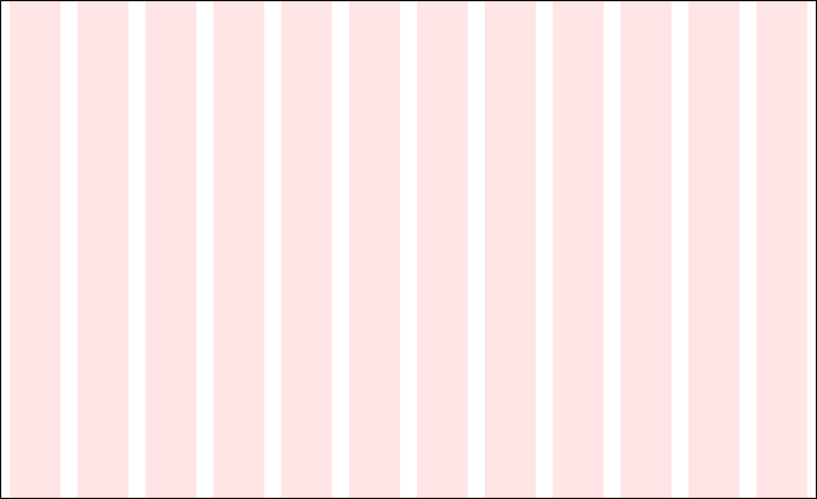
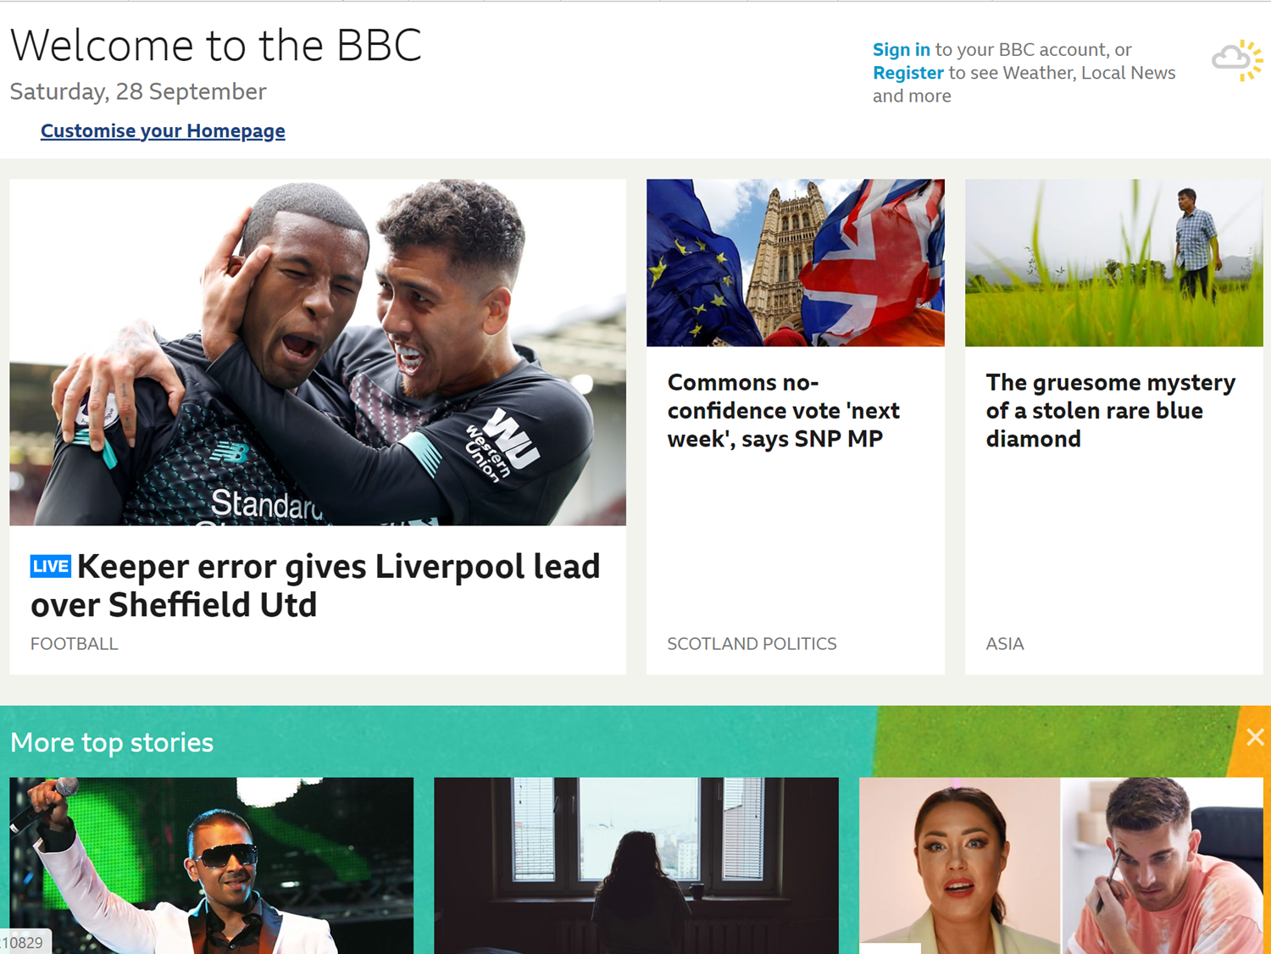
Grid Systems in Web Design
An Example
Row 1: 2 Columns
Column 1: spans 8 columns
Column 2: spans 4 columns
Row 2: 3 Columns
Column 1: spans 6 columns
Column 2: spans 3 columns
Column 3: spans 3 columns
Notes:
Image Source: BBC Website (https://www.bbc.co.uk/) [accessed: 28-Sep-2019 14:20]

Slide 20
Flexible Grid Layout
Flexible Grid Layout means flexible box models for Container Elements.
That is:
  Flexible Widths
  Flexible Padding
  Flexible Borders
  Flexible Margins
Usually it is the width that needs to be flexible.
  Thus, it is the left and right padding, margin, borders that need to be flexible.
Margin: Clear, Transparent Space around the Border.
Border: an Edge that goes around the content and padding
Padding: Space around content.
Content: the actual HTML content (text, images, etc.)

Slide 21
Flexible Grid Layout Options
CSS Frameworks e.g. Bootstrap
CSS Floats
CSS Flexbox
  Not supported in <= IE 10
  Not intended for grid layouts (see notes below).
    It is intended for laying out items in a single dimension i.e. either a row or a column.
CSS Grid (uses CSS setting display:grid)
  Not fully supported by all browsers.
Notes:
The trickiest part in building CSS for the grid elements is the CSS to make the columns stack side by side.
The listed options are all different ways to do this.
Note: Flexbox is intended for laying out items in a single dimension i.e. either one row or one column
Not two dimension, rows and columns, so not the best for creating nested grid layouts.
Better for positioning smaller details inside a row/column.
See more:
https://rachelandrew.co.uk/archives/2016/03/30/should-i-use-grid-or-flexbox/
https://tutorialzine.com/2017/03/css-grid-vs-flexbox
Try and Google: should I use CSS flexbox for layout
CSS Grid
https://www.w3schools.com/css/css_grid.asp
https://css-tricks.com/snippets/css/complete-guide-grid/
https://developer.mozilla.org/en-US/docs/Web/CSS/CSS_Grid_Layout

Slide 22
Flexible Grid: An Important Formula
Constrain the grid width to a max-width value – this is where your breakpoints come in.
Then use the formula:
  target / context = result¹
target: is the width of the target element to be sized i.e. width, padding, margin, border.
context: is the width of target’s parent.
result: is the resulting flexible width. Multiply by 100 to get the percentage (%) width (do not round).
¹Ethan Marcotte, pioneer of Responsive Web Design

Slide 23
Demo: Flexible Grid Formula
Formula
  target / context = result¹

Slide 24
CSS Grid Frameworks
CSS Grid Frameworks contain ready-made CSS classes that you can use for website layouts.
When looking for a framework to use, look for Responsive Grid Frameworks.
We will be using the popular CSS framework, Bootstrap.
Notes:
If you have plans of going into web development, especially the front-end side of things, you should learn the three methods of creating grids:
CSS Floats: https://www.w3schools.com/css/css_float.asp
CSS Flexbox: https://www.w3schools.com/css/css3_flexbox.asp
CSS display: grid: https://www.w3schools.com/css/css_grid.asp
These techniques are also useful for achieving other design features in your website and we will revisit flexbox and probably floats.

Slide 25
Bootstrap’s CSS Grid
Bootstrap is a CSS framework providing front-end website solutions.
Bootstrap’s grid is a 12-column, responsive CSS grid framework.
Bootstrap 4 is the current version and it supports 5 different grid layout widths:
  Extra small devices
  Small (sm) devices
  Medium (md) devices
  Large (lg) devices
  Extra large (xl) devices

Slide 26
Bootstrap 4 Flexible Grid System
 | Extra small <576px | Small (sm) ≥576px | Medium (md) ≥768px | Large (lg) ≥992px | Extra Large (xl) ≥1200px
Max container width | None (auto) | 540px | 720px | 960px | 1140px
CSS class prefix | .col- | .col-sm- | .col-md- | .col-lg- | .col-xl-
 | You append the number of columns to span after the class prefix
No of columns | 12
Gutter width | 30px (15px on each side of a column) You can remove the gutter by using the class .no-gutters
Nestable | Yes
Column ordering | Yes
Notes:
Bootstrap version 3 had just the 1st four and used the column class prefixes .col-xs-, .col-sm-, .col-md- and .col-lg-.

Slide 27
Bootstrap Grid: Containers
Containers are the most basic element in the Bootstrap grid.
  A container represents a grid.
  Rows and columns are nested inside containers.
  You can also have nested grids.
Two container CSS classes:
  .container: a fixed-width grid centred by default.
    Constrains the grid width to max value.
  .container-fluid: a 100% full-width grid.

Slide 28
Bootstrap Grid: Rows
Rows come next and are parents of columns.
  They are used to create horizontal groups of columns to ensure columns line up properly.
Rows are usually children of:
  Containers
  Columns (to create a nested grid)
The CSS class is .row
<div class="container">
<div class="row">
<div class="col-12">
<!-- Content -->
</div>
</div>
</div>

Slide 29
Bootstrap Grid: Columns
Content is placed within columns and columns are children of rows.
There are 12 CSS column classes for each of the five grid sizes: .col-size-n.
Device Size | CSS Size | CSS Classes
Extra small devices (portrait phones) |  | col-1, …, col-12
Small devices (landscape phones) | sm | col-sm-1, …, col-sm-12
Medium devices (tablets) | md | col-md-1, …, col-md-12
Large devices (desktops, etc.) | lg | col-lg-1, …, col-lg-12
Extra large devices (large desktops, tvs, etc.) | xl | col-xl-1, …, col-xl-12

Slide 30
Grid Example
Extra Small Devices
1 | 2 | 3 | 4 | 5 | 6 | 7 | 8 | 9 | 10 | 11 | 12
<div class="container"> <div class="row"> <div class="col-3"> <!-- Content --> </div> <div class="col-9"> <!-- Content --> </div> </div> </div>
col-3 (spans across 3 columns) |  |  | col-9 (spans across 9 columns)
Notes:
The Grid is based on 12 columns, which means it can contain a maximum of 12 columns per line.
The -n, sm-n, md-n, lg-n, xl-n represent the classes that determine column widths.
-n is a value from 1 to 12.

Slide 31
Grid Example
Extra Small Devices
1 | 2 | 3 | 4 | 5 | 6 | 7 | 8 | 9 | 10 | 11 | 12
<div class="container"> <div class="row"> <div class="col-6"> <!-- Content --> </div> <div class="col-6"> <!-- Content --> </div> </div> </div>
col-6 (spans across 6 columns) |  |  |  |  |  | col-6 (spans across 6 columns)
Notes:
The Grid is based on 12 columns, which means it can contain a maximum of 12 columns per line.
The -n, sm-n, md-n, lg-n, xl-n represent the classes that determine column widths.
-n is a value from 1 to 12.

Slide 32
Grid Example
Extra Small Devices
1 | 2 | 3 | 4 | 5 | 6 | 7 | 8 | 9 | 10 | 11 | 12
<div class="container"> <div class="row"> <div class="col-12"> <!-- Content --> </div> <div class="col-12"> <!-- Content --> </div> </div> </div>
col-12 (spans across all 12 columns)
col-12 (spans across all 12 columns)
Notes:
The Grid is based on 12 columns, which means it can contain a maximum of 12 columns per line.
The -n, sm-n, md-n, lg-n, xl-n represent the classes that determine column widths.
-n is a value from 1 to 12.

Slide 33
Grid Example
1 | 2 | 3 | 4 | 5 | 6 | 7 | 8 | 9 | 10 | 11 | 12
<div class="container"> <div class="row"> <div class="col-12 col-sm-6 col-md-3"><!--Content--></div> <div class="col-12 col-sm-6 col-md-9"><!--Content--></div> </div> </div>
Extra Small screens (will create two rows because each div uses all 12 columns)
col-12 (spans across all 12 columns)
col-12 (spans across all 12 columns)
Small screens
col-sm-6 (spans across 6 columns) |  |  |  |  |  | col-sm-6 (spans across 6 columns)
Large screens
col-md-3 (spans across 3 columns) |  |  | col-md-9 (spans across 9 columns)
Notes:
The Grid is based on 12 columns, which means it can contain a maximum of 12 columns per line.
The -n, sm-n, md-n, lg-n, xl-n represent the classes that determine column widths.
-n is a value from 1 to 12.

Slide 34
Additional Grid Options
Column Reordering
You can use the .order-n to control the visual order of your columns. (Based on Flexbox Order)
It is used to prioritise content by changing the default order. The following example will swap the columns round on medium screens.
  <div class="col-12 col-md-9 order-md-2">...</div>
  <div class="col-12 col-md-3 order-md-1">...</div>
On a medium screen, Column 2 will display first and column 1 second:
col-md-3 order-md-1 |  |  | col-md-9 order-md-2
Notes:
In Bootstrap 3, push and pull classes were used.

Slide 35
Additional Grid Options
Offsetting Columns and Margins
Offsetting Columns
  Used to move columns to the right or left, when the columns in a row do not add up to 12.
    offset-size-n
Margin utility classes are used to automatically add margins based on space left in row.
    ml-size-auto: automatically add some margin to column’s left side
    mr-size-auto: automatically add some margin to column’s right side

Slide 36
Flexible Images and Media
There are two issues with flexible images and media:
  Resizing/scaling to fit the current viewport region.
  Serving up different images based on device capabilities e.g. higher res images for larger screens.

Slide 37
Scaling Images and Media
Setting the image/media width property to 100% will make it responsive and scale it up and down based on parent element’s width:
    img, video {
    width: 100%;
    height: auto;
    }
Setting max-width to 100% will make it responsive. Image will scale down, but prevents the image from scaling up to be larger than its original size:
    img, video {
    max-width: 100%;
    height: auto;
    }
Heck! What’s the difference?
Notes:
https://www.w3schools.com/howto/howto_css_image_responsive.asp

Slide 38
Bootstrap’s Flexible Image Class
.img-fluid: will apply the following CSS styles:
  max-width: 100%
  height: auto
See more here

Slide 39
Lab Exercise
Download Instructions from Moodle

