Slide 1

DIGITAL SKILLS AND RESEARCH METHODS
BMSW4003
HOW DO WE USE TECHNOLOGY TO COLLABORATE AT UWTSD?
Tutor: Seyed Navid Nasirpourosgoei
Diana Baltatu-2122576
Cristina Sardaru-1816279
Elena Daniela Dumitrescu-1918144
1

Slide 2
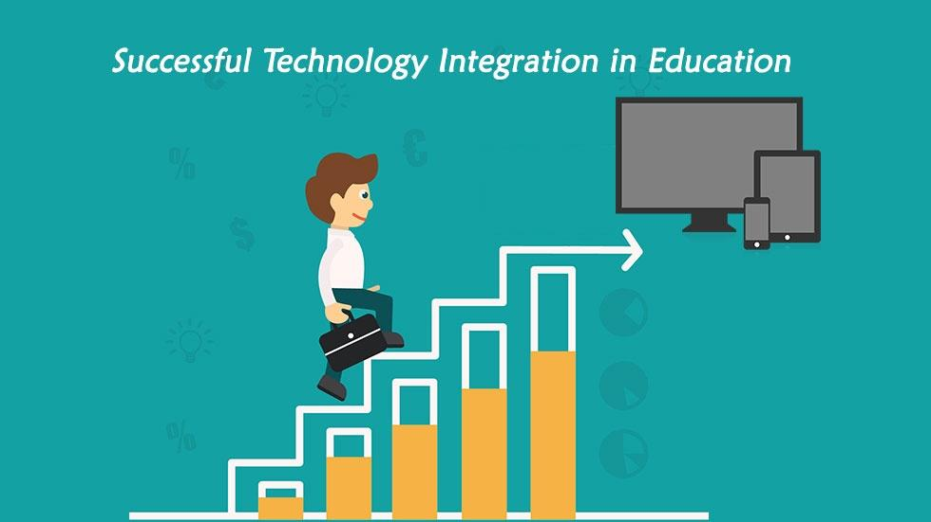
INTRODUCTION
Are staff and students confident in using technology to collaborate?
Today, technology can be considered such a big part of the world. The number of people that use the technology is now increasing, compared with the past were not everyone had access to it.
Technology is being used by adults and children in so many ways, but the most important, is the impact that it had in schools, and it is benefits for students.
Diana Baltatu
2
Notes:
2

Slide 3
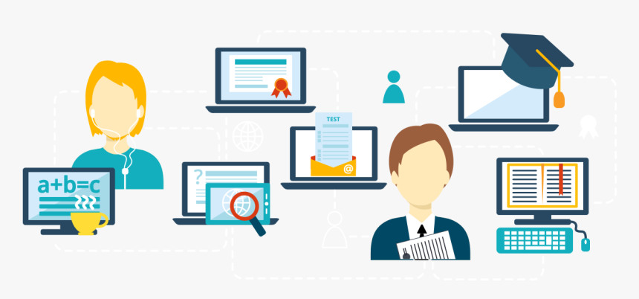
Relevant existing research
Technology is considered to be the best tool for students, to learn and increase the collaboration between them.
Many students can have communication problems, which can be due to distance/disabilities or not being able to “fit in” at schools. Here is where technology facilitate and solve all those problems by being capable of unlocking keys of learning for all students.
Students work together to create projects or they can learn from each other by reading the work of their peers” (Keser, Huseyin& Ozdamli, 2011).
A study from Kevin C. shows the most important effects that technology have on students:
increase student motivation
increase students collaboration
allows learning at all levels
gives students confidence in learning technology skills
Diana Baltatu
3

Slide 4
Our Proposed Method
(What? Who? How?)
Our proposed method is to have a person dedicated to helping the people who are not confident in using technology as while the majority of people know how to use the different programs needed at UWTSD.
There is still minority of people that do not know how to use the technology needed at UWTSD in order to collaborate with the teachers so in order to fix that we came up with the idea of having a questionnaire in order to identify who is in that minority that does not how to operate and access the technology needed.
The questionnaire would questions such as How long have you been using technology such as phone, laptops etc.? How confident are you in your ability to use that device? Have you had a lot of access to technology in your lifetime?. These are some of the questions which we would ask the students here at UWTSD in order to figure out who is confident in using technology and who isn’t and these questions would be asked in a polite manner to the students during their lunch break or after lessons.
Cristina Sardaru
4

Slide 5

Ethical Considerations
One Ethical Considerations that should be made is that some people might come from a lower income country so therefore they might have had little to no access to technology so they need more time in order to learn how to operate and access the different programs.
Another Ethical consideration that needs to be taken in consideration is the language barrier as there might be some students who struggle to speak and understand English but this can be fixed by hiring a translator or having a student who speaks the same language help the struggling student.
Cristina Sardaru
5

Slide 6

Our Research Timeline
We would start this process of asking students to fill out our questionnaire in March 2022 and we would spend the whole month in order to make sure we get to ask each student.
We will make sure we are not going to miss anyone out and we would start to analyze the answers and make a list and a graph in order to show how high the percentage of people who are confident in using their skills and how low would be the percentage of people who could not handle it.
The list would be in order to figure out who needs help in order to learn how to operate their devices and access the programs needed and we would analyse and create the graphs and list in April 2022
6
Elena Daniela Dumitrescu

Slide 7
Hypothesis
Our Hypothesis is that we would find out if the majority of people that attend UWTSD are confident in using technology to collaborate with the teachers, however this does not mean there isn’t a minority that is not confident in their ability to use technology as there should be some people that still struggle with it and there isn’t nothing wrong with that as we could help.
Nowadays technology has a very important role in our lives and we believe that from generation to generation we will all develop ourselves and we have to adapt.
Being student means that you have a lot of opportunities but also there is going to be some moments and times when the struggle of using this technology will appear but the most important thing is to believe in yourself and to be confident.
Elena Daniela Dumitrescu
7

Slide 8
References
Wallace, A. (2020). The average person spends more than 8 hours a day using technology, study says. [online] Deseret News. Available at: https://www.deseret.com/u-s-world/2020/3/17/21184252/technology-screen-time-bed-sleep-8-hours-pbs-cnn-fox-news.
Keser, H., Uzunboylu, H. and Ozdamli, F., 2011. World Journal on Educational Technology. 2nd ed.
Kevin,C. (2014) The positive effects of technology on teaching and students learning.
8

