Slide 1
Brynrhyd Solar P.V. Farm Development Proposal: Environmental Impact Assessment Evaluation.
A Case Study illustrating strengths and weaknesses of the E.I.A. Process regarding Ground Based Solar Array Developments in Agricultural Settings.
L. Zanoni
Student Number: 25000107
Module Number: ACBA7004
Environmental Planning and Policy (2023)
Notes:
Welcome:
Today I am briefly going to speak about Brynrhyd Solar Farm: a not ‘atypical’ solar PV array farm development, in the context of its EIA evaluation carried out in 2020-2021.
Chosen as it corroborates a key weakness identified in the literature concerning E.I.A. Regarding assurance of continuous monitoring and follow-up of mitigation measures.
It also illustrates commonly perceived benefits and disbenefits of solar farms, as highlighted in the literature.

Slide 2
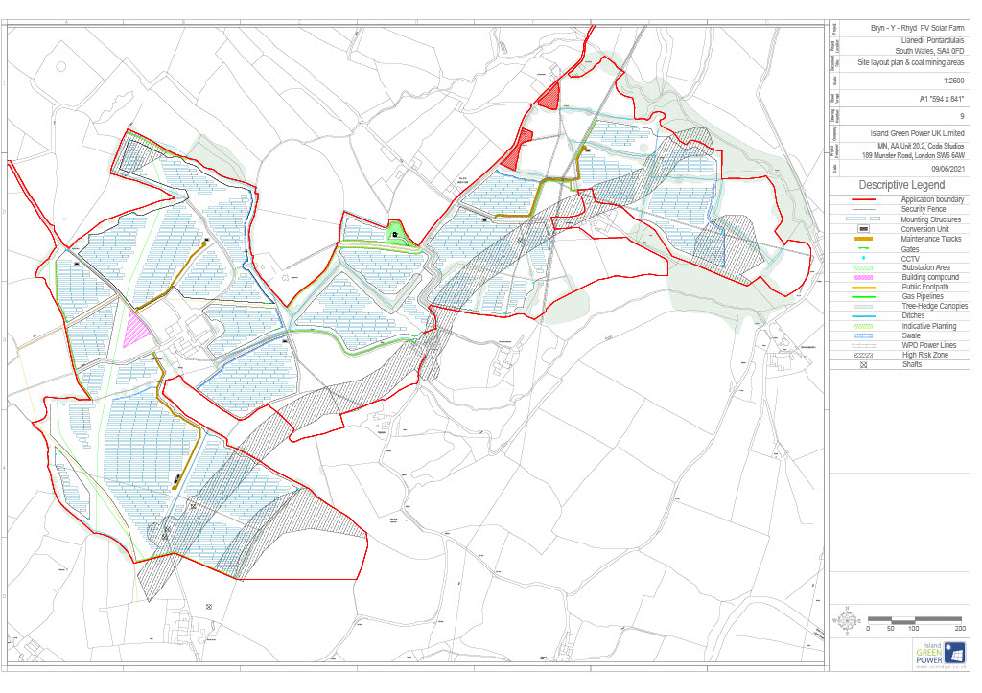
E.I.A. Screening Opinion for Brynrhyd Solar Farm: November 2020
On November 4th 2020, the Planning Inspectorate confirmed the development required an E.I.A.based on the fact that the scheme would be in an area ‘where there may be cumulative impacts with other solar developments’ additionally they noted that the north western fields were NRW priority habitat comprising ‘species rich grassland which may support marsh fritillary butterfly, breeding skylark and meadow pipit’
The screening opinion was summarized as being due to “likely significant effects in regards to cumulative landscape and visual impacts and ecology(Pegasus Group,2021)
Fig One: Diagram to show array design, NRW priority habitat and site boundaries(Pegasus Group,2022)
Notes:
Over 30 MW, covering 72 hectares of 3b grade Agricultural ,the proposal is considered to be a ‘development of National Significance under Welsh Policy, meaning the planning application will be dealt with directly by PINs(now PEDW) in WG .
On seeking a screening opinion of Pins in October 2020, they determined it needed an E.I.A.( Environmental Impact Assessment) was determined on grounds of likely significant effects in regards to cumulative landscape and visual impacts and ecology’
Subsequently from Nov 2020 to Sept 2021- ‘The Pegasus Group’ coordinated the E.I.A. process on behalf of Brynrhyd Solar Farm Ltd (a company set up by the parent Development Company: Island Green Power)

Slide 3
Summary of EIA Assessment for Brynryd Solar Farm.
1) The case study was chosen as it appeared to display in the main, a competent and iterative approach to E.I.A., providing a sound basis for assessing impact magnitude and effectiveness of mitigation proposals. Climate Change Policy and Planning Policy at National and local levels relevant to renewable had also been clearly considered as per the E.I.A.regulations. Alternative schemes had also been considered, with the scheme in accordance with the regulations.
3) ES Sept 2021, submitted with planning application comprised of competent technical topic reports comprised of a clear site description, pre post consultation surveys and addendums: inclusive of Habitat Regulation Assessment to screen out effects on nearby SAC, Noise, Ground, Flood Risk and Heritage and Archeological assessments.
4)As Per Schedule 4 of E.I.A. Regulations: contained a robust Construction Environmental Management Plan(CEMP),Construction Traffic Management Plan(CTMP) and an extensive Landscape and Ecological Management Plan(LEMP)& Arboriculture Tree Survey, to inform root protection measures for all trees near to proposed construction. Also carried out: Extensive Landscape and visual Impact assessments(LIVA , Resident Visual Amenity (RVAA) &Glint and Glare Assessments to assess mitigation of impacts on Landscape Character, element and Visual elements.( )
2) Evidence of an inclusive, consultation process, during pre informal/formal application period in the form of written, verbal, notices, community consultations and a website, which is still live. Also non statutory and statutory stakeholder feedback has been considered as evidenced by design reiterations, following on from feedback and revised RVAA/LIVA reporting. Community Benefit requests have also been accommodated according to preference stated.
Notes:
Not in the scope of this presentation to go over all the minutiae of EIA summary shown in this slide, but it was mainly a competent effort, in accordance with the guidelines in EIA Regs (Wales 2017)( put in title- cite/ref)
Main Impressions:
A transparent consultation process was carried out where non statutory and statutory stakeholders allowed extra time to feed back.
Issues raised were followed up/acted upon, resulting in subsequent design changes, community benefit adjustments to Llanedi CC and updates to technical topic reports.
Demonstrated EIA being effective in identifying and mitigating complex short comings, e.g. developer failed initially to appreciate the required level of scope by relying on the screening opinion as the basis of the ES Tech topics, resulting in the first ES report (June 2021) being turned away twice by PIn’s .
Addendums & extra survey data to be produced for revised scoped in- topics concerning Noise, Heritage and Archeology, Ecology and Conservation, Landscape and Visual Amenity Assessments and Accident Risk.
Rec 1 :Scoping should be mandatory for DNS projects, saving time for WG and Developers( in regs)

Slide 4
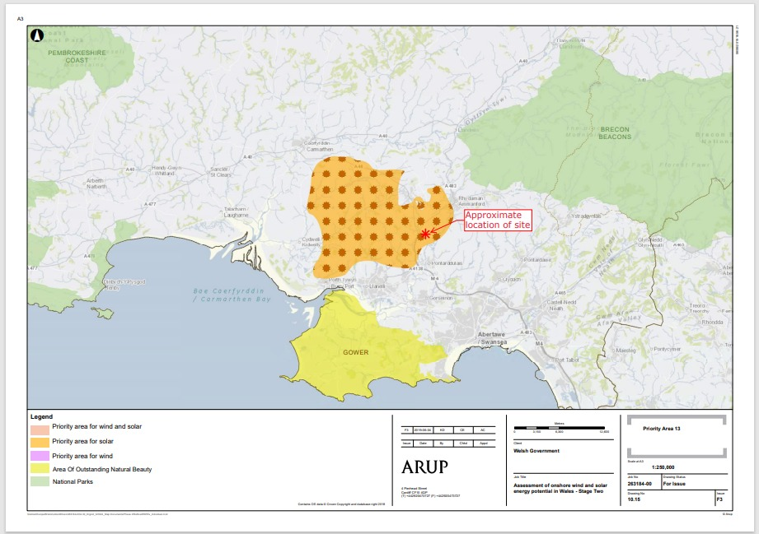
Brynrhyd Solar Farm: A typical example arising in response to Welsh Government renewable energy targets.
Welsh Government(WG) is aiming to generate 70% of its electricity consumption from renewable energy by 2030.
They have therefore identified a number of areas of ‘opportunity’ across Wales suitable for solar energy development
Many of these opportunity zones are in agricultural areas. This has resulted in an increase in solar PV array developments on existing Welsh farms. Brynrhyd Solar Farm, is a typical example and lies in area 13 on the edge of an opportunity map for solar development shown opposite in Fig 2.
Fig Two : ARUP Solar Energy Development Opportunity Map, displaying position of Brynrhyd Solar Farm( Pegasus Group,2022)
Notes:
BSF lies in ‘Welsh Government Priority Area 13 for Solar PV Development’
shown in fig 2, a map adapted from opportunity maps, developed by ARUP for WG in 2019, for renewable energies. Some are in brown site areas, however majority of these sites are in agricultural locations, typically on low grazing pasture sites. hence popularity for livestock farmers to take advantage of solar farm development in these zones)
Crucial Point:
The area is considered ‘less sensitive’ for large scale solar PV Development under the CCC landscape and capacity study, which accepts “ … pressures for solar PV development will naturally fall within these identified areas leading to cumulative effects, as the areas potential is maximized in accordance with PPW2021.
Last point is also a reinforced in national/local policy Future Wales 2040,Clauses 17/18 and Carmarthenshire CC SPG supplementary planning guidance to main LDP 2021-2030)
Next few slides will illustrate some of the typical cumulative impacts and biodiversity impacts perceived as a consequence of solar farm equipment and installations:

Slide 5
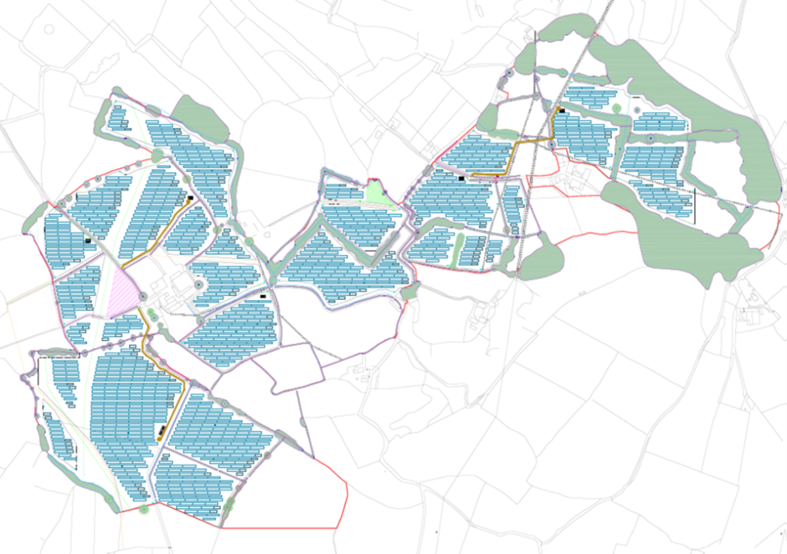
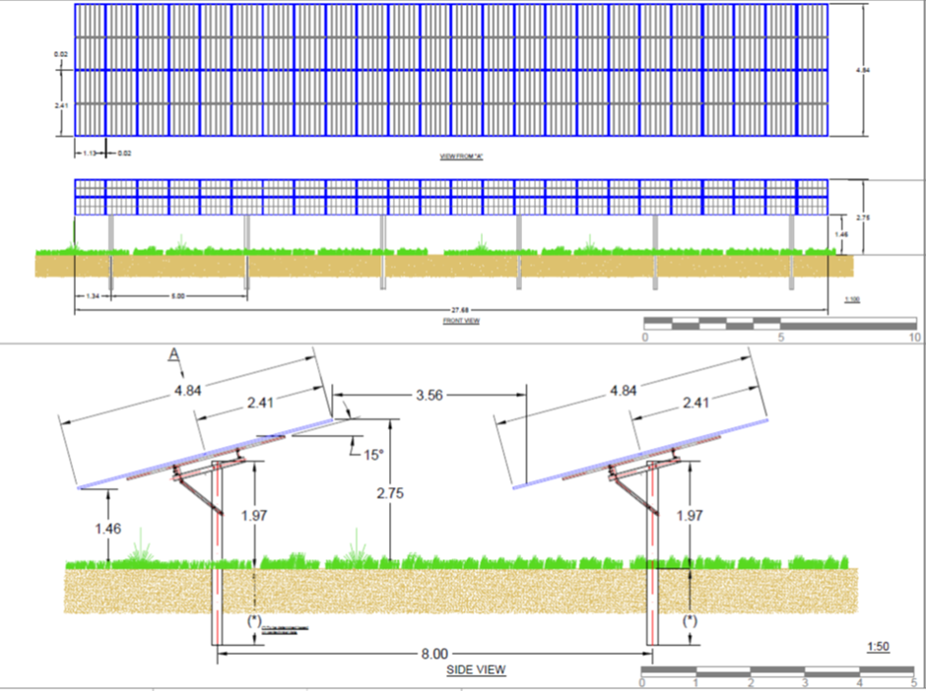
Brynrhyd Solar Farm PV Array final plan and profile view of panels
Brynrhyd Solar Farm also has other common elements: Solar arrays, access tracks. Temporary compounds, underground cabling and connections( to nearest DCO in Ammanford)
Substation building, conversion unit, security(deer) fencing and CCTV equipment.
A number of hedgerow removals will also be required, though Landscape& Ecology mitigation plan(LEMP) shows additional planting will be provided to compensate, resulting in net gain to sites native tree and hedgerow resources.
Fig Three below, shows the final distribution of solar array design and a profile view of the solar arrays for Brynrhyd Solar Farm, taken from ES (The Pegasus Group,2022)
Notes:
Brynrhyd a typical PV Solar Farm set up:
Figure 3 and 4- show final array layout, NW field of extra habitat ,typical array designs for BSF proposal, ubiquitous in these schemes : note in Fig 3 The blue rectangular areas denote the solar panels final location design, after EIA informal and formal consultation processes informal with all stakeholders.
Brynrhyd Solar Farm also has all common elements of solar farms- as listed on the slide:
Temporary compounds/substation buildings have been moved away from the rural lane.
Underground cabling and connections( to nearest DCO in Ammanford) will go under the road running alongside farm.
A number of hedgerow removals will also be required, though Landscape& Ecolo
gy mitigation plan(LEMP) shows additional planting will be provided to compensate, resulting in net gain to sites native tree and hedgerow resources.

Slide 6
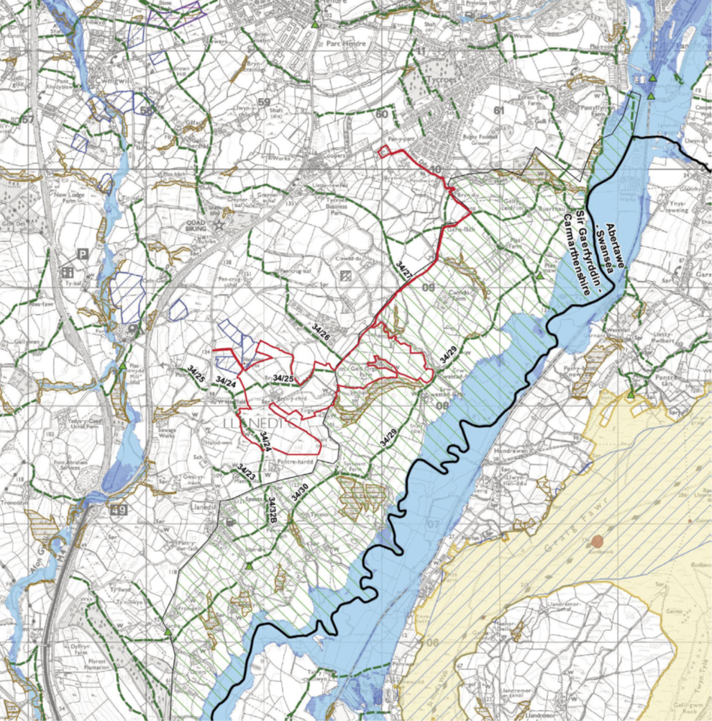
Brynrhyd Solar Farm: Cumulative Aspect Summary
BSF : Ground Mounted Solar Array Development covering 72 hectares , shown in Fig 3 opposite.
Near to Caeau Mynydd Mawr SAC, SSSI’s and landscape areas of special character.
HRA Screening confirmed no effects on SAC,SSSI’s so screened out.
8 Main cumulative schemes in proximity to Brynrhyd Solar Farm
Clawdd ddu farm(0.18 km operational)
Tycroes( east, central and west areas): 0.42 km approved not constructed
Penderi :34.5 MW approved not yet constructed
Fig Four : Site Map Boundaries overlaid over ordinance survey map: Brynryhd Solar Farm (Pegasus Group,2022)
Notes:
Equipment installed ,as per last slide illustrate there will be immediate landscape element impacts. There will also be visual amenity and landscape character effects, and subsequent cumulative effects magnified especially when proximal to other farms:
Brynrhyd solar farm is in proximity to 8 other solar farms, of varying sizes, most consented and a few operational.
Main ones potentially contributing to the cumulative impact of this scheme are
Clawdd Ddu(operational) and Tycroes ( east and central West areas) and Penderi Solar farms ( both consented but not yet operational)

Slide 7
Cumulative Impact Comparisons with Tycroes and Brynrhyd Solar Farm.
Tycroes Solar Farm:
EFFECT: Medium sensitivity and a high magnitude of change
The cumulative sites would appear subdivided and framed by the strong network of hedgerows around relatively small fields and some woodland within the Llanelli hills.
In summary the proposed solar farm development could be successfully integrated into the surrounding landscape without causing significant harm to the landscape character and visual amenity in the local area.
Long term residual effects ranged from ‘no change’ to moderate which is considered to be ‘Not Significant’ following the implementation and establishment of the scheme of landscape mitigation.
Brynrhyd Solar Farm : in combination with Clawdd Du and Tycroes eastern scheme will result in a major significant cumulative effect on the landscape character of the LANDMAP
In this respect the operational Clawdd Du and the consented Tycroes scheme has already set a precedent for solar PV in this area : Brynrhyd would be perceived as an extension of these schemes.
Where the Brynrhyd scheme is visible, the character of the views will already have been affected by Clawdd Du and Tycroes schemes, thus limiting the effects….. despite these significant cumulative and visual effects,
If the Brynrhyd scheme is consented, there is merit in grouping such effects together to avoid impacts on more identified sensitive areas a point also made by their study into desert solar facilities (Lovich & Ennen,2011)
.
Notes:
Comparing Tycroes, Clawdd Ddu and BSF LIVA/RVAA and Glint and Glare documentation re: Cumulative effects, the impact is mitigated by the undulating countryside elements, hedgerows and woodlands ‘subdividing the landscape, such that the schemes can be successfully integrated with residual effects being ‘no change’ or non significant, post implementation of LEMP strategies.
The main point here being BSF developer puts forward argument that as the landscape character, already impacted by existing schemes forming a new base line – this scheme should be seen as an extension of solar array provision and thus limits the effects.
Lovich & Ennen 2011: recommend that this thinking is more deeply investigated: i.e. notion that there is merit grouping such effects together to avoid impacts on more sensitive areas elsewhere.

Slide 8
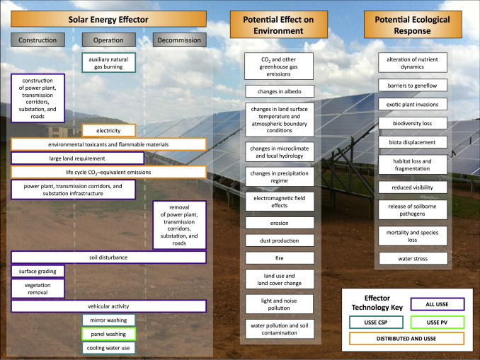
Summary of Potential Effects on Environment and Eco receptors from the Construction, Operation and Decommissioning phases of Solar Farms, from Hernandez et al (2014)
Notes:
Similarly Diagram above shows, despite the obvious energy and climate change benefits and potential net gains in BD that there are other, disbenefits associated with Solar Farms (Hernandez et al (2014) summarizes as these acting on biodiversity, land use and land cover change, soil, water and human health impact during all phases construction, operation and decommissioning- largely which should be considered and refined mitigations put in place as a result of the E.I.A. process and its useful stakeholder consultation mechanism
Hernandez et al (2014) evaluates the general beneficial and adverse effects of solar technology on

Slide 9
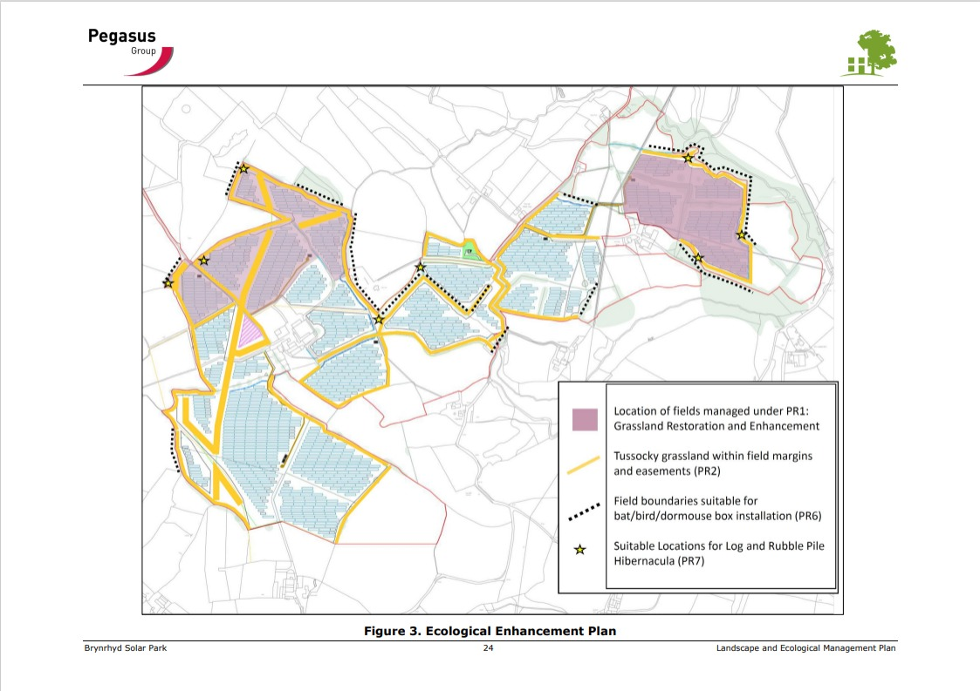
Ecology and Conservation Issues Common to Solar Development & Brynrhyd Solar Farm Biodiversity Enhancements
A relatively small research body on solar farm impacts with respect to impacts on animal and plant populations as noted by (Chock, Clucas, Peterson, at al, 2021) ‘studies of wildlife behavioural response to solar facilities have been called for, including bird interactions with solar facilities ‘.
(Montang,Parker & Clarkson,2016) suggest ,with particular reference to solar farms in agricultural settings that further studies to be made with respect to nocturnal raptors(i.e. owls) ,skylarks, small mammals, bats and brown hares. Also recommend ed research into their effects on amphibians, reptiles and other invertebrate species.
(Lovich & Ennen,2011) call for studies regarding the cumulative impacts on wildlife from solar farm technologies ,i.e is there wildlife betterment if development was concentrated or small, scattered over larger areas.
Fig Five: Brynrhyd Solar Farm : LEMP plan showing range of Biodiversity Enhancements and Mitigation Measures.
Notes:
BSF in its comprehensive LEP, Aboricultural survey , CEMP and CTMP, has in fairness put in considerable measures in accordance to best practice: Fig Five is a schematic showing some of these enhancements in the form of planting, sward and new habitat creation, meadow/wildflower grass management regimes in buffer areas& provision of bird,bat, dormouse boxes and hibernaculae for reptiles/amphibians. As a result of the process temporary compound was moved.
These measures are in line with current best practice guidance by industry Solar UK and the literature: Montang, Parker and Clarkson 2016.
These authors however and others such as Chock, Clucus and Peterson , advocate for far greater scientific knowledge and evidence to be gathered regarding the effects long term of solar farms on animal and plant populations, pre and post construction, due to a current paucity of data.

Slide 10
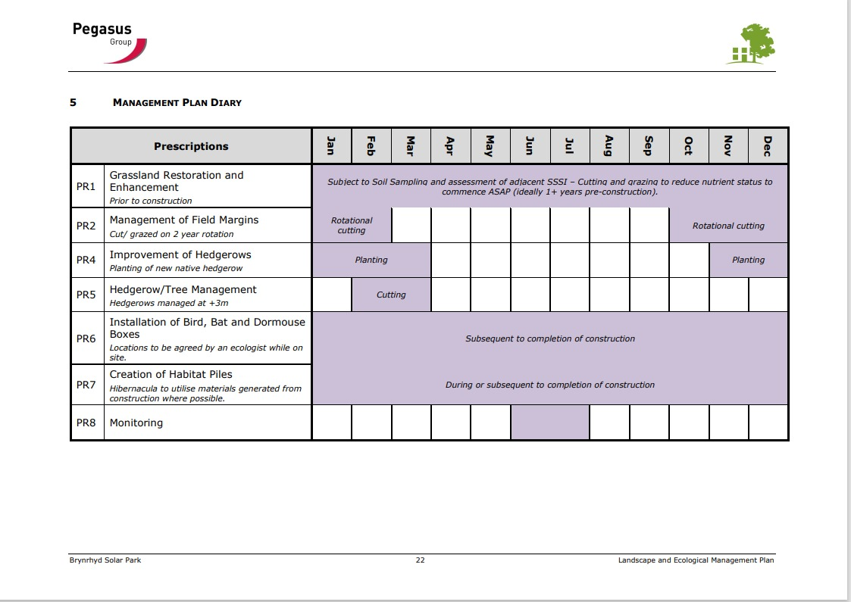
Brynrhyd Solar Farm Biodiversity Habitat Management Measures and Monitoring
The measures summarised in the BSF LEMP Habitat management plan (Pegasus Group,2022)are in line with current best practice measures outlined in the literature to date plan above (Montang, Parker & Clarkson,2016) and industry reports (CIEEM,2022) and outlined by Solar UK Ltd.
However the LEMP, as with those of Tycroes and Talgren, though exemplar in biodiversity enhancements and mitigations demonstrate a common weakness ,in terms of long term monitoring and adaptive follow up:.
Monitoring and follow – up is described and are allowed for in respective LEMPs during construction, operational and decommissioning phases, however they are not subject to any form of ‘successive management’ strategy nor mandated sufficiently in current legislation and regulations, inclusive of (Environment Act (Wales),2016)
Notes:
This brings me to my main finding on evaluating BSF via E.I.A- that it’s LEMP and those of the previous farms reviewed and another( as a control )Talgren although thorough and comprehensive re: baseline species surveys and bio D enhancements and longterm H Man plans( illustrated above) and urge monitoring /follow up during the operational phases- these are not MANDATED, nor definite responsibility guaranteed for the latter during the duration of the development:

Slide 11
Monitoring and Follow up:
Talgren: Cardiff Solar Farm Comparison to Brynrhyd Solar Farm.
E.I.A. Monitoring and Follow up Weaknesses:
Regarding monitoring and follow up, current literature perceives this as weakness in E.I.A.: (Thakur, U.J. & Fischer, T.B.,2016) and (Morrison-Saunders, A. et al, 2021) comment respectively that they advocate for mandatory data collection standards and post evaluation of development schemes to be included in national policy/guidance.
In this example the LEMP for Brynrhyd allows for significant biological enhancements and mitigation of construction impacts and incorporates a monitoring program, during the operational phase and data collation prior to decommissioning. However, regarding the latter it does not tacitly describe any form of ongoing management responsibility or succession management strategy.
This leaves an open-ended process, whereby the long-term effects of impact mitigation in the ES cannot be effectively assessed, providing no ability to review and correct ineffective measures. It would also contribute to a lack of scientific data for assessing the effects solar farm technology on animal and plant populations.
“Monitoring is a fundamental component of biodiversity management and requires thorough planning to identify key indicators, establish baseline conditions at the outset of the project, and assess biodiversity changes through the life of the solar farm.
Monitoring is to be undertaken annually for the first 5 years, and then a form of biodiversity monitoring is to be continued at least every 3 years for the life of the project. ”
Recommendations:
Adaptive management approach adopted,
Results of monitoring to be fed back into solar farm. Management.
Problems identified during monitoring is translated into appropriate management action.
If positive results are returned, consideration should be give to maximize this success.
Such management revisions are likely to require specialist ecological knowledge and discussions with local wildlife organisations
(adapted from (TalgrenSolar (2022))
Notes:
Reiterated in the slide above both the Talgren LEMP and BSF LEMP, emphasize the importance of Monitoring and follow up as part of a continuation of EIA throughout the lifetime of the development: as an effective way to practice adaptive ecological management.
The current literature critiquing EIA also is advocates for formalising this aspect of EIA i.e. mandatory data collection standards and post evaluation of development schemes to be included in national policy/guidance.Brynrhyd Solar farm, for example :provides a perfect opportunity for conducting long term monitoring /data collation to enable better understanding for the solar renewables research re cumulative effects of grouped developments and the efficacy of potential mitigation measures. Therefore the next logical evolution for E.I.A, in my opinion is for long-term monitoring and follow up to be folded into existing planning and environmental policy /legislation at all levels, and to strengthen this aspect in 7(A) of the current UK. Effectively closing the current open-ended loop regarding monitoring and follow up currently reported and provide real time data for scientific appraisal of current practices to mitigate impacts of Solar farms in agricultural and urban settings.

Slide 12
References
Carmarthenshire Local Development Plan,2014
Available at: http://www.cartogold.co.uk/CarmarthenshireLDP/english/text/00_Contents.htm
(Accessed:01 December 2022)
Chock, RY, Clucas, B, Peterson, EK, Bradley, F., Blackwell, D.T., Blumstain, K.C., Fernández-Juricic,E., Francescoli,G. et al(2021)’Evaluating potential effects of solar power facilities on wildlife from an animal behavior perspective’ Conservation Science and Practice. 3(e.319) p.2
Available at: The Society for Conservation Biology (wiley.com)
(Accessed: 1st December 2022)
CIEEM (2022) ‘CIEEM Briefing: Welsh Government’s Approach to Net Benefits for Biodiversity and the DECCA Framework’
Available at: https://cieem.net/wp-content/uploads/2022/08/Net-Benefits-briefing.pdf
(Accessed: 1st December 2022)
Environment (Wales) Act 2016(anaw3)
Available at: https://www.legislation.gov.uk/anaw/2016/3/contents
(Accessed 1 November 2022)

Slide 13
Hernandez, R.R, Easter, S.B., Murphy, M.L., Mariscald, F.T., Tavassolib, E.B., Allen., E.B., Barrows, W. Belnap, J. et al (2014) ‘‘Environmental impacts of utility-scale solar energy ’Renewable and Sustainable Energy Reviews, 29, p 766-779
Available at::https://www.sciencedirect.com/science/article/abs/pii/S1364032113005819?via%3Dihub
(Accessed:15 December 2022)
Lovich,J.E. & Ennen,J.R. ‘Wildlife Conservation and Solar Energy Development in the Desert Southwest, United States’ Bioscience’.61(12) p982-992
Available at: https://academic.oup.com/bioscience/article/61/12/982/392612
(Accessed 1 December 2022)
Montag, H. Parker, G. & Clarkson (2016) The Effects of Solar Farms on Local Biodiversity; A Comparative Study. Clarkson and Woods and Wychwood Biodiversity.
Available at::https://www.clarksonwoods.co.uk/wp-content/uploads/PDF/Solar_Farms_Biodiversity_Study.pdf
(Accessed: 1 December 2022)
Morrison-Saunders, A.,Arts,J.,Bond,A.,Pope,Retief,F.(2021) ‘Reflecting on, and revising, international best practice principles for EIA follow-up’ Environmental Impact Assessment Review ,89
Available at: https://www.sciencedirect.com/science/article/pii/S0195925521000469
(Accessed: 01 December 2022)
References continued

Slide 14
The Pegasus Group (2022). ‘Environmental Statement Technical Appendices September 2021’
Available at: https://www.brynrhydsolarfarm.co.uk/_files/ugd/146daf_059240996ef043f89447349e4bb1cc17.pdf
[Accessed :1 November 2022].
References continued
Planning Policy Wales 11th Edition,2021
Available at: https://www.gov.wales/planning-policy-wales
(Accessed:01 December 2022
Thakur, U.J. & Fischer. (2016)’25 years of the UK EIA System: Strengths, weaknesses, opportunities and threats’ Environmental Impact Assessment Review V.61, pp 19-26
Available at: https://www.sciencedirect.com/science/article/pii/S0195925515300585
(Accessed 1 December 2022)
The Pegasus Group (2022). ‘Environmental Statement Written Statement September 2021’
Available at: https://www.brynrhydsolarfarm.co.uk/_files/ugd/146daf_0eb2e32721ea474d83615789d0cfa86d.pdf
[Accessed :1 November 2022]
TalgrenSolarFarm(2022) ’Appendix 4.8.8 Landscape and Ecological Management Plan’
Available at: https://talgrensolar.co.uk/wp-content/uploads/2022/10/4.8.8-LEMP-DRAFT-lowres.pdf
Accessed: 21st January 2023
The Town and Country Planning (Environmental Impact Assessment) (Wales) Regulations 2017(SI 2017/567(W136)).
Available at: The Town and Country Planning (Environmental Impact Assessment) (Wales) Regulations 2017 (legislation.gov.uk)
(Accessed :1 November 2022)
Welsh Government (2019) ’Future Wales: The National Plan 2040’
Available at: https://www.gov.wales/future-wales-national-plan-2040-0
(Accessed 1 November 2022)

