Slide 1
ECES5020C
Ymchwil Addysgol
Educational Research
Sesiwn 7 / Session 7

Slide 2
Nodau’r Modiwl / Module Aims
Archwilio ystod o ddulliau ymchwil addysgol.
Datblygu dealltwriaeth o ddylunio a gweithredu ymchwil.
To examine a range of educational research methods.
To develop an understanding of research design and implementation.

Slide 3
Deilliannau Dysgu / Learning Outcomes
Gwerthuso oblygiadau moesegol cynnal ymchwil gyda phlant a phobl ifanc mewn amrywiaeth o gyd-destunau addysgol.
Evaluate the ethical implications of carrying out research with children and young people in a variety of educational contexts.

Slide 4
Deilliannau Dysgu/ Learning Outcomes
Dangos ymwybyddiaeth feirniadol o amrywiol fethodolegau ymchwil sy’n berthnasol i addysg, a’u cryfderau, eu gwendidau a’u cyfyngiadau.
Demonstrate a critical awareness of various research methodologies that are relevant to education and their strengths, weaknesses and limitations.

Slide 5
Mae dadansoddi data yn broses o archwilio, glanhau, trawsnewid a modelu data gyda'r nod o ddarganfod gwybodaeth ddefnyddiol, dod i gasgliadau, a chefnogi'r broses o wneud penderfyniadau.
Dadansoddi Data / Data Analysis
Data analysis is the process of exploring, cleaning, transforming, and modelling data with the aim of discovering useful information, drawing conclusions, and supporting decision making.

Slide 6
Natur eich cwestiwn ymchwil fydd yn penderfynu’n bennaf sut y byddwch yn dadansoddi eich data.
Yn eu tro, dylai'r iaith a'r termau a ddefnyddiwch wrth gynnal eich dadansoddiad data ac adrodd arno, adlewyrchu'r rhain.
Dadansoddi Data / Data Analysis
The means by which you analyse your data are largely determined by the nature of your research question,
In turn, the language and terms you use in both conducting and reporting your data analysis should reflect these.

Slide 7
Pa fath o ddata? / What type of data?
Mae eich ymchwil yn annhebygol o gynnwys llawer o ddadansoddi meintiol
Mae'r rhan fwyaf o'r data a gesglwch yn debygol o fod yn feintiol
Meddyliwch – Beth yw'r gwahaniaeth rhwng data meintiol ac ansoddol?
Your research is unlikely to involve large amounts of quantitative analysis
The majority of the data that you collect is likely to be qualitative
Reflection – What's the difference between quantitative and qualitative data?

Slide 8
Mathau o ddata ansoddol / Types of qualitative data
Nodiadau o arsylwadau ystafell ddosbarth
Adborth gan athro am gynnydd myfyriwr
Trawsgrifiad o grŵp ffocws
Recordiadau sain/gweledol o ddosbarth
Trawsgrifiad o gyfweliad
D.S. Trawsgrifiadau yw’r ffordd orau o ddadansoddi data ansoddol o grwpiau ffocws neu gyfweliadau
Beth yw trawsgrifiad?
Sut allwn greu trawsgrifiad?
Notes from classroom observations
Feedback from a teacher about a student’s progress
A transcript from a focus group
Audio/visual recordings of a class
A transcript from an interview
N.B. Qualitative data from focus groups or interviews is best analysed in the form of transcripts
What is a transcript?
How can we create a transcript?

Slide 9
Mathau o ddadansoddi data – Dadansoddi thematig
Types of data analysis - Thematic analysis
Dadansoddi thematig - yn golygu darllen y data'n ofalus a thro ar ôl tro er mwyn nodi a marcio themâu neu batrymau cylchol neu gysylltiedig.
Wedyn caiff y canfyddiadau eu crynhoi dan benawdau thematig.
Mae'n debyg mai hwn yw'r dull a ddefnyddir amlaf ar gyfer dadansoddi prosiectau ymchwil addysgol.
Thematic analysis - involves careful and repeated reading of the data to identify and mark recurring or connected themes or patterns.
Findings are then summarised under thematic headings.
This is probably the most commonly used method for analysing educational research projects.

Slide 10
Cwestiynau i'w hystyried / Questions to consider
Pa batrymau/themâu cyffredin sy'n dod i'r amlwg ynghylch eitemau penodol yn y data?
Sut mae'r patrymau hyn (neu ddiffyg y rhain) yn helpu i daflu goleuni ar gwestiwn/cwestiynau ehangach yr astudiaeth?
A oes unrhyw wyriadau o'r patrymau hyn?
Os oes, pa ffactorau a allai esbonio'r ymatebion annodweddiadol hyn?
Pa straeon diddorol sy'n deillio o'r data?
Sut y gall y straeon hyn helpu i fwrw goleuni ar y cwestiwn astudio ehangach?
A oes unrhyw un o'r patrymau/themâu sy'n dod i'r amlwg yn awgrymu bod angen casglu data ychwanegol?
A yw'r patrymau sy'n dod i'r amlwg yn cefnogi canfyddiadau dadansoddiadau ansoddol a meintiol cyfatebol eraill a gynhaliwyd?

Slide 11
Cwestiynau i'w hystyried / Questions to consider
What patterns/common themes emerge around specific items in the data?
How do these patterns (or lack thereof) help to shed light on the broader study question(s)?
Are there any deviations from these patterns?
If, yes, what factors could explain these atypical responses?
What interesting stories emerge from the data?
How can these stories help to shed light on the broader study question?
Do any of the patterns/emergent themes suggest that additional data needs to be collected?
Do the patterns that emerge support the findings of other corresponding qualitative and quantitative analyses that have been conducted?

Slide 12
Dadansoddi cynnwys / Content analysis
Researchers use content analysis to find out about the purposes, messages, and effects of communication content. They can also make inferences about the people producing the text and their audience.
Content analysis can be used to quantify the occurrence of certain words, phrases, subjects or concepts in a set of historical or contemporary texts.
How can I use this?
An analysis of school documentation and interview transcripts.
Mae ymchwilwyr yn dadansoddi cynnwys i gael gwybod am ddibenion, negeseuon ac effeithiau y cynnwys a gyflëir. Gallant hefyd lunio casgliadau am y bobl sy'n creu'r testun a'u cynulleidfa.
Gellir dadansoddi cynnwys i fesur faint o eiriau, ymadroddion, pynciau neu gysyniadau penodol a ddefnyddir mewn cyfres o destunau hanesyddol neu gyfoes.
Sut galla i ddefnyddio hwn?
Dadansoddiad o ddogfennau'r ysgol a thrawsgrifiadau cyfweliadau.

Slide 13
Dadansoddi disgwrs / Discourse analysis
Discourse is the complete system by which people communicate.
Oral, written and non-verbal communication.
This could be used to analyse classroom interactions around a particular topic area
Disgwrs yw'r system gyflawn y mae pobl yn ei defnyddio i gyfathrebu.
Cyfathrebu ar lafar, yn ysgrifenedig ac yn ddi-eiriau.
Gellid defnyddio hwn i ddadansoddi’r rhyngweithio ar lawr dosbarth ynghylch maes pwnc penodol

Slide 14
Gwyliwch y fideo a gwnewch nodiadau am y gwahanol fathau o ddulliau dadansoddi data ansoddol
Watch the video and make notes on the different types of data analysis methods
Dulliau Dadanosddi Data Ansoddol / Qualitative Data Analysis Methodss
Adborth / Feedback

Slide 15
Codio / Coding
Tasg ymchwil
Beth yw gwerth codio fel offeryn ar gyfer dadansoddi data?
Pa ffurfiau o godio sydd ar gael i chi?
Ydy e’n syml/cymhleth?
Fyddwch chi’n ystyried codio i ddadansoddi eich data?
Pam?
Research task
What is the usefulness of coding as a tool for data analysis?
What forms are coding are available to you?
Is it simple/complicated?
Might you consider coding for analysis of data?
Why?

Slide 16
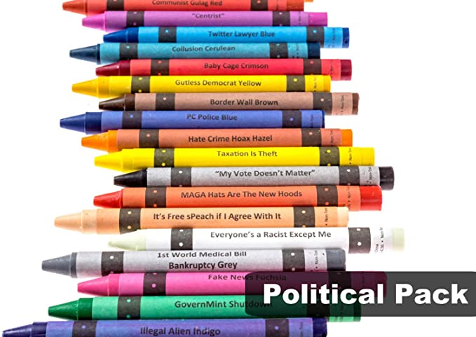
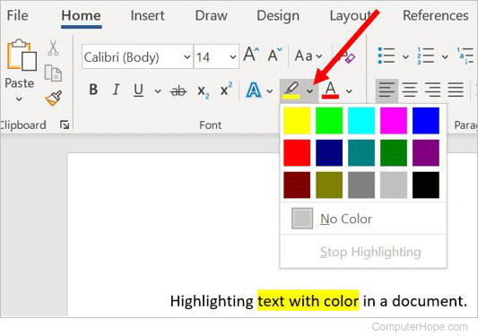
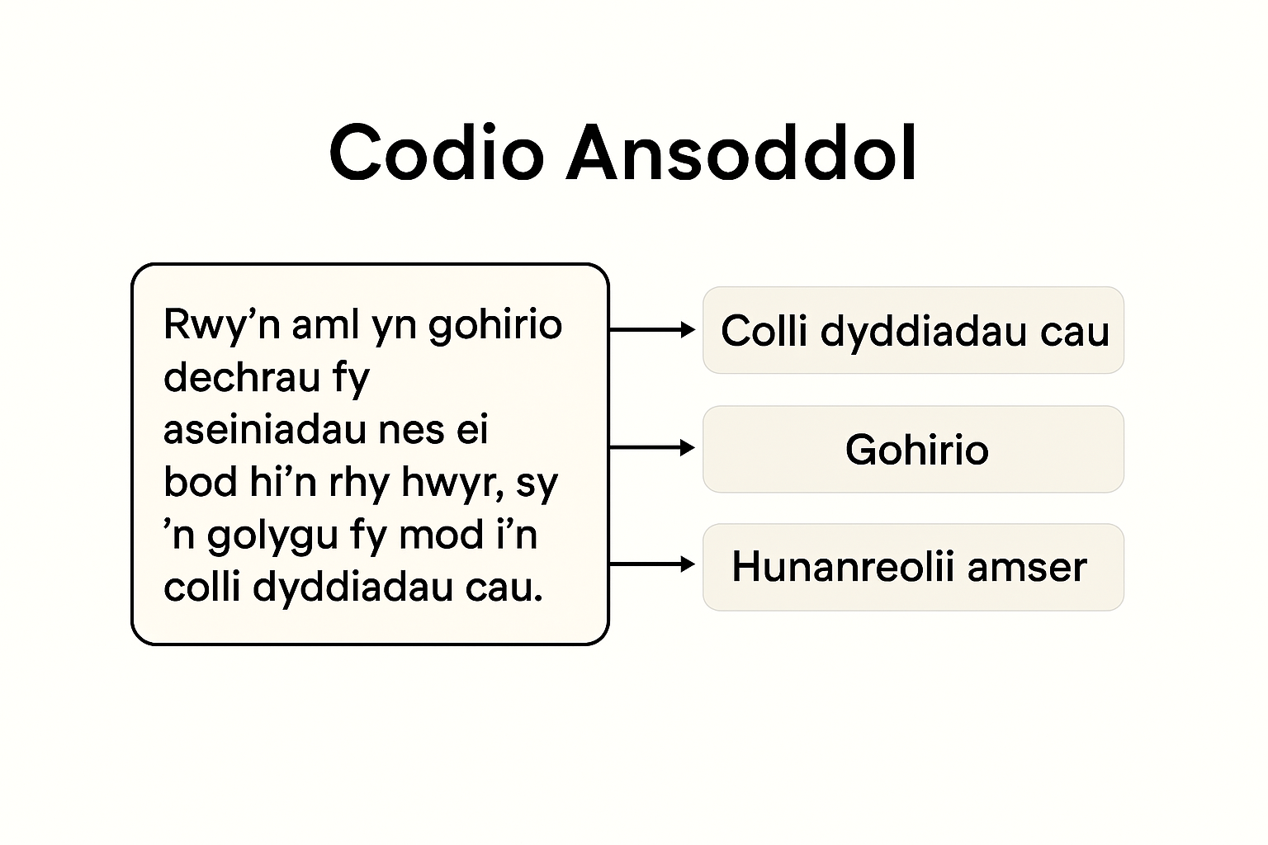
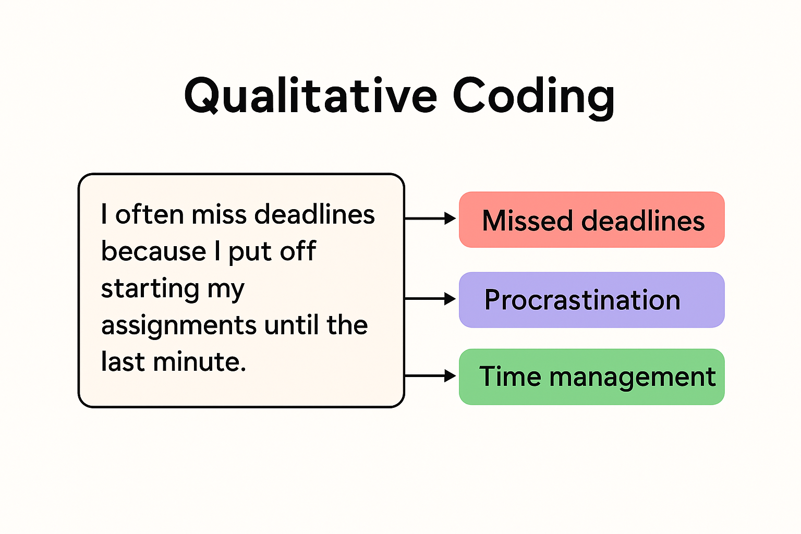
Tasg Codio/Coding Task

Slide 17

Cwestiynau
Questions
This Photo by Unknown Author is licensed under CC BY

Slide 18
Darllen pellach / Further reading
Peel, K. (2020) A Beginner's Guide to Applied Educational Research using Thematic Analysis. Available at: https://scholarworks.umass.edu/cgi/viewcontent.cgi?article=1390&context=pare
Children's understandings’ of obesity, a thematic analysis Available at: https://www.ncbi.nlm.nih.gov/pmc/articles/PMC3166520/

Slide 19
Cyfeiriadau / References
Glaser, B. and Strauss, A. (1967) The discovery of grounded theory: strategies for qualitative research. New York: Aldine de Gruyter.
Strauss, A. and Corbin, J. (1994). Grounded Theory methodology: An overview, In: Handbook of Qualitative Research (Denzin, N., K. and Lincoln, Y.,S., Eds.). Sage Publications, London, 1-18

