Slide 1
Law Reform

Slide 2
Aims
Explain the ways in which Parliament can change the law.
Explain judicial influences in changing the law.
Identify the different groups pushing for reform.
Explain the role of law reform agencies.
Evaluate the role and performance of law reform bodies.
Discuss the problems with law reform bodies.
Y Gyfraith LA 2 – Diwygio'r Gyfraith : Dulliau

Slide 3
Reforming the Law
Legal systems cannot stand still, and must adapt; there are a number of ways to create change:
What ways can you think of to create change?
  Judicial change.
  Amended by Parliament.
  Pressure groups.
  Law reform bodies.
Y Gyfraith LA 2 – Diwygio'r Gyfraith : Dulliau

Slide 4
Reform/change by Judges
One example: R v R ( 1991)
Discussion point: Should courts/judges be making such important changes to the law like the one see in R v R?
Y Gyfraith LA 2 – Diwygio'r Gyfraith : Dulliau

Slide 5
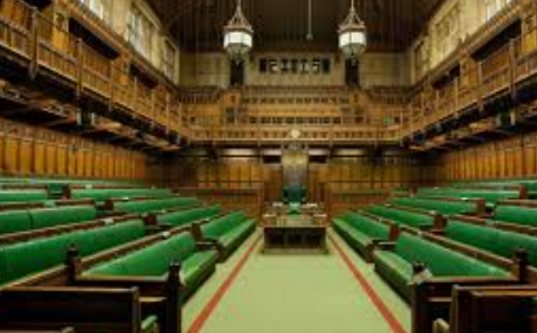
Reform by Parliament
Most reforms to the law are made by Parliament –
4 ways:
Repeal or abolition of old law
Create a new law
Consolidation
Codification, e.g. Police and Criminal Evidence Act 1984

Slide 6
Pressure Groups
Task 1:
What pressure groups can you think of that try to impact the government into changing laws?
Y Gyfraith LA 2 – Diwygio'r Gyfraith : Dulliau

Slide 7
Pressure Groups
Task 2
If you were a member of a pressure group, how would you go about campaigning for a change in the law?

Slide 8
Pressure Groups
Task 3
There are several example of petitions which have prompted a change in the law… research and locate 3 of them.

Slide 9
Other influences on reform
Public opinion e.g. Snowdrop petition after the Dunblane tragedy.
Pressure from the media/media campaigns e.g. Stephen Lawrence; ‘name and shame’ paedophiles;
Treaty obligations which influence changes to our law.
The Opposition or other political parties.
The Civil Service.

Slide 10
Law Reform Bodies
The Law Commission
Established in 1965.
Consists of members from the judiciary, the legal profession, law academics with support from legally qualified civil servants.
https://lawcom.gov.uk/law-reforms/
Y Gyfraith LA 2 – Diwygio'r Gyfraith : Dulliau

Slide 11
The Law Commission
Law Commissions Act 1965 ( as amended in 2009)
The Law Commission's task is:
  Codification of the law;
  Doing away with inconsistencies in the law;
  Repeal antiquated and unnecessary legislation
  Consolidate the law;
  Simplifying and modernizing the law.
The Commission publishes a consultation paper and the final recommendations are set out in a report with a draft Measure.

Slide 12
Law Reform Bodies
Criminal Law Reform Committee (CLRC) was set up to consider reforms to the criminal law. The CLRC has not met since 1985 and was superceded by the Law Commission
Royal Commissions - were set up to look at particular areas of law from time to time. Examples:
  Royal Commission of 1981 Criminal Procedure ( led to significant reform of police procedure and powers - PACE 1984)
  Royal Commission of 2000 on reform of the House of Lords
(But no new Royal Commissions since 2000 ( largely now replaced by Public Inquiries)
Public Inquiries – see next slide

Slide 13
Public Inquiries
Temporary committees set up to look at one matter and then disbanded
Examples include:
The Hillsborough football stadium disaster
Stephen Lawrence
Conviction of Harold Shipman
The Chilcot Inquiry - an inquiry into the war in Iraq
Leveson Inquiry 2011 – an investigation into the press's use of mobile phone hacking.
Post Office Horizon IT scandal
Covid 19 Inquiry

Slide 14
Specific Inquiries set up by Government
Sometimes Government departments set up temporary projects for a specific area of ​​law; e.g. Lord Woolf's Inquiry into the Civil Justice System which led to significant changes to the system which were once in a generation changes.

Slide 15
Are law reform bodies considered successful?
Law Commission – consolidation has not been very successful
Criminal Law Reform Committee – did lead to Theft Acts 1968 and 1978 which is seen as their biggest achievement.
Royal Commissions – impact has been mixed in terms of law reform.
Public Inquiries – largely depends on the political will of the time and the Governments as to whether they influence much change.

Slide 16
Problems with law reform bodies
Little power
No obligation on the Government of the day to follow the recommendations at all and any recommendations which are picked up can be changed significantly from what was intended initially.
Have little influence over how any suggestions/recommendations are put into practice.
Bodies tend to compromise.
Waste of expertise – once a committee is disbanded, they no longer play any further part in the process despite by this stage being expert in the field or on the question.
There is no single ministry in the Government tasked with law reform.
Y Gyfraith LA 2 – Diwygio'r Gyfraith : Dulliau

Slide 17
TASKS – and discussion points
What do you think about campaigns by various newspapers to influence changes in the law? Find an example and discuss your views and your research with the class.
Go to the Law Commission website and choose an area of ​​law that you will or are studying, find a report prepared in this area and summarise 3 of its recommendations.
Go to the Home Office website and read the Macpherson report into the death of Stephen Lawrence - discuss whether or not this was effective in reforming the English legal system

Slide 18

QUESTIONS?

