Slide 1
LCLM5002
Developing and Managing Individuals and Teams
Student Name: Ewelina Bernas
Student ID: 2509446

Slide 2

Introduction
HealthConnect UK is a rapidly expanding digital healthcare company based in the UK, which faces a range of issues, such as the need for qualified staff, staff retention and a skills gap in digital skills.
Effective Human Resource Management (HRM) is the solution to these problems (Caldeira et al., 2021).
Notes:
HealthConnect UK is a rapidly expanding digital healthcare company based in the UK, which faces a range of issues, such as the need for qualified staff, staff retention and a skills gap in digital skills. Effective Human Resource Management (HRM) is the solution to these problems (Caldeira et al., 2021). There are many ways to improve organisational performance, such as by using proper workforce planning, internal and external recruitment, online recruitment, and competency-based recruitment. The presentation will discuss the ways HRM can help in attracting talented skills, employee growth and sustainable growth of the organisation with the help of appropriate theories and current practices in HRM.

Slide 3


Organisation Overview
HealthConnect UK is an innovative digital healthcare service provider based in the UK with rapidly expanding virtual patient monitoring and virtual consultation services (HealthConnect UK, 2026).
The company is currently dealing with several challenges such as acquiring skilled employees in the Healthcare industry
Notes:
HealthConnect UK is an innovative digital healthcare service provider based in the UK with rapidly expanding virtual patient monitoring and virtual consultation services (HealthConnect UK, 2026). The company is currently dealing with several challenges such as acquiring skilled employees in the Healthcare industry, employee retention, employee well-being, shortage of digital skills, higher engagement and multidisciplinary teams. These problems can impact the efficiency of the company in terms of its operations, the quality of its services, and the future development of the company. Therefore, it is important to have good Human Resource Management (HRM). By applying appropriate recruitment and selection, training and development, fair rewards, assessing performance, and providing competent management, the company can attract, motivate, and retain employees. This will enhance employee skills, teamwork, experience of the patient and the long-term viability of the organisation.

Slide 4
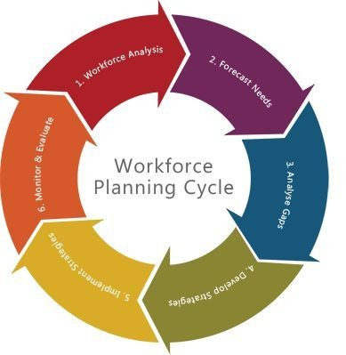
Workforce Planning and Recruitment
Workforce Planning and Skill Gap Identification
The demand for healthcare and technology professionals is increasing, and HealthConnect UK is now in a phase of rapid expansion; this makes workforce planning a necessity.
This type of planning enables the organisation to understand what it has and what it requires in the future and what skills it requires (Purwadi et al., 2024).
Notes:
The demand for healthcare and technology professionals is increasing, and HealthConnect UK is now in a phase of rapid expansion; this makes workforce planning a necessity. This type of planning enables the organisation to understand what it has and what it requires in the future and what skills it requires (Purwadi et al., 2024). It is possible to identify skill gaps in digital healthcare, patient monitoring and information technology through the evaluation of employee skills, the evaluation of job descriptions and training needs. However, if the forecast is wrong or plans are poorly made, there is a risk of understaffing, overloading the employees and causing employee burnout. The organisation should therefore regularly analyse the skills, determine the needs for staffing in the future and train the staff accordingly. This ensures that the staff with the necessary skills are available when needed.

Slide 5
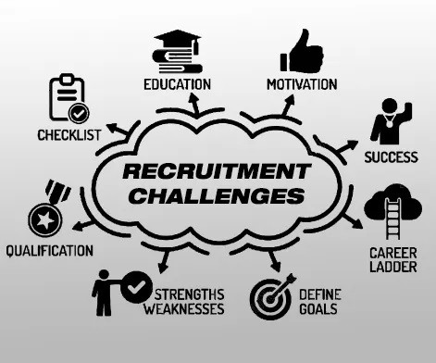
Workforce Planning and Recruitment
Recruitment Challenges and Critical Assessment
Competition to recruit skilled employees in the medical care industry and technology industry and the high recruitment cost and experienced staff shortage, are the main challenges in recruitment for HealthConnect UK (Tursunbayeva, 2019).
It is difficult to find the right candidates for the field of working in digital healthcare, since a combination of clinical, technical, and communication skills is required.
Notes:
Competition to recruit skilled employees in the medical care industry and technology industry and the high recruitment cost and experienced staff shortage, are the main challenges in recruitment for HealthConnect UK (Tursunbayeva, 2019). It is difficult to find the right candidates for the field of working in digital healthcare, since a combination of clinical, technical skills and communication is required. The traditional approach of job advertisements may restrict the pool of candidates. On the other hand, online job sites, professional networks, university affiliations, and employee referrals can be used to boost the number of candidates. Structured interviews and competency-based tests are used, making it easier to find the correct candidates. However, it is not acceptable to rush the process at the expense of considering the skills of the candidates, equal opportunities, and cultural fit. The organisation will be able to attract the best employees and keep them for the long term through proper recruiting and the right compensation, career growth and employee care.

Slide 6
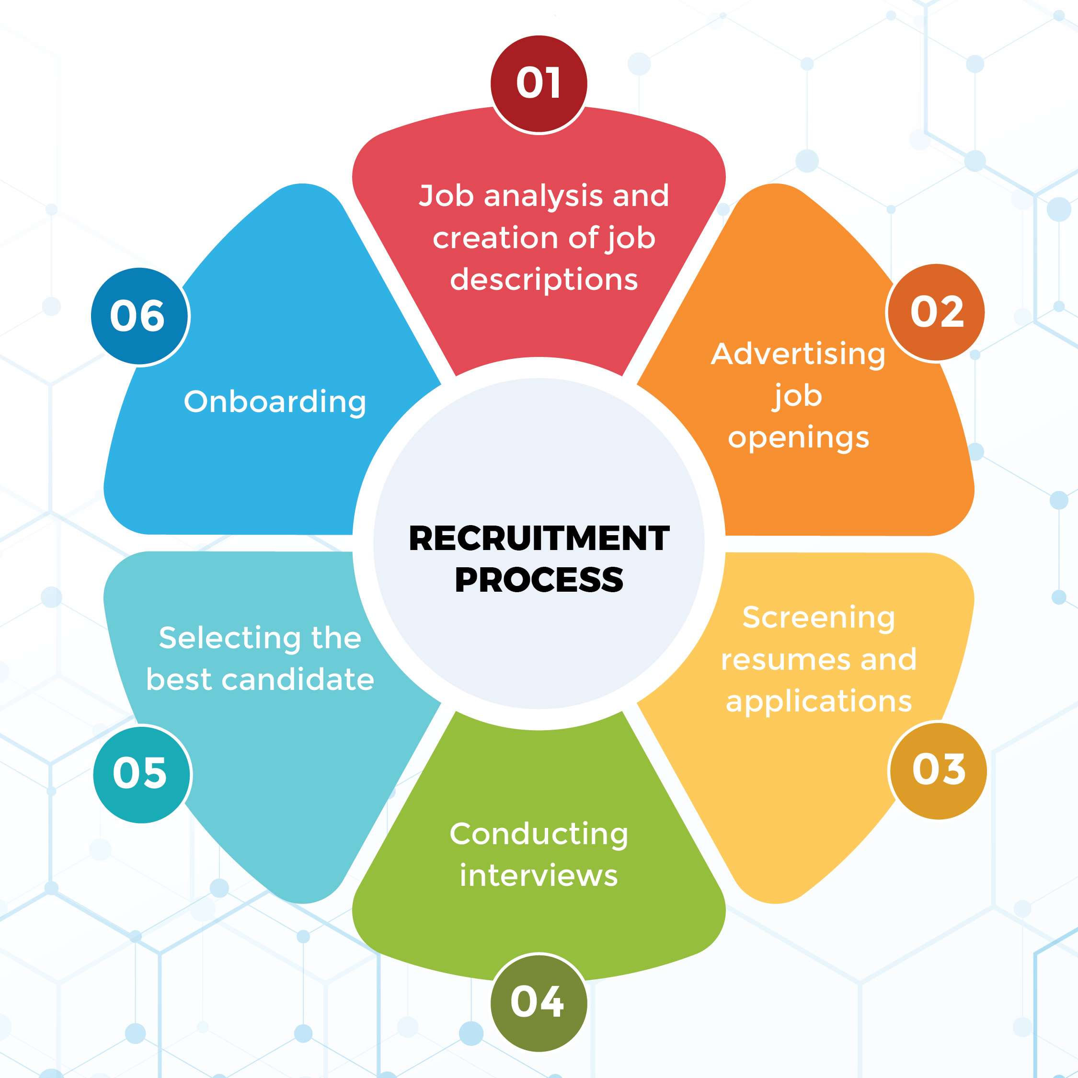
Recommendation
Internal Recruitment
External Recruitment
Online Recruitment
Social Media Recruitment
Notes:
Internal Recruitment: It should be ensured that current employees get opportunities for promotion and internal transfer. This is a time- and cost-saving strategy for the recruitment process and improves employee motivation and retention (Gupta & Khanna, 2022).
External Recruitment: Utilise external recruitment agencies (such as NHS, universities, professional networks within healthcare and technology sectors) to attract talented people. This will enable the recruitment of the specialists who are needed in digital healthcare, software development and clinical areas.
Online Recruitment: Advertisements should be made on online advertisement websites such as Indeed, NHS Jobs and LinkedIn. This enables outreach to the eligible applicants across the UK and fastens the process of hiring applicants.
Social Media Recruitment: LinkedIn and other social media platforms will be used to promote the organisation environment, training, career growth and experience of the organisation (Farsi, 2021). This enhances the employer brand and makes it easier to attract professionals in healthcare and technology fields.

Slide 7
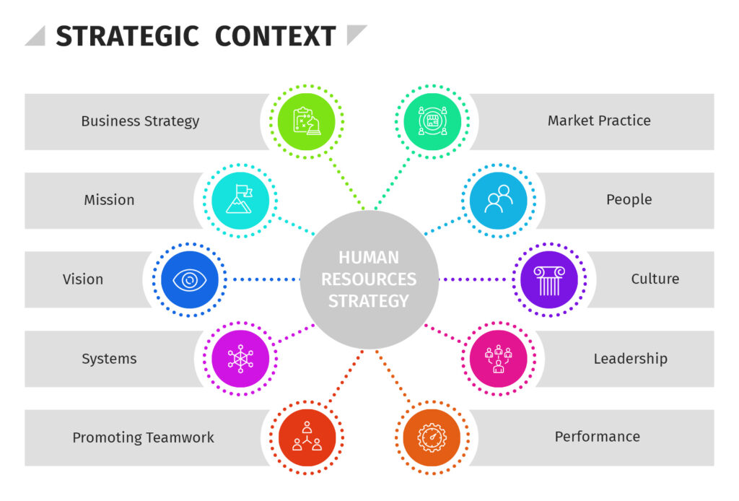
Justification in support of the recommendations
Rationale for recommendations based on HRM theories and concepts
The recruitment strategy that is used by HealthConnect UK should be aligned to the theories and concepts of Human Resource Management (HRM).
According to Strategic Human Resource Management (SHRM), the organisational workforce planning and development should be linked with the long-term goals and business strategy (Caldeira et al., 2021).
Notes:
The recruitment strategy that is used by HealthConnect UK should be aligned to the theories and concepts of Human Resource Management (HRM). According to Strategic Human Resource Management (SHRM), the organisational workforce planning and development should be linked with the long-term goals and business strategy (Caldeira et al., 2021). So it's important to provide promotion opportunities to talented staff through internal recruitment and new skills and experience through external recruitment. Furthermore, in the Person-Job Fit concept, the applicant's abilities, knowledge and experience should align with the requirements of the specific job. HealthConnect UK can use a competency test and structured interview to select the right candidates. These techniques can be applied to quality recruitment, to increase the productivity of the employee and to reduce staff turnover.

Slide 8

Justification in support of the recommendations
Rationale for recommendations based on contemporary HRM practices
Modern HRM practices emphasise digital hiring, social media usage, competency-based selection, and employee experience overall.
With HealthConnect UK, LinkedIn, Indeed and NHS Jobs could be employed to access able healthcare and technology workers across the UK (Purwadi et al., 2024).
Notes:
Modern HRM practices emphasise digital hiring, social media usage, competency-based selection, and employee experience overall. With HealthConnect UK, LinkedIn, Indeed and NHS Jobs could be employed to access able healthcare and technology workers across the UK (Purwadi et al., 2024). By communicating about a positive work environment, training programs, and career development opportunities on social media, you can help to develop a positive reputation as an employer. Furthermore, there is potential to promote existing employees through internal recruitment and external recruitment brings new knowledge and new ideas. However, online recruitment should offer equal opportunities for everyone who applies and safeguard personal data. The organisation will be able to recruit and retain competent employees and improve its long-term organisational performance through online hiring and human-based evaluation, impartial selection and diversity in hiring.

Slide 9
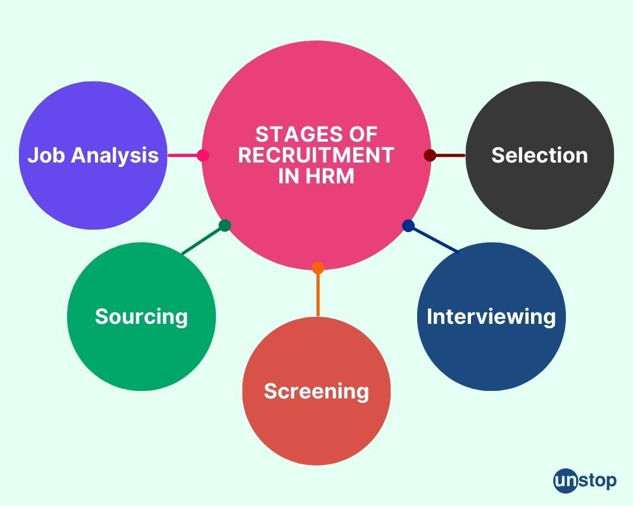
Critical Analysis
The HealthConnect UK Recruitment Methods Analysis reveals the advantages and disadvantages of all of the approaches.
While being cost- and time-efficient, internal hiring can also weaken the learning of new skills and concepts, yet improve employee morale (Gupta & Khanna, 2022).
However, in reality, the organisation should seek to evaluate its own resources for staffing and promotion and only look to external and digital recruitment if it has a skills gap (Al-Hanawi et al., 2019).
Notes:
The HealthConnect UK Recruitment Methods Analysis reveals the advantages and disadvantages of all of the approaches. While being cost- and time-efficient, internal hiring can also weaken the learning of new skills and concepts, yet improve employee morale (Gupta & Khanna, 2022). However, while recruiting from the outside can be achieved, it is a more costly and time-consuming process to bring on new staff members with experience in digital healthcare and technology, and it can be difficult to integrate the newcomers into the organisation. While recruitment via online and social media can bring in a broad cross-section of applicants in a short amount of time, it also presents an employer with numerous problems to navigate, such as, the digital divide, bad data, and an abundance of applications. So a dual recruiting approach should be used, rather than a single approach.
However, in reality, the organisation should seek to evaluate its own resources for staffing and promotion and only look to external and digital recruitment if it has a skills gap (Al-Hanawi et al., 2019). In line with CIPD's guidelines for recruitment and selection, it is important to establish what is required for the job and apply appropriate selection methods. Similarly, structured interviews and competency-based testing enable fairer comparisons between participants. The criteria for measuring recruitment success should be time and cost of hire, new hire performance, retention after six months, retention after a year, etc., and the experience of the candidate in the process. HealthConnect UK will benefit from ongoing enhancement of recruitment practices based on this data, resulting in more efficient recruitment and reduced staff turnover, and sustainable organisational development.

Slide 10
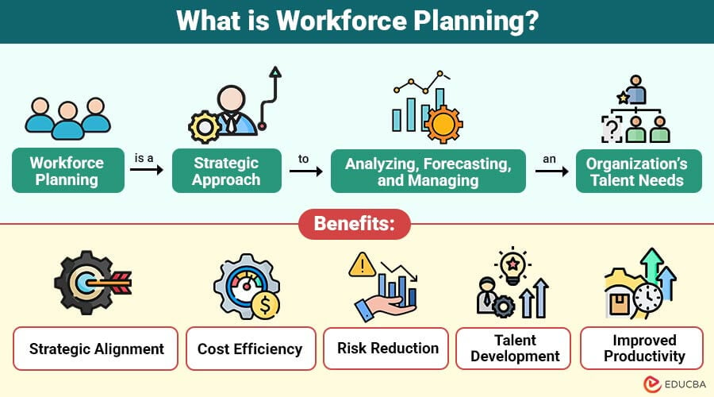
Practical Application
HealthConnect UK might want to adapt the concept of Strategic Human Resource Management (SHRM) in the context of recruitment and workforce planning,
So that the staffing of the company is correlated with the long-term plans of the company and the further development of the digital healthcare service (de Lange et al., 2020).
Notes:
HealthConnect UK might want to adapt the concept of Strategic Human Resource Management (SHRM) in the context of recruitment and workforce planning, so that the staffing of the company is correlated with the long-term plans of the company and the further development of the digital healthcare service (de Lange et al., 2020). The steps need to begin with an assessment of the current staff and the skills that are lacking in fields such as digital technology, patient monitoring, and team management. The candidates then have to be selected on the basis of Person-Job Fit, i.e., matching the qualifications, experience and technical skills of the candidate with the requirements of the job. They should include inviting good internal staff and also recruiting via external recruiting and online recruiting campaigns on websites like LinkedIn, Indeed and NHS Jobs. The organisation will base its decisions on applying an Evidence-Based HRM approach, which involves regular analysis of various HR metrics such as recruitment costs, time-to-hire, employee performance, and retention rates.

Slide 11

Conclusion
HRM could be all that it takes to get to grips with workforce challenges and improve the chances of success for HealthConnect UK.
Studies show that using internal recruitment methods increases the number of employees promoted; external recruitment provides new skills and online and social media recruitment enables the appropriate people to be targeted quickly.

Slide 12
Reference List
Al-Hanawi, M.K., Khan, S.A. and Al-Borie, H.M. (2019) ‘Healthcare Human Resource Development in Saudi Arabia: Emerging challenges and opportunities—A critical review’, Public Health Reviews, 40(1). doi:10.1186/s40985-019-0112-4.
Caldeira, C. et al. (2021) ‘Managing healthcare conflicts when living with multiple chronic conditions’, International Journal of Human-Computer Studies, 145, p. 102494. doi:10.1016/j.ijhcs.2020.102494.
de Lange, A.H. et al. (2020) ‘Editorial: Healthy healthcare: Empirical Occupational Health Research and evidence-based practice’, Frontiers in Psychology, 11. doi:10.3389/fpsyg.2020.02236.
Farsi, D. (2021) ‘Social Media and health care, part I: Literature review of social media use by Health Care Providers’, Journal of Medical Internet Research, 23(4). doi:10.2196/23205.
Gupta, S.D. and Khanna, A. (2022) Healthcare System Management: Methods and Techniques. Singapore: Springer.
HealthConnect UK (2026) Health Connect (UK) ltd, GOV.UK. Available at: https://find-and-update.company-information.service.gov.uk/company/07289227 (Accessed: 13 October 2026).
Purwadi, P. et al. (2024) ‘Strategic Human Resource Management in healthcare: Elevating patient care and organizational excellence through effective HRM practices’, Golden Ratio of Data in Summary, 4(2), pp. 88–93. doi:10.52970/grdis.v4i2.540.
Tursunbayeva, A. (2019) ‘Human Resource Technology Disruptions and their implications for Human Resources Management in healthcare organizations’, BMC Health Services Research, 19(1). doi:10.1186/s12913-019-4068-3.
Notes:
Al-Hanawi, M.K., Khan, S.A. and Al-Borie, H.M. (2019) ‘Healthcare Human Resource Development in Saudi Arabia: Emerging challenges and opportunities—A critical review’, Public Health Reviews, 40(1). doi:10.1186/s40985-019-0112-4.
Caldeira, C. et al. (2021) ‘Managing healthcare conflicts when living with multiple chronic conditions’, International Journal of Human-Computer Studies, 145, p. 102494. doi:10.1016/j.ijhcs.2020.102494.
de Lange, A.H. et al. (2020) ‘Editorial: Healthy healthcare: Empirical Occupational Health Research and evidence-based practice’, Frontiers in Psychology, 11. doi:10.3389/fpsyg.2020.02236.
Farsi, D. (2021) ‘Social Media and health care, part I: Literature review of social media use by Health Care Providers’, Journal of Medical Internet Research, 23(4). doi:10.2196/23205.
Gupta, S.D. and Khanna, A. (2022) Healthcare System Management: Methods and Techniques. Singapore: Springer.
HealthConnect UK (2026) Health Connect (UK) ltd, GOV.UK. Available at: https://find-and-update.company-information.service.gov.uk/company/07289227 (Accessed: 13 October 2026).
Purwadi, P. et al. (2024) ‘Strategic Human Resource Management in healthcare: Elevating patient care and organizational excellence through effective HRM practices’, Golden Ratio of Data in Summary, 4(2), pp. 88–93. doi:10.52970/grdis.v4i2.540.
Tursunbayeva, A. (2019) ‘Human Resource Technology Disruptions and their implications for Human Resources Management in healthcare organizations’, BMC Health Services Research, 19(1). doi:10.1186/s12913-019-4068-3.

Slide 13

Thank You
Any questions?

