Slide 1
Menu presentation
MODULE: BMIH4002
STUDENT NAME: GABRIEL MIHAI ANTON
STUDENT NUMBER: 2122258
LECTURER’S NAME: STEVE JONES

Slide 2

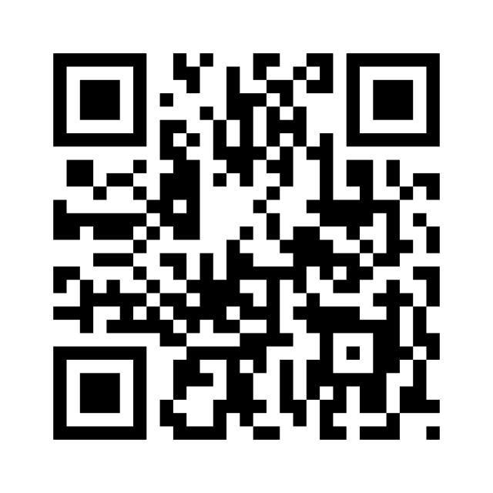
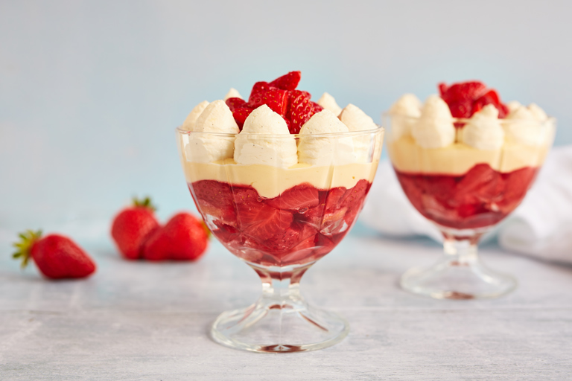





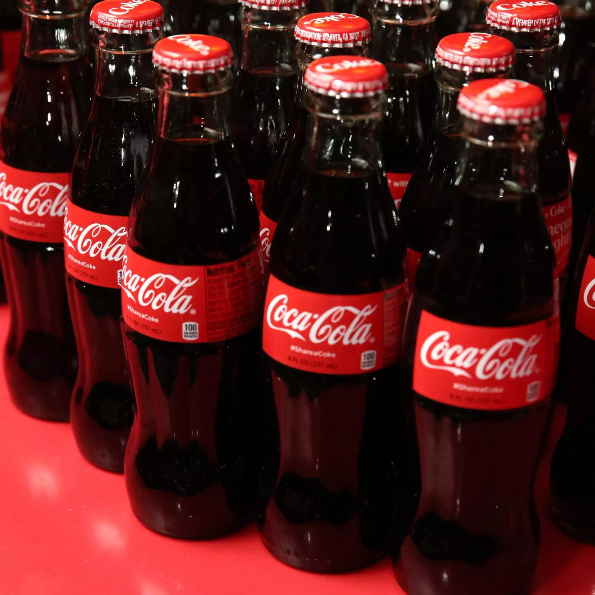
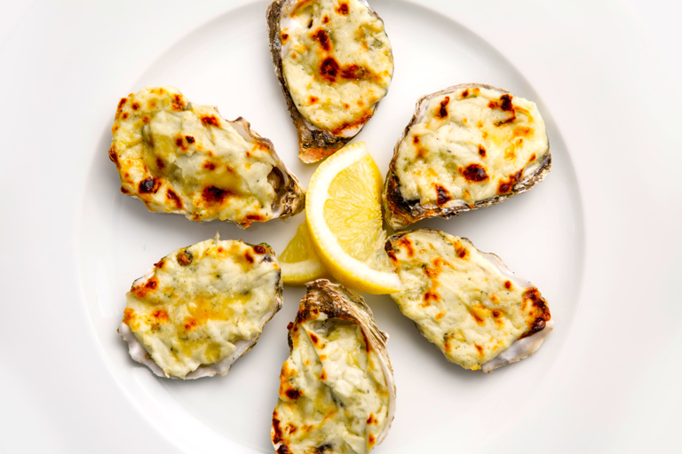
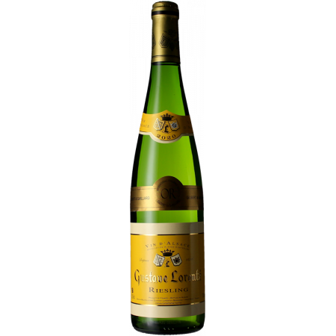
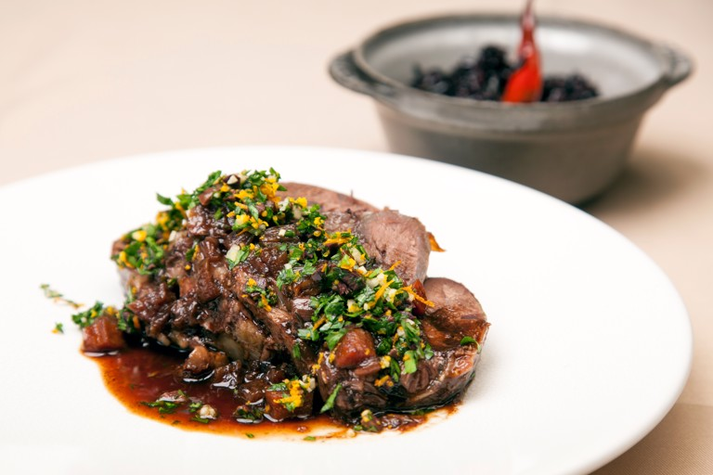

Desserts
Pashka 3,00
(with curd cheese, honey, dried fruits and almonds)
Trio of apple deserts 2,75
(serving up a miniature apple and calvados, apple crumble tart and creamy apple shot)
Strawberry trifle 3,50
(fresh strawberry's with coulis, compote, custard)
Qr code
Trinity Hotel
Contact: Bathurst Street
Swansea, SA1 3SA
Website: www.trinityhotel.couk
. Phone: 01234 567 891
Mon-Sun: 12:00-23:00
Coffee
Espresso 2,00
(30ml/1 fl. Oz.)
Cappuccino 2,50
(espresso 30ml/1 fl. oz., milk 150ml/5 fl. Oz., froth 1,5cm/0.6 inches)
Macchiato 2,50
(espresso 30ml/1 fl. oz., froth 0.5 fl. Oz.)
Menu
Starters
Drinks
Oysters 12,00
(oysters covered with stilton and cream cheese blended together baked in oven, served with laverbread) *why not try with our sweet white wine. Sold separately
Laverbread ravioli 7,50
(with roasted onion stock and Welsh beach vegetables)
Welsh rarebit 6,85
(slices of bread with cheddar, English mustard and egg yolk)
Coke 1,35/330ml
Diet coke 1,35/330ml
Fanta orange 1,35/330ml
Sprite 1,35/330ml
Highland still water 1,20/500ml
Highland sparkling water 1,20/500ml
Beverages
Main course
Rump of lamb 8,75
(served with baked aubergine and pesto in a delicious garlig and herb oil to maximise the flavour) *why not try with our medium red wine. Sold separately
Breast of Madget’s 7,60
(farm duck breast served with potato pancakes, apple flavour-fresh fruit, juice, cider and Calvados)
Braised whole beef shin with gremolata 8,00
(beef braised in a orange and red wine with olive gremolata, slow-cooked for a wonderful aromatic flavour, served with Camargue black rice)
Riesling Gustave Lorenz, France 14,74/75cl
This 2020 Riesling has everything it needs to win you over
Sodale merlot, Italy 21,90/75cl
Still dry wine has a red colour with violet hues with a finish persistence and sweet tannin
Corona extra 2,25/33cl
If you suffer from any special dietary requirements or suffer from a food allergy please let us know before you order.
i food.gov.uk/ratings i ganfod sgôr hylendid bwyd ein busnes neu gofynnwch inni beth yw ein sgôr hylendid bwyd wrth archebu. / Go to food.gov.uk/ratings to find out the food hygiene rating of our business or ask us for our food hygiene rating when you order”.

Slide 3
REFERENCES
https://www.vinatis.co.uk/44813-riesling-reserve-2020-gustave-lorentz
https://www.greatbritishchefs.com/recipes/braised-beef-shin-recipe-with-gremolata
https://www.greatbritishchefs.com/recipes/strawberry-trifle-recipe
https://www.greatbritishchefs.com/recipes/oysters-recipe-laverbread-stilton
https://www.youtube.com/watch?v=sdNkCxAPXaI&t=196s

