Slide 1
SJEQ7004 Sustainable Communities: Equality in Action
Carol Morgan
Student number: 1705514

Slide 2
Introduction
Future Generations (Wales) Act.
Sustainable & equitable community.
Defined group:
  Retired Elderly People
  Economically inactive
  Pension receivers
  Not cared for within own family group
  Reliant on ‘others’ for provision of care
  No longer perceived as useful ….. (by society/family/business)
(Head, 2000 p.3)

Slide 3
Disappearing Nature and Lessons of the Past
‘Much of our thinking on these issues is constrained by a number of dualisms within Western thinking’
(Head, 2000 p.3)

Slide 4
Love Thy Nature
The interdependence that once co-originated between man and nature spoiled by the arrogance of man.
‘All things in life arise and co-exist together.’
(Rokab, 2017)

Slide 5
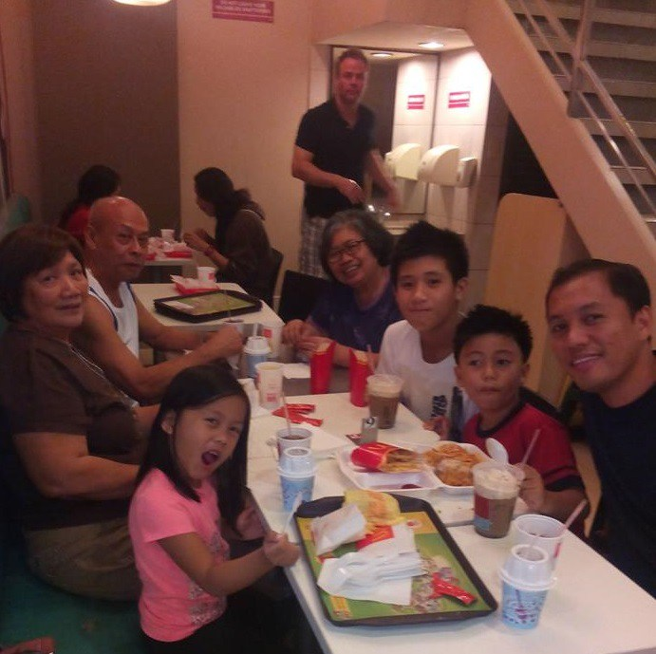
Other Cultural View?
Filipinos – belong to community first then family (child/adult/elderly).
‘Filipinos are generally known to take care of their elderly family members and not leave them to the care of an institution or other people’
(OSM, 2018)

Slide 6
The Act Claims
The Welsh Government claim in the Well-being of Future Generations (Wales) Act 2015 their intention ‘on improving the social, economic, environmental and cultural well-being of Wales’.
Aspirations of the Act:
      It aspires to make public bodies:
      Think about the long term
      Work better with people/communities/each other
      Look to prevent problems
      Take a more joined up approach
(Welsh.gov, 2016; Wales.gov, 2018)

Slide 7
Capitalist Mentality
In a capitalist world (NEED and WANT profit and usefulness), we only value things if they are worth something. Elderly people are considered the ‘coffee grinds’ of our society (used, no longer contributing to the economy)
  drain on resources/service needs
  worthless/inconvenient
  a burden (moved away from nature, someone else look after them)
  loss of identity
  ‘Identities are so important, and ultimately so powerful in this ever changing power structure because they build interests, values and projects around experience’.
(Castells, 1997 cited in O’Riordan 2001)

Slide 8
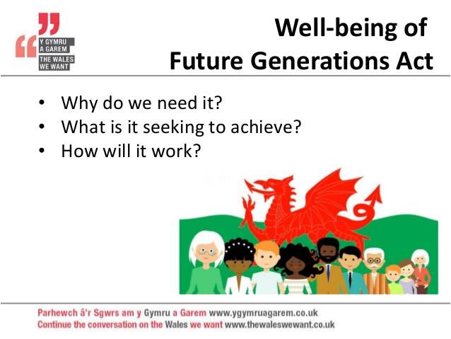
Aims
With the aim of:-
Helping ‘us to create a Wales we all want to live in, now and in the future’
(WCVA, 2018)

Slide 9
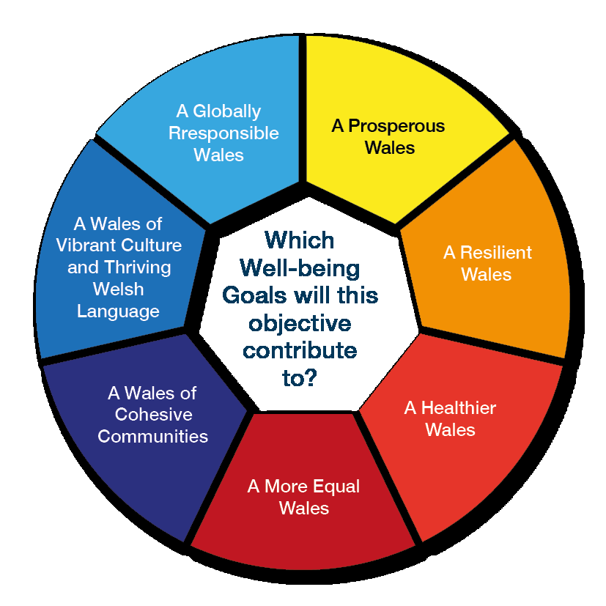
Well-being Goals
It has put 7 well-being goals in place with the stipulation of working towards the same vision
However, for all goals to be reached, joined up thinking of all is essential
(Wales.gov, 2018; WCVA, 2018)

Slide 10
Critical Evaluation of Claims and Aspirations
How can the government say we will reach these goals by ???
Compare it to Tony Blair’s concept of ‘Ending Child Poverty’ by 2020, stating that his government’s "historic aim will be for ours to be the first generation to end child poverty“. Leading us to not accepting things at face value.
It’s all about funding and commitment
If no finance in place then will never happen
How is this all achievable – NHS and SS are grossly underfunded atm
(UK Parliament, 2010; BBC, 1999)

Slide 11
Module Question and Focus
This seminar presentation will focus on the following 2 well-being goals to critically evaluate how the Well Being of Future Generations (Wales) act 2015 may promote a more ‘sustainable and equal community’, and whether it is aspirational and achievable.
(Wales.gov, 2018; WCVA, 2018)

Slide 12


The Wellbeing of Future Generations
(Wales) Act 2015
A healthier Wales
A Wales of cohesive communities
(Wales.gov, 2018; WCVA, 2018)

Slide 13
Elderly Community Living in Residential Care
The area of inclusive practice I am going to consider is ‘Elderly Community living in Residential Care’, whilst meeting the following outcomes:-
critically analyse ‘the contested nature of sustainable development, and to differentiate and critically evaluate different interpretations of the discourse and theories of society-environment relationships’
explore in depth definitions of sustainable communities and critically analyse it as a concept to promote an inclusive approach to sustainability that exists within current sustainability policies
(SJEQ7004, 2018)

Slide 14
Sustainability and The Elderly Population
Is it sustainable to keep putting our elderly people into an ‘institution’?
In differentiating the differing interpretations in elder care
The different interpretations of the discourse ‘where people should be kept’
The underpinning theories that support this:-
  Cameron’s medical models of care
  LA paradigm of care – a capitalist society can’t afford a workforce to stay at home and look after the elderly, go to work in the homes so they have a paid job, pay tax and contribute to a capitalist society.
(Cameron, 2014; Marx, 2009)

Slide 15
Elderly Community Living in Residential Care
‘Despite the wide usage and popular appeal of the concept of sustainability in UK policy, it does not appear to have challenged the status quo in urban regeneration because policy is not leading in its conceptualisation and therefore implementation’ (Lombardi et al, 2010) who question:
‘finds that conceptualisations of sustainability are fundamentally limited’?

Slide 16
Elderly Community Living in Residential Care
‘Despite the wide usage and popular appeal of the concept of sustainability in UK policy, it does not appear to have challenged the status quo in urban regeneration because policy is not leading in its conceptualisation and therefore implementation’ (Lombardi et al, 2010) who question:
‘finds that conceptualisations of sustainability are fundamentally limited’?
‘disparate conceptualisations of stakeholders demonstrate even less coherence than policy’?

Slide 17
Elderly Community Living in Residential Care
‘Despite the wide usage and popular appeal of the concept of sustainability in UK policy, it does not appear to have challenged the status quo in urban regeneration because policy is not leading in its conceptualisation and therefore implementation’ (Lombardi et al, 2010) who question:
‘finds that conceptualisations of sustainability are fundamentally limited’?
‘disparate conceptualisations of stakeholders demonstrate even less coherence than policy’?
‘urban policy discourse that is limited to solutions within market-based constraints’?

Slide 18
Elderly Community Living in Residential Care
Reasons For:-
Structure – daily routine/care
Experienced carers – caring for elderly, especially frail/unwell
Dedicated carers – feel a ‘calling’ to care for older people/chosen to be there
Social interaction – natural opportunities for activities/recreation
Dietary provision – healthy/nutritious food
Medication – administered appropriately and their effect monitored
Services – rehab/therapy services readily available when needed
’receiving quality care that will result in their achieving or maintaining their ‘highest practicable’ physical, mental, and psychosocial well-being.’
(IPC, 2017)

Slide 19
Elderly Community Living in Residential Care
Reasons Against:-
  Cost – especially if self funding
  Choice – limited
  Unfamiliar surroundings
  Loneliness – loss of contact with neighbours/old friends
  Emotional effect – family feel guilty even though caring is no longer practical
  Feel rejected – explain unable to give care needed/maintain regular contact
  Loss of independence – good homes encourage to be as much as they can be
  Lack of privacy – might find difficulty to adjust to
  Small living space – limited amount of their furniture/personal possessions
  Variations in care – quality of care may vary from home to home
  ‘The care system is failing to provide the support that we and our loved ones need.’
(Which?, 2017)

Slide 20
A Healthier Wales
Are sufficient funds in place to meet current needs/equitably available for the future to meet the increase in demand of:-
  beds in our hospitals to cope with ageing population presenting with complex health problems
  nursing/residential places (delayed discharges)
  health funding/targets
  plan services/finances over the medium term
Conservatives claim Labour is responsible for health funding cuts/targets not being met. Wales NHS finances found Welsh Government had:-
  increased health spending
  greater focus on the longer term thinking and planning across NHS Wales.
  (Wales Audit Office, 2017; Wales Government, 2018; BBC,2018)

Slide 21
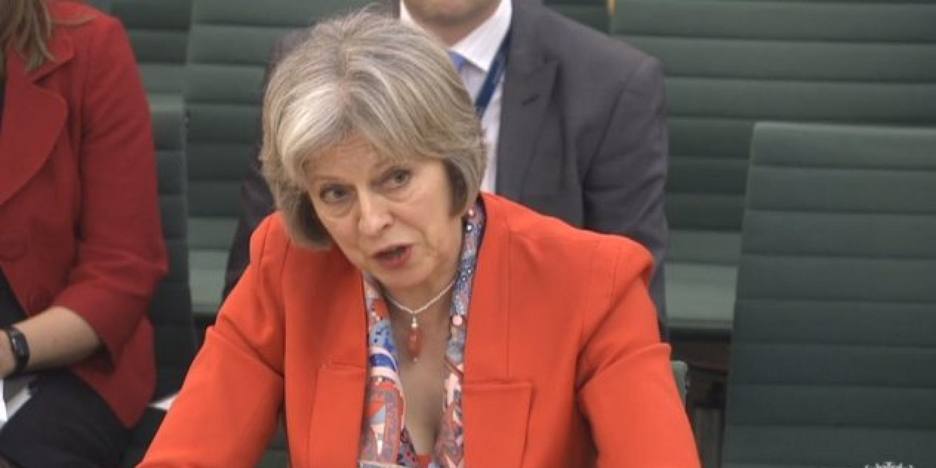
Current Government Paradigm of Care
‘If the Labour Party have got all the answers, why is it that we see funding being cut and targets not being met in Wales where the Labour Party is responsible?’
(May, cited in BBC, 2018; Google Images, 2018)

Slide 22
Inclusive Practice in Community Care
Carers in the community – heavy reliance on unpaid carers (family members, friends, neighbours), impacting on their health, employment, finances and general well-being.
Provide access/transport to GP’s, HCP’s, support services, recreation services
(Wales Audit Office, 2017; Welsh Government, 2017, 2018)

Slide 23
Cultural Sanitisation of the Elderly?
‘Residential care denies older people the rights most of us take for granted. We do need to consider whether the model of residential care is fit for the future.’
(Wood cited in Community Care, 2013)

Slide 24
Paradigm of Care
Some Local Authorities use medical model of care, some use social model
Society seeing the Future Generation as being:
  Other
  Different
  Seeking to assert their ability on the basis of other inability or disability
  i.e. Old Age
The Benjamin Franklin effect where:
  We dislike those we treat badly and vice versa
(Cameron, 2013; Ransom, 2011)

Slide 25
Paradigms of Care
Medical Model – says fit for discharge
‘Resources are targeted at individuals in order to fix them for participation in the world around them, while the environment in which they live is regarded as unproblematic’.
Social Model – says not…
‘…reconceptualised…not as an individual problem or as a personal trouble but as a social structural issue’.
(Cameron, 2013 p. 99)
(Barnes cited in Cameron, 2013 p. 137)

Slide 26
Cohesive Policy?
‘The residential and nursing care home sector becomes a sector of primary national strategic importance for Wales, is shaped by policies to improve the quality of care, and care home managers are registered and are members of a professional body which has disciplinary powers’
(Wales on Line, 2015; Lombardi et al, 2010)

Slide 27
A Wales of Cohesive Communities?
‘The needs of care home residents must always come first and they and their families must have the peace of mind of knowing that they will always be looked after properly and be treated with respect and dignity’
(Wales on Line, 2015)

Slide 28
A Wales of Cohesive Communities
How can we be a cohesive society when:-
  discard/segregate our elderly people from society
  families sanitise their home/get rid of their elderly due to capitalist pressures they feel to work/provide/perform
Carers should feel privileged to look after elderly people who have contributed to society but…..
  not reflected in wages
  undervalued occupation
  if people hate their job they end up hating elderly people (Benjamin Franklin Effect)
  (Ransom, 2011; Head, 2000)
‘Natural capital is a stock of resources.’ (Thiele, 2013 p.156)

Slide 29
A Wales of Cohesive Communities
‘The Union recognises and respects the rights of the elderly to lead a life of dignity and independence and to participate in social and cultural life’.
‘Older people get sick from disease, not old age. People can remain healthy, vibrant and of sound mind well into their 70s, 80s and even 90s.’
(Stall cited in Aging-Care, 2017)
(European Union Agency For Fundamental Rights, 2018)

Slide 30
A Wales of Cohesive Communities
The Human Rights Act 1998 states everyone’s rights to:-
  have and express own opinion
  an education
  a private and family life
  not be mistreated or wrongly punished by the state
‘Human rights are the basic rights and freedoms that belong to every person in the world, from birth until death. They apply regardless of where you are from, what you believe or how you choose to live your life. These basic rights are based on shared values like dignity, fairness, equality, respect and independence’.
  (Equality and Human Rights Commission, 2018)

Slide 31
A Wales of Cohesive Communities
‘Our ability to reach unity in diversity will be the beauty and the test of our civilization.’
‘The true measure of any society can be found in how it treats its most vulnerable members’
‘Relationships are based on four principles: respect, understanding, acceptance and appreciation.’
(Gandhi, cited in Pathak 2016; A’la Mawdudi, 2006)

Slide 32
In Conclusion
It is argued that ‘Well-being of Future Generations (Wales) Act 2015:-
  does not reflect what this ‘Future Generation’ really wants
  fails to negate the Benjamin Franklin/Tony Blair effect, in that there is no guarantee that the aspirations of the act will be met
  tends towards requesting rather than demands
  what evidence supports such claims?
(Wales.gov, 2018 ; UK Parliament, 2010; BBC, 1999; Ransom, 2011)

Slide 33
Giants of Poverty
Government’s 1945 programme of social reform based on the ‘Beveridge Report’ aimed to eradicate the five “giant evils”
  Want – (NI – social provision from ‘cradle to the grave’)
  Disease – (NHS – free medical, dental, optical services, GPs and hospitals)
  Squalor – (housing – building of new houses and towns).
  Ignorance – (education – secondary education ‘compulsory until the age of 15 years, pupils to be provided meals and medical services at every school)’
  Idleness – (employment – maintain high levels of employment via nationalisation)
  (BBC, 2014; ITV, 2018; The Guardian, 2014, 2017)

Slide 34
Giants of Poverty (contd.)
Almost 75 years later the five “giant evils” still remain
  Want – ‘(roughly 2% of population in world’s fifth largest economy struggling to eat/keep warm/clean/find a bed for the night)’
  Disease – (stagnating life expectancy/health inequalities)
  Squalor – (councils house building ban contribute to shortage of homes)
  Ignorance – (schools at ‘breaking point’ due to budget cuts)
  Idleness – (low unemployment/high employment rates disguise under-employment i.e. part time/zero hours contract)
  (The Guardian, 2014, 2017; ITV, 2018)

Slide 35
Poverty of Aspiration
Poverty and deprived communities…….
  contributing to health inequalities resulting in shorter life expectancy
  demonstrates negative impact of socio economic circumstances on health and well-being
(BBC, 2013; ITV, 2018; The Guardian, 2014, 2017)

Slide 36
Ageing Population
Increase in demand/dependence on medical support due to having multiple and more complex conditions
Increase in number of people with dementia/learning disabilities/mental health issues placing additional demands on care and support (both in hospitals and community)
(Wales.gov, 2018; BBC,2018; Wales Audit Office, 2017)

Slide 37
Funding for Health Promotion
Funding for health promotion initiatives/screening/health education etc.
Providing affordable/accessible recreation facilities – improve physical/mental health and well-being
(Wales.gov, 2018 ; BBC, 1999, 2018)

Slide 38
Raising Aspirations
Next Generation Thinking
Ill educated
Time served
Limited vision of what care could be like
(Wales.gov, 2018 ; The Guardian, 2014, 2017)

Slide 39
Self Reflection
‘We but mirror the world. All the tendencies present in the world are present in our body. If we could change ourselves, the tendencies in the world would change’.
(Gandhi cited in Pathak, 2016; A’la Mawdudi, 2006)

Slide 40
Who is Speaking up for the Elderly? Now?
‘Early work will involve supporting all older people to have voice and control over their health and social care, with a focus on commissioning, safeguarding and advocacy’
(Welsh Government, 2018; Advocacy Charter, 2018)

Slide 41
Health Definition
‘Health is a state of complete physical, mental and social well-being and not merely the absence of disease or infirmity’.
(WHO, 2014)
‘Yet older people face physical, environmental, psycho-emotional and attitudinal barriers to meaningful inclusion’.
(Cameron, 2014 p.7)

Slide 42
Sustainability & The Community
Sustainable Communities: Equality in Action
‘Sustainable development is development that meets the needs of the present, without compromising the ability of future generations to meet their own needs.’
(Sustainable Development Commission, 2011)

Slide 43
References:
A’la Mawdudi, S.A. (2006) Towards Understanding The Qur’an. UK: THE ISLAMIC FOUNDATION.
Advocacy QPM (2018) Advocacy Charter (4th Ed). Available at https://qualityadvocacy.org.uk/resources/ Accessed on 07.06.2018.
Baker, S. (2006) Sustainable Development. UK: Routledge.
BBC (1999) Pledge to eliminate child poverty. Available at http://news.bbc.co.uk/1/hi/uk_politics/298745.stm Accessed on 29.05.2018.
BBC (2014) Beveridge’s Five Giants. Available at http://www.bbc.co.uk/bitesize/higher/history/labour/five/revision/2/ Accessed on 22.05.2018.
BBC (2018) Reality Check: Is NHS funding worse in Wales? Available at http://www.bbc.co.uk/news/health-42655140 Accessed on 29.05.2018.
Cameron, C. (2014) Disability Studies, a student’s guide. UK: Sage.

Slide 44
Community Care (2013). Available at http://www.communitycare.co.uk/2013/05/15/in-2013-do-we-still-need-residential-care-for-older-people/ Accessed on 17.05.2018.
Cudworthy, E. (2003) Environment and Society. UK: Routledge.
Daley, J. (2002) The Telegraph: Poverty of aspiration is what keeps people poor. Available at https://www.telegraph.co.uk/comment/personal-view/3580964/Poverty-of-aspiration-is-what-keeps-people-poor.html Accessed on 23.05.2018.
Dillon, M. (2010) Introduction to Sociological Theory: Theorists, Concepts and Their Applicability to the Twenty-First Century. UK: Wiley-Blackwell.
Equality and Human Rights Commission (2018) What are human rights? Available at https://www.equalityhumanrights.com/en/human-rights/what-are-human-rights Accessed on 06.06.2018.
European Union Agency For Fundamental Rights (2018) EU Charter of Fundamental Rights: Article 25 - The rights of the elderly. Available at http://fra.europa.eu/en/charterpedia/article/25-rights-elderly Accessed on 06.06.2018.

Slide 45
Future Communities (2018) Developing and Delivering a Cohesive Community. Available at http://futurecommunities.net/ingredient/45/developing-and-delivering-cohesive-community Accessed on 18.05.2018.
Giddens, A., & Sutton, P.W. (2017) Sociology. (Ed. 8). UK: Polity.
Head, L. (2000) Cultural Landscapes and Environmental Change. UK: Arnold.
IPC (2017) Why Nursing Homes Are a Good Place to Live. Available at http://seniorcareofcolorado.com/index.php?option=com_content&id=134&Itemid=148 Accessed on 04.06.2018.
ITV News (2018). Available at http://www.itv.com/news/wales/2018-01-11/headteachers-warn-schools-in-wales-are-at-breaking-point-due-to-budget-cuts/ Accessed on 29.05.2018.
Legislation.gov.uk (2018) Well-being of Future Generations (Wales) Act 2015. Available at http://www.legislation.gov.uk/anaw/2015/2/contents/enacted Accessed on 23.05.2018.

Slide 46
Lombardi, D.; Porter, L. & Barber, A. (2010) Conceptualising Sustainability in UK Urban Regeneration: a Discursive Formation. Available at http://journals.sagepub.com/doi/pdf/10.1177/0042098009360690 Accessed on 03.06.2018.
Marx, K. (2009) Das Kapital. USA: Regnery Publishing.
Moule, P. (2018) Making Sense of Research in Nursing, Health and Social Care. UK: Sage.
Muff, K. (2015) Building Sustainable Legacies: The New Frontier of Societal Value Co-creation. (Issue 5). UK: Greenleaf.
O’Riordan, T. (2001) Globalism, Localism and Identity: Fresh Perspectives on the Transition to Sustainability. London, UK: Earthscan Publications Ltd.
OSM (2018). Available at http://justcliqit.com/filipinos-known-to-take-care-of-their-elderly/#prettyPhoto Accessed on 30.05.2018.

Slide 47
Pathak, B. (2016) Mahatma - Gandhi’s Life in Colour. India: Gandhi Serve.
Ransom, C.F. (2011) What Was the Continental Congress? And Other Questions About the Declaration of Independence. USA: Lerner.
Rokab, S. (2017) Love Thy Nature. Available at http://www.lovethynature.com/ Accessed on 03.06.2018.
Scott, W. & Gough, S. (2003) Sustainable Development and Learning: Framing the Issues. UK: Routledge.
Smith, M. (2015) Wales Online: Care home owner at centre of abuse probe ‘could and should’ have been prosecuted, scathing report finds. Available at https://www.walesonline.co.uk/news/wales-news/care-home-owner-centre-abuse-9651502 Accessed on 02.06.2018.
Sollitto, M. (2017) Geriatricians: The Antidote to Ageism in Senior Healthcare. Available at https://www.agingcare.com/Articles/discrimination-against-elderly-150458.htm Accessed on 06.06.2018.

Slide 48
Sustainable Development Commission (2011) What is sustainable development. Available at http://www.sd-commission.org.uk/pages/what-is-sustainable-development.html Accessed on 06.06.2018.
The Guardian (2014) The Beveridge report revisited: where now for the welfare state? Available at https://www.theguardian.com/society-professionals/2014/jul/07/-sp-beveridge-report-revisited-where-now-for-the-welfare-state Accessed on 29.05.2018.
The Guardian (2017) Want, disease, ignorance, squalor and idleness: are Beveridge’s five evils back? Available at https://www.theguardian.com/society/2017/oct/10/beveridge-five-evils-welfare-state Accessed on 23.05.2018.
Thiele, L.P. (2013) Sustainability. UK: Polity.
Wales Audit Office (2017) Welsh Government using the NHS finances act to drive better planning of services and finances. Available at https://www.audit.wales/news/welsh-government-using-nhs-finances-act-drive-better-planning-services-and-finances Accessed on 29.05.2018.

Slide 49
Wales Government (2018) Paying for Social Care Report. Available at http://gov.wales/topics/health/socialcare/care/?lang=en Accessed on 17.05.2018.
WCVA, (2018) The Well-being of Future Generations (Wales) Act - All You Need To Know. Available at https://www.wcva.org.uk/what-we-do/the-future-generations-(wales)-act-all-you-need-to-know Accessed on 03.06.2018.
Welsh Government (2016) Sustainable Development Charter. Available at https://gov.wales/topics/people-and-communities/people/future-generations-act/sdcharter/?lang=en Accessed on 06.06.2018.
Welsh Government (2017) Carmarthenshire Well-Being Assessment. Available at http://www.thecarmarthenshirewewant.wales/media/8178/psb-wellbeing-assessment.pdf Accessed on 04.06.2018 Accessed on 04.06.2018.
Welsh Government (2017) Social Services and Well-being (Wales) Act 2014. Available at https://gov.wales/topics/health/socialcare/act/?lang=en Accessed on 23.05.2018.

Slide 50
Welsh Government (2018) Making older people’s rights a reality will make Wales the best place in the world to grow old. Available at https://gov.wales/newsroom/health-and-social-services/2018/olrights/?lang=en Accessed on 05.06.2018.
Which? Elderly Care (2017) The benefits and drawbacks of care homes. Available at https://www.which.co.uk/elderly-care/housing-options/care-homes/343028-the-benefits-and-drawbacks-of-care-homes Accessed on 05.06.2018.
Wood, A. (2013) Community Care: ‘In 2013, do we still need residential care for older people?’ Available at http://www.communitycare.co.uk/2013/05/15/in-2013-do-we-still-need-residential-care-for-older-people/ Accessed on 06.06.2018.
World Health Organisation (2014) Mental health: a state of well-being. Available at http://www.who.int/features/factfiles/mental_health/en/ Accessed on 05.06.2018.

