Slide 1
Physical Activity and Health
Guidelines for Exercise Testing and Prescription ACSM (2018) and UK Chief Medical Officers’ Physical Activity Guidelines (2020)

Slide 2
Key terms
Physical Activity - ‘any bodily movement produced by the contraction of skeletal muscles that results in a substantial increase in caloric requirements over resting energy expenditure’
Exercise - ‘a type of PA consisting of planned, structured, and repetitive bodily movement done to improve and/or maintain one or more components of physical fitness’

Slide 3
Physical Fitness
‘the ability to carry out daily tasks with vigour and alertness, without undue fatigue, and with ample energy to enjoy leisure-time pursuits and meet unforeseen emergencies’
Generally divided into health-related and skill-related components.

Slide 4
Health-related physical fitness components
Cardiorespiratory endurance
Body Composition
Muscular Strength
Muscular Endurance
Flexibility

Slide 5
Skill-related physical fitness components
Agility
Coordination
Balance
Power
Reaction time
Speed

Slide 6
UK Chief Medical Officers’ Guidelines (2020)

Slide 7
Benefits of Physical Activity
Regular PA reduces likelihood of:
Premature mortality, CVD, hypertension, stroke, osteoporosis, Type 2 diabetes, metabolic syndrome, obesity, 13 different cancers, depression, falls, cognitive function decline.

Slide 8
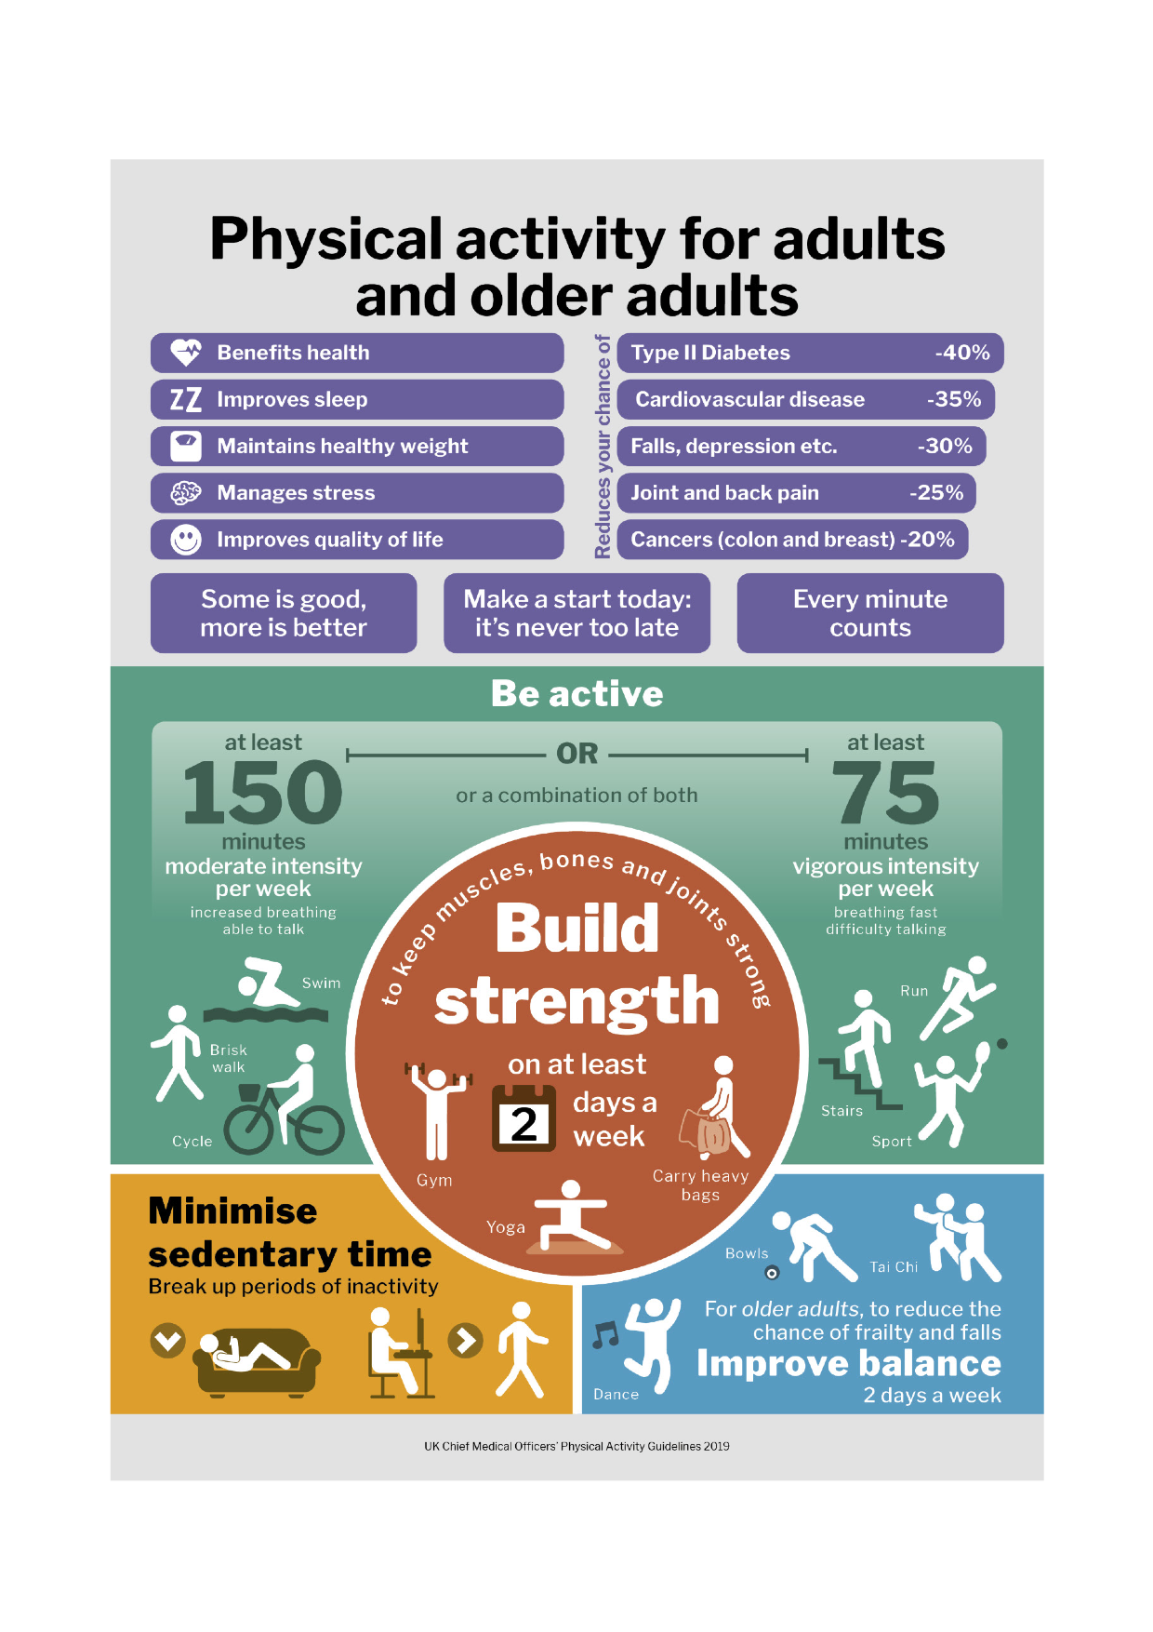

Slide 9
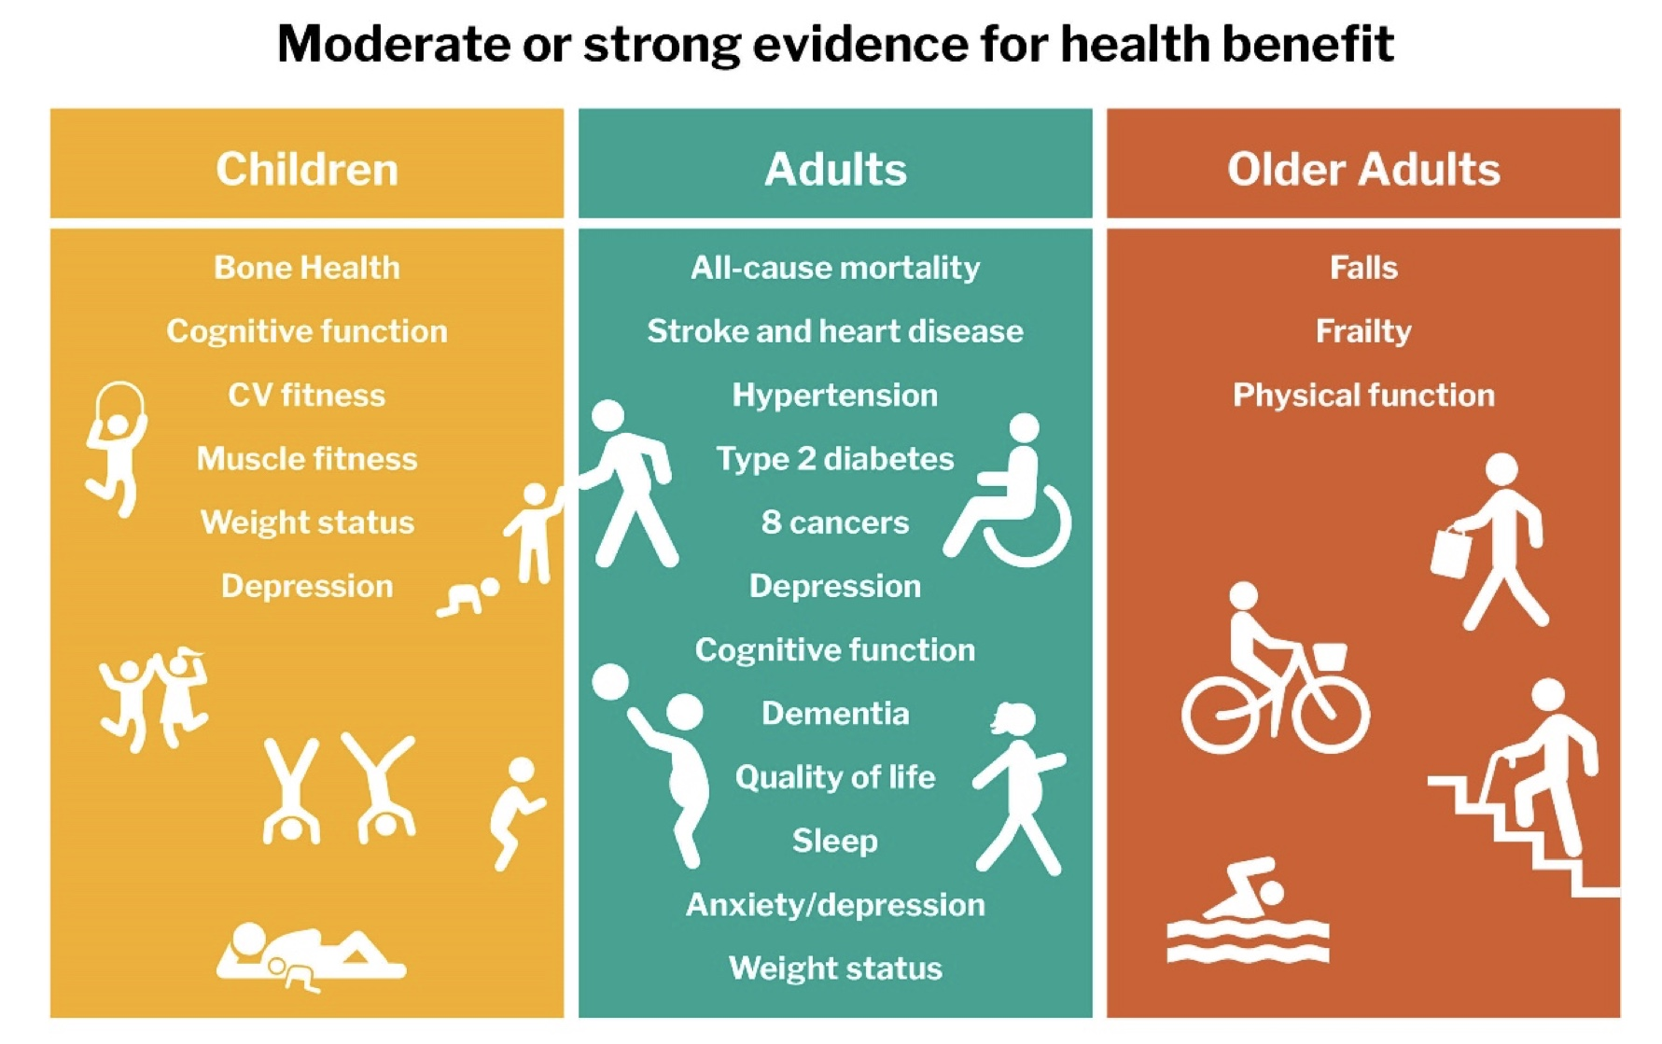

Slide 10
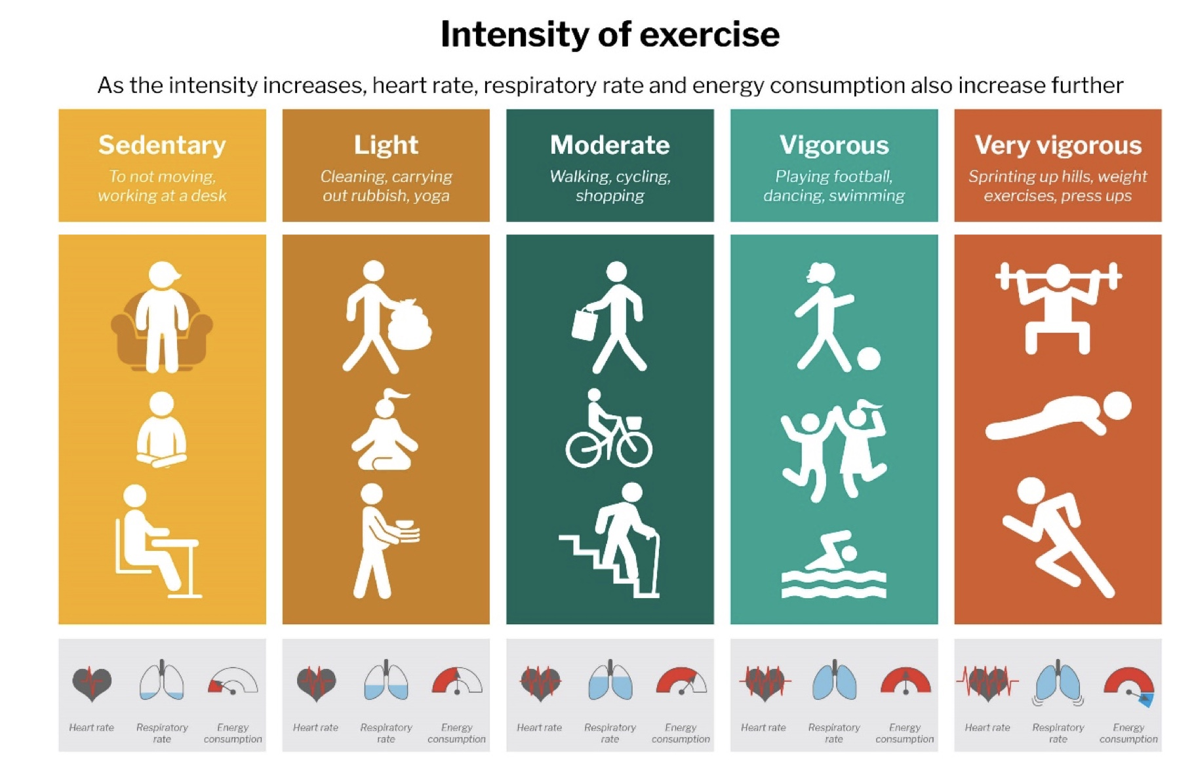

Slide 11
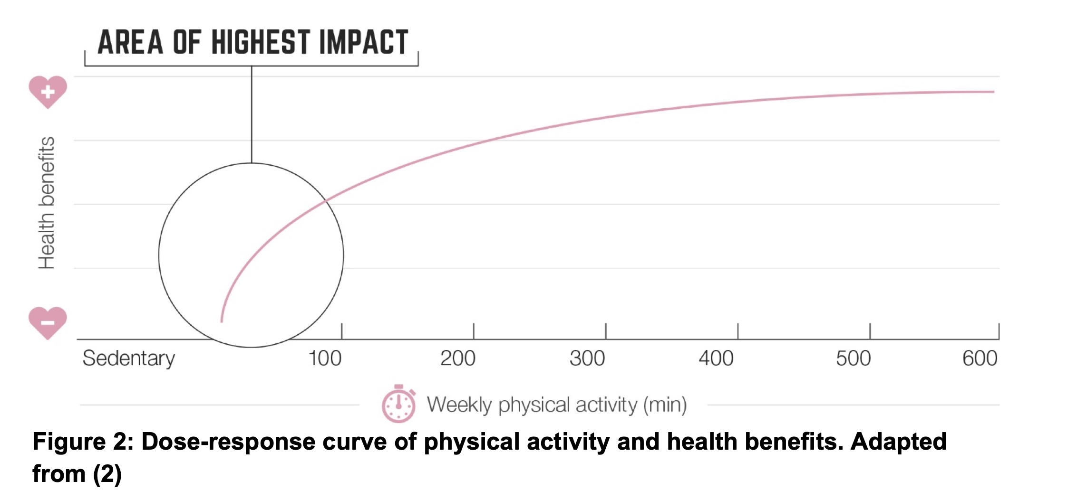

Slide 12
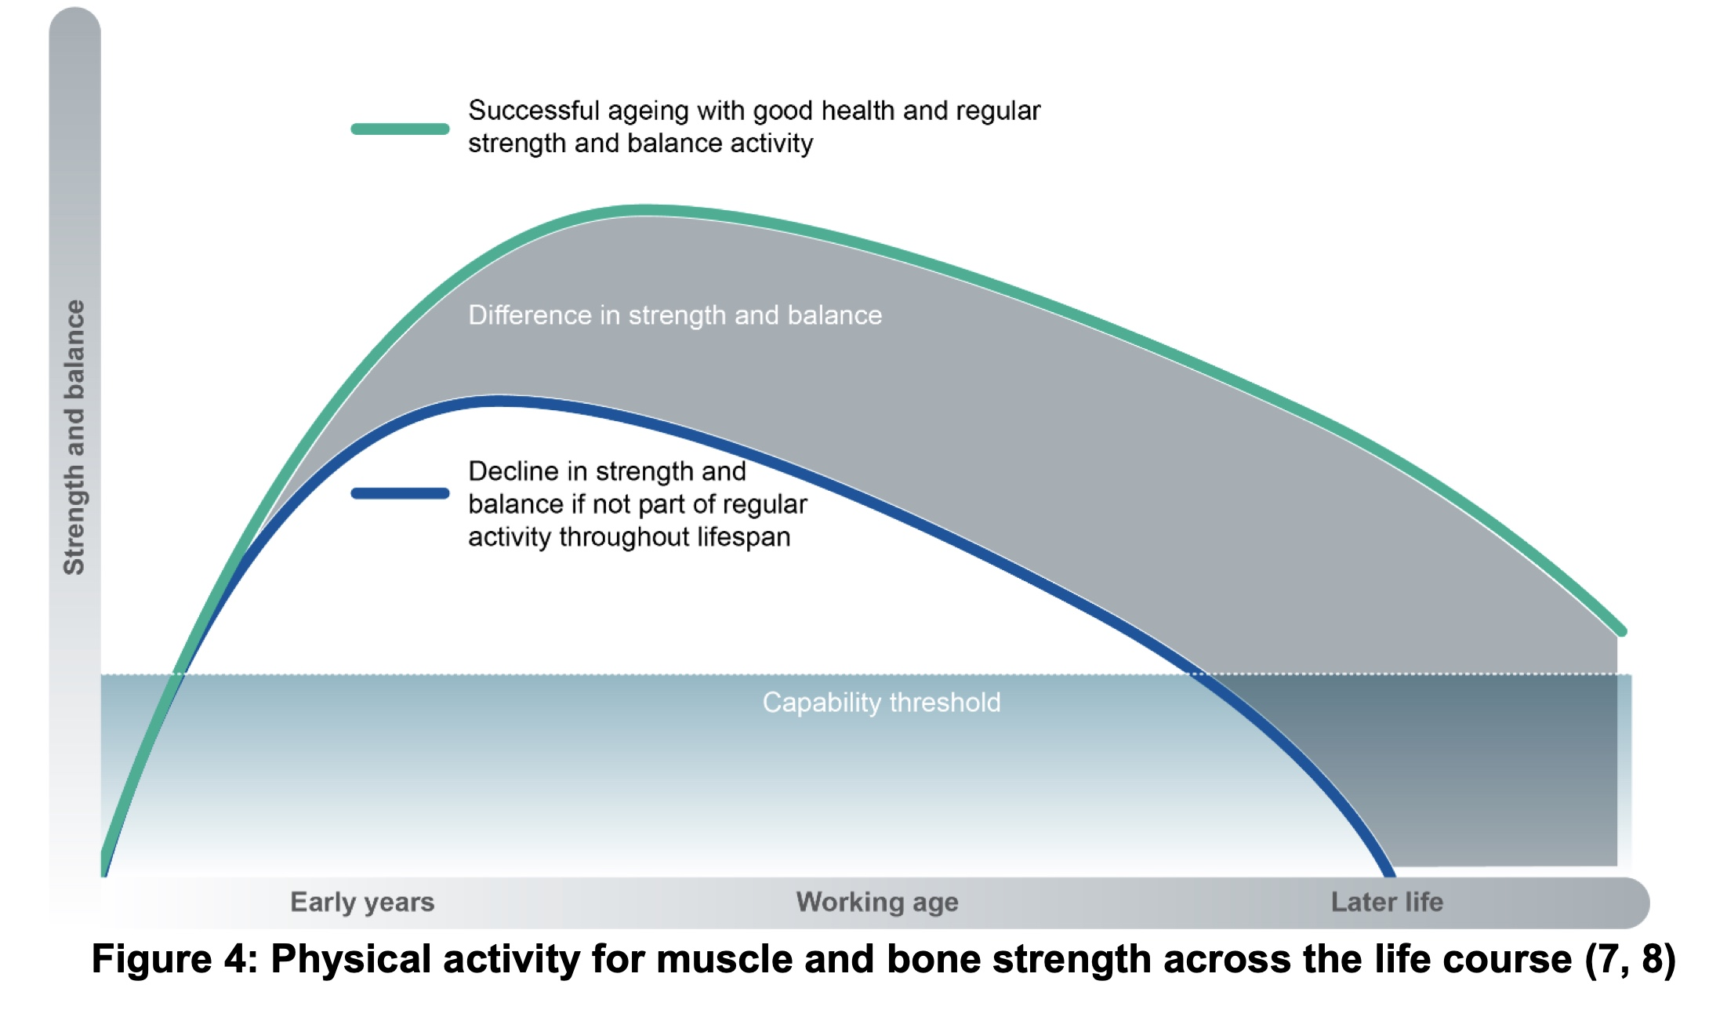

Slide 13
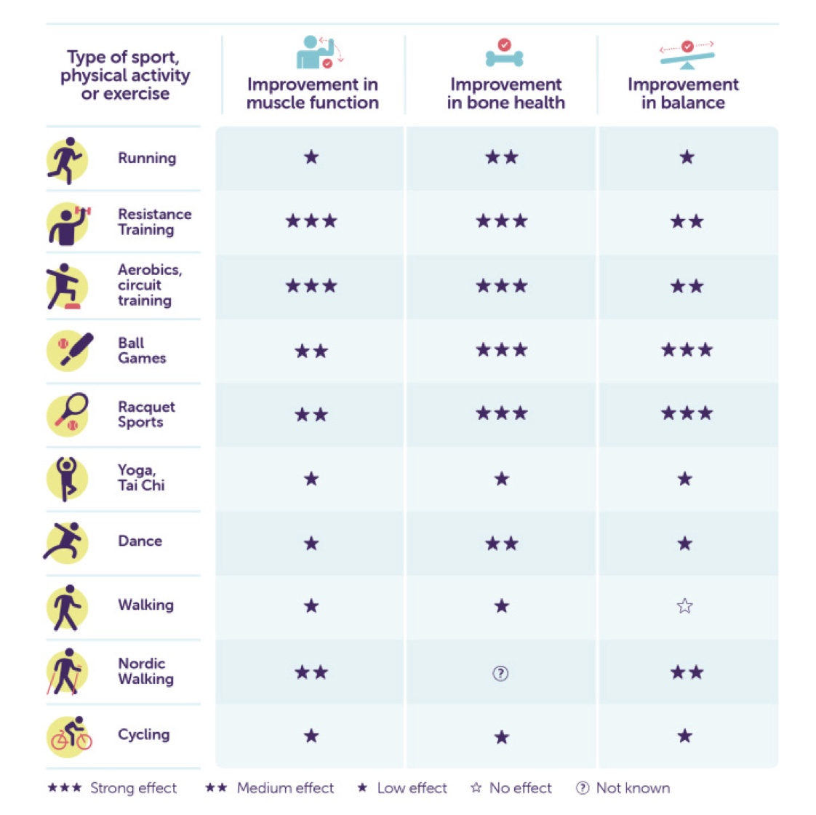

Slide 14
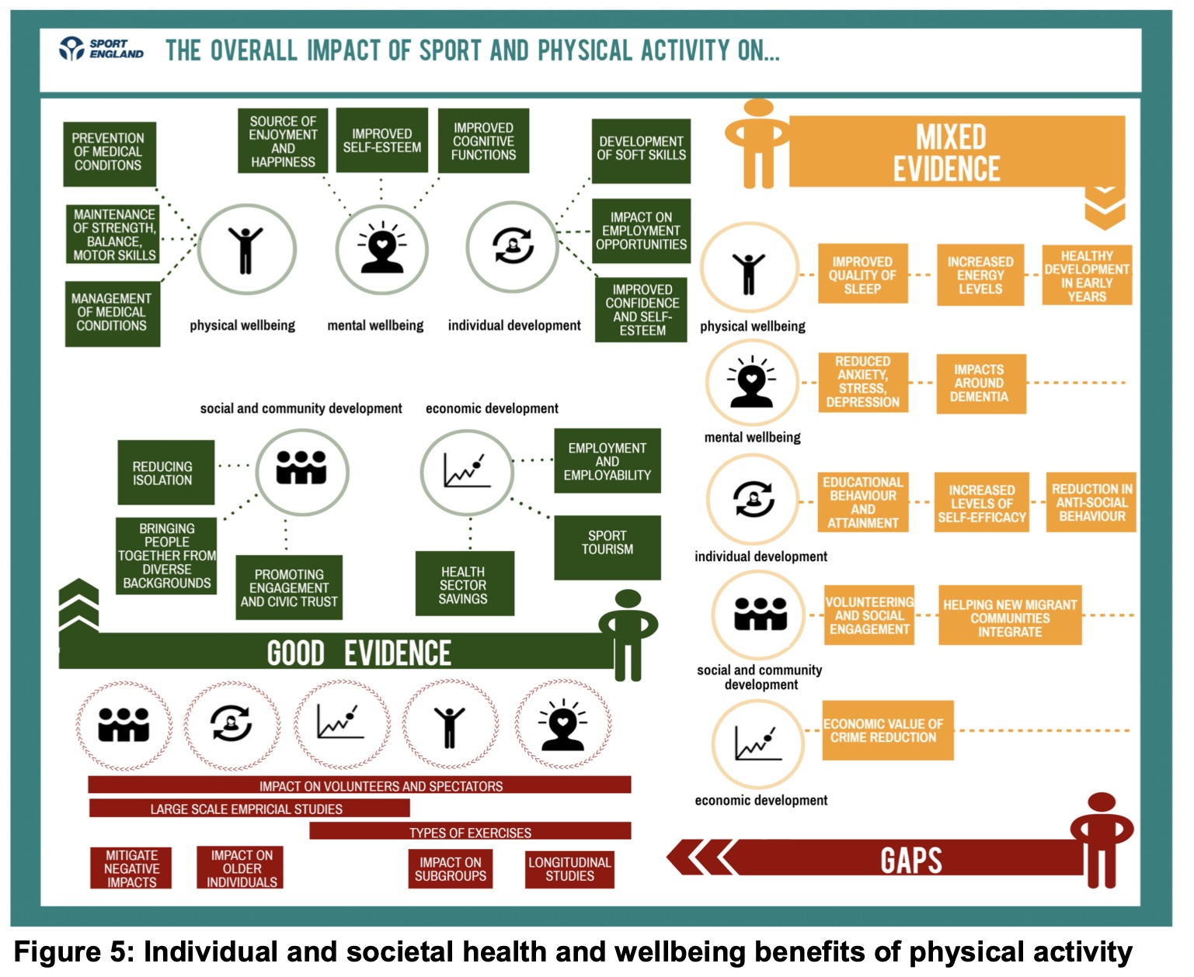

Slide 15
Physical Activity Recommendations
All adults should participate in moderate intensity PA for 150 min/week or vigorous intensity PA for 75 min/week, or a combination of the two.
Bouts should last a minimum of 10 mins
Activities that maintain or improve muscular strength should be performed at least twice per week.
Additional benefits are gained from greater amounts of PA

Slide 17
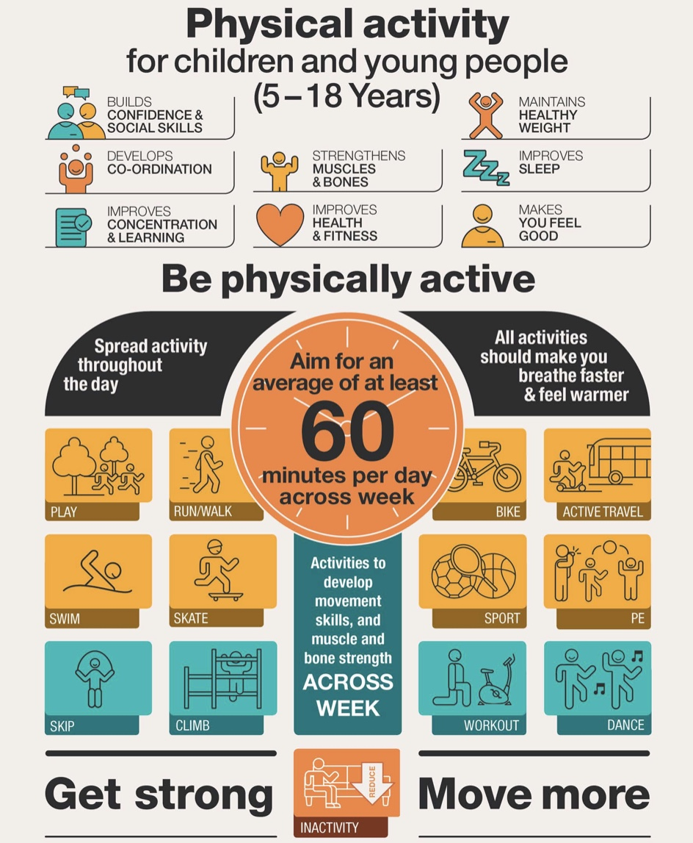

Slide 18
WHO (2020) Guidelines

Slide 19
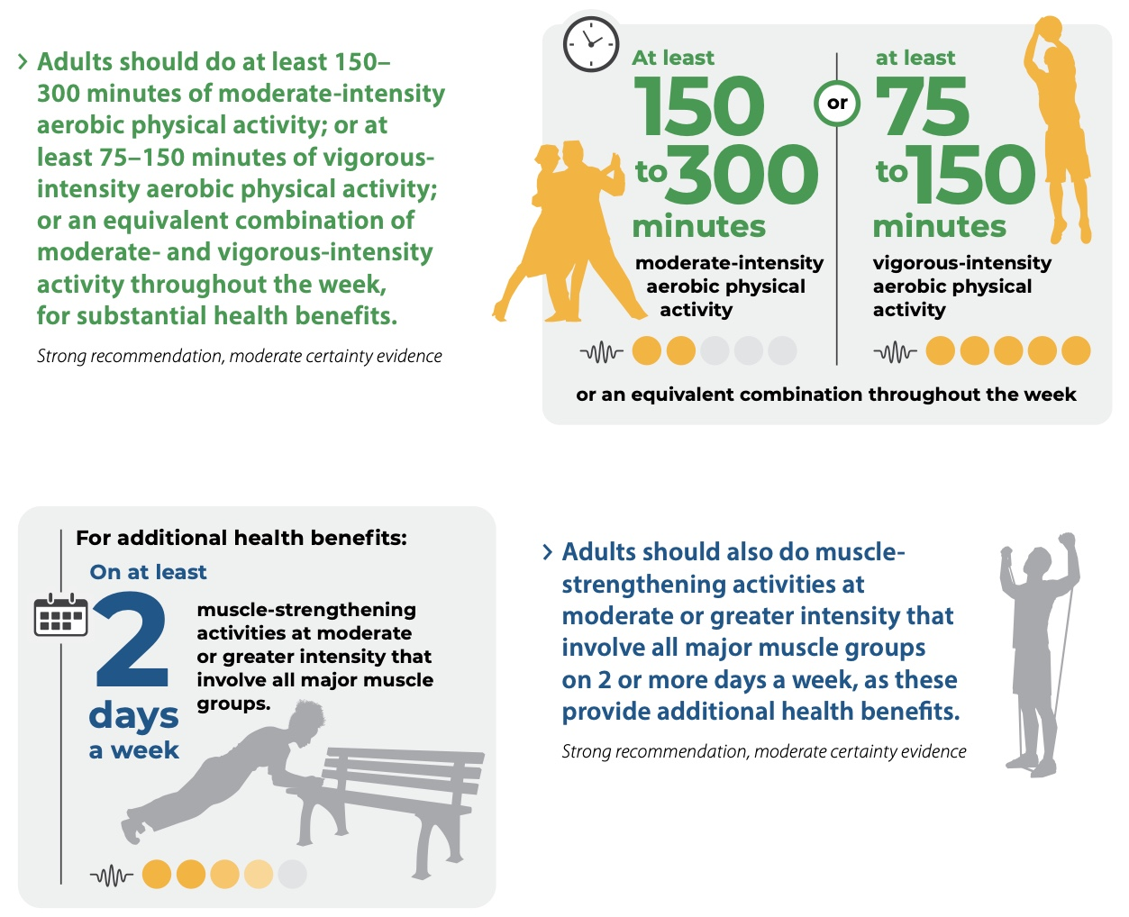

Slide 20
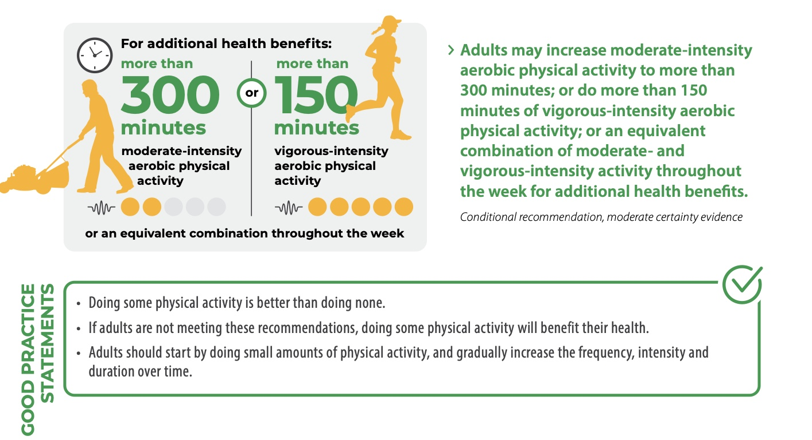

Slide 21
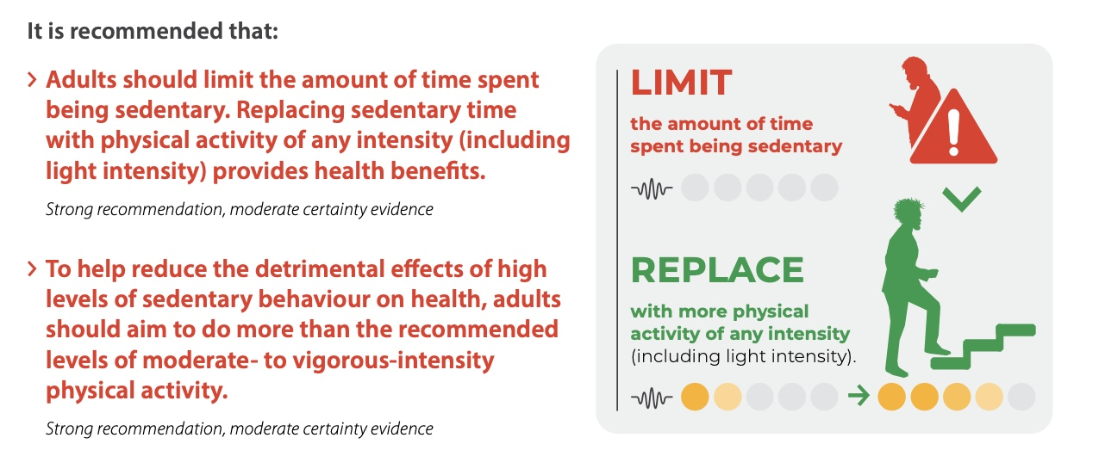

Slide 22
Physical Activity Intensity Zones

Slide 23
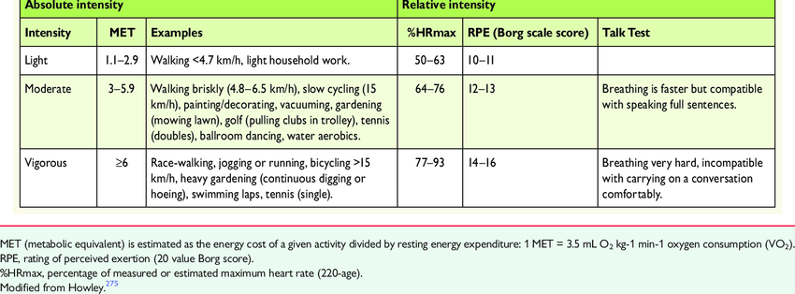

Slide 24
Actual Physical Activity Levels
Physical Inactivity is a global pandemic that has been identified as one of the four leading contributors to premature mortality.
Globally 31.1% of adults are physically inactive
IN the US, only 51% of adults meet aerobic activity guidelines, 29% meet muscle strengthening guidelines, and 20% meet both.

Slide 25
Sedentary Behaviour

Slide 26


Slide 27
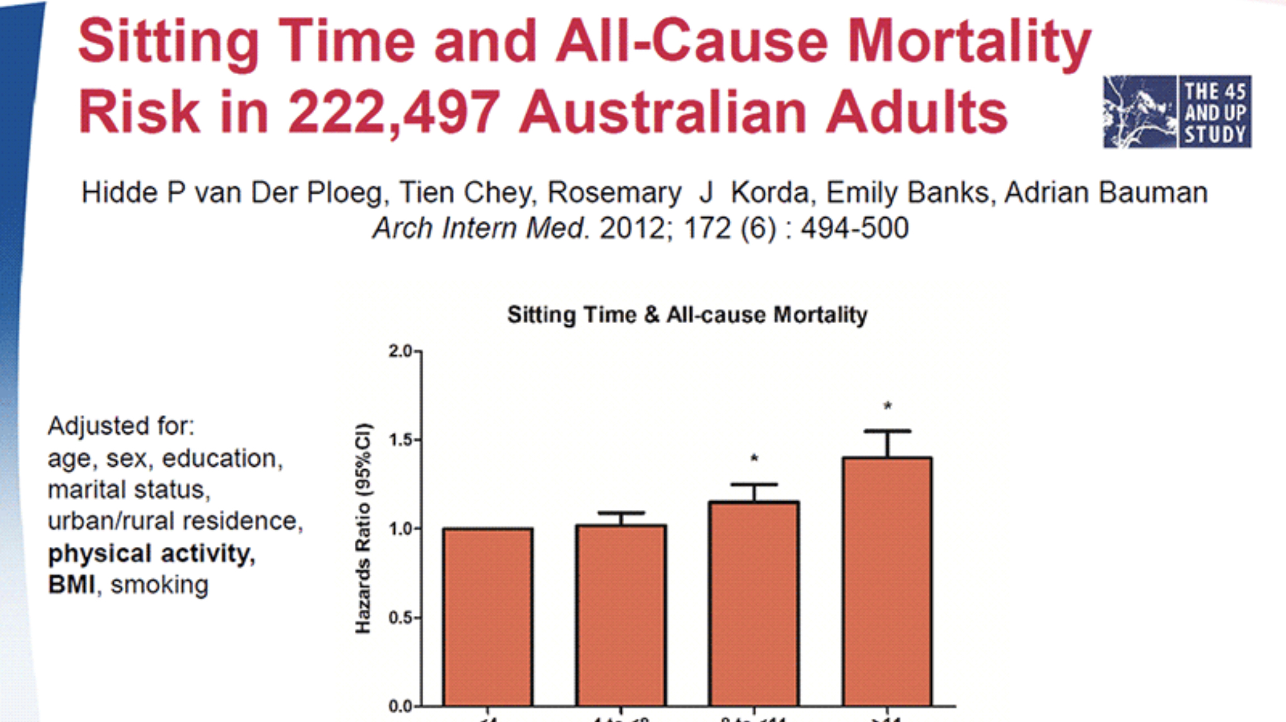
Notes:
Compared to <4hours, 8-11 15% higher, >11 40% higher risk
Inactivity also associated with decreased mental health, plus PA interventions can treat mental health issues.
WHO list physical inactivity higher on risk factors for premature mortality than obesity or high cholesterol.
That’s the bad news, the problem. Now for the solution. Remember lifestyle is a choice. Small habits can add up to make a big difference.

Slide 28
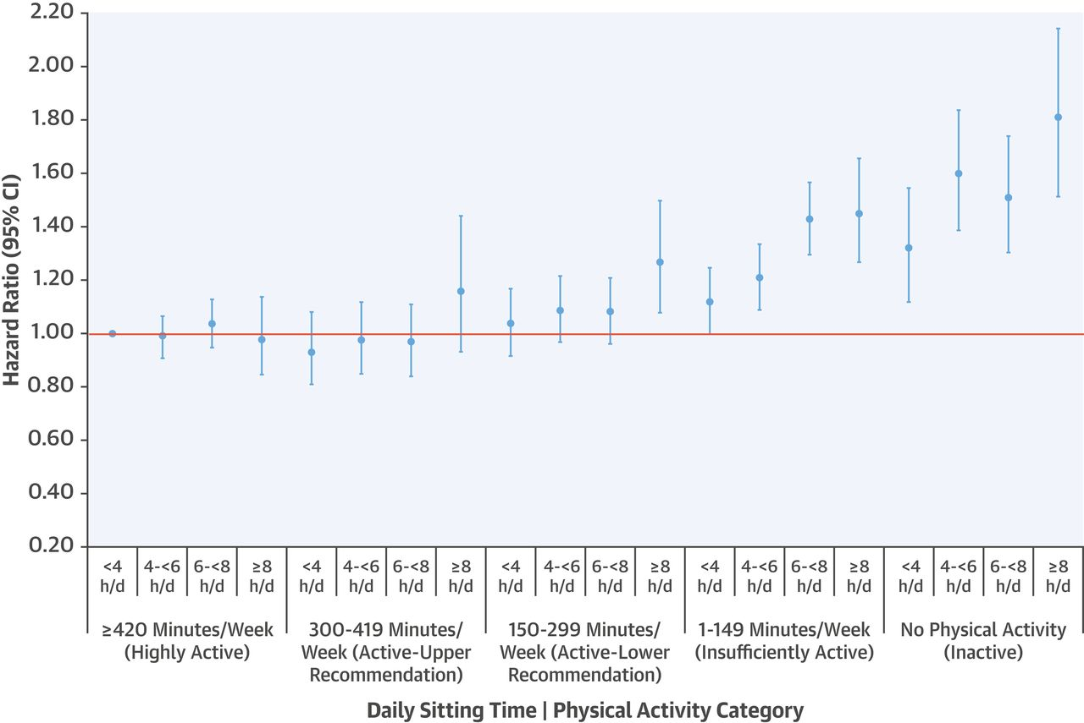
Stamatakis et al (2019)

Slide 29
Financial Implications
The negative impact of this physical inactivity is vast and is estimated to cost worldwide health care systems $53.8 billion per year (Ding et al., 2016).
      Cited in Draper and Stratton (2018)

Slide 30
Move more, Sit Less

