Slide 1
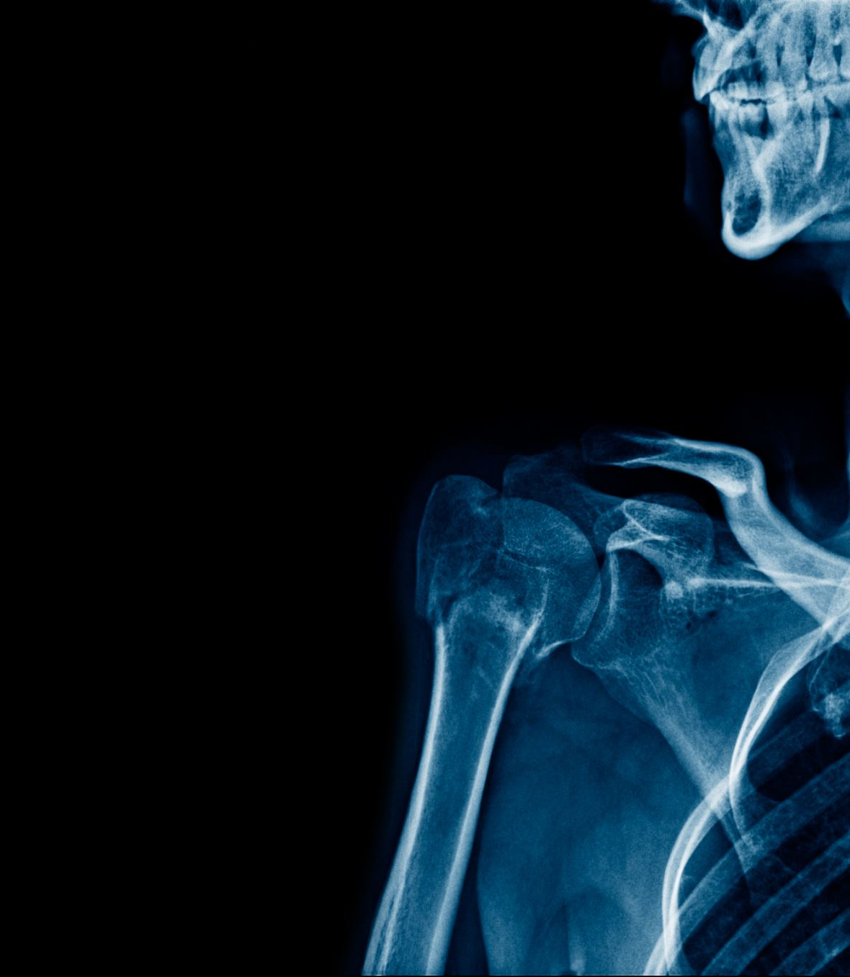
Grade 2 Anterior Talofibular Ligament (ATFL)Injuries
2304127. BMST5003

Slide 2
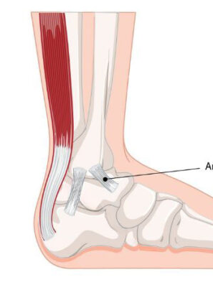
What Is The ATFL
ATFL short for Anterior Talofibular Ligament
The anterior talofibular ligament (ATFL) is located on the lateral side of the ankle and connects the fibula to the talus.
Function: It provides stability to the ankle joint and prevents excessive inversion and plantar flexion movements of the foot.
It is widely recognized that the ATFL is one of the most commonly strained ligaments in the foot. A grade 2 tear indicates a partial tear of the ligament.
The ATFL connects to the anterior aspect of the lateral malleolus and directly attaches to the ankle joint capsule. In a neutral position, the ATFL is horizontal and passes to the intersection on the talar body anterior to the joint surface.
(Al-Mohrej, O.A. and Al-Kenani, N.S., 29 February 2016).

Slide 3
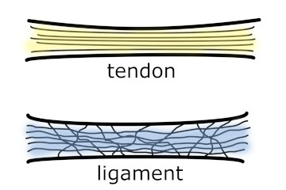
Tissue Mechanics Of The Ligament
Dense, collagen-rich structure that provides stability to the ankle joint
Attaches bone to bone (e.g talus, fibula)
Stabilising joint for normal range of movement
Made up of type 1 collagen
The structure of the ligament is multidirectional, which allows the ligament to support tensile loads better and prevent excessive movement
(Bobzin, L. at el 2021)
the ATFL it is 10 mm in length, 2 mm in thickness and between 6 and 10 mm in width. The ATFL is 1 cm proximal to the distal tip of the fibula
(Al-Mohrej, O.A. and Al-Kenani, N.S., 29 February 2016).

Slide 4
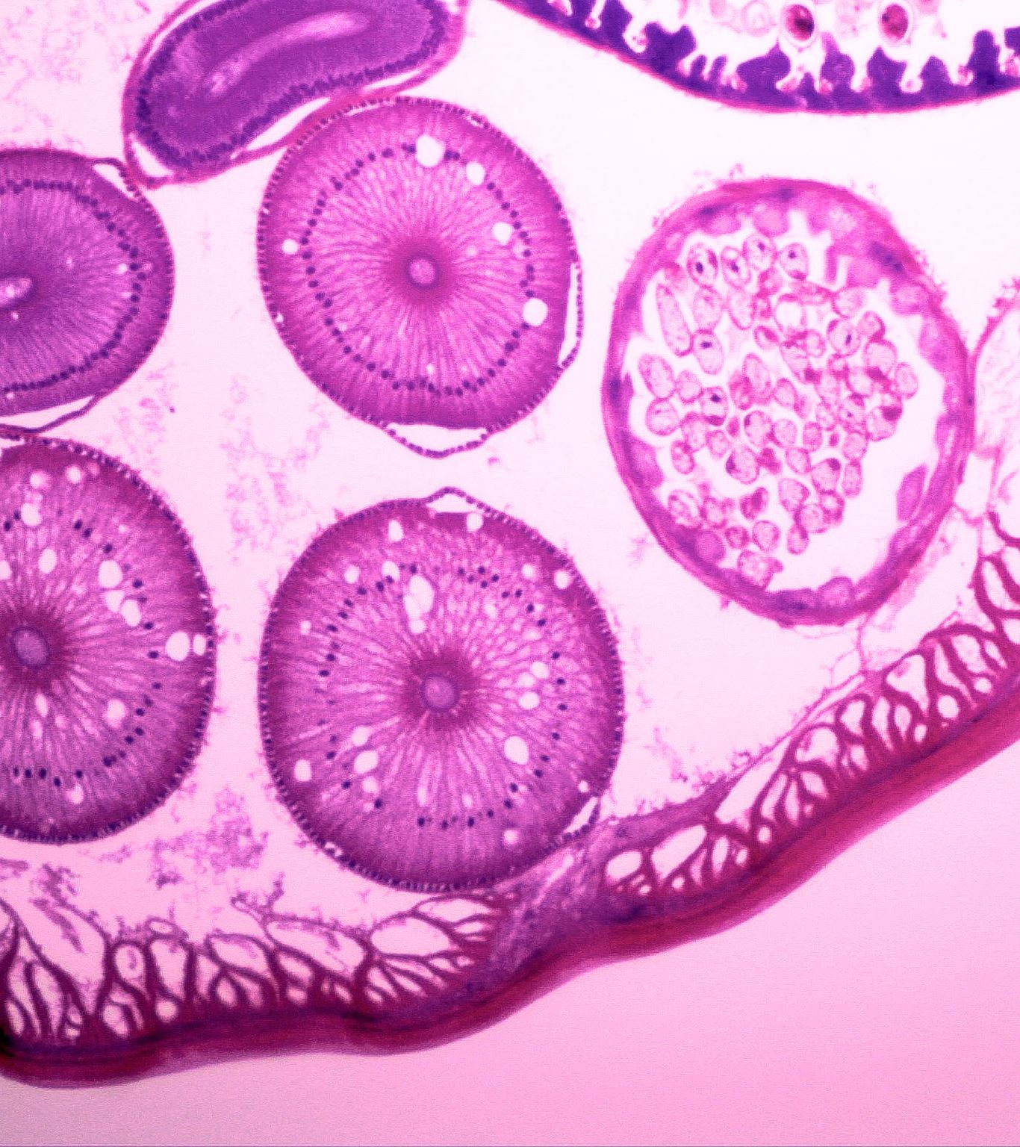
Tissue Healing
Inflammatory Phase (0-7 days): During this phase, platelets and inflammatory cells are active, which helps to form clots and release cytokines.
Proliferative Phase (1-6 weeks): In this phase, cellularity increases along with the extracellular matrix (ECM). Fibroblasts migrate to the area, new blood vessels develop, and collagen synthesis begins, starting with type 3 collagen.
Remodeling Phase (6 weeks - several months): In the remodeling phase, type 3 collagen fibers are gradually replaced by type 1 collagen.
(Leong, N.L. et al 2019)

Slide 5
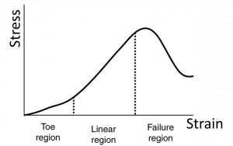
Ligaments Stress-Strain Curves
In the failure region, the ligament cannot return to its original length at all, which leads to a complete tear of the ATFL.
The toe region ends when the anterior talofibular ligament (ATFL) is stretched but can return to its normal state.
In the linear region, if the stress applied is low, the tissue can return to its original form. However, if it is stretched beyond a certain point, the ligament begins to tear.
The plastic region occurs when the ATFL has exceeded the point where it can no longer return to its original length.
(Takeuchi, Y. et al 2021)

Slide 6
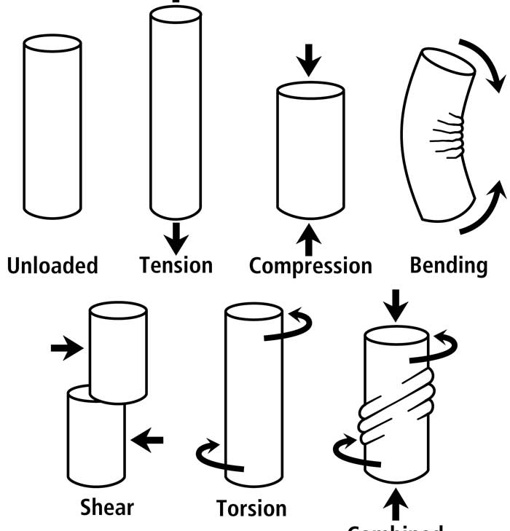
Load Tolerance And Forces
The typical tensile strength of the anterior talofibular ligament (ATFL) is estimated to be around 200–300 N (Newtons).
The ATFL experiences more strain during plantar flexion and inversion. When the load exceeds the ligament's tensile strength, it can lead to tearing or rupture.
The types of forces that ligaments can withstand include tensile, compressive, shear, bending, and torsional forces.
Help while walking, running and landing from a jump
(Beumer, A. et al 2003)

Slide 7

Surgical And Conservative Management Methods
Surgery is not needed for a grade 2 ATFL injury. Surgical intervention may be required for higher-grade injuries, complete tears, or avulsion fractures.
Lateral ligament reconstruction is done if the ligament has completely torn or not healed with conservative treatment. It involves either repairing the ligament back or using a tendon graft.
(Al-Mohrej, O.A. and Al-Kenani, N.S., 29 February 2016)
(Guillo, S. 1 June 2024)
(Dubois, B. and Esculier, J.F., 2019)
Peace and love
Protect
Elevate
Avoid anti-inflammatory medication
Compress
Educate
Load
Optimistic outlook
Vascularization
Exercise

Slide 8
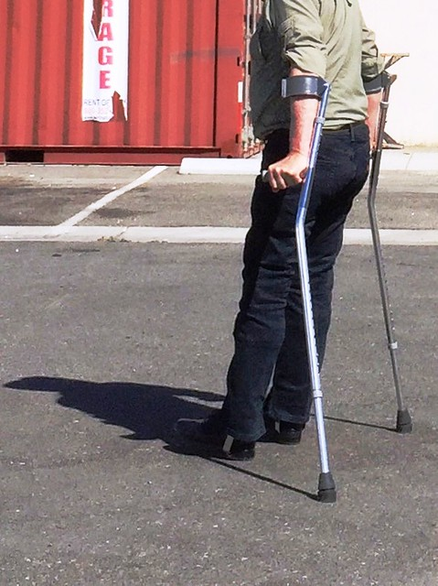
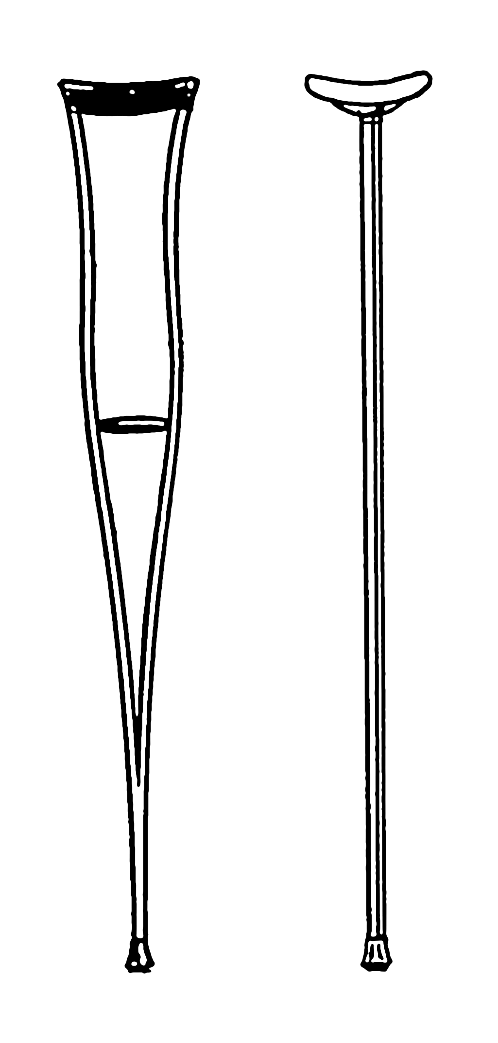
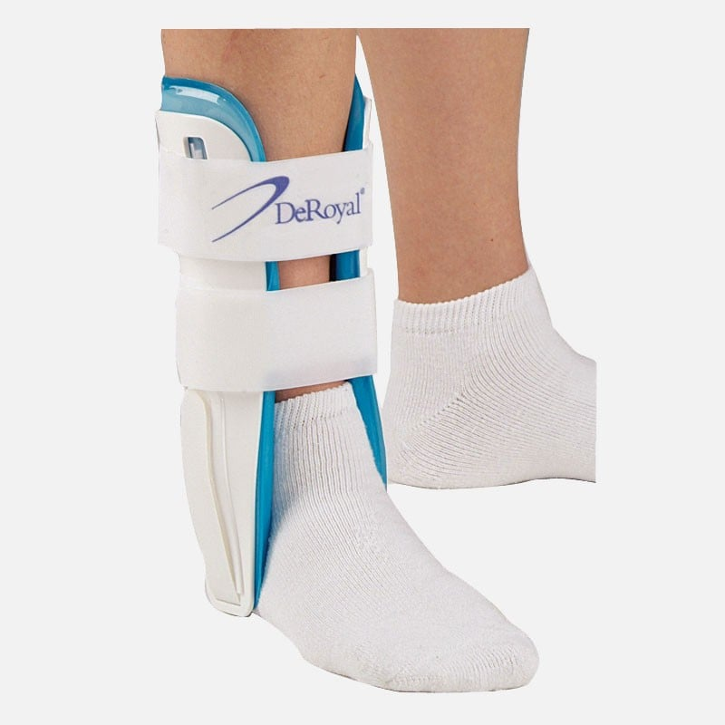
Assistive Devices For Non/partial Weight Bearing
Crutches – Axillary crutches and forearm crutches
Compression brace for the ankle
Stirrup splints
Aircast
ThePhoto by PhotoAuthor is licensed under CCYYSA.

Slide 9
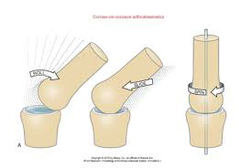
Arthrokinematics
Arthrokinematics involves several types of movements including rolling, sliding, and rotation.
The talocrural joint is made up of the talus, fibula, and tibia.
During dorsiflexion, the talus moves posteriorly relative to the fibula and tibia. In this motion, the arthrokinematics action consists of the talus slides posterity in relation to the tibia and fibula. During plantarflexion, the talus glides anteriorly in relation to the tibia and fibula.
The subtalar joint consists of the talus and calcaneus. The movements associated with this joint are inversion and eversion.
During inversion, the calcaneus rolls medially and slides laterally relative to the talus. In contrast, during eversion, the calcaneus rolls laterally and slides medially in relation to the talus.
(Medina McKeon, J.M. and Hoch, M.C. 2019)

Slide 10
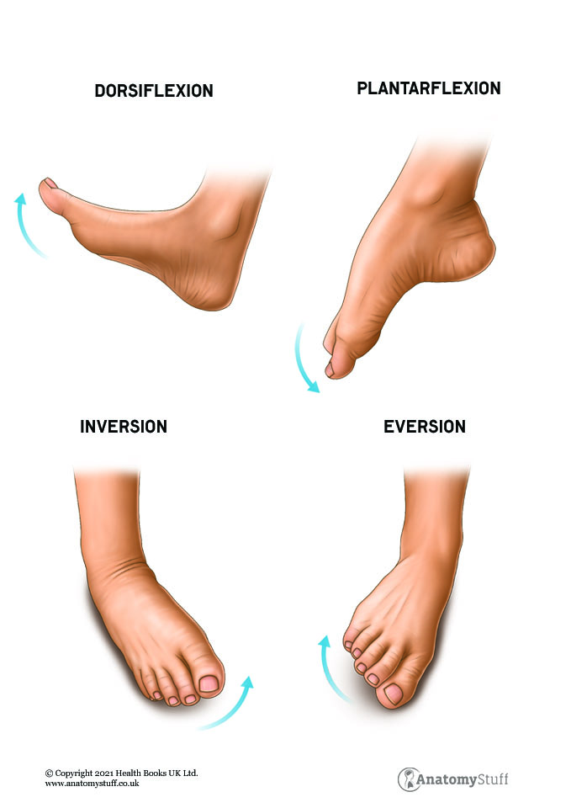
Restoration of Normal Movement
Passive, Active, Prolonged, and Assisted Methods
Rehabilitation should begin as early as three days after the injury occurs.
To restore passive movement, it should be done within pain limit. This can involve the therapist moving the foot or the client using a towel, this is done to assist in passive movement and restore mobility.
Active movement should also be performed within the pain limit, where the client moves the foot independently, without assistance from a towel or therapist, to help restore strength.
Prolonged stretching involves holding stretches once both active and passive movements have been performed and pain has been reduced. This technique aims to lengthen the anterior talofibular ligament (ATFL).
Assisted methods involve using equipment such as bands or towels to movement and hold stretches. These techniques can help clients perform movements they are unable to do on their own.
(Palermi, S., et al 2021).

Slide 11

Hydrotherapy
Reduced Impact on Joints: Water buoyancy reduces weight-bearing stress, allowing movement with lower joint load.
Improved Circulation: Water pressure can help improve blood flow and reduce swelling in the injured area.
Muscle Strengthening: Resistance of water provides a low-impact way to strengthen muscles without overloading the injured ligament.
Enhanced Flexibility: Water's warmth can promote muscle relaxation and improve range of motion.
The depth of the water, waist hight weight bearing, good for reducing sress on the lihament, wasit to chet strength and endurance, the increases resistance build strength and aslo helping to reduce the stress on the ligament
Exercises for ATFL walking, lunges, calf raisees.
(BHAT, I. NAJIB, A 2023)

Slide 12
Isometric, Concentric and Eccentric Strength
Isometric exercises: Muscle contracts without changing length, stabilizing the joint (Berardi, G., et al 2021).

Slide 13
Isometric, Concentric and Eccentric Strength
Concentric exercises: Muscle shortens as it contracts to produce movement (Berardi, G., et al 2021).

Slide 14
Isometric, Concentric and Eccentric Strength
Eccentric exercises: Muscle lengthens while under tension, controlling joint movement (Lepley, L.K. et al 2023).

Slide 15
(Lepley, L.K. et al 2023) (Berardi, G., et al 2021).
Strength Type | Muscle Action | Purpose | Example Exercises
Isometric | No change in muscle length | Stabilizes ankle without movement, early phase | Wall Sit, Isometric Ankle Inversion/Eversion
Concentric | Muscle shortens to move the joint | Rebuilds strength for functional movement | Heel Raises, Resistance Band Dorsiflexion
Eccentric | Muscle lengthens under tension | Controls movement and improves dynamic stability | Eccentric Heel Drops, Slow Squat Descent

Slide 16
Agility, Balance, Coordination And Proprioception
Balance Benefits:
Enhances neuromuscular efficiency and joint/muscle receptor function.
Improves sensory input to the CNS, boosting proprioception and kinesthesia.
Coordination Benefits:
Increases proprioception for better joint awareness and posture.
Reduces reaction time to unexpected movements.
Develops ankle stability during activities like running and jumping.
Proprioception Benefits:
Restores stability and neuromuscular control around the ankle.
Enhances response to sudden movements, lowering re-injury risk.
Improves coordination and postural control for faster recovery.
Agility Benefits:
The ATFL stabilizes the ankle during lateral movements and inversion.
Agility exercises improve joint position awareness.
Strengthens the ankle’s response to unexpected movements and changes in direction
(Gidu, D.V., 2022) (Sumartiningsih, S., 2021)

Slide 17
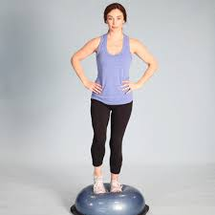
Agility, Balance, Coordination And Proprioception
Standing on a bosu.
Exercises on a bosu ball can be modified to strengthen an injured ankle by standing on one leg.
To improve coordination and proprioception, try spelling the alphabet using a ball under your foot.
For agility training, perform lateral hops by jumping from side to side.
Another effective exercise is passing a ball while standing on a bosu ball.
(Gidu, D.V., 2022) (Sumartiningsih, S., 2021)

Slide 18

Muscular Strength Endurance, Strength, Hypertrophy and Power
Muscular strength can help to reduce the load on the ATFL e.g peroneus longus and peroneus brevis in assisting eversion and tibialis anterior and tibialis posterior for assisting with inversion of the foot.
Exercises like resisted Eversion with a Band and Resisted Inversion with a Band.
Muscular endurance will reduce how quickly muscle fatigue as well as stabilising of the joints e.g. gastrocnemius, soleus, peroneus longus and peroneus brevis.
Exercises like calf raises to target the soleus and gastrocnemius with reps of 15 and set of 3.
Hypertrophy can help stabilize the ankle and reduce the strain on the anterior talofibular ligament (ATFL).
Power training can improve reaction times and the ability to absorb greater forces.
Plyometric exercises, such as box jumps and lateral hops, should be performed at a low to moderate of repetitions and at a high intensity.

Slide 19
Prevention of deconditioning
To prevent muscle atrophy, engage in resistance training, which can include exercises like walking with the assistance of crutches wearing an aircast
Incorporate cardiovascular exercise with the goal of achieving 150 minutes of moderate-intensity exercise or 75 minutes of vigorous-intensity exercise each week.
Focus on flexibility by actively or passively stretching the ankle into plantarflexion, dorsiflexion, inversion, or eversion.
balance training to enhance stability by using a bosu ball.
(Peyrusqué, E., et al 2023)

Slide 20
Exercise selection and prescription
To prescribe an early rehabilitation exercise, you have to think about the goals the client wants to achieve, e.g. improve strength and flexibility, reduce pain and help stop recurring injuries.
Implement flexibility first, followed by muscle strength and endurance, proprioception such as balance, agility, and coordination, make it sport-specific, and lastly, return to play.
Think about the intensity and progressive loading.
What exercise work out what muscle and the function of the muscle e.g. Gastrocnemius, soleus planterflexies the foot

Slide 21
Exercise programming
Hydrotherapy: Walking and calf raises.
Passive Stretches: Plantarflexion, dorsiflexion, inversion, and eversion. Hold each stretch for 20 to 30 seconds.
Active Stretches: Plantarflexion, dorsiflexion, inversion, and eversion. Perform each stretch for 20 to 30 seconds.
Muscle Endurance and Strength:
Isometric Resistance Band Ankle Inversion/Eversion hold for 10 seconds 4 sets
Concentric Heel Raises , Resistance Band Dorsiflexion 3 set 15 reps
Eccentric Strength: Eccentric Heel Drops 3 set 15 reps
Proprioception Training Exercise
by standing on a bosu ball with both feet firmly planted. Start with the goal of holding this position for 30 seconds, gradually working your way up to 1 minute progress to balancing on the injured leg. passing a ball back and forth during this single-leg stance. This will not only improve your balance but also increase your coordination and stability.

Slide 22
Reference
Al-Mohrej, O.A. and Al-Kenani, N.S., (29 February 2016). Acute ankle sprain: conservative or surgical approach?. EFORT open reviews, 1(2), pp.34-44 (Accessed 29 December 2024)
Bobzin, L., Roberts, R.R., Chen, H.J., Crump, J.G. and Merrill, A.E., (16 April 2021). Development and maintenance of tendons and ligaments. Development, 148(8), p.dev186916 (Accessed 1 January 2025)
Berardi, G., Senefeld, J.W., Hunter, S.K. and Bement, M.K.H., (22 February 2021). Impact of isometric and concentric resistance exercise on pain and fatigue in fibromyalgia. European journal of applied physiology, 121, pp.1389-1404 (Accessed 1 January 2025).
Beumer, A., Van Hemert, W.L., Swierstra, B.A., Jasper, L.E. and Belkoff, S.M., (May 2003). A biomechanical evaluation of the tibiofibular and tibiotalar ligaments of the ankle. Foot & ankle international, 24(5), pp.426-429 (Accessed 30 December 2024)
Clas, H., Ehrnthaller, C., Herrmann, O., Schraeder, D.T., Böcker, W., Manz, K. and Thaller, P., (9 Auggust 2024). Quality of Life and Patient Satisfaction After the Provision of an Orthopedic Knee Scooter: A Multicenter Randomized Controlled Trial. Deutsches Ärzteblatt International, 121(16), p.519 (Accessed 17 January 2025)
BHAT, I. NAJIB, A. ( 8 December 2023). HYDROTHERAPY AS A TREATMENT FOR NON-SPECIFIC LOW BACK PAIN: A SYSTEMATIC REVIEW. INTERNATIONAL JOURNAL OF ALLIED HEALTH SCIENCES, DOI: https://doi.org/10.31436/ijahs.v7i5.884 (Accessed 2 January 2025).
Dubois, B. and Esculier, J.F., (3 August 2019). Soft-tissue injuries simply need PEACE and LOVE. British journal of sports medicine, 54(2), pp.72-73 (Accessed 30 December 2024)
Gidu, D.V., Badau, D., Stoica, M., Aron, A., Focan, G., Monea, D., Stoica, A.M. and Calota, N.D., (14 January 2022). The effects of proprioceptive training on balance, strength, agility and dribbling in adolescent male soccer players. International journal of environmental research and public health, 19(4), p.2028 (Accessed 10 January 2025)
Guillo, S., Takao, M., Stone, J.W. and Glazebrook, M., (1 June 2024). Arthroscopic anatomical reconstruction of the lateral ankle ligaments. In The Foot and Ankle (pp. 95-104). CRC Press (Accessed 17 December 2024)
Hiroki, I. Kodama, T. Yamaguchi, H.(1 June 2023). 'A novel evaluation system for arthrokinematic ankle motion using a rotary encoder' Research Square DOI: https://doi.org/10.21203/rs.3.rs-2985794/v1(Accessed 20 December 2024).

Slide 23
Reference
Kubwimana, O., Murwanashyaka, E., Kanyemera, E., Ingabire, J.A., Munthali, J., Byimana, J., Buteera, A.M. and Byiringiro, J.C., (14 June 2023). Short-term comparison of backslab and aircast ankle brace for the management of acute lateral ankle sprain, Kigali experience. East African Orthopaedic Journal, 17(1), pp.34-40 (Accessed 27 December 2024)
Leong, N.L. Kator, J.L. Clemens, T.L. James, A. Enamoto-Iwamoto, M. Jiang, J.(17 September 2019) ‘Tendon and ligament healing and current approaches to tendon and ligament regeneration’, Journal of Orthopaedic Research, 38(1), pp. 7–12. doi:10.1002/jor.24475 (Accessed 20 December 2024).
Lepley, L.K., Stoneback, L., Macpherson, P.C. and Butterfield, T.A., ( 23 April 2023). Eccentric exercise as a potent prescription for muscle weakness after joint injury. Exercise and Sport Sciences Reviews, 51(3), pp.109-116 (Accessed 1 January 2025).
Medina McKeon, J.M. and Hoch, M.C., (11 June 2019). The ankle-joint complex: a kinesiologic approach to lateral ankle sprains. Journal of athletic training, 54(6), pp.589-602 (Accessed 8 January 2025)
Palermi, S., Massa, B., Vecchiato, M., Mazza, F., De Blasiis, P., Romano, A.M., Di Salvatore, M.G., Della Valle, E., Tarantino, D., Ruosi, C. and Sirico, F., (29 July 2021). Indirect structural muscle injuries of lower limb: Rehabilitation and therapeutic exercise. Journal of Functional Morphology and Kinesiology, 6(3), p.75 (Accessed 8 January 2025)
Peyrusqué, E., Buckinx, F., Kergoat, M.J. and Aubertin-Leheudre, M., 2023. Exercise guidelines to Counteract Physical Deconditioning in Long-Term Care facilities: what to do and how to do it?. Journal of the American Medical Directors Association, 24(5), pp.583-598 (Accessed 3 January 2025)
Sumartiningsih, S., (6 June 2021). The Effect of Balance Training on Ankle Sprains in Badminton Players. ACPES Journal of Physical Education, Sport, and Health (AJPESH), 1(1), pp.57-63 (Accessed 1 January 2025)
Takeuchi, Y., Inokuchi, R., Takao, M., Glazebrook, M., Martin Oliva, X., Yamazaki, T., Kubo, M., Lowe, D., Matsui, K., Katakura, M. and Ozeki, S., 2021. Three-dimensional analysis of anterior talofibular ligament strain patterns during cadaveric ankle motion using a miniaturized ligament performance probe. BMC Musculoskeletal Disorders, 22, pp.1-7 (Accessed 18 December 2024)

