Slide 1

Presentation-Strategies for Effective Communication in a Business Setting.
Student Name: Sonia Dworkin
Student ID Number: 2028974
Module Code: BMSW4002

Slide 2

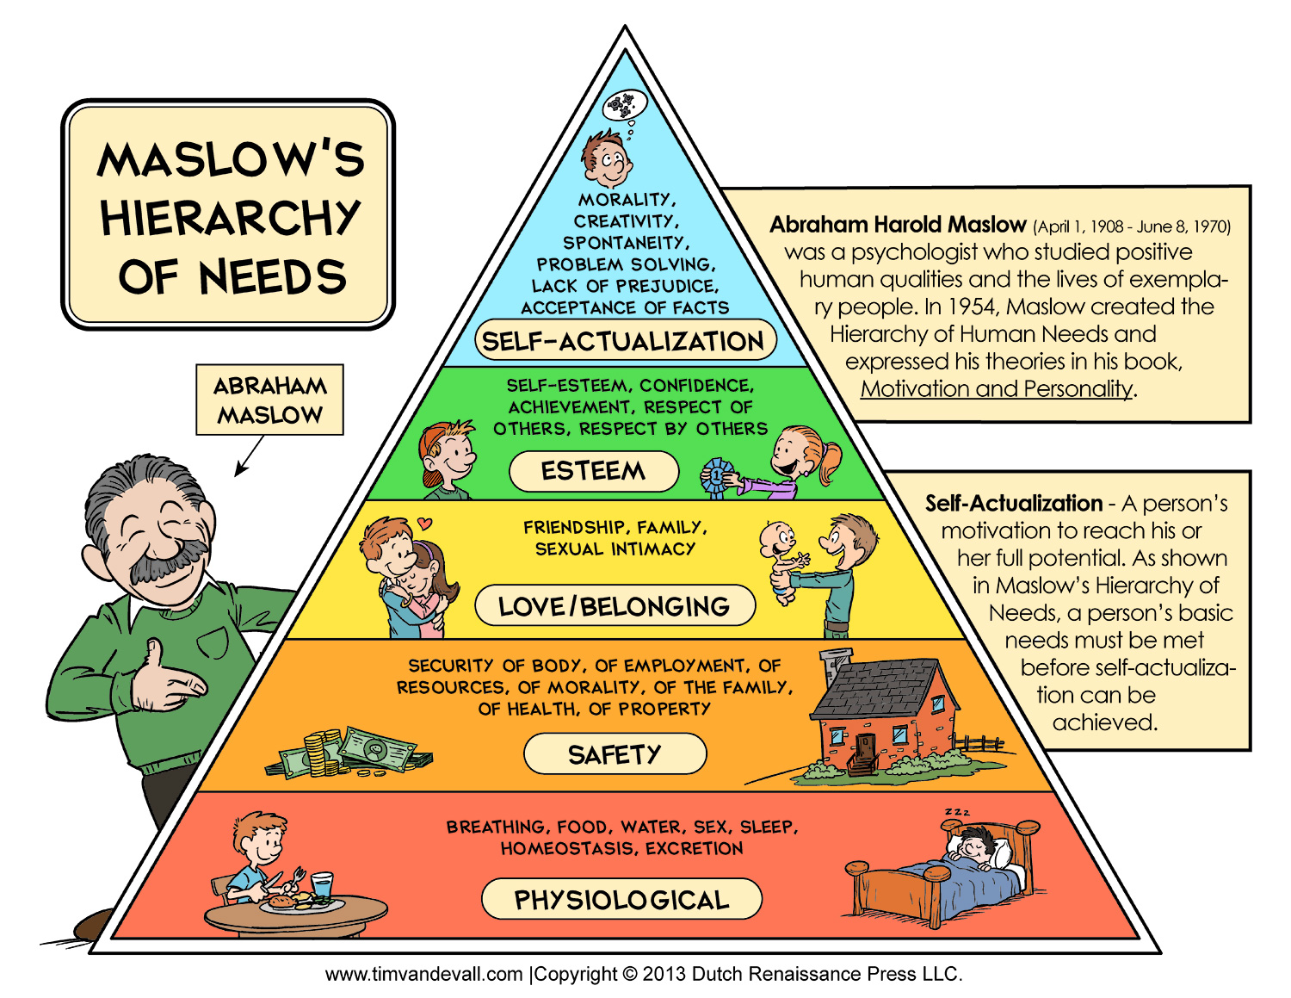
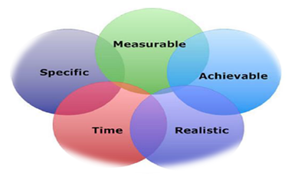
How does the organisation use the theories relating to models of Communication?
Tesco uses the "Mayo theory" in everything he does in the company, communication is an extremely important factor in motivating employees.
Communication At Tesco, Mayo's theory is considered to operate across the company. Communication is crucial to motivating employees. These can be individual discussions with managers, company intranet, newsletters, or more formal structures such as assessments.
Elton Mayo developed his theory in (1924-1932) based on human relations.
Abraham Maslow developed his theory in (1943) based on human needs.

Slide 3
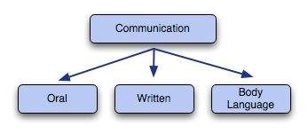
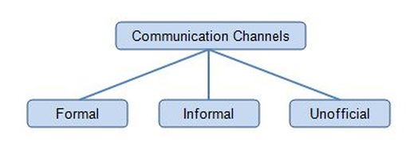
Group Presentation slides
SONIA DWORKIN
BIANCA CALTEA
LAISVYDAS ZIBALAS
How does the organisation use the theories relating to models of Communication?
Tesco uses the "Mayo theory" in everything it does throughout the company, communication is an extremely important factor in employee motivation.
7 different channels of communication.
Face-to-Face communication
Video conferencing
Phone calls
Emails
Text messages
Online message platforms.
Social media

Slide 4
What are the channels of communication used by the organisation and channels that can be used to improve communication?
Tesco introduces new initiative
Communication Methods
Online community for suppliers network.
Weekly staff meetings.
Reports
Memos
Forms
Internal and External Communication
Investment in technology is the key to growth.
Improve operational performance.
Improve the customer journey and key to revenue growth like shopping machines and delivery.

Slide 5
Advantages and Disadvantages (barriers) of Communication
Advantages
Disadvantages
Extremely important factor for employee motivation.
Line managers have a daily team meeting to provide information to staff.
Tesco organizes monthly staff meetings to discuss issues, new arrangements, new ideas, promotional ideas.
Barriers can stand in the way of effective communication.
The recipient is not able to understand the message.
Attitude toward the sender.
No feedback, use of language, fuzzy message.
Poor choice of communication channels can also act as an obstacle to communication.

Slide 6
CONCLUSION
We believe that in a business environment, communication is a sharing of messages from one person to another. It is the acknowledgement of particular message received is understood and expecting some kind of action as a result. According to Wilbur Schramm (1955), communication "is the time when we establish a thought between a shipper and a recipient". This can help employees work toward an objective and give them a similar direction in which the effectiveness of communication is achieved. In an organization, communication would give information to its audience and employees, you will find that the point of communication is to influence something in the enterprise. In business problems occur due to inadequate and imperfect communication. The organisation reports that their main obstacles are due to inadequate and imperfect communication. Brooke (1996). Poor communication channels can also present a barrier to communication. However, cultural differences can be an obstacle in the sense that they affect communication between people of different backgrounds, the departments of the organization. It is important to have good channels of communication, but bad channels can lead to poor communication and loss of business and business income.

Slide 7
REFERENCES
Craig, Robert T. Communication Theory as a field (1999). Communication Theory. 9 (2): 119-161.
Miller, Katherine (2005). Communication Theories: Perspectives, Processes, and Contexts (2nd Ed.). MC Graw-Hill Higher Education.
Chaffee, S.H. (1988). In Memoriam: Wilbur Schramm, 1907-1987. The public opinion Quarterly, 52(3),372-373.
Rogers, E.M. (1994). A history of communication study: A biographical approach. New York: Free Press.
Schramm, W. (Ed.). (1960). Mass communications (2nd Ed.). Urbana, IL: University of Illinois Press. Schramm, W. (1963). The science of human communication. New York: Basic Books.
Mason, L (2018), Contract Administration, chartered Institute of procurement & supply, p. 116
Cooks, s. 2009). Building a high- performance team proven techniques for effective working 1st Ed., Ely, England: IT.
Rogers, Everett M. (2001). “The department of communication at Michigan state university as a seed institution for communication study”. Communication Studies. 52 (3): 234-248.
Berol, D.K. (1960). The process of communication; an introduction to theory and practice. New York: Holt, Rinehart, and Winston.
Maslow, A. H. ( 1970). Motivation and personality. New York, Harper & Row.

Slide 8
Teamwork Evaluation | Team responses.
Who was in your team? | Sonia Dworkin Bianca Caltea Laisvydas Zibalas
What were the key strengths of your team? | We worked well together by making a WhatsApp group so we could communicate. We all produced our sections and made each power point, so it looked good. Everyone completed each section and researched all the subject areas.
What were the challenges that you overcame as a team? | We had to overcome the challenges of the time stealers, which was work, home life, communication barriers, understanding what was expected of us all. We succeeded in completing the presentation slides.
What would you do differently if you worked as a team again? | I would make sure that I had started my presentation slides earlier so that I was not stressing about doing the presentation. We did meet up on WhatsApp but I wish that we had spoken more and had not tried to complete it all in one night.
How would you rate your team working? Out of 10? | I would rate my team as a solid 10 out of 10 because we had completed the presentation.

Slide 9

CHANNELS OF COMMUNICATION

Slide 10
TABLE OF CONTENT
INTRODUCTION
MAIN BODY
Different channels of communication
CONCLUSION
REFERENCES

Slide 11
INTRODUCTION
A good communication system will help the company in delivering the information within the organisation efficiently. It is necessary for the organisation to avoid any miscommunication within the organisation also it helps the employees in adjusting ion the physical and social aspects of work.
The management can motivate, influence and satisfy their employees with the help of effective communication. In this presentation, different types of communication channel in an organisation is given

Slide 12
INTRODUCTION
A good communication system will help the company in delivering the information within the organisation efficiently. It is necessary for the organisation to avoid any miscommunication within the organisation also it helps the employees in adjusting ion the physical and social aspects of work.
The management can motivate, influence and satisfy their employees with the help of effective communication. In this presentation, different types of communication channel in an organisation is given

Slide 13

Different channels of communication

Slide 14
Face to face conversation
It refers to the communication which takes place in between two people or group of people in order to share ideas or gossips. It refers to as the most common and most effective way of communication as in this case the person will be able to analyse the facial expressions, body language and voice pitch of the other person.
In any organisation it is the best channel in order to have lengthy conversations and to deliver sensitive or complex messages. It helps in conducting formal meeting and make them effective and productive.

Slide 15
Emails
When a formal meeting is needed to be conducted in an organisation but managers does not want to waste time in scheduling then it can be an effective method of delivering information to the employees or third parties.
It is a great way of delivering information in a more formal and structured manner specially when the message is to be send down the chain of command. It provide different facilities to the organisation specially when the documents are needed to be protected or highly confidential.
The Blind carbon copy will help the sender in protecting the identity of the receiver. It can be a great method for marketing as well.

Slide 16

Social media
These platforms have recently come into light as a communication method which can help in providing information to potential customers or parties.
These are basically channels which can connect people outside the workplace and can help in communication via face book groups or linked In group. It is a grate way of communicating with the potential customers of the company.

Slide 17

Phone calls
It is a great way of communication if the information is needed to be provided to the other party in case of emergency or if the communicator needs a quick answer.
It is important for the companies to make sure that the information is reached to the other party and phone calls if answered will provide assurance.
A two way communication channels will let you hear the voice or pitch of both the parties and will ensure that the message or information is communicated properly.

Slide 18
CONCLUSION
From the above presentation it is concluded that, communication is an essential part in the process of sharing information within an organisation.
It is important for the organisations to make sure that the workers are using effective communication channels so that there is no scope for misunderstanding.

Slide 19
REFERENCES
Kim, D.K.D. and Kreps, G.L., 2020. An analysis of government communication in the United States during the COVID‐19 pandemic: recommendations for effective government health risk communication. World Medical & Health Policy, 12(4), pp.398-412.
Guffey, M.E. and Loewy, D., 2021. Business communication: Process & product. Cengage Learning.
Lee, K., 2020. Serious leisure is social: Things to learn from the social world perspective. Journal of Leisure Research, 51(1), pp.77-87.
Enke, N. and Borchers, N.S., 2019. Social media influencers in strategic communication: A conceptual framework for strategic social media influencer communication. International Journal of Strategic Communication, 13(4), pp.261-277.

Slide 20
THANK YOU

Slide 21
Strategies for effective communication in a business setting

Slide 22
STUDENT NAME: BIANCA-IRIAM CALTEA
STUDENT ID: 2025318
MODULE CODE: BMSW 4002
ASSIGNMENT TITLE: PRESENTATION-STRATEGIES FOR EFFECTIVE COMMUNICATION IN BUSINESS SETTINGS
LECTURER NAME: RICHMOND LAMPTEY

Slide 23
Introduction
Organizational theory is the focus of the organizational structure. There are Four important theories contribute to this subject.
The organizational theory has a focus on the decision theory and know about the systems that should be known.

Slide 24
Organizational theory and model of communication
A theory is a collection of ideas or structures that are connected in order to explain why certain occurrences occur.
An organizational theory is a collection of connected concepts/constructs that describe how humans act in social units referred to as organizations.
The organizational theory has a direct focus on the model of communication. The purpose

Slide 25
Cont…
Aristotle's approach of communication is primarily a speaker-centered paradigm, emphasizing the speaker and speech.
It is separated into five major components: the Speaker, the Speech, the Occasion, the Audience, and the Effect. The speaker delivers the discourse in this approach, while the intended audience is passively impacted.

Slide 26
Channel of communication
There are different kinds of communication that includes the face-to-face communication and uses the broadcast media.
The mobile channel, electronic communication and written communication will be used as the channel.

Slide 27
Types of barriers
The status and power consciousness are the types of barriers that is in the way. The message filtering is the issue.
Organizational structure and the absence of formal channel that should be used.

Slide 28
Cont…
Some of the other barriers includes the psychological barriers, linguistic barriers and the emotional barriers.
Another barrier is to take care of the physical points and make sure that the issues will be resolved.

Slide 29
impact of effective communication
Additionally, effective communication strengthens connections, both with coworkers and with friends and family members.
Listening attentively and providing appropriate comments enables individuals to feel heard and understood. This fosters mutual respect.
The communication model is important to be improved for knowing about taking the positive way.

Slide 30
conclusion
To be concluded, The organization's culture establishes its identity and distinguishes it from competitors. Communication and relationships are critical components of a strong organizational culture.
Communication is critical in boosting employee comfort and, ultimately, fostering a healthy workplace culture.

Slide 31
references
Ishak, A. W., & Williams, E. A. (2018). A dynamic model of organizational resilience: Adaptive and anchored approaches. Corporate Communications: An International Journal.
Norris, J. I., de Calvo, M. P. C., & Mather, R. D. (2020). Managing an existential threat: how a global crisis contaminates organizational decision-making. Management Decision.
Khan, N. A., Khan, A. N., & Gul, S. (2019). Relationship between perception of organizational politics and organizational citizenship behavior: testing a moderated mediation model. Asian Business & Management, 18(2), 122-141.
FAKHRI, M., SYARIFUDDIN, S., WINARNO, A., NURNIDA, I., & HANUM, S. (2021). Democratic Leadership Practice to Construct Clan Organizational Culture in Family Companies. The Journal of Asian Finance, Economics, and Business, 8(1), 803-811.
Dolamore, S., Lovell, D., Collins, H., & Kline, A. (2021). The role of empathy in organizational communication during times of crisis. Administrative Theory & Praxis, 43(3), 366-375.
Wang, W., Fu, Y., Qiu, H., Moore, J. H., & Wang, Z. (2017). Corporate social responsibility and employee outcomes: A moderated mediation model of organizational identification and moral identity. Frontiers in psychology, 8, 1906.

Slide 32
Teamwork Evaluation
The findings of the teamwork assessment will identify any areas of weakness in the team and provide further guidance on how to implement more effective collaboration management practices.
The practice of teamwork assessment is critical in a variety of circumstances where individuals must operate in groups or as a team.

