Slide 1

DR. Gregory Cowan
Developing
Relationships and Workplace Achievement
BMSW 5102
‘Training and Development needs for a HR officer’
Laszlo Gamsz
1922117

Slide 2
Pimento Connection Ltd
Pimento Connection Ltd - Head hunting and recruitment.
Foster & Partners contract – Luxury Residential Apartment Concierge & Security Service.
Power Station Development – Luxury Apartments for 30.000.- people.
Enhanced HR activity for staff recruitment.
Notes:
The main activity of the Pimento Connection Ltd is special professional head hunting and management recruitment. In 2020 became a subcontractor of the biggest architecture company of UK the famous Foster & Partners Ltd. Winston (2014)
Beside its architecture activity Foster & Partners owns and manage many luxury residential apartments, Pimento Connection is responsible for concierge and security services as subcontractor. Actually in London, the biggest project of Foster & Partners is the Battersea Power Station Site, including 1300 homes and a 160 rooms hotel, shops, bars, coffees and restaurants. Battersea Power Station ( Foster and Partners, 2012)
Pimento Connection have a chance to expand after the competition of this huge project and to get a contract to provide concierge and security service in numerous luxury apartments. In case to fill the staff with suitable workers, Pimento have to extend its HR department. In the following slides would like to introduce my required abilities as the appointed graduating trainee HR Officer for this important role.

Slide 3
My required knowledge, skills and behaviour, (KSB) as HR Officer of the Pimento Ltd.
Excellent communication
Clear writing
Conflict management
Critical listening
Trustworthiness
Give Credit
Notes:
Communication is the most important KSB for the HR role in Pimento, positive intention with colleagues and clear verbal and written communication through day by day cooperation and recruitment is essential. The basic of good communication is emotional intelligence and experience.
The 5 essential skills to hone to be fit and to increase my communication for Pimento standard is:
Clear writing, in case to avoid grammatical mistakes and miscommunication by emails, texts, letters.
Conflict management, I have to be personable without getting personal in high tempered quarrels and uncomfortable situations.
Critical listening, listen for the employees. Not just what they say, but also how they say it. Different emotions and perspectives behind every words.
Trustworthiness, to handle personal and private information’s, needs high value protection and correct data handling.
Give credit, the right employee recognition and reward system is the key for healthy workplace. Prakash, 2021

Slide 4
Good knowledge about behavioural science
Psychology, personal and organisational
Accounting and bookkeeping
Marketing
Notes:
Behavioural science or “social science” based of the disciplines of sociology, psychology, psychiatry, law, political science, etc deals with human actions and its impacts for an organisation. Behavioural science ( Britannica, 2021)
Psychology, personal and organisational, employee selection and motivation, to really understand their personal motives, to fit them together with the motives of the company is one of my main goal.
Accounting and book keeping, recruiting, training and the welfare of the staff have to be registered and precisely followed. All employee related costs have to be tracked and categorised.
- Marketing, rather inbound marketing, how can I promote organisational goals and to convey to the employees.

Slide 5

Understand the company business goals
Increase Organisational adaptability
Monitor and increase employee wellness
Notes:
Understand the company business goals, in case to convey them to the staff precisely.
Increase organisational adaptability, for example Covid-19 situation is an excellent example how necessary to change old routines in a short time for new ones. How flexible and quick decisions and implementations necessary to achieve in short time. Good occasion to build adjustable plans and strategies for any emergencies and special solutions. Long days planning can be changed for temporary solutions. 15 Human Resources Goals Every Company Should Set For Q1 2021 (Forbes, 2021)
- Monitor and increase employee wellness, always important to follow the health and wellbeing of all employees but now because of Covid-19 have a significant impact of our world, the danger of that we have to follow and monitor continuously. To me as HR officer it is time to assess the company health and benefits strategy. (Fischer and Jones, 2021)

Slide 6

Knowledge of law
Data processing
Notes:
Knowledge of law, interpret and advise on employment law.
Data processing, I have to take care with all aspects of the GDPR requirements and have to be able to store and to make easily accessible all relevant employees, recruitment and performance data.
“Digital transformation is the integration and acceptance of new technology in all areas of a business, enabling a more innovative and productive workforce. It's a people-centric process, which is why HR plays such an essential part.” (Li, 2018)

Slide 7

Required trainings for the role:
Learning and development plan.
The aims of the learning and development plan.
Create a learning culture and promoting individual learning
Notes:
Piment Connections needs employees with high level of knowledge, skills and abilities. Learning and development is the process of ensuring that Pimento Connection has the skilled, knowledgeable and engaged employees. The key and the guarantee for successful staff education and development is mainly me, as HR officer so my education and training for my role have to be spotless. My effort to motivate people to learn have to start with my own education. In case to be trained on the right way I have to assess the relevant trainings for myself. (Armstrong, 2014)

Slide 8
Required trainings for the role:
The Professional Development Scheme (PDS) has four parts:
Core management
People management and development
Specialist and generalist personnel and development
Applied personnel and development
Notes:
The company use online trainings because of the size of the company, and because of the actual virus situation much easier and safer to provide online trainings. The necessary trainings are planned, and designed through the Citation Atlas site by our management and the professional performance assessment supervised by them continuously.
Individual differences and social perceptions needs special attentions through my training and how to manage them. Anti-harassment prevention, employment and labour law online trainings all available. (Winfield, Bishop and Porter, 2000)

Slide 9
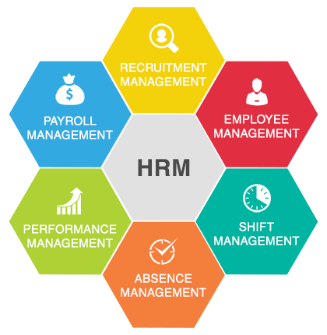
Benefits of my trainings:
Fair employment practices
Feelings and performance
Notes:
The critical evaluation of my training and development as trainee HR Officer is quite complex as the role itself. The main aim of my role is to prove fair employment practices and work environment. Based of many laws and regulations have to prove fair employment and treatment for employees and many research proves its increase profitability of the company and to increase P-CMM (People Capability Maturity Model) levels. This is the best way to improve the workforce capability.
The good human resource cycle mainly will be my responsibility and all the employees individual performance will summarize the Pimento Connection organisational performance.
(Losey at al. 2005)

Slide 10

Performance Management Cycle
(Animations see in appendix)
Data processing
Notes:
Close connection between the Performance Management Cycle and the P-CMM level of the organisation. Individual Performance Management and Development not just the individual employee’s responsibility, but will be my role also. Based on SMART objectives ( see in appendix) help to create all employees, individual performance plan is part of my job.

Slide 11

Conclusion:
Notes:
The main aim of my training to learn how to improve my HR managerial skills and to avoid managerial obsolescence. To be well prepared to solve any argument and dispute during work and try to choose the best applicants for all vacancies. Increase the maturity level of the employees with good employee retention plane, and help the new colleagues to learn their duties quickly. To create personal carrier plan to everyone and how to help to achieve their goals one of the main part of my training. Without to know exactly the company business goals, impossible to reconcile them with the employees personal career plane.

Slide 12
References
Armstrong, A, 2014) Armstrong’s handbook of Human Resource Management.
New York, Rogan Page
Britannica (2021) Behavioural Science
Available at: https://www.britannica.com/science/behavioral-science
(Accesssed: 2021)
Fischer, A and Jonas, J (2021) Employee Benefits and Wellness Excellence Essentials
Aurora, (2021) June
Foster and Partners (2012) Battersea Power Station
Available at: https://www.fosterandpartners.com/projects/battersea-power-station/
(Accessed at: 2021)
Forbes (2021) 15 Human Resources Goals Every Company Should Set For Q1 2021
Available at: https://www.forbes.com/sites/forbeshumanresourcescouncil/2021/12/30/15-human-resources-goals-every-company-should-set-for-q1-2021/?sh=6af582c766aa
(Accessed: 30th December 2020).

Slide 13
References
Losey, M.. et al. (2005) The Future of Human Resource Management
Hoboken ,Wiley-Blackwell
Li, C (2018) HR and Digital Transformation
Available at: https://www.linkedin.com/learning/hr-and-digital-transformation/the-crucial-role-of-hr-in-digital-transformation
(Accessed: 13th November 2018)
Ved Prakash (2021) Newsblare. Five Essential Communication Skills for HR Professionals.
Available at: https://newsblare.com/leadership/careers/five-essential-communication-skills-for-hr-professionals/
(Accessed: 25. November. 2021)
Winston, A (2014) Foster + Partners over a third bigger than any other architecture firm in UK
Available at: https://www.dezeen.com/2014/05/23/foster-partners-biggest-architecture-firm-in-uk/
(Accessed: 23rd May 2014)
( Winfield, P, Bishop, R and Porter, K. (2000) Core Management for HR Students and Practitioners
Oxford, Linacre House

Slide 14
Appendix B
Personal Skills Audit
Name: Laszlo Gamsz
Job role: Human Resource Officer
Please tick as appropriate to indicate how you would rate your skills in relation to the following work / functional areas.
 | Very good |  | Good | Adequate | Little or no experience
Information Technology
Use Microsoft Office Word |  | x
Use Excel spreadsheet |  |  | x
Use a Database |  | x
Use specialist HR software |  | x
Use the internet |  | X
Use e-mail |  | X
Use PowerPoint |  |  | x
 | Very good | Good | Adequate | Little or no experience
Communication Skills
Drafting contracts of employment | x
Taking notes of disciplinary hearings |  | X
Write reports |  | X
Produce material to support presentations |  | X
Delivering a training session |  | X
Resolving disputes/complaints |  | X
Interviewing | X
Advising on HR issues |  |  | x

Slide 15
 | Very good | Good | Adequate | Little or no experience
Problem solving skills
Make good use of verbal reasoning skills, able to handle complex data and make selective use of information |  | x
Explore more than one solution in order to solve a problem |  | X
Consider the ideas of others to help solve problems | X
 |  |  | X
 |  |  |  | X
Supervisory Management
How much experience have you had in your role? | < 1 month | 1-3 months | > 3 months
How many people have you managed at any one time? | None | 1-5 | Above 5
I declare that the information given in this form is true
Signed: Laszlo Gamsz
Date 11.12.2021

Slide 16
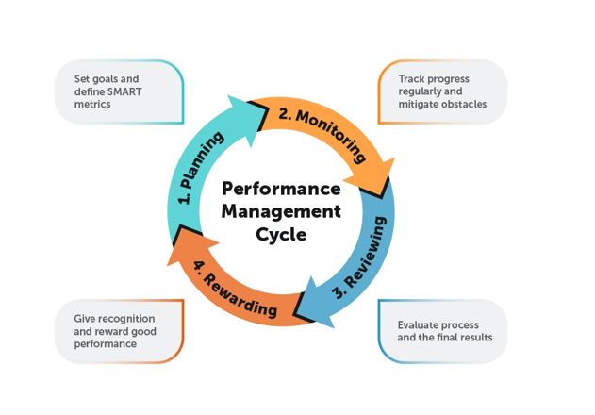

Slide 17


