Slide 1

Sources of law
By Zita Draper

Slide 2

Content
Aims and learning objectives.
Assignment 2.
Where to submit assignment two?
Sources of law recap.
Activities
Summary
Thank you, any questions?

Slide 3

Aims and Learning objectives
The aim of today’s session is to recap the lecture content and introduce students to their second assignment.
By the end of today’s session, students should be able to understand the sources of law, what their second assignment is and the requirements for their second assignment.

Slide 4
How are we all feeling after the first assignment?
Put an emoji in the chat.
First of all, well done to all of you on completing your first assignment.
Second, take a break before starting the next one.
Tutors are here to support you.

Slide 5
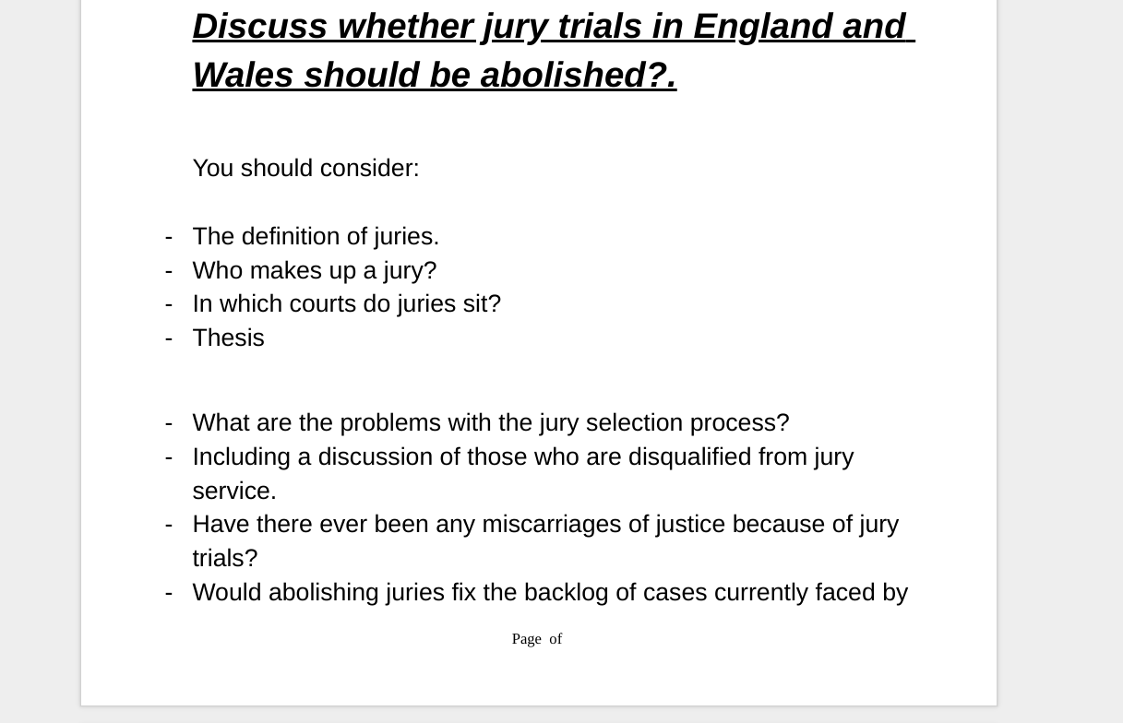
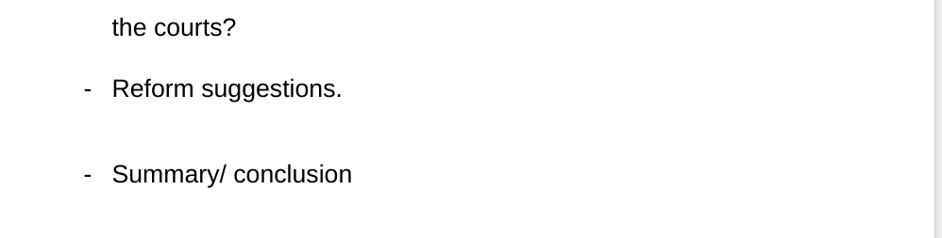
Assignment two

Slide 6
Requirements
Do not use informal language
Follow the Harvard referencing guide on Moodle.
Write in third person.
You do not need to wait until we go over the content because there is alot of information is online about this.

Slide 7
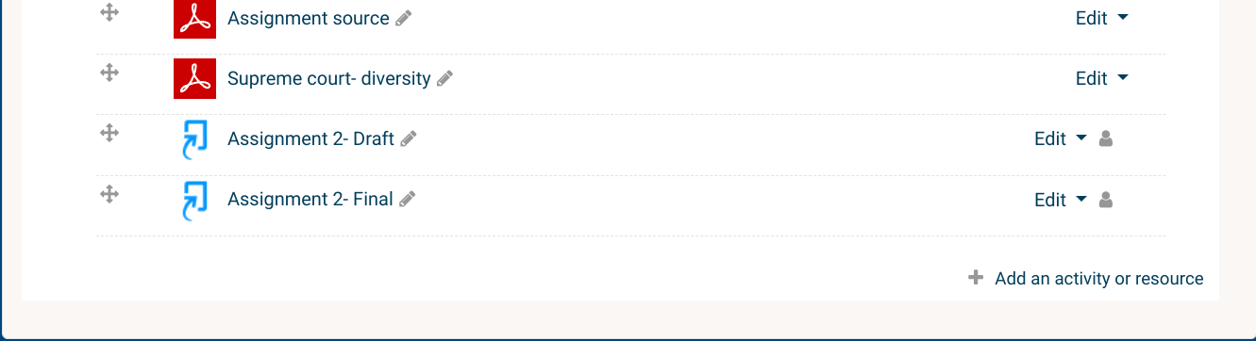
Submitting your assignment
Draft’s
Final

Slide 8

Sources of
https://www.youtube.com/watch?v=fPzBl_EsdFk

Slide 9

Where does law come from?
Acts of parliament
Delegated legislation
Statutory interpretation
EU law
ECHR
Custom
Case law
Equity

Slide 10
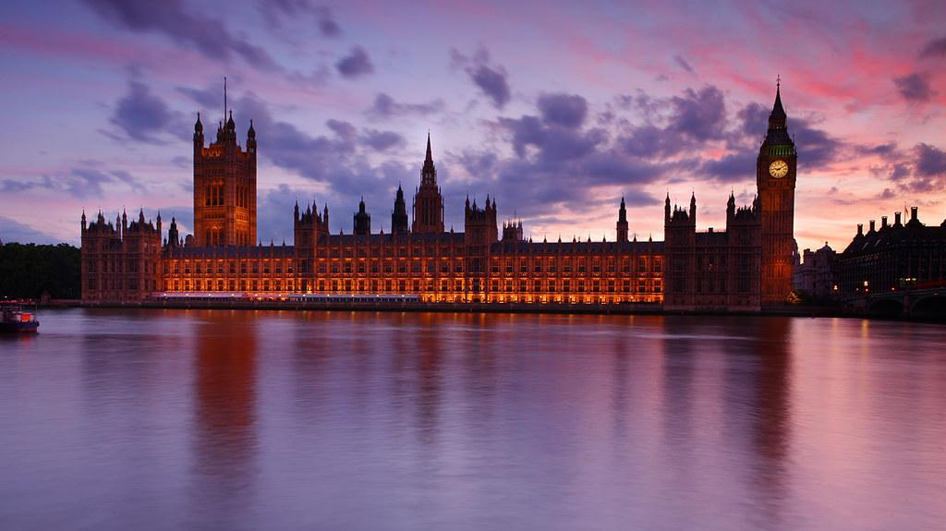
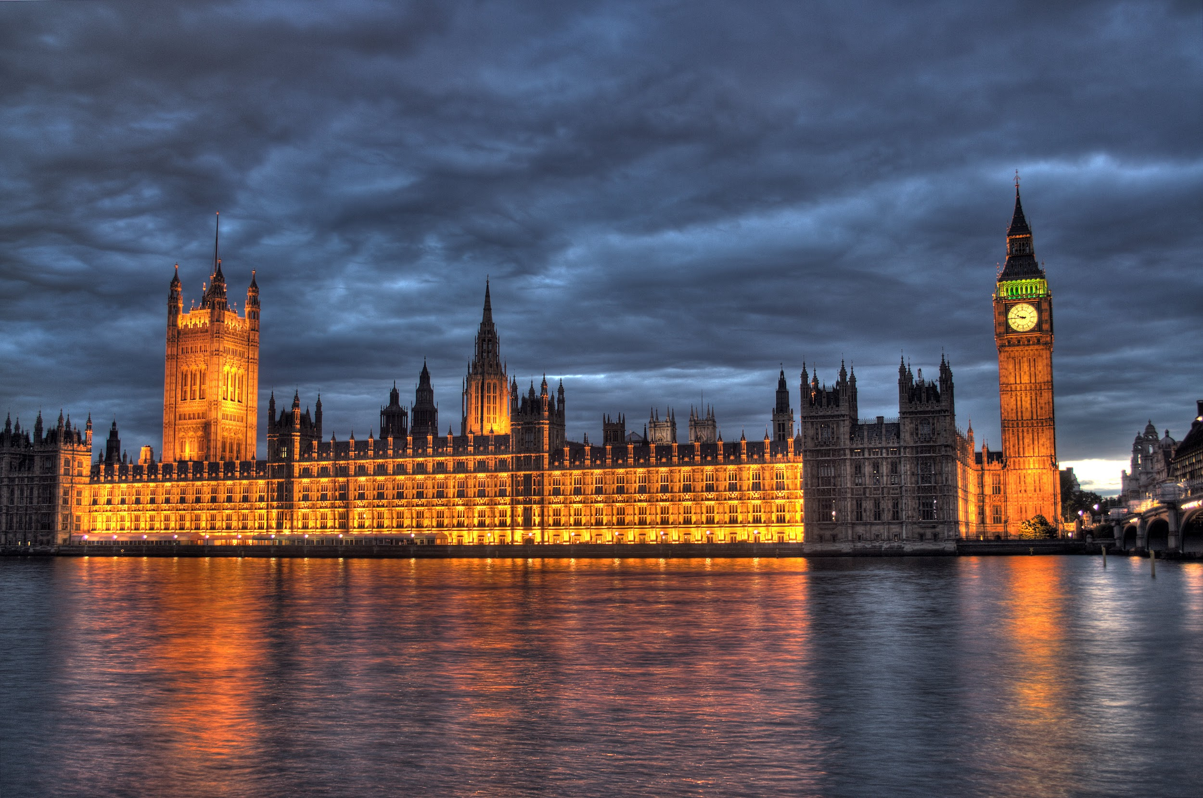
Acts of parliament
Primary law - Offences Against the Persons Act 1861.
Law that cannot be challenged.
Can also delegate legislation.

Slide 11
Types of Legislation
Primary
Main law
Created by parliament (Wales, Uk, Scotland)
Also called statute.
Explanatory notes
Secondary
Delegated legislation.
Statutory interpretation.
By laws
Orders in council
Can be challenged.

Slide 12

Delegated Legislation
Also known as secondary/subordinate legislation.
Includes;
By laws
Devolution
Orders in council
And more!

Slide 13

Statutory interpretation
Need to interpret the law.
How to use statutory interpretation?
Mischief rule
Golden Rule
Literal rule
Down to the judge which one they apply.

Slide 14
European Union Law
The Uk became part of the EU due to the ‘ European Communities Act’ , the Uk signed up in 1972.
Now the brexit vote has changed this.
https://www.youtube.com/watch?v=YJxPok5c7G0
Due to the European Union (Withdrawal) Act 2018, the Uk is no longer part of the EU.

Slide 15
Activity one
Research;
A piece of European Union legislation;
Include; The name of the legislation
What it is about?
Why you chose it?

Slide 16
European Convention on Human Rights
Is a source of the Human Rights Act 1998.
Has its own court called the European Court of Human Rights.
Well known cases;
Pretty v United Kingdom;

Slide 17
Activity two
Research;
Case law from the European Court of Human Rights.
https://www.echr.coe.int/Pages/home.aspx?p=caselaw/reports&c

Slide 18
Common law
Also known as precedent
Only solution is damages
Developed by the courts and judges
Everyone is aware of it.
An example if the offence of Murder.

Slide 19
Case Law
Second most important.
Law made by judges
Also known as precedent.
Judges make law by statutory interpretation or develop the common law.

Slide 20

Equity
https://www.youtube.com/watch?v=yqxwI6lfawk&t=34s

Slide 21
Activity three
Lecture activity;
What is a convention?
You need to download the lecture and scroll to the activity which says ‘’tutorial activity’’ and click on the link.
10 Minutes to do this.

Slide 22

Notes
You cannot be working and attending workshops because you need to be answering questions.
This is a higher education course and therefore you need to be challenged.
4 Weeks left.

Slide 23
Notes
Last lesson.
Appointment only drop in’s.
If not enough students book appointments for me to look at drafts then there will be a class.
Need to let me know appointment times by the 6th July
First come first served basis.

Slide 24


Slide 25


