Slide 1
Embedding Sustainability within Organisations
International Gastronomy Management
[BMGM5000/D]
Week 2 – Sustainable Hospitality

Slide 2
Recap
Introductions
Module Overview & content to be covered
Module Handbook & Assessments
What is sustainability?
Introduction of key terms

Slide 3
Today’s objectives
Sustainable Hospitality: definitions, history, changing consumer wants & needs.
Principles & Pillars of Sustainability.
Key Global Policies & Players.

Slide 4


Definitions, History & Changing Consumer Wants & Needs

Slide 5

What is sustainable hospitality?

Slide 6
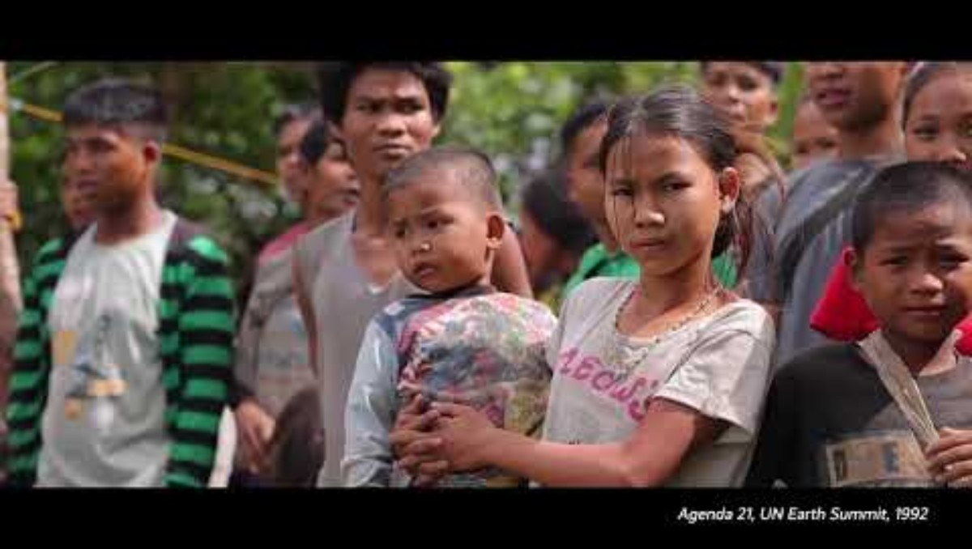
The history of sustainable hospitality

Slide 7
Sustainable Gastronomy
“Sustainable gastronomy recognises that food is never only about consumption. It connects agriculture, culture, health, livelihoods and the environment – and reminds us that what we grow, cook and eat has a direct impact on both people and planet.” – Food and Agriculture Organization of the United Nations.
Notes:
FAO Goodwill Ambassadors and Champions spotlight Sustainable Gastronomy Day

Slide 8
Celebrating Sustainability in Gastronomy
Sustainable Gastronomy Day – 18 June yearly
Sustainable Gastronomy Week – established 2024
World Food Forum | Sustainable Gastronomy Week
2026 edition of Sustainable Gastronomy Week had the theme of “Celebrating Food Heritage”
World Food Forum, 2026

Slide 9

Sustainable Tourism

Slide 10

Why Sustainable Tourism?
Travel Forward “a global non-profit driving positive change in tourism” (Welcome to Travel Forward) argues the case for sustainable tourism and working in partnership for a sustainable future.

Slide 11

Changing consumer wants & needs
Recent years have seen a growing awareness of responsibilities that consumers hold in relation to environmental concerns.
Achieving balance between health, environmental protection and affordability.
Over 80% of travellers consider sustainable travel to be important (Statista, 2026).
Higher costs appear to be the main barrier.

Slide 12

Changing consumer wants & needs
World Travel and Tourism Council (2025) discovered a gap between “traveller’ desire for sustainable options and their actual behaviour”.
Whilst sustainability is a key concern, “cost and quality remain the dominant priorities”.
Full report:
Bridging The Say-Do Gap: How to create an effective sustainability strategy by knowing your customers | WTTC Research Hub

Slide 13
Sustainable Food Barometer
Sodexo UK & Ireland research discovered that:
“UK consumers feel a mix of emotions about sustainable food”.
It is therefore fundamental that the gastronomy & food industry show consumers that sustainable food is “healthy, good for the planet”.
This is a key concern to achieve net-zero targets.

Slide 14
Sustainable Food Barometer
34% choose sustainable food.
45% hesitate to choose sustainable food.
21% have no intention of eating more sustainable products.
3 key priorities = price, taste & nutrition.
36% are willing to pay a premium for low-carbon meals.
“Foodservice providers must lead by example”.
(Sodexo, 2025)

Slide 15
Principles and Pillars of Sustainability

Slide 16

The Principles & Pillars of Sustainability
What are the 3 principles of sustainability?
The principles of sustainability are the foundations of what this concept represents.
Sustainability is made up of 3 pillars:
Environment
Society/Social
Economy
These principles are also commonly referred to as:
Planet
People
Profit

Slide 17
The Principles & Pillars of Sustainability
Environment: protect natural resources/ecosystems & minimise negative environmental impacts.
Society/Social: strengthen well-being, culture & quality of life for local communities & ensure equity & inclusion.
Economy: establish long-term benefits that are fairly distributed & support local communities.

Slide 18

Let’s look at some factors…
As we go through the slides, consider which category the factor may fit into. Is it environment, society, or economy? Perhaps some or all will fall into more than one?

Slide 19
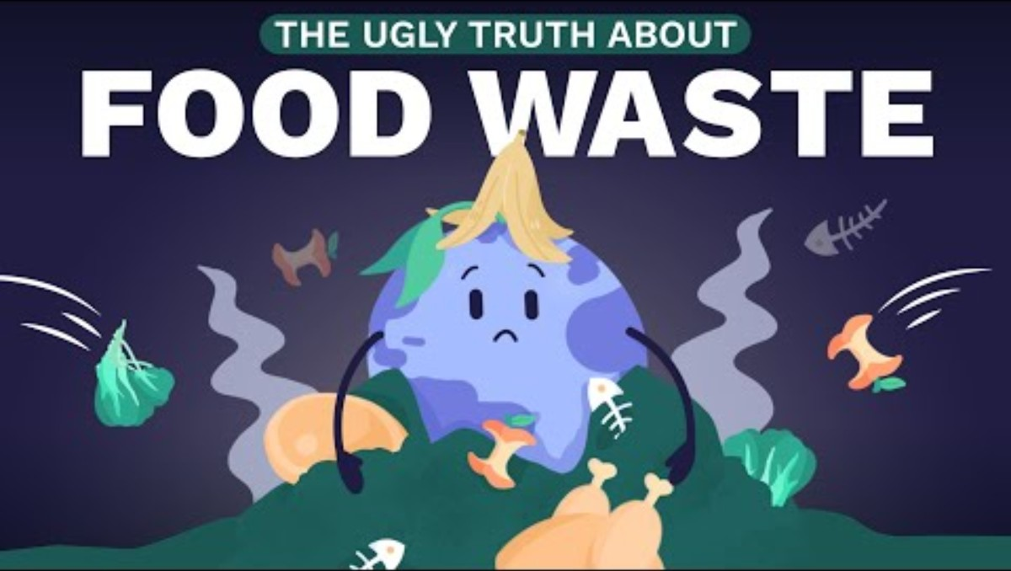
Food Waste

Slide 20
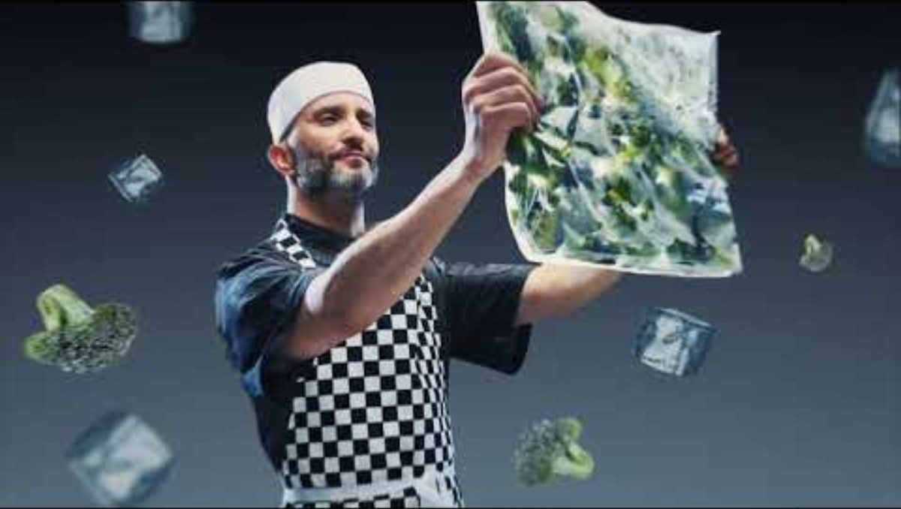
Food Waste

Slide 21
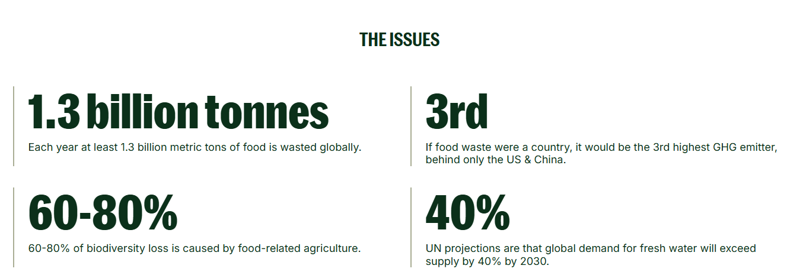
Guardians of Grub
(WRAP, 2026)

Slide 22
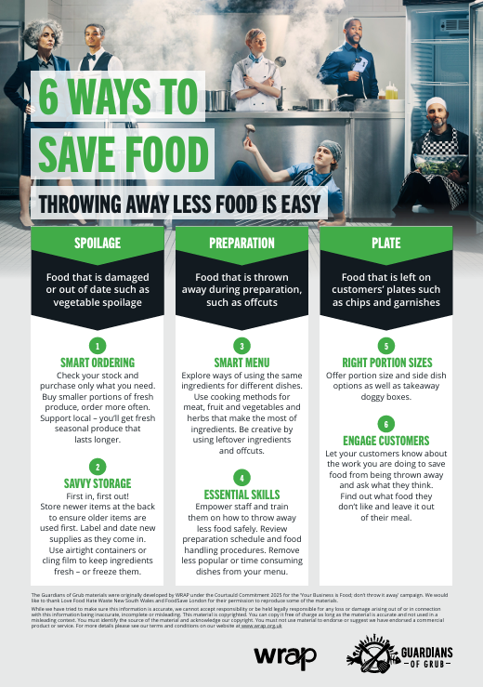
Smart Ordering: local & only what you need.
Savvy Storage: FIFO, freeze where possible.
Smart Menu: ingredients that can be used for multiple dishes, be creative with leftovers.
Essential Skills: empower staff, train effectively, regular procedure reviews, remove less popular menu items.
Right Portion Sizes: different portion sizes available, side dish options & takeaway.
Engage Customers: communicate/market your efforts. Feedback to see what works.
(WRAP, 2026)

Slide 23
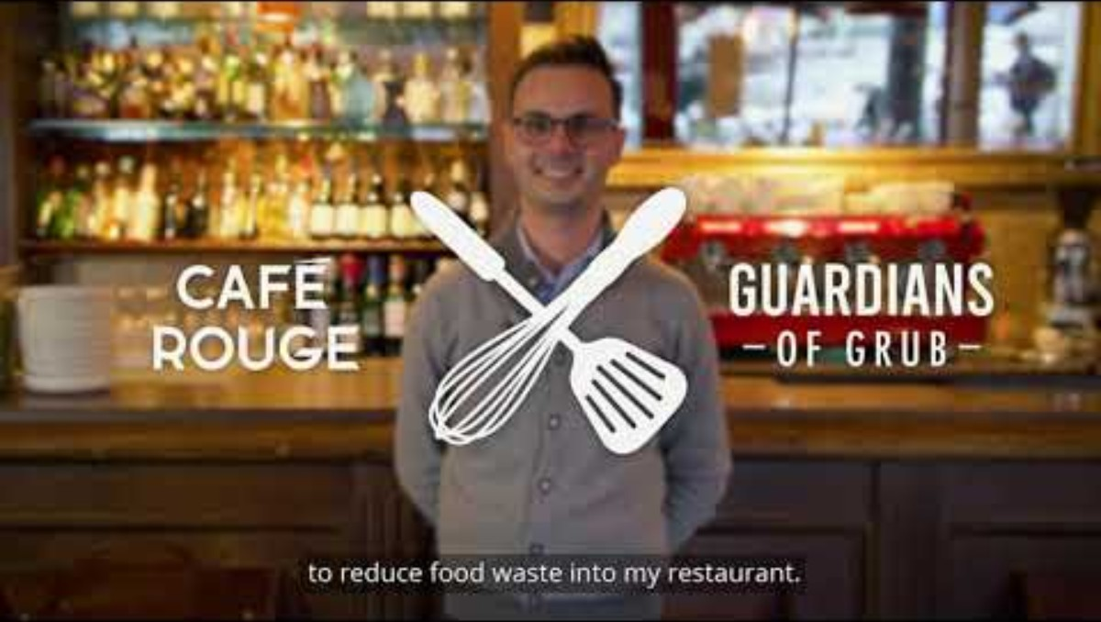
Putting it into practice

Slide 24
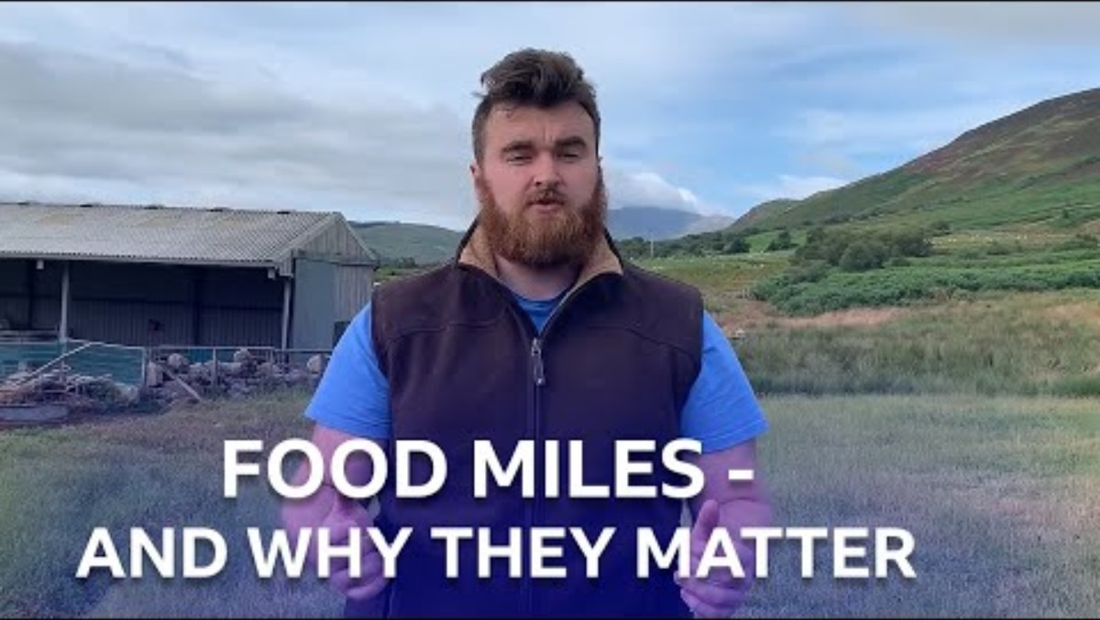
Food Miles – Seasonality | Local Produce | Farm to Fork

Slide 25
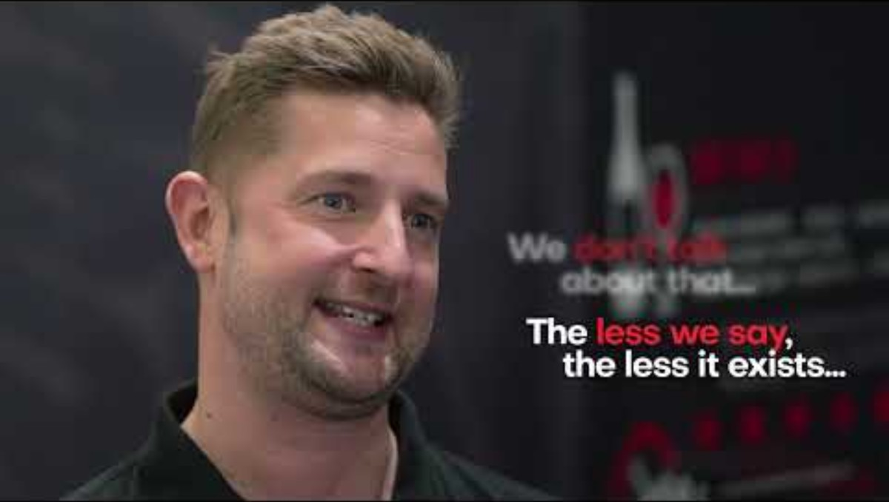
A sustainable workforce – The Burnt Chef Project

Slide 26

A sustainable workforce – The Burnt Chef Project
Provided free mental health support & therapy to 8.5k
Provided support & education to 184 countries
In a survey of 1273 hospitality professionals, 8 out of 10 or 84% confirmed they have experienced mental health issues within their career
46% of survey respondents “would not feel comfortable talking about their health concerns with their colleagues”
(The Burnt Chef Project, 2026)

Slide 27
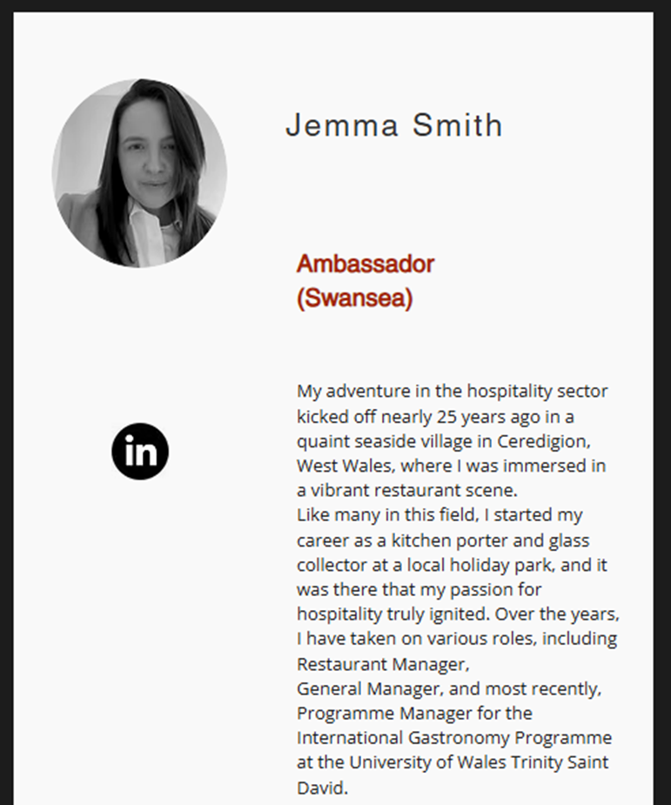
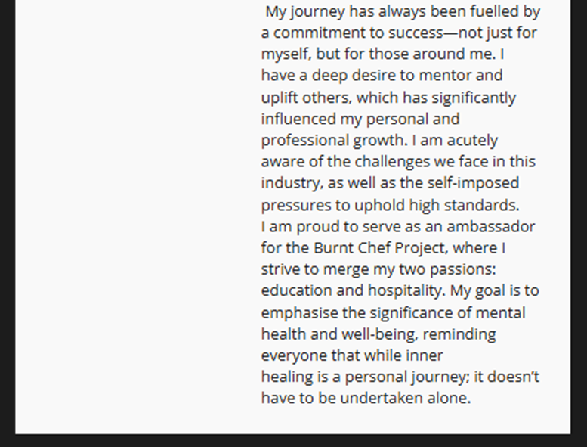
(The Burnt Chef Project, 2026)

Slide 28
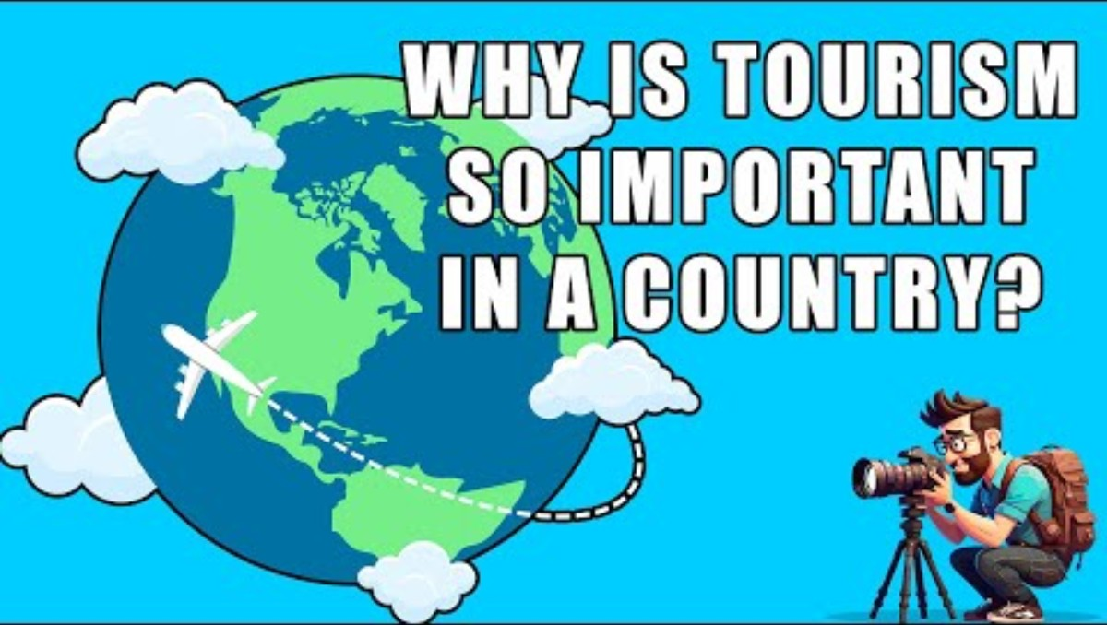
Sustainable Economies Worldwide

Slide 29

Sustainable Economies Worldwide
World Tourism Day – 27th September 2026.
Many organisations support cultural tourism.
Why?
To connect people through local cultures, arts & traditions.
To support local economies to generate income & create jobs.
To establish and protect respect through mutual understanding of customs.
Notable examples:
UN Tourism & The Global Sustainable Tourism Council
And a little closer to home:
Visit Wales & National Trust

Slide 30
Activity

Slide 31

Let’s find out more…
Select one of the following:
UN Tourism
The Global Sustainable Tourism Council
Visit Wales
National Trust
Find out a little more about what they are doing to promote sustainable tourism.

Slide 32
Key Global Policies & Players

Slide 33

The Paris Agreement 2015
A framework to inform strengthened commitments to climate control with parameters to track progress & guide towards long term success.
A universal agreement “to pursue efforts to limit warming to 1.5 degrees C” (above pre-industrial levels).
Progress over the past ten years has been apparent, although uneven overall.
Positives = increased usage of renewable energy & electric vehicles.
Drawbacks = global conflicts & economic challenges (cost-of-living) etc.
(Cogswell, N. 2026)

Slide 34
The Paris Agreement 2015
Important – The Paris Agreement cannot implement or enforce climate policies.
Success depends on governments, businesses & communities acting.
“The Paris Agreement is just one piece of a multifaceted approach to climate action.”
As of January 2026: 196 parties have adopted The Paris Agreement.
(Cogswell, N. 2026); United Nations Climate Change, 2026).

Slide 35
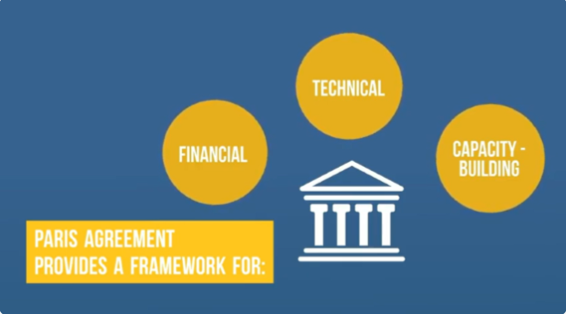
United Nations Climate Change, 2026).
Notes:
Developed countries should help those with less resources/heightened vulnerability.
Guidance in the form of a technology framework to enable improved resistance to climate change.
Some developing countries will have insufficient capacities to deal with challenges brought by climate change & require developed countries to support.

Slide 36
The 2030 Agenda for Sustainable Development
United Nations initiative – “a plan of action for people, planet and prosperity”
Collaborative partnerships on a global scale = key to success
17 Sustainable Development Goals (SDGs)
169 associated targets
These goals and targets “balance the three dimensions of sustainable development: the economic, social and environmental”
Notes:
Transforming our world: the 2030 Agenda for Sustainable Development | Department of Economic and Social Affairs

Slide 37
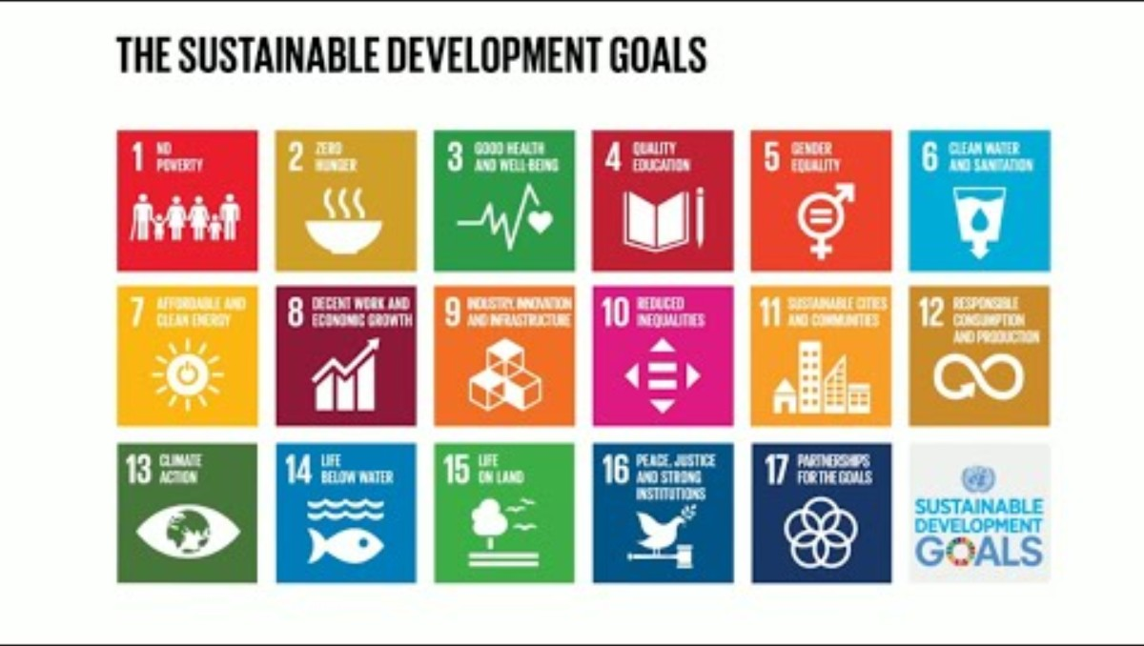
Sustainable Development Goals (SDGs)
Notes:
About us | The Sustainable Restaurant Association

Slide 38

The Global Sustainable Development Report
Produced every four years to help inform the yearly progress reports for the SDGs.
Next report due – September 2027
Most recent report – 2023 and outlined that progress had been hampered by the pandemic, rising inflation/cost-of-living crisis and global distress such as conflicts and natural disasters. It calls on active political leadership and societal support to enable effective participation to increase the likelihood of success.
Full report available: FINAL GSDR 2023-Digital -110923_1.pdf

Slide 39
The Sustainable Development Goals Report 2026
Published 7th July 2026
“meaningful gains have been made across the SDGs, but they remain uneven and insufficient”
Priorities for final 3 years = “increased investment, strengthened international cooperation, expanded access to technology & data, faster energy transition, greater gender equality, and renewed commitments to peace.
Full report available: The-Sustainable-Development-Goals-Report-2026.pdf

Slide 40
Activity

Slide 41
Research Activity – 30 mins
Conduct your own research into the 17 SDGs and list them in the order that you feel is most relevant to sustainable tourism. Explain how and why you listed in this order.

Slide 42


Slide 43
Order | SDG | Why?
1 | Responsible Consumption and Production | A core principle of sustainable tourism – reduce waste/source sustainably & encourage responsible visitor behaviour.
2 | Climate Action | Tourism contributes to carbon emissions through transport/accommodation/supply movement & activities.
3 | Decent Work & Economic Growth | Tourism = major global employer. Sustainable tourism needs quality jobs, fair wages & economic benefits for local communities.
4 | Sustainable Cities & Communities | Support rather than damage destinations/attractions & facilities. Helping to ensure reduced disruption to local communities.
5 | Life on Land | Protecting landscapes/wildlife/attractions that tourists visit.
6 | Life below Water | Critical for coastal & marine tourism (beaches/diving/cruises) but also for sustainable gastronomy (sustainable fishing etc.).
7 | Clean Water & Sanitation | Tourist sites (hotels, restaurants etc.) use huge amounts of water so sustainable management is essential.

Slide 44
Order | SDG | Why?
8 | Partnerships for the Goals | Collaboration between governments/businesses/communities & tourists is crucial.
9 | Industry, Innovation and Infrastructure | Green transport, locally sourced products & sustainable measures within infrastructure.
10 | Reduced Inequalities | Fair distribution of tourism gains & local population accessibility opportunities.
11 | Quality Education | Training, skills development, environmental awareness & sustainable tourism practices.
12 | No Poverty | Local employment opportunities & community-based tourism initiatives.
13 | Good Health and Well-being | Commitment to visitor & local resident well-being, health tourism, & destination resilience for job security etc.
14 | Affordable and Clean Energy | Renewable energy usage in hotels, resorts & transport systems.

Slide 45
Order | SDG | Why?
15 | Gender Equality | Equality in employment opportunities across the board, but also in leadership positions.
16 | Peace, Justice and Strong Institutions | Stable governance & safety of destinations are key components of successful tourism.
17 | Zero Hunger | Becomes relevant when discussing the utilisation of local suppliers/food systems & sustainable gastronomy but arguably not as directly linked to sustainable tourism as industry, innovation and infrastructure which acknowledges similar/same concerns.

Slide 46

World Sustainable Hospitality Alliance
Founded in 1992 following the 1992 United Nations Conference on Environment and Development.
Throughout the 90’s publications were shared to encourage/spread the word about sustainability in all sectors of hospitality including the Green Hotelier Magazine.
2004 saw expansion into supporting youth employment to extend sustainability of the industry in the long-term.
2010’s saw collaborations with governments to address global concerns & support communities through collaborative working. In 2014 work began to address human rights risks in the hospitality industry.
Notes:
History: See our organisational journey - Sustainable Hospitality Alliance

Slide 47
World Sustainable Hospitality Alliance
In 2017 the International Tourism Partnership Goals for 2030 was launched to address human rights, youth employment, climate action and water stewardship.
2021 saw the launch of the Core Employability Skills curriculum to support disadvantaged individuals to pursue a career in the hospitality industry.
2023 brought the launch of the updated Pathway to Net Positive Hospitality initiative incorporating People, Planet, Place & Prosperity for a holistic approach to sustainable hospitality.
Notes:
History: See our organisational journey - Sustainable Hospitality Alliance

Slide 48

The Sustainable Restaurant Association
Founded in 2008 to link the sustainable food movement and the hospitality industry.
Supported by 50 founding restaurants The SRA created a framework for promoting best practice across the industry.
In 2010 the Food Made Good Standard was launched to assess sustainability of over 15,000 sites globally, covering high end to high street.
Today the association has expanded into consultancy, partnership programmes & education/networking sessions.
Notes:
About us | The Sustainable Restaurant Association

Slide 49
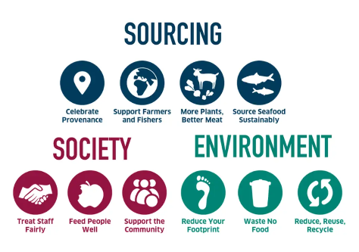
The SRA Framework
Notes:
Provenance = origin or source of item.
Framework | The Sustainable Restaurant Association

Slide 50
Today’s objectives – did we achieve them?
Sustainable Hospitality: definitions, history, changing consumer wants & needs.
Principles & Pillars of Sustainability.
Key Global Policies & Players.

Slide 51
Any Questions?

Slide 52

Corporate Social Responsibility & Ethical Business Practice
Responsible leadership
Inspiring sustainability & CSR
The changing world & evolution of CSR
Business ethics: the impact of philosophy on contemporary businesses & decision-making processes
Examples of good vs bad practice

Slide 53
Reference List
BBC Scotland. (2021). What Are Food Miles – And Why Do They Matter? | BBC The Social [online], available at: What Are Food Miles - And Why Do They Matter? | BBC The Social – YouTube
ClimateScience – Solve Climate Change. (2021). Food Waste: The Hidden Cost of the Food We Throw Out | ClimateScience #9 [online], available at: Food Waste: The Hidden Cost of the Food We Throw Out I ClimateScience #9
Cogswell, N. (2026). What the Paris Agreement Was Built to Do – and Why It Still Matters, available at: The Paris Agreement’s Role in Climate Action | World Resources Institute
EconomicExplorer101. (2023). Why Is Tourism So Important In a Country. [online], available at: Why Is Tourism So Important In a Country. – YouTube
Rachel – Sustainable Tourism. (2017). Sustainable tourism [online], available at: Sustainable tourism – YouTube
Sodexo. (2025). New Sodexo research reveals UK consumers value sustainable food, but barriers still remain, available at: New Sodexo research reveals UK consumers value sustainable food, but barriers still remain
Statista. (2026). Sustainable tourism worldwide – statistics & facts, available at: Sustainable tourism worldwide - statistics & facts | Statista
The Burnt Chef Project. (2026). About, available at: Learn More | The Burnt Chef Project

Slide 54
Reference List
The Burnt Chef Project. (2025). The Burnt Chef Project – Origin Story [online], available at: The Burnt Chef Project - Origin Story – YouTube
Tourism and hospitality guide. (2025). Sustainable Practices in the Hospitality Industry [online], available at: Sustainable Practices in the Hospitality Industry
Travel Forward. (2013). Why sustainable tourism? [online], available at: Why sustainable tourism? – YouTube
United Nations. (2026). The Paris Agreement, available at: The Paris Agreement | UNFCCC
United Nations. (2026). The Sustainable Development Goals Report 2026, available at: The-Sustainable-Development-Goals-Report-2026.pdf
United Nations. (2023). Times of Crisis, Times of Change, Science for Accelerating Transformations to Sustainable Development, Global Sustainable Development Report 2023, available at: FINAL GSDR 2023-Digital -110923_1.pdf
United Nations. (2026). Transforming our world: the 2030 Agenda for Sustainable Development, available at: Transforming our world: the 2030 Agenda for Sustainable Development | Department of Economic and Social Affairs
United Nations. (2026). The 17 Goals, available at: THE 17 GOALS | Sustainable Development
World Food Forum. (2026). Sustainable Gastronomy Week, available at: World Food Forum | Sustainable Gastronomy Week

Slide 55
Reference List
World Sustainable Hospitality Alliance. (2023). 30 years of driving collaboration for a better world [online], available at: 30 years of driving collaboration for a better world – YouTube
World Travel & Tourism Council. (2025). Consumers in favour of sustainable travel but cost is king, reveals WTTC report, available at: Consumers in favour of sustainable travel but cost is king
WRAP. (2019). Introducing the Guardians of Grub [online], available at: Introducing the Guardians of Grub – YouTube
WRAP. (2022). Guardians of Grub – Café Rouge [online], available at: Guardians of Grub - Café Rouge – YouTube
WRAP. (2026). Future-Proof Food, available at: Future-proof food | WRAP - The Waste and Resources Action Programme

