Slide 1
Transfer Functions
Steve Mosey

Slide 2
Contents
Concept
Gain response
Time response
Laplace
Example

Slide 3
Transfer Functions: Concept
In order to model a system, or an element of a system, we need to be able to describe how that object behaves.
This is the job of a transfer function: it describes the behaviour of a system or system element using mathematical terms.
In many cases, these descriptions can become extremely large and cumbersome and even if a single numerical answer can be obtained, the operation of the system is not obvious.
To alleviate some of the ambiguity, the Laplace transform is applied to the transfer function which can simplify things somewhat.

Slide 4


Gain response
Consider a perfect amplifier with a gain of 10. – Its output voltage will be 10 times its input voltage
$$V_{in}$$
$$V_{out}$$
x10
The transfer function of this perfect amplifier would simply be its gain.

Slide 5
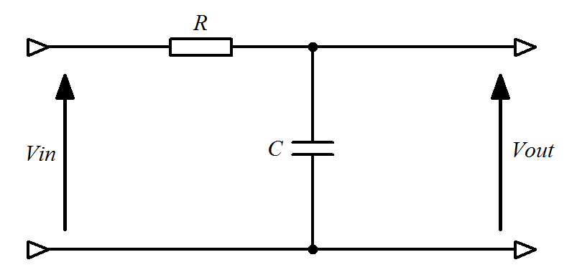


Time response
What about when our system includes a delay?
This RC circuit has a delay caused by the charging effect of the capacitor.
$$V_{out}$$
$$V_{in}$$

Slide 6
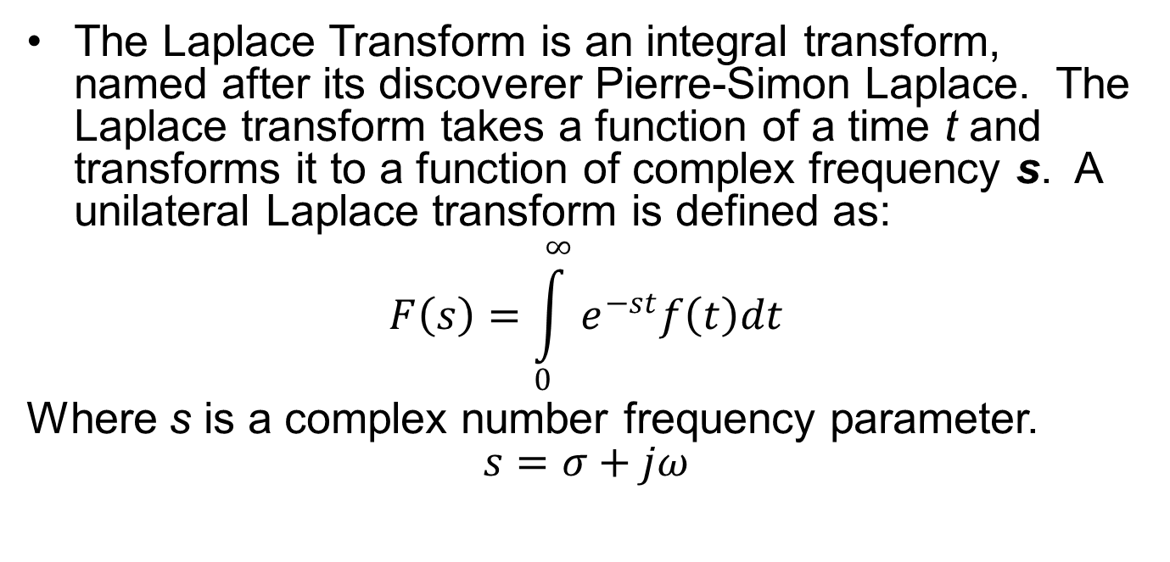
Laplace Transforms
The Laplace Transform is an integral transform, named after its discoverer Pierre-Simon Laplace. The Laplace transform takes a function of a time t and transforms it to a function of complex frequency s. A unilateral Laplace transform is defined as:
$$F\left(s\right)=\int_{0}^{∞}{e^{−st}f\left(t\right)dt}$$
Where s is a complex number frequency parameter.
$$s=σ+jω$$

Slide 7
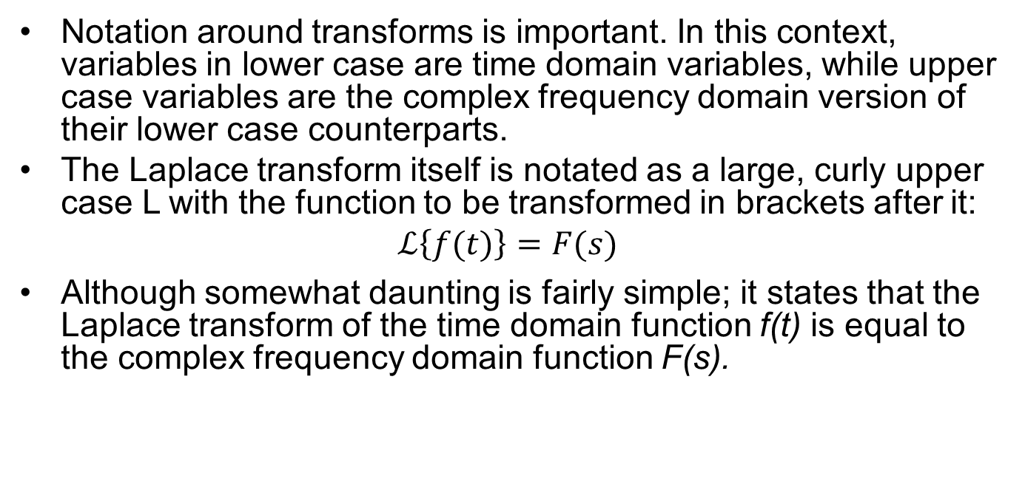
A Note on Notation
Notation around transforms is important. In this context, variables in lower case are time domain variables, while upper case variables are the complex frequency domain version of their lower case counterparts.
The Laplace transform itself is notated as a large, curly upper case L with the function to be transformed in brackets after it:
$$ℒ\left\{f(t)\right\}=F(s)$$
Although somewhat daunting is fairly simple; it states that the Laplace transform of the time domain function f(t) is equal to the complex frequency domain function F(s).

Slide 8
Laplace Transforms
Having to perform this transform may seem like a chore, but thankfully we are able to use a table of common transforms and simply interchange sections of our functions to perform the Laplace transform.
A condensed table of Laplace transforms is shown on the following slide

Slide 9
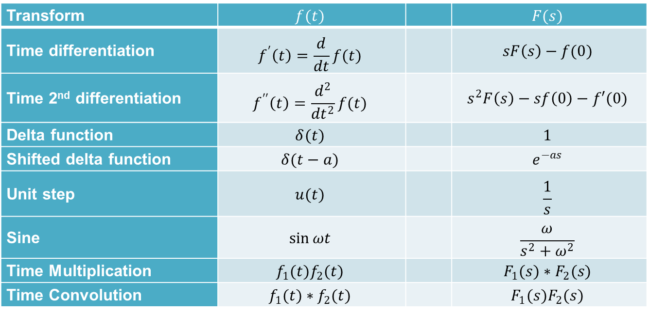
Common Laplace Transforms
Transform | $$f(t)$$ |  | $$F(s)$$
Time differentiation | $$f^{′}\left(t\right)=\frac{d}{dt}f(t)$$ |  | $$sF\left(s\right)−f(0)$$
Time 2nd differentiation | $$f^{′′}\left(t\right)=\frac{d^{2}}{{dt}^{2}}f(t)$$ |  | $$s^{2}F\left(s\right)−sf\left(0\right)−f′(0)$$
Delta function | $$δ(t)$$ |  | $$1$$
Shifted delta function | $$δ(t−a)$$ |  | $$e^{−as}$$
Unit step | $$u(t)$$ |  | $$\frac{1}{s}$$
Sine | $$\sin{ωt}$$ |  | $$\frac{ω}{s^{2}+ω^{2}}$$
Time Multiplication | $$f_{1}(t)f_{2}(t)$$ |  | $$F_{1}(s)∗F_{2}(s)$$
Time Convolution | $$f_{1}(t)∗f_{2}(t)$$ |  | $$F_{1}(s)F_{2}(s)$$

Slide 10
Laplace Transforms
While the reasoning for adding this extra layer of complexity may seem somewhat obscure, there is a very good reason for it.
While a Laplace transform transforms a function to the complex frequency domain, it also simplifies the analysis of the system.
To determine the time domain response of a system to a given input without using Laplace transforms would need one to calculate a time domain transfer function for the system and then convolve this with the time domain input signal.
This approach is computationally heavy and the same result can be obtained using Laplace transforms.
In the complex frequency domain, what would be calculated using a convolution in the time domain can be calculated using a simple multiplication.

Slide 11
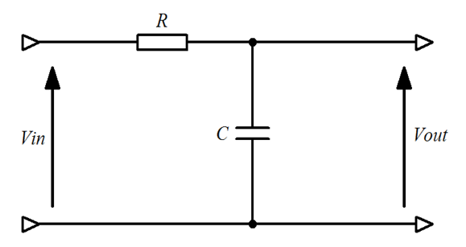
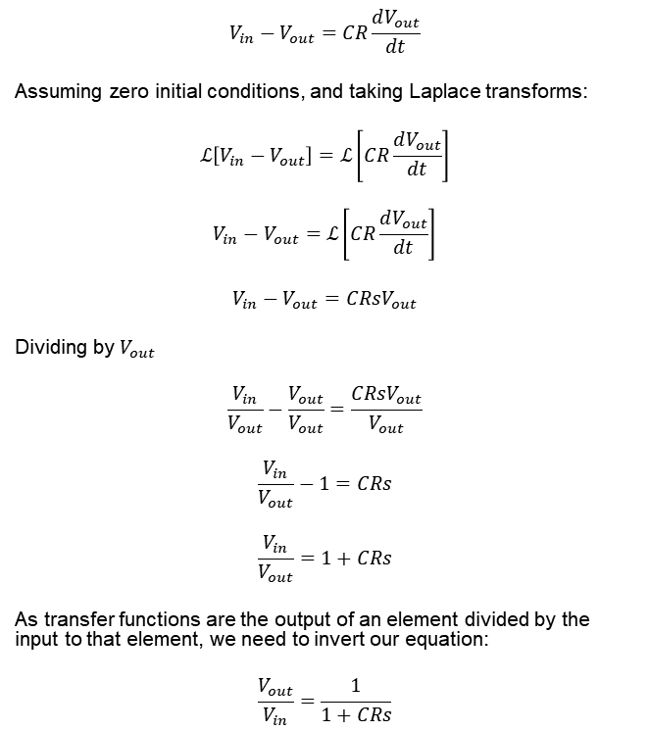
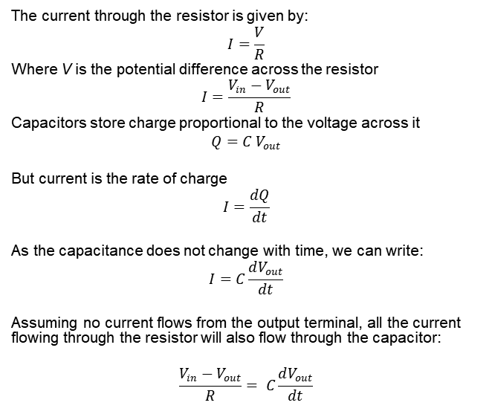
RC Circuit example
$$V_{in}−V_{out}=CR\frac{dV_{out}}{dt}$$
Assuming zero initial conditions, and taking Laplace transforms:
$$ℒ\left[V_{in}−V_{out}\right]=ℒ\left[CR\frac{dV_{out}}{dt}\right]$$
$$V_{in}−V_{out}=ℒ\left[CR\frac{dV_{out}}{dt}\right]$$
$$V_{in}−V_{out}=CRsV_{out}$$
Dividing by $V_{out}$
$$\frac{V_{in}}{V_{out}}−\frac{V_{out}}{V_{out}}=\frac{CRsV_{out}}{V_{out}}$$
$$\frac{V_{in}}{V_{out}}−1=CRs$$
$$\frac{V_{in}}{V_{out}}=1+CRs$$
As transfer functions are the output of an element divided by the input to that element, we need to invert our equation:
$$\frac{V_{out}}{V_{in}}=\frac{1}{1+CRs}$$
The current through the resistor is given by:
$$I=\frac{V}{R}$$
Where V is the potential difference across the resistor
$$I=\frac{V_{in}−V_{out}}{R}$$
Capacitors store charge proportional to the voltage across it
$$Q=C{ V}_{out}$$
But current is the rate of charge
$$I=\frac{dQ}{dt}$$
As the capacitance does not change with time, we can write:
$$I=C\frac{dV_{out}}{dt}$$
Assuming no current flows from the output terminal, all the current flowing through the resistor will also flow through the capacitor:
$$\frac{V_{in}−V_{out}}{R}= C\frac{dV_{out}}{dt}$$

Slide 12
Summary
Transfer functions are used to mathematically describe the behaviour of a system
The are the ratio of the output to the input of a system
Laplace transforms can simplify the process of determining the time domain response of a system

