Slide 1
Ramen Tesigen
Presentation skills
Student number: 1715716
DSAW4077

Slide 2
HOW TO WRITE A MENU

Slide 3
Points to consider before writing a menu
Menu creation
Menu design
Products to create the menu
Menu equilibration
Pricing the menu

Slide 4
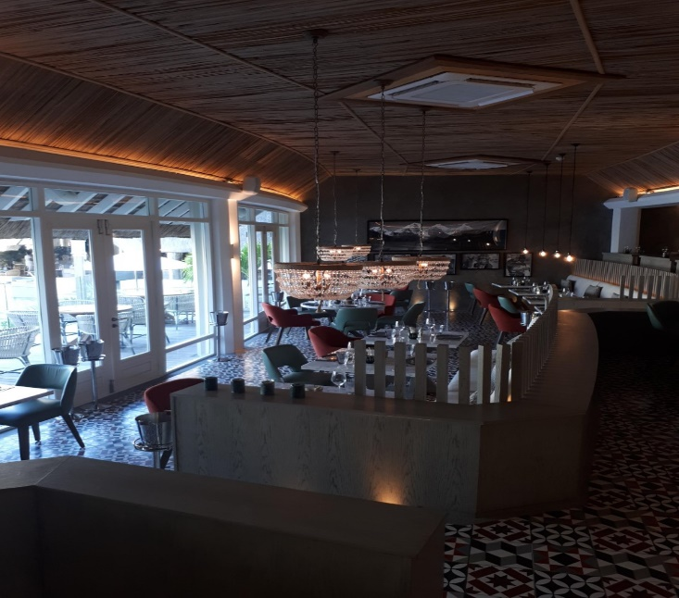
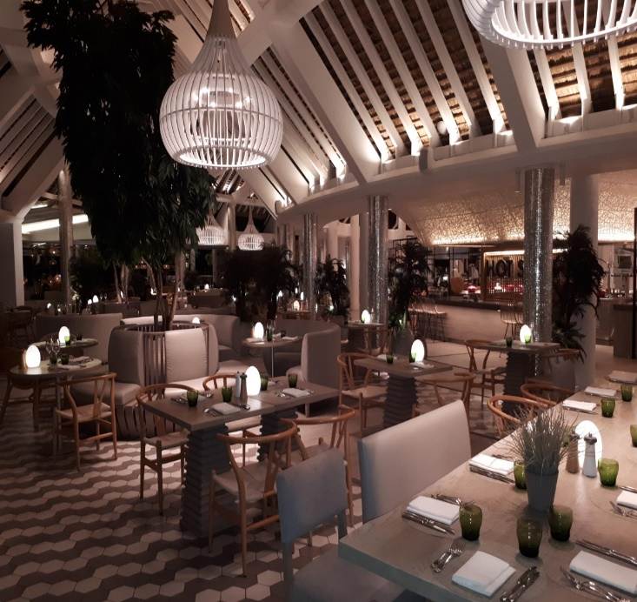
Menu creation
Style of your restaurant
Nationality of guest
Manning to produce the dish
Signature dish
Notes:
Before writing a menu, there are many factors that we should take into considerations
Whether its an A la Carte menu or a Buffet menu
What nationality of guest we are expecting to create the menu.
Manning is very important because we should know how many chefs we will need to prepare the menu and the seating capacity of the restaurant
A signature dish identifies an individual chef or a restaurant and ideally it should be unique to the chef in a blind tasting.

Slide 5
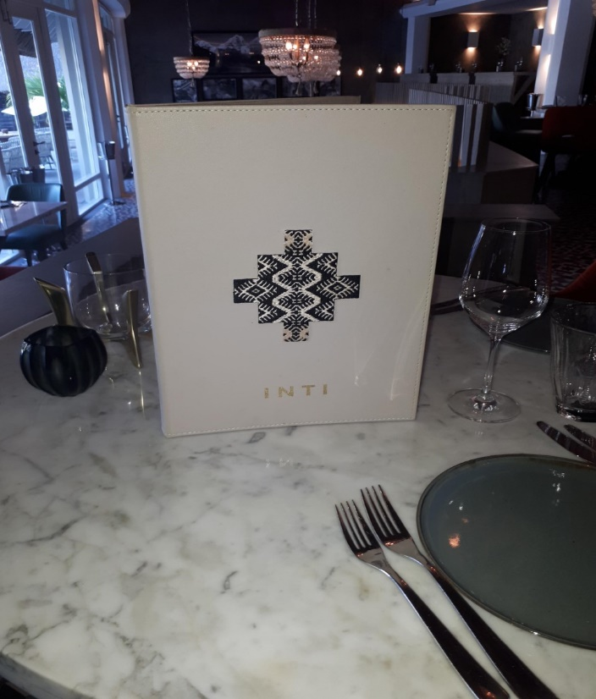
Menu Design
Presentation of the menu
Easily readable
Right size
simple wording
Notes:
The menu should be well presented
It should be easily readable because some guest have vision problem
It should have the right size so as to better handle the menu
Simple wording to better understand the menu

Slide 6
Products
Seasonal, local or imported products
Availability on the market and supplier
Menu equilibration
Simple and fresh
Notes:
Before writing a menu, products availability should take into consideration.
Imported products cost more money than local products.
Whether it will be available throughout the year.
The menu should be well balanced because nowadays lots of guest are vegetarian and intolerant to gluten free, diary free, nuts and many more allergies

Slide 7
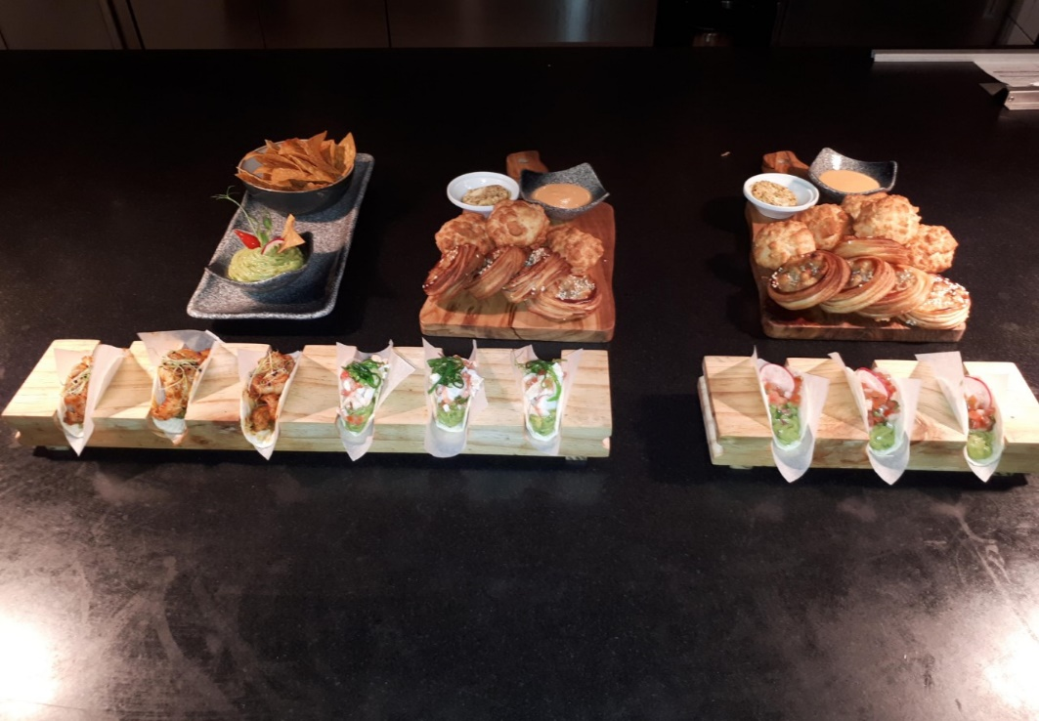
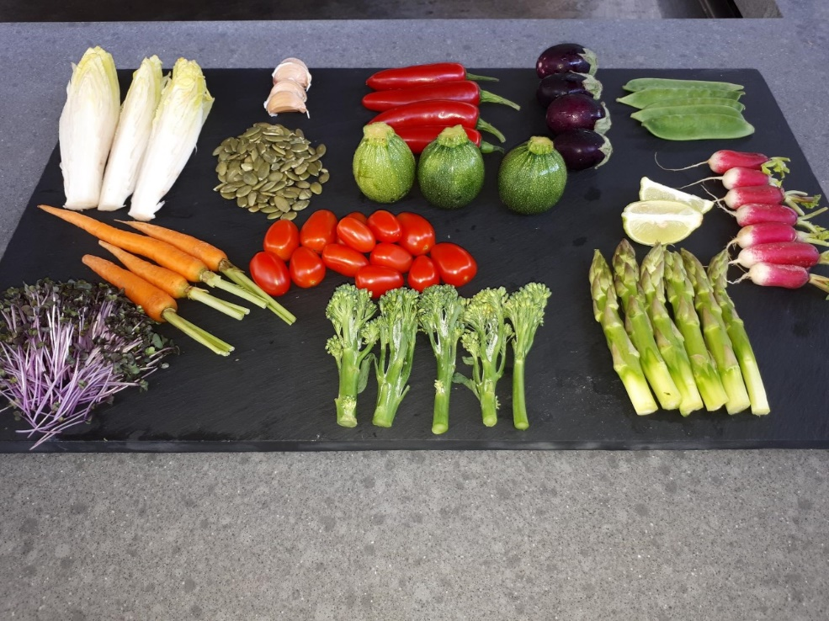
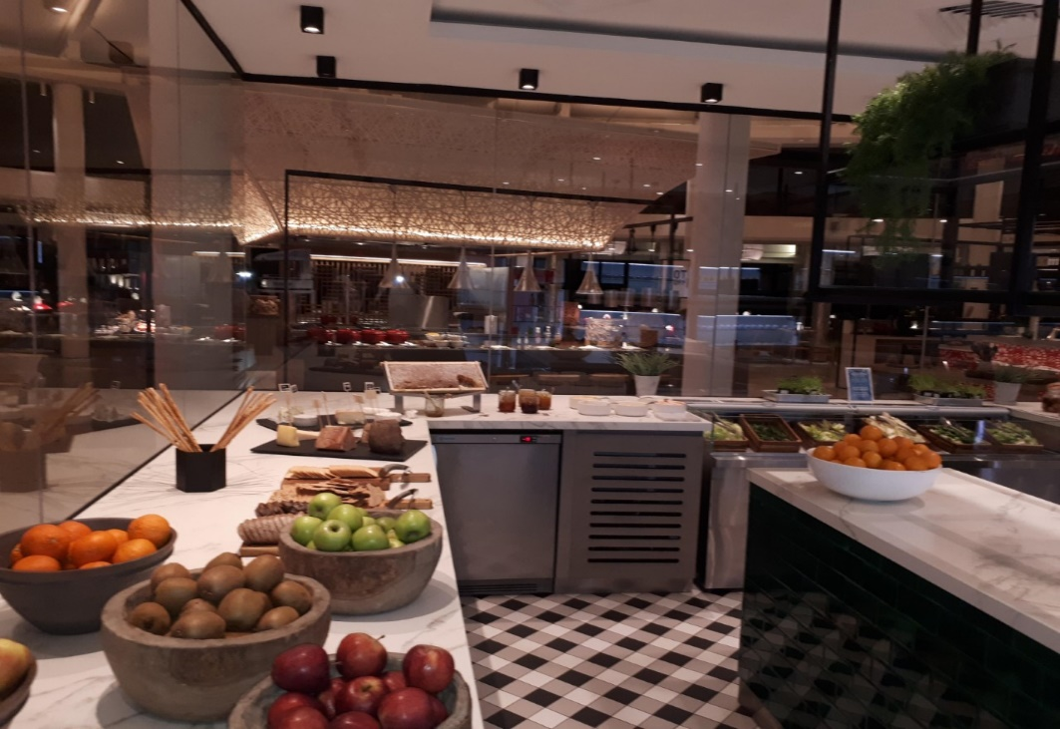
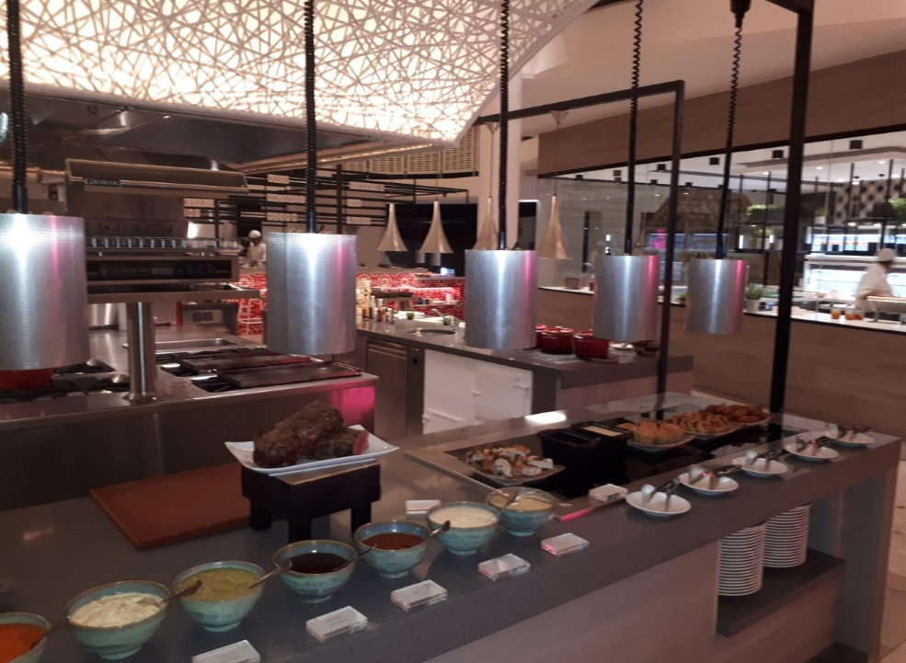

Slide 8
Pricing the menu
Food cost
Important factors
(Labour, Water, Building rent, Gas, Electricity)
Selling price
Notes:
When the menu has already been created, we should sell it
Selling price will determined by a food cost
The money we spend to create on the menu including the important factors mention.

Slide 9
Finally
Creating a menu is not a simple task for a chef
A great meal is not about the food.
A great meal is an emotional experience.
If the guest are happy, the chef is happy

Slide 10
Thank you

