Slide 1

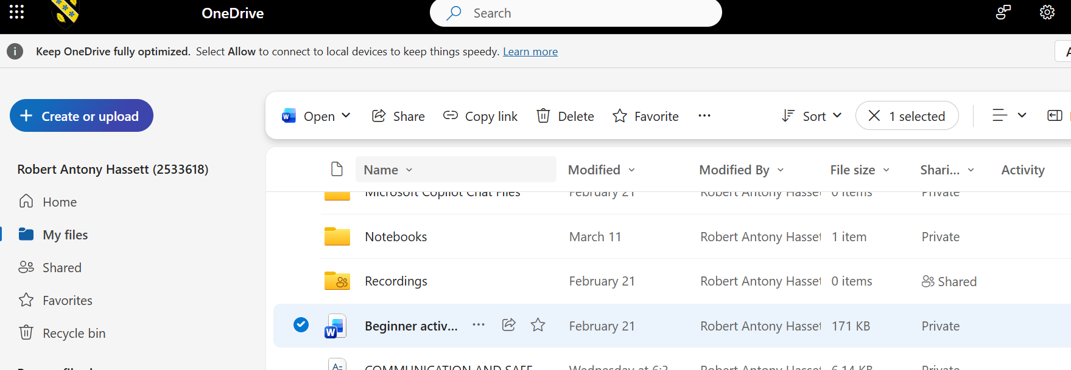
How to Share File via ONEDRIVE
Step 1: Open the OneDrive
Step 2: Upload the file to OneDrive
Step 3: Select the file
Step 4: Click on the share button
Step 5: Add the recipient emails
Step 6: Click Send

