Slide 1
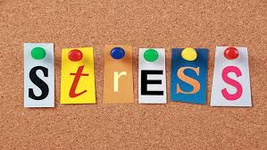
levels in the UK
Student Number: 2026576
Name: Andrea Voros
Module: 4004
Lecturer: Yohan Mendis

Slide 2
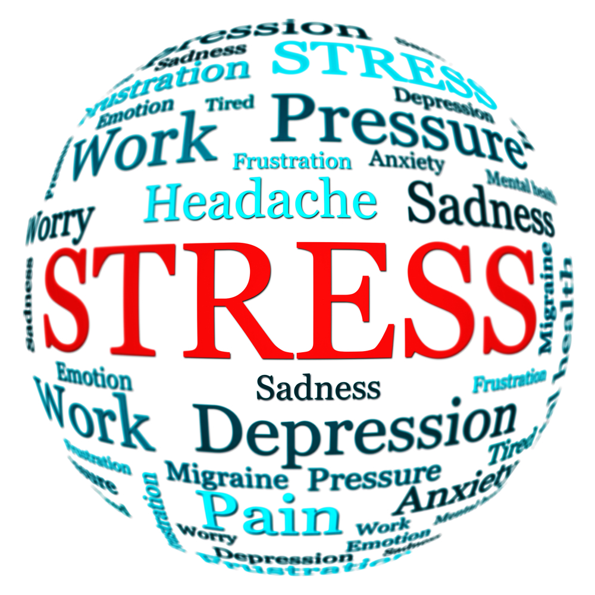
.

Slide 3

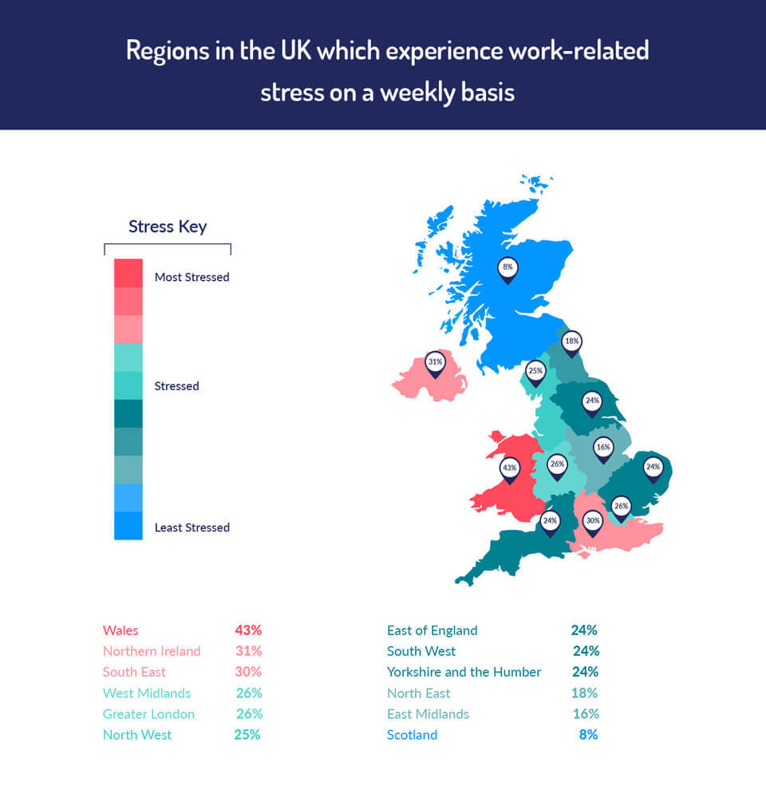
Introduction
Work-related stress in the UK is one of the most common problems
Modern world, modern problems
Causing serious health problems
Stress is a problem because effects the happiness and everyday life
.

Slide 4
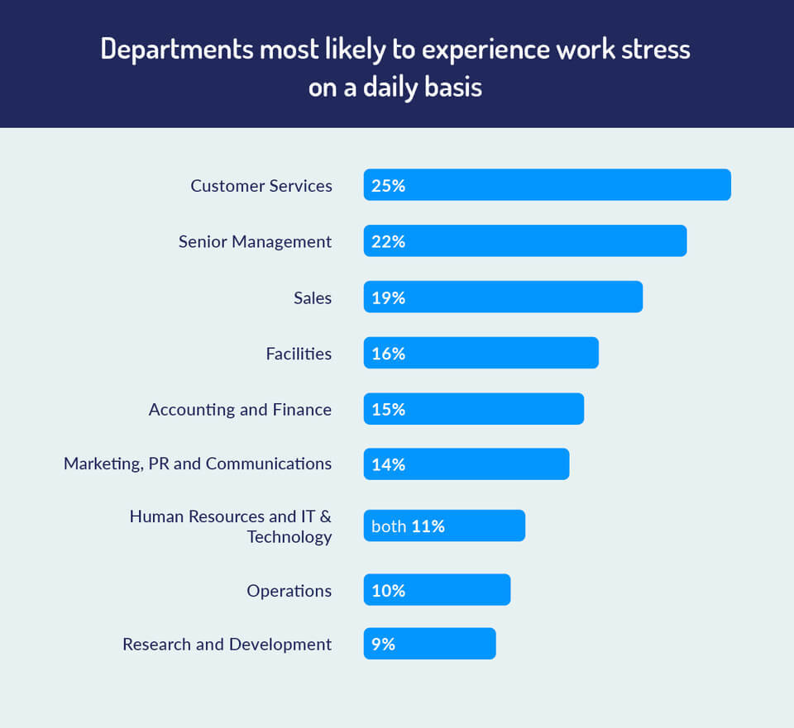
Work stress in different departments in UK

Slide 5

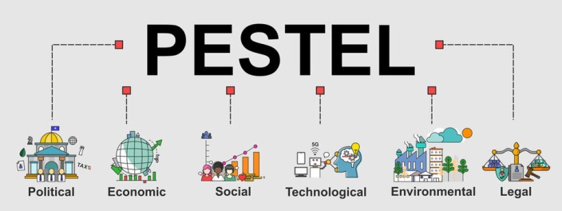
Tax policies -Inflation rates -lifestyle attitudes -Innovation levels -Weather -Data protection
Trade tariffs -Interest rates -Population age -Technological awareness -Climate change -Health and Safety
Political stability -Exchange rates -Cultural barriers -New processes -Recycling -Industry regulations
Government policy -Unemployment -Workforce trends -Automation -Air and water
        rates pollution

Slide 6

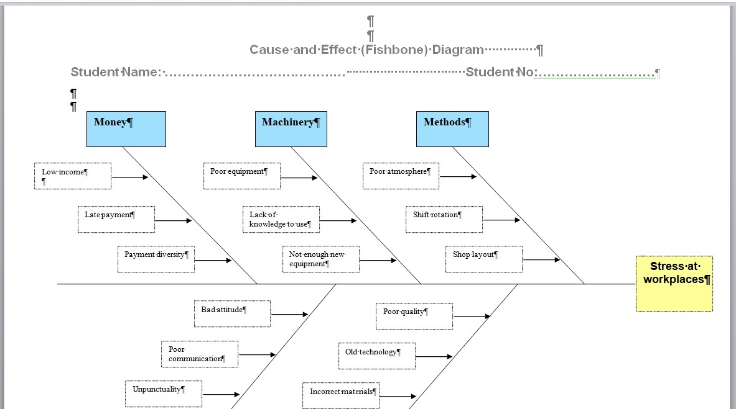
Cause and Effect Analysis (Fishbone analysis)

Slide 7

Possible solutions
Team meetings to discuss the problem
Extra support in general
Increase income
Technology development

Slide 8
Solution 1 : Team meeting to discuss the problem
Plus | Minus | Interesting
More interaction 5 | Individuals may feel shy to ask help- --1 | Find a leader to support the team 4
Better Communication 4 | Not everybody have extra time for it -3 | Sharing knowledge 3
Mixing opinions 3 | Diversity of the points of view- 4 | Sharing experience and wisdom 3
Team building 5 | Quarrels -3 | Testing patience of the members 3
Effective attempt to solve the problem 5 | Lack of tolerance -2 | Highlight the strengths and weaknesses of the team 5
Total 22 Grand total 27 | -13 | 18

Slide 9
Solution 3-Increase income
Plus | Minus | Interesting
More activity 5 | Possible paying differences -3 | Impact of the extra income 5
Motivation to develop 4 | Dissatisfaction -4 | Positive attitudes emerge 5
Positive behaviour at workplace 5 | Jealousy between colleges -2 | Negative attitudes emerge 3
Increasing long term goals 5 | Increasing pretensions -3 | Team convergence 5
Satisfied employees 5 | Gossips between team members -2 | Team dissension 3
Total 24 Grand total 31 | -14 | 21

Slide 10
Solution 4-Technology development
Plus | Minus | Interesting
Easier work 4 | Lack of knowledge to use the new equipment -3 | Improving digital skills 5
Developed work environment 4 | Competitive situations -2 | Challenging situations 3
Faster work 5 | New challenges -4 | Team building 5
Satisfied employees 5 | Lack of motivation to improve digital skills -2 | Time management development 4
Increasing effectiveness 5 | Negative attitude -5 | Impact of the faster work 3
Total 23 Grand total 28 | -16 | 20

Slide 11

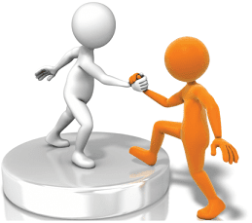



Slide 12

Solution 2 –Extra support in general
Plus | Minus | Interesting
People feeling comfort 5 | Team members maybe shy to ask help -2 | Easy to find out what cause the lack of productivity 5
Individuals feeling trust 5 | Anxiety caused by lack of efficiency -3 | Team leader can help to the members individually 5
Amplify the strengths of the team 5 | Not everybody need extra support, as they confident -2 | Good impacts from the benefits of the extra help 5
Extra focus on weaknesses 4 | Jealousy between colleges -1 | Better communication 5
Building self-confidence 5 | Lack of trust between the leader and the employees -3 | Calmer work environment 5
Total 24 Grand total 38 | -11 | 25

Slide 13

Grid Analysis
Criteria | Time management | Costs | Technology | Health and Safety | Effectiveness | Total
Weight | 4 | 1 | 2 | 3 | 5
Team meeting | 4X4 = 16 | 1X3=3 | 2X3=6 | 3X5=15 | 5X5=25 | 64
Extra support | 4X5=20 | 1X5=5 | 2X4=8 | 3X4=12 | 5X5=25 | 70
Increase income | 4X3=12 | 1X3=3 | 2X4=8 | 3X5=15 | 5X5=25 | 63
Technology development | 4X4=16 | 1X3=3 | 2X4=8 | 3X2=6 | 5X5=25 | 58

Slide 14
Implementation plan
Executive managers need to listen to all employees
Team meeting in practise
Balance all the problems
Support the team and individuals in need
Motivate all members to the self-developing system
Evaluate all the progress
Repeat the team meetings regularly to avoid stress
LISTEN AND OBSERVE = COMPREHEND

Slide 15

Summary and Conclusions
Stress is a body’s reaction to feeling threatened or under pressure, causing a lot of problem, like anxiety, health problems, workplace fights, etc.
Possible solutions are team meetings, technology development, increasing income or extra support for the employees
Executive managers, team leaders have to control all problems, and reduce the stress at work asap, and support the team in different ways

Slide 16


